Slide 1
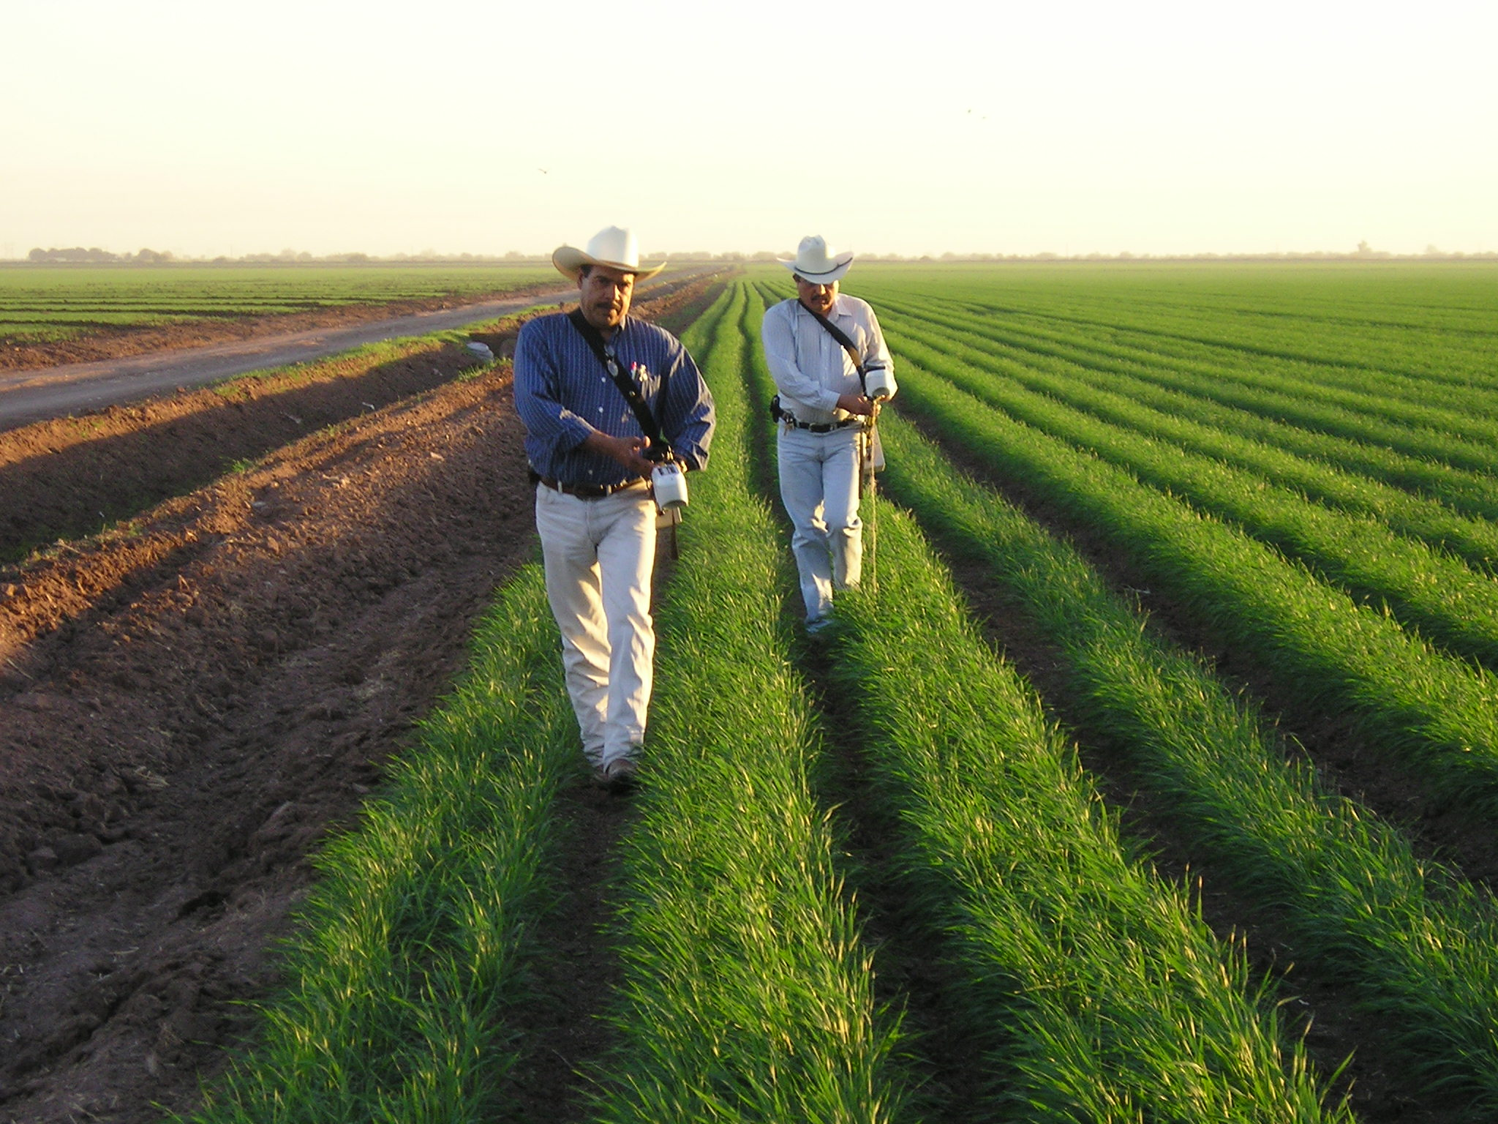
Sensor Based N Management in the Yaqui Valley
Ivan Ortiz-Monasterio
CIMMYT
Oklahoma State University

Slide 2
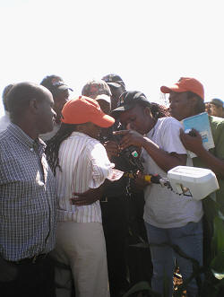
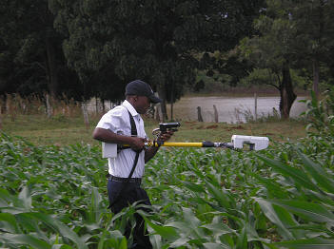
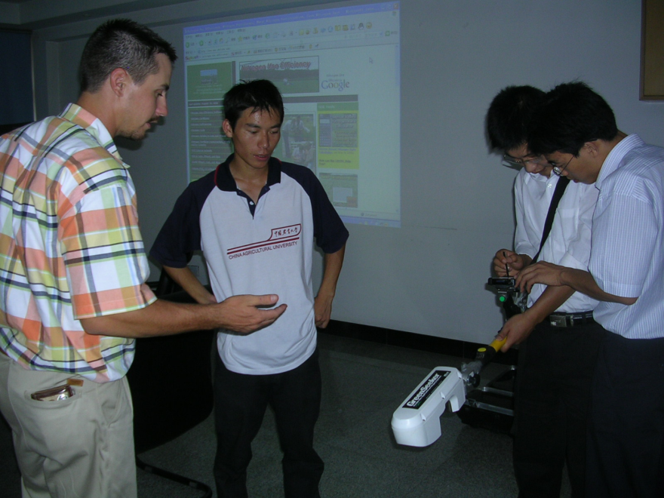
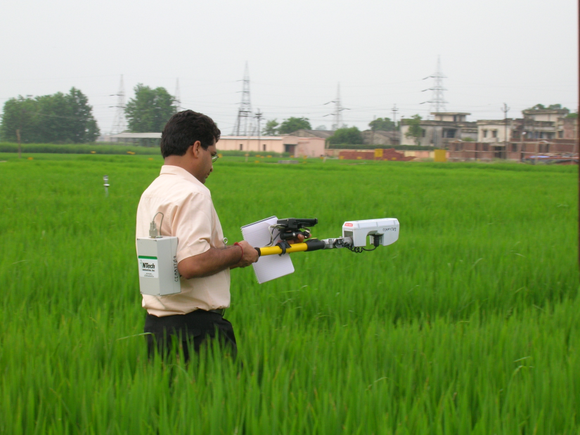
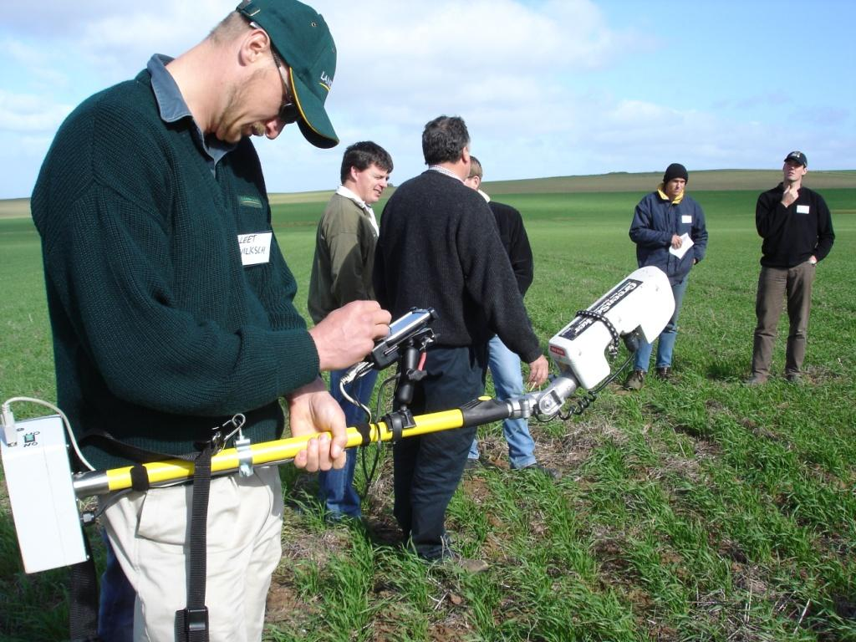
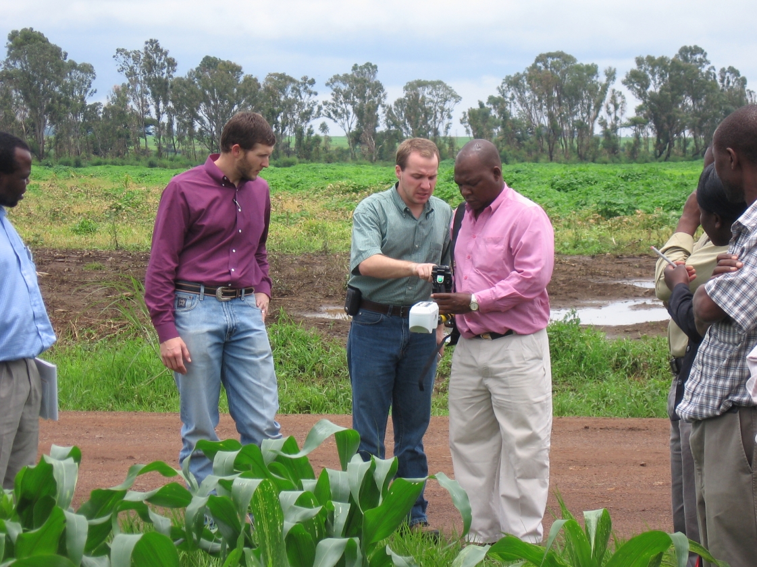
China
Kenya
India
Australia
Zimbabwe

Slide 3
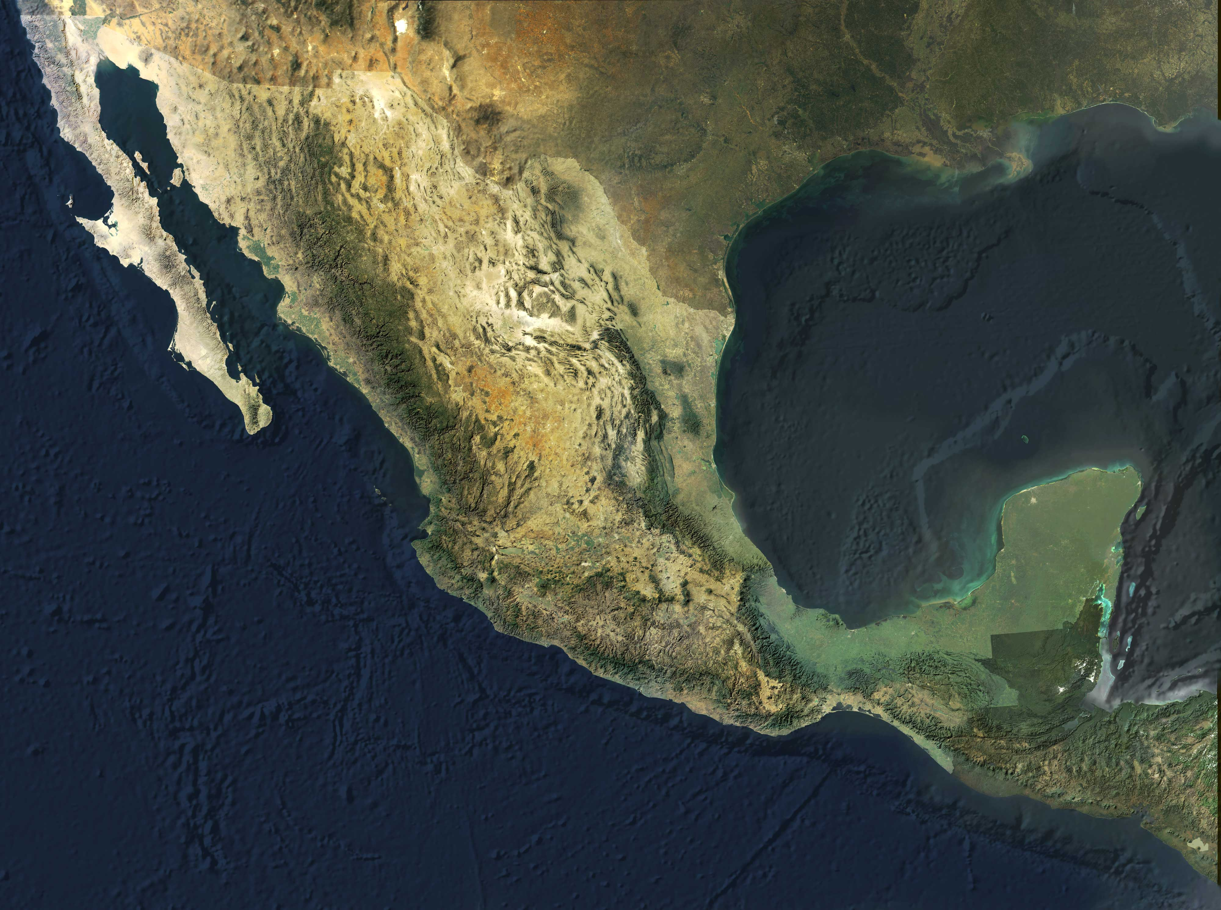
Yaqui Valley

Slide 4
Percentage Nitrogen Recovery in
Wheat in the Yaqui Valley
(average of 30 fields)
Recovery by
the plant
Losses

Slide 5
Losses to the environment
NH₃
NOx
N₂O
N₂
Urea
NH₄⁺
NO₃⁻
Organic
Matter
NH₄⁺
NO₃⁻
N₂O
N₂
Nitrification
Denitrification

Slide 6
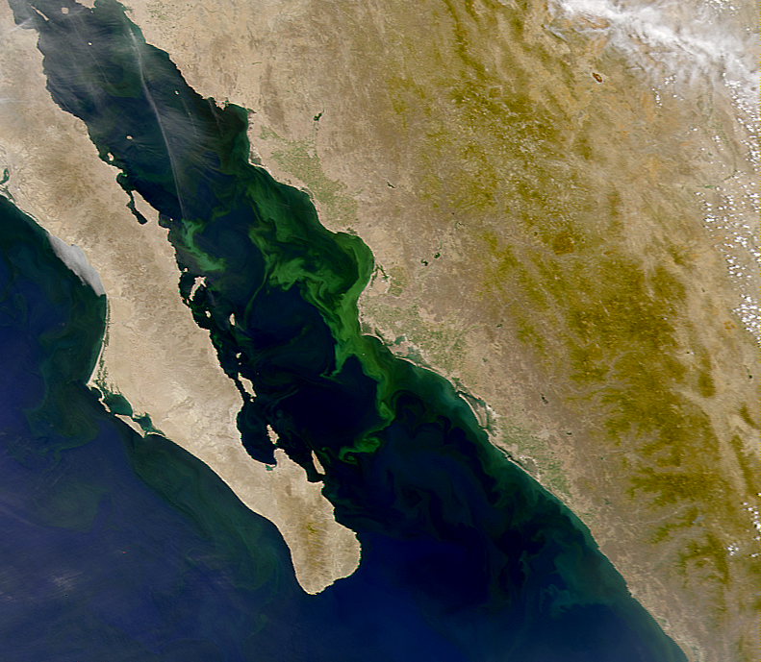
Beman et al. 2005
Nature

Slide 7
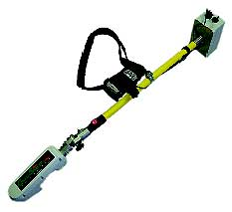
Sensor Technology GreenSeeker
Diagnostic tool that allows you to identify the optimum N rate for each individual farmer’s field

Slide 8
Technology Components
Establishment of an N rich strip
NDVI reading in the N rich strip and farmer’s field that will be diagnosed
Use of a crop algorithm to derive N recommendations

Slide 9
N Rich
Strip
Apply pre-plant or
at planting
20 has
10 meters

Slide 10
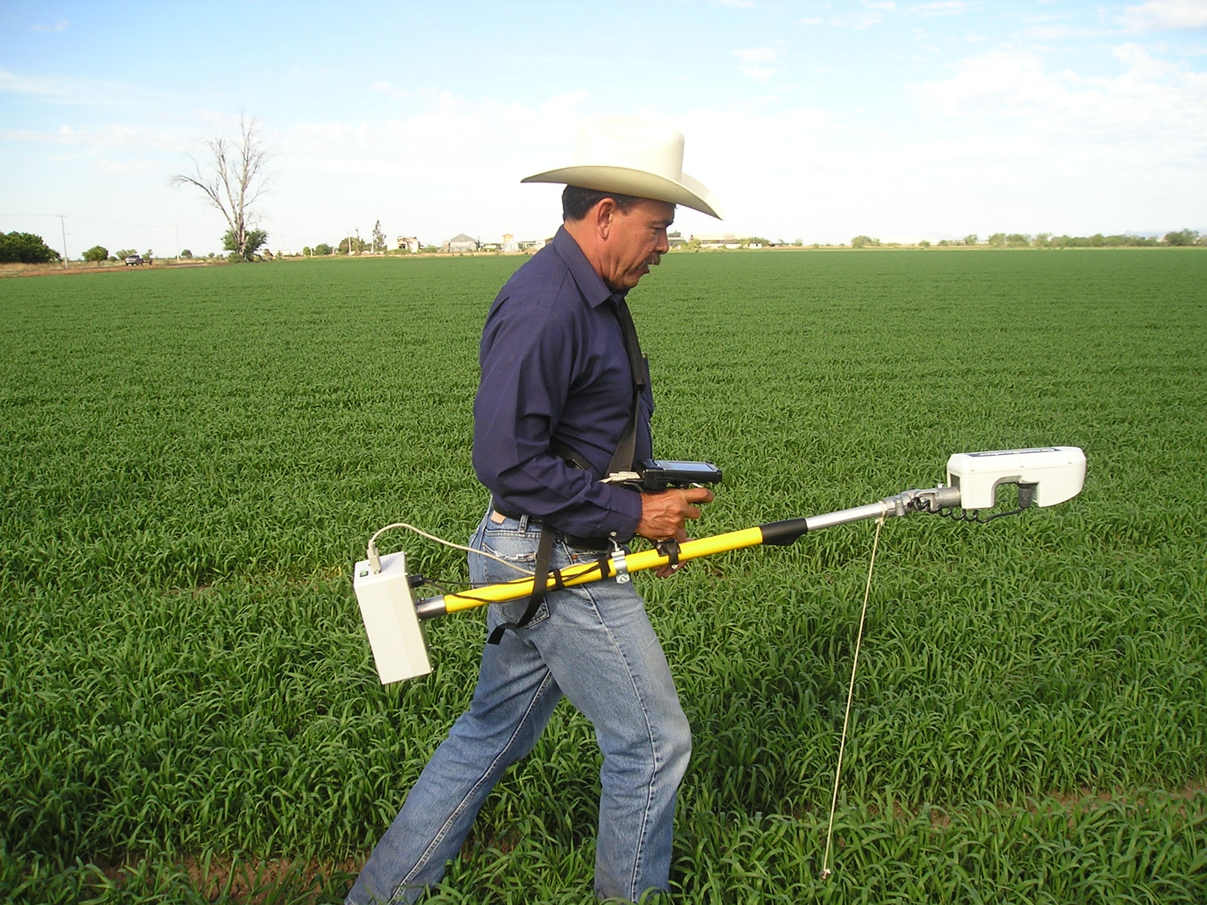
2. NDVI reading in the N rich strip and the farmer’s field that will be diagnosed
Measurement: As close as possible to the first post plant
irrigation but 40 days after planting.

Slide 11
3. Use of the Crop Algorithm to derive a N recommendation

Slide 12
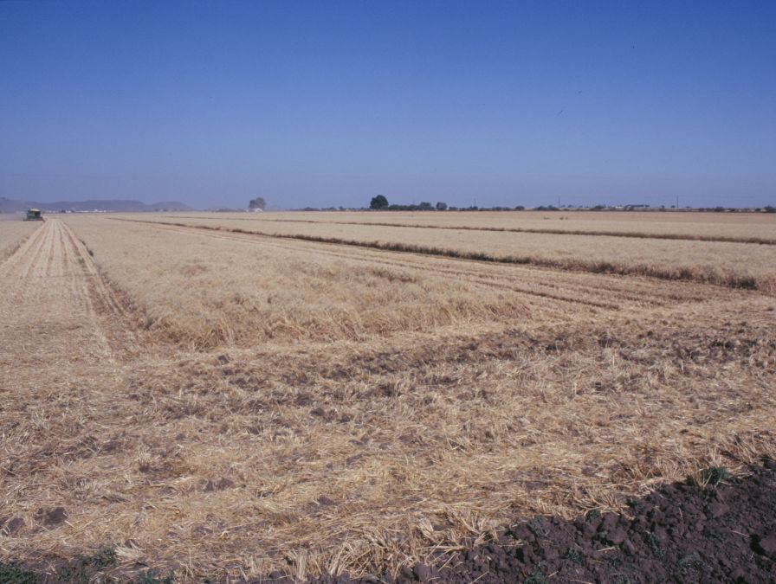
RESULTS
2009-2010

Slide 13
TECHNOLOGY TRANSFER IN SONORA
CIMMYT
Oklahoma State University
AOASS
PIEAES
FUNDACION PRODUCE SONORA / COFUPRO
FIRA
SAGARPA
CONACYT
Uniones de Agricultores

Slide 14
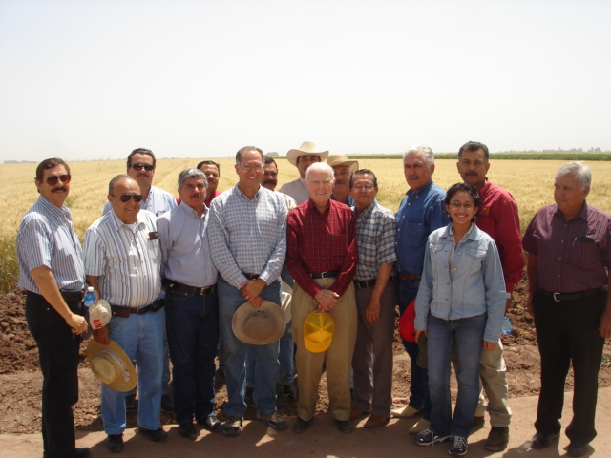
TECHNICAL TEAM
COOPERATIVE AOASS | FARM ADVISERS Ing. Arturo Muñoz Cañez (coordinador)
UCAC | Ing. Emilio Acosta M. Ing. Julio Galaz Gil
UCAY | Ing. Ramón Gil Cota.
UCAH | Ing. Julio C. Espinoza.
AAVYAC | Ing. Carlos Remy M.
UCAYVISA | Ing. Raúl Salinas G.
USPRUSS | Ing. Carlos Rodríguez P Ing. Manuel Ferra M. Ing. Carlos Quiñones.
UCAMAYO | Ing. Manuel H. Alcántar
APRONSA | Ing. Ignacio Miranda I.
CIMMYT
Dr. Ivan Ortiz-Monasterio
Ing. Maria Elena Cardenas

Slide 15
N Rich
Strip
Sensor
Management
Sensor Management
107 fields

Slide 16
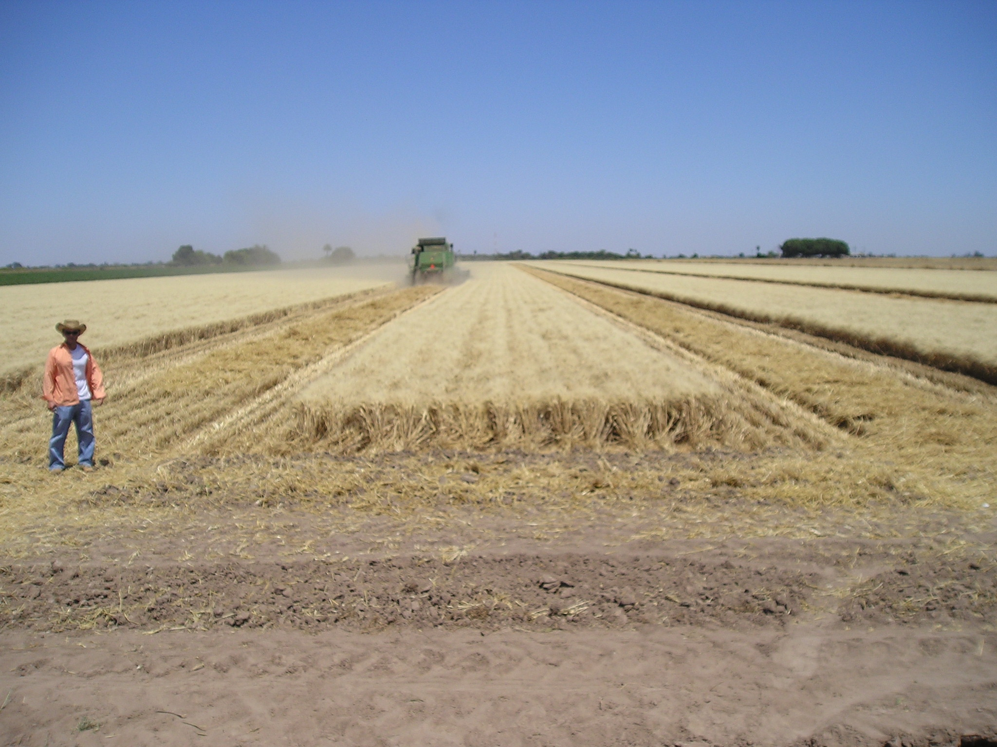

Slide 17
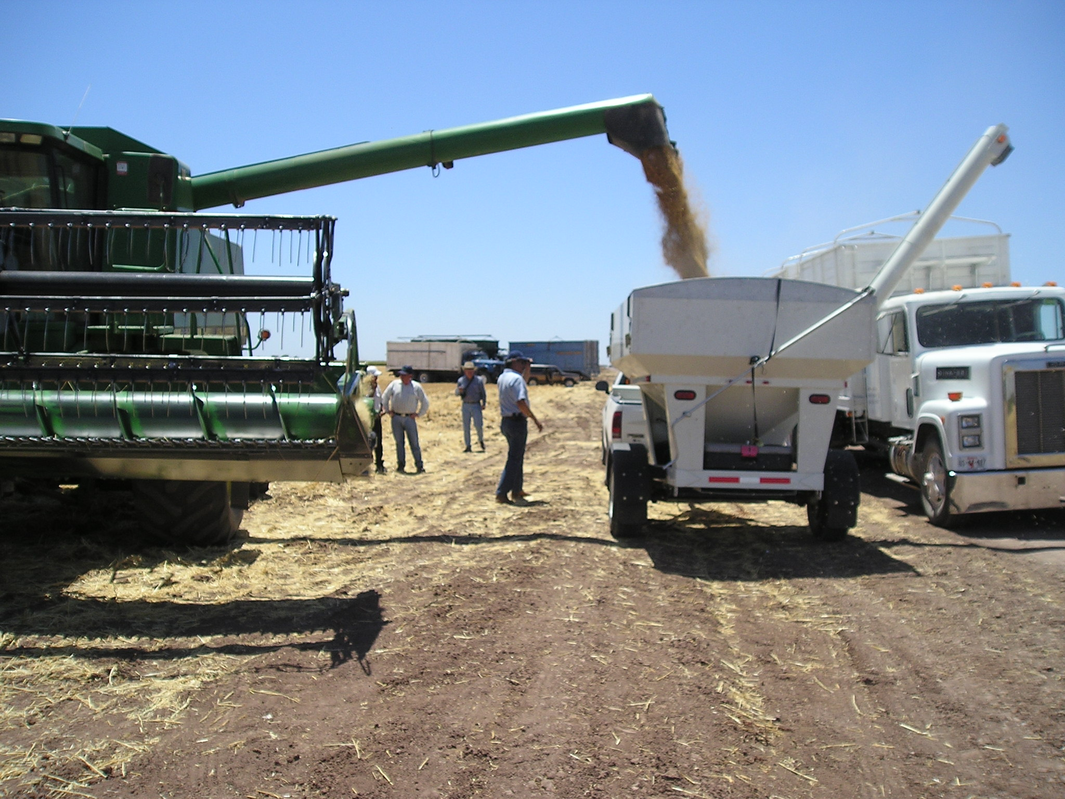

Slide 18
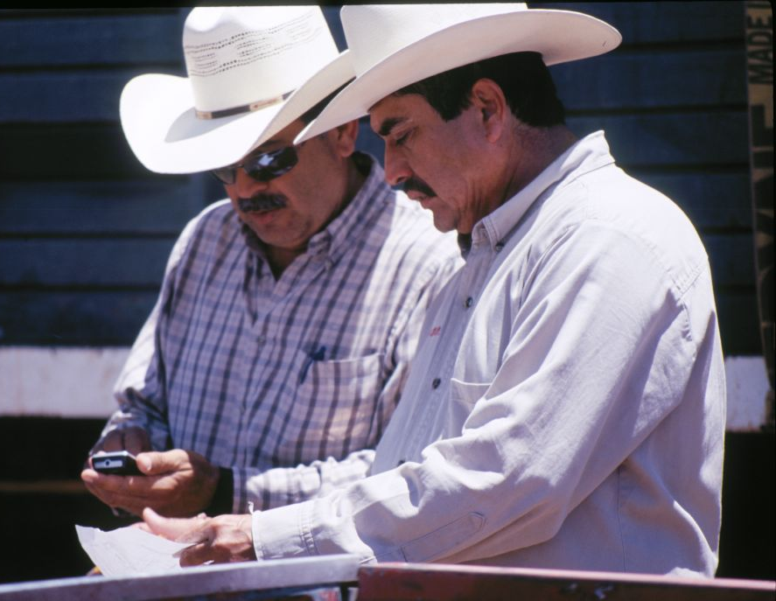
PROGRAM 2009-2010
7363 hectares
38% tested
105 participating
farmers
316 field with an
N rich strip

Slide 19
107 Fields
Difference
85 kg N/ha
64kgN/ha

Slide 21
60-68 kgN
86
60
101
107
fields

Slide 22
N Saving Using the GreenSeeker
2007-2008
60 kgN/ha
1.00 USD/kgN = 60 USD/ha
2008-2009
68 kgN/ha
1.30 USD/kgN = 88 USD/ha
2009-2010
64kg N/ha
1.00 USD/kgN = 64 USD/ha

Slide 23
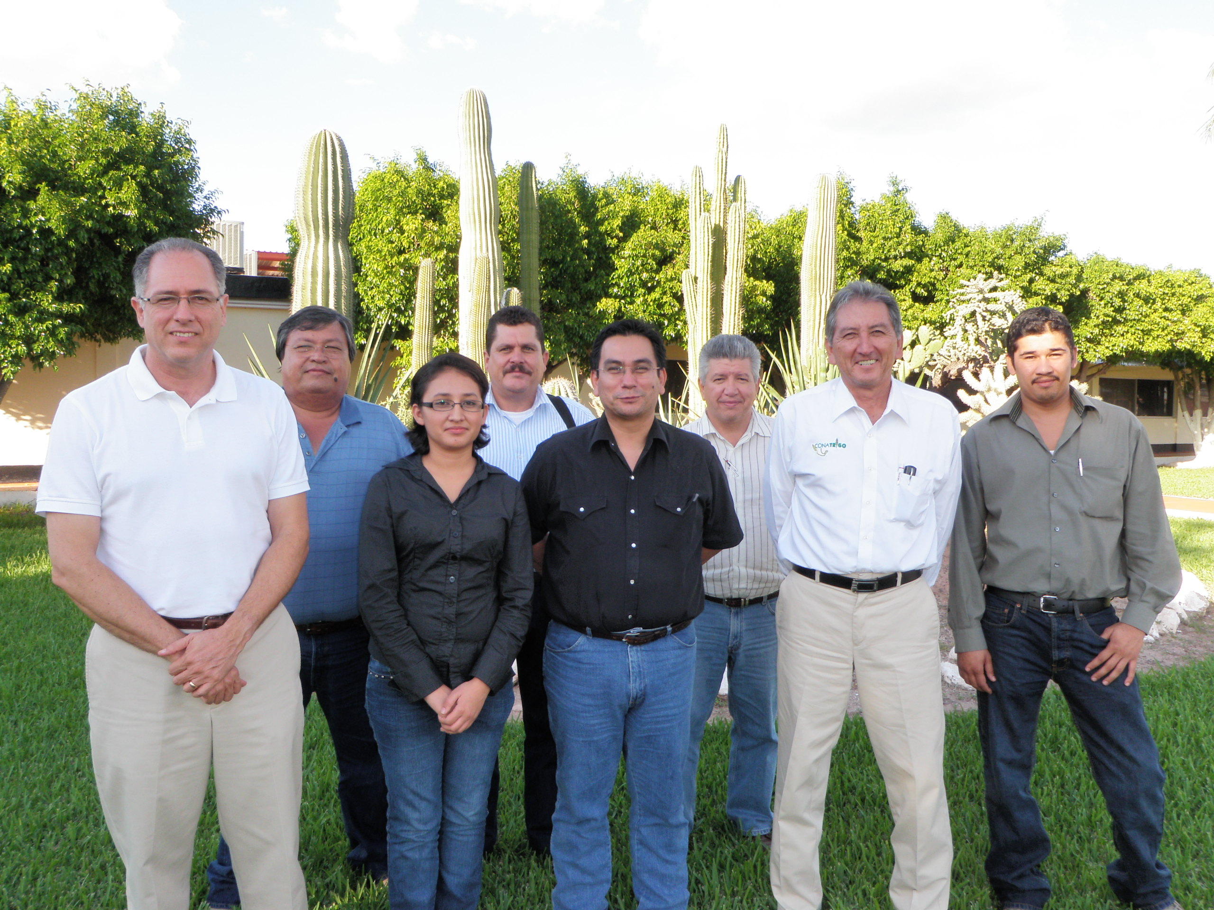
NATIONAL SENSOR PROGRAM

Slide 24
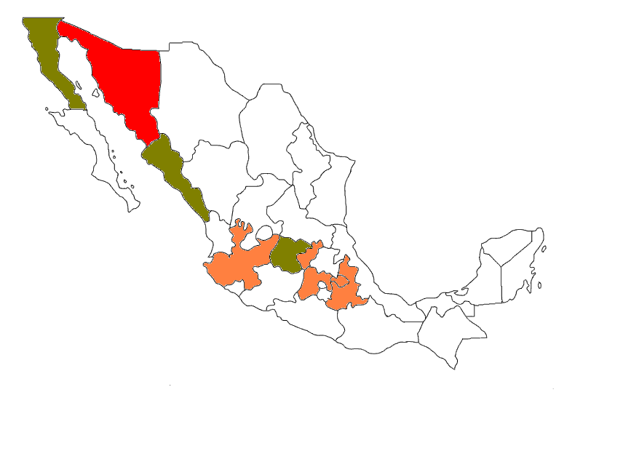
1
WHEAT
2
3
5
7
4
6
8
9
1: B.C.
2: Sonora
3: Sinaloa
4: Jalisco
5: Guanajuato
6: Edo. México
7: Querétaro
8: Tlaxcala
9: Puebla

Slide 25
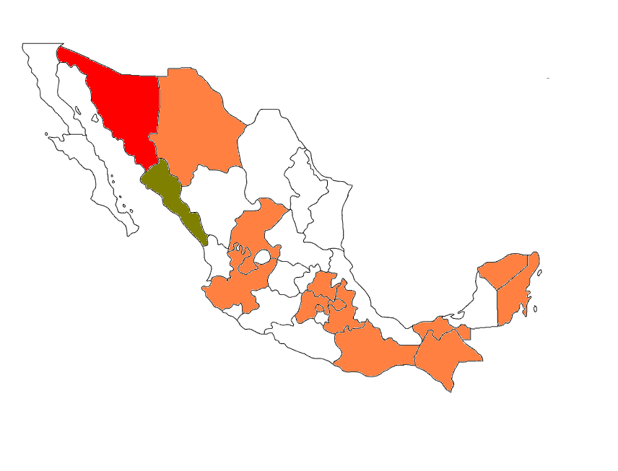
MAIZE
1
3
2
5
7
14
1: Sonora
2: Sinaloa
3: Chihuahua
4: Jalisco
5: Zacatecas
6: Edo. México
7: Hidalgo
8: D.F.
9: Tlaxcala
10: Puebla
11: Oaxaca
12: Chiapas
13: Tabasco
14: Yucatán
15: Quintana Roo
4
15
6
9
8
10
13
11
12

Slide 26
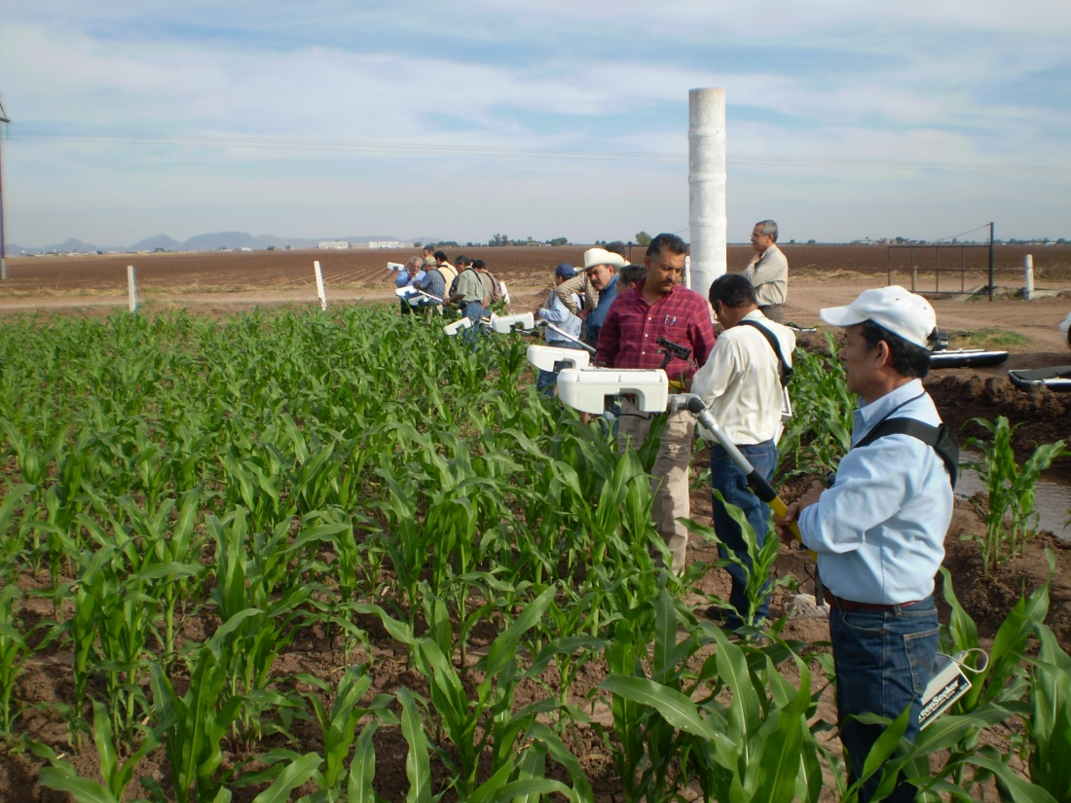
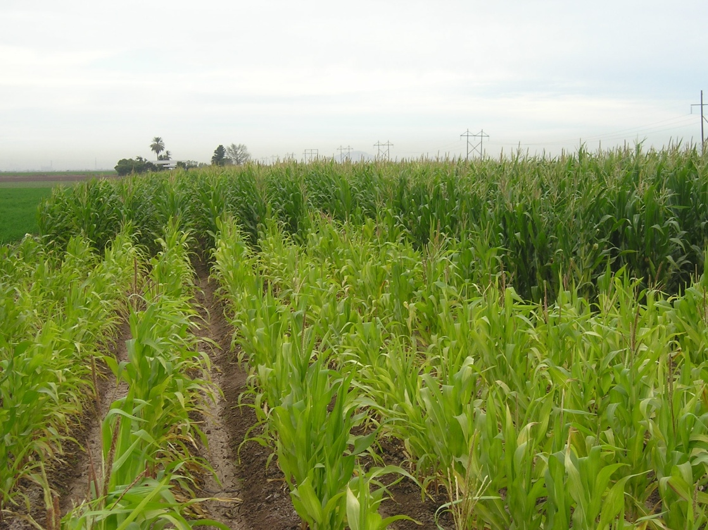
GreenSeeker in Maize

Slide 27
Ten nitrogen experiments over four years
Treatment Preplant N (kg/ha) Starter N (kg/ha) Sidedress N (kg/ha) V6
1 0 0 0
2 200 0 0
3 0 40 0
4 0 40 30
5 0 40 60
6 0 40 90
7 0 40 120
8 0 40 150
9 0 40 180

Slide 28
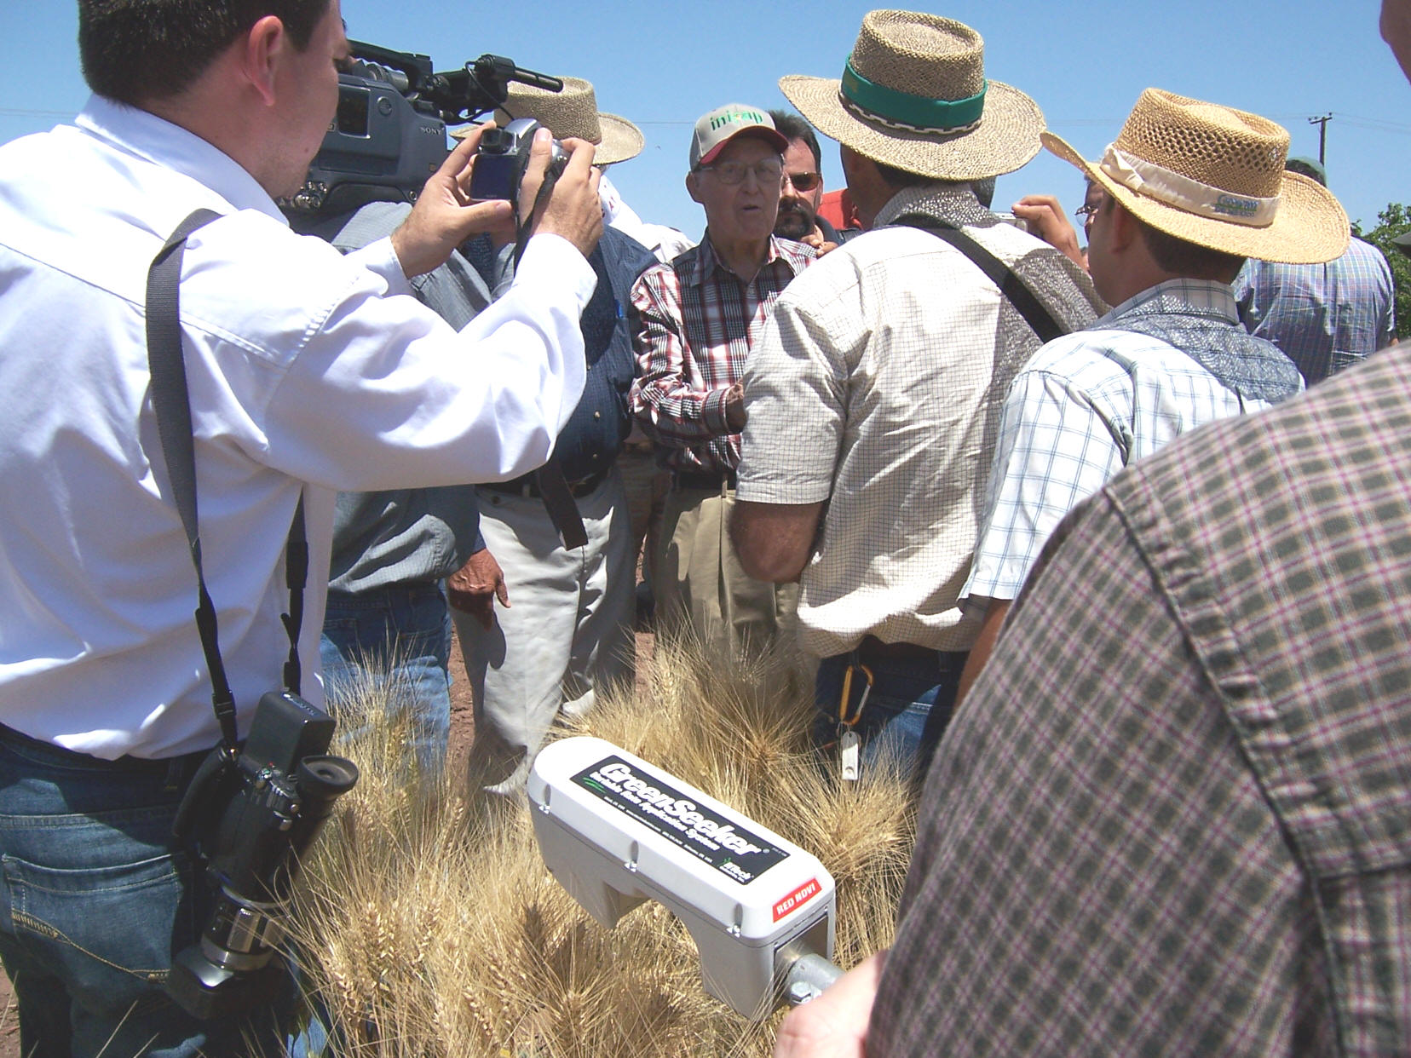
The late Dr. Norman Borlaug visits with reporters in a farmer field near Ciudad Obregon, Sonora, Mexico concerning the GreenSeeker N management approach that has now been used in the Yaqui Valley since 2002. This due to pioneering efforts from Dr. Ivan Ortiz-Monasterio. Attending the field day and announcement included a reporter from the Wall Street Journal, and many press representatives from various regions in Mexico.

Slide 29
Sensor Training, Ciudad Obregon, Mexico,
Ivan Ortiz-Monasterio, CIMMYT

