Slide 1
Evaluation of Midseason UAN Application Depth in Winter Wheat
Ryan Bryant-Schlobohm

Slide 2
Global Cereal Production
Global cereal production in 2013 – 2.7 billion Mg
World populations continue to rise
Grain production must keep pace
Improved genetics and production practices are central to this effort
Table 1. Statistics courtesy of FAOSTAT: http://faostat3.fao.org/browse/Q/QC/E

Slide 3
Global Fertilizer Usage
Large quantities of N are annually consumed
Global N use efficiency is 33%
Sustainable recommendations to producers must be central to current research practices
Table 2. Statistics courtesy of FAOSTAT: http://faostat3.fao.org/browse/R/*/E

Slide 4
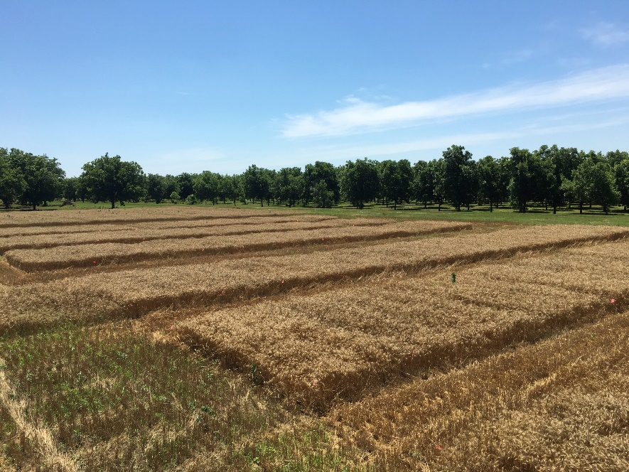
Subsurface N Applications
Urea based fertilizers are vulnerable
Ammonia volatilization is a critical factor affecting NUE
Unincorporated, surface applications are highly sucesptible
Losses as great as 40% (Fowler and Brydon, 1989; Hargrove et al., 1977).
Denitrification is high in no-till, surface applications Aulakh et al. (1984)
Figure 1. Perkins plots prior to harvest.

Slide 5
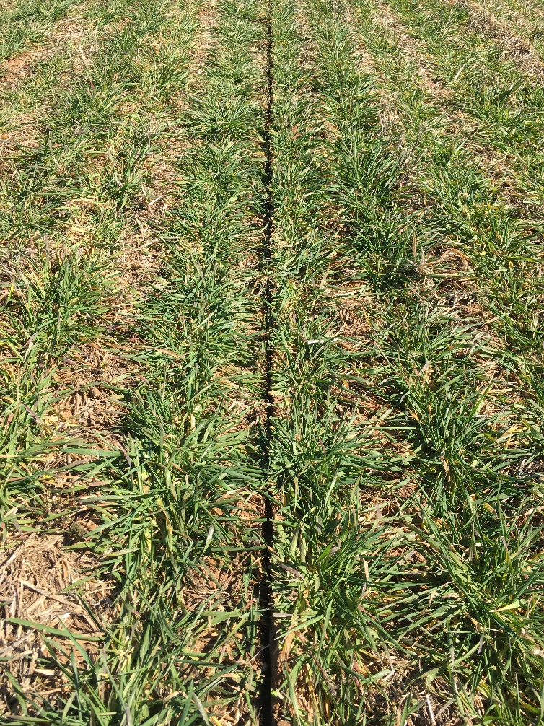
Subsurface N Applications
Subsurface applications of N are highly efficient
Reduces ammonia volatilization and N immobilization, especially in no-till cropping systems (Rao and Dao, 1996)
Continuous innovation and refinement
What is the proper application depth for UAN fertilizer?
Figure 2. Subsurface application to winter wheat from a coulter applicator.

Slide 6
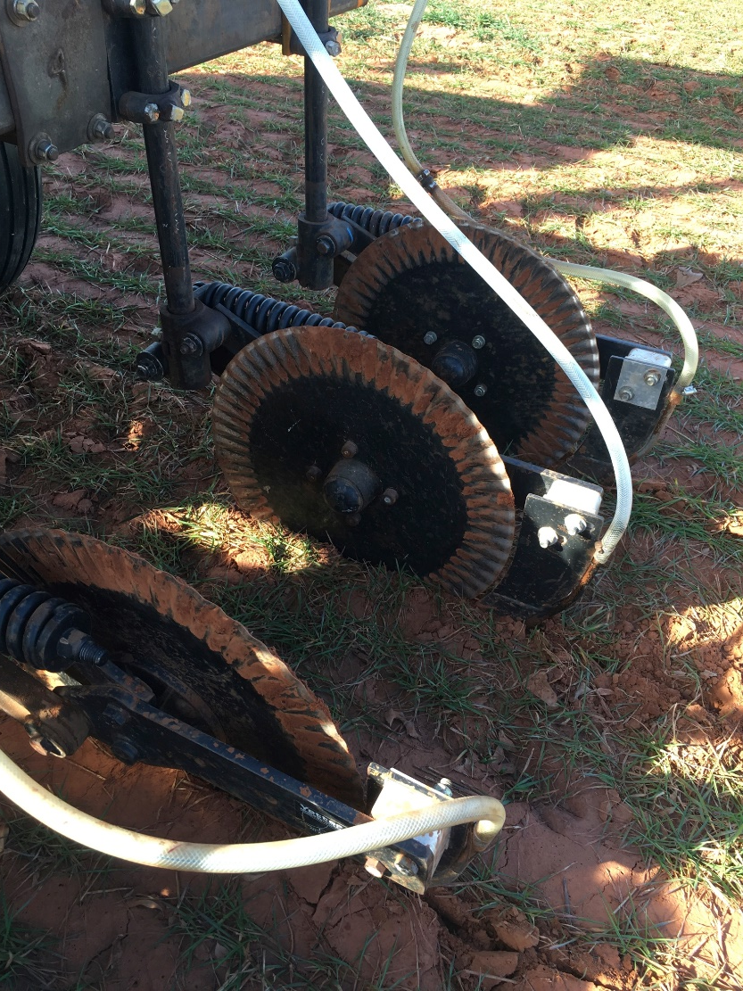
Objective
The objective of this study was to evaluate midseason application depths of UAN fertilizer in winter wheat.
Figure 3. Coulter applicator applying subsurface treatments.

Slide 7
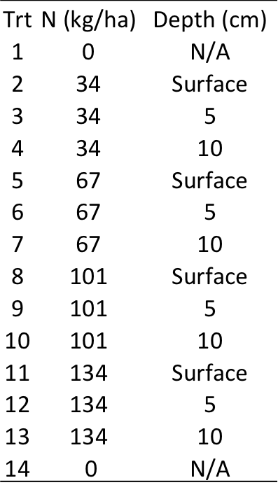
Materials and Methods
Four locations within the state of Oklahoma
Hennessey (no-till), Lahoma (conventional), Lake Carl Blackwell (conventional), Perkins (no-till)
Randomized complete block design
14 treatments with 3 replications, Table 3
Dependent variables
Application depth – surface, 5 cm, and 10 cm
Midseason N rate – 0, 34, 67, 101, and 134 kg N/ha
All treatments received 45 kg/ha of pre-plant N, except treatment 14
Table 3. Treatment structure for
all locations.

Slide 8
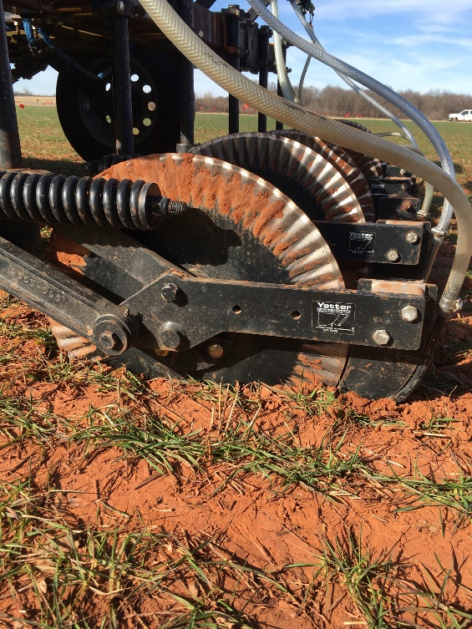
Materials and Methods
Independent variables
Grain yield, grain N content, NDVI, NUE
Subsurface treatment applications were made with a coulter applicator, Figure 4
All sites received midseason N at Feekes growth stage 5
Data was analyzed with SAS 9.4
PROC GLM, LSD alpha=0.05, single df contrasts
Figure 4. Coulter applicator.

Slide 9
Lahoma Grain Yield Results
At rates of 34 kg N/ha, yields from surface applications were significantly higher than the subsurface applications
67 kg N/ha saw the surface application being statistically better than the 5 cm depth, and numerically higher than both subsurface depths
10 cm depth was significantly higher than the 5 cm depth
The 10 cm depth witnessed higher yields, overall, when compared to the 5 cm depth
Different letters above bars represent significant treatment differences at alpha=0.05.
Table 4. Grain yield results from Lahoma.

Slide 10
Lahoma Grain N
Positive trend of increased applied N equaling elevated grain N levels
67 kg N/ha, 5 cm depth was significantly superior to surface and 10 cm treatments
134 kg N/ha, 5 cm depth was statistically higher than the surface treatment
Contrasts for surface vs. 5/10 cm were significant for both subsurface applications
Contrast between 5 and 10 cm treatments was not significant
Different letters above bars represent significant treatment differences at alpha=0.05.
Table 5. Grain N results from Lahoma.

Slide 11
Lahoma Grain Yield/NDVI F7
Strong correlation between NDVI at Feekes 7 and grain yield
Table 6. Grain yield by NDVI F7 results from Lahoma.

Slide 12
Perkins Grain Yield Results
At rates of 34 kg N/ha, the inverse of Lahoma occurred – the subsurface application of 10 cm was significantly higher than the surface application, with 5 cm being numerically superior to the surface treatment
When comparing the 5 cm and 10 cm depths, 10 cm saw the highest yields, except at the 134 kg N/ha rate, yet lacked statistical significance
Different letters above bars represent significant treatment differences at alpha=0.05.
Table 7. Grain yield results from Perkins.

Slide 13
Perkins Grain N
Positive trend of increased applied N equaling elevated grain N levels
100 kg N/ha, subsurface applications were significantly greater than the surface treatment
134 kg N/ha, 5 cm depth was significantly higher than the surface application
No statistical difference between 5 and 10 cm
Contrasts for surface vs. 5 cm/10 cm were significant for both subsurface treatments
Different letters above bars represent significant treatment differences at alpha=0.05.
Table 8. Grain yield results from Perkins.

Slide 14
Perkins Grain Yield/NDVI F7
Strong correlation between NDVI at Feekes 7 and grain yield
Table 8. Grain yield by NDVI F7 results from Perkins.

Slide 15
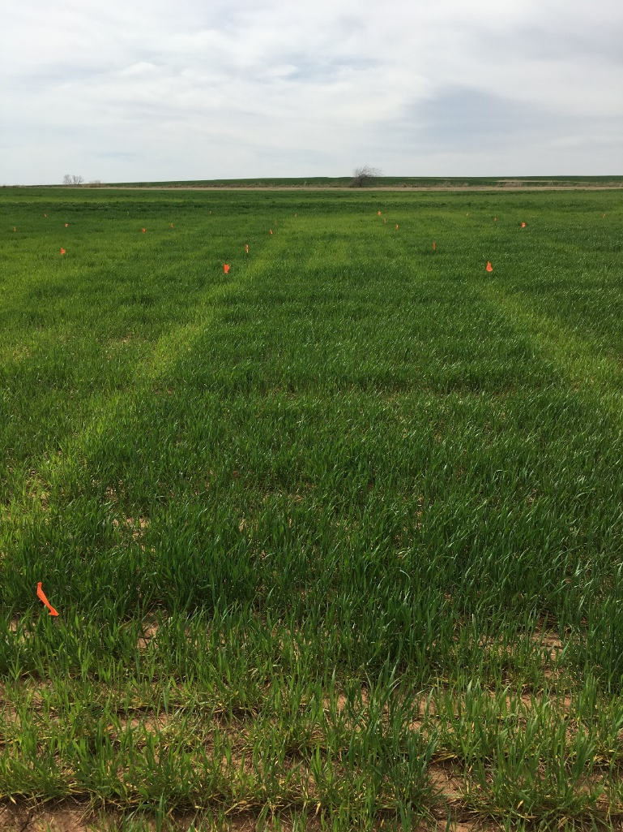
Conclusions
Variability in N response across locations confirms the need for site specific, midseason N management
10 cm depth was more impactful to grain yield than 5 cm
Clear, positive impact to grain yield from the addition of 45 kg/ha of pre-plant N
No damage from subsurface application equipment
At Lahoma, 34 kg N/ha on the surface was significantly higher than subsurface counterparts
No statistical difference of surface and 10 cm treatments at the 67 kg N/ha rate
Figure 5. Visible N response at Lahoma.

Slide 16
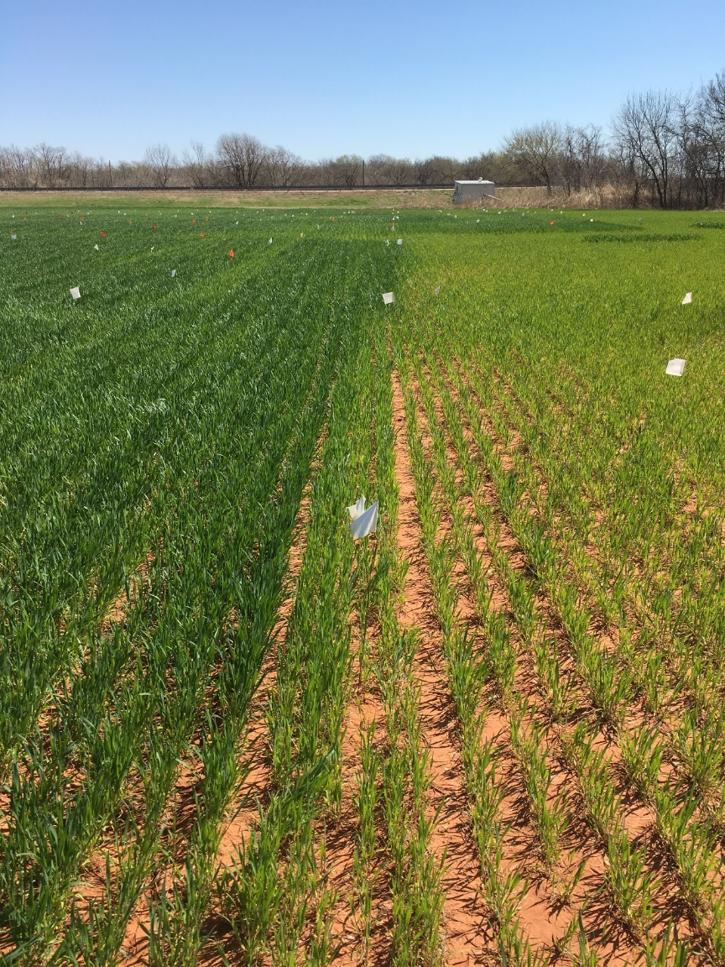
Conclusions
Perkins witnessed the inverse at the 34 kg/ha N rate
Subsurface applications were superior
Specifically 10 cm depth
Application zone bypassed the active microbial zone
Subsurface treatments provided better grain N content
Clear, positive trend for elevated grain N at higher N rates
Overall, depths of 10 cm were more effective than 5 cm
Especially at lower midseason N rates in no-till systems
Figure 6. Treatment response at Lake Carl Blackwell.

Slide 17
Acknowledgments
Department of Plant and Soil Sciences at Oklahoma State University
Oklahoma Agricultural Experiment Station
Oklahoma Fertilizer Checkoff
Dr. Bill Raun
Dr. Hailin Zhang
Dr. Randy Taylor
Soil Fertility graduate students and staff
Ryan Bryant-Schlobohm
055 Agricultural Hall, Stillwater, OK – 74078
ryan.schlobohm@okstate.edu

