Slide 1
Oklahoma State University – AGCO Hand planter 2013 Asia Testing Field Trials, Results, Benefits
Joshua Ringer - Indigdev
joshuaringer@indigdev.com
Jethro Adang – Asian Rural Life Development Foundation

Slide 2
Background
Introduced to the OSU-AGCO Hand planter during Oklahoma State University Winter Crop School by Dr. Bill Raun.
Real application for upland corn farmers in Southeast Asia.
I offered to conduct field testing using my company Indigdev and partnerships with Asian Rural Life Foundation in Thailand.

Slide 3
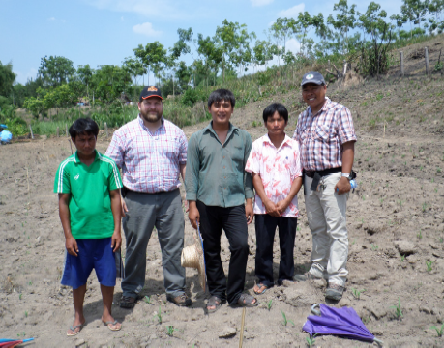
Field Testing Purpose
Test the usefulness of the hand planter in a farmer setting compared to local practice.
Test the durability of the hand planter under field use.
During hand planter use look for adaptations the farmers recommend.

Slide 4
Setting up Field Testing
Memorandum of agreement with ARLDF – Thailand
Plot template
Video demonstration of Hand planter assembly & use.
Hand planter field test unit
Stipend for farmer test plot implementation

Slide 5
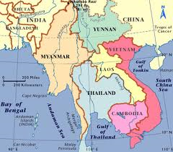
Testing Location Doi luang District, Chiang Rai Province, Thailand & Lashio, Northern Shan State, Myanmar

Slide 6
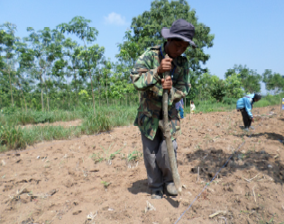
Local Conditions
Climate – 1,733 mm (68 inches) rainfall from May through October
Elevation – 550-600 meters asl
Soils – alluvial soils, near the floodplain of the Mekong River and some Ultisols on the hillsides.
Soils described as clay loam.
Plots were tilled with a hand tractor

Slide 7
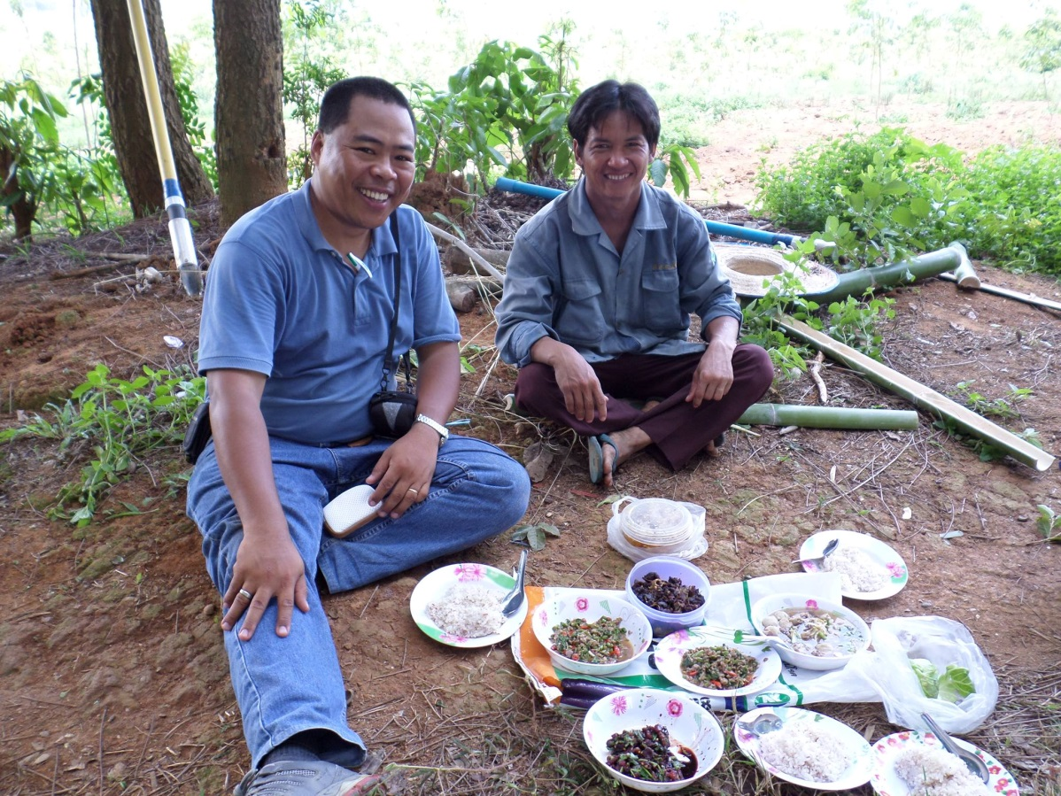
Relationship Building in an Innovation Feedback Loop
Cooperating farmers were marginalized farmers
Farmer plots were on rented land similar to other farmers around them.

Slide 8
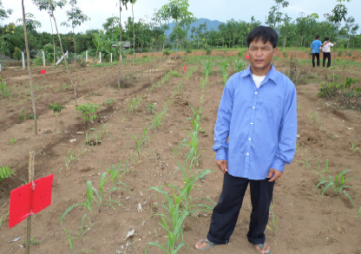
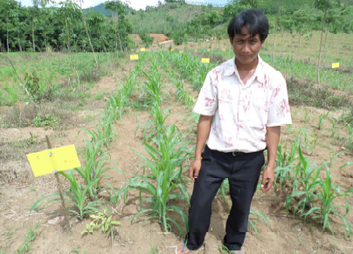
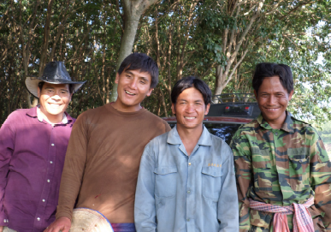
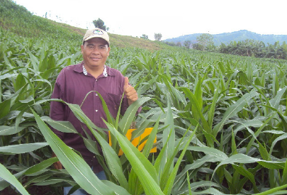
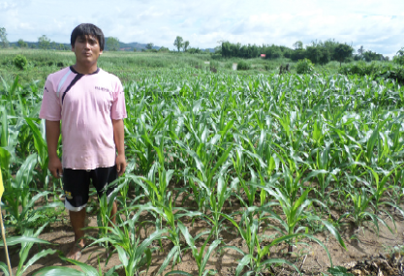
Corn Growers Farmer Interest Group

Slide 9
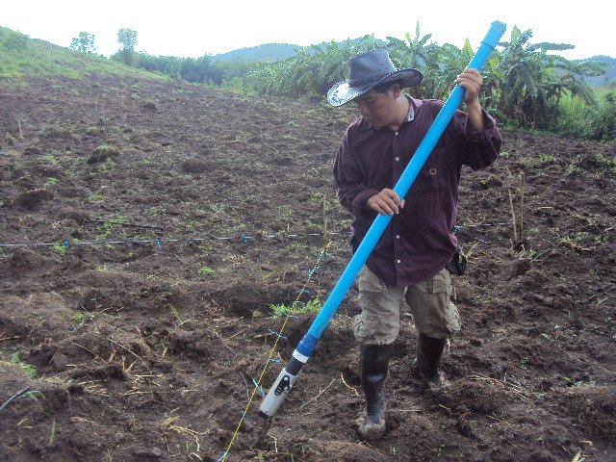
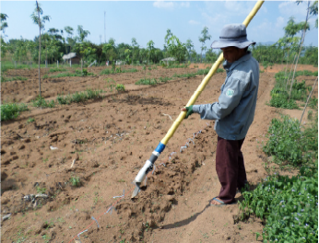
Farmer use of the Hand Planter
Advantages
ease of use
faster then traditional method.
Disadvantages
Weak handle
Easily clogged planter tip
Seed not falling into the seed hole
Recommendations
Add back plate to tip
Improved handle

Slide 10
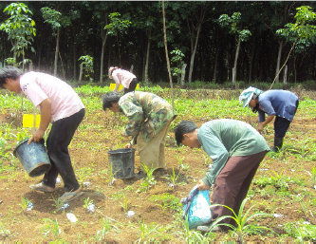
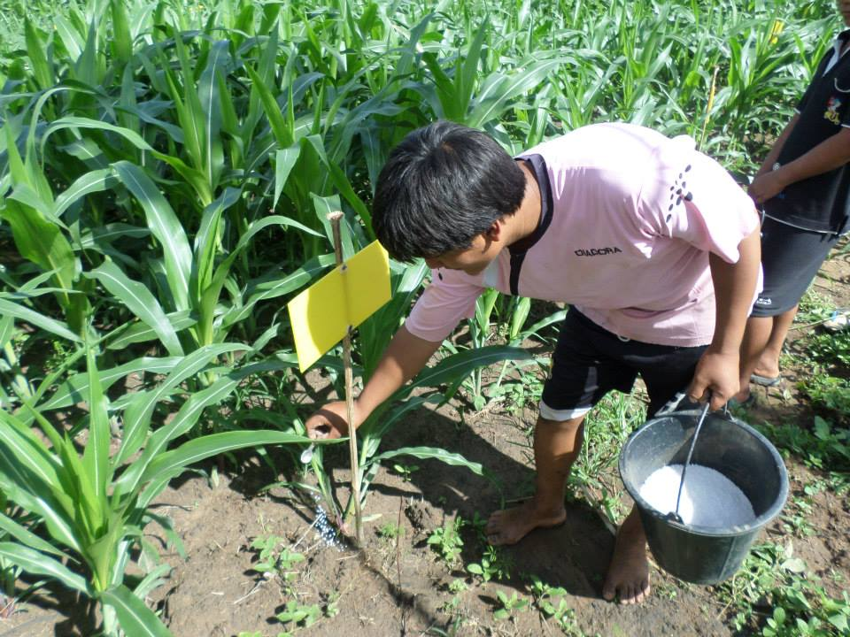
Farmer Interest Group worked together
Plot layout & Planting
1st weeding and fertilization
Herbicide application
Monitoring
Problem solving
Harvesting

Slide 11
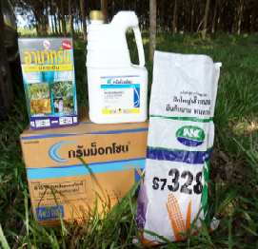
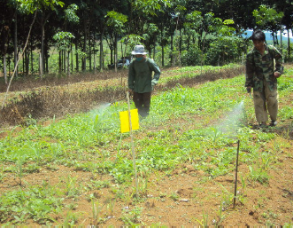
Farmer Practice

Slide 12
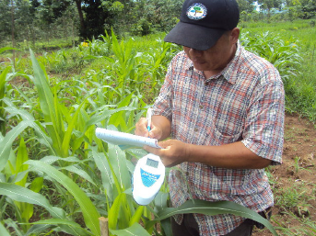
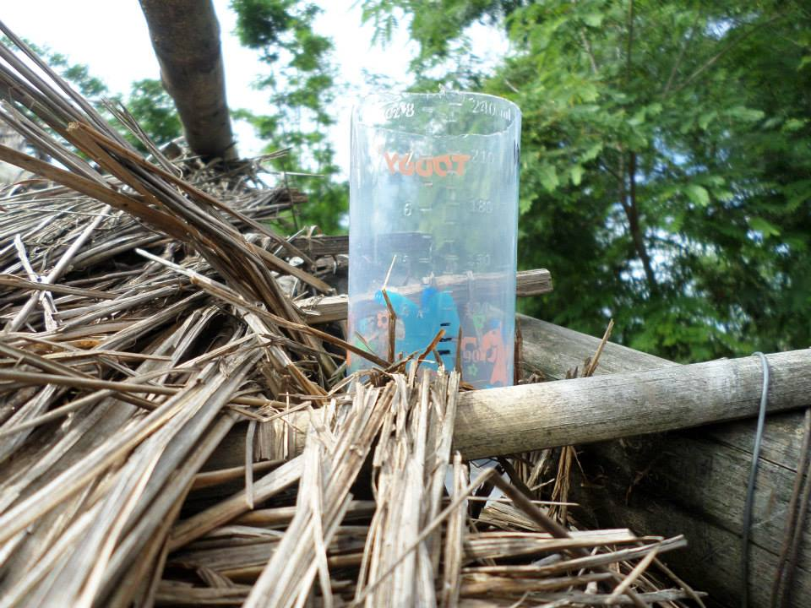
Measurements conducted during test
Record all activities on test plot reporting sheet.
Pictures and video taken of each step.
Rainfall measurement
Temperature measurement
Note disease problems.
Greenseeker readings.

Slide 13
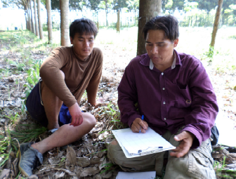
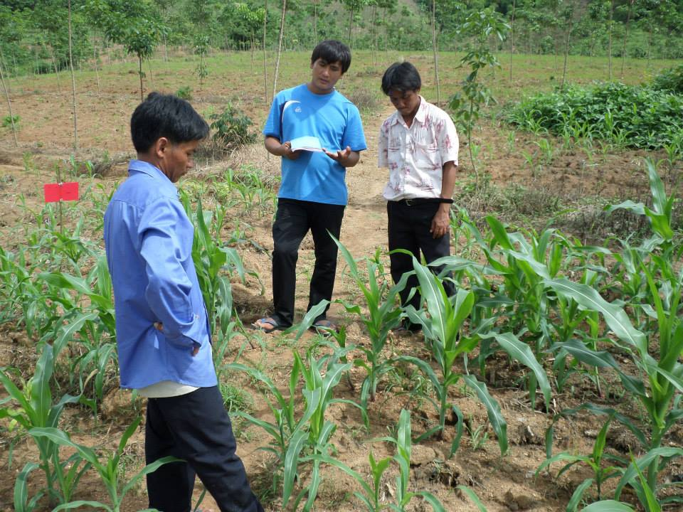
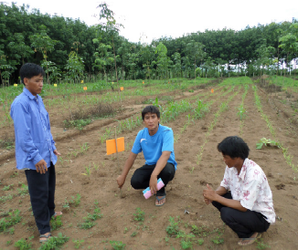
Data Gathering
Advantages
Farmer group monitoring and data gathering meetings were conducted every 7 to 10 days.

Slide 14
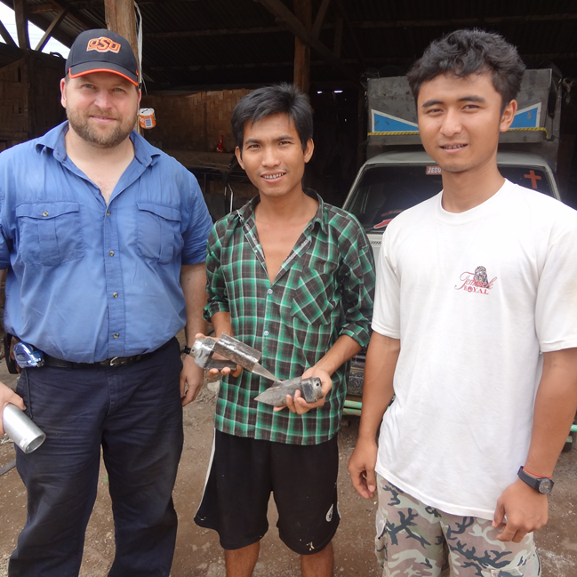
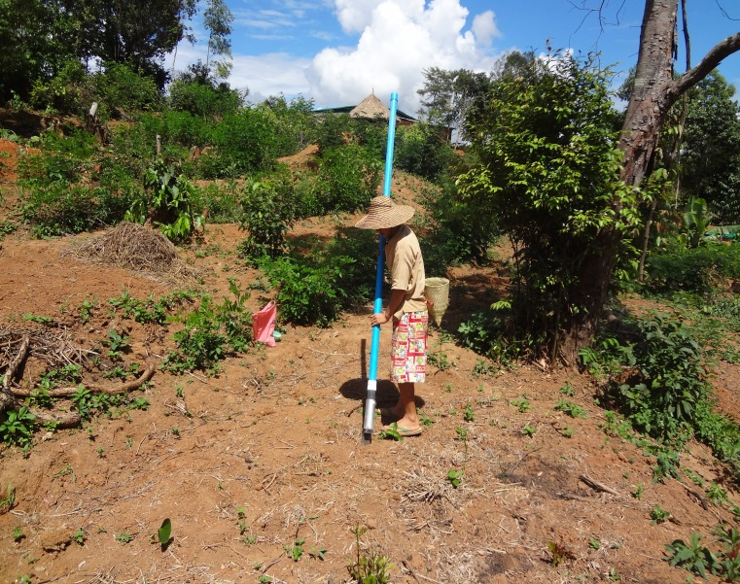
Working with farmers to innovate
Keys to Innovation
The design has “built in adaptability”
OSU Team encouraged feedback.
Explained the process and listened to feedback.

Slide 15
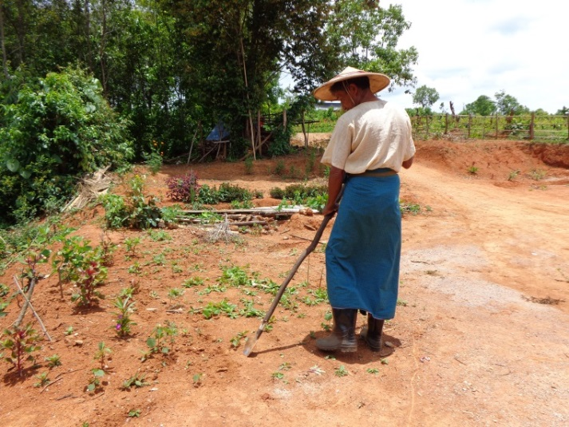
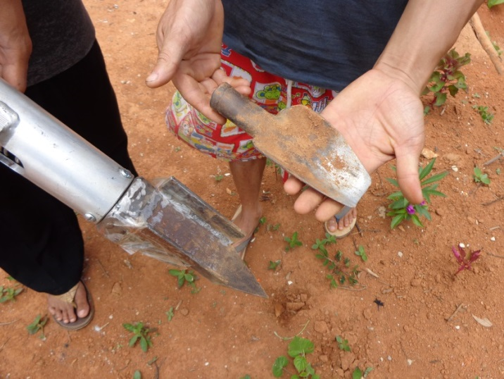
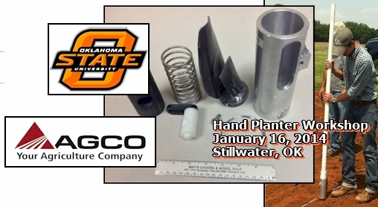
Indigenous technology put back in Hand Planter design
Acted on the feedback and retested
Listened again for more feedback.
Shan Planting Tip with Thai-Lahu input.
The key is treating farmers as co-researchers.

Slide 16
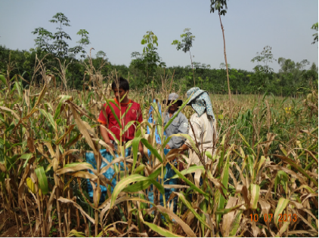
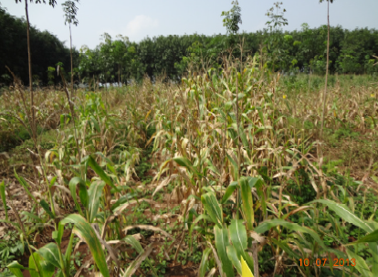
Difficulties faced during Growing Season
Farmers are reluctant to see some plots grow poorly.
Some farmers want to drop out if they believe their plots are not doing as well as others.

Slide 17
Farmer # 1: Harvest Data collection result: Date Planted: 6/8/13 Date Harvested: 10/5-6/13 Weigh each plot: Corn with shield and cobs.
Examle Data Sheet - Farmer # 1. OSU-AGCO Hand planter – Chiang Rai Testing – IndigDev LLC - Data Collection (Farmer # 1= Mr. Ghani, of Doi Luang Chiangrai, Thailand.)
# | Activities | Emergence 0-7 days Date Planted: 6/8/13 | 2 leaves fully emerged (0.5 stage) 7-13 days | 5 leaves fully emerged (Stage 1) 14-22 days | 8 leaves fully emerged (Stage 2) 23-32 days | 12 leaves (Stage 3) 33-47 days | 16 leaves (Stage 4) 48-61 days | 20 leaves Pollination- Silking/Tasselling (Stage 5) 62-68 days | Maturity (Stage 6–7) 90-110 days
 | Vital Tasks | Record planting date: Date Planted: 6/8/13 | Fertilization: 46-0-0 6/22/13 | 6/27/2013 | 7/6/13 | 7/13/13 | 7/29/13 | 8/13/13 | Record harvest date. Date Harvested: 10/5-6/13
 | Pictures & Video | Planting
 | Measure Rainfall Write amount in ml | 7/7/13, 15 ml. 7/23/13, 50ml. 8/2/13, 80 ml. | 7/8/13, 20 ml. 3/8/13, 40 ml. | 7/9/13, 75ml. 7/25/13, 30 ml. 8/4/13, 20ml. | 7/10/13, 160 ml 8/10/13, 40 ml. 8/12/13, 30 ml | 7/11/13,160ml 7/27/13, 60 ml 8/19/13, 60 ml 8/20/13, 30 ml | 7/12/13, 70 ml. 7/28/13, 80 ml. 8/23/13, 30 ml. | 7/13/13, 120 ml. 7/29/13, 180 ml. 8/27/13, 70 ml. | 7/22/13, 80 ml. 7/30/13,110ml 8/4/13, 30 ml.
 | Measure Temperature Write in Celsius | 7/7/13, 34 Cs 7/15/13, 29 Cs 7/23/13, 26 Cs | 7/8/13, 26 Cs 7/16/13, 28 Cs 7/24/13,31 Cs | 7/9/13, 26 Cs 7/17/13,29 Cs 7/25/13, 27 Cs | 7/10/13,26 Cs 7/18/13, 27 Cs 7/26,13,25 Cs | 7/11/13,26 Cs 7/19/13, 30 Cs 7/27/13, 26 Cs | 7/12/13, 25 Cs 7/20/13,26 Cs 7/28/13, 25 Cs | 7/13/13, 26 Cs 7/21/13,31 Cs 7/29/13, 24 Cs | 7/14/13,31 Cs 7/22/13, 30 Cs 7/30/13, 26 Cs
 | Take note of Hand weedings or Spraying of Herbicide | 7/2/13,Spray round up mix with gramoxone | 7/27/13 Spray with round up gramoxone
 | Note any pests attacking the corn, take pictures if found | Black ants and red ants use the corn leaves as shelter.
 | Note any discoloured leaves, take pictures if found | Grow slow, some plants are yellowing, | Some plants were flooded cause lodging of the corn plant.
 | Interview Farmer after harvest to see their opinion about the results of the test | It was a good experience, this is my first time to this kind of activity in farming, and it helps me a lot in increasing my knowledge and skills. The hand planter must be improve base from the previous recommendation and try/test it again.
Tr.1, R1= 22.5 kg. | Tr.1, R2=30 kg. | Tr.1, R3=32kg. | Tr.4, R1= 34 kg. | Tr.4, R2=35kg. | Tr.4,R3=26 kg. | Tr.7,R1=20 kg | Tr.7,R2=80 kg | Tr.7, R3=17.5 kg.
Tr.2, R1= 34 kg. | Tr.2, R2= 23 kg. | Tr.2, R3=29 kg. | Tr.5, R1=38 kg. | Tr.5,R2=30 kg | Tr.5,R3=23 kg | Tr.8,R1= 22kg | Tr.8, R2=18 kg. | Tr.8, R3=25.5 kg.
Tr.3,R1=33 kg | Tr.3,R2=29 kg | Tr.3,R3=37 kg | Tr.6, R1= 34 kg. | Tr.6, R2=25 kg. | Tr.6, R3= 22 kg. | Tr.9, R1= 18 kg. | Tr.9, R2= 17 kg. | Tr.9, R3= 25 kg.

Slide 18
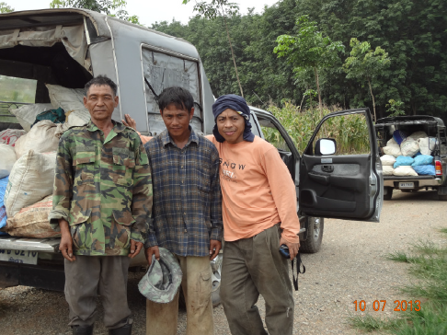
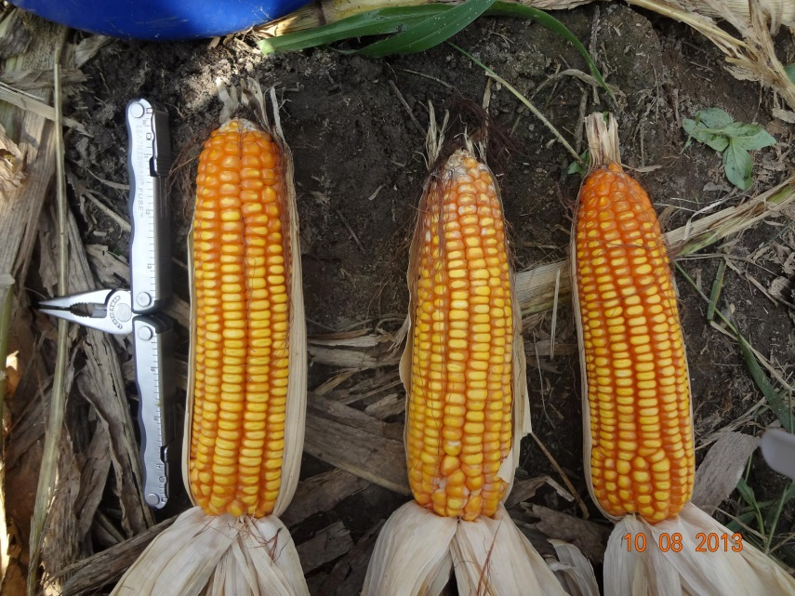
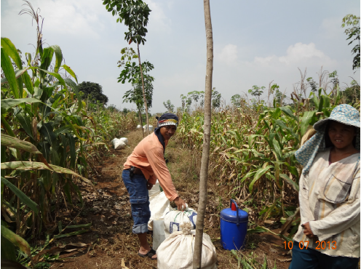
Harvesting
Farmers were pleased with yields from the Hand planter planted plots.
Valuable data for improving planter reliability.
Incorporation of farmer viewpoints.
Integration of an indigenous corn planting tip into the OSU-AGCO hand planter design

Slide 19
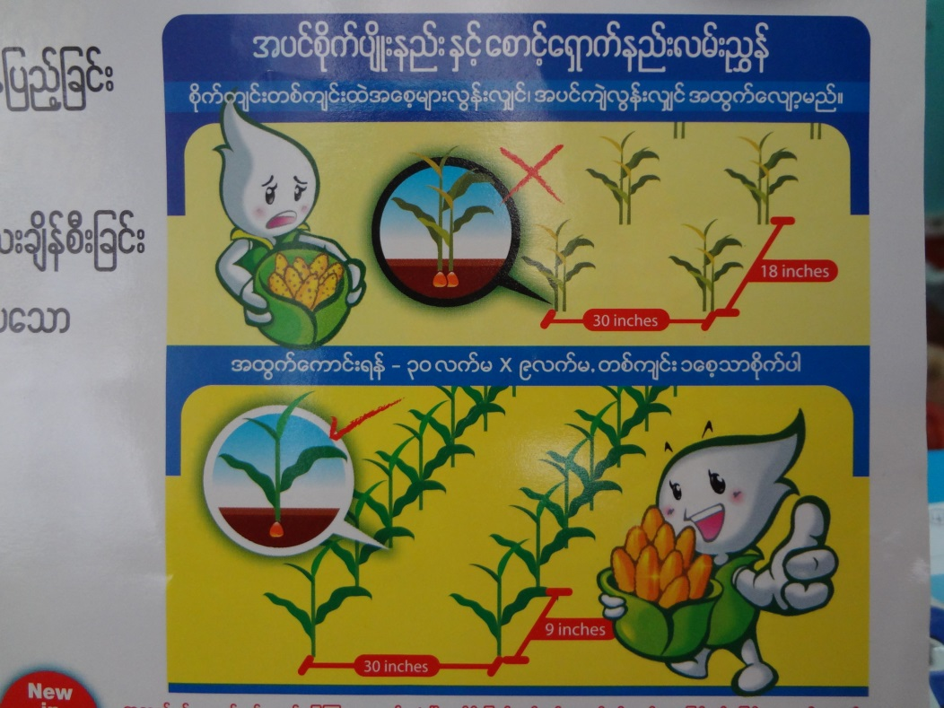
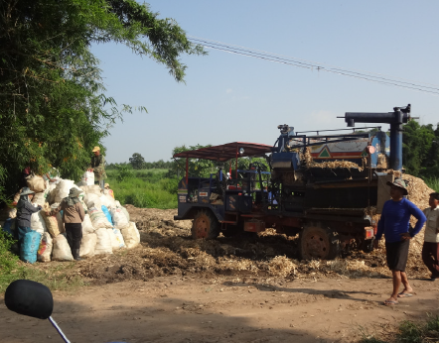
Implications
Farmers see OSU-AGCO hand planter as important for upland corn growing areas.
OSU – AGCO Hand planter is a needed tool for no-till application in Upland farming systems.
Partners in the process
New technologies can empower marginalized farmers if implemented in a participatory manner
Room to experiment

Slide 20
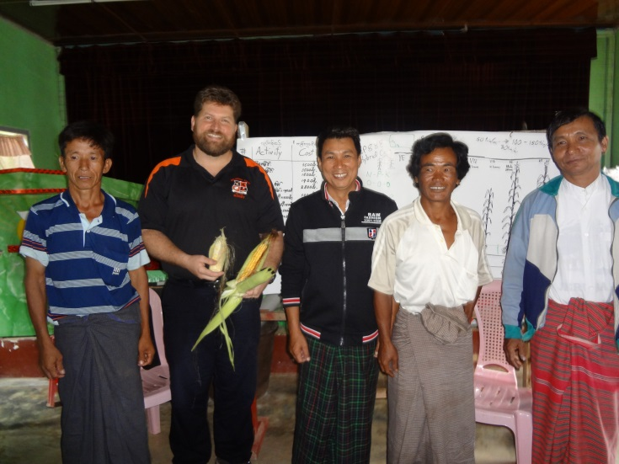
Next steps in Hand Planter Improvement
More field testing is needed.
Continued emphasis on feedback from field trials and farmer use in the field according to local practice, soil types, and seed size.
Drum for fertilizer application

Slide 21
Final Thoughts
Keys to effective development of innovation feedback loops:
Be open to innovation from marginalized small-holder farmers.
Encourage a learning mindset from all involved.
Implement testing with farmer groups that face similar constraints of those the technology is intended to help.
Build long-term relationships for effective innovation feedback loops.
Small-holder farmer as a co-researcher.
If you would like assistance with your field testing and integration of the OSU-AGCO hand planter into small-holder corn production systems contact me at joshuaringer@indigdev.com or find us on the web at www.indigdev.com

