Slide 1

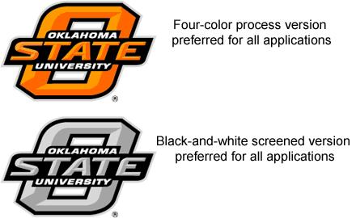
Effect of Seed Distribution and Population on Maize Grain Yield
Bee Khim Chim
Graduate Student
Department of Crop, Soil & Environmental Sciences
Email: bchim@vt.edu

Slide 2
Introduction
Production of maize in World, U.S.A and Sub Saharan Africa.
 | World | United States of America | Sub Saharan Africa
Population | 7, 045, 483, 640* | 314, 572, 078* | 874, 841, 049†
Production (Mt) | 840, 308, 214‡ | 327, 879, 500‡ | 63, 580, 236‡
Area Harvested (Ha) | 161, 765, 388‡ | 34, 163, 300‡ | 30, 910, 018‡
Yield (Mt/Ha) | 5.20 | 9.60 | 2.06
* From United States Census, 2012
† From World Bank, 2011
‡ From www.faostat.org , 2010

Slide 3
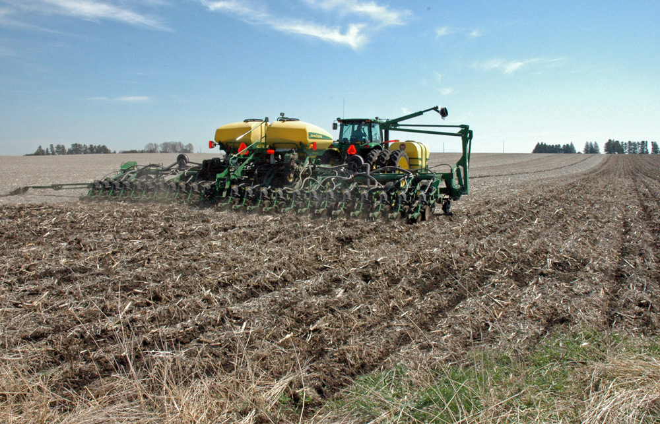
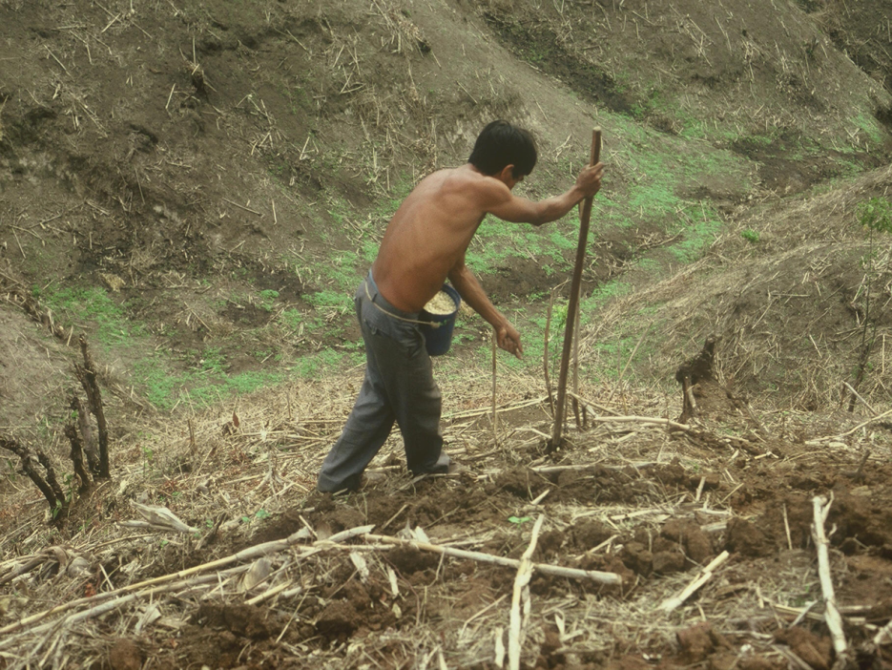
Introduction (cont’d)
Developed Countries, maize planting
Developing Countries, maize planting
http://www.ia.nrcs.usda.gov/technical/JensenPhotos.html
http://nue.okstate.edu/Hand_Planter/img21.jpg

Slide 4
Introduction (cont’d)
Maize area, ha (FAOSTAT, 2010)
Total 161, 765, 388 ha
Sub Saharan Africa 30, 910, 018 ha
Planted by hand (60%) * 18, 546, 011 ha
Potential yield increase (25%)* 15, 895, 059 Mg
(single seeds 14-17 cm apart)
Yield increase of 25% for 60% hand planted maize worth more than 4.6 billion dollars/ year (corn price at $ 0.295/kg)
*From(http://nue.okstate.edu/Hand_Planter/summary_AGCO1.pdf )

Slide 5
Literature Review
Plant Spacing
Narrow: tall and weak steam plants, decreased yield due to lodging (Rowland, 1993; Futuless et. al, 2010)
Wider: Encourage weed and pests infestation, influences maize yield (Whiteman, 1981)
Increased row spacing from 0.35 to 1m will decrease grain yield (Riahinia and Dehdashti, 2008)
Light Interception
Development of crop growth related to light interception (Gardner et al., 1985)
Optimization of light interception increased grain yield (Stewart et al., 2003)
Light interception can be increased by reduced row spacing (Andrade et al., 2002)

Slide 6
Objective
To determine the value of equadistant plant spacing when compared to “hills”, placing 2-3 seeds per hill
Materials and Methods
Locations: Lake Carl Blackwell research station and Efaw research station
Cropping year: Summer 2011 and Summer 2012
10 treatments with 3 replications arranged in RCBD, middle two rows planted by hand
Preplant N rate: 395.2 kg N ha⁻¹ applied in the form of urea (46-0-0)
Light Interception, LI-COR

Slide 7
Materials and Methods (cont’d)
Treatment structure
Treatment | Seeds Hill⁻¹ | Distance Between Hills | Estimated Plant Population
 |  | m | Plants ha⁻¹
1 | 1 | 0.16 | 81,984
2 | 2 | 0.16 | 163,968
3 | 3 | 0.16 | 245,952
4 | 1 | 0.32 | 40,992
5 | 2 | 0.32 | 81,984
6 | 3 | 0.32 | 122,976
7 | 1 | 0.48 | 27,328
8 | 2 | 0.48 | 54,656
9 | 3 | 0.48 | 81,984
10 | (Twin row) | 0.32 | 81,984

Slide 8
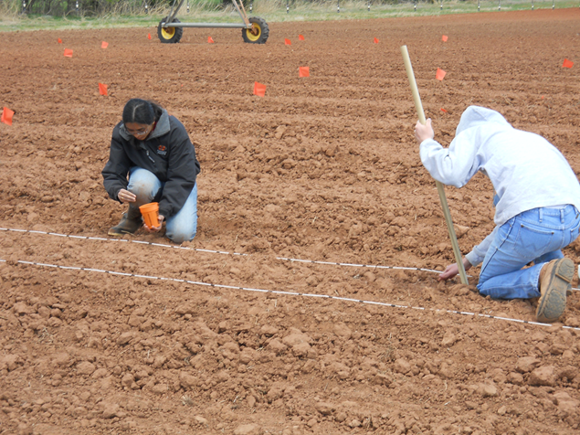
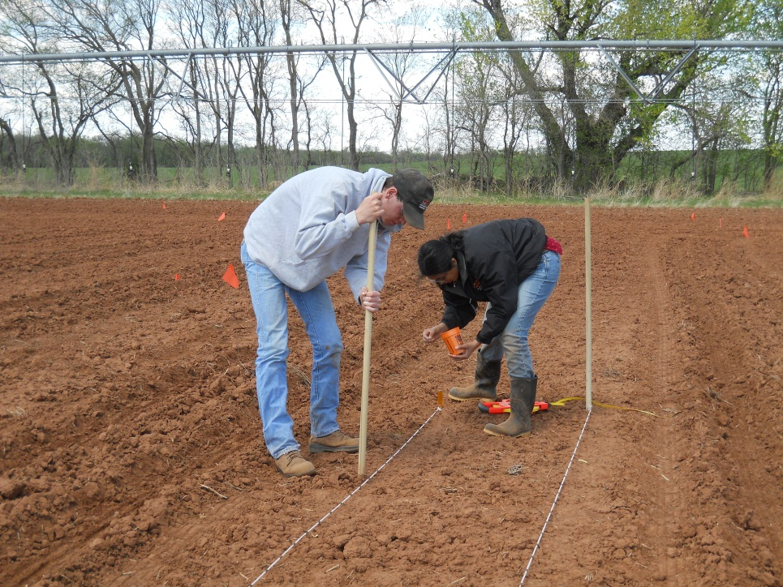
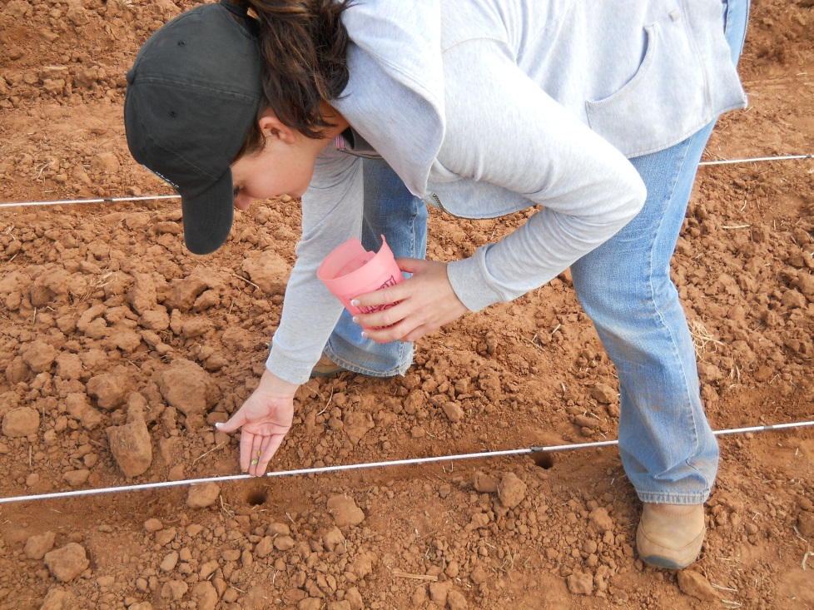
Materials and Methods (cont’d)
Notes:
Hand planting maize simulating of the system used in developing countries by “poking” with a wooden stick to a depth of 0.26m.

Slide 9
Results
Grain yield versus seeds/hill in Lake Carl Blackwell and Efaw research station, Oklahoma, 2011-2012.

Slide 10
Results
Intercepted photosynthetically active radiation (IPAR) between treatments in Lake Carl Blackwell and Efaw research station, Oklahoma, 2011-2012.

Slide 11
Results
Intercepted photosynthetically active radiation (IPAR) between treatments in Lake Carl Blackwell and Efaw research station, Oklahoma, 2011-2012.

Slide 12

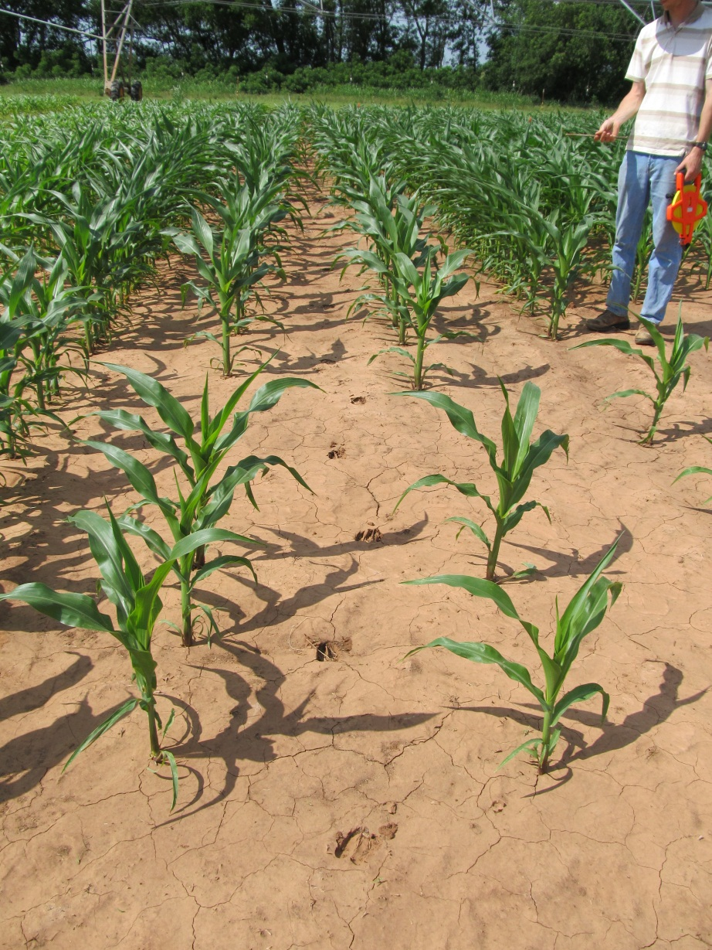

Possible Factors?????
Arghh!!!!!

Slide 13
Weather
Total monthly rainfalls (mm), surface air temperature (°C) in Lake Carl Blackwell and Efaw research station, Oklahoma, 2011-2012.

Slide 14
Conclusion
Trend for decreasing yields with increasing number of seeds per hill (same population) range (200 to 1000 kg/ha) except Efaw research station, 2012.
Trend for decreasing IPAR with increasing number of seeds per hill (same population) range ( 6 to 17%) except Efaw research station, 2012
IPAR was correlated with final grain yield.
Excessive heat lowered yield levels and decreased the ability to decipher treatment differences

Slide 15
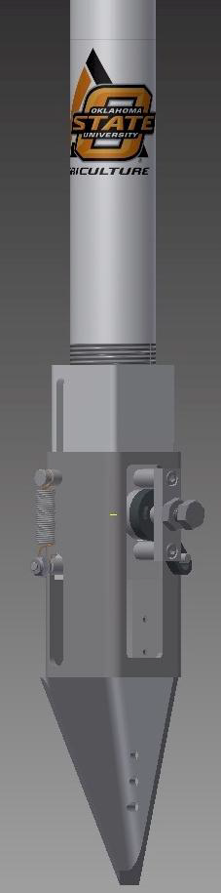
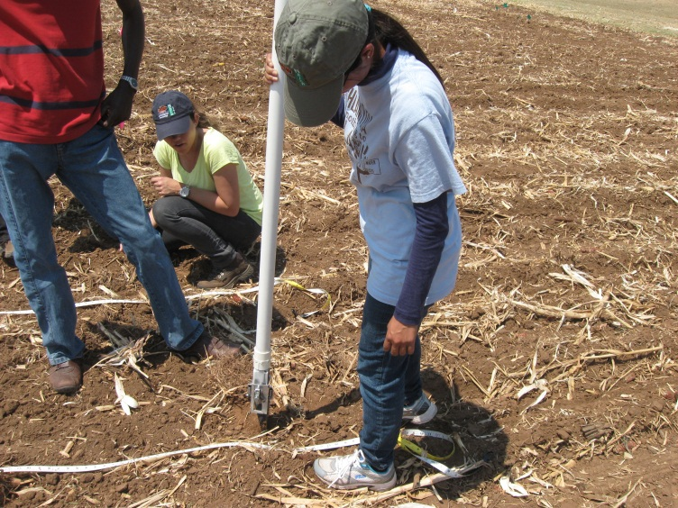
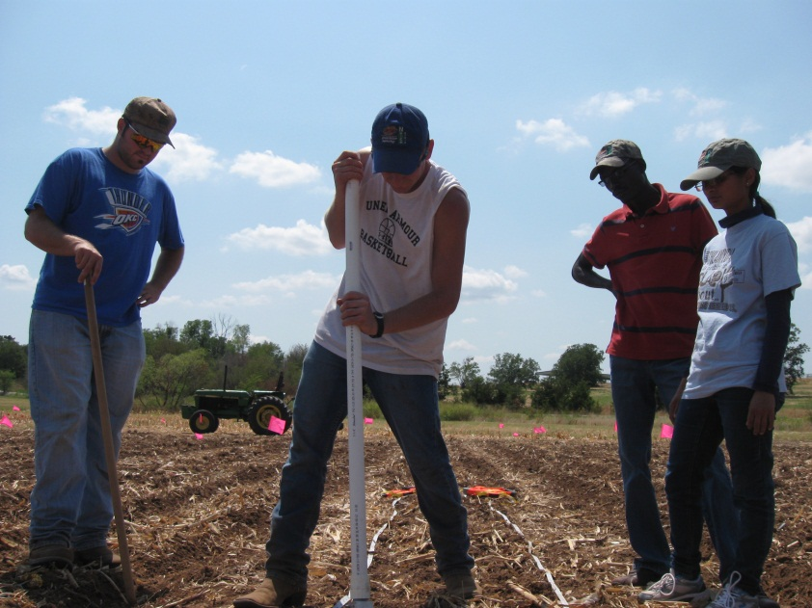
Current and Future Research
http://nue.okstate.edu/Hand_Planter.htm

Slide 16
Acknowledgement
Advisor at OSU: Dr. Bill Raun
Advisor at VT: Dr. Wade Thomason
Soil fertility Graduate students at Oklahoma State University( Jeremiah Mullock, Emily Rutto, Guilherme Torres, Jacob Bushong, Sulochana Dhital, Natasha Macnack, Candibyani Fnu, Alex Cumbie, Michael Reinert, etc. )

Slide 17

Thank you so much for your attention~!!!

