Slide 1
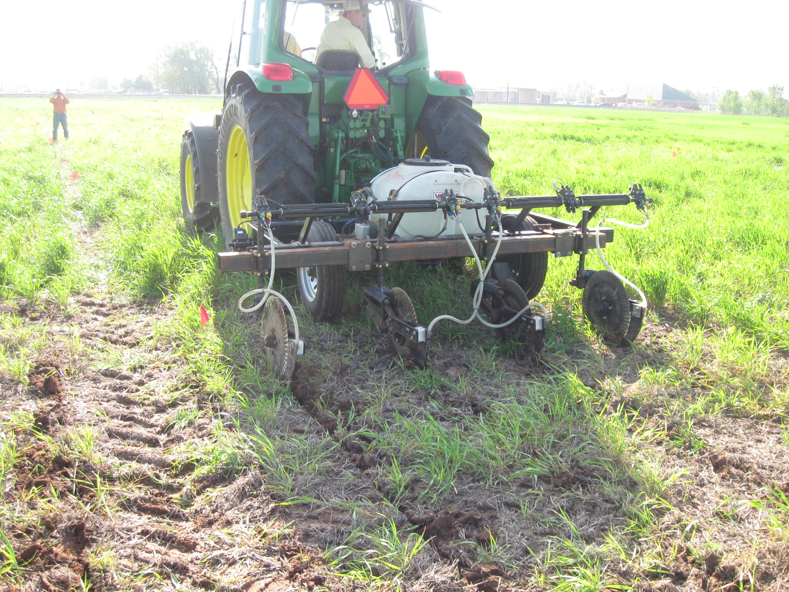
Maize Grain Yield Response to Preplant Nitrogen Placement At Different Distances from the Row
J.L. Mullock¹, J.T. Bushong¹, B. Chim², W.R. Raun¹, and R.K. Taylor³
¹Plant & Soil Sciences, Oklahoma State University, ²Crop & Soil Environmental Science, Virginia Tech, ³ Bio-Systems & Agriculture Engineering, Oklahoma State University
INTRODUCTION
RESULTS
Equipment with RTK Global Positioning Systems correction can provide sub-inch accuracy for nitrogen (N) applications
Maize grain yield has shown a positive response to mid-season N applied at distances closer to the row
This benefit was greater under hot, dry conditions.
OBJECTIVE
Figure 4. Mean maize grain yield response to preplant N placement at different distances from the maize row, Lake Carl Blackwell, OK, 2012.
This study was conducted to evaluate the effect of preplant N placement at different distances from maize rows on grain yield
Preplant N Placement, from Row
LAKE CARL BLACKWELL
No significant main effect for preplant placement, from row
Trend analyses not significant
HENNESSEY
Significant linear trend yield to increase with increased placement of N from the row (α=0.05)
Quadratic trend, not significant
Cubic trend for placement (α=0.10)
Figure 2. Mean maize grain yield response to preplant N rate, Lake Carl Blackwell, OK, 2012.
Preplant N Rate
LAKE CARL BLACKWELL
Over-all average yield of 3168 kg ha⁻¹
No significant main effect of N-rate (α=0.10)
Quadratic trend for N-rate (α=0.10)
No linear or cubic trend for N-rate
HENNESSEY
Over-all location yield average of 1981 kg ha⁻¹
No significant main effect of N rate
No linear, quadratic, or cubic trend for N-rate
Lcb
Figure 1. Preplant N applicator with moveable toolbar to change distance from the planted row mounted on an RTK equipped tractor.
MATERIALS & METHODS
Study was conducted at two dryland locations, summer of 2012
Lake Carl Blackwell (LCB) - (Pulaski coarse-loamy, mixed, superactive, nonacid, thermic Udic Ustifluvents)
Hennessey - (Bethany fine, mixed, superactive, thermic Pachic Paleustolls)
Preplant N rates, 0, 56, 112, & 224 kg N ha⁻¹
Nitrogen was applied in the form of urea-ammonium nitrate (28-0-0)
Preplant N distances from the maize row were 0, 8, 15, 25, and 38 cm.
Treatments were arranged in a RCBD with 3 replications.
Figure 5. Mean maize grain yield response to preplant N placement at different distances from the maize row, Hennessey, OK, 2012.
CONCLUSIONS
Yield levels were low at both locations, and response to N placement was reduced
After 2 site-years, results are inconclusive and evaluation will be continued
Figure 3. Mean maize grain yield response to preplant N rate, Hennessey, OK, 2012.
OKLAHOMA STATE UNIVERSITY

