Slide 1







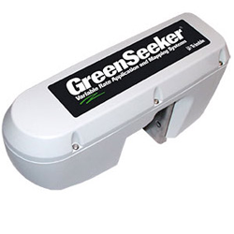



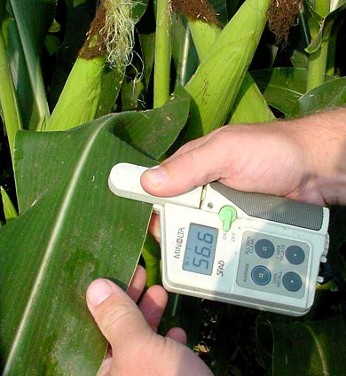

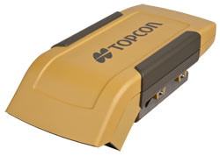

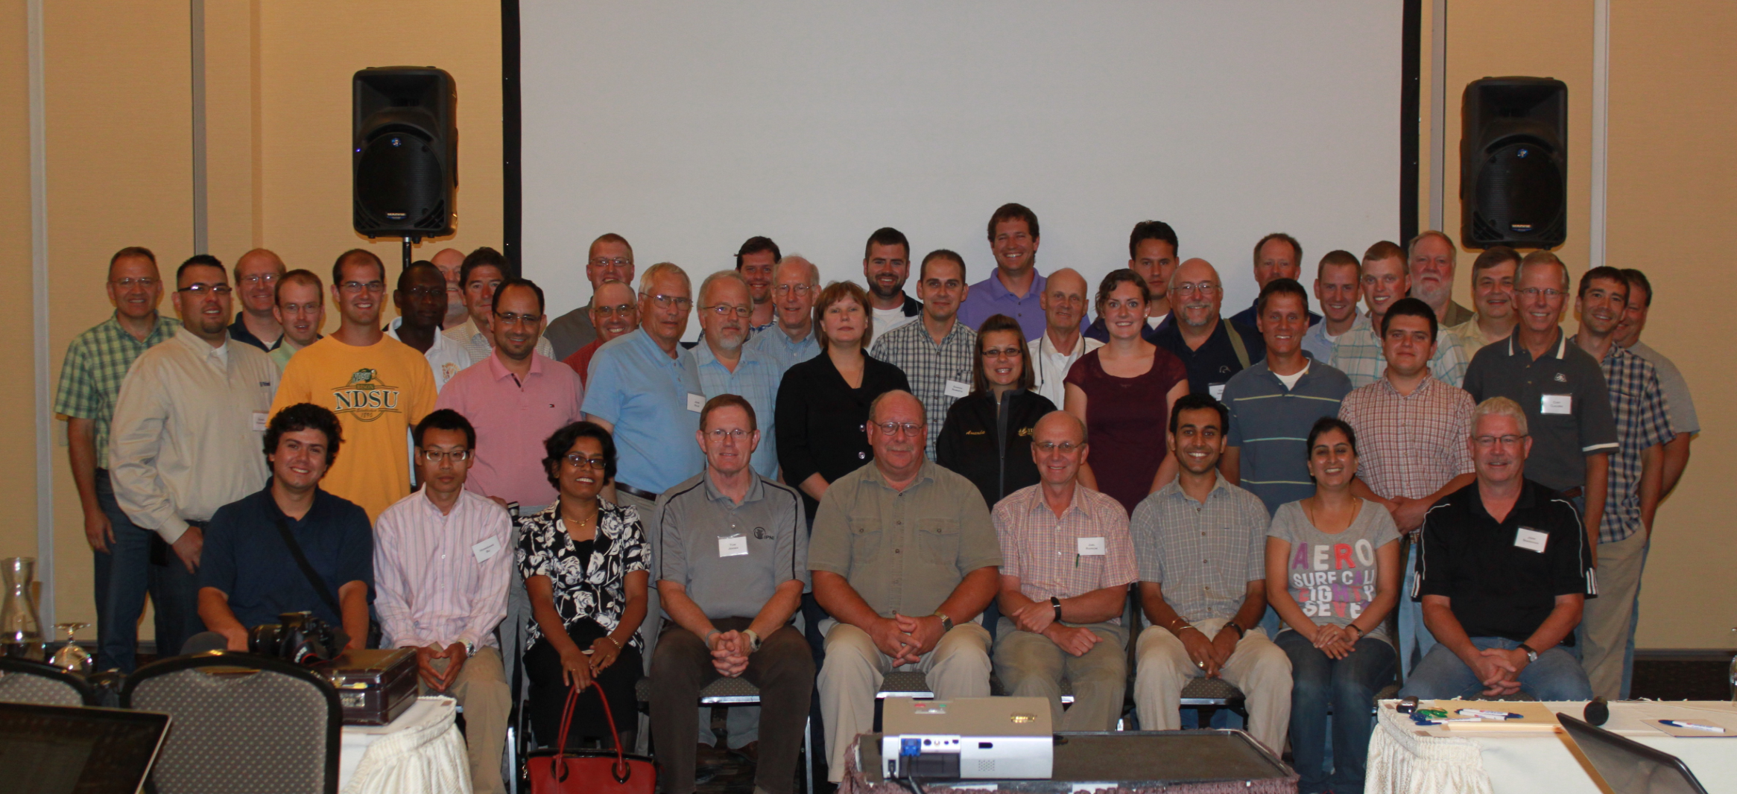



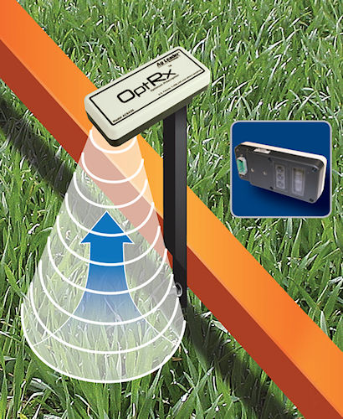



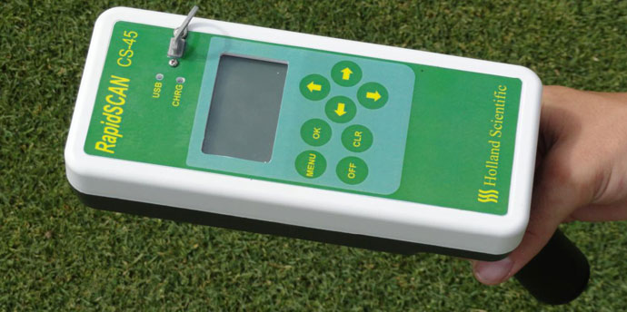
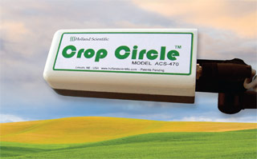
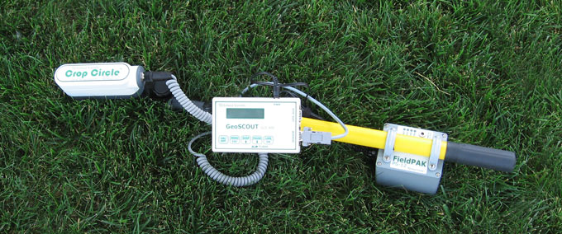

Sensor-Based Nutrient Management Community
2012 Chair: James S. Schepers
Introduction:
Community Activities:
Published Literature:
This community focuses on applications of sensor-based technologies including field studies that cover interpretation of sensor data, nutrient recommendations, and use of sensors to assess crop vigor in general. Unique applications that are linked to other production considerations are encouraged, as are experiences from producer fields.
Members of this community publish in several
journals.
Agronomy Journal
Scharf, P.C., D.K. Shannon, H.L. Palm, K.A. Sudduth, S.T. Drummond, N.R. Kitchen, L.J. Mueller, V.C. Hubbard, and L.F. Oliveira. 2011. Sensor-based nitrogen applications out-performed producer-chosen rates for corn in on-farm demonstrations. Agron. J. 103:1683-1691.
Solie, J.B., A.D. Monroe, W.R. Raun, and M.L. Stone. 2012. Generalized algorithm for variable-rate nitrogen application in cereal grains. Agron. J. 104:378–387.
Tubaña, B., D. Harrell, T. Walker, J. Teboh, J. Lofton, Y. Kanke, and S. Phillips. 2011. Relationships of spectral vegetation indices with rice biomass and grain yield at different sensor view angles. Agron. J. 103:1405-1413.
Precision Agriculture
Editor: James S. Schepers
Poetz, G., J.P. Molin, and J. Jasper. 2012. Active crop sensor to detect variability of nitrogen supply and biomass on sugarcane fields. Precision Agric. 13:33-44.
Vincini, M. and E. Frazzi. 2012. Comparing narrow and broad-band vegetation indices to estimate leaf chlorophyll content in planophile crop canopies. Precision Agric. 12:334-344.
Tomkiewicz, D. and T. Piskier. 2012. A plant based sensing method for nutrition stress monitoring. Precision Agric. 13:370-383.
Remote Sensing of Environment
Editor-in-Chief: Marvin Bauer
Ciganda, V.S., A.A. Gitelson , and J. Schepers. 2012. How deep does a remote sensor sense? Expression of chlorophyll content in a maize canopy. Remote Sensing of Environment 126:240–247.
2011 ASA In-Season Nutrient Management Symposium
2012 Precision Agriculture Conference in Indianapolis, IN
August 6-8, Fargo, ND
2012 Optical Sensing
Nitrogen Management Group
Participants of the 2012 Optical Sensing Nitrogen Management Group
Poster Competition:
2012 Optical Sensing Nitrogen Management Workshop in Fargo, ND
The Sensor-Based Nutrient Management Community is sponsoring a graduate student poster competition. The posters being evaluated are in Division C3 section 100, Division S4 section 133, and Division S8 section 152.
Upcoming Events:
The 2013 InfoAg Conference will be held July 16-18 in Springfield, IL.
Business Meetings:
Sensor-Based Nutrient Management Community
Wednesday, October 24th
4:00 pm – 4:30 pm
Duke Energy Convention Center, Room 263, Level 2
Division S4/S8 Joint Business Meeting
Tuesday, October 23rd
4:00 pm – 5:00 pm
Duke Energy Convention Center, Room 200, Level 2
The 2013 Optical Sensing Nitrogen Management Workshop will be hosted by Pioneer Hi-Bred in Johnston, IA during the month of August.

