Slide 1

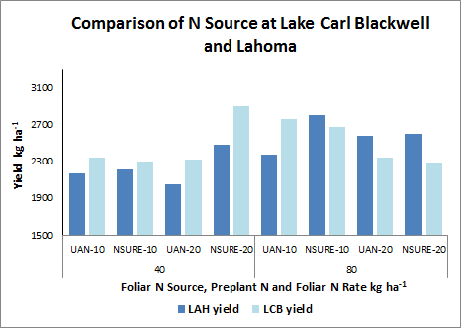
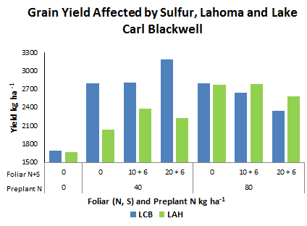
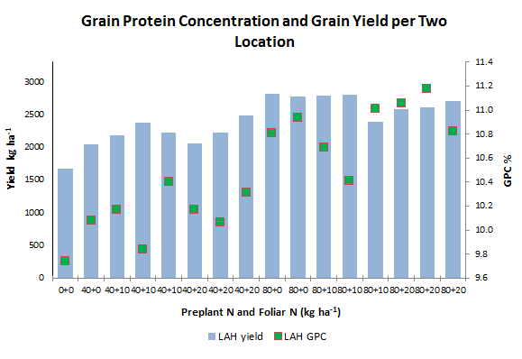
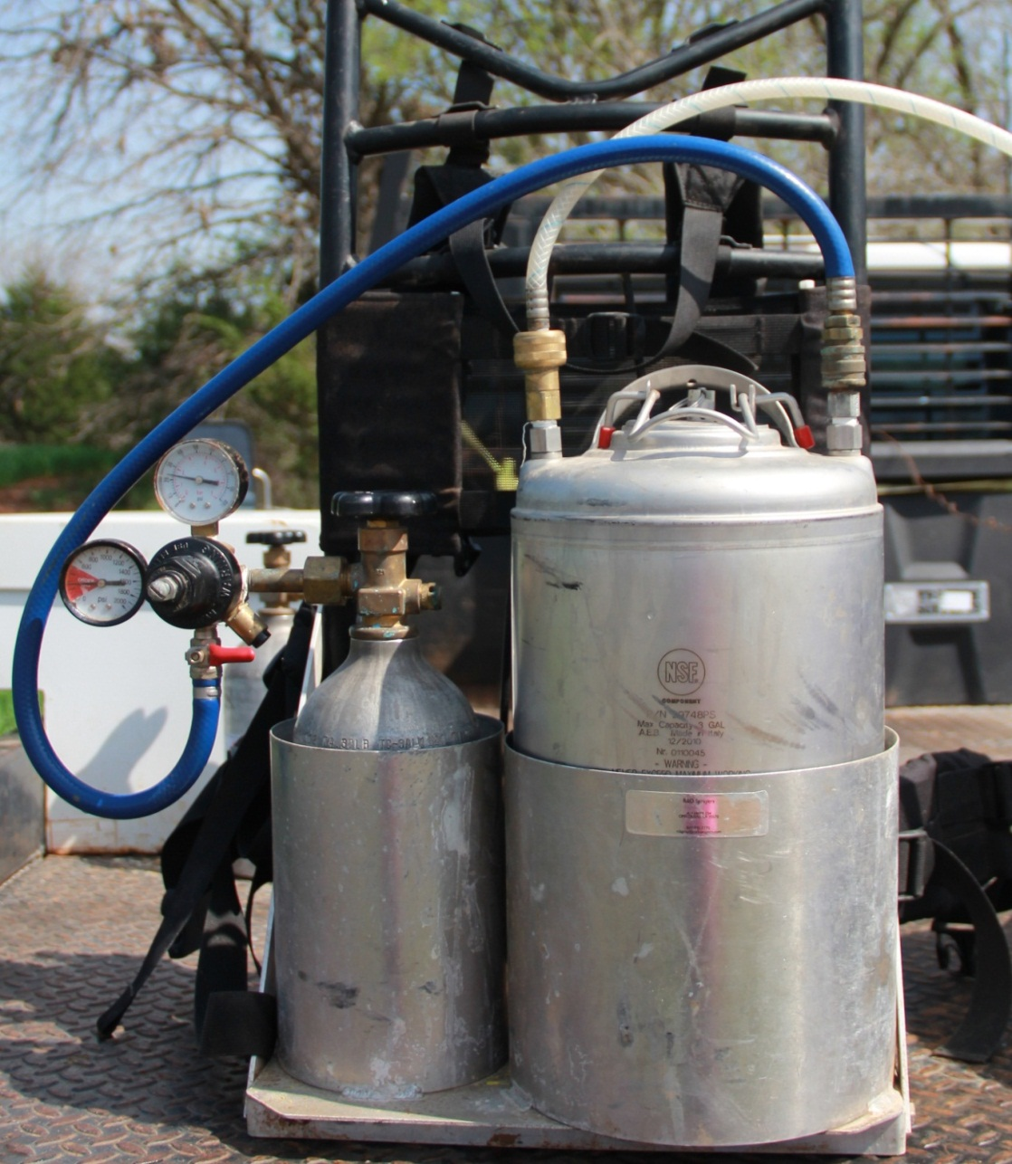
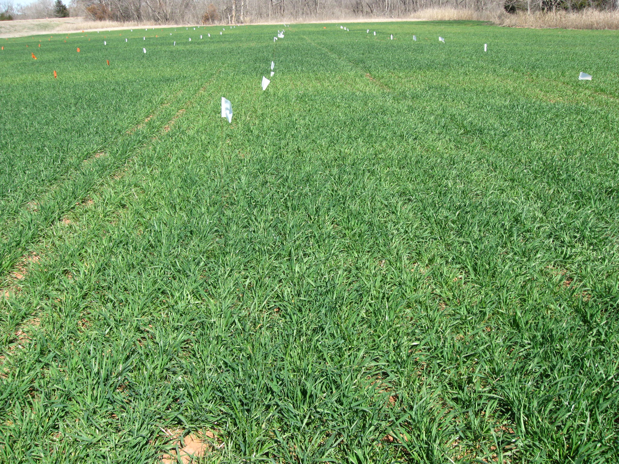
INFLUENCE OF FOLIAR SULFUR, CHLORIDE AND NITROGEN ON WINTER WHEAT GRAIN YIELD AND QUALITY
S. Dhital¹, B. Chim², J. Mullock¹, and W. Raun¹.
¹Department of Plant and Soil Sciences, Oklahoma State University
²Department of crop, Soil and Environmental Sciences, Virginia Tech
O K L A H O M A S T A T E U N I V E R S I T Y
INTRODUCTION
RESULTS
P L A N T & S O I L S C I E N C E S
Optimum use of nitrogen (N) is a key component in improving grain yield and quality in winter wheat (Triticum aestivum L.). The combined effect of other nutrients with N can have a positive impact on crop production. Use of sulfur (S) and chloride (Cl) with N is considered to be more effective in optimizing wheat grain yield and grain protein.
Table 1: Treatment means for grain yield, grain N and grain protein, Lake Carl Blackwell , OK, 2012
Trt | Preplant N kg ha⁻¹ | Foliar N Source | Foliar N kg ha⁻¹ | Foliar S kg ha⁻¹ | Yield kg ha⁻¹ | Grain N mg kg⁻¹
1 | 0 | Check | 0 |  | 1700 | 144
2 | 40 | Check | 0 |  | 2797 | 154
3 | 40 | UAN | 10 |  | 2351 | 165
4 | 40 | UAN | 10 | 6 | 2815 | 166
5 | 40 | NSURE | 10 |  | 2304 | 171
6 | 40 | UAN | 20 |  | 2327 | 174
7 | 40 | UAN | 20 | 6 | 3192 | 175
8 | 40 | NSURE | 20 |  | 2903 | 166
9 | 80 | Check | 0 |  | 2044 | 182
10 | 80 | UAN | 0 |  | 2804 | 158
11 | 80 | UAN | 10 | 6 | 2641 | 174
12 | 80 | NSURE | 10 |  | 2684 | 174
13 | 80 | UAN | 10 |  | 2760 | 171
14 | 80 | UAN | 20 | 6 | 2345 | 186
15 | 80 | NSURE | 20 |  | 2288 | 169
16 | 80 | NSURE | 20 | 6 | 2945 | 177
 |  |  |  | CV, % | 15 | 6
 |  |  |  | SED | 131 | 4
OBJECTIVE
To determine the benefits of foliar N application, before flowering, on winter wheat grain yields and to determine the synergistic effects of applying foliar N, S, and Cl on winter wheat grain yield.
Mean yields higher for NSURE at Lahoma, UAN higher for most treatments at LCB
MATERIALS AND METHODS
S O I L N U T R I E N T M A N A G E M E N T
Two sites: Lake Carl Blackwell and Lahoma.
RCBD with 4 replications and 16 treatments.
Treatments received preplant Urea Ammonium Nitrate (UAN) 0, 40, 80 kg N ha⁻¹ .
UAN & NSURE were used as Foliar N source
10 kg N ha⁻¹ and 20 kg N ha⁻¹ was applied at pre-flowering growth stage.
Gypsum was used as the S source and applied at 6 kg S ha⁻¹ .
Half of each plot in rep. 4 and treatment 16 in each rep received foliar Cl as CaCl₂ at 10 kg Cl ha^{-1.} .
Grain yield, protein, and P concentration (GPC) were determined for each treatment.
Data was analyzed using non-orthogonal contrasts in SAS.
Mean yield and grain protein increased with preplant linear N rate at both locations.
N (40 or 80) + 6 kg S/ha was effective at LCB and LAH
CONCLUSIONS
Yield was higher at Lake Carl Blackwell and grain protein was higher at Lahoma
Grain yield inversely correlated with grain protein
Grain yield, and grain protein increased with the application of preplant N and Foliar N
Treatment vs. Control and preplant linear N contrasts were significantly different for both locations
Chloride increased yield at Lahoma
N+S increased yield at both locations
CO₂Backpack Sprayer for foliar application
Feekes 4 Growth stage wheat, Lake Carl Blackwell, OK

