Slide 1
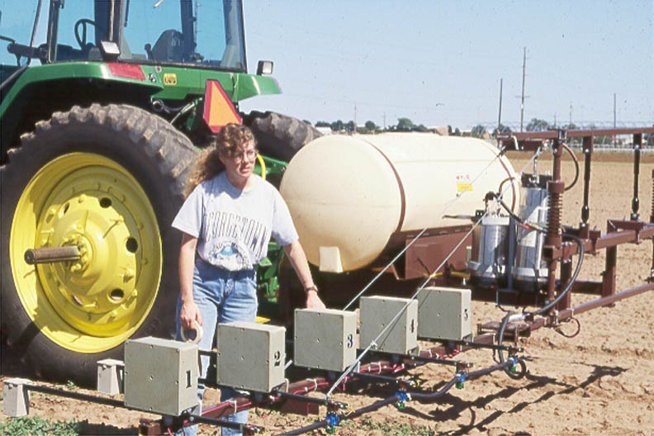
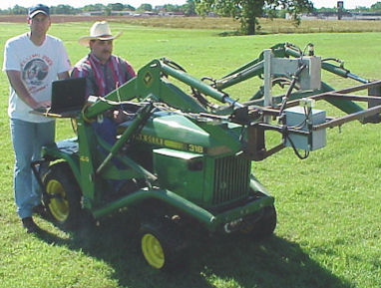
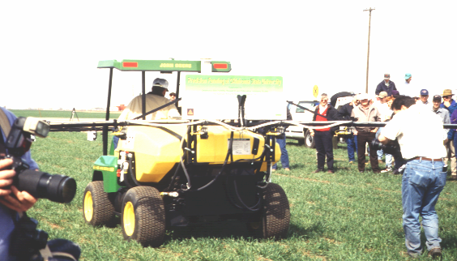
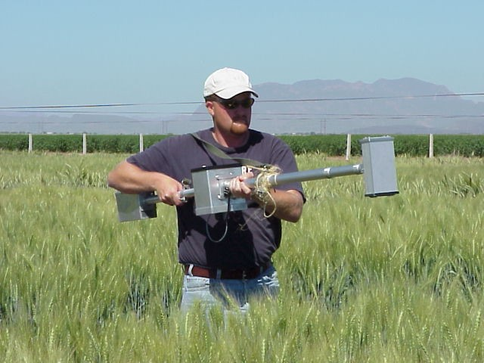
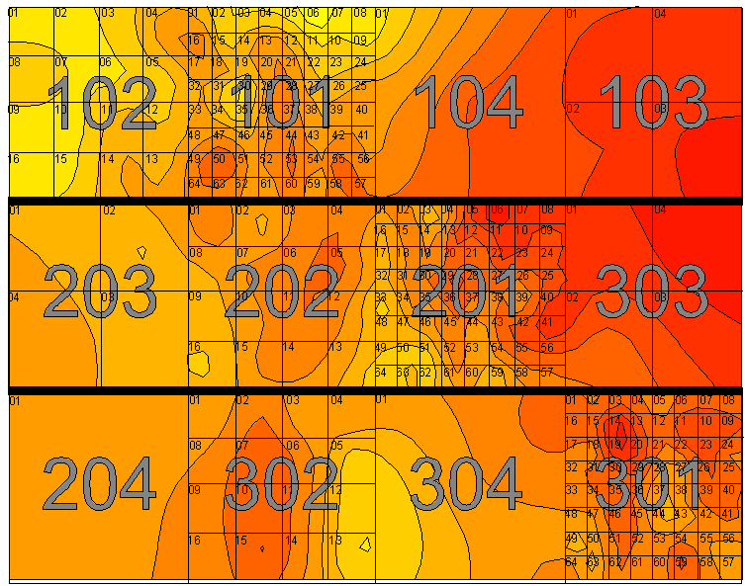
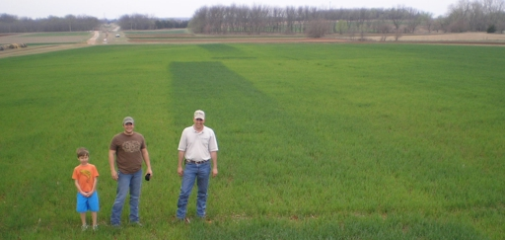
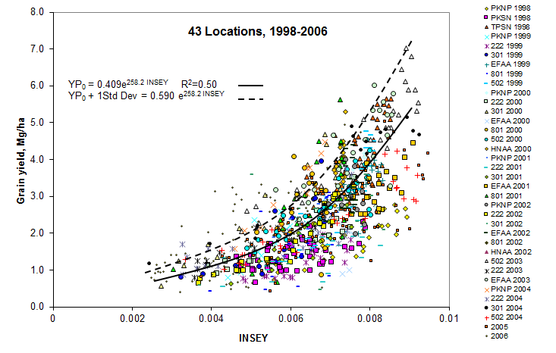
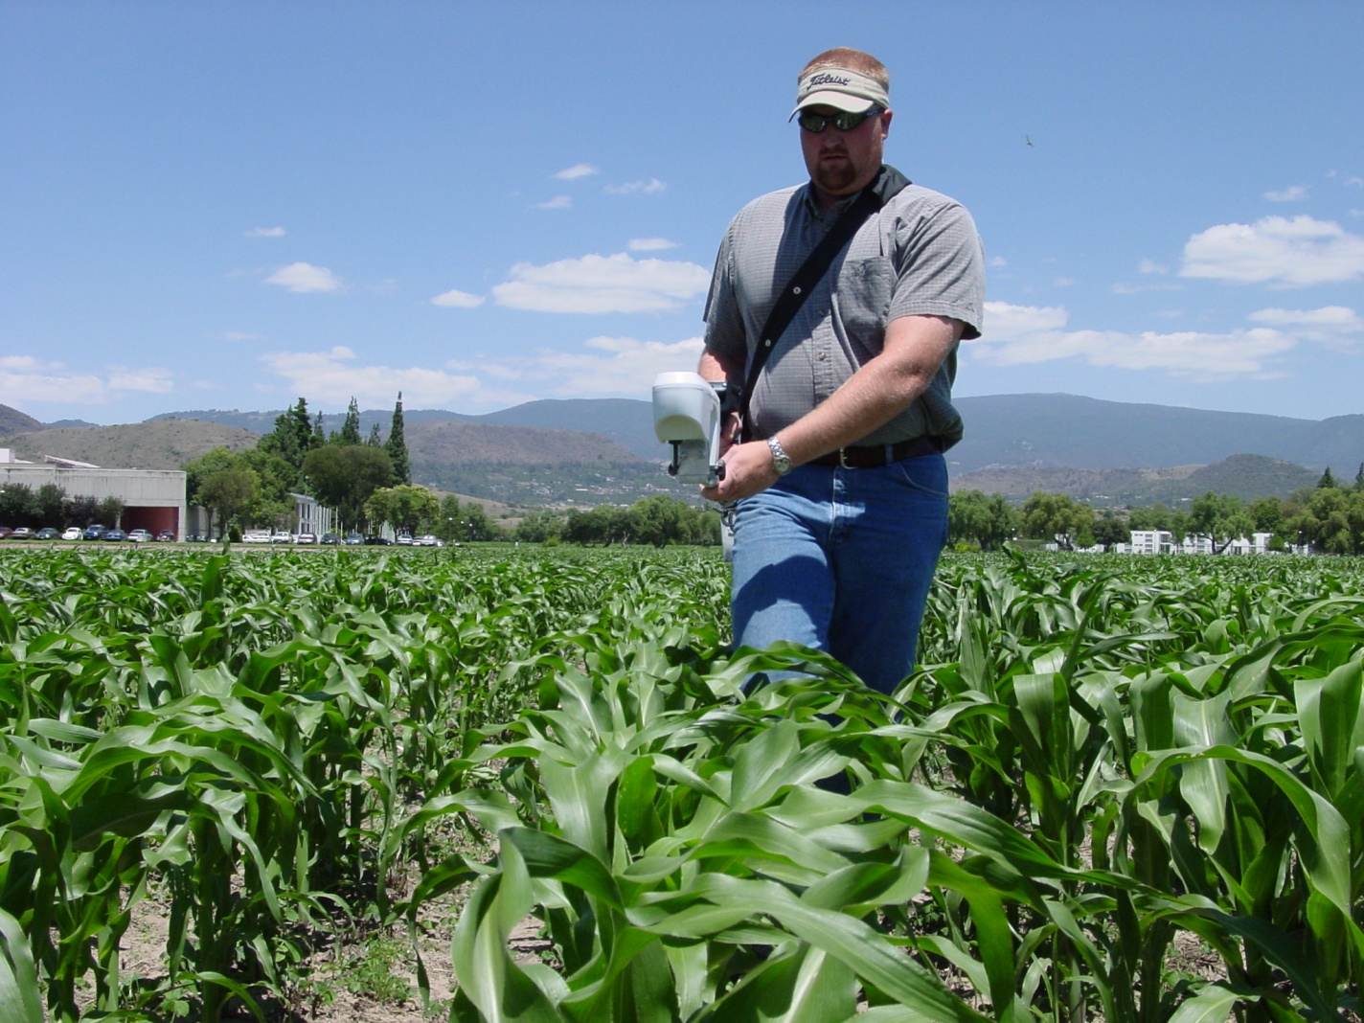
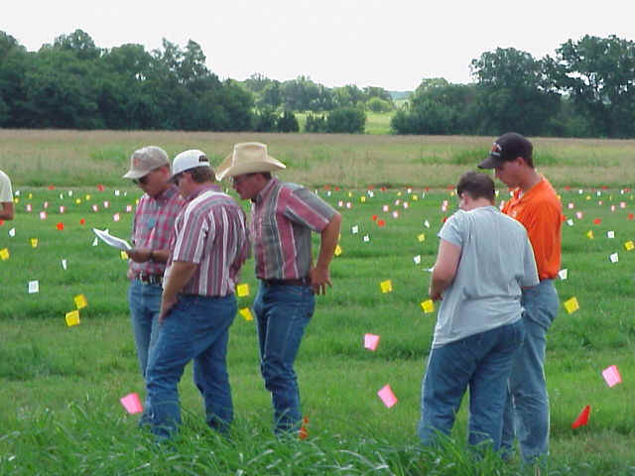
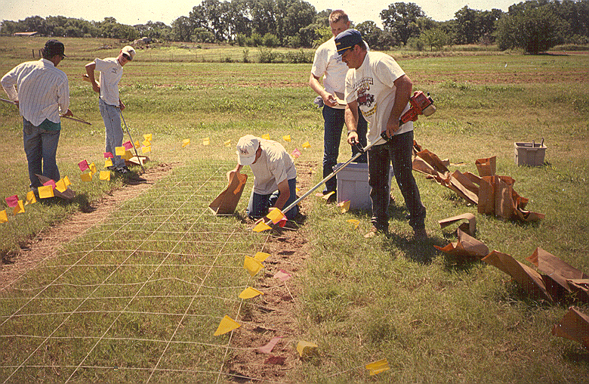
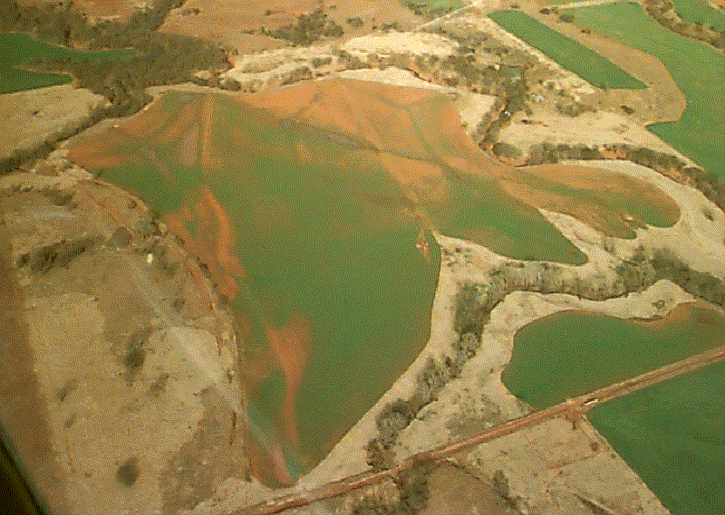
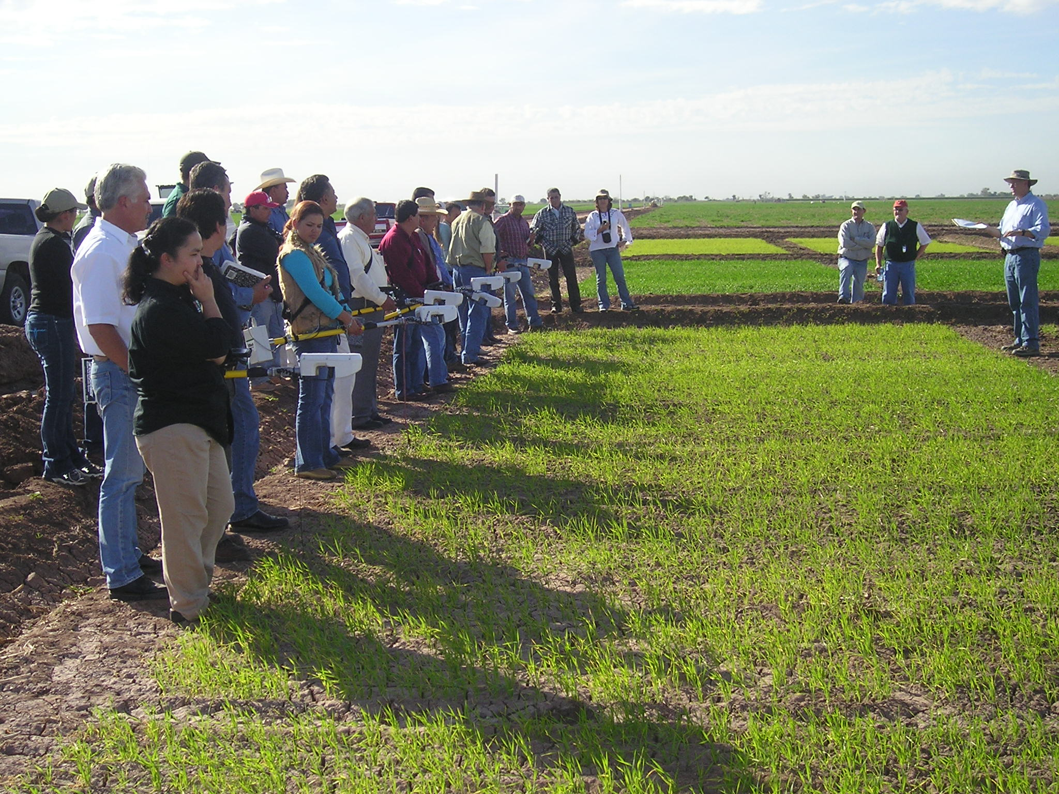
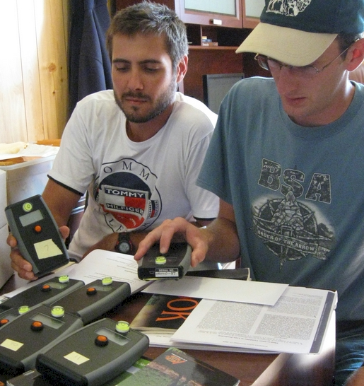
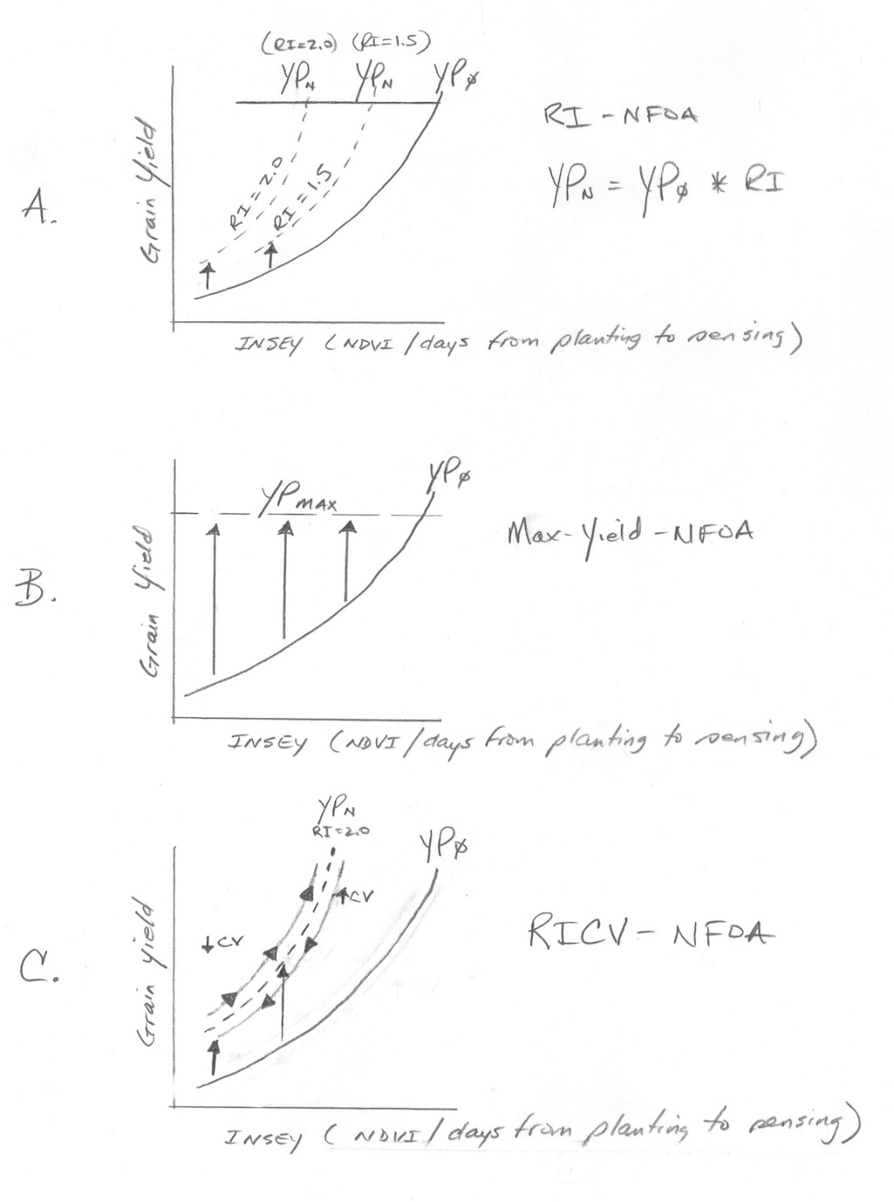
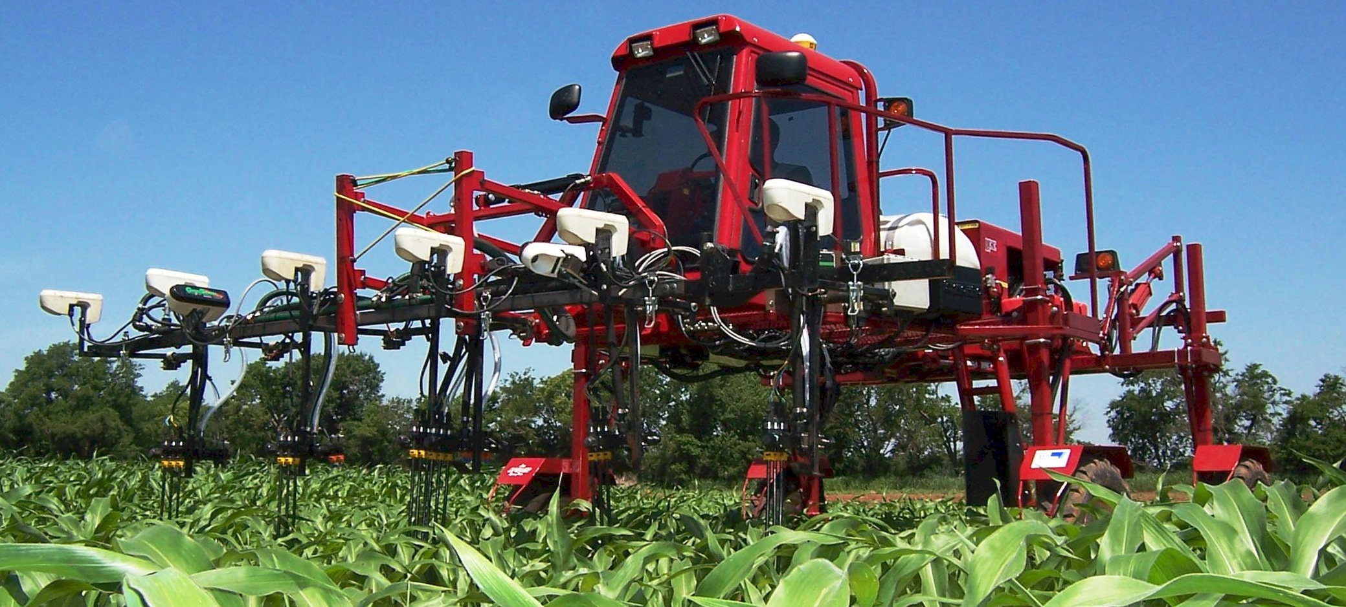
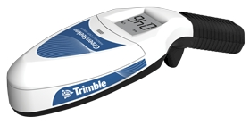
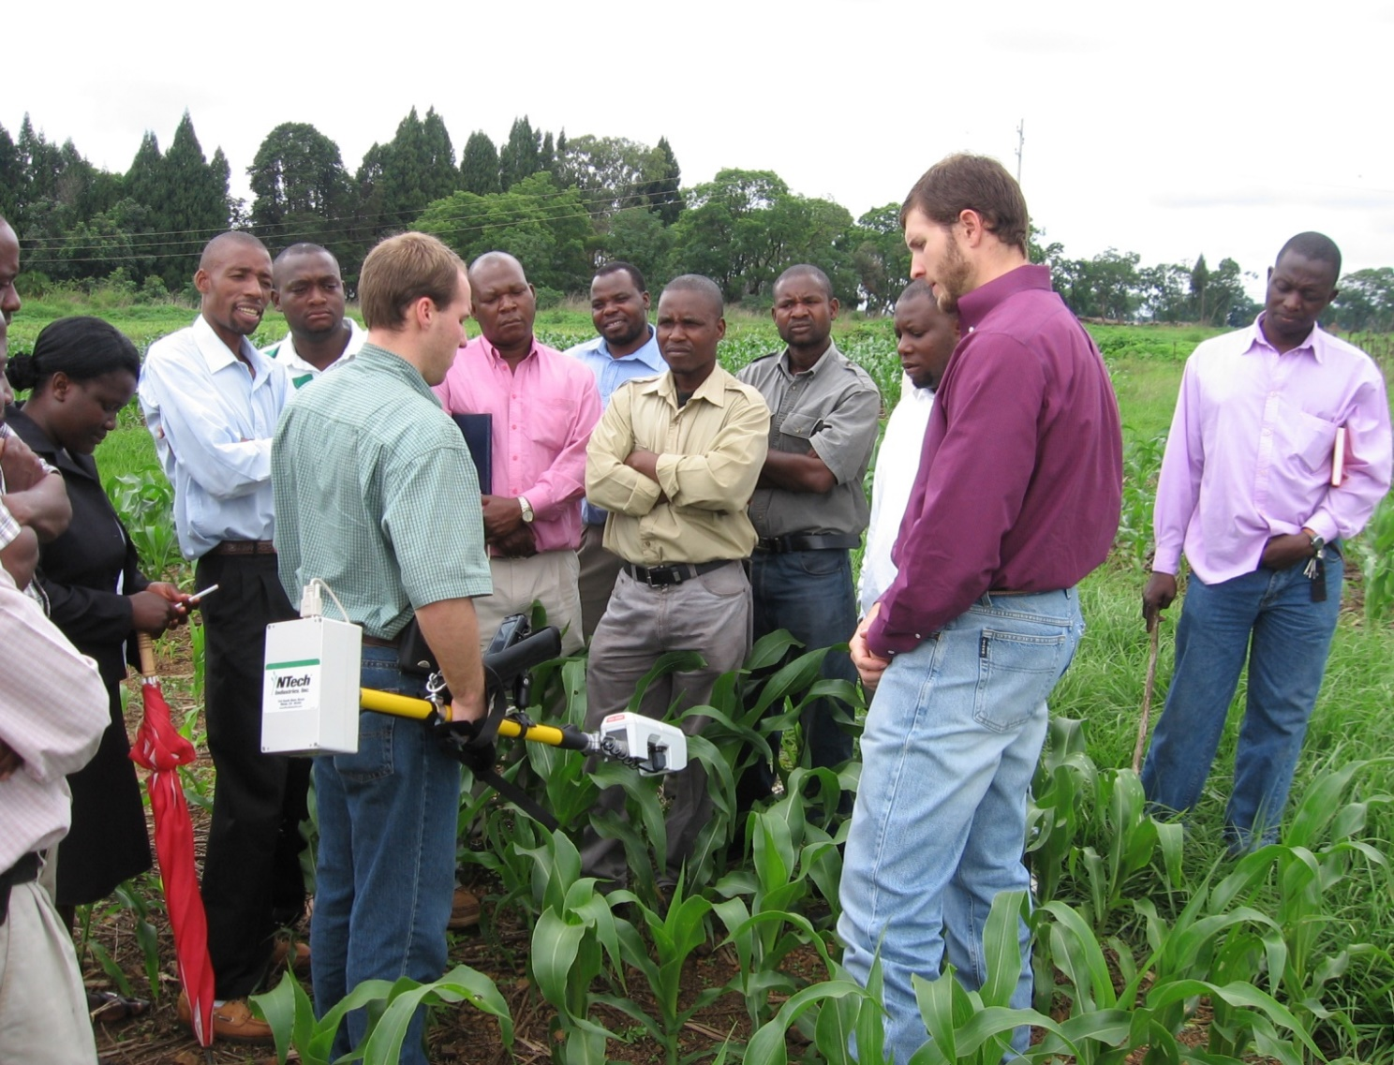
Greenseeker Sensor Development 1989-2015
M.L. Stone, J.B. Solie, and W.R. Raun
Oklahoma State University
TIMELINE
Initial passive sensors developed in 1989 were for detecting and spraying weeds. In 1990, the first order bindweed detector/ sprayer was evaluated. By 1992, engineers and agronomists successfully used NDVI for sensing plant biomass. In 1996, the very first variable N rate applicator was built that could sense and treat every 10 ft² at 10 mph. By 1998, spring wheat grain yields could be predicted using advanced-passive sensors, CIMMYT, Ciudad Obregon, MX.
2001, commercial scale 60 foot applicator could sense and fertilize every 4 ft² at 15 mph.
1989
1996
1998
1992
2001
In 2002, robust prediction of wheat grain yield potential was possible using climatological data that normalized NDVI.
1995
Accurate prediction of mid-season N rates based on Greenseeker readings, predicated on having an N Rich Strip (1995)
2002
Documenting small scale spatial variability
Greenseeker sensors used all over the world
In 2007, sensing and fertilizing corn, by-plant was possible using Greenseeker sensors and high speed rate controllers
2008
2003
Greenseeker sensor used to collect coefficient of variation (CV) data to better characterize small scale variability and refine fertilizer N rates
2007
In 2008, small scale, more affordable hand held sensor developed, tested and commercialized by Trimble
OKLAHOMA STATE UNIVERSITY

