Slide 1
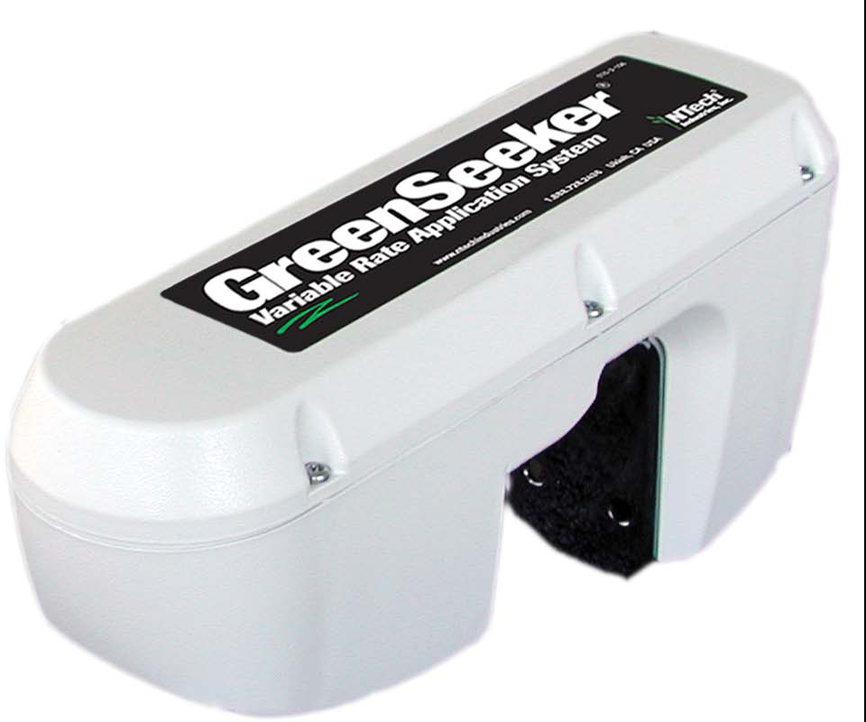
GreenSeeker Sensing Technology
New Tools for Your
Consulting Toolbox
Jack Gerhardt
GreenSeeker Product Manager
NDSU Advanced Crop Advisors Workshop
February 12, 2009
jgerhardt@ntechindustries.com
Notes:
Stand in for Dr. Bill Raun—the father of optical sensing. Practical vs. Academic

Slide 2

Agenda
GreenSeeker Adoption & Current Technology
Common Misconceptions & Objections
Why Add GreenSeeker to your Toolbox

Slide 3
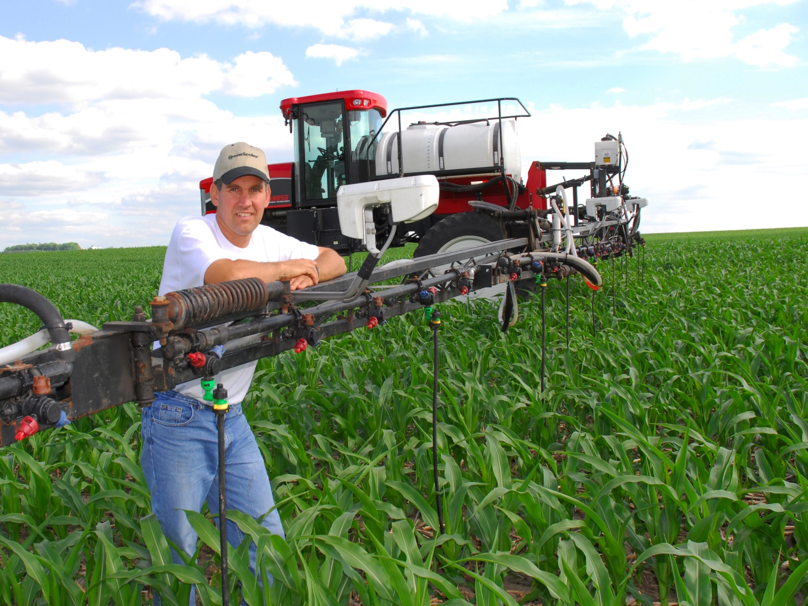
State of Sensing Technology
28 US States, Canada, Mexico , Europe
250,000 + Domestic Real-Time VR Acres
Applicators:
70% Drops/Steamers
20% Liquid/AA Nitrogen Bars
10% Dry Spinners
100’s of Single Sensor & Mapping Systems
Notes:
Transition slide: speak to changes in geography/crops

Slide 4
State of GreenSeeker Technology
Commercial Adoption—Real-Time Variable Rate:
  Plant Growth Regulators
  Desiccants
  Fungicides
Commercial Adoption—Real-Time VR Nitrogen Mgt:
  Corn
  Winter Wheat
  Sorghum
Commercial Adoption—In Season Vigor Mapping
  All crops and turf grasses
  Multi Sensor or Single Sensor

Slide 5
State of GreenSeeker Technology
Rapid Adoption of Sensor Technology Seed & Chemical Cos.
  Stand Counts
  Early Season Vigor
  Growth Rates
  Stress Resistance
  Herbicide Tolerance
Early Adoption for Real-Time VR Nitrogen Management:
  Canola
  Malting Barley
  Durum Wheat
  Hard Red Spring Wheat
  Oats
Late Stage Testing:
  Early season Corn Nitrogen-(v4--0 rate strip)
  Cotton Nitrogen
  Numerous other niche crops (Agave)
Positive Adoption Curve similar to Strip Till or No Till

Slide 6
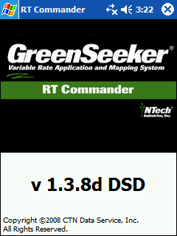
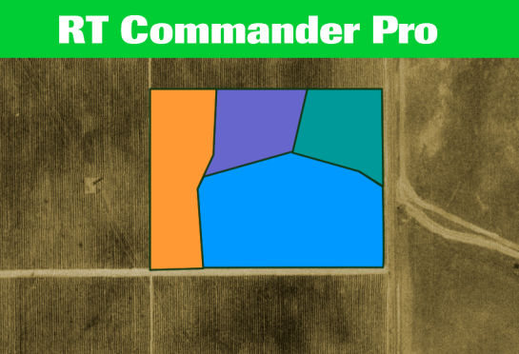

GreenSeeker® RT200 with RTC Pro
v 1.3.8
Introducing RT Commander Pro
Featuring Variable Rate Technology driven by both:
-Historic Field Data
- Real Time field data

Slide 7
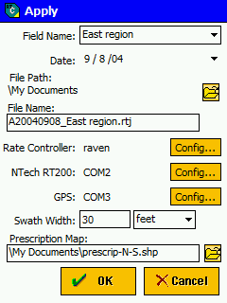
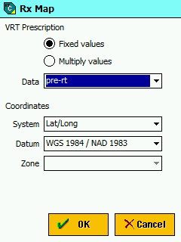
GreenSeeker® Background Map
When setting up a job,
RT Commander Pro includes a background prescription map option.
Completely override the algorithm in selected areas, or
Multiply the algorithm values
to increase or decrease the recommended rate

Slide 8
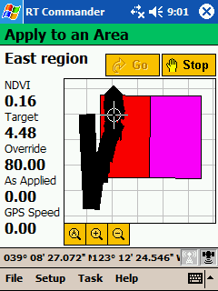
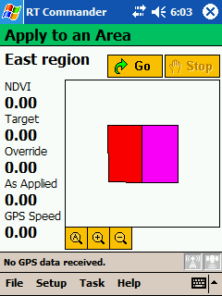
GreenSeeker® Background Map
The pre determined management zones appear on the monitor as a background map.
The target rate applies outside the bounded areas, but is replaced by the over-ride prescription value (80) in the example above.

Slide 9
Misconceptions
Fallacy: GreenSeeker is a Nitrogen Sensor
Fact: Nitrogen leaf content is not a good predictor of yield potential.
Fact: NTech abandoned sensing of Leaf N content as a research goal in the late ‘90s.
Fact: GreenSeeker is primarily a biomass sensor.
Fact: Biomass/color (coupled with GDU data) is highly correlated with yield potential.

Slide 10
Winter Wheat
Enid, OK 2005
Notes:
10
This slide illustrates that across a gradient of N rates and a change in soils, NDVI at feekes 5 growth stage correctly estimated end of season yield potential.
This is because NDVI relative to a time (or heat unit) parameter is an excellent predictor of ending yield.

Slide 11
Misconceptions
Fallacy: “I can see variability with my eyes—I don’t need a sensor”
Fact: We can see macro variation in a field, but not subtle changes.
Fact: We cannot remember where the variations are and to what degree.
Fact: A flat rate is typically not the optimal answer to variability.

Slide 12
GreenSeeker vs. Subjective Scoring
Notes:
This is how plots were scored using subjective visual scoring. Note that the subjective scores had almost no correlation to physically weighed biomass.

Slide 13
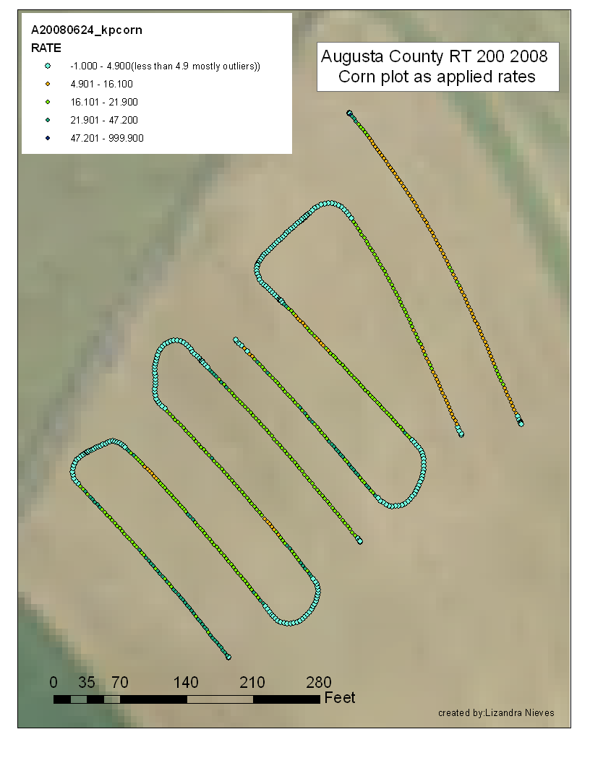
Surface-applied
Manure
72 lb N/ac
72
70
61 lb N/ac
Injected
Manure
70
78
75
63
60
47

Slide 14
Misconceptions
Fallacy: “I can do variable rate N with historic data—I don’t have the time nor the need for an in-season device.”
Fact: In certain seasons, 1 year of quality in-season data can be more valuable than 10 years of historic data.
Fact: Normalized information has bias that will limit the high end and over estimate the low end.
Fact: In wet years hills do best, in dry years the bottoms do best.

Slide 15
Current vs. Historic Data
Kansas Corn 2008
Notes:
Notice the red band of low yield on the normalized yield map and how inconsistent it is with current year NDVI data. Historic information would give you a completely different N recommendation that the current year NDVI. (Also note the color scheme on the As Applied map is somewhat counter intuitive)

Slide 16
TEMPORAL VARIABILITY

Slide 17
Misconception
Fallacy: “If you give me your yield goal, I’ll tell you how much nitrogen to apply”
Fact: “Yield Goal” fertility is a dis-service to your clients and the environment.
Fact: Yield Potential or Realistic Yield Expectation (RYE) derived from sensor information and GDD consistently improves Nitrogen Use Efficiency.
Fact: You can’t estimate mineralization rates, residual N, or lost N without in season info. (ex. Nitrogen Rich Strip vs. Farmer Practice or control area)

Slide 18
Yield Potential Varies by Year
Source: Elwyn Taylor Iowa State Meteorologist
Notes:
Only when weather cooperates can we capture the “Maximum Attainable Yield” of a given hybrid. Unfortunately, the weather doesn’t cooperate most years. In fact, between 1945 and 2007 “Maximum Attainable Yield” was only achieved 5 times, or once every 12 years on average. Yet, most producers (and consultants) fertilize for Max Yield every year!

Slide 19
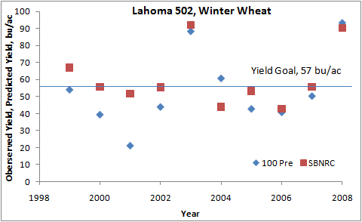
Sensor Based Yield Potential (Feb) vs. Harvest Yield
Notes:
Blue dots = actual yield from 100 pre plant, Red squares are predicted yield early February. Plot average yield is around mid 40 bpa. Prior to 2003, 70 bpa was highest recorded yield.
19

Slide 20
US Corn: NDVI vs. Yield
Rx:16 gpa 28% UAN
43.6 bu/ac
N Rich
Strip
Notes:
This slide demonstrates the correlation between NDVI @ V9-V10 and ending yield, and how this information drives the Rx generation.
In this hypothetical example; If field NDVI is .6 vs. N rich NDVI of .7, then looking at the relationship curve, there is a 43.6 bu/ac difference in yield potential if we do nothing.
However, If we intervene with in-season N management we can correct for the N deficiency as follows:
43.63 bu/ac opportunity x 1.6% grain N per bu (43.63 bpa x 56 lbs/bu x 1.18% grain N content) equals 28.83 lbs of N/ac shortage
28.83 lbs of N/ac divided by (our assumed Nitrogen efficiency factor of) .6 equals 48 lbs of N to be applied/ac
48 lbs per acre divided by ~3 lbs per gallon of UAN 28% equals 16 gpa rate

Slide 21
What are Growers Saying?
2008 North Dakota Farmer comments:
  “In the past, I had protein all over the board. Sometimes 10.5%, often in the 11% range.”
  “This year what was encouraging to me was the variable rate application with GS gave me a consistent 12.25 to 12 ¾.”
  “I figured I got an extra $10/a on protein. Just on the protein side alone, I got a 3:1 return on the extra investment in fertilizer.”
  “I am pleased with the GS. What I saw on winter wheat convinces me that it is an excellent tool.”

Slide 22
What are Consultants Saying?
2008 Missouri Crop Consultant comments:
  "GS helps me in my work. It reduces my headaches in prescribing inputs. It puts it on just like I want it. It takes a load off me.“
  "I loved it. It is so far ahead of InTime [aerial imagery] you don’t want to use those two in the same sentence.“
  "It is untouched compared to other technologies. We had fields that looked like a tabletop when we got through with them.”
  “Eager to use GS more extensively with N on corn in 09.”

Slide 23
North Dakota Spring Wheat
2008 GreenSeeker Variable Rate Side Dress
3-20 GPA

Slide 24
North Dakota Spring Wheat
2008 GreenSeeker Variable Rate Top Dress
9-23 GPA

Slide 25
Adding GreenSeeker to Your Toolbox
Considerations for mapping services:
  Give clients a “visual” to add value to your services.
  Increase profit margins on custom application through map generation on standard field passes.
  Streamline scouting & sampling efforts by recognizing & getting to “opportunity spots” quickly.
  Utilize in-season sensor information to fine tune recommendations.
  Grow clients by differentiating your offering.

Slide 26
Adding GreenSeeker to Your Toolbox
Considerations for Real Time Variable Rate
  Reduce hours of tedious, undervalued work in Rx generation.
  Spend more time in the field where you can create value.
  Customize GreenSeeker Rx to meet your objectives.
  Add high margin custom application acres to your equipment. (MN Coop added 5000 new acres for 2009)
  Become a GreenSeeker Dealer
    (KS consultant sold $250,000+ of GS in <2 yrs)

Slide 27
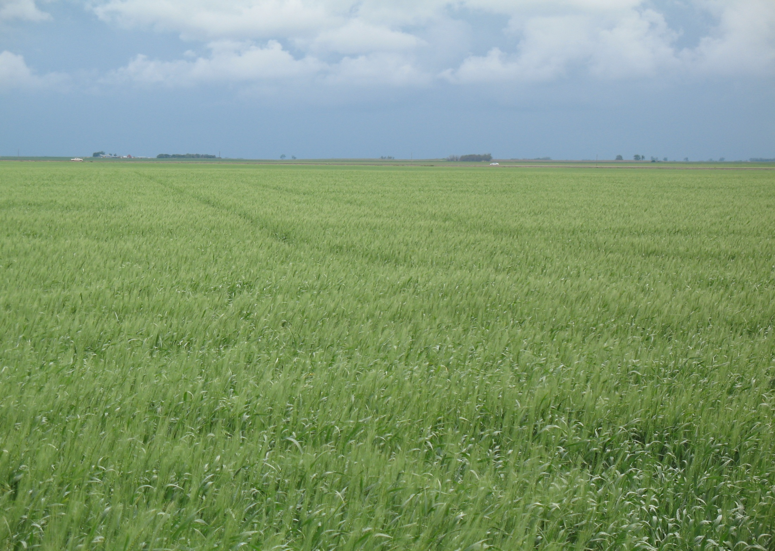
Conclusion
GreenSeeker Technology is being adopted worldwide.
Farmer experiences has been overwhelmingly positive.
It is not a silver bullet, but it is a tool that can overcome many of the common nitrogen misconceptions.
Hand held sensing and/or basic mapping is good place to start.
Question: Will your business lead or follow?

Slide 28
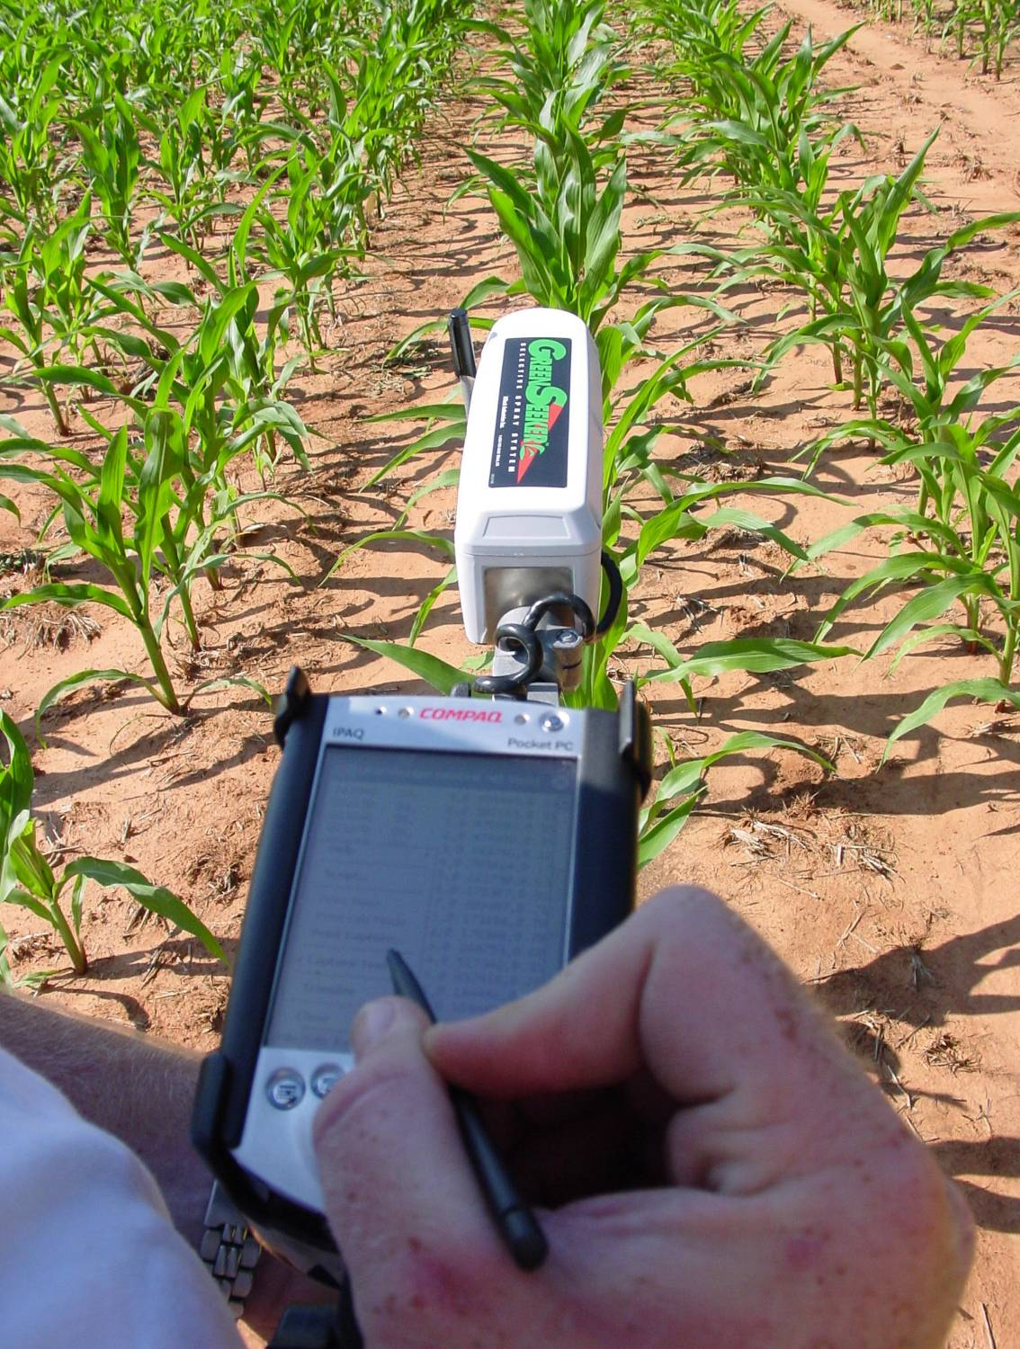
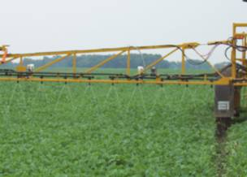
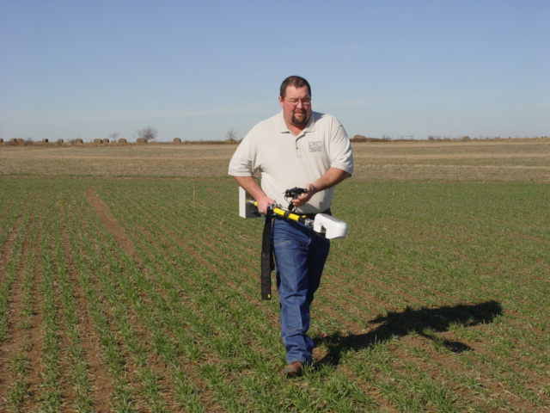
Thank You
Jack Gerhardt
NTech Industries
507.236.1144

