Slide 1
Plant sensing technology
A critical element to improving agricultural productivity
Marvin Stone
Regents professor emeritus
Biosystems and Agricultural Engineering
Oklahoma State University
Stillwater, OK
mstone@okstate.edu

Slide 2
Rationale for focus on managing N
Crop production practice is heavily dependent on inorganic nitrogen (N) fertilizer
Nitrogen fertilizer costs are one of the most expensive crop inputs
Nitrogen use efficiency is very poor
Nitrogen costs are linked directly to energy demand Petroleum (Natural gas)
Nitrogen loss from crop fertilization has a high potential for environmental degradation

Slide 3
We are dependent on fertilizer for food production
Over 40% of the people on Earth owe their existence to the food production made possible by N fertilizers
C.S. Snyder, International plant nutrition institute,
World Fertilizer N Consumption and Challenges,
Nitrogen Use Efficiency Conference,
Stillwater, Oklahoma August 3, 2010

Slide 4
Crop production heavily dependent on inorganic N fertilizer
Organic fertilizers are inadequate to meet needs
“no more than 10-15% of world fertilizer needs could be met by animal manure”
(Wolman and Fournier, SCOPE, 1987)
US Human wastes could supply “about 15% of the amount presently marketed as inorganic fertilizer”
(Wolman and Fournier, SCOPE, 1987)
In China, the proportion of mineral fertilizer to organic fertilizers has gone from 0% in 1949 to 69.7% in 1995
(Portch and Jin, UNESCO-EOLSS 2012)
Notes:
Land Transformation in Agriculture. Ed, Wolman and Fournier, Scientific Committee on Problems of the Environment (SCOPE). Published by John Wiley & Sons Ltd., 1987.
Encyclopedia of Life Support Systems (EOLSS). Agricultural Sciences, Vol II, Sam Portch and Ji-yun Jin, Fertilizer Use in China: Types and Amounts. UNESCO-EOLSS, Eolss Publishers, Oxford ,UK, .
blue-green algae in
fixing nitrogen in the rice paddy. Amounts in the range 10-20 kg/ha are
recognized-not great for the given year's crop but significant over many
years' in nitrogen conservancy. Likewise,the Azolla,anitrogen-fixing fern in China
The dominant influence that inorganic fertilizers are having on agriculture in
the world today is inescapable. They now account for at least 30% of all
agricultural produce of the United States, and probably more of the order of
50% of cereal grain production.

Slide 5
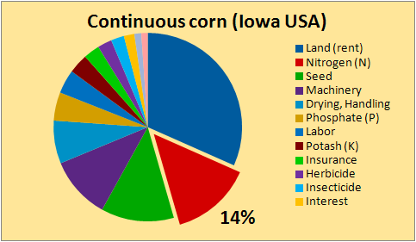
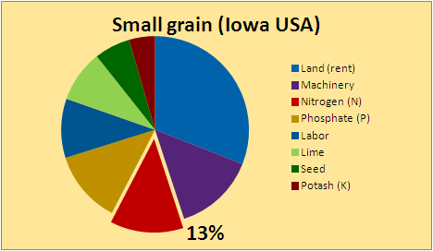
Nitrogen is #1 variable expense in crop production
For US production systems, Land is the most expensive fixed input
Nitrogen fertilizer costs are the most expensive variable input

Slide 6
Nitrogen use efficiency (NUE) is low
World-wide NUE has been estimated at 33%
Raun and Johnson, Agron. J. 91:357–363 (1999)
In North China Plain wheat and corn production, “N fertilizer could be cut in half without loss of yield or grain quality”
Vitousek et al., SCIENCE Vol. 324:19 June 2009.
“Nitrogen use efficiency is declining as nitrogen fertilizer consumption increases faster than grain production.”
Current world fertilizer trends and outlook to 2011/12. FAO, Rome, 2008.
Notes:
Current world fertilizer trends and outlook to 2011/12. FAO, Rome, 2008.
NUE of cereal crops is about 25% in North China Plain (Pan et al., 2001)

Slide 7
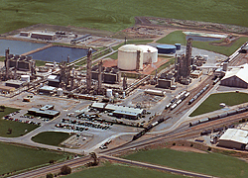
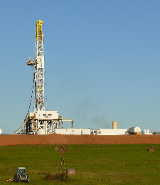
N fertilizer production linked to Energy
One tonne of fertilizer N synthesized through the Haber–Bosch process requires 873 m³ of natural gas
(Vance, 2001)
N₂ + 3 H₂ ⇌ 2 NH₃
CH₄
NH₃
Notes:
1090 to 1250 m3 of natural gas to produce 1 metric ton of anhydrous ammonia

Slide 8
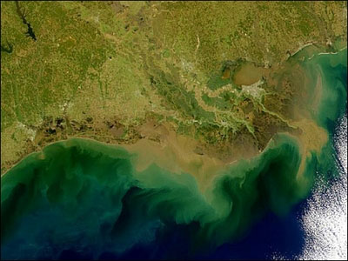
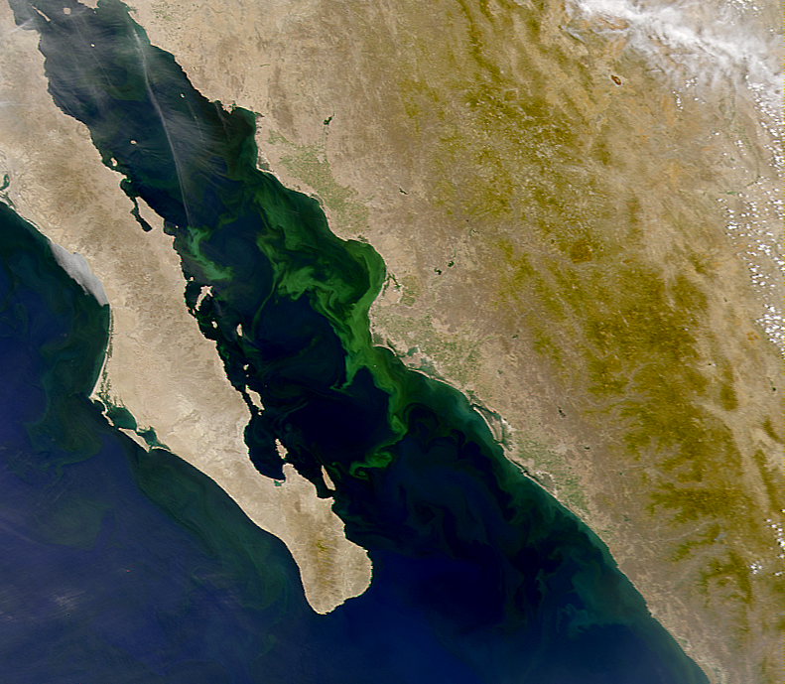
Nitrogen loss has high potential for environmental degradation
Impact of N loss from Agriculture is world-wide news
Mississippi Delta USA
Gulf of California
Mexico
NASA
Michael Beman J, Arrigo KR, Matson PA.
Nature. 2005 Mar 10; 434(7030):211-214
Green Tide Photograph from Imaginechina/AP
Notes:
Green tide photo - http://forum.china.org.cn/redirect.php?tid=14895&goto=lastpost

Slide 9
Strategies for improving NUE
Crop rotations with legumes
Genetic improvements focused on NUE
Management of de-nitrification
Source selection
Controlled release
De-nitrification inhibitors
Sensor based management of In-season N application

Slide 10
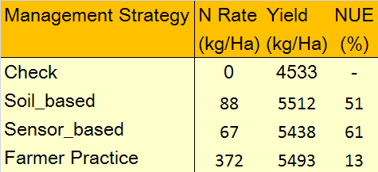
Potential for Sensor based N management
Sensor based N management has demonstrated NUE above 60% for wheat in North China Plain
Similar results in other studies world-wide
Nitrogen Management Strategy for Winter Wheat in North China Plain
Li et al. Performance of GreenSeeker-Based Nitrogen Management Strategy for Winter Wheat in North China Plain. NUE Workshop, July 31 - August 1, 2008. Manhattan KS.
CAU/Hebai AAFS/OSU

Slide 11
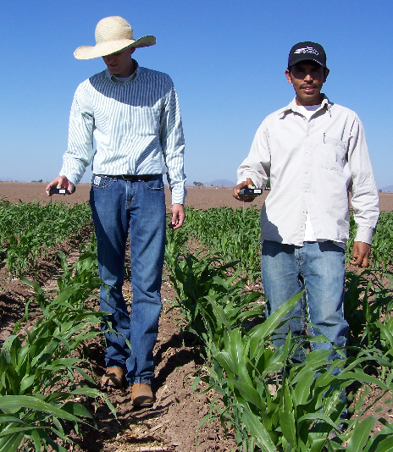
Crop canopy reflectance sensors
Sensors detect optical reflectance based NDVI

Slide 12
Spectral Response to Nitrogen
Measure of living plant cell’s ability to reflect infrared light
Photosynthetic Potential

Slide 13
Yield Estimation INSEY vs. Wheat Yield (24 locations, 1998-2001)

Slide 14
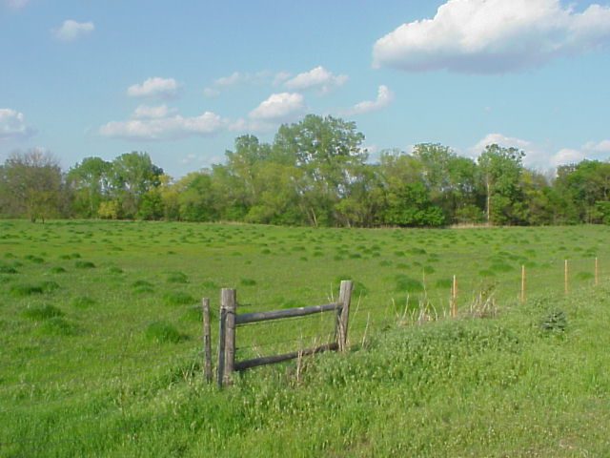
Response Index can allow estimation of in-season mineralization

Slide 15
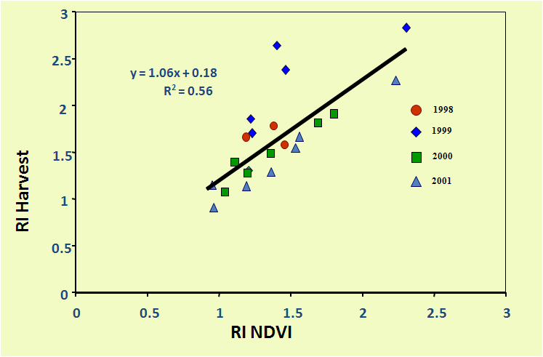
Role of RI in Yield Estimation
RI Estimates yield with added N

Slide 16
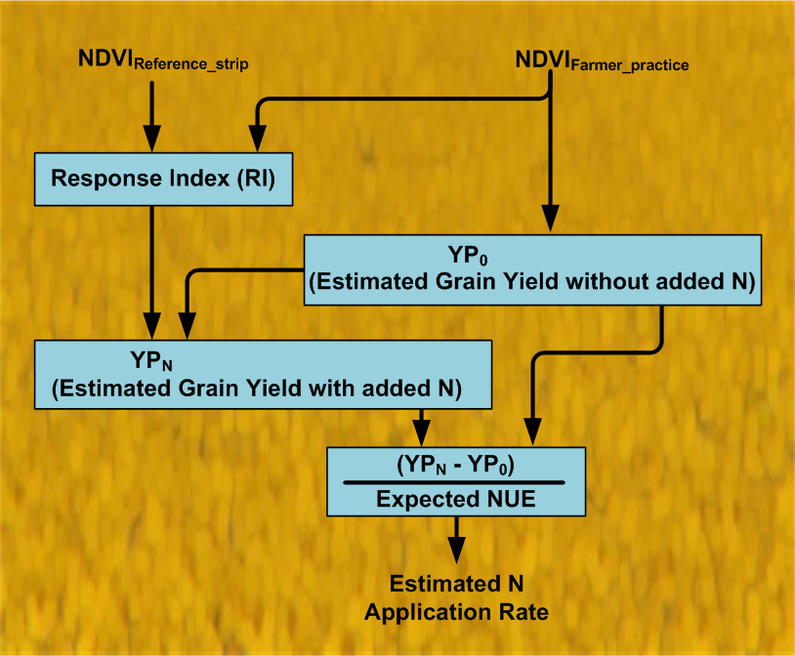
N Fertilization Rate Algorithm
Optical reflectance based yield estimate
Mass balance based N estimate

Slide 17
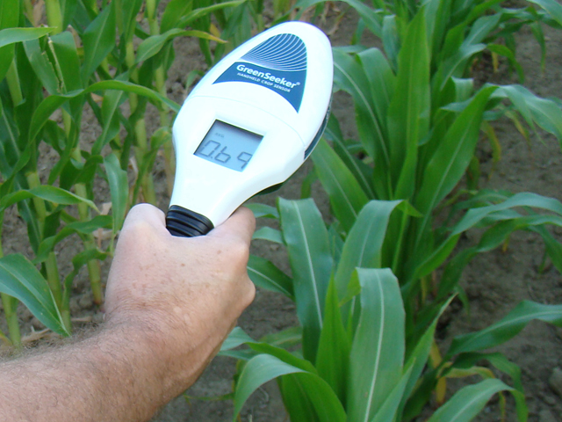
Locally appropriate sensors needed
Trimble handheld with algorithm

Slide 18
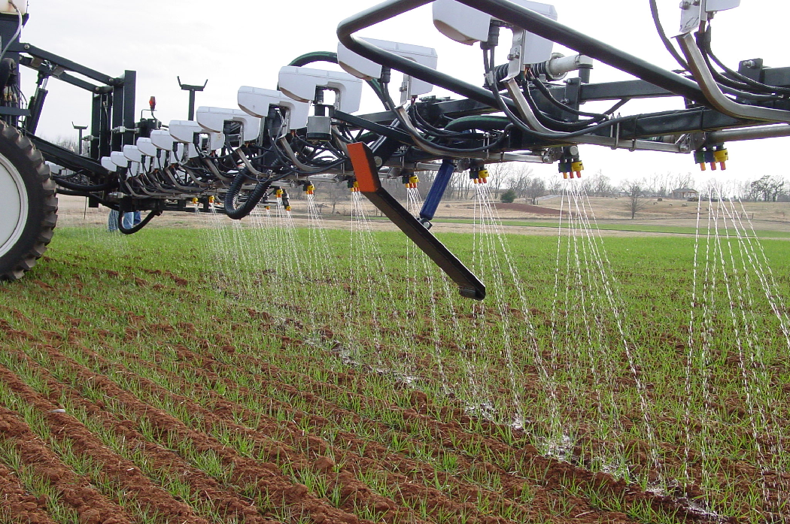
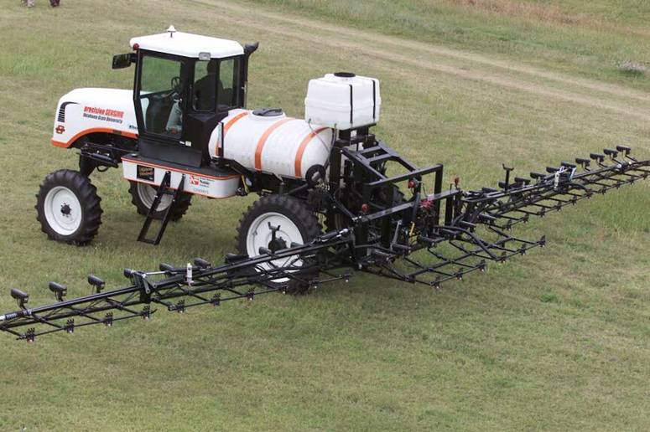
Early OSU self-propelled applicator

Slide 19
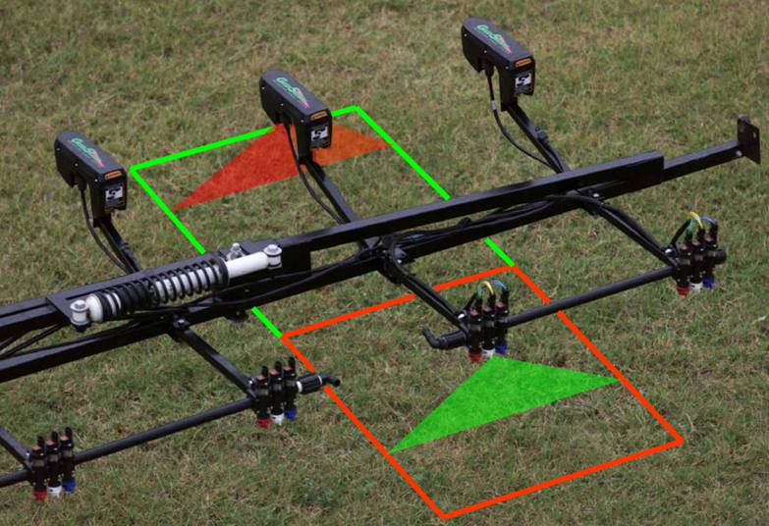
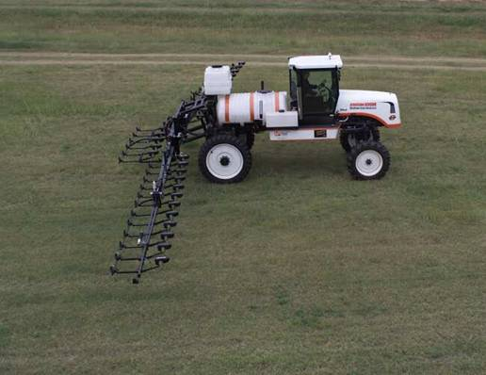
High-resolution not accepted yet
Sense and treat each 0.5 m x 1 m spot
Variable nozzle system
Accomplish this while driving 25 kilometers/hr
Operate day or night

Slide 20
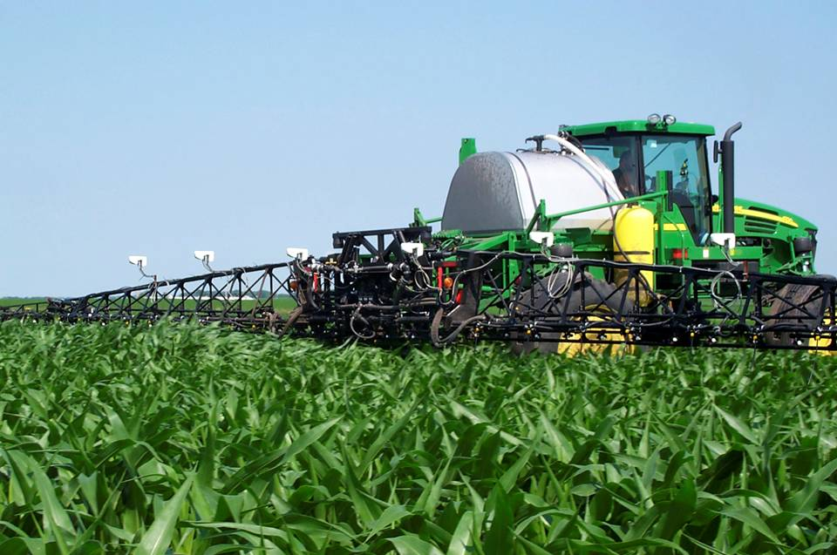
Commercial self-propelled applicator

Slide 21
Adoption of sensor based N management
Local algorithms
Suitable for local crops and cultural practices
Sensor technologies
Adapted to local crops and cultural practices
Cost appropriate for local conditions
Training of farmers and technical support
Manage risk through locally demonstrated results

