Slide 1
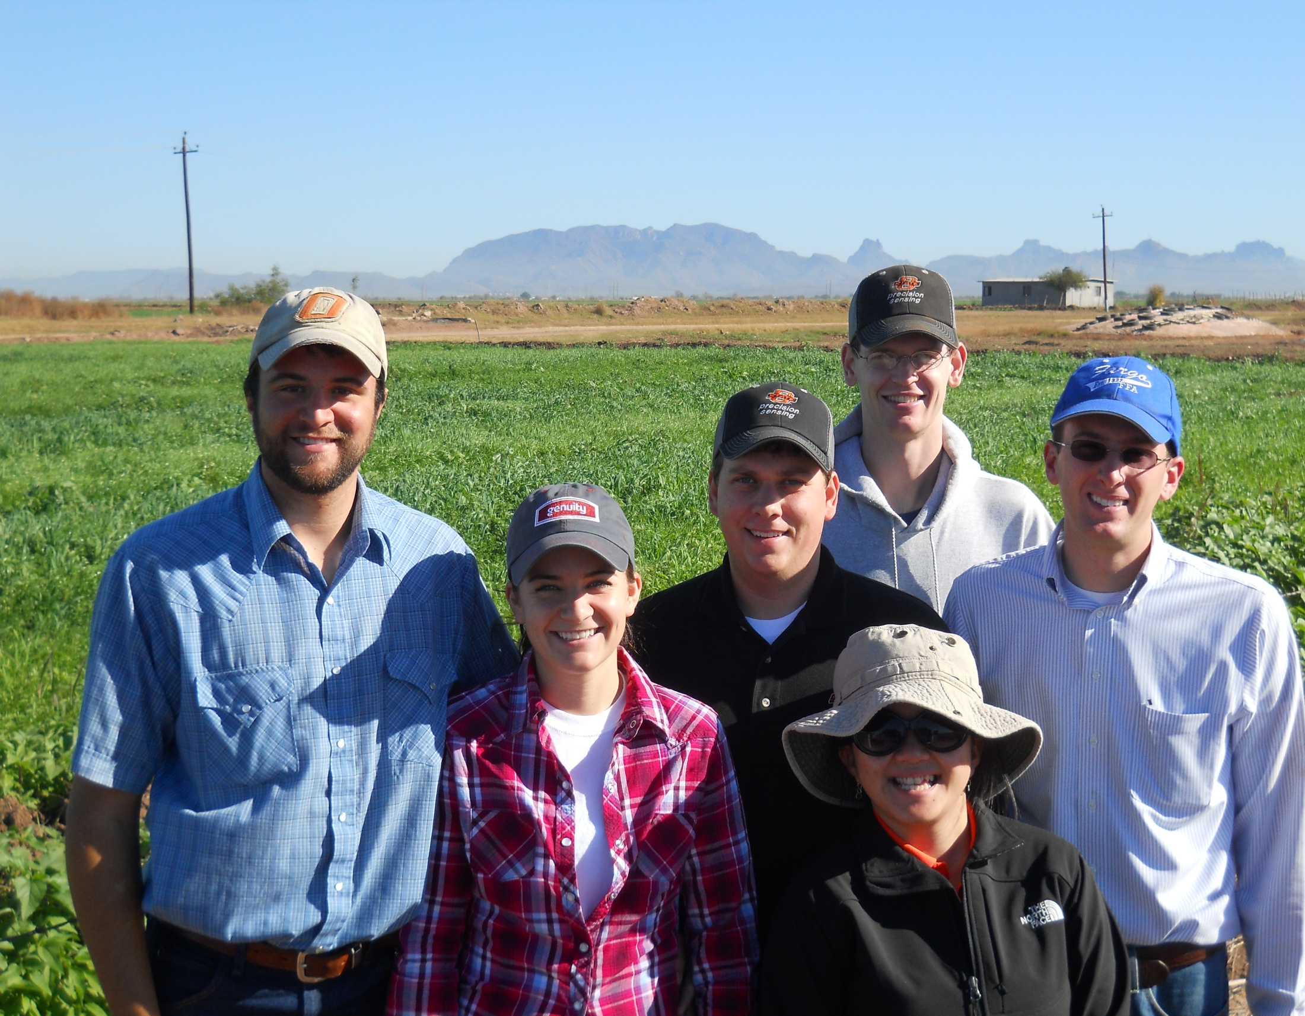
PASS Seminar
OSU Pocket Sensor
3rd World Planter
Adrian Koller, Guilherme Torres, Jeremiah Mullock, Bee, Chim, Kevin Waldschmidt, Kyle Hiner, Jorge Rascon, Jonathan Kelly, Eric Lam, Emily Rutto, Natasha Macnack, Jared Crain, Clayton Boaldin, Tyler Grimes,
OSU faculty

Slide 2
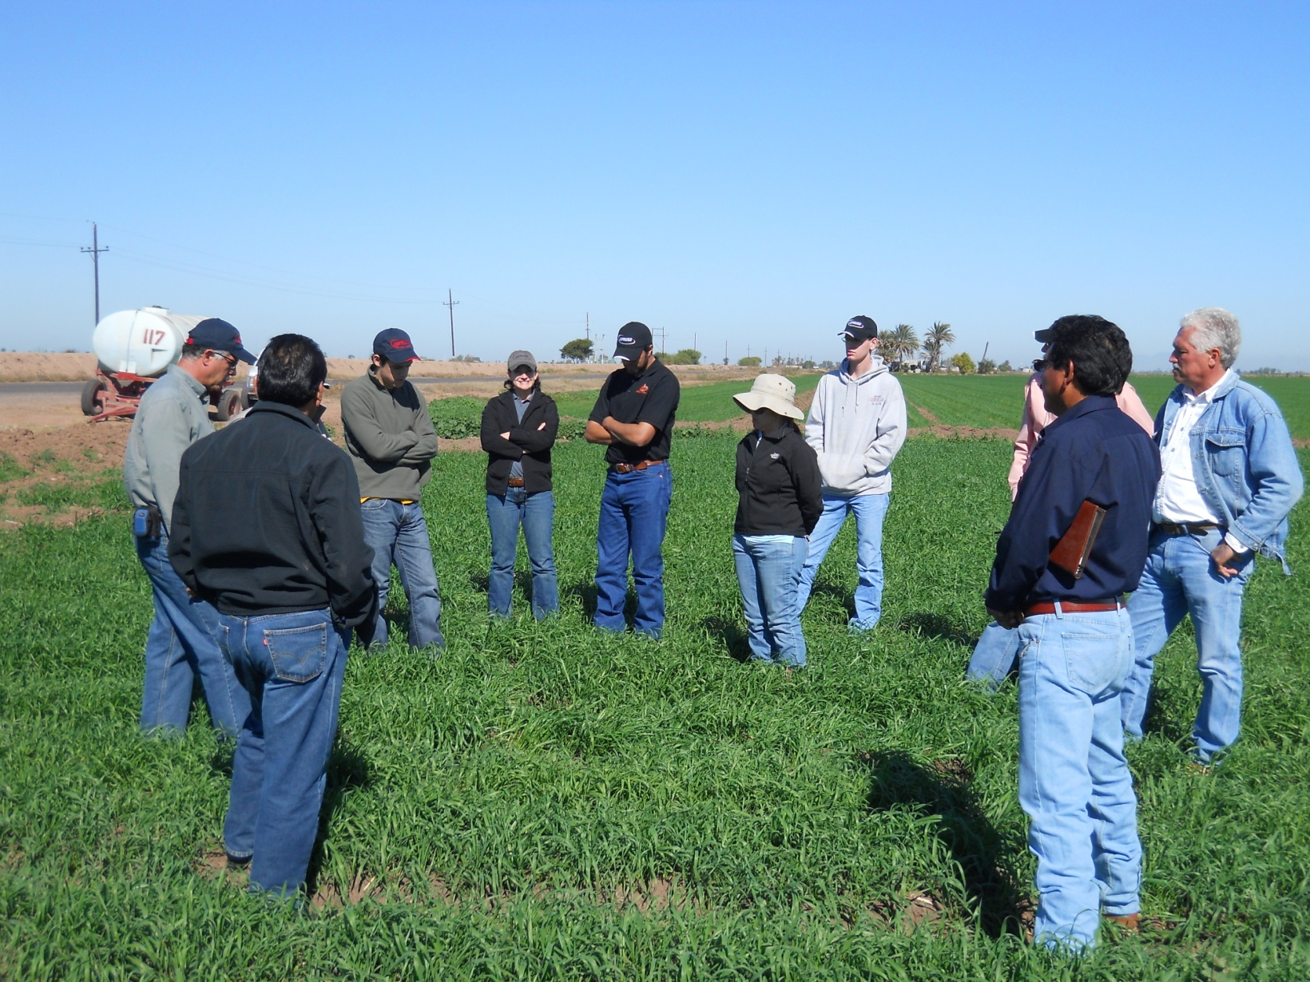
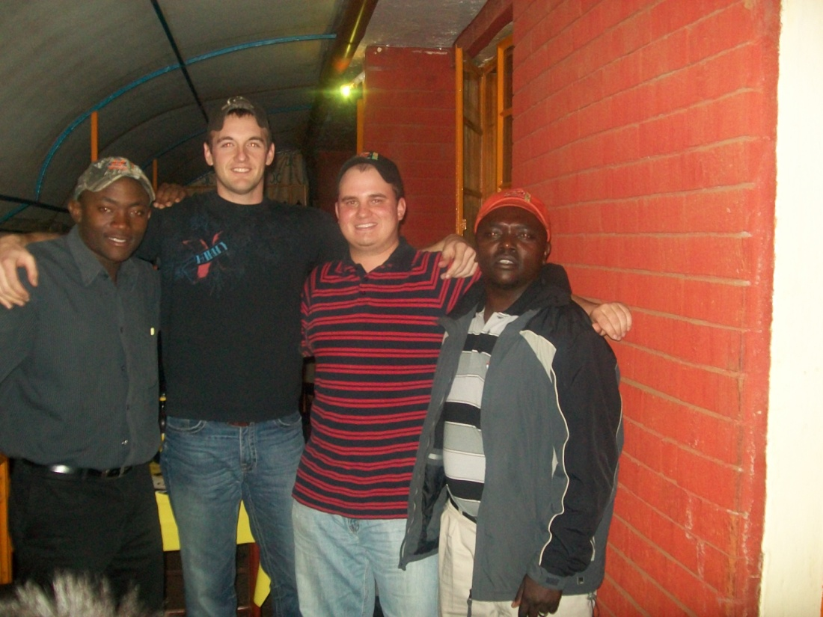
http://nue.okstate.edu/International_Student_Activities.htm
88 Students, CIMMYT, Art Klatt

Slide 3
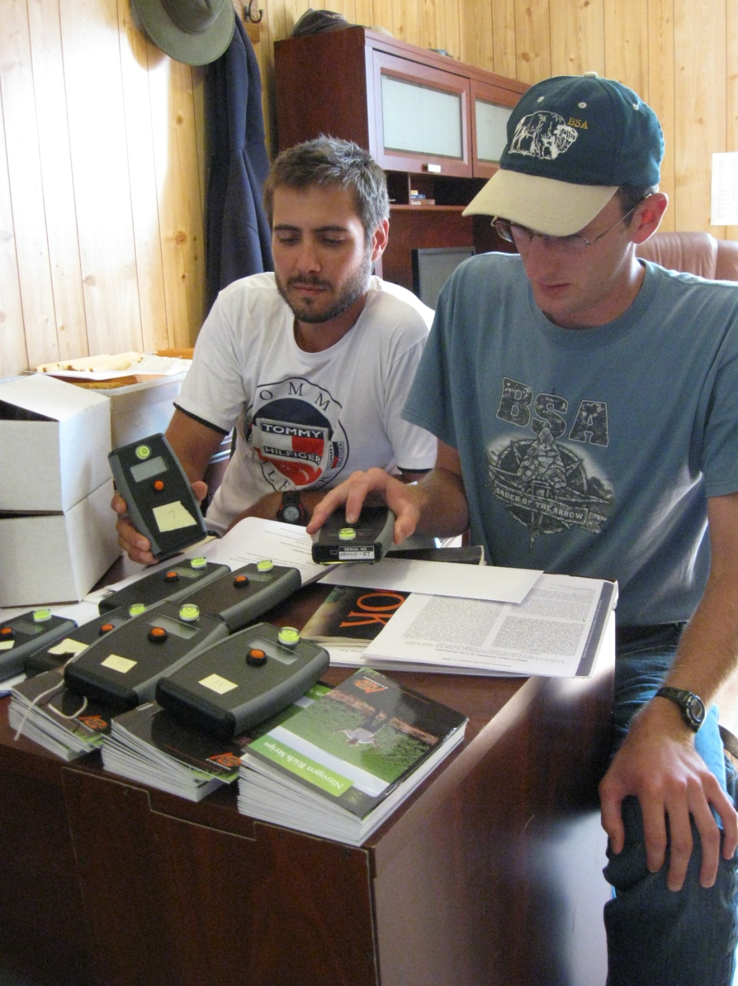
OSU Pocket Sensor
http://nue.okstate.edu/Pocket_Sensor/Pocket_Sensor.htm

Slide 4
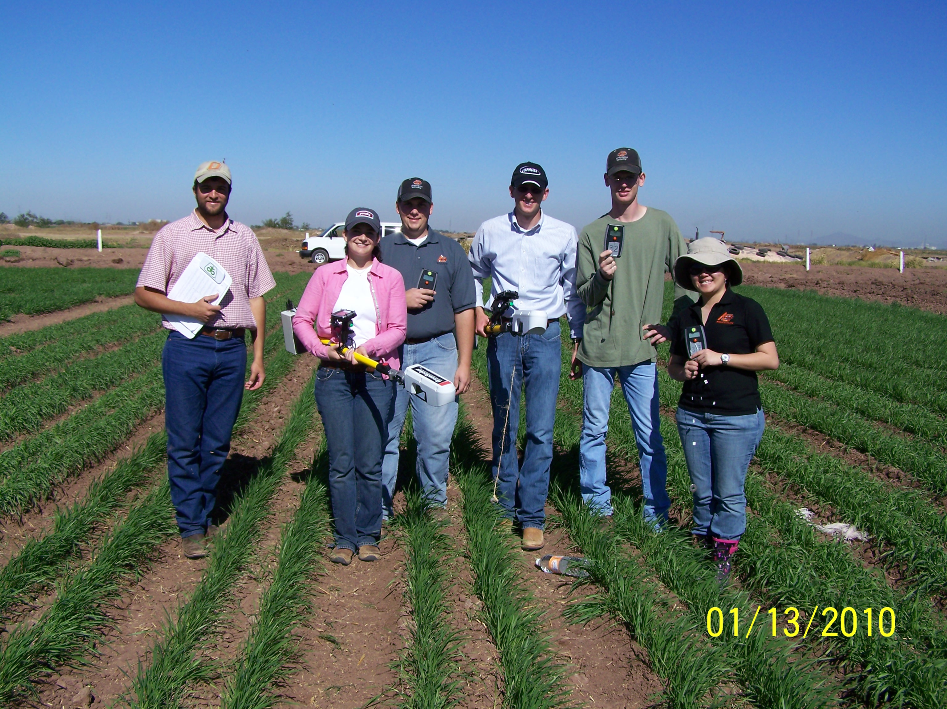

Slide 5
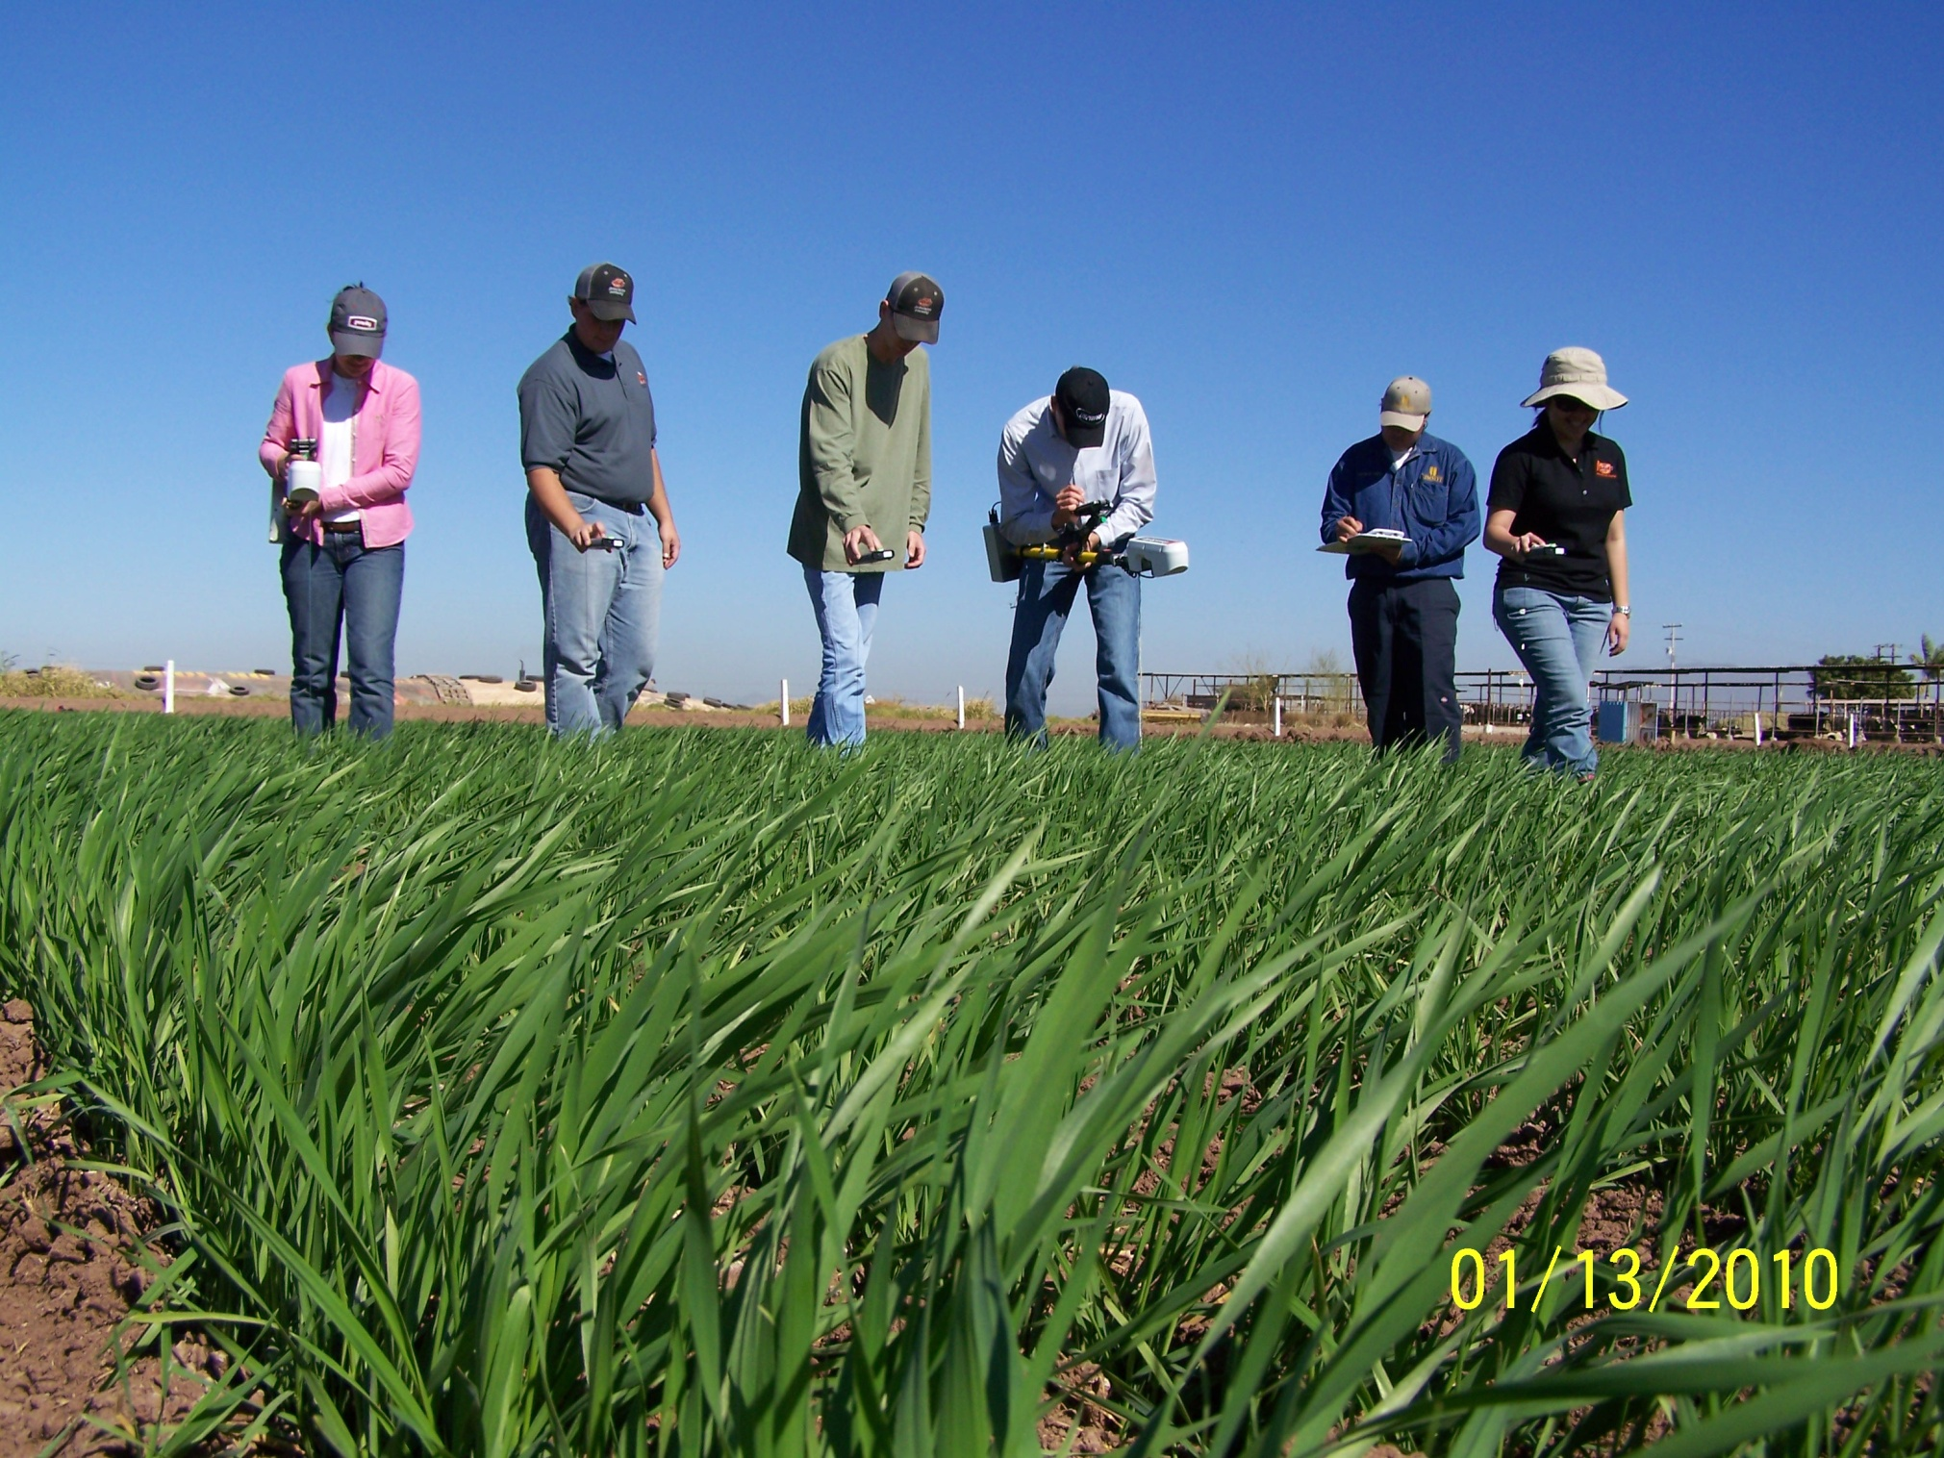

Slide 6
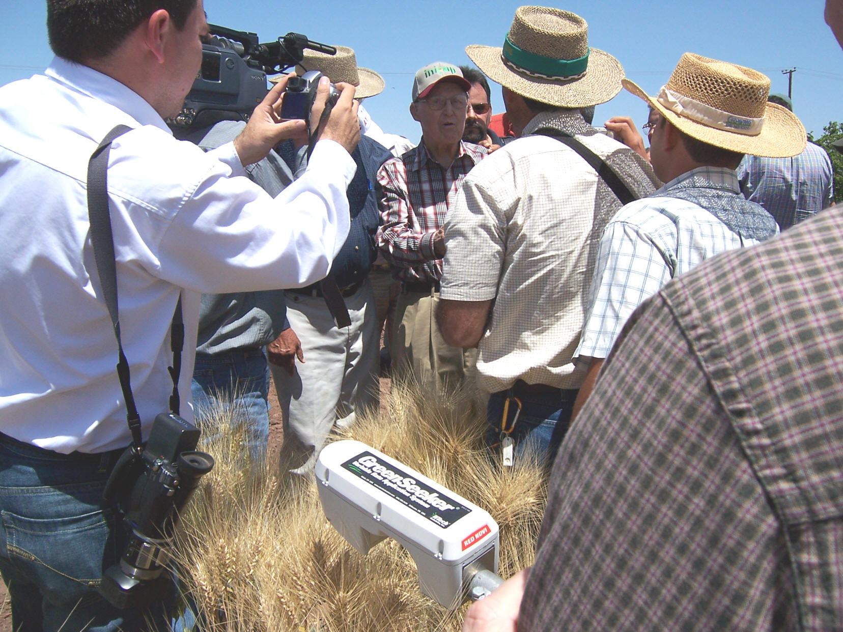
April 16, 2007
Dr. Norman Borlaug
Ciudad Obregon, MX

Slide 7
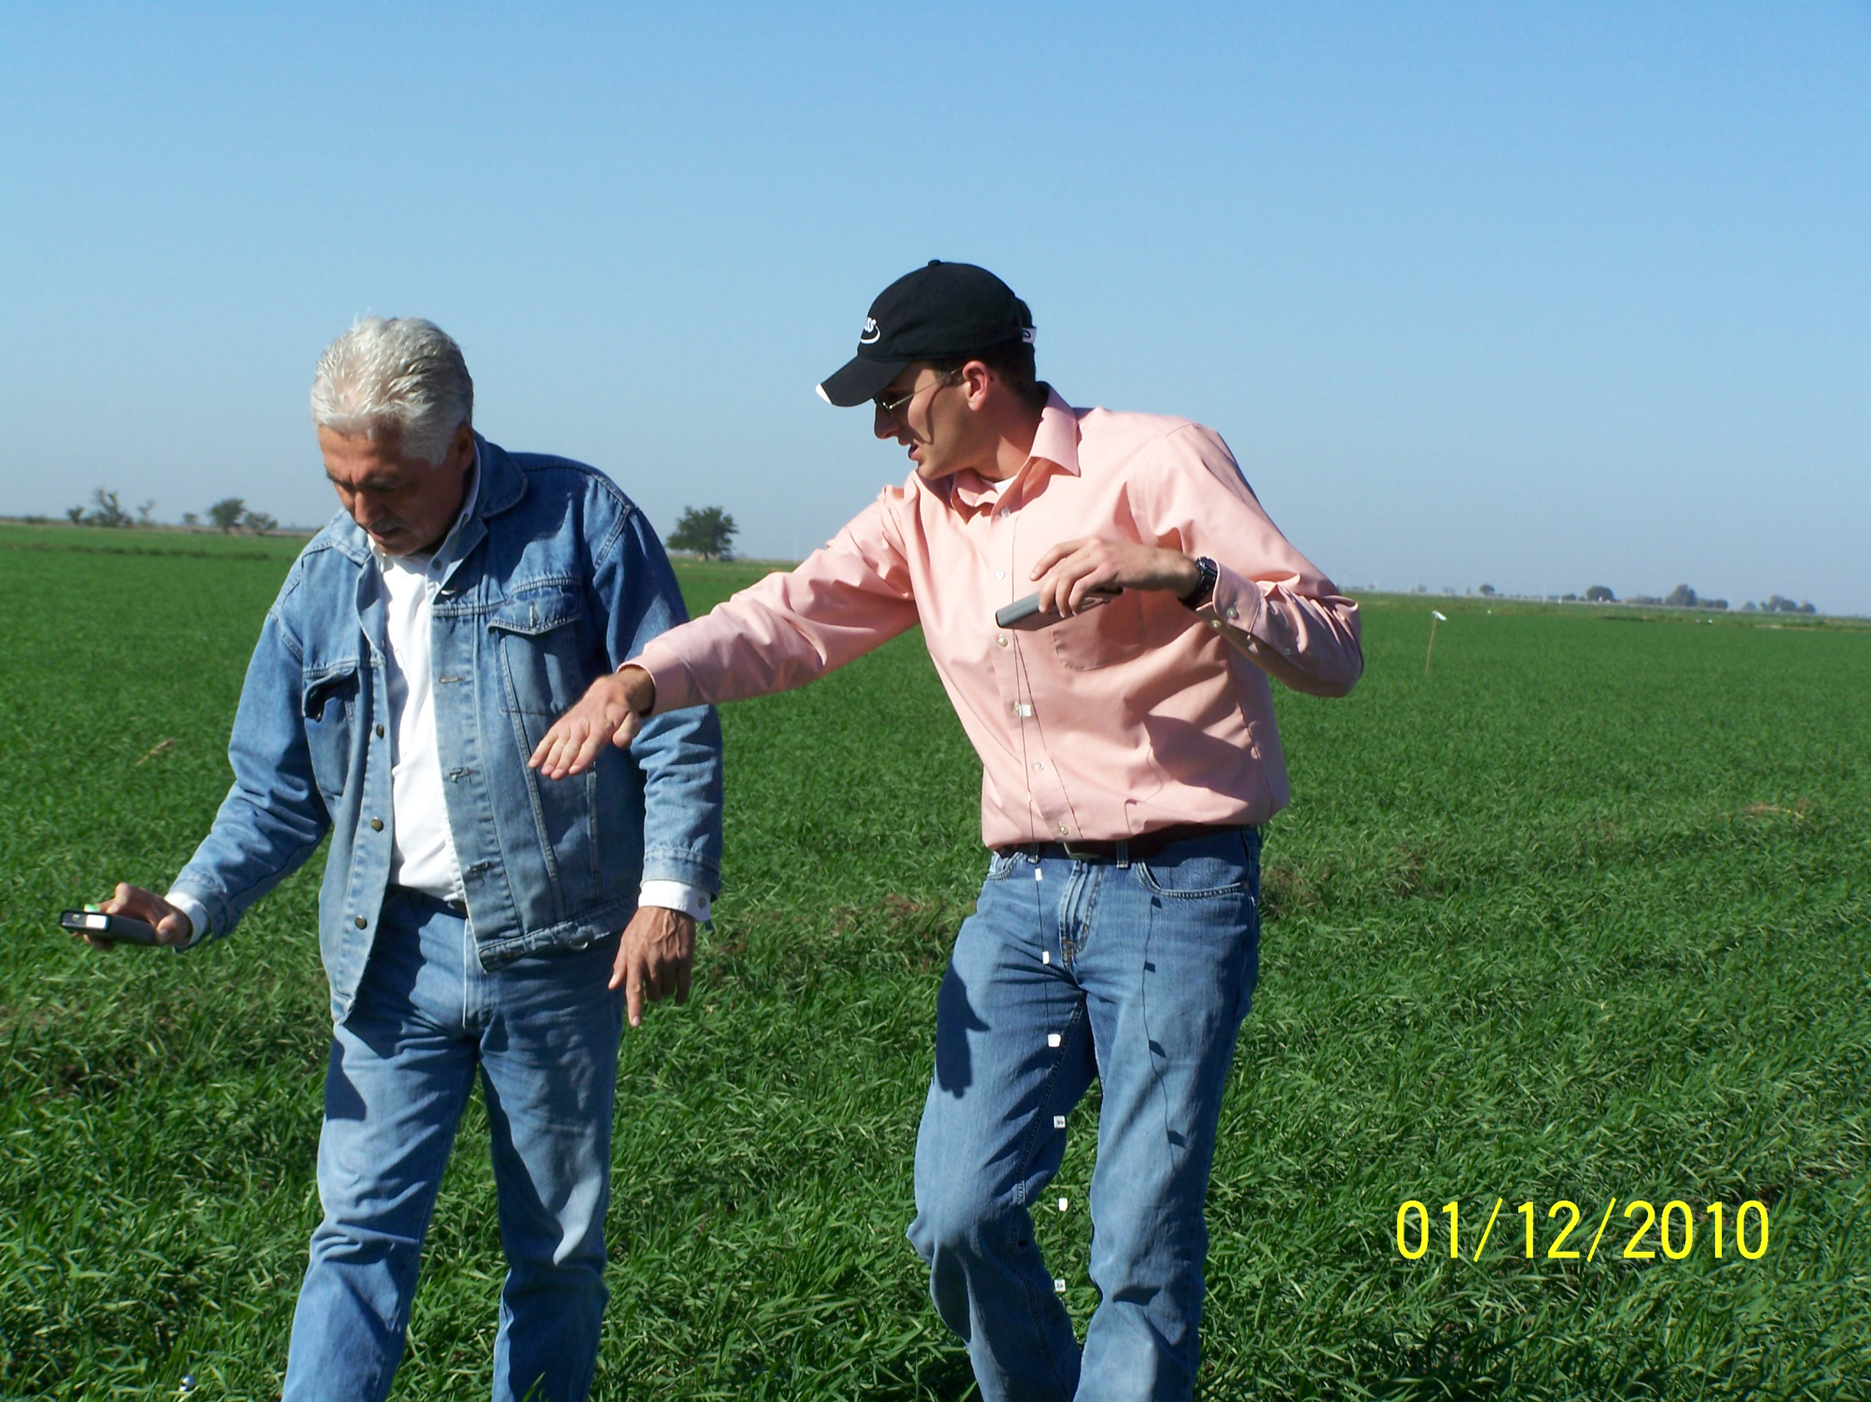

Slide 9
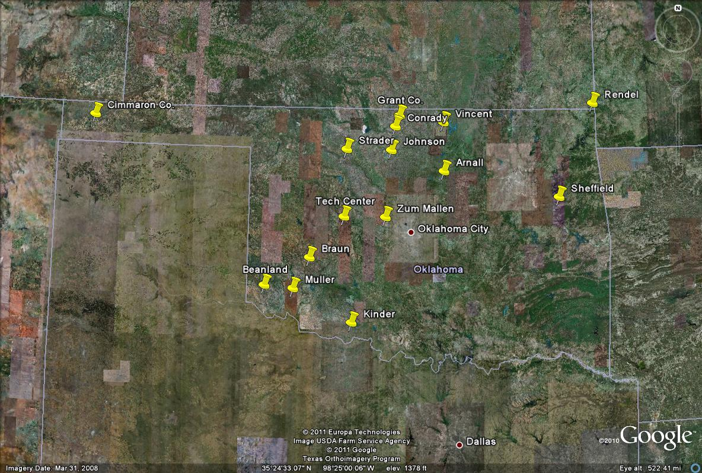
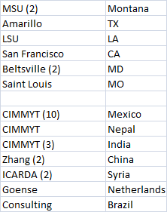
Pocket Sensor Locations

Slide 10
3rd World Hand Planter
Plan
In country survey, anthropology
  Develop 4 potential prototypes
Singulation
Ergonomics
Function
  soil texture
  tillage
  soil moisture
Weight
handle, size
height
hopper size (seed/fertilizer)
In country testing

Slide 11
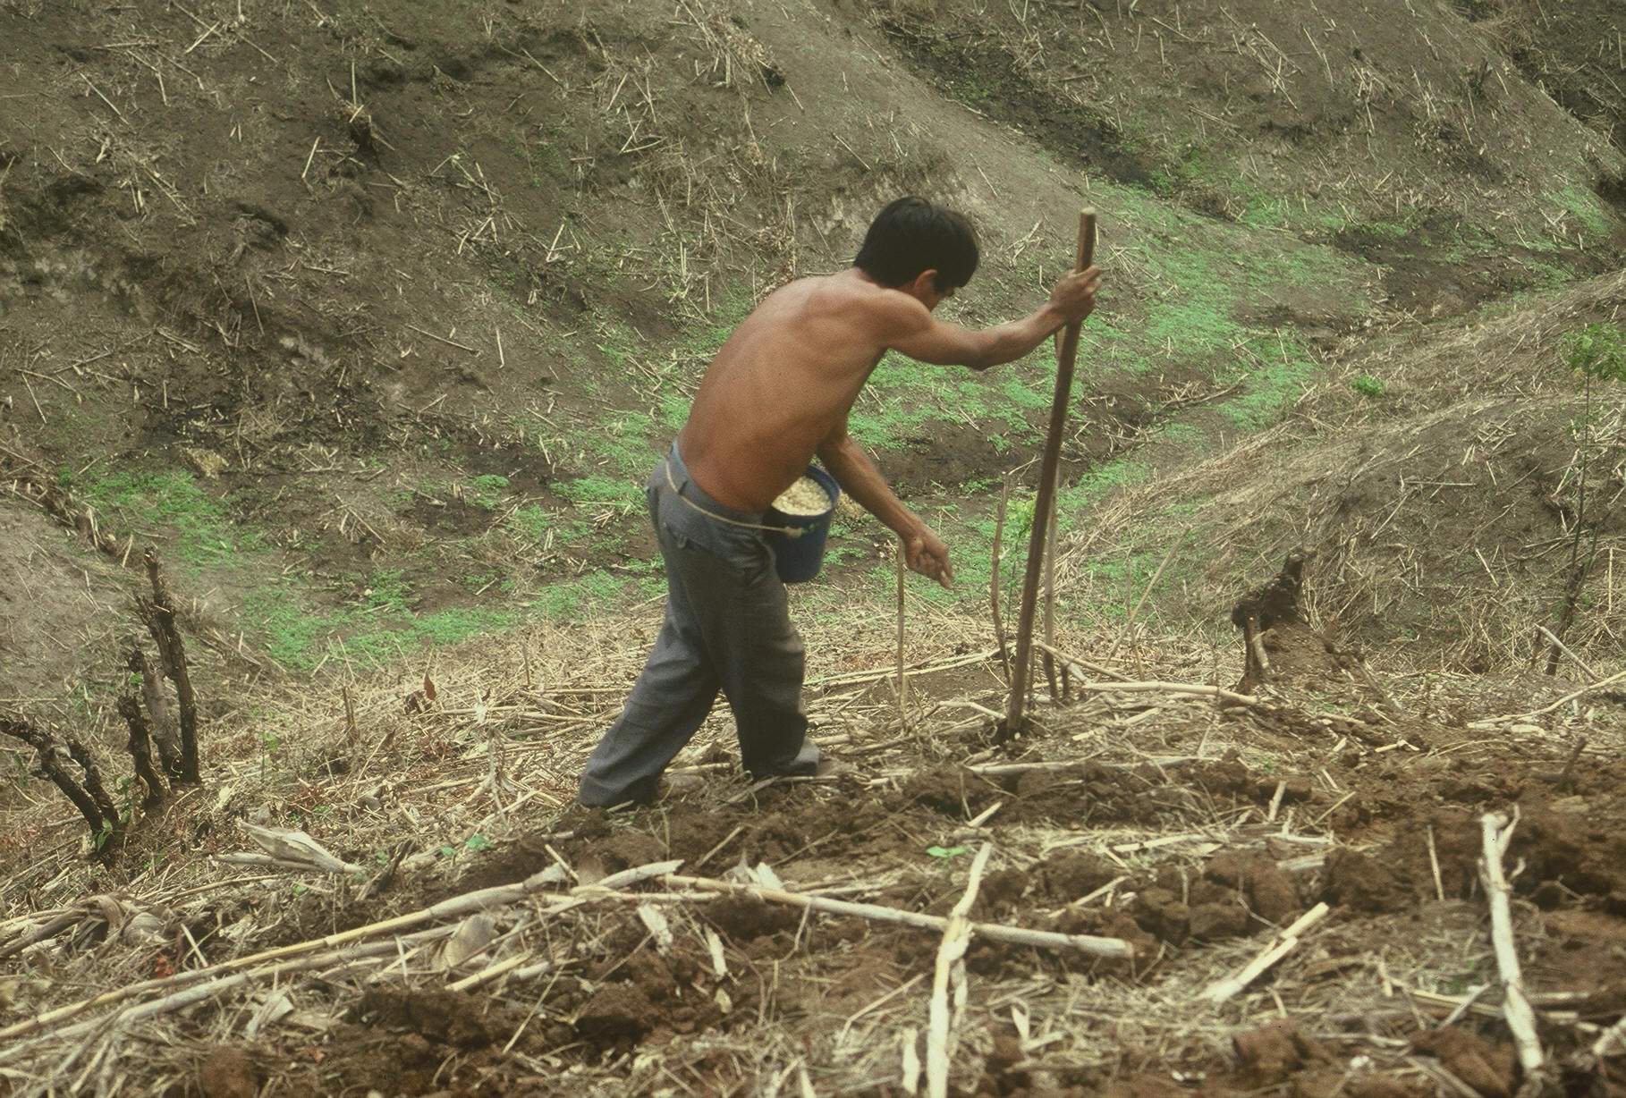

Slide 12
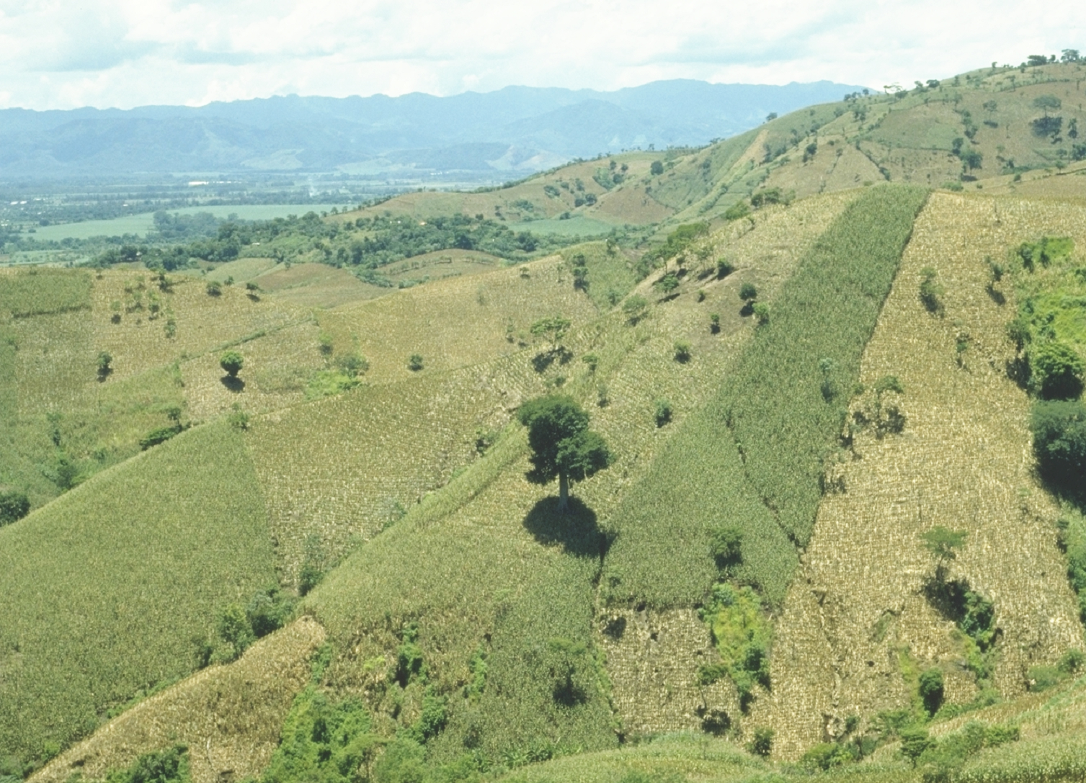

Slide 13
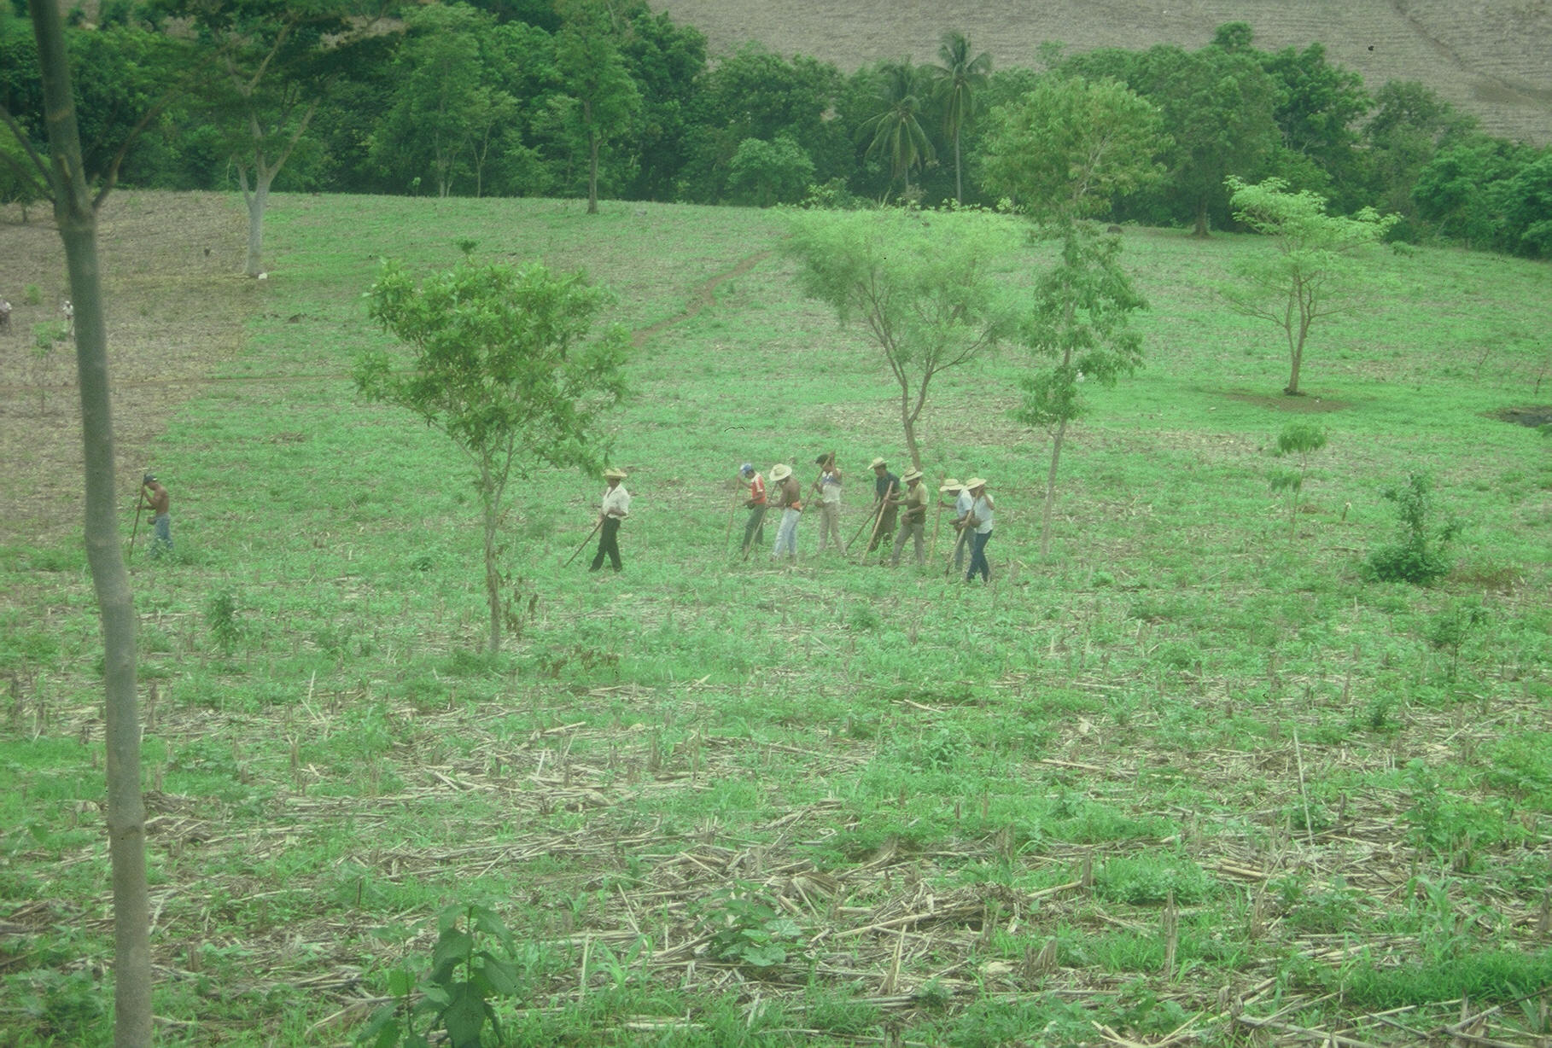
Opico Quezaltepeque, El Salvador
Social aspects/technology transfer

Slide 14
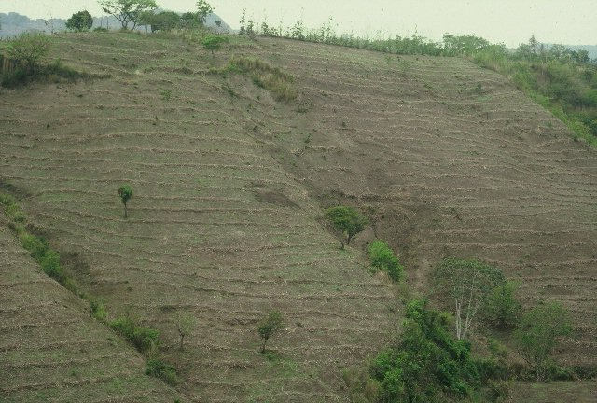

Slide 15
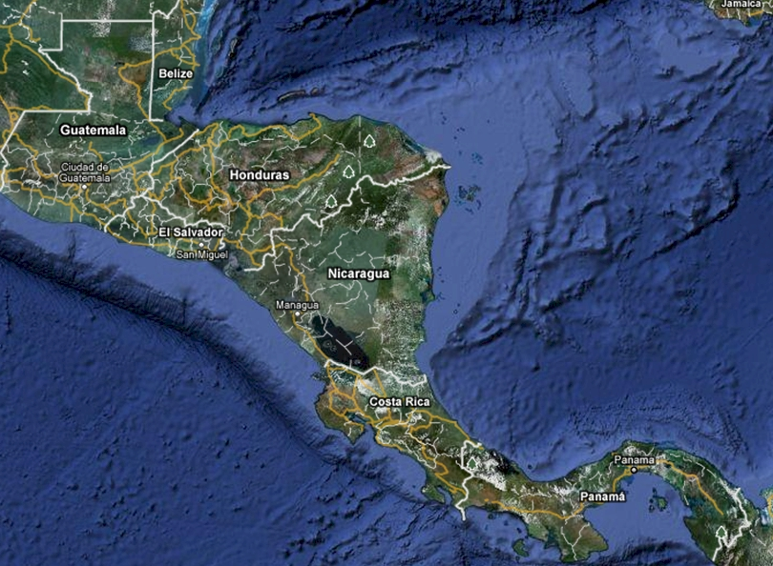
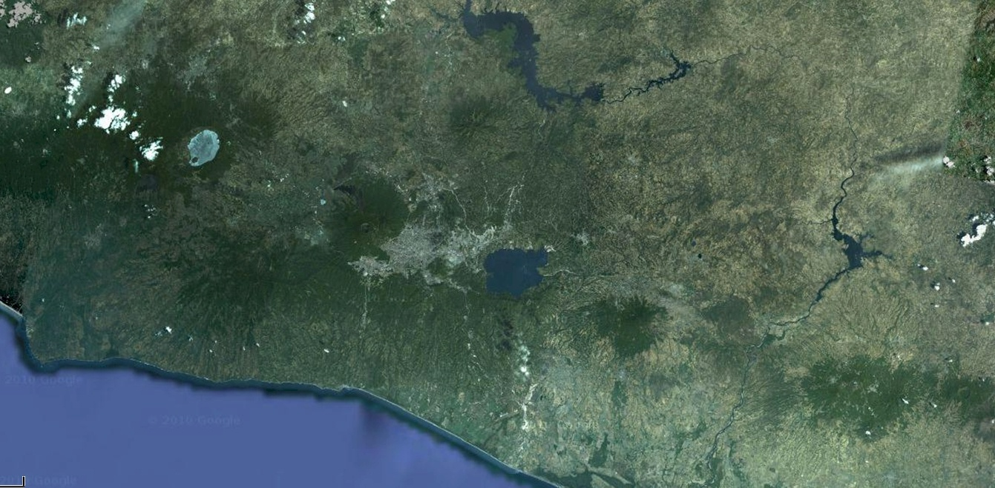

Slide 16
Hand Planter
159,531,007 hectares of maize in 2009
34,409,010 hectares in the developing world 60% was planted by hand
    = 20,645,000 hectares or 13% of the total maize area in the world
    February 14, 2011
    Corn $7.06/bu
    Soybeans $14.18/bu
    Wheat $8.82/bu

Slide 17
2009 World Production, Mt
    Corn Soybeans Wheat
    USA 333010910 91417300 60314290
    China 163118097 14500141 114950296
    Brazil 51232447 56960732 4964665
    Mexico 20202600 120900 4148000
    Argentina 13121380 30993379 7573254
    India 17300000 10217000 80680000

Slide 18
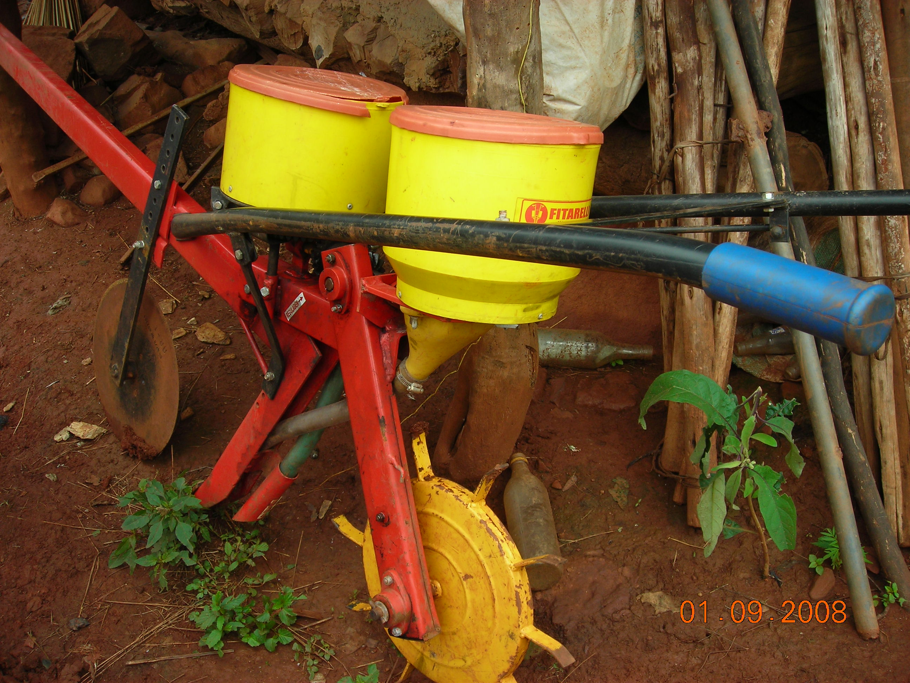

Slide 19
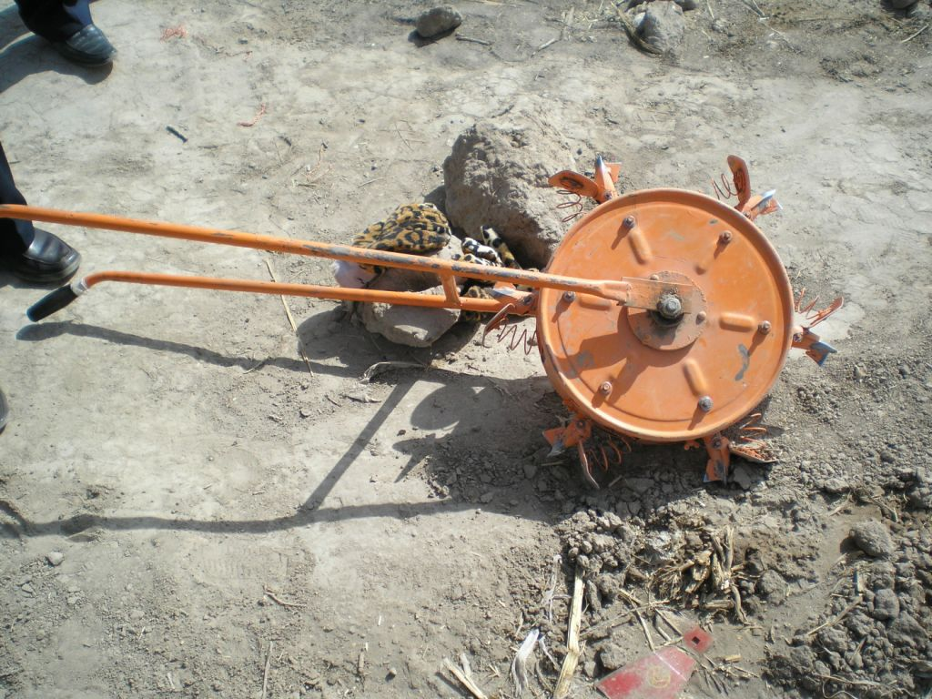

Slide 20
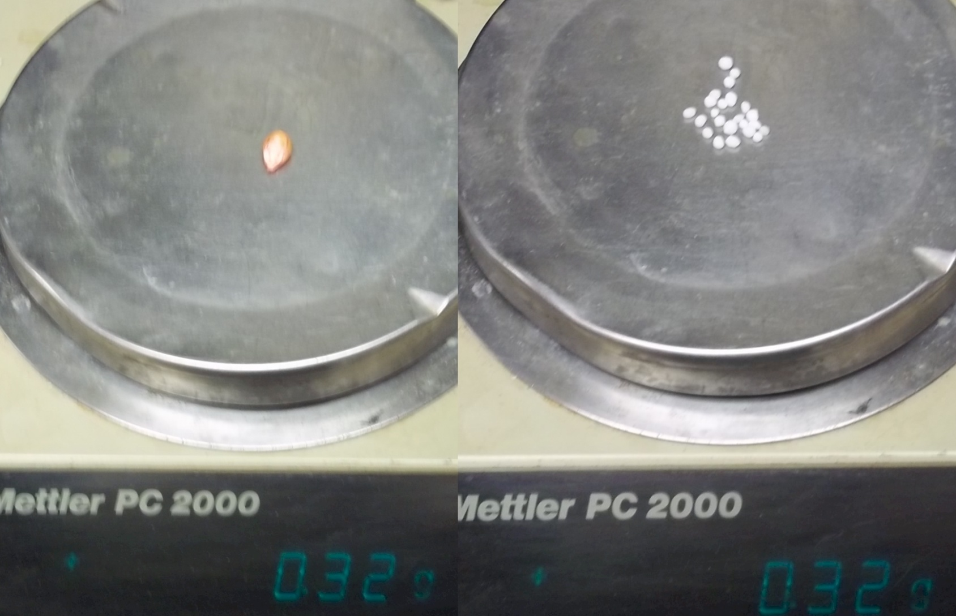
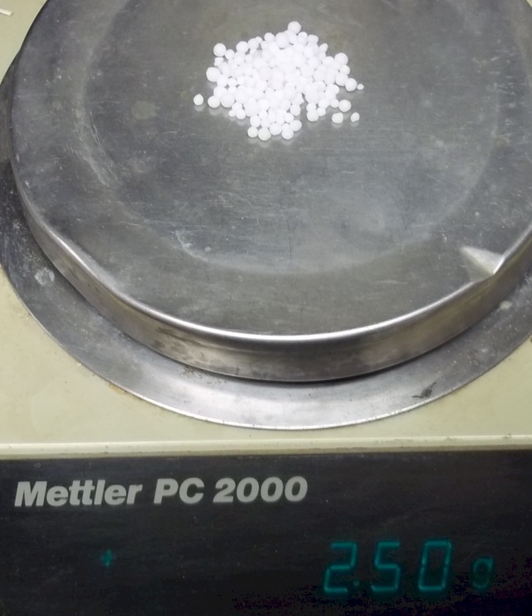
0.32 g urea * 30,000 = 9600 g = 21.1 lb = 10 lb N/ac
4x (40 lb N/ac)
Apply per 2 plants
2.5 g urea (applied every 2 plants = 40 lb N/ac)

Slide 21
3rd world hand planter
If single seeds could be planted 14-17 cm apart, much like conventional planters accomplish in the developed world, production levels could easily increase 25%.
Despite the fact that third world maize yields are generally less than 2.0 Mg/ha (Dowswell et al., 1996), this 25% yield increase on 60% of the hand planted maize area in the third world would be worth more than 3 billion dollars/year (corn price at $0.3/kg)
20,000,000 ha* 2.0 Mg/ha*0.25(% increase) *0.3
http://nue.okstate.edu/Hand_Planter.htm

Slide 22
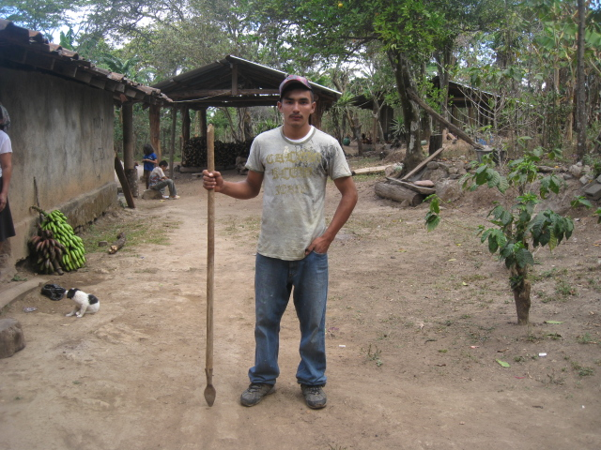
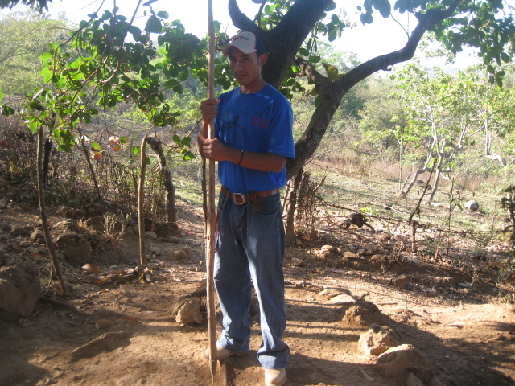
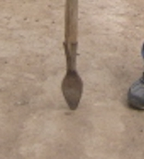
0.29g/seed
454g/lb
1565 seeds/lb
28,000 sees/ac
1 lb hopper
17 times refill
http://nue.okstate.edu/Hand_Planter.htm

Slide 23
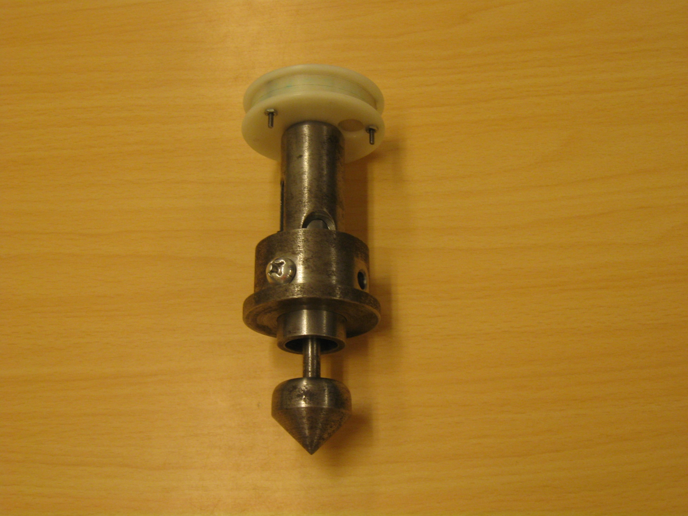

Slide 24
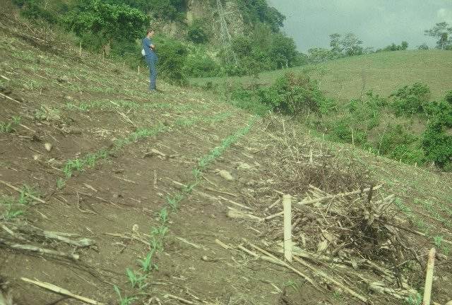
Residue Management

Slide 25
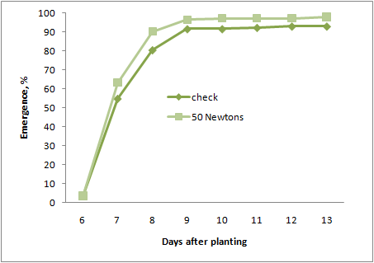
Influence of impact (force) on corn seed and resultant emergence

Slide 26
New work
By-plant
  Prediction of yield (stalk diameter)
  N management
  Variable inputs based on YP0
Seed Orientation
Foliar P
Field scale VRT trials
Alternative plant properties - sensors
Data management, statistical properties
Variety selection – P inefficiency

Slide 27
Mean Yield vs Std. Dev.
318 bu/ac
Average corn grain yield plotted against the standard deviation from by-plant yield over 46 transects in Argentina, Mexico, Iowa, Nebraska, Ohio, Virginia, and Oklahoma.

Slide 28
Dielectric properties,
  Estimates of corn stalk diameter

Slide 29
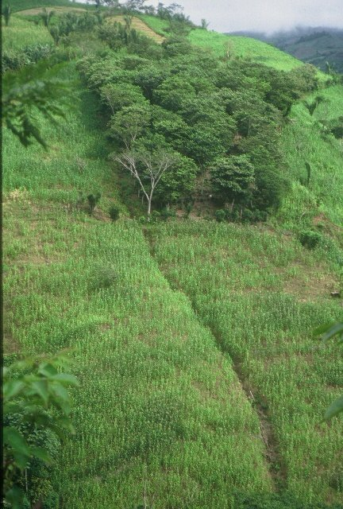
Thank You

Slide 30
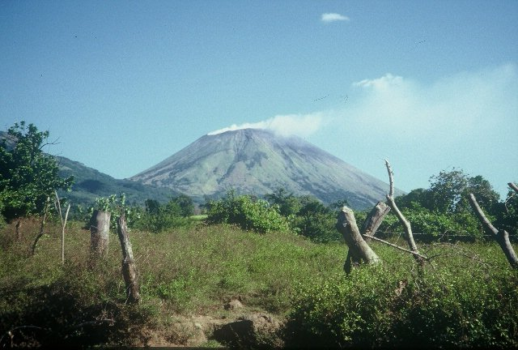

Slide 31
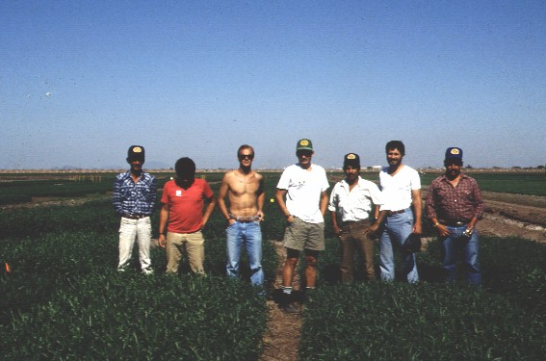

Slide 32
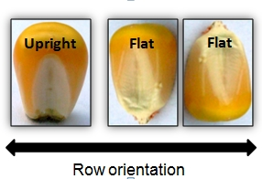
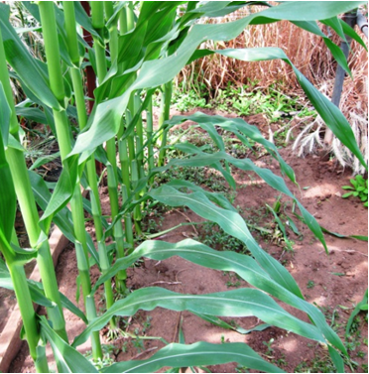
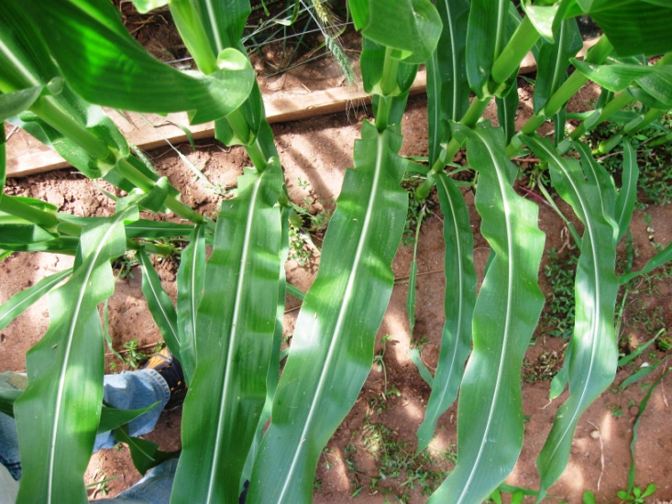
Seed Placement and Leaf Orientation
Yield increase up to 27.1% and 30.6% (prostrate and erect hybrids respectively at pop 74,100 plants/ha) when compared to random placement

Slide 33
