Slide 1
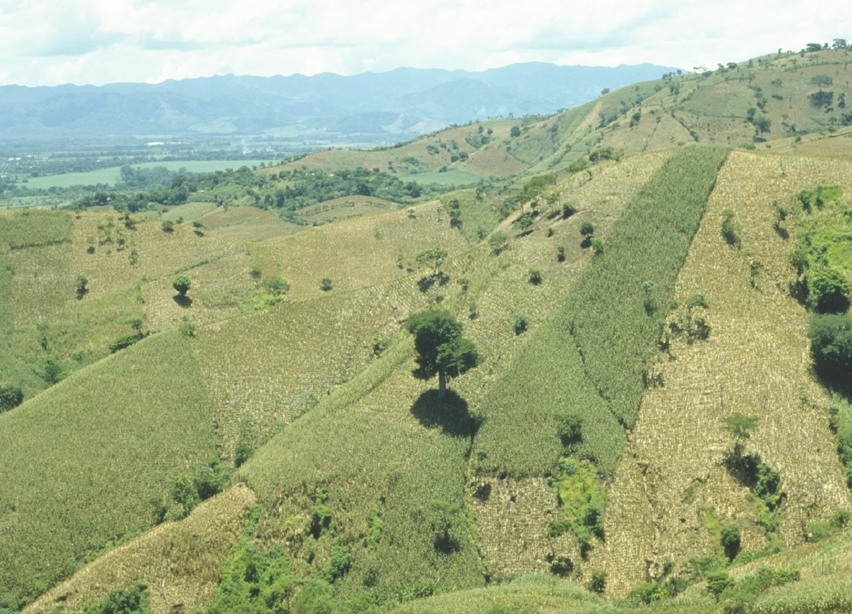
Third World Hand Planter
http://nue.okstate.edu/Hand_Planter/summary_HP1.pdf

Slide 2
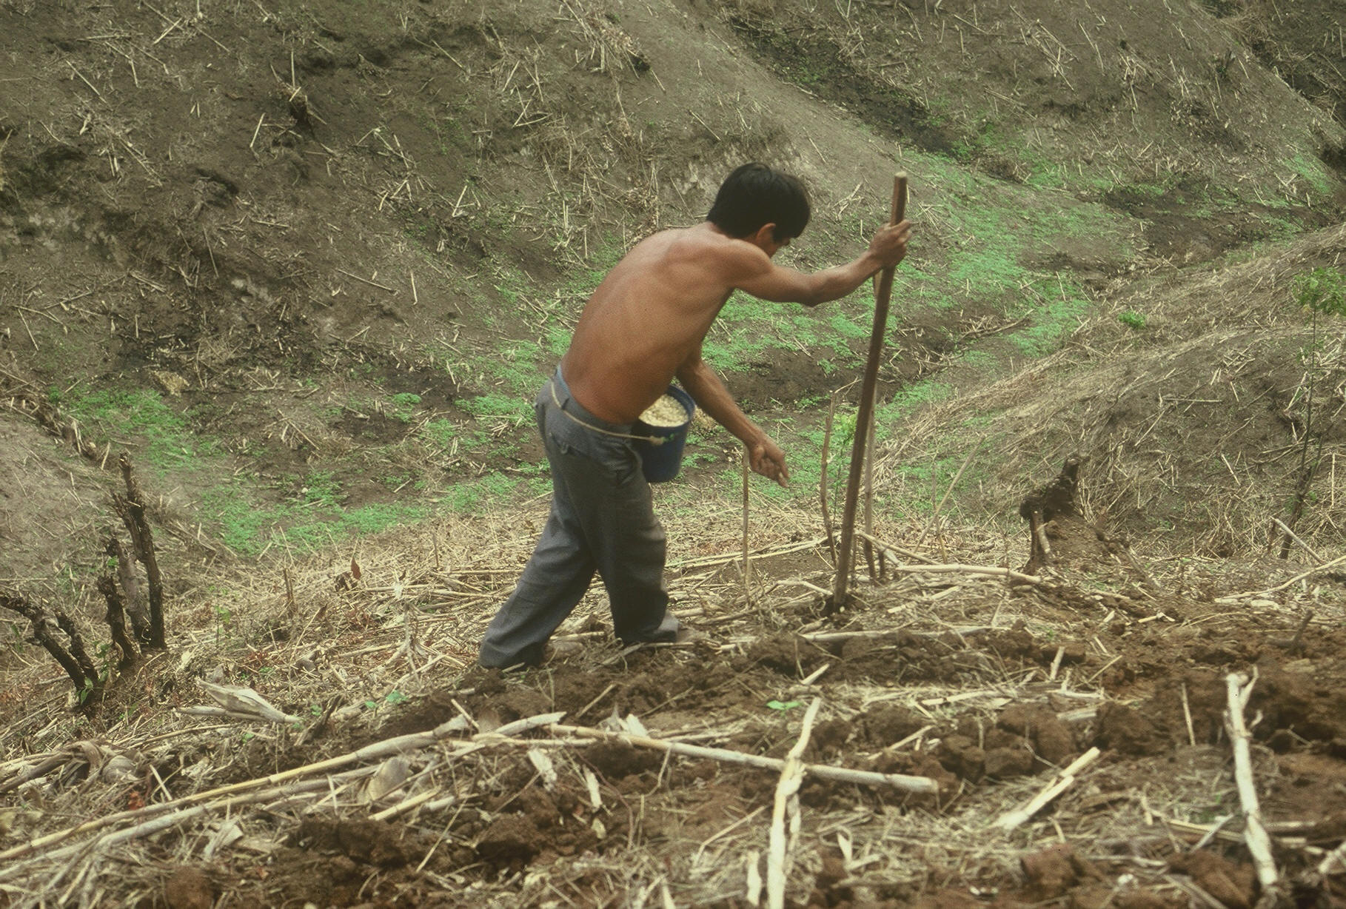

Slide 3
Benefits
Remove chemically treated seeds from the hands of small farmers
Decreased soil erosion from improved plant spacing
Accommodate mid-season applications of urea-N fertilizer
Place urea below the surface reducing NH3 losses
Adoptable technology for virtually all 3rd world corn producers
Potential to provide significant increases in third-world corn
production.
World Values
World corn, 400,000,000 acres
Developing world corn, 83,000,000 acres
Developing world corn acres planted by hand (60% of total) 50,994,152 ac* 25% increase on world hand planted corn ($6.00/bu) = $2,270,994,660

Slide 4
