Slide 1
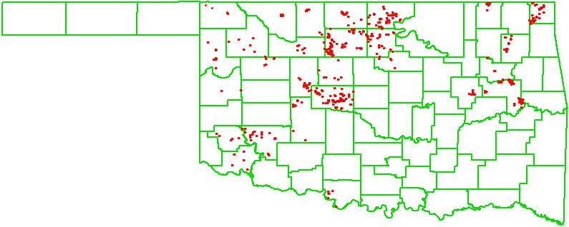
OSU GreenSeeker Update
2006-07 Ramp Program
586 farmer’s fields
2007-2008 (3000-4000, N Rich or Ramps)

Slide 2
Lahoma, OK, Winter Wheat
Exp. 502, 1971-2007
N rate = (N uptake 100 lb/ac - N uptake 40 lb/ac)/0.5
Optimum N Rate (assuming 40 lbs N/ac preplant) Average Yield
Avg. 60 N/ac 42.8 bu/ac +/- 12.7
Avg. Loss = $27.5/acre (N at $0.70/lb)

Slide 3
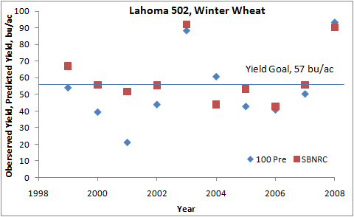
SBNRC (YP0*RI = YPN)
100 Pre (100 lbs N/ac applied preplant)

Slide 4
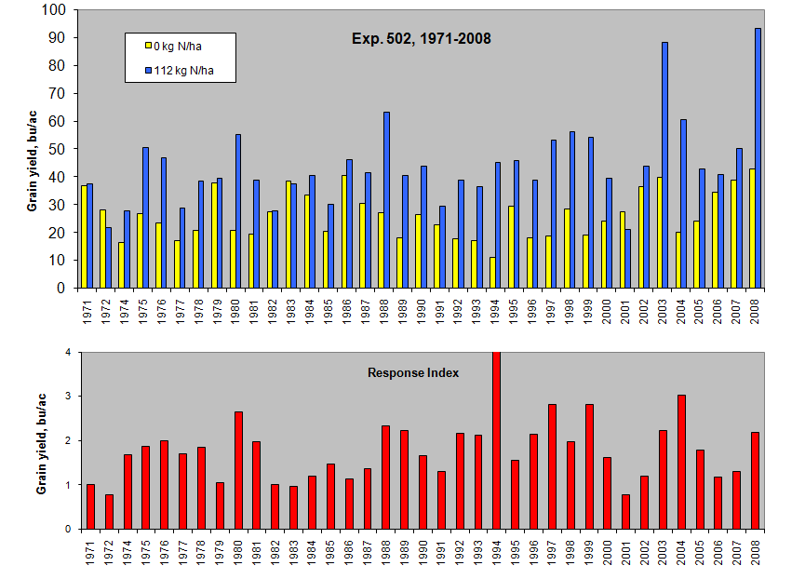

Slide 5
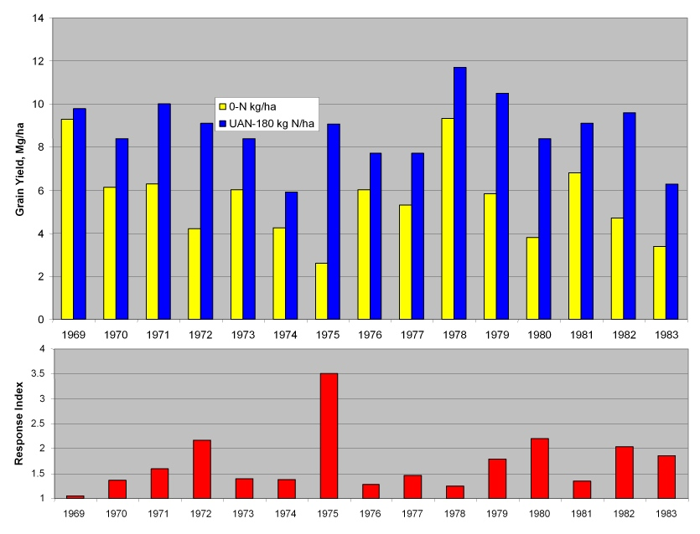
Mead, NE, 1969 - 1983

Slide 8
Data compiled by Dr. Robert Mullen, The Ohio State University

Slide 9
Data compiled by Dr. Robert Mullen, The Ohio State University

Slide 10
Data compiled by Dr. Robert Mullen, The Ohio State University

Slide 11
SBNRC (YP0*RI = YPN)

Slide 12
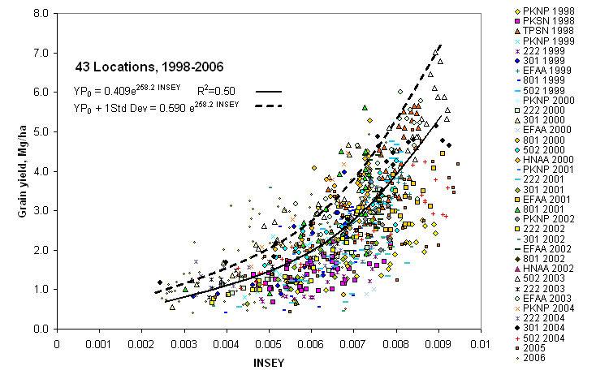
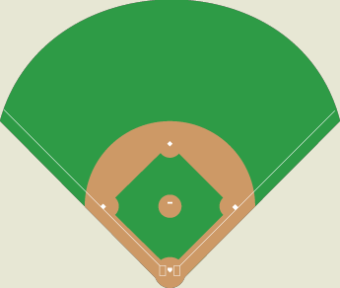
Home Run 4%
In field double-triple 12%
Pop fly-out 25%
In-field single 25%
In-field out 15%
Pop-up out 10%
In-field grounder 9%

