Slide 1
NUE meeting history
Nitrogen Conference 2012 (August 5-7, Fargo, ND)
Nitrogen Conference 2010 (August 2-4, Stillwater, OK)
Nitrogen Conference 2009 (August 4 - August 6, West Lafayette, Indiana)
Nitrogen Conference 2008 (July 31 - August 1, Manhattan, KS)
Nitrogen Conference 2007 (August 6-8, Monmouth, IL)
Nitrogen Conference 2006 (August 7-9, Waseca, MN)
Nitrogen Conference 2005 (August 10-12, Columbia, MO)
Nitrogen Conference 2004 (Lincoln, NE)
Nitrogen Conference 2003 (Stillwater, OK)
June 10-12, 2002, Shelton, NE (USDA-ARS, OSU)
January 17-19, 2002, Lincoln, NE (USDA-ARS, OSU, CIMMYT, Virginia Tech)
July 19-20, 2001, Stillwater, OK “2X Strip” (USDA-ARS, OSU)
March 1, 1999, Stillwater, OK, Schepers Lecture
June 6-7, 1998, Lincoln, NE (USDA-ARS, OSU, CIMMYT)
November 21-22, 1996, Lincoln, NE (USDA-ARS, OSU, CIMMYT)

Slide 2

Development of Active Optical Sensors for Improving NUE
Algorithm Development
Independence of YP0 and RI
Fargo, ND, August 7, 2012

Slide 3
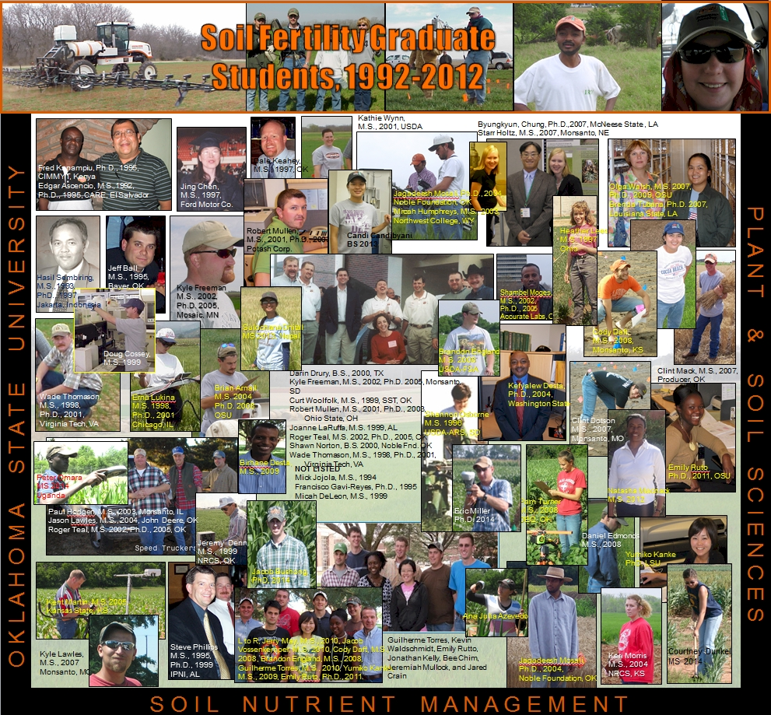
67 Graduates
46 MS
21 PhD
25 Graduates
16 MS
9 PhD

Slide 4
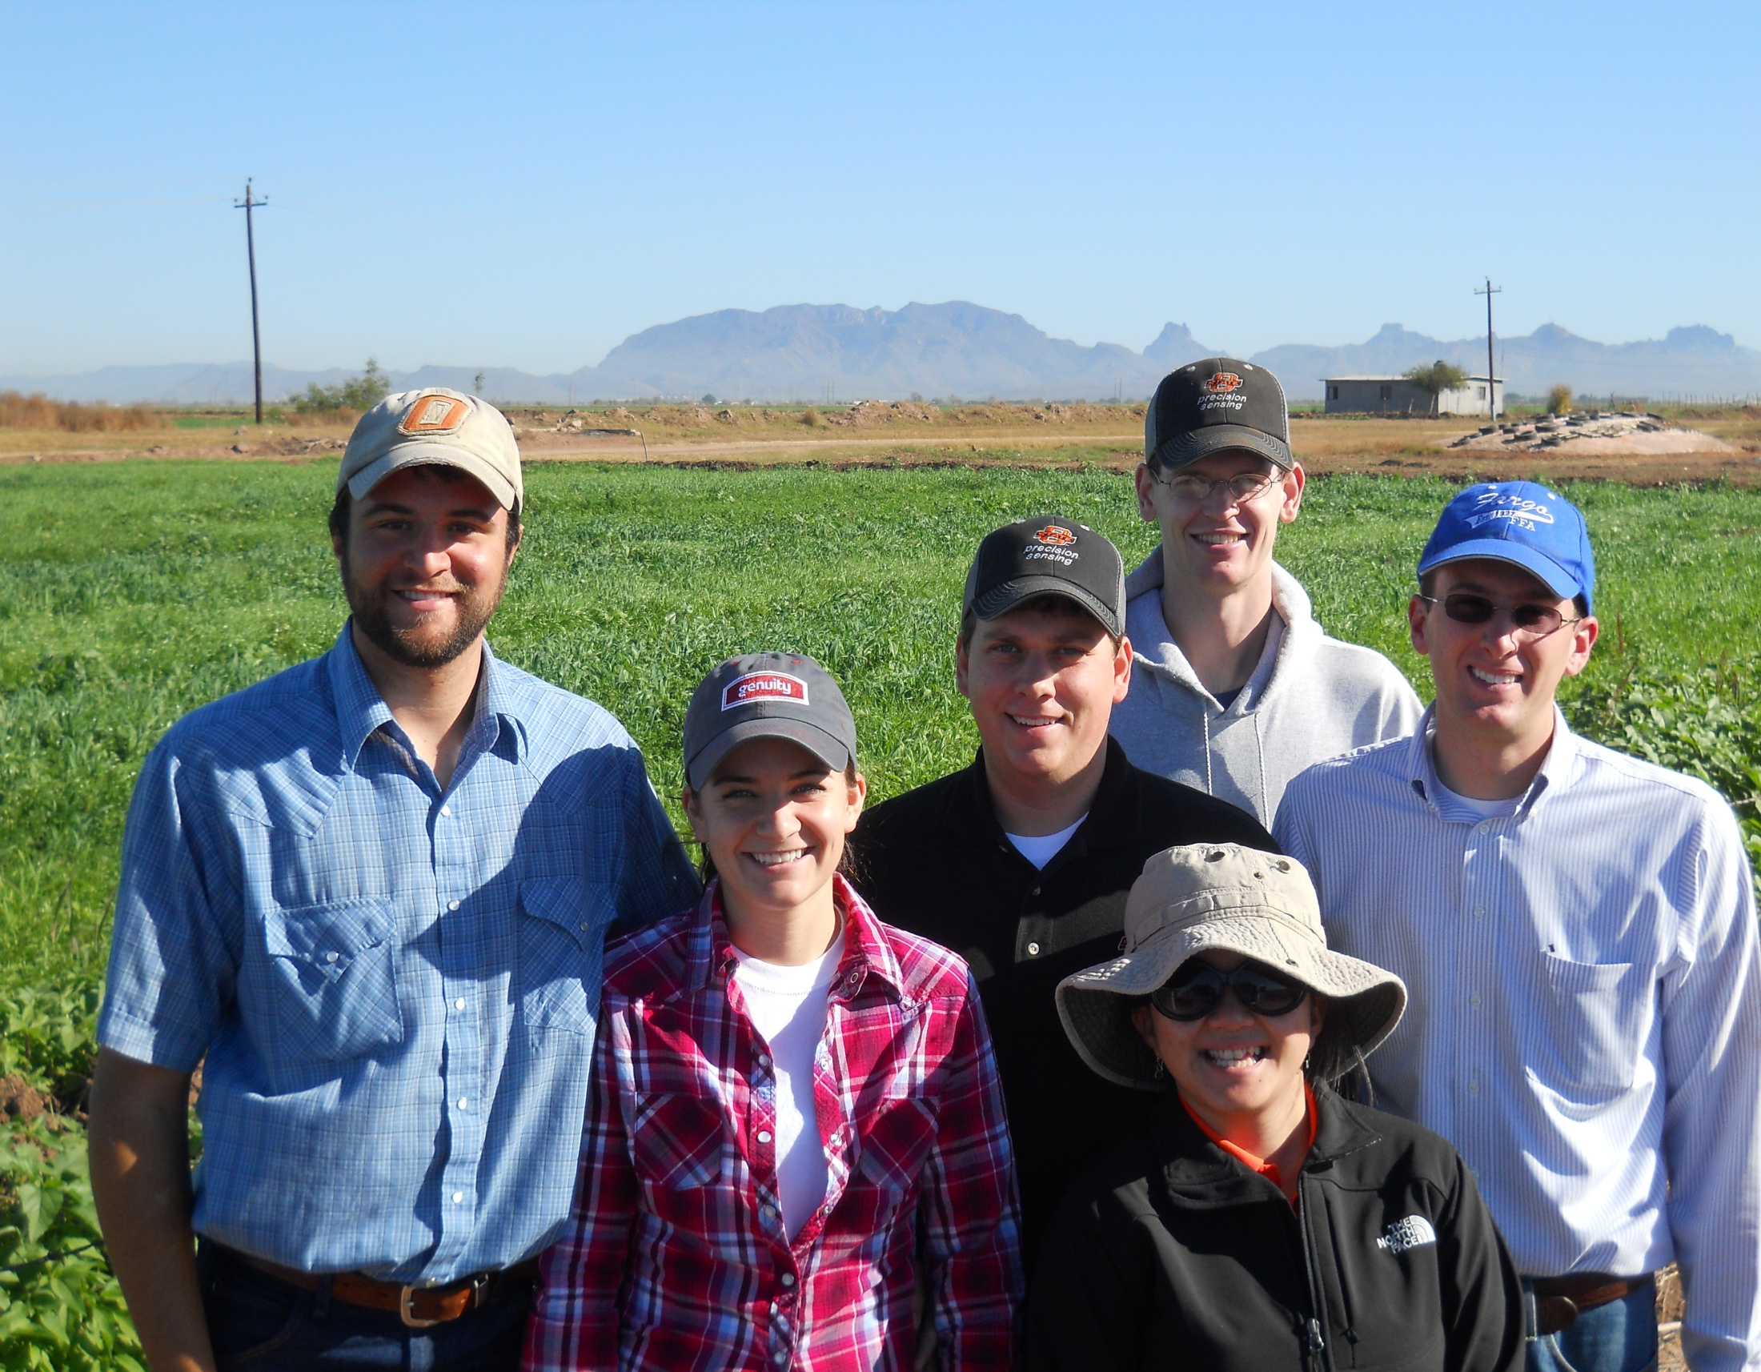
Students
CIMMYT
Uganda
Kenya
Zimbabwe
Mexico
Argentina
Uzbekistan
China

Slide 5
Nebraska
Missouri
Minnesota
Kansas
Colorado
North Dakota

Slide 6
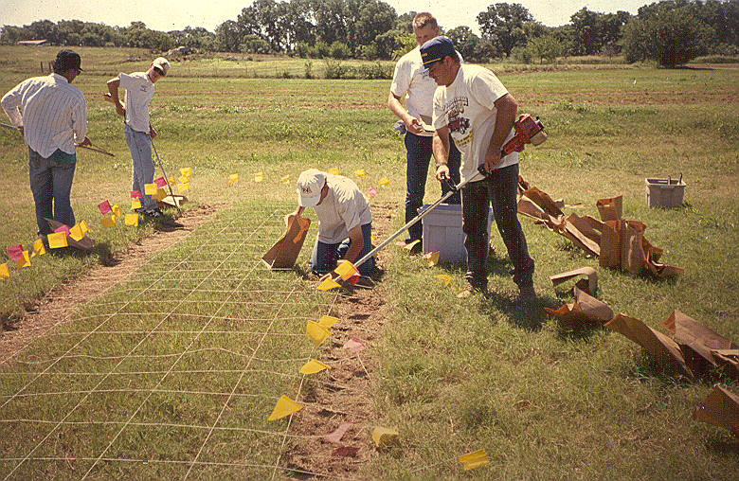
1992: scale for biological differences

Slide 7
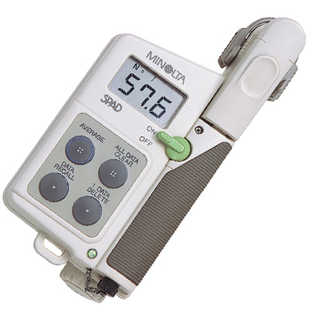
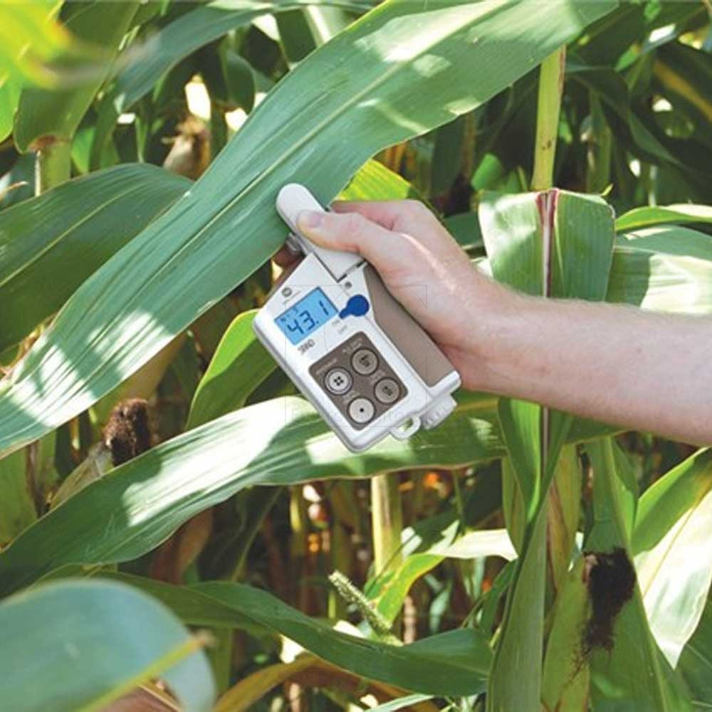
Minolta SPAD, chlorophyll meter, 1984

Slide 8
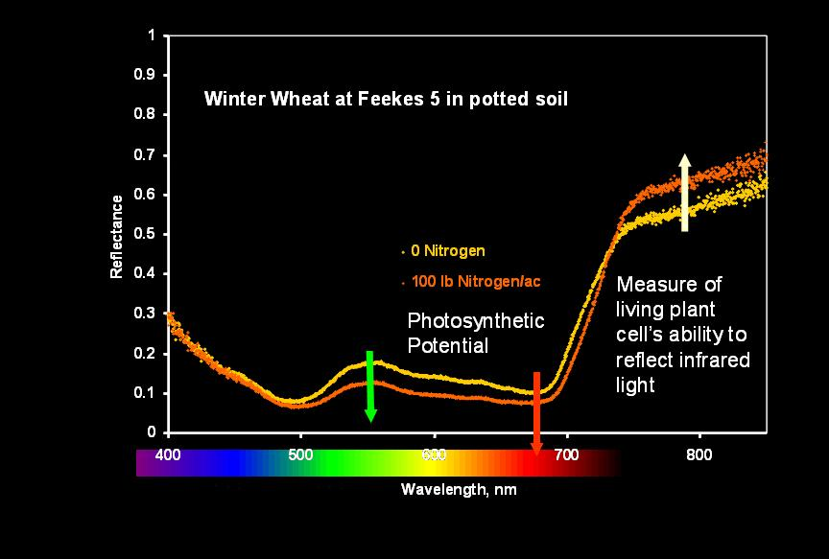
Reflectance

Slide 9
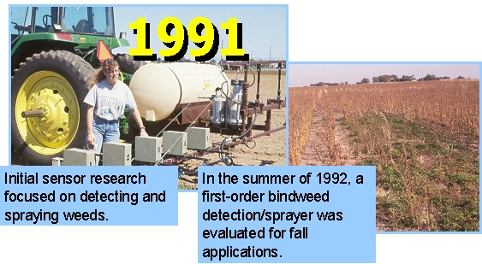
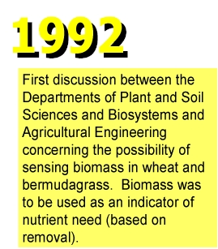

Slide 10
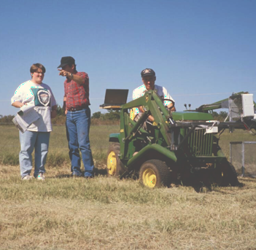
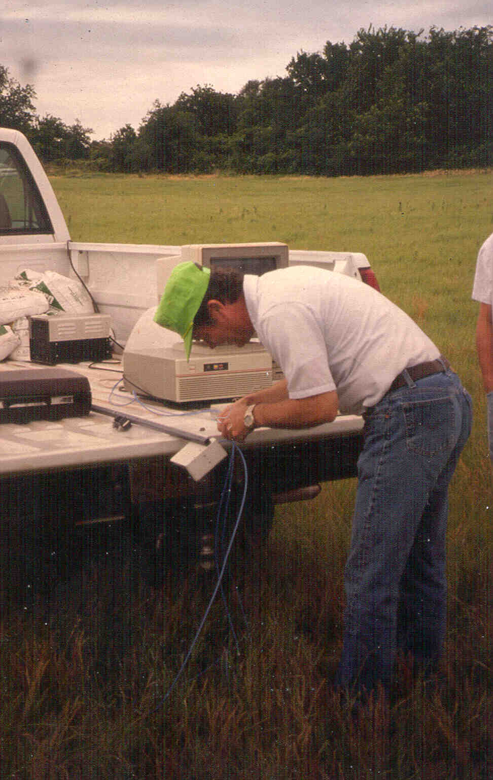
1993
Dr. Marvin Stone adjusts the fiber optics in a portable spectrometer used in early bermudagrass N rate studies with the Noble Foundation, 1994.
Sensor readings at ongoing bermudagrass, N rate * N timing experiments with the Noble Foundation in Ardmore, OK. Initial results were promising enough to continue this work in wheat.

Slide 11
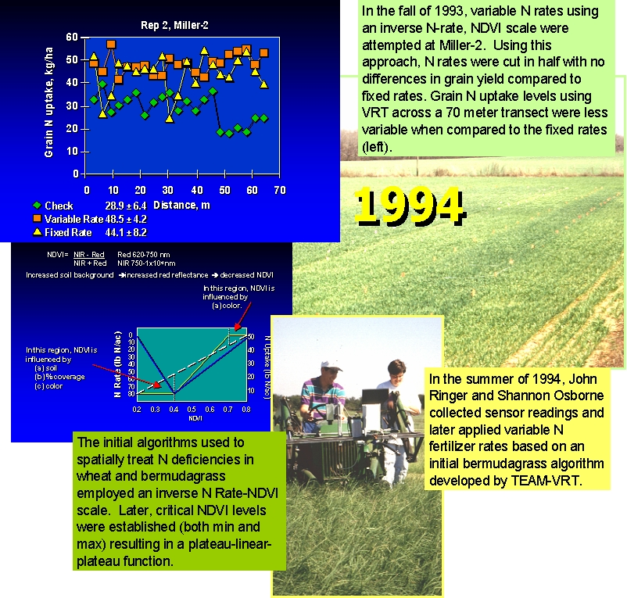

Slide 12
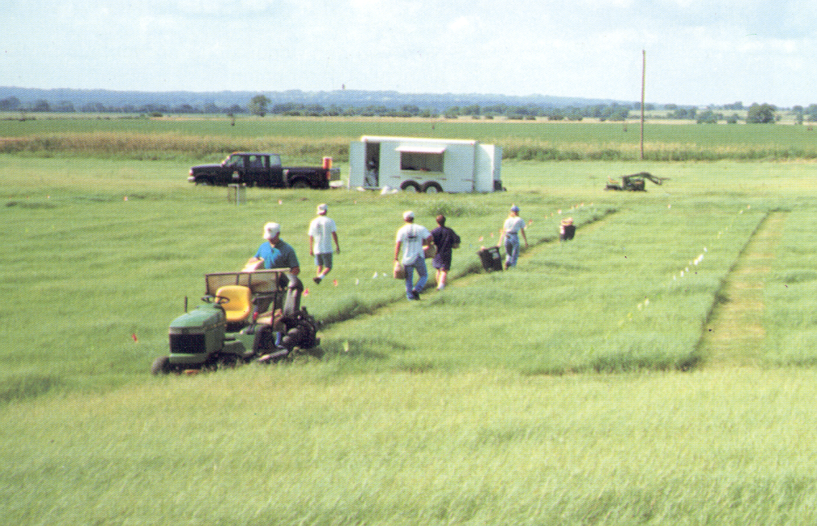
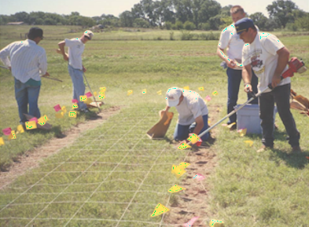
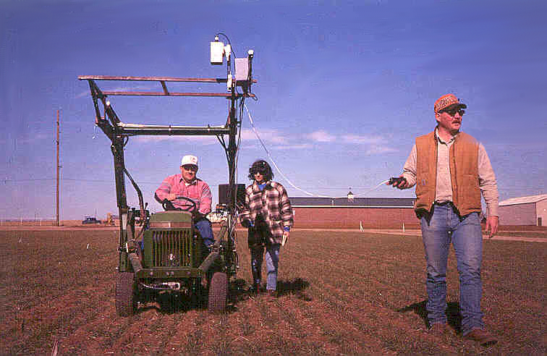
Samples were collected from every 1 square foot. These experiments helped to show that each 4ft² in agricultural fields need to be treated as separate farms.
1995
Extensive field experiments looking at changes in sensor readings with changing, growth stage, variety, row spacing, and N rates were conducted.

Slide 13
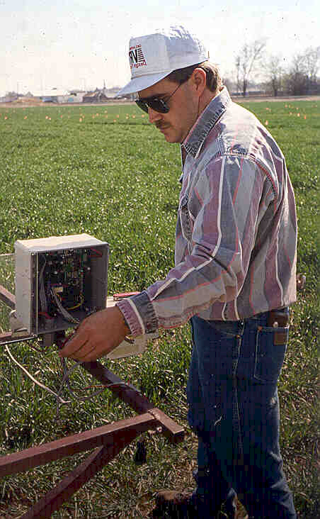
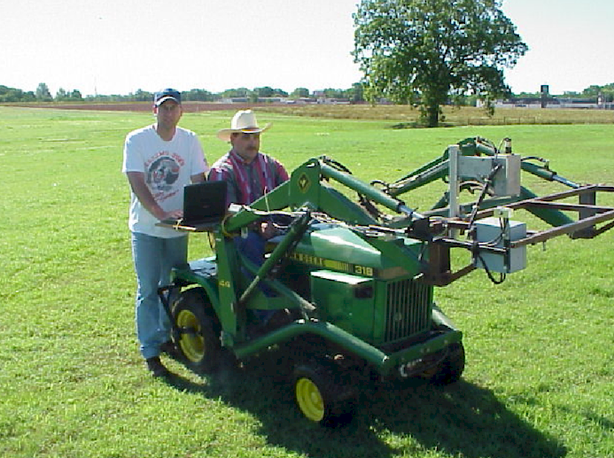
New ‘reflectance’ sensor developed.
Notes:
Here is the optical sensor we used. It’s mounted on a John Deere tractor. It measures both solar irradiance and plant surface reflectance.

Slide 14
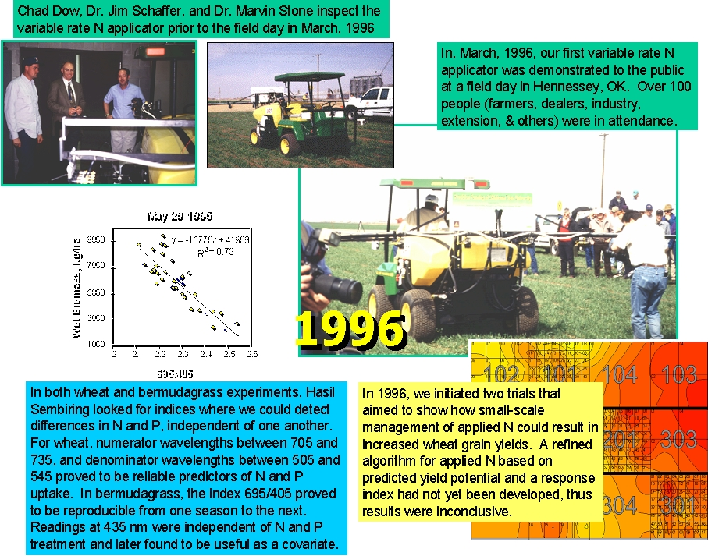

Slide 15
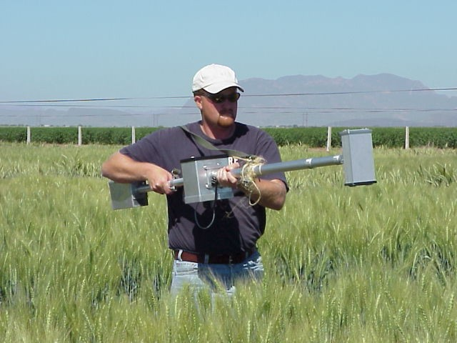
Cooperative research program with CIMMYT. Kyle Freeman and Paul Hodgen have each spent 4 months in Ciudad Obregon, MX, working with CIMMYT on the applications of sensors for plant breeding and nutrient management.
1998
Cooperative Research Program with Virginia Tech

Slide 16
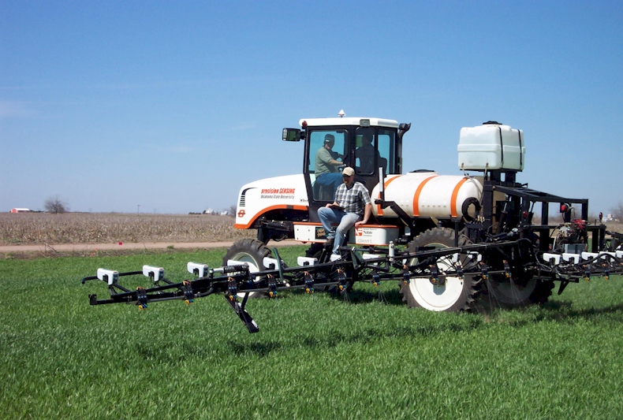


2001
Capstan nozzle controller hooked to a Trimble or Raven rate controller
precision SENSING

Slide 17
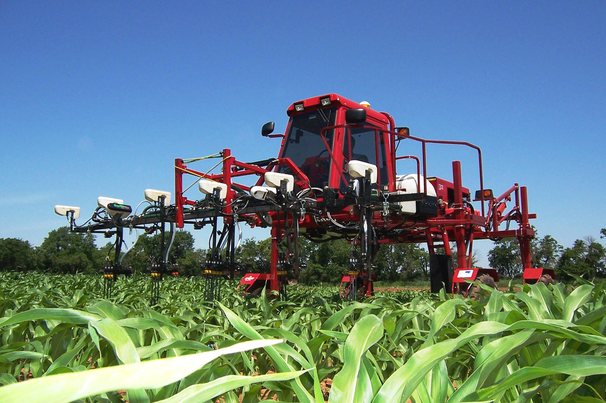
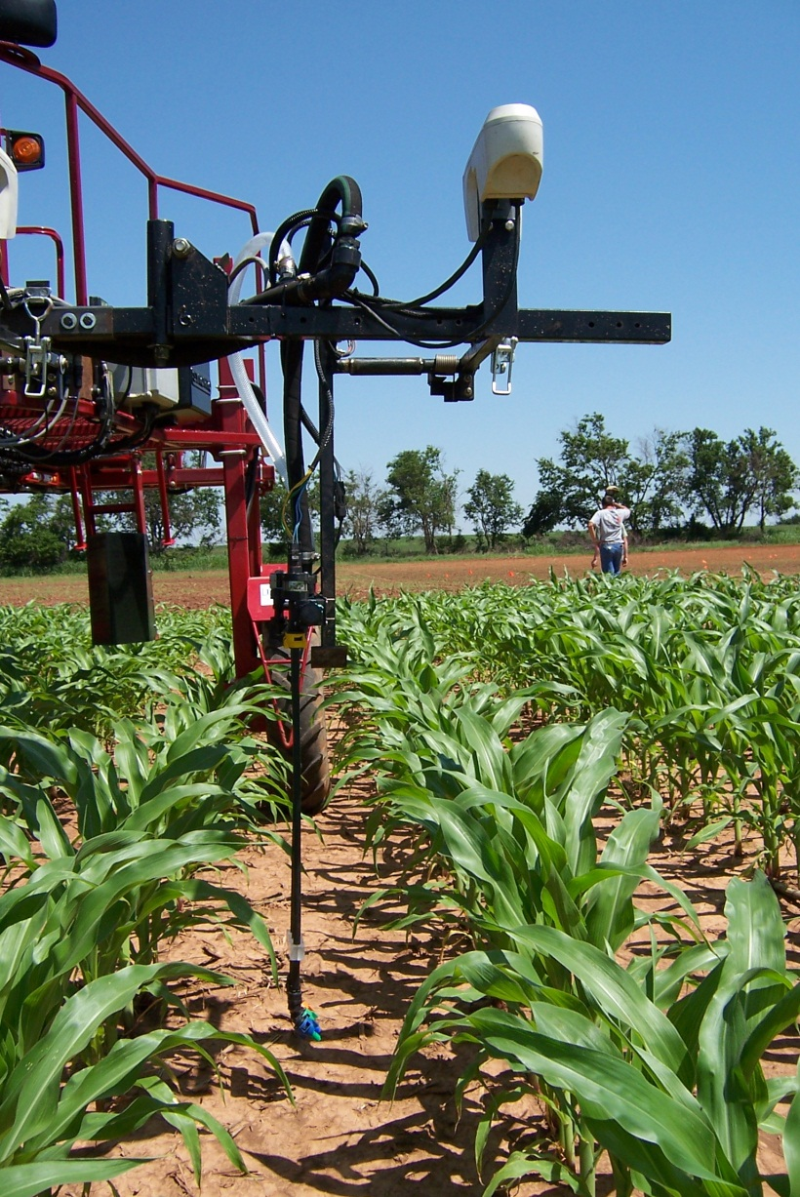
2004

Slide 18
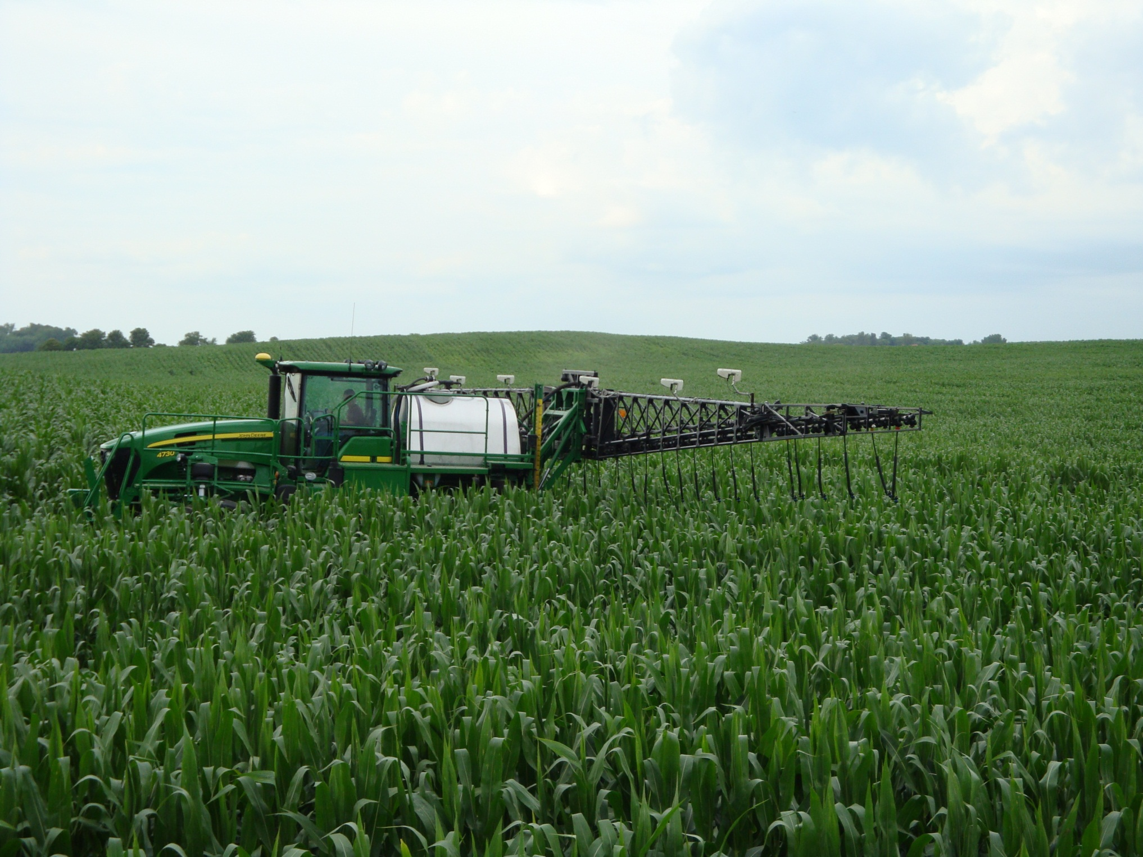
2008

Slide 19
Simultaneous development of engineering and agronomy
Extension

Slide 20
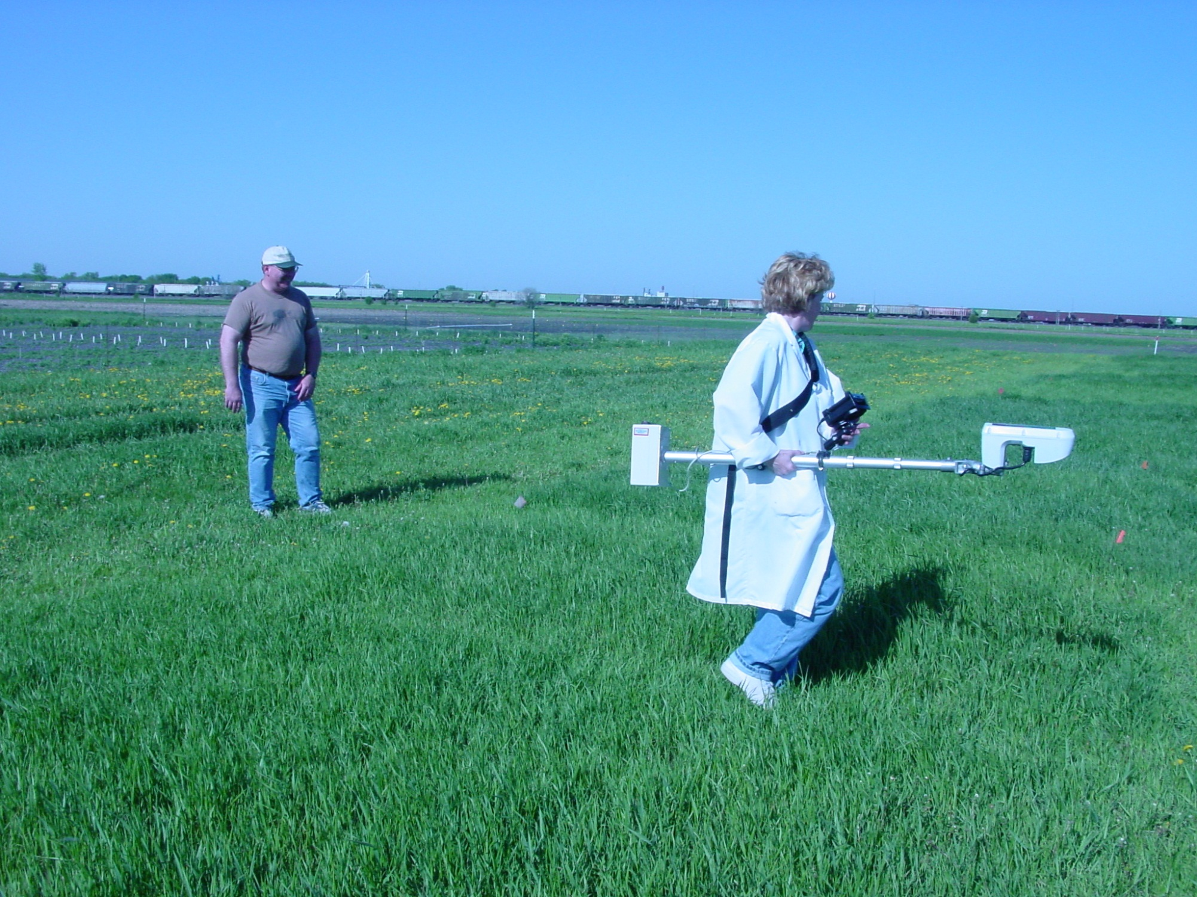
Dr. Dave Franzen looks on as sensor readings are collected from long-term Bromegrass plots that were first initiated in 1956

Slide 21
N Rich Strip Adoption
2003: OSU applied 62 NRS
2004: 300 NRS in Farmers Fields
2005: SBNRC released, 1000 NRS
2006: OSU applied 568 NRS
1,500 NRS by 1 cooperator alone
estimated 230,000 acres under NRS
2007: 25 county educators reported having NRS
2009: Survey reported 4,000 NRS
2011: Estimated 500,000 acres utilizing NRS

Slide 22
Oklahoma
N-Rich Strips applied in:
  Wheat, Rye, Oats, Barley, Sorghum, Field Corn, Sweet Corn, Canola, Bermuda grass Hay, Pastures, and Sesame
N-Rich Strip and online SBNRC
  Conservative estimate 400,000 acres in 2010-2011 Winter Wheat crop.
Difficult to estimate. Many producers utilize without OSU’s assistance or knowledge

Slide 23
Oklahoma State University
From 2005 to 2011, 18,413 Nitrogen Rich Strips were put on in Oklahoma that represented 1,473,040 acres. Average profits of $10.00/ac for OK producers using the GreenSeeker and OSU N Rate recommendation, has resulted in a total positive economic impact >$10,000,000.

Slide 24
Quotes from Dr. Brian Arnall
“first NRS required hand holding”
“some farmers think it doesn’t work if they cannot see the NRS”
“adoption has been greater when the increased N rate recommended resulted in a higher yield” versus the lower rate savings at the same yield
“making money” vs “saving money”
el gambler el banker

Slide 25
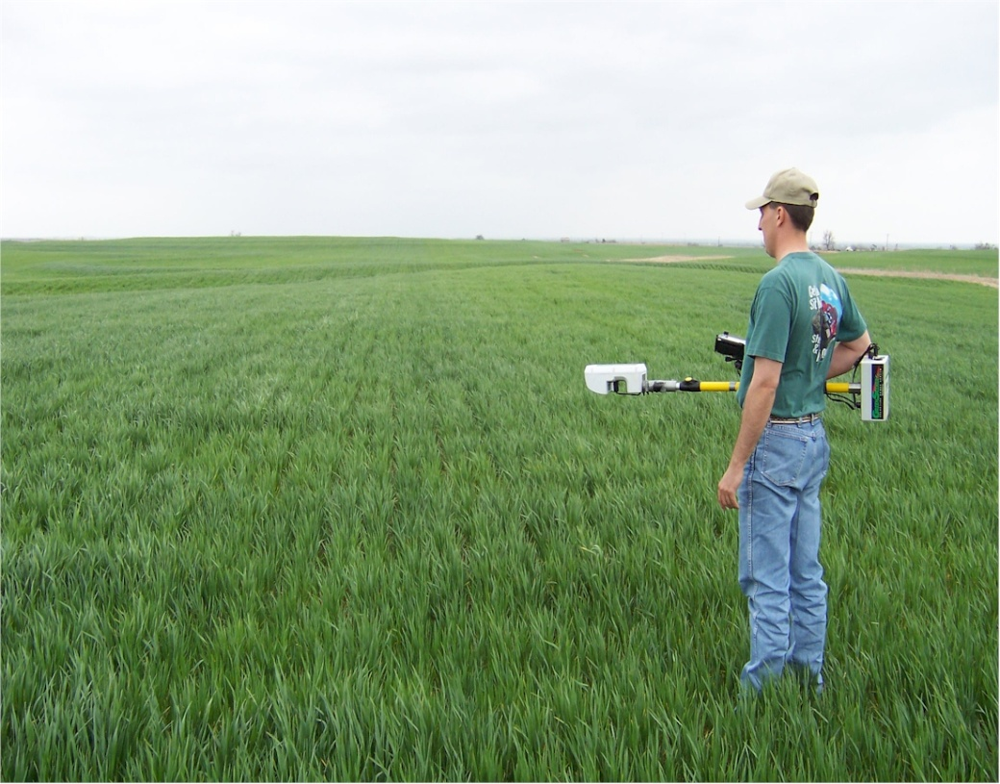
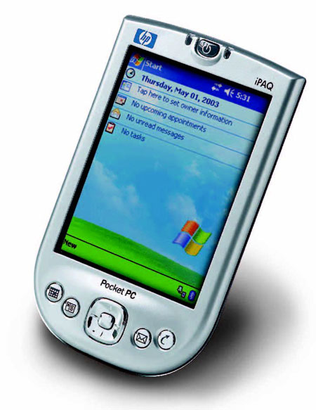
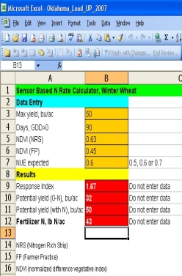
Current Uses
N-Rich Strip
Sensor Based N Rate Calculator
VRT

Slide 26
Steps to Develop Algorithms

Slide 27
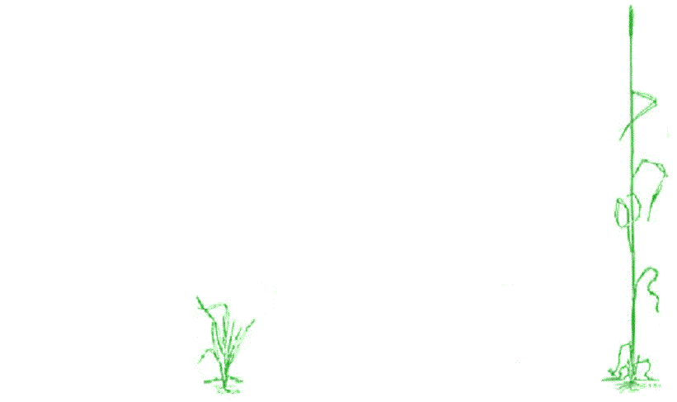
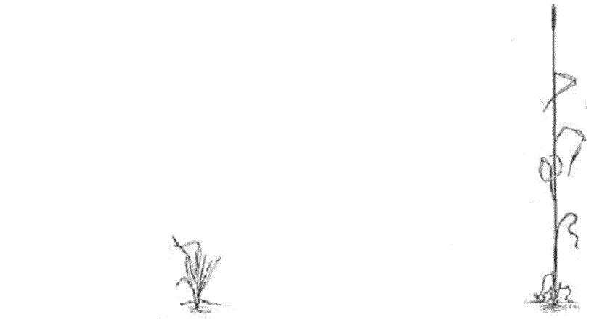
3
2001
YP_{N} < YP_{MAX}
1
Predict RI
Predict YP₀
Predict YP_{N} based on RI
Fertilizer N = GNUP-FNUP/0.7
2
2
3
4
1
4

Slide 28
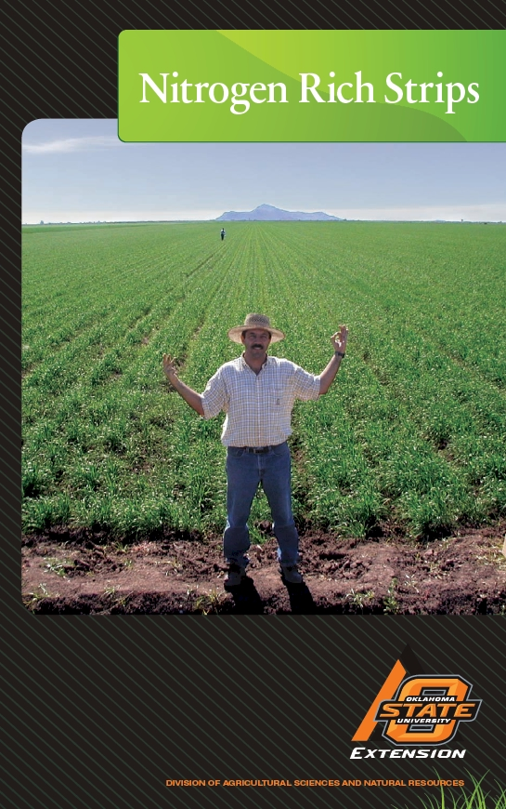

Slide 29
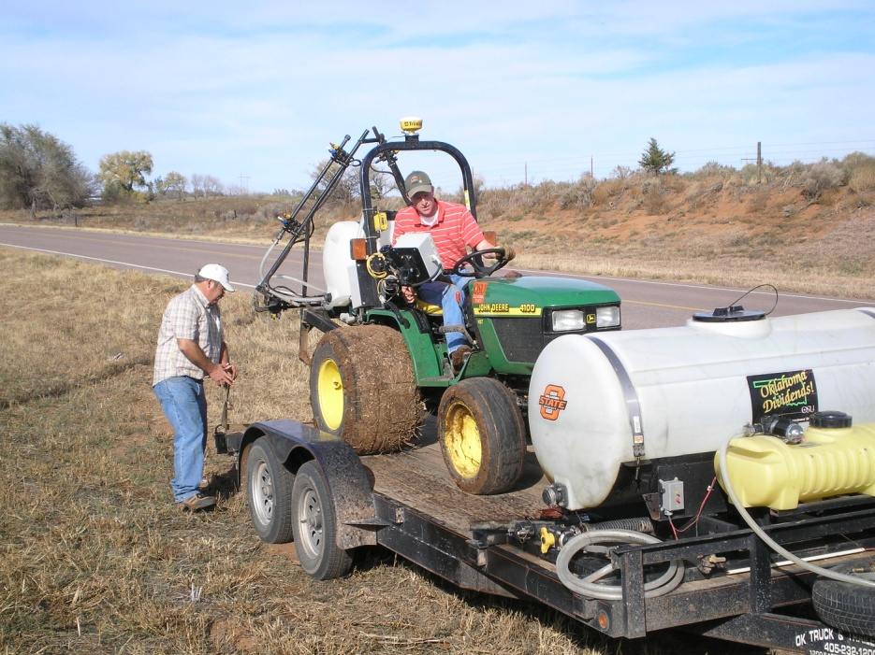
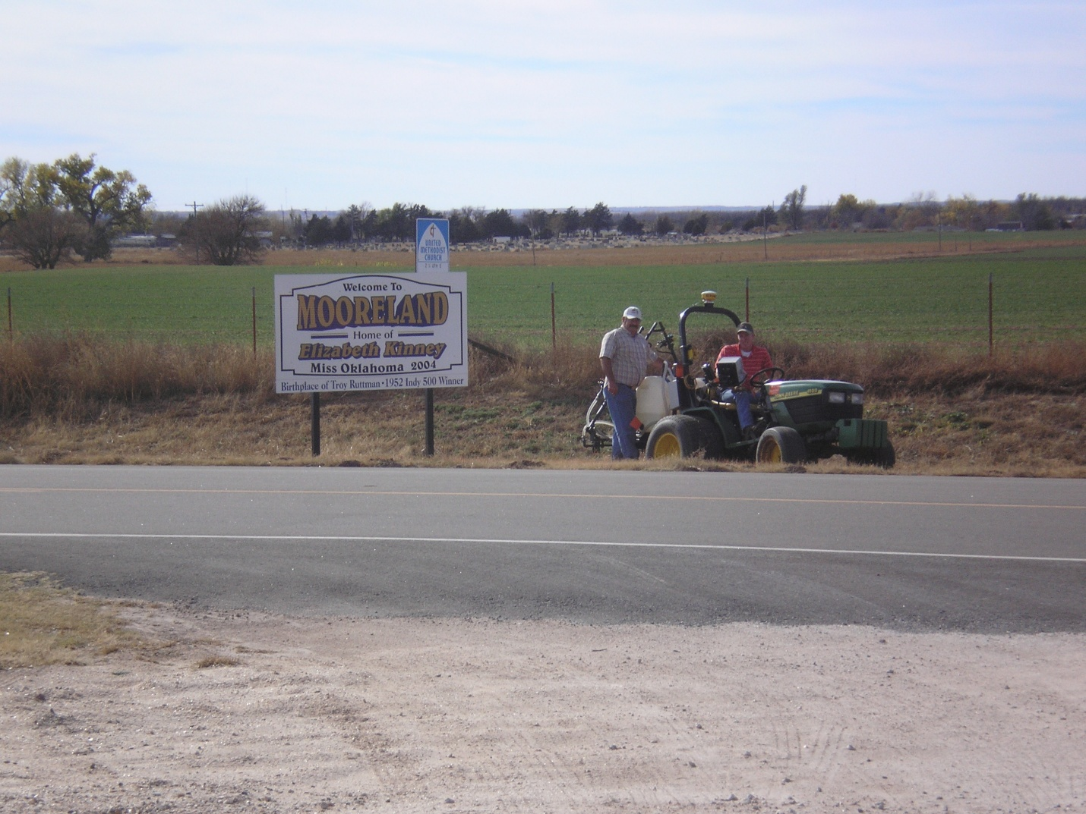
N Ramp

Slide 30
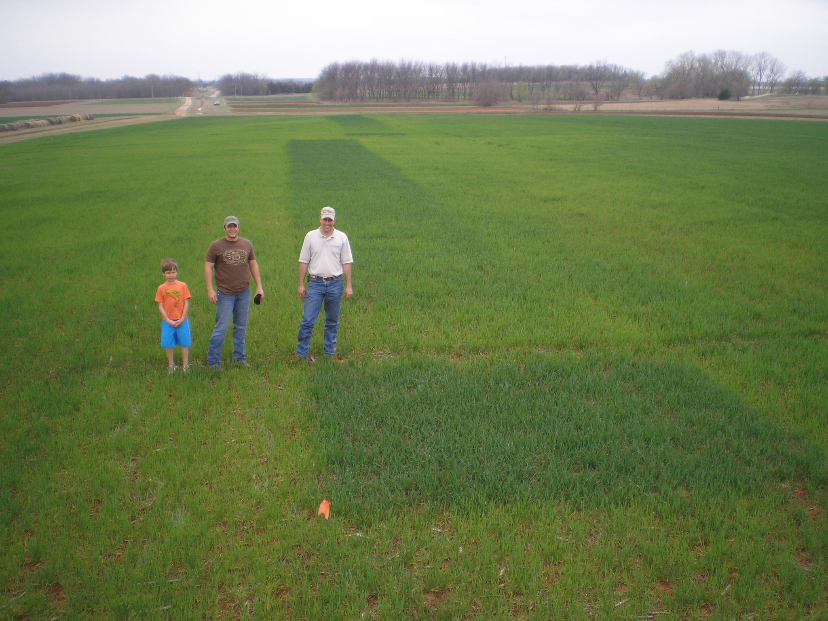
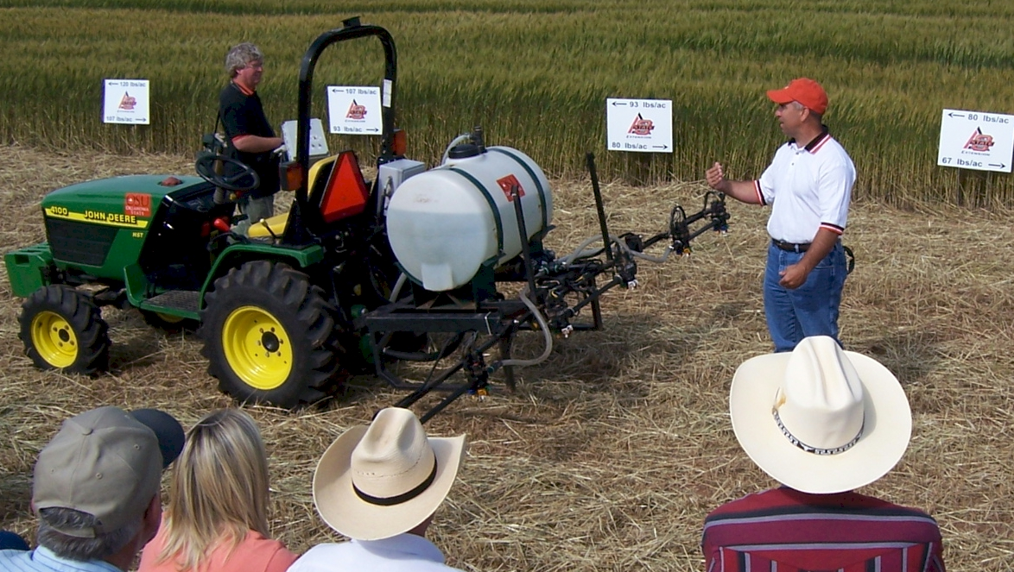
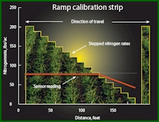
Nitrogen Ramps

Slide 31
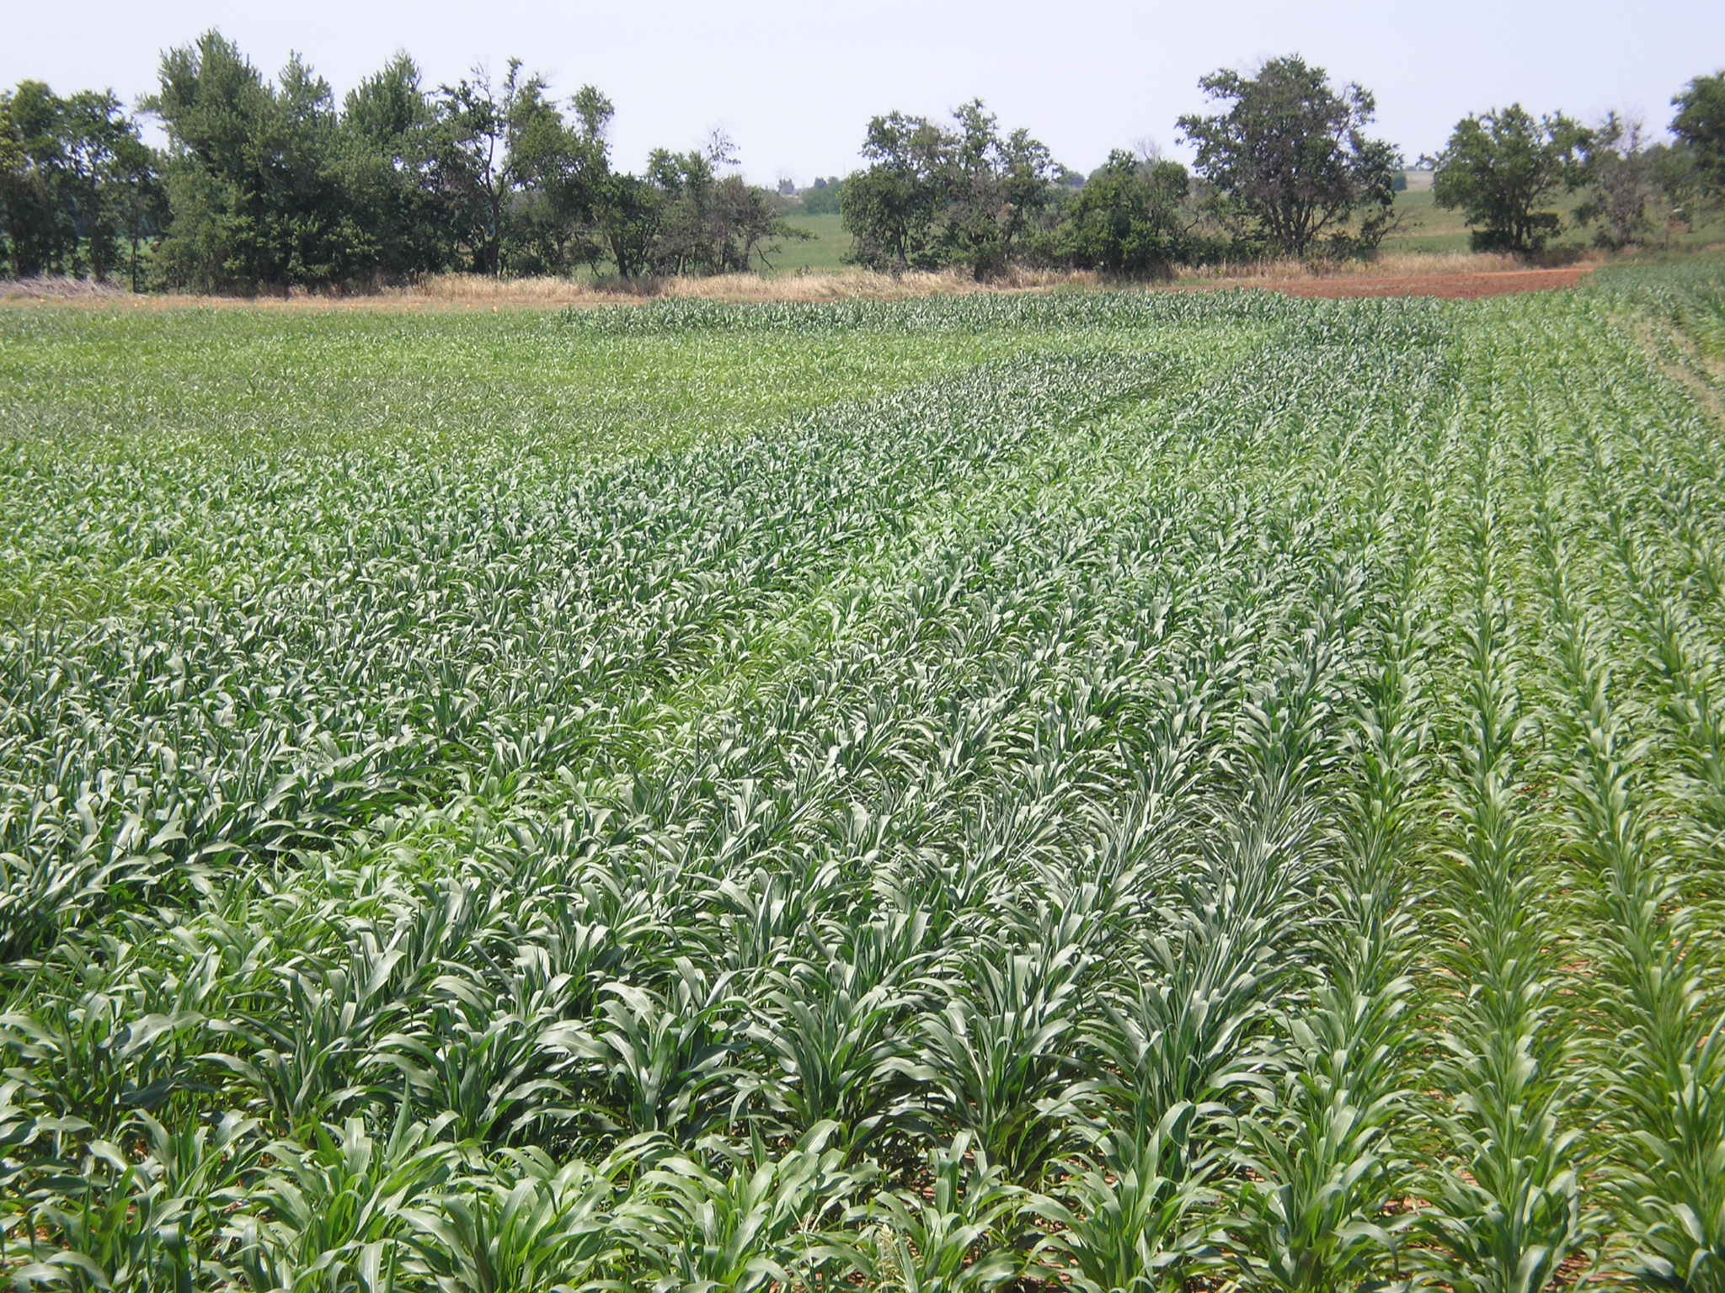

Slide 32
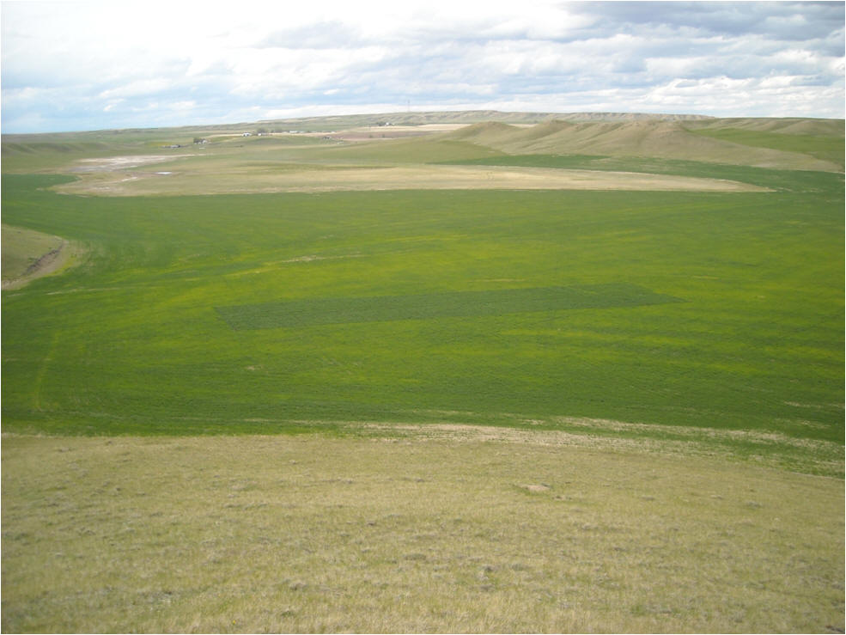

Slide 33
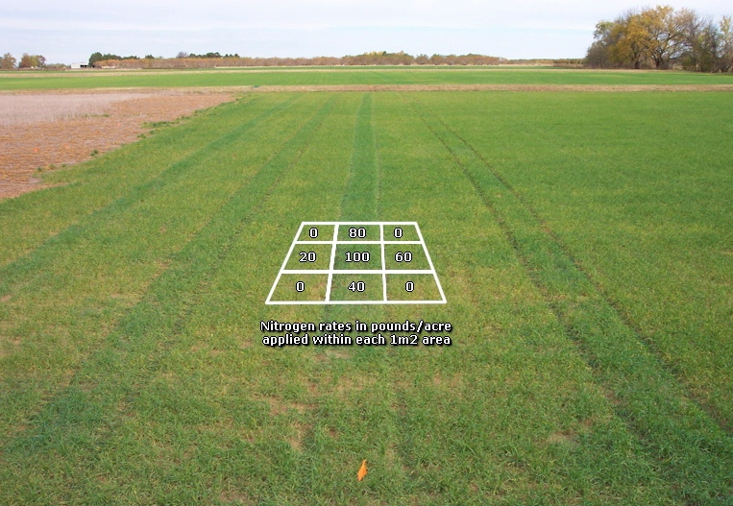
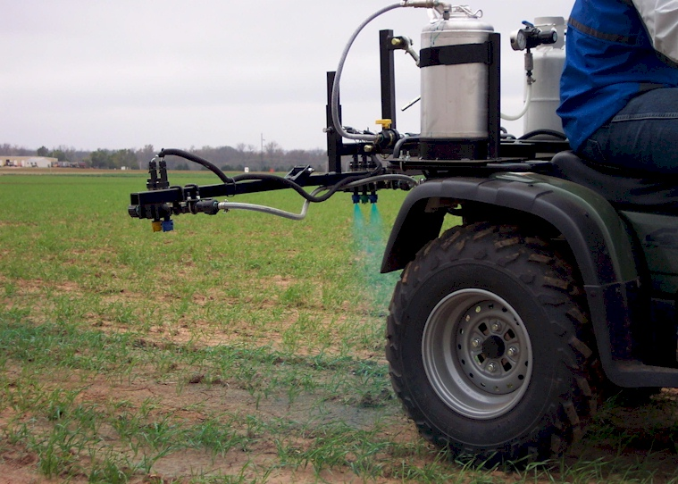

Slide 34
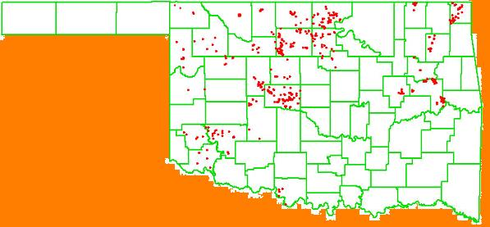
Year OSU Dealer/Producer
2005 80 400
2006 586 Ramps -
2007 512 Ramps 2000
2008 15 -
2009 20 3500
2010 20 3800
2011 60 4000 (includes canola)
Strategy: Have to have experience seeing the different responses from one year to the next
2006

Slide 35
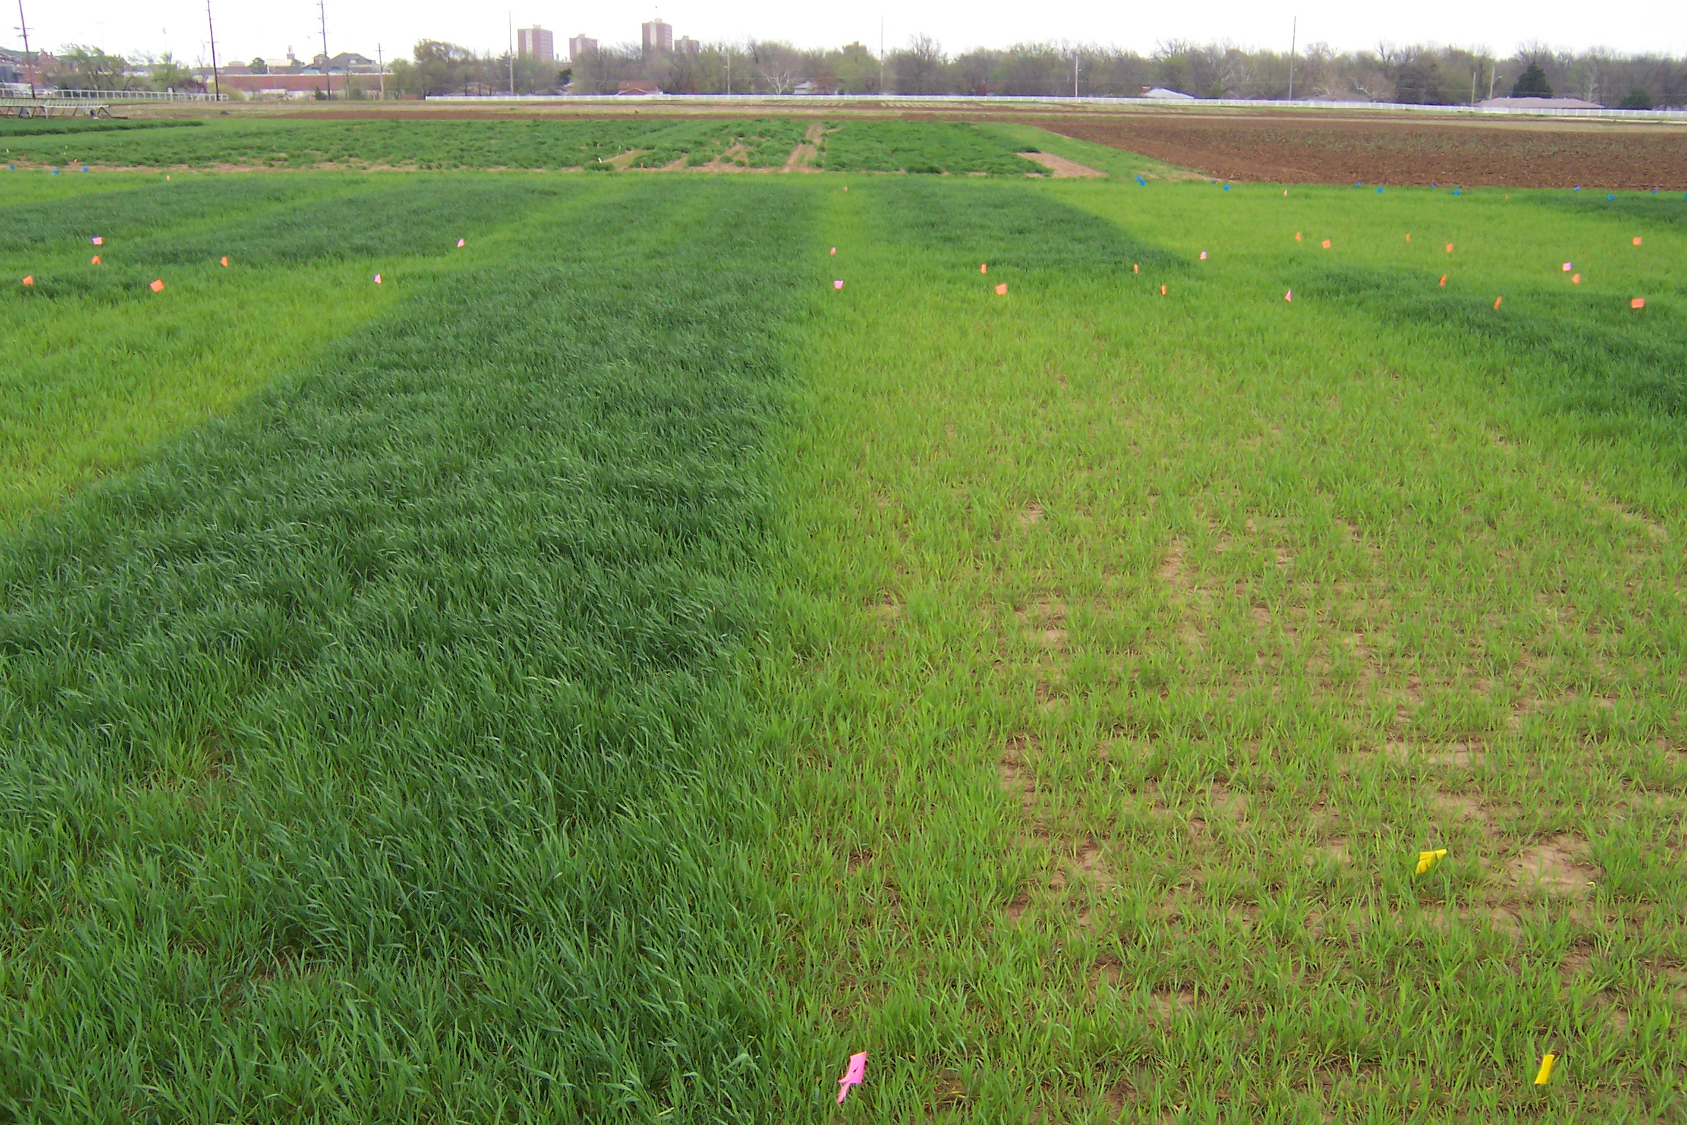
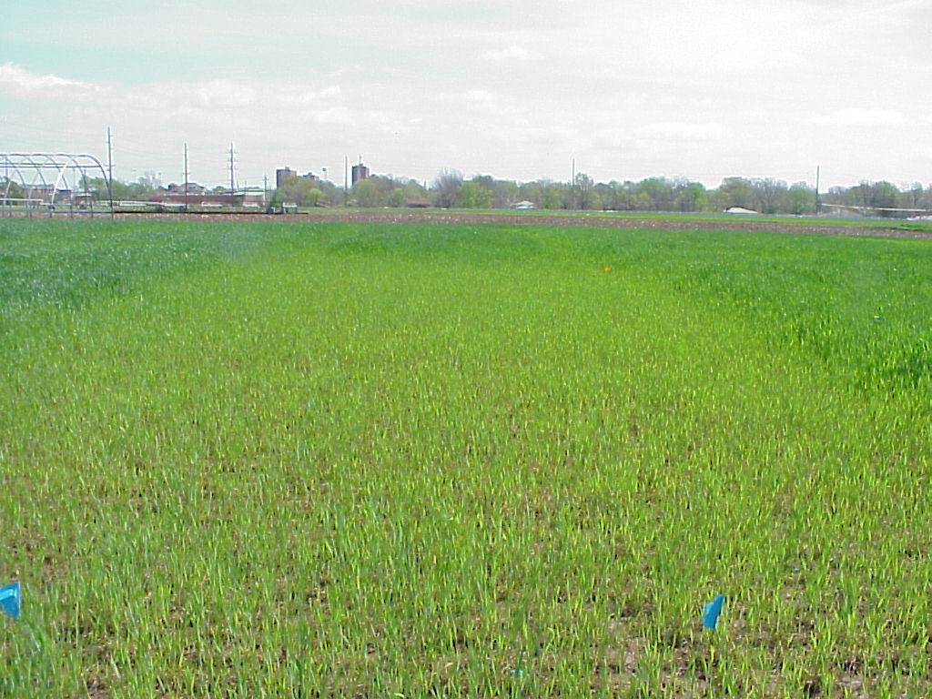

Response Index
2004
1995
Long term N-P-K Experiment
#222 (1969-2004)
Dr. Billy Tucker

Slide 39
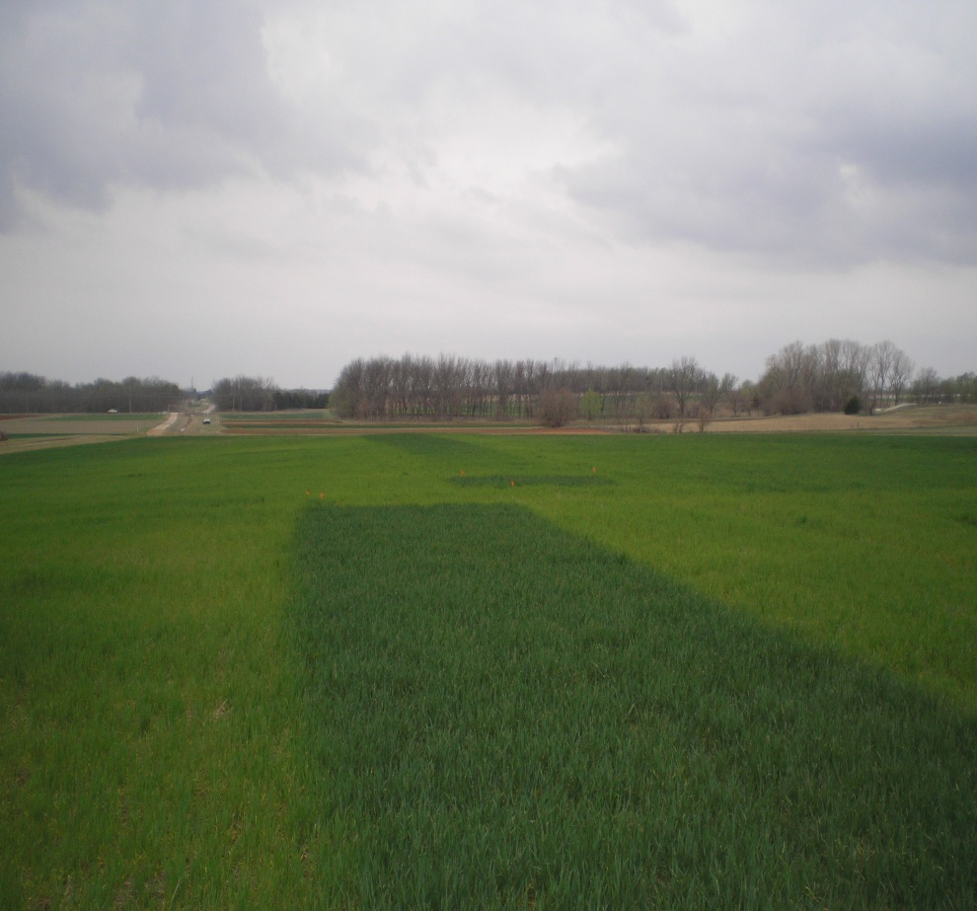
RI NDVI and RI Harvest
Therefore some algorithms use adjusted RI based on research. Calculation differs across crops and environments (great plains vs east coast).

Slide 40
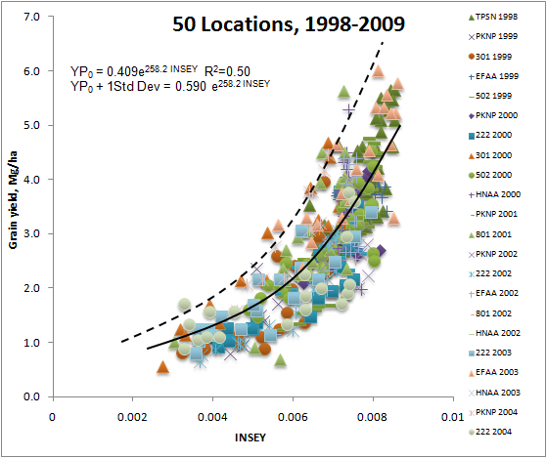
Predicting yield potential
INSEY = NDVI/cumulative GDD

Slide 41
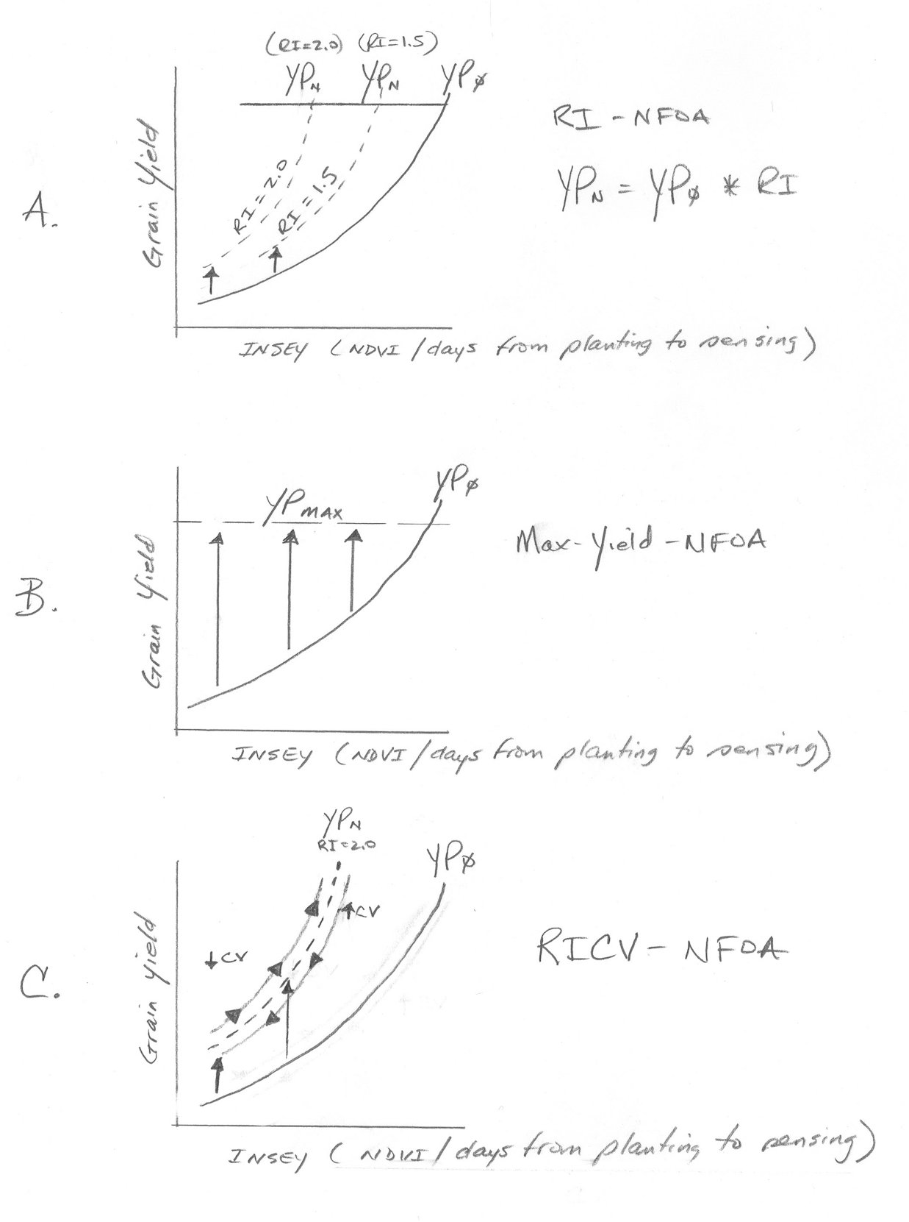

Slide 42
OSU Approach
YP_{N}
YP_{N}
YP₀
YP_{MAX}
RI=1.5
Grain yield
RI=2.0
RI-NFOA
YP_{N}=YP₀ * RI
INSEY (NDVI/days from planting to sensing)
Nf = (YP₀*RI) – YP₀))/Ef
Yield potential is predicted without N (YP₀)
The yield achievable with added N (YP_{N}) = YP₀*RI
Grain N uptake for YP_{N} – YP₀ = Predicted Additional N Need
Fertilizer Rate = #3/ efficiency factor (usually 0.5 to 0.7)

Slide 43
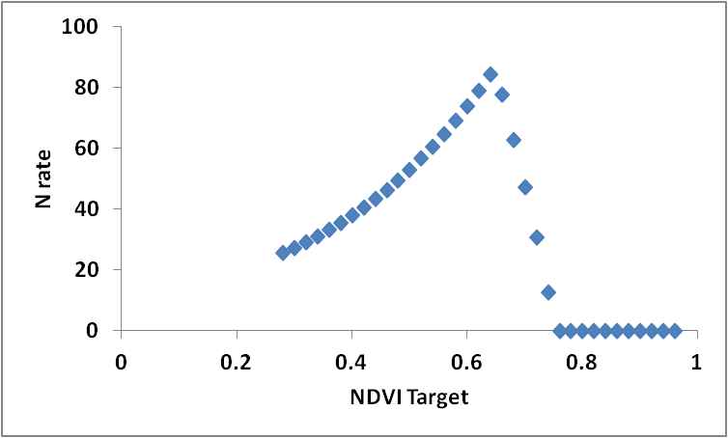
OSU/Canada/KSU/LSU
Uses Yield Prediction and RI (OSU) in ex.
If (YP0*RI<YPNR, YPN*RI, YPNR)-YP0
*56lb/bu *.0125 %N / .60%NUE

Slide 44
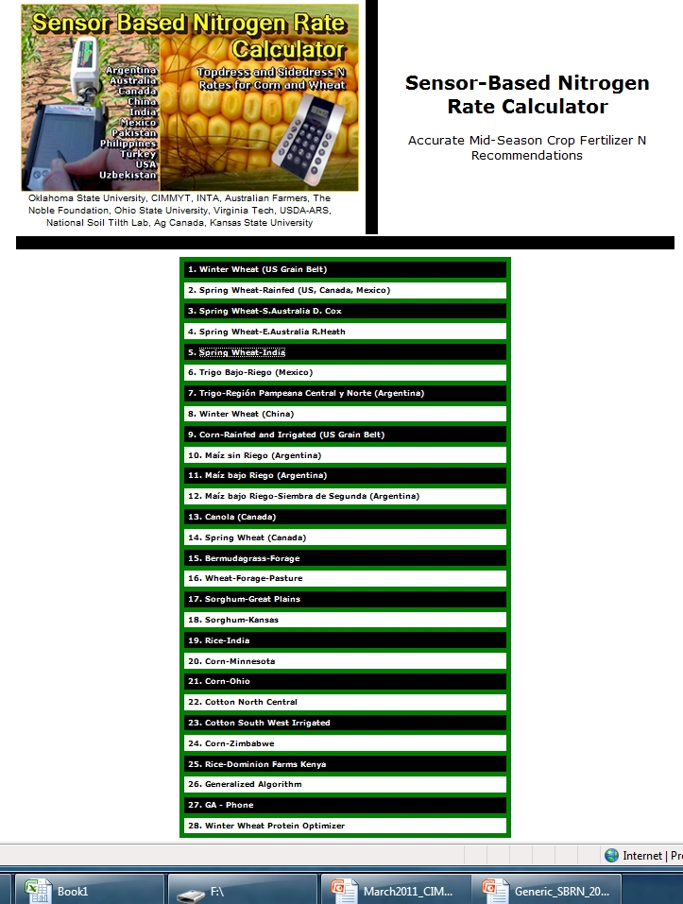
http://www.soiltesting.okstate.edu/SBNRC/SBNRC.php
currently 28 options,

Slide 45
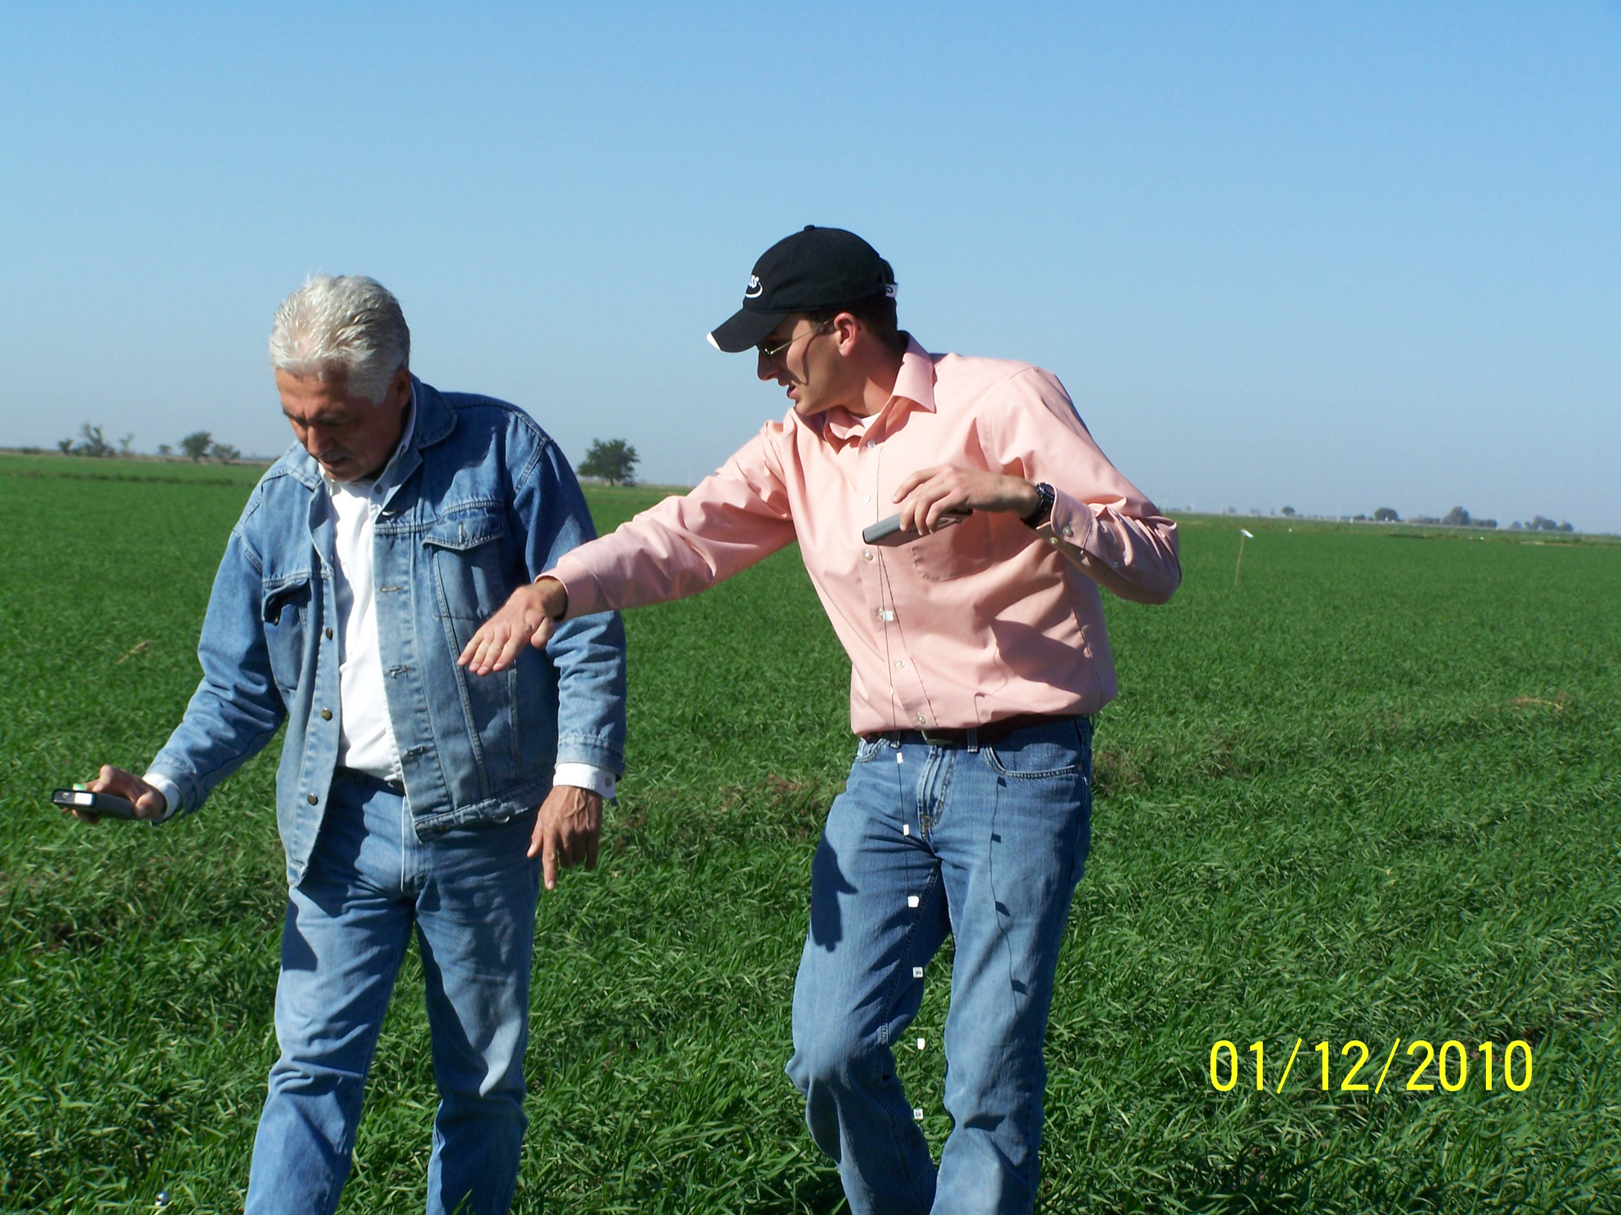
Farm advisor in Ciudad Obregon, manages 1000 ha using GreenSeeker technology

Slide 46
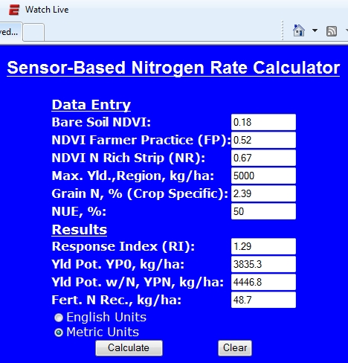
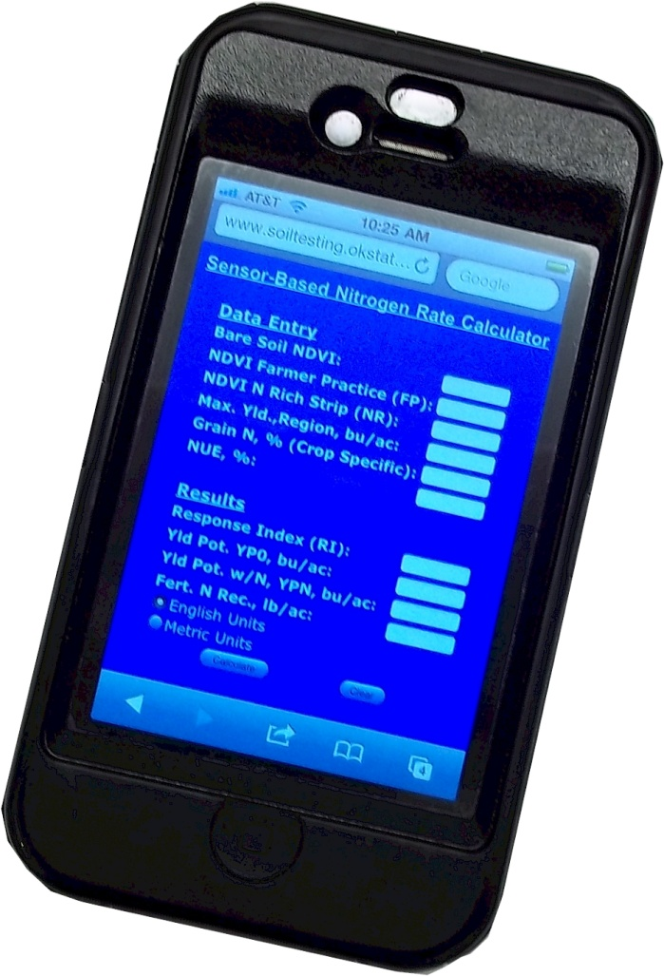

Slide 47
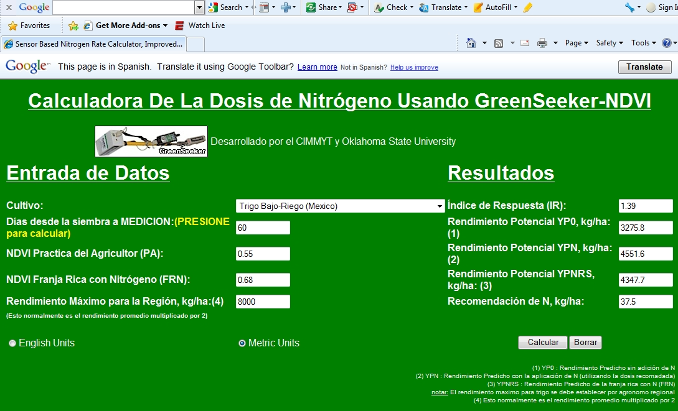

Slide 48


Slide 49
Algorithm Testing
Regional Wheat
Regional Corn
Sufficiency
Chlorophyll meters
Alternative indices
Added nutrients
Commercial sensors
Notes:
u

Slide 50
Independence of YP0 and RI

Slide 51


Slide 52
Hypotheses
Does the environment influence N demand differently from one year to the next?
Does yield level influence the final N rate?

Slide 53
Table 3. Linear regression results including r2, slope and slope significance for the relationships between
response index (RI, determined 2 different ways), grain yield, and year, for Magruder, Experiment 406,
Experiment 407, Arlington WI, and Shelton, NE.
Experiment | Variables |  | Slope | Slope significance | Model r²
 | Independent | Dependent |  | pr > |t|
Magruder | RI _{0-N} | Grain yield | 0.23 | 0.16 | 0.04
Exp. 406 | RI _{0-N} | Grain yield | 0.79 | 0.09 | 0.08
Exp. 407 | RI _{0-N} | Grain yield | 0.59 | 0.06 | 0.09
Arlington WI (1958-1983) | RI _{0-N} | Grain yield | 0.12 | 0.78 | 0.01
Arlington WI (1984-2007) | RI _{0-N} | Grain yield | 0.56 | 0.14 | 0.09
Shelton, NE | RI _{0-N} | Grain yield | -0.22 | 0.61 | 0.03
Magruder | RI _{mid N} | Grain yield | - | - | -
Exp. 406 | RI _{mid N} | Grain yield | 1.03 | 0.37 | 0.02
Exp. 407 | RI _{mid N} | Grain yield | 1.55 | 0.1 | 0.06
Arlington WI (1958-1983) | RI _{mid N} | Grain yield | -5.54 | 0.18 | 0.09
Arlington WI (1984-2007) | RI _{mid N} | Grain yield | -0.39 | 0.95 | 0.01
Shelton, NE | RI _{mid N} | Grain yield | -1.19 | 0.78 | 0.01

Slide 55
2011. Independence of yield potential and crop nitrogen response. Precision Agric. 12:508-518.

Slide 61
Conclusions
Yield and N responsiveness were not related whether or not the medium N rate or check plot (0-N) was used to determine N responsiveness (7 long-term maize and wheat experiments)
Both N responsiveness and yield potential influence the final demand for fertilizer N
N responsiveness and yield potential are independent of one another
Algorithms for accurate mid-season fertilizer N rates require the inclusion of both potential yield and the response index as independent variables

Slide 62

Hand Planter
161,908,449 hectares of maize in 2010
34,409,010 hectares in the developing world
60% was planted by hand
    = 20,645,000 hectares or 12% of the total maize area in the world
    25% increase = 2.4B

Slide 63


Slide 64


Slide 65


Slide 66



Slide 67


Slide 68


Slide 69


Over all sites in all countries and states, plant-to-plant variation in corn grain yield averaged 2765 kg ha⁻¹ (44.1 bu ac⁻¹).
Mexico, Argentina, Iowa, Virginia, Nebraska, Ohio, Oklahoma, 46 transects (Agron J. 97:1603)

Slide 70
Optical Sensor Values
NDVI
  Regardless of sensor is essentially a measure of biomass.
  NDVI = (NIR-VIS)/(NIR+VIS)
Simple Ratio
  SR = NIR/VIS
Red-edge: Chlorophyll measurement

Slide 71
RI calcs
OSU 1.64 * (NR/FP) + .5287
tOSU -1.5926*((1-LN)/(1+LN))/(1-NR)/(1+NR))+2.6557
VT NR/LN
Yield with N, YPN
OSU YPN*RI
tOSU 20*exp(-.06 *((1-FP)/(1+FP))*DFP)*
100*2.2/56/2.47*YP0
VT 3500*exp((FP*(NR/LN)/DFP

Slide 72
Virtual RI
Measurements from the greenest area of the field for N-Rich value
Used with SI on On-The-Go sensors.
http://www.agleader.com/products/directcommand/optrx/

Slide 73
Yield with N YPN
OSU YPN*RI
tOSU 20*exp(-.06 *((1-FP)/(1+FP))*DFP)*
100*2.2/56/2.47*YP0
VT 3500*exp((FP*(NR/LN)/DFP

Slide 74
Winter Wheat: Relationship between NDVI sensor readings from Pocket Sensor#32 and GreenSeeker#818, December 2010 through May 2011.

Slide 75
Figure 6. Relationship between Pocket Sensor #37 and GreenSeeker #798 NDVI readings in maize V4-V10 growth stages, Ciudad Obregon, Mexico, 2011.

Slide 76

Foliar P
Mosali, J. Kefyalew Girma, R. K. Teal, K. W. Freeman, K.L. Martin, Jason W. Lawles, and William R. Raun. 2006. Effect of foliar application of phosphorus on winter wheat grain yield, phosphorus uptake and use efficiency. J. Plant Nutr. 29:2147-2163.
Girma, Kefyalew, K.L. Martin, K.W. Freeman, J. Mosali, R.K. Teal, W.R. Raun, S.M. Moges, and D.B. Arnall. 2007. Determination of optimum rate and growth stage for foliar applied phosphorus in corn. Commun. Soil Sci. Plant Anal. 38:1137-1154.

Slide 78


Slide 79


