Slide 1
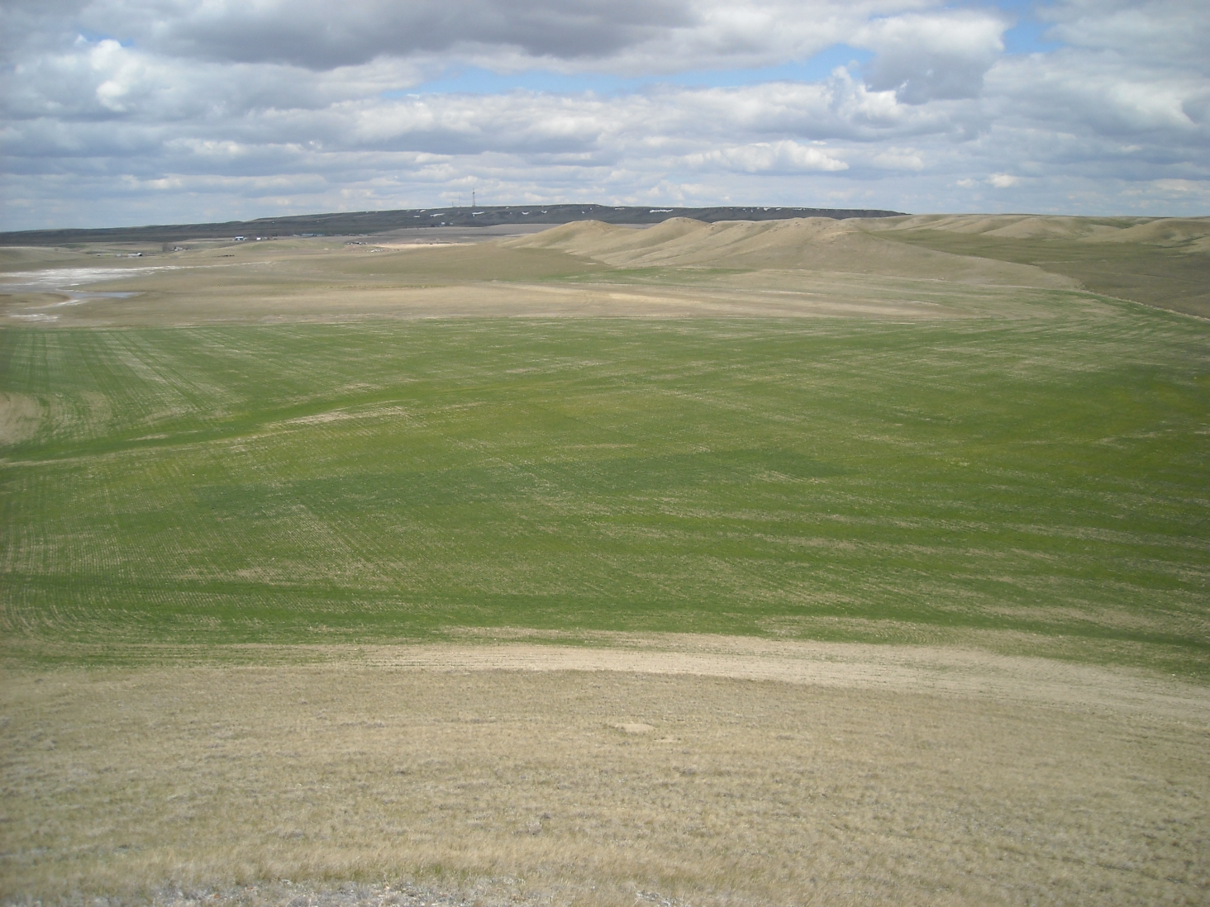


Improvements in Sensor Based N Recommendations
John Solie, Marvin Stone, Brian Arnall,
Ivan Ortiz-Monasterio, Bill Raun

Slide 2
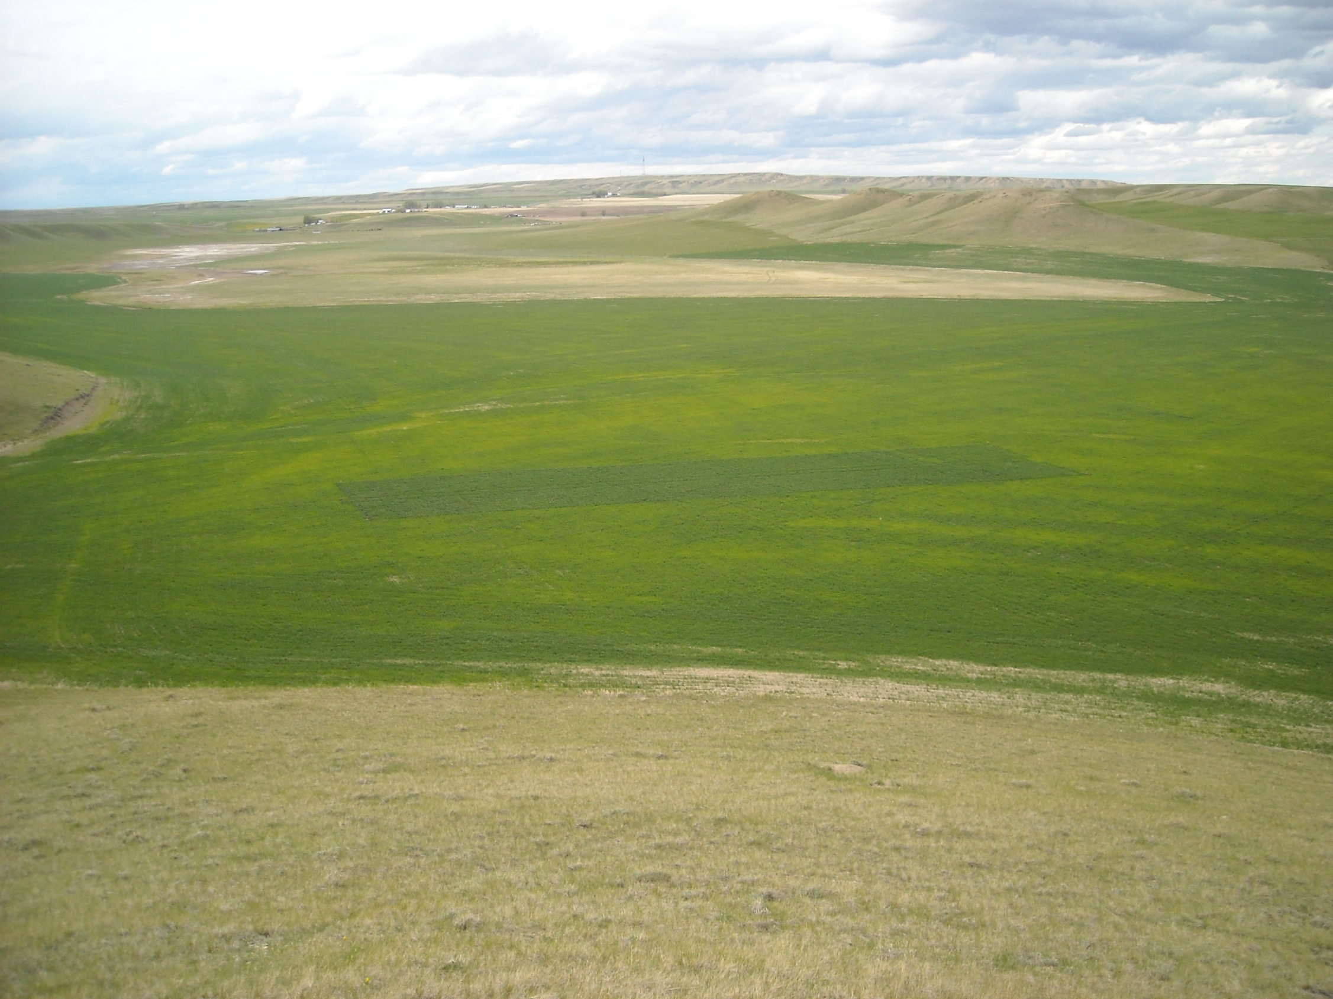
Rob Lightner
Conrad, Montana

Slide 3
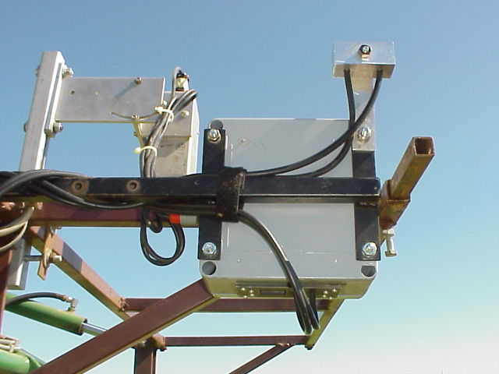
Passive Sensor Accounting for Incident Light
1994

Slide 4
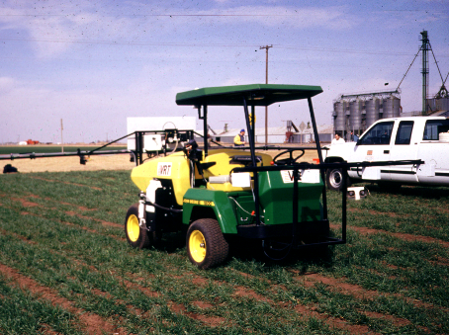
1996
Variable rate
spray nozzle
Sensor assembly
Sensed area
(treated area)

Slide 5
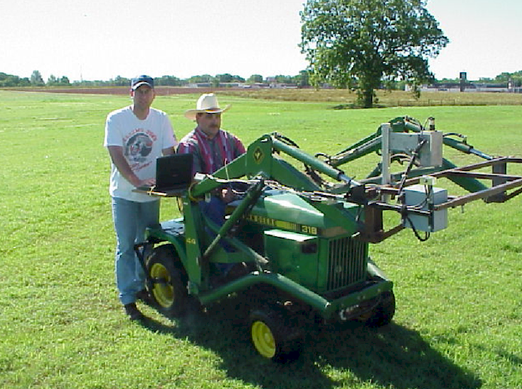
1997
Notes:
Here is the optical sensor we used. It’s mounted on a John Deere tractor. It measures both solar irradiance and plant surface reflectance.

Slide 6
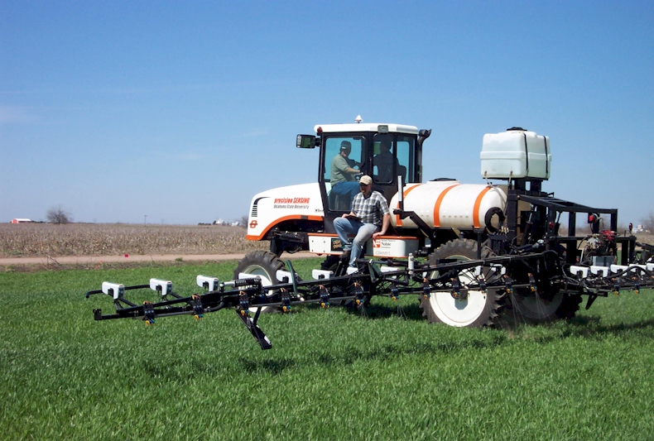

Active sensing/fertilizing
2001
precision SENSING

Slide 7
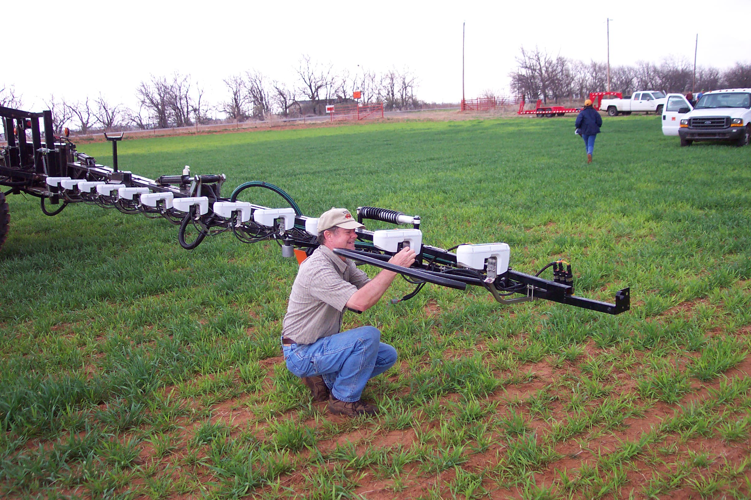

Slide 8
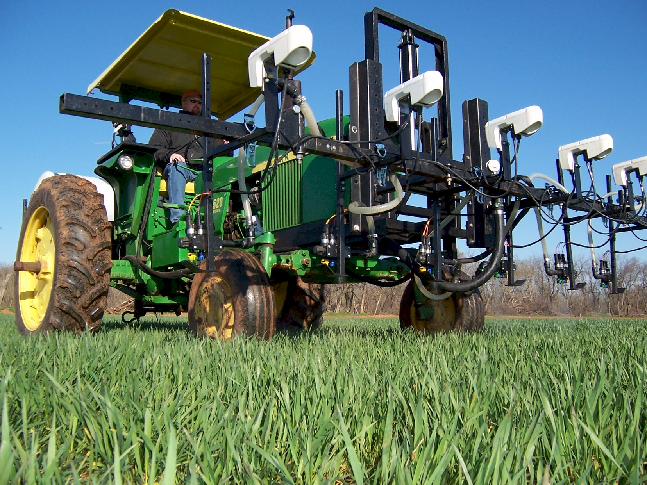
2003
Data Logging/Mapping

Slide 9
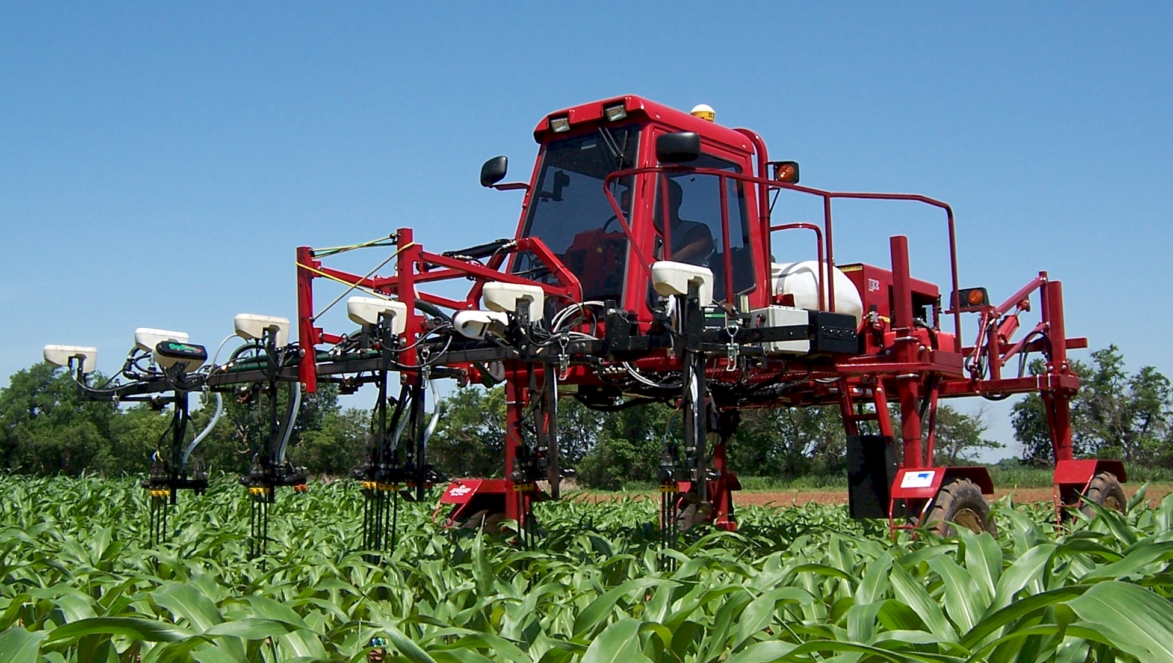
Sense and Fertilize by-plant
2006

Slide 10
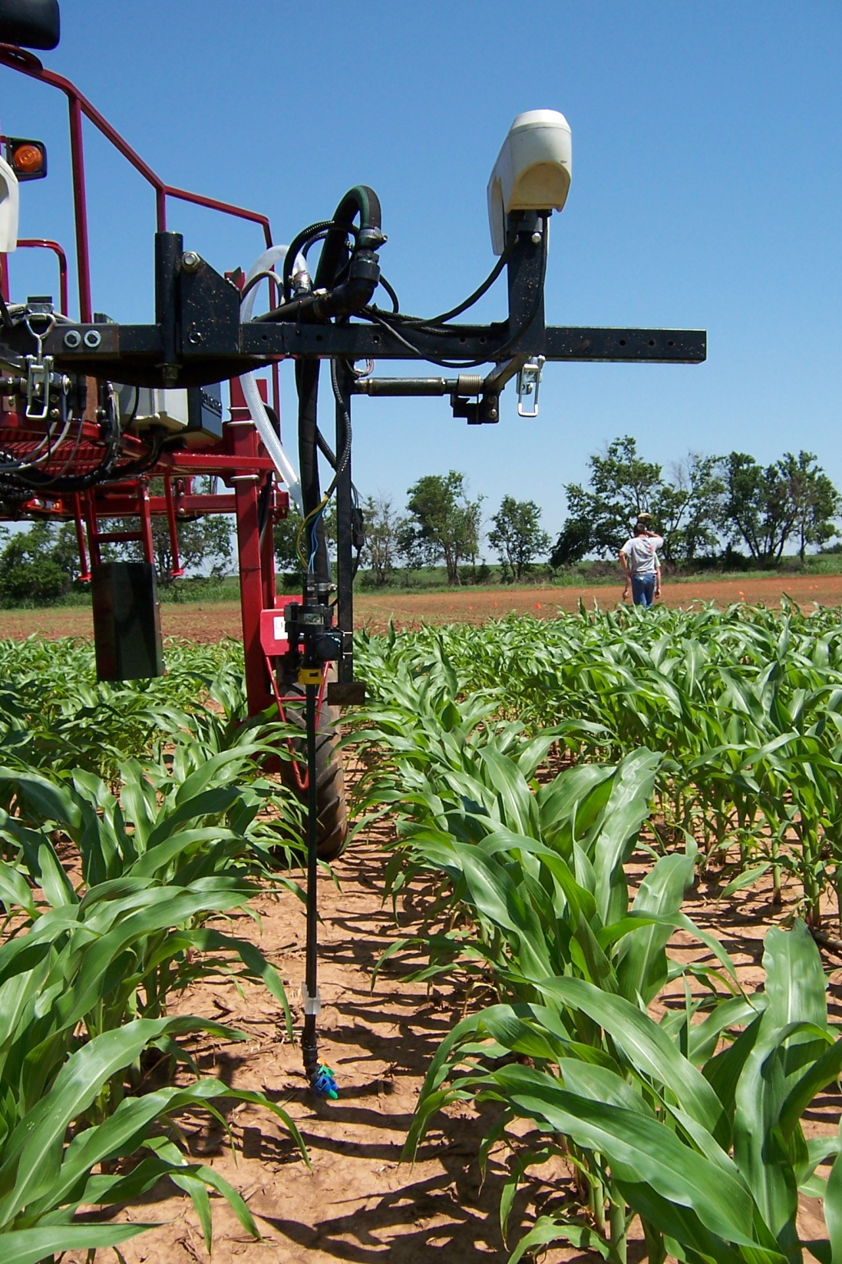

Slide 11
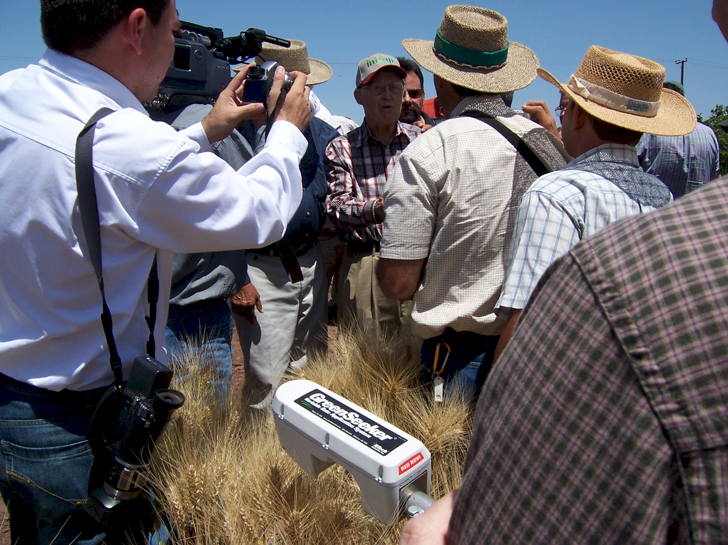
GreenSeeker sensing technology endorsed by Dr. Norman E. Borlaug, April 2007

Slide 12
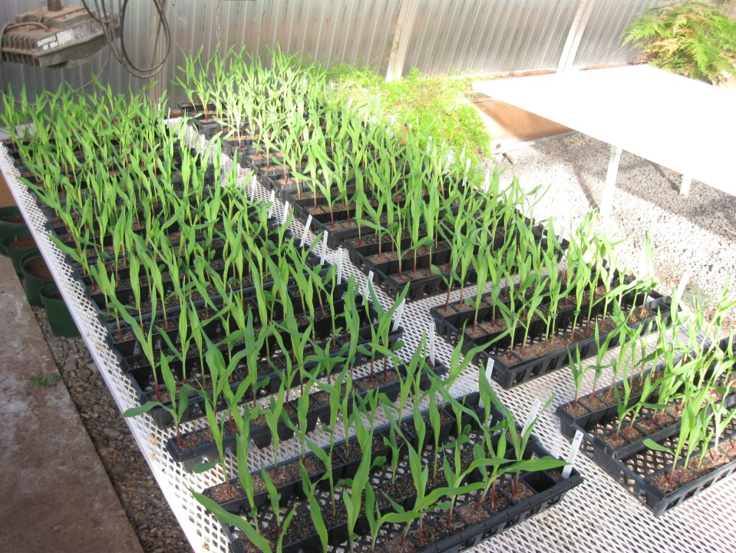
Seed Orientation
Sensor Restriction

Slide 13
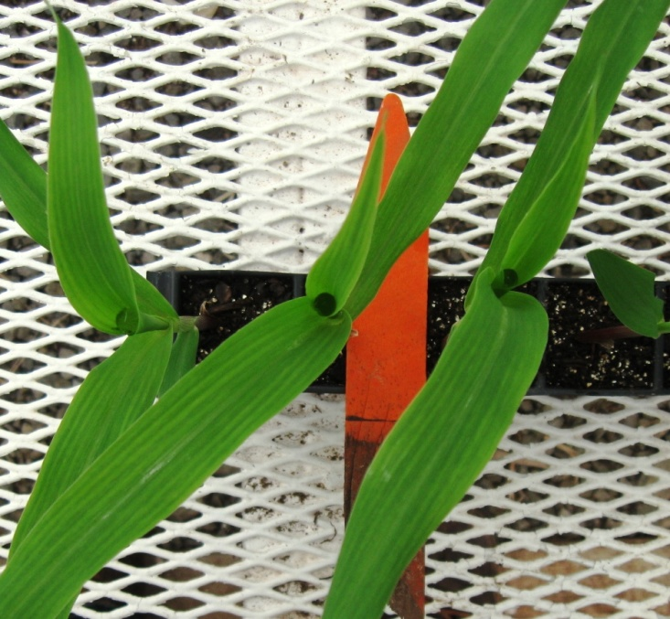
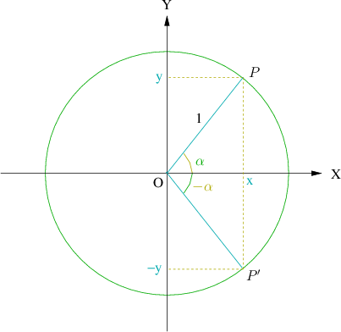
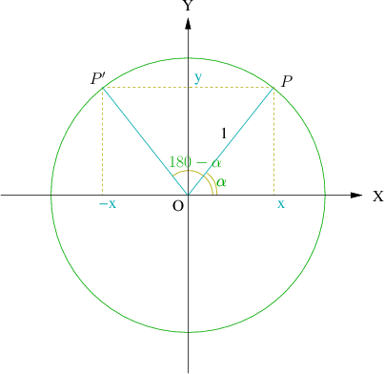
Leaf angle
Between 0° and 90°
Deviation from the corn row

Slide 14
Experiment #1 (E1)
Pioneer 33B54
6 treatments
3 leaf stage
Experiment #2 (E2)
Pioneer 33B54
13 treatments
4 leaf stage

Slide 15
With-row
Leaf orientation
Across-row
Leaf orientation

Slide 16
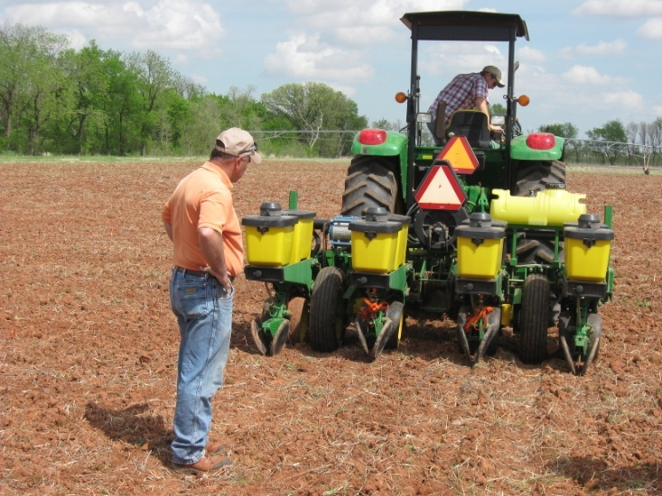
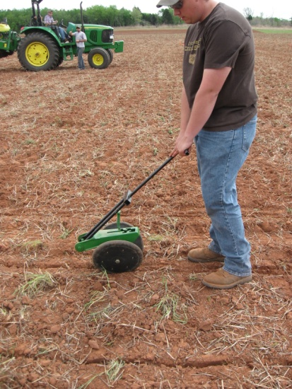
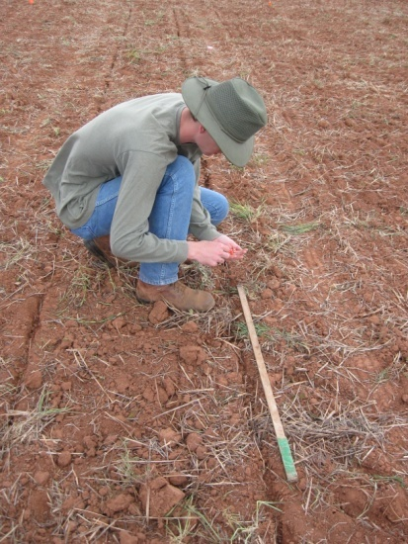

Slide 17
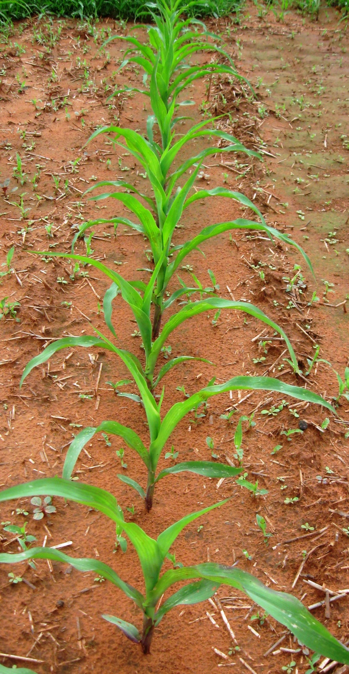
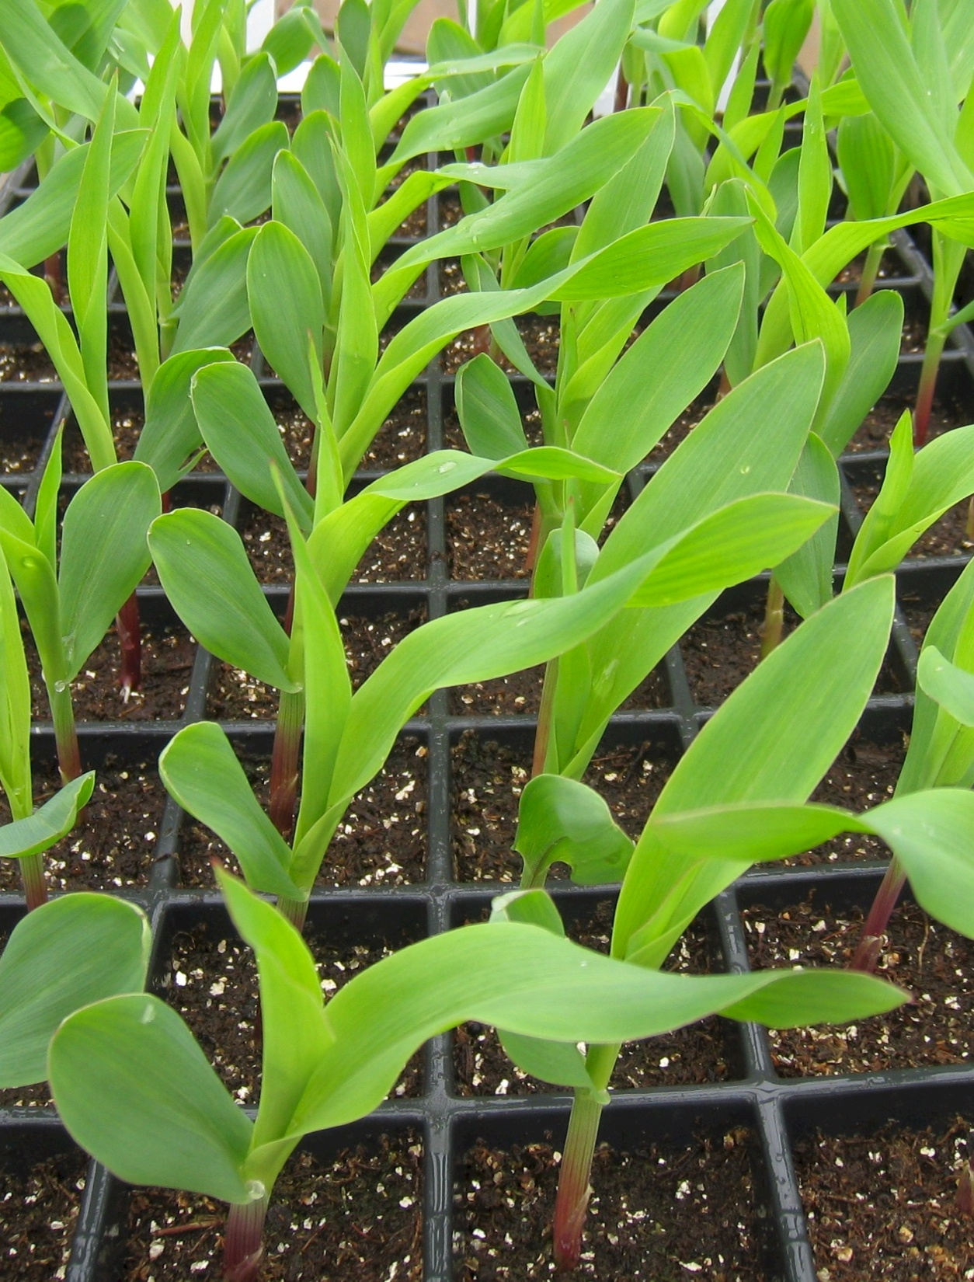

Slide 18
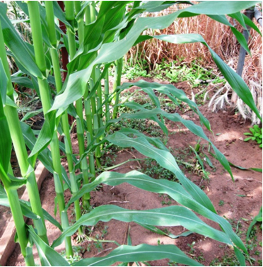
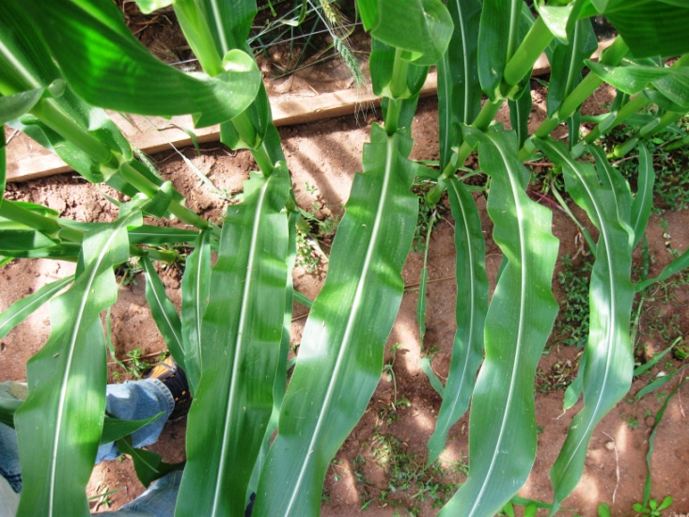

Slide 19
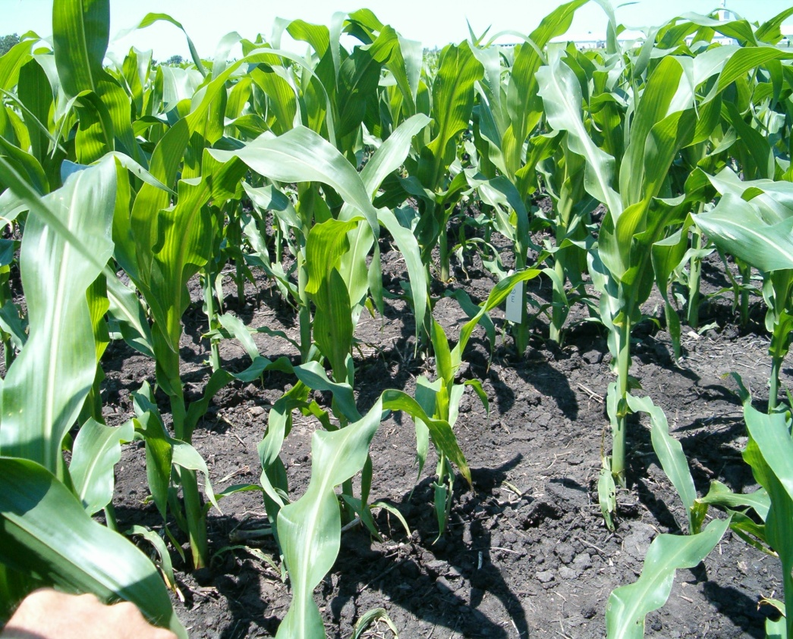
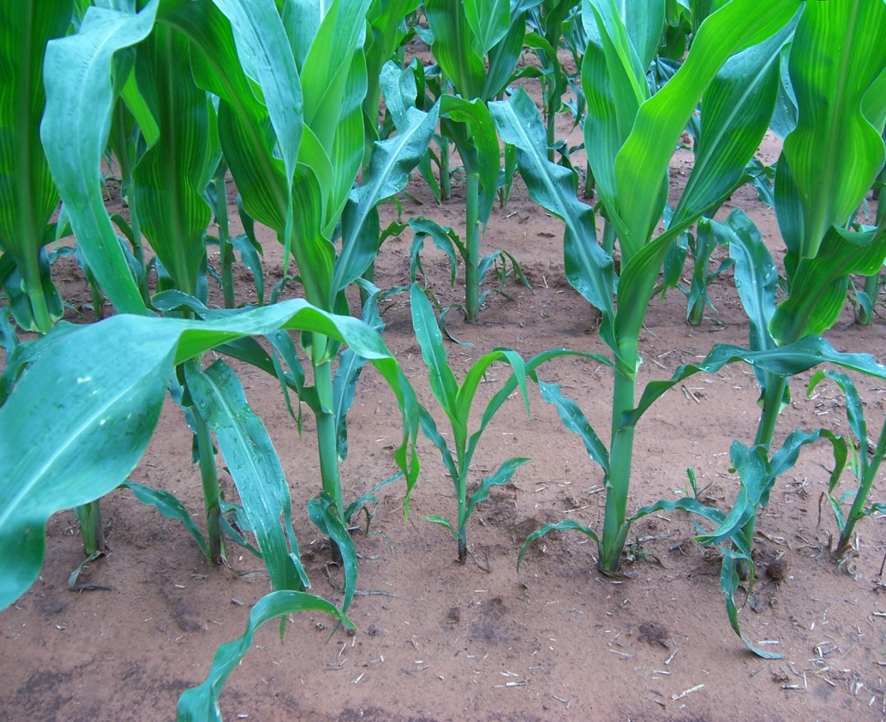
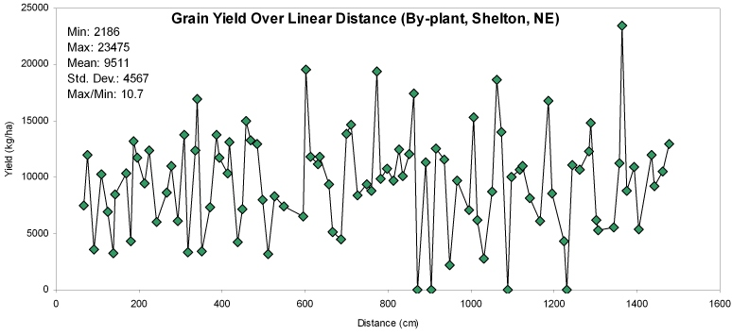
By-Plant N Management
IOWA
OKLAHOMA

Slide 20
Spatial Variability in Winter Wheat, Yields Every 3 Feet
Kevin Waldschmidt

Slide 21
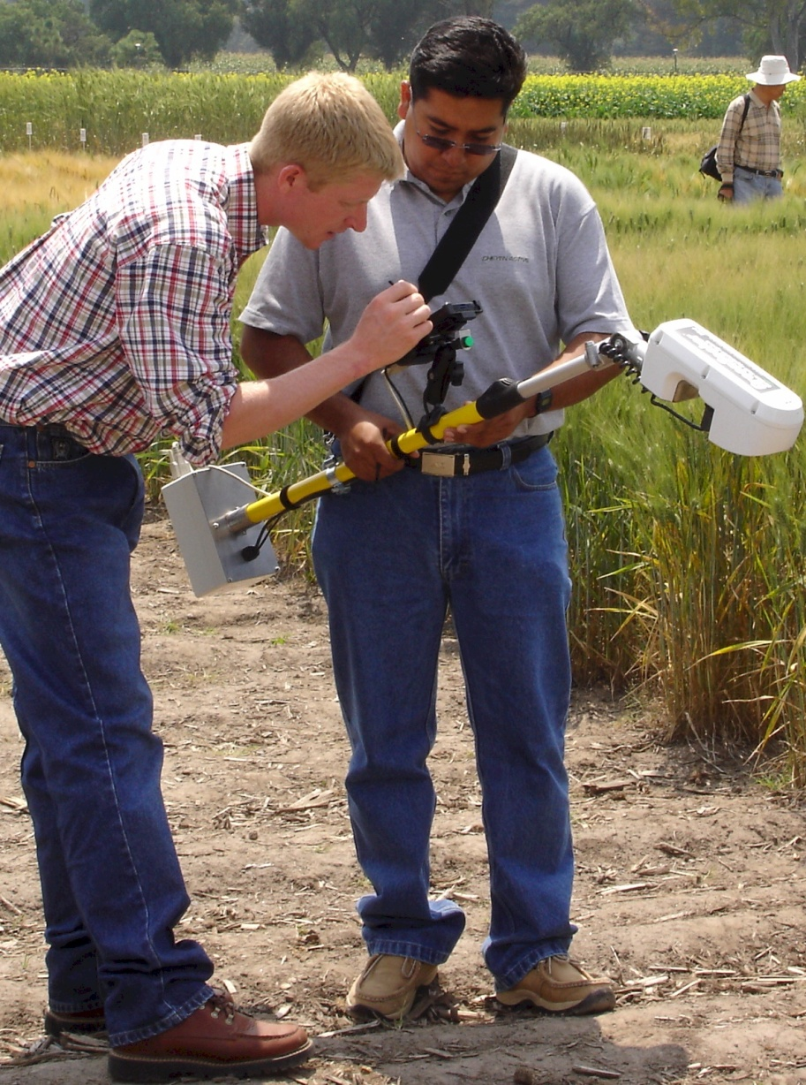
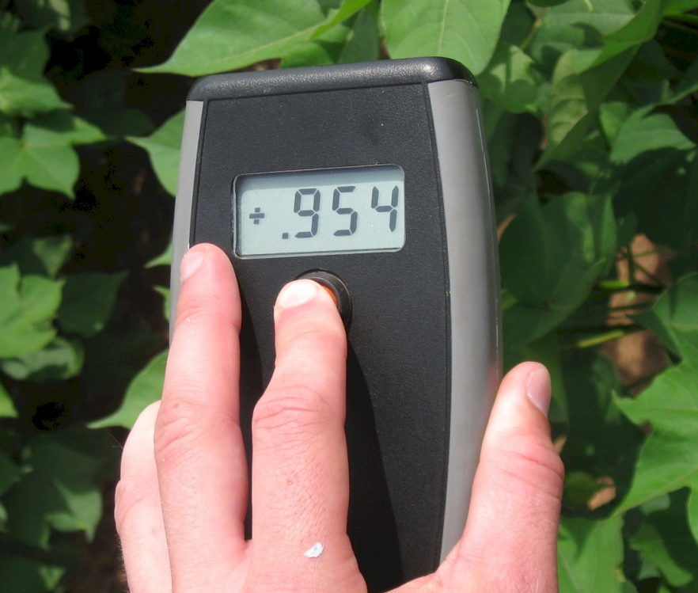
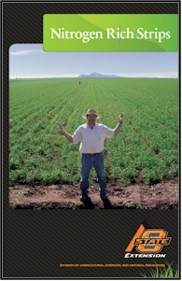
Pocket Sensor
  3rd world
  Common Farmer Tool
Pocket Sensor
Notes:
Economists: Profit is directly proportional to risk

Slide 22
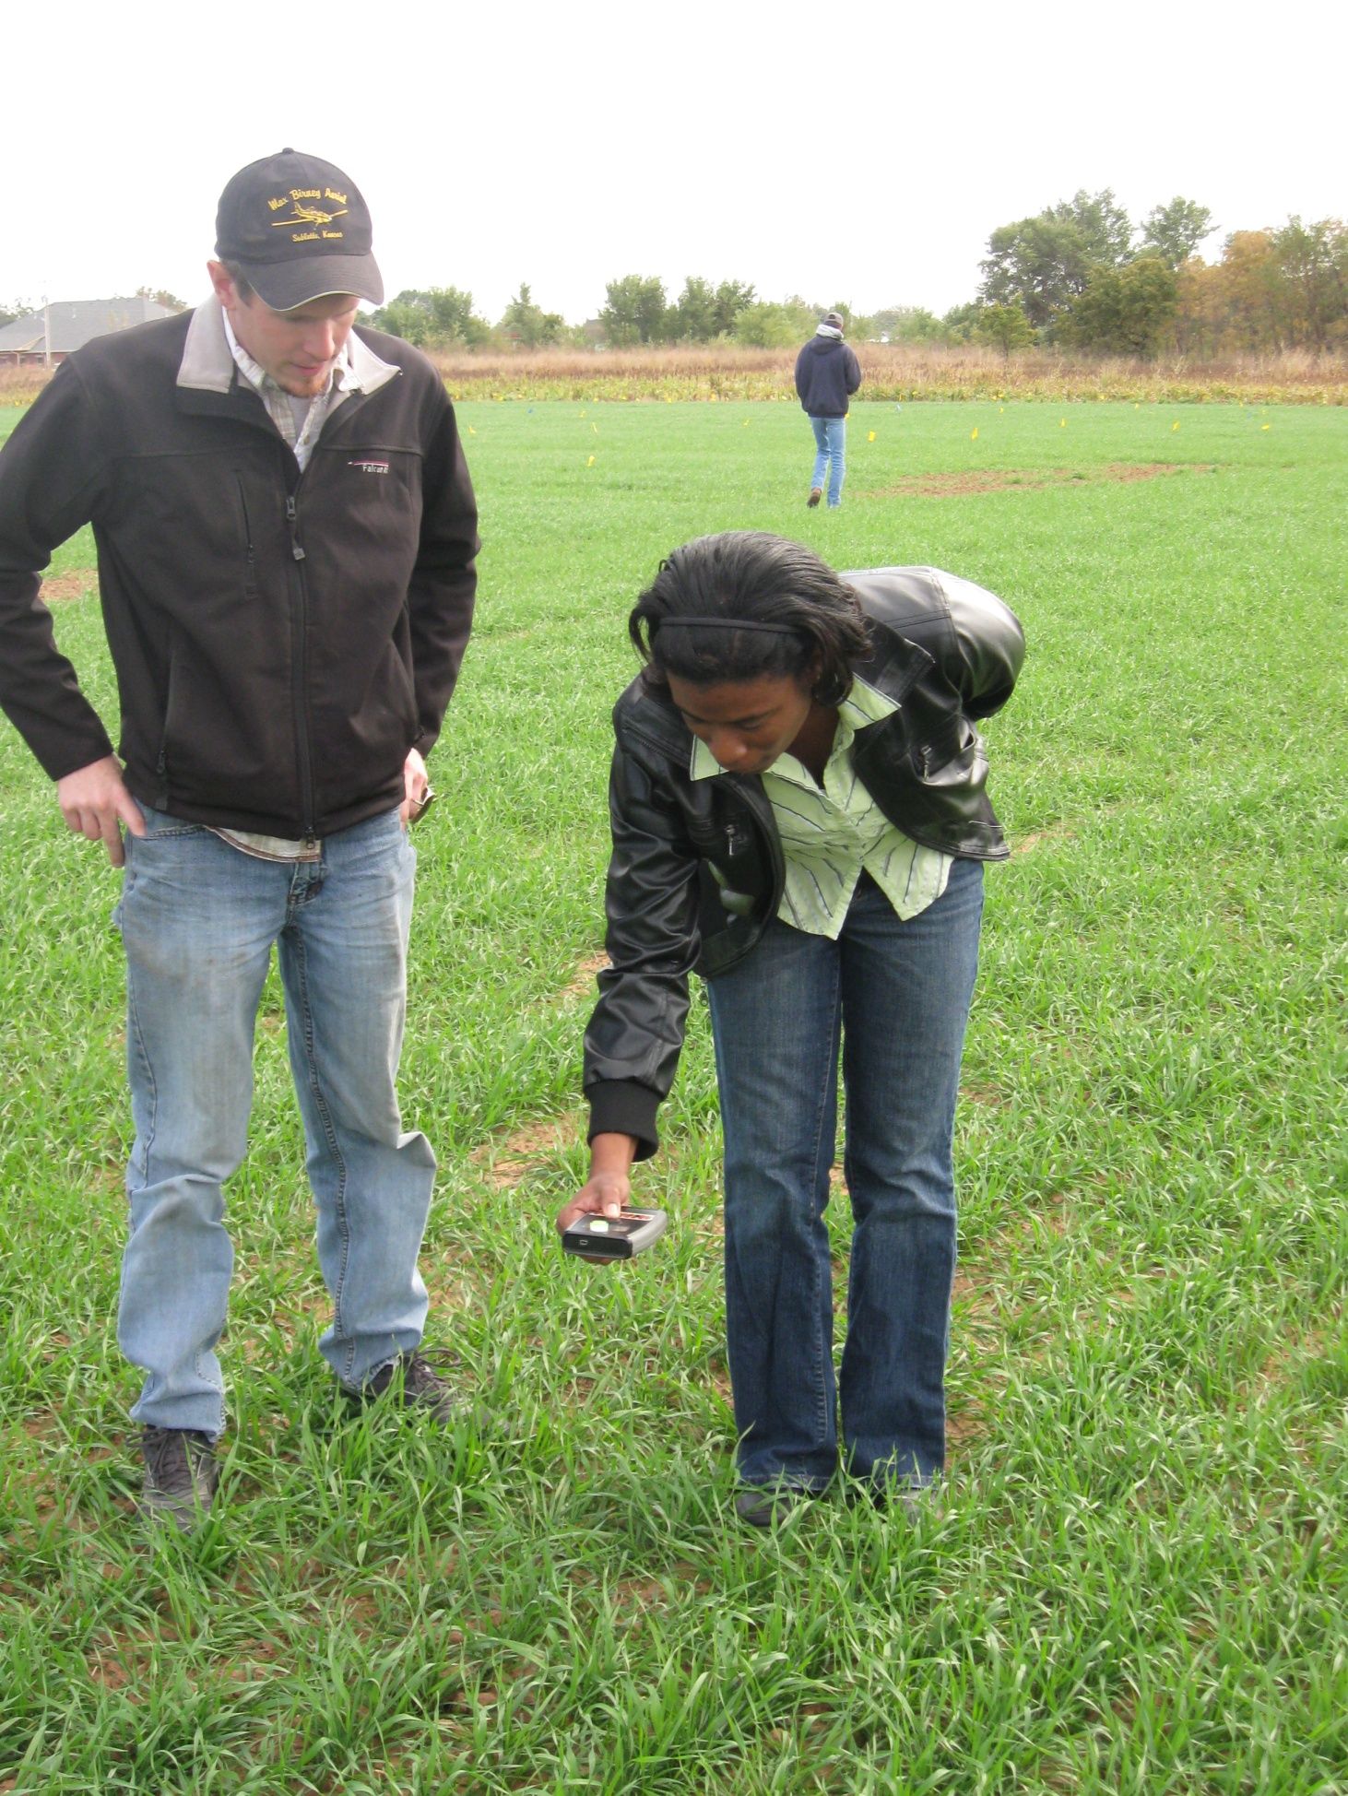
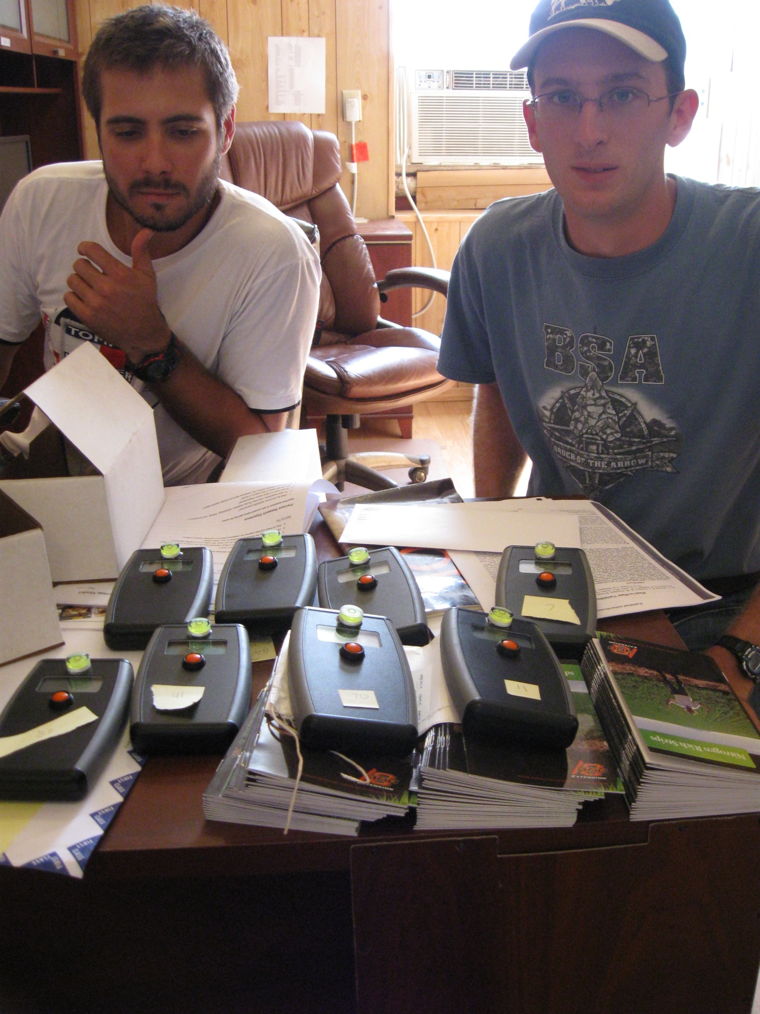

Slide 23
GreenSeeker 2010
2010, >500,000 acres, GreenSeeker sensors
>110,000 acres Europe

Slide 24
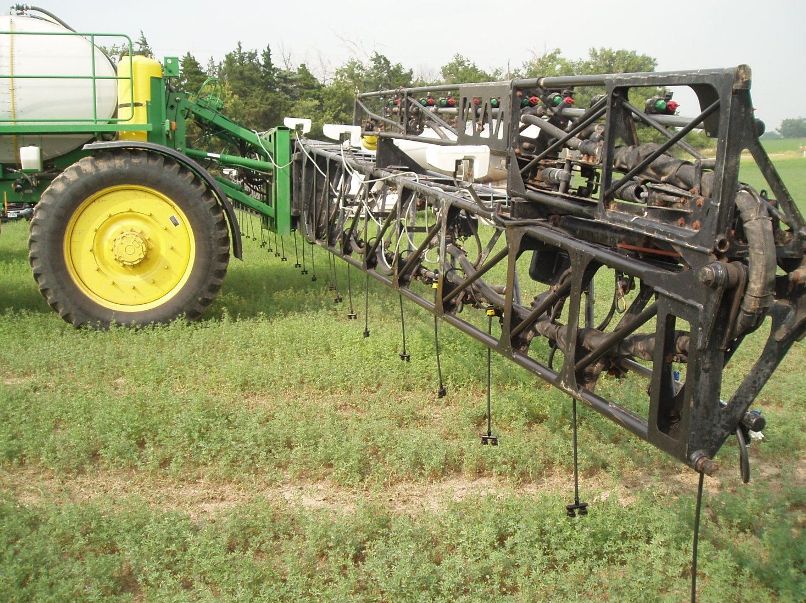
Minden, Nebraska

Slide 25
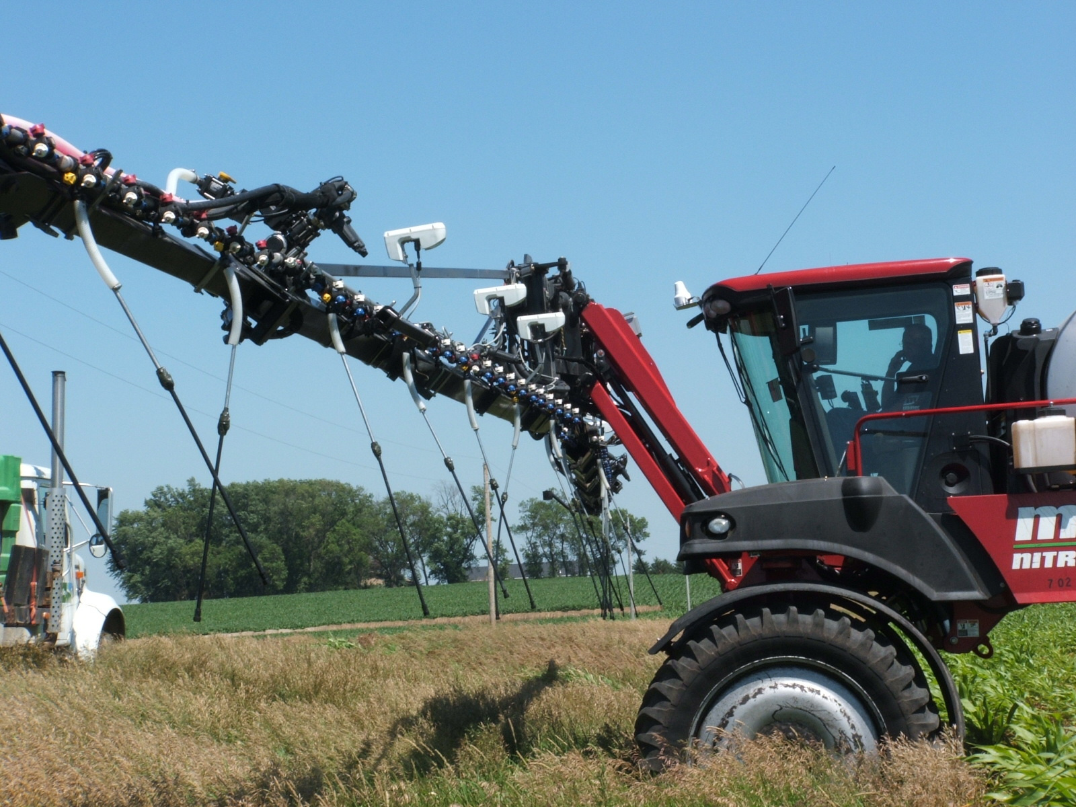
Custom designed drop tube assemblies. Made to penetrate through the canopy to get fertilizer to the ground pre-tassle. Used in 22" to 30" row spacing

Slide 26
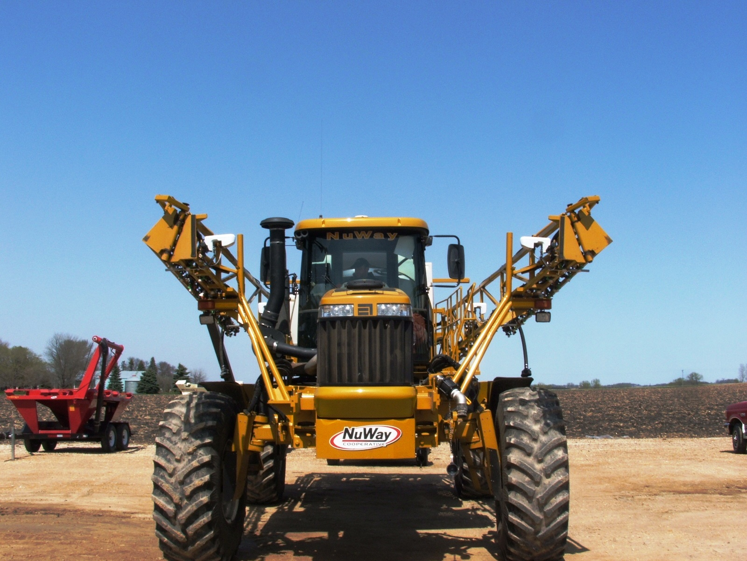

Slide 27
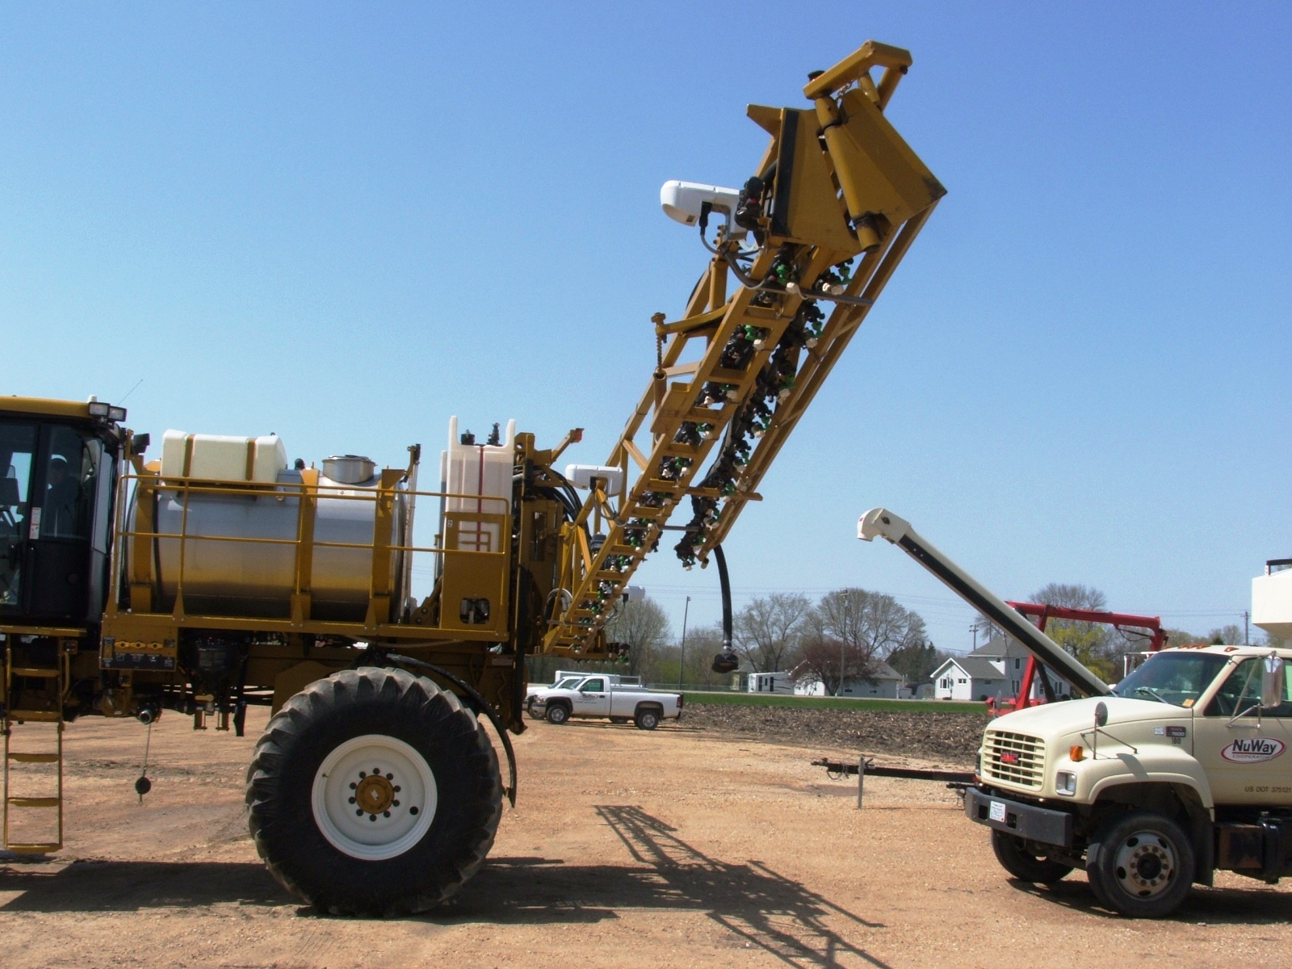
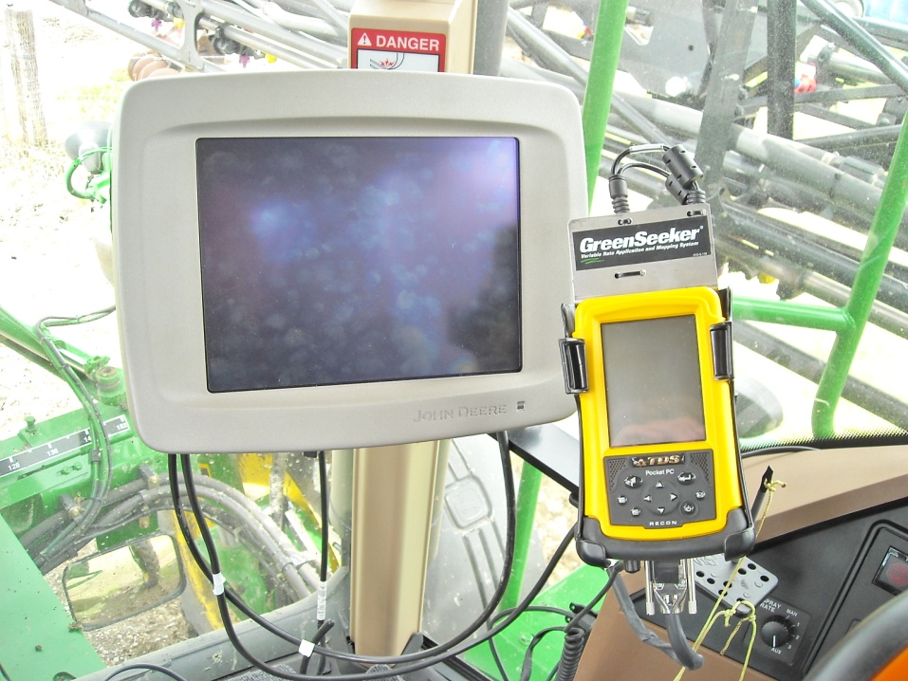

Slide 28
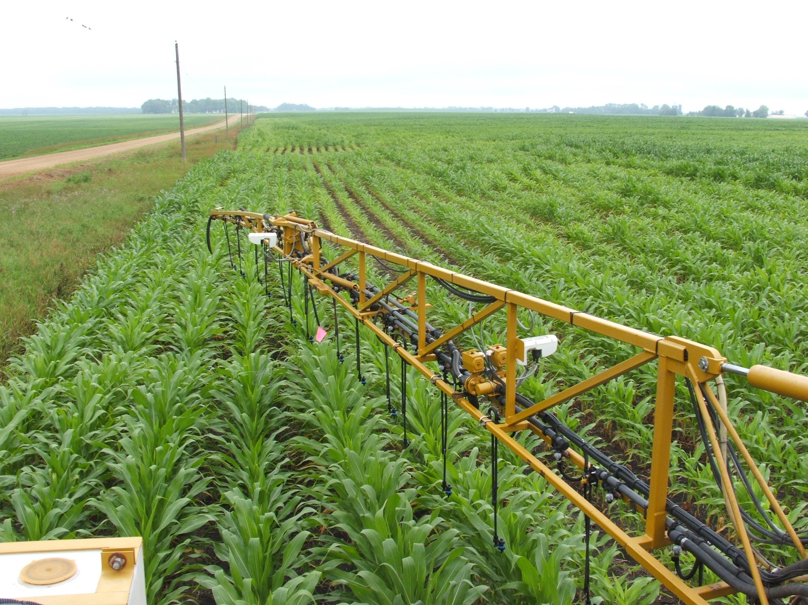

Slide 29
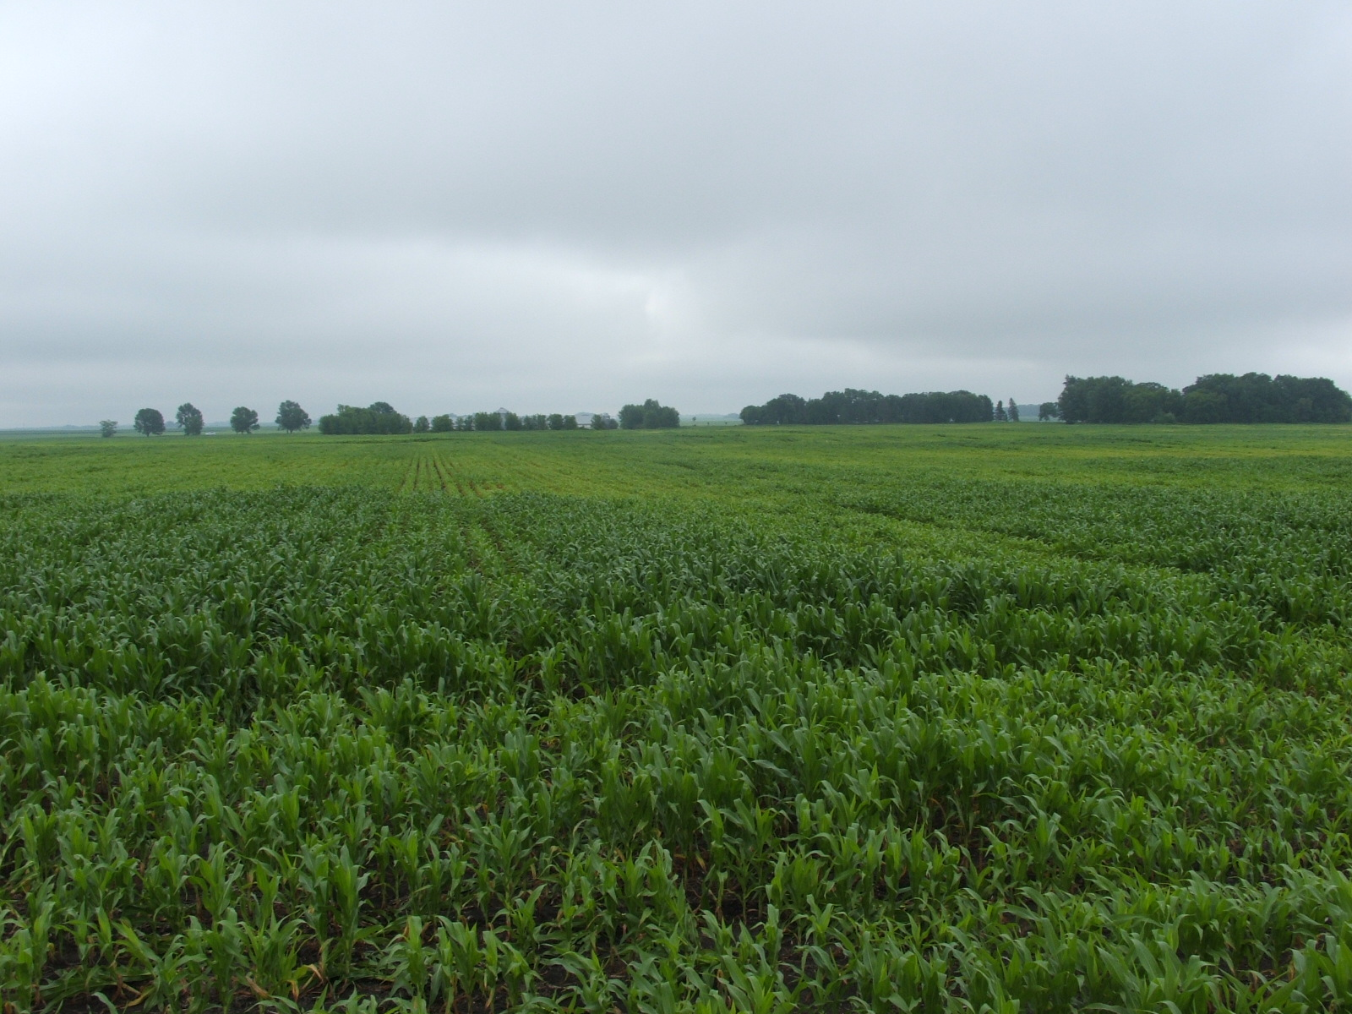

Slide 30
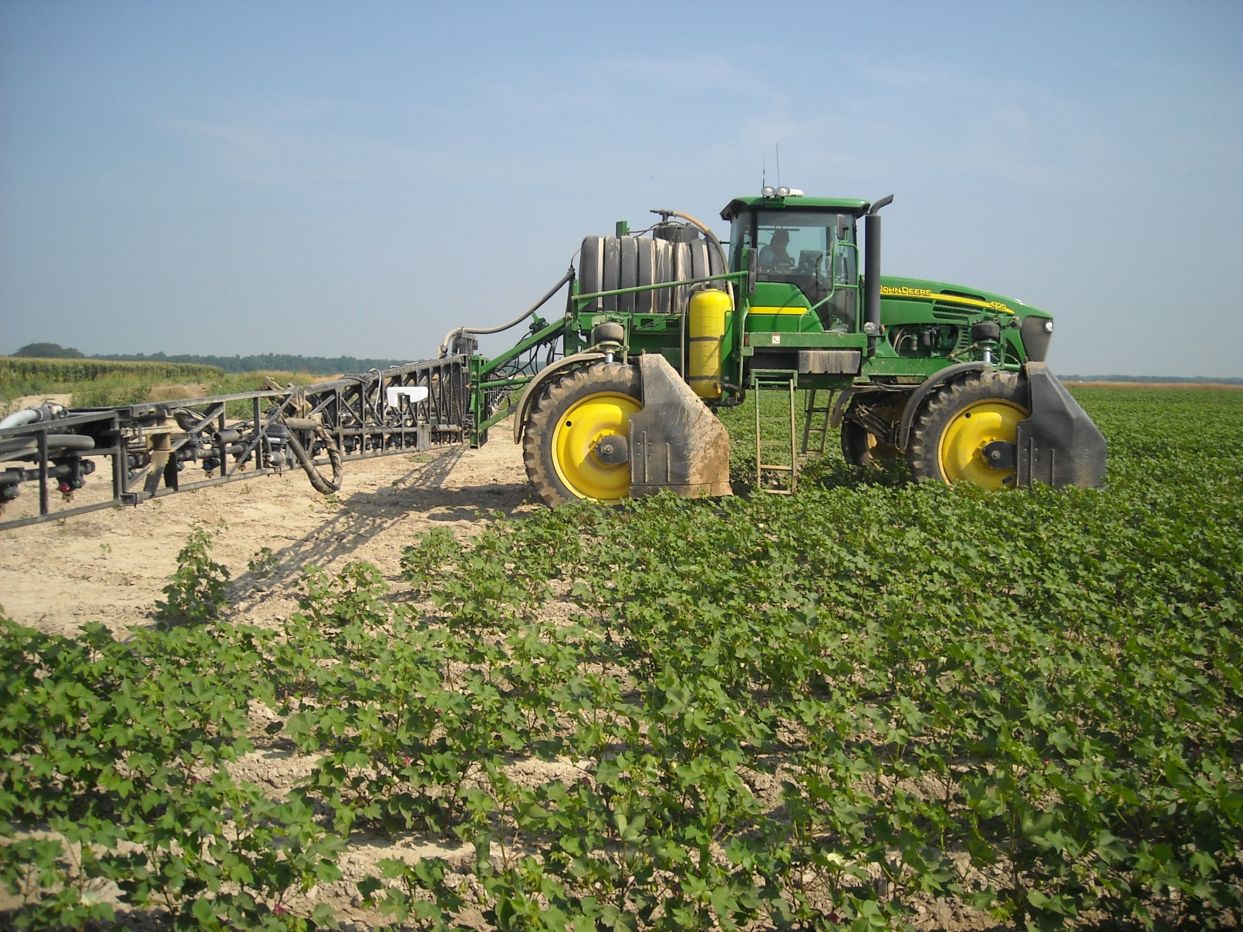
West Helena, Arkansas (1st pass PGR)

Slide 31
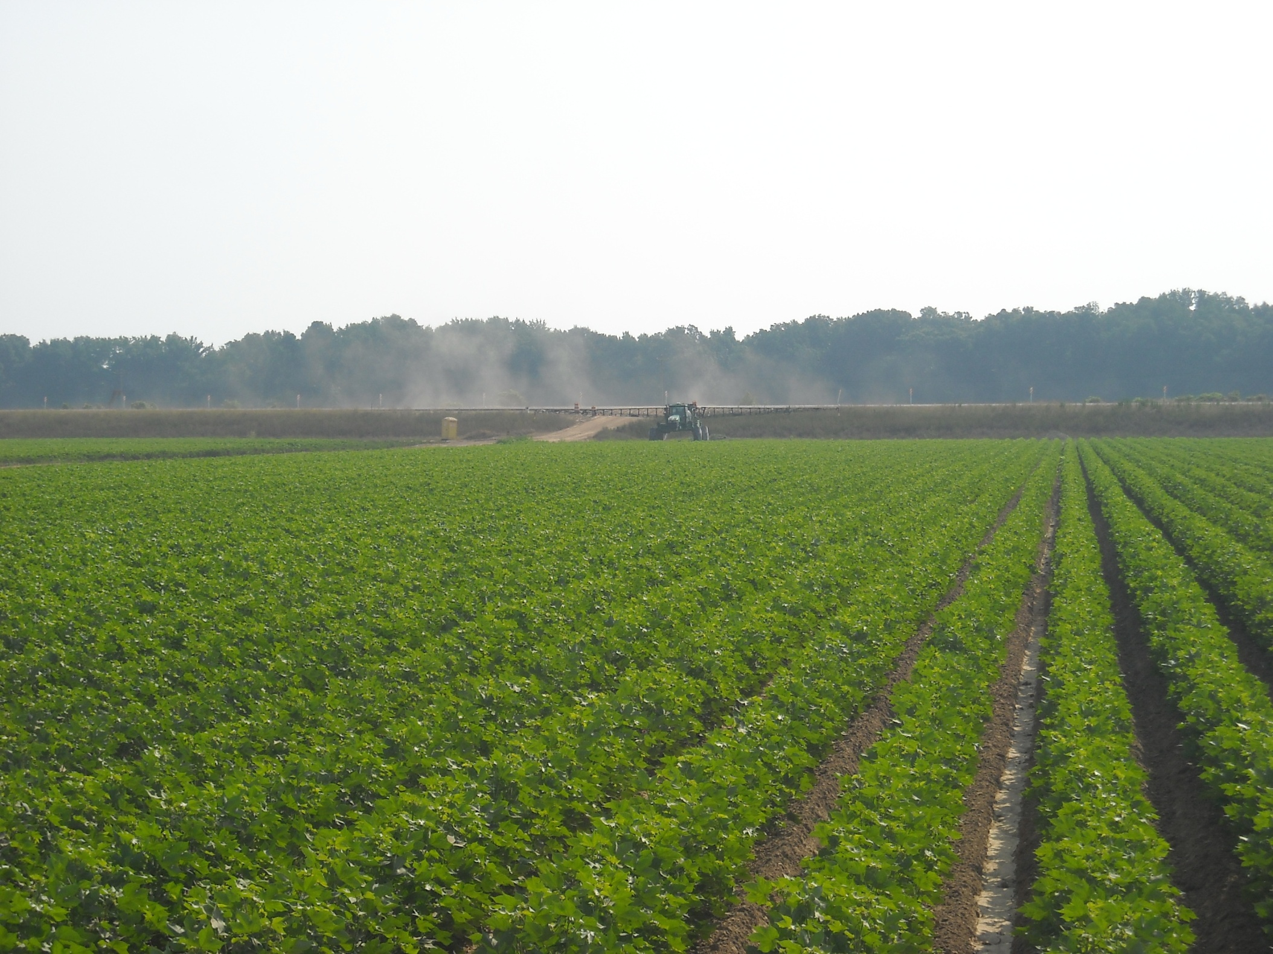

Slide 32
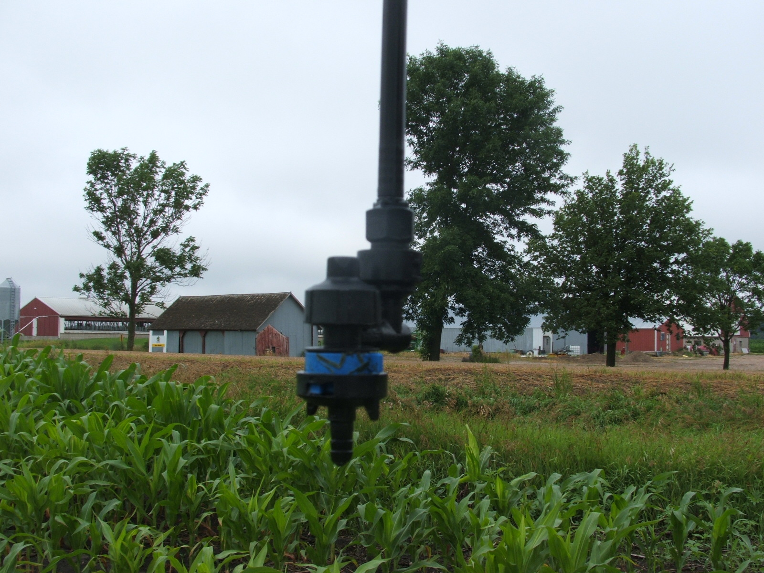
VARI-TARGET
variable rate nozzle bodies,
most widely used metering orifice
used with GreenSeeker

Slide 33
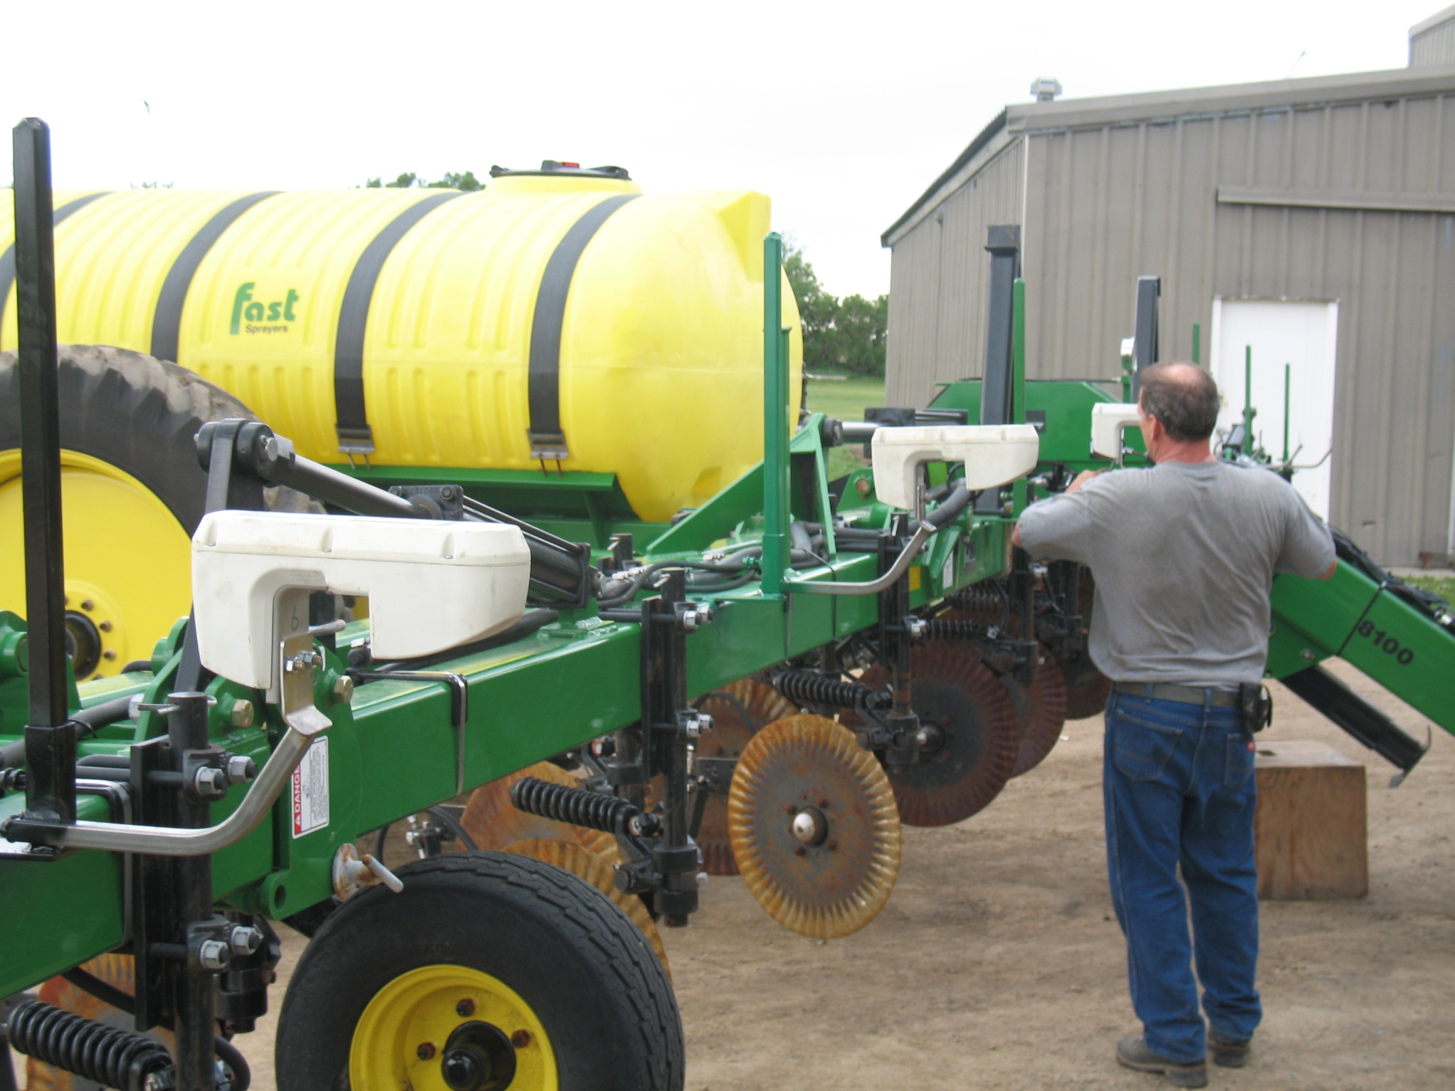

Slide 34
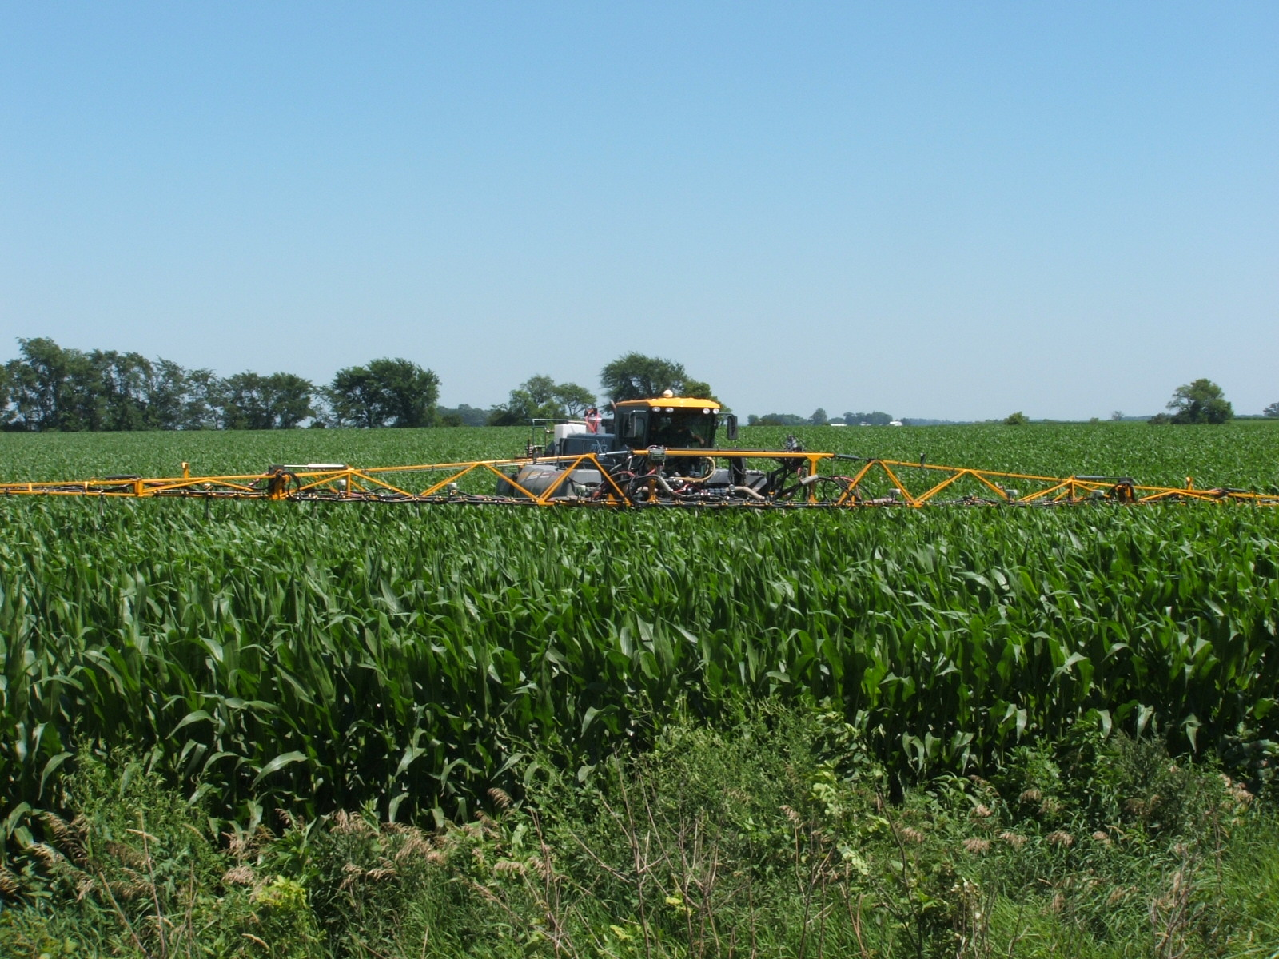
One of 5 high clearnace sprayers equipped with GS RT200
Crystal Valley Cooperative

Slide 35
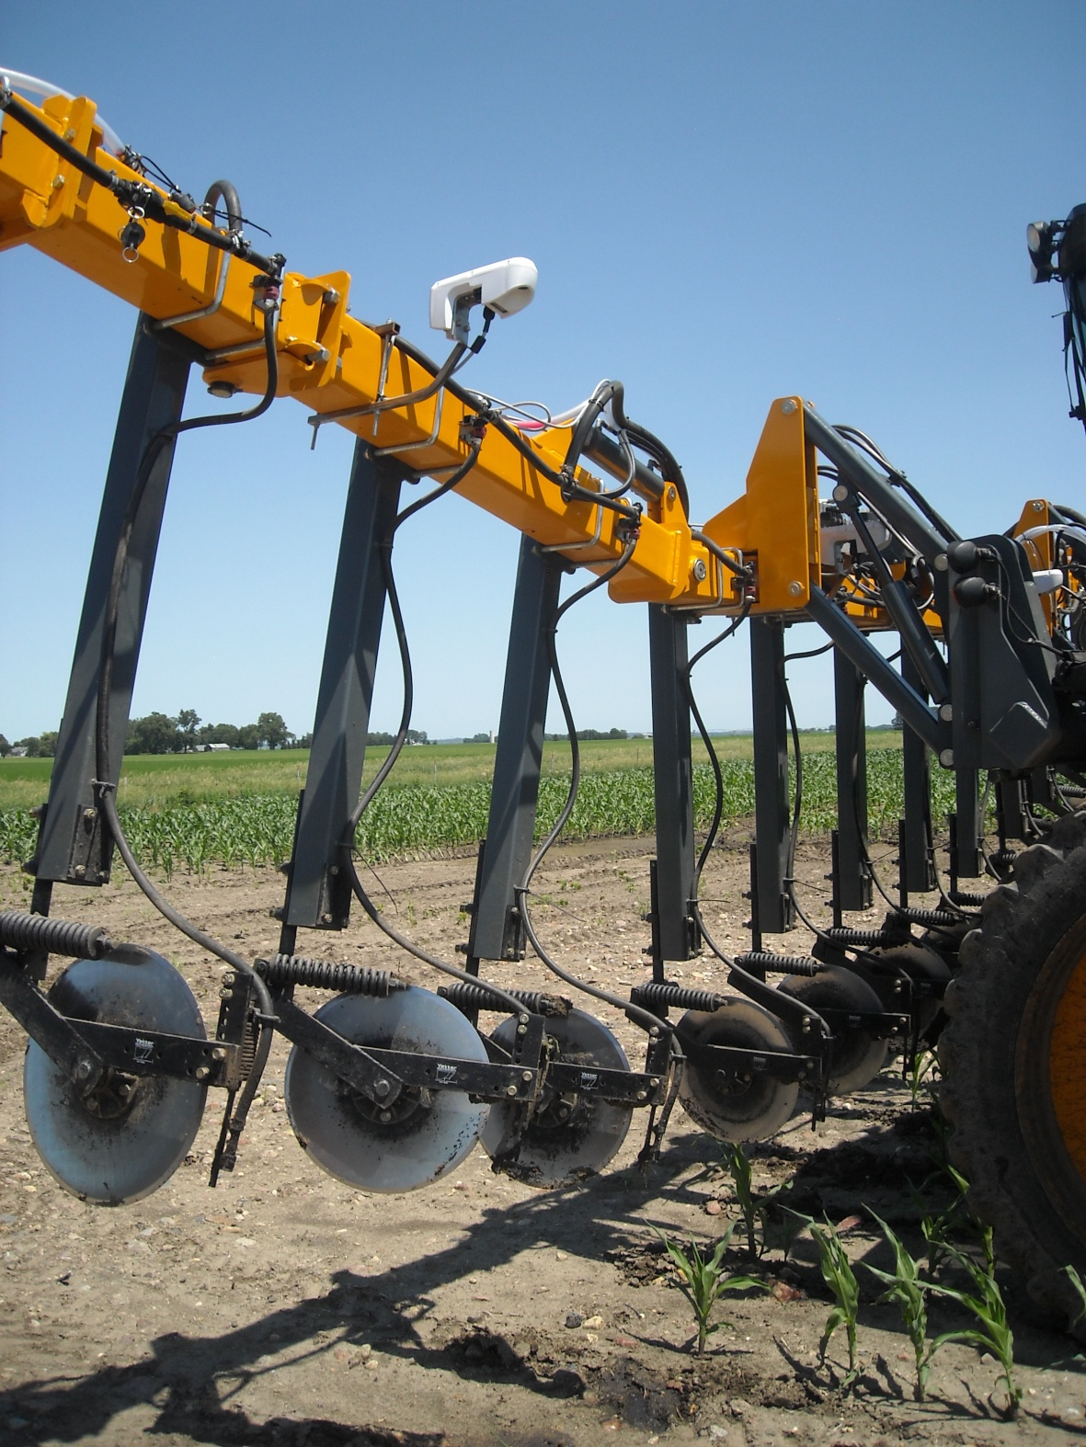
Gayville, South Dakota

Slide 36
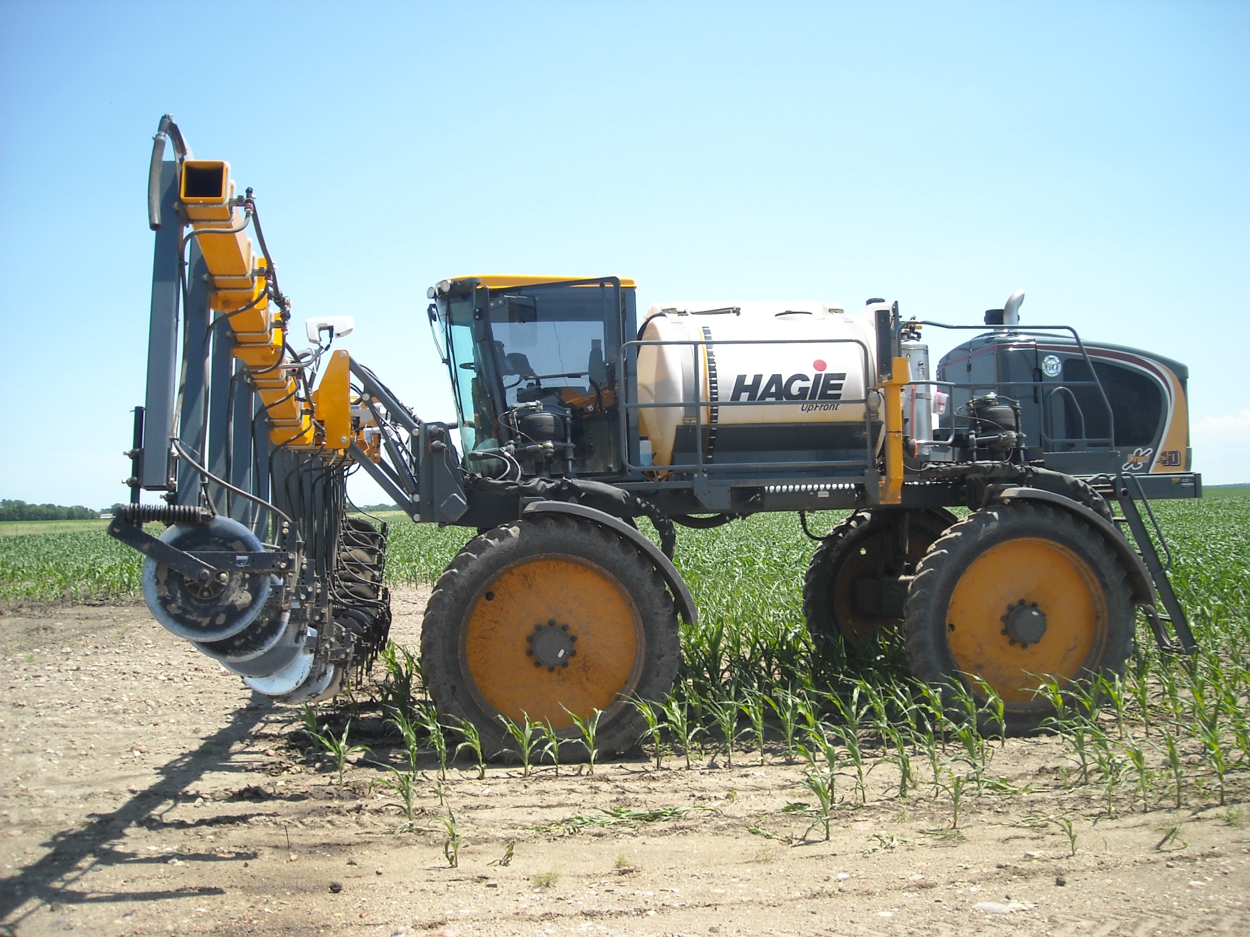
Valley Ag Supply, Gayville, SD GreenSeeker RT 200 4 sensor system on HAGIE 16/30" front mount bar. Purchased mid June for rescue operation in water logged corn acres. Traditionally this area is anti-side dress. Final acre count was in excess of 4,500 acres of GS sidedress. Harvesting right now, will have data post harvest.

Slide 37
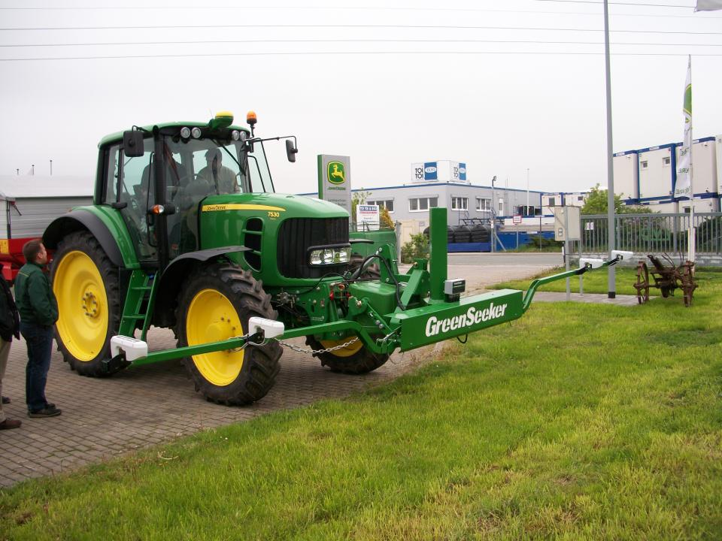
Frankfurt, Germany

Slide 38
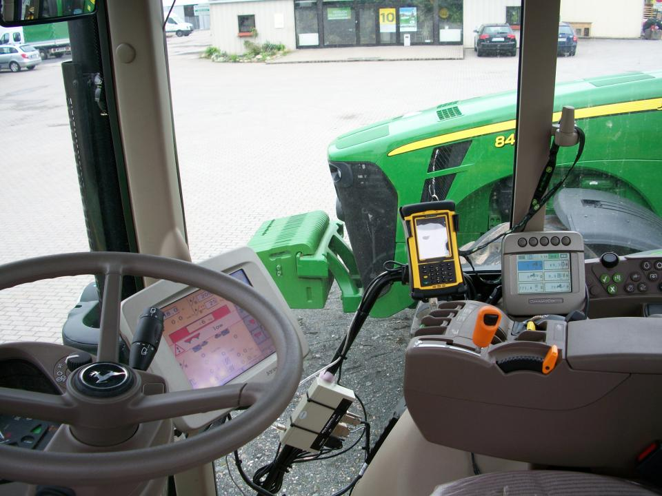
Intimidation of Precision Agriculture

Slide 39

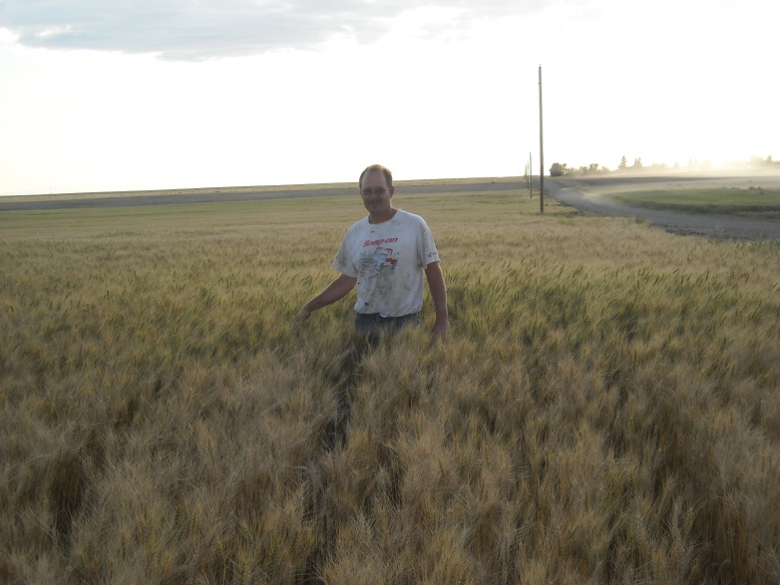

Slide 40
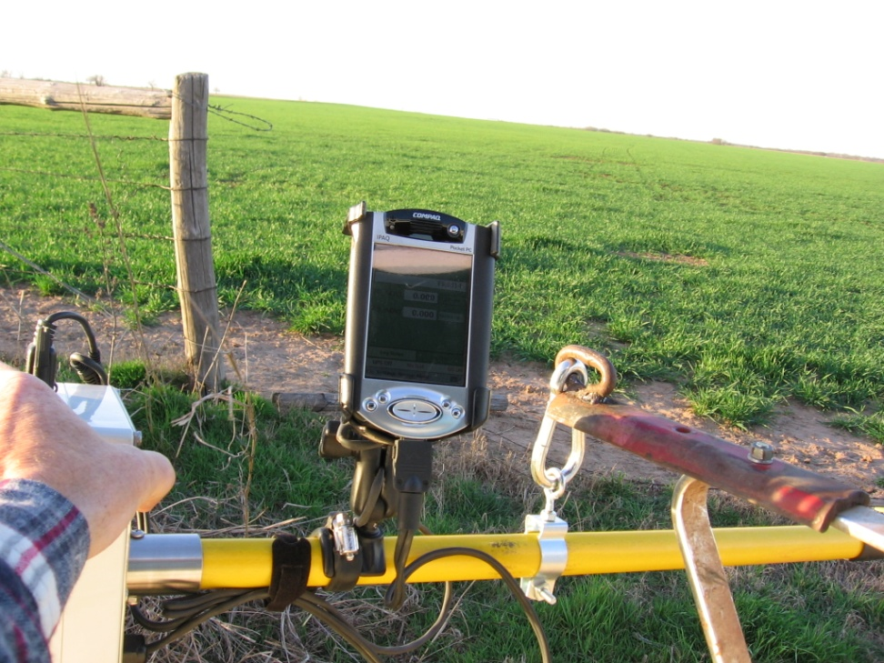
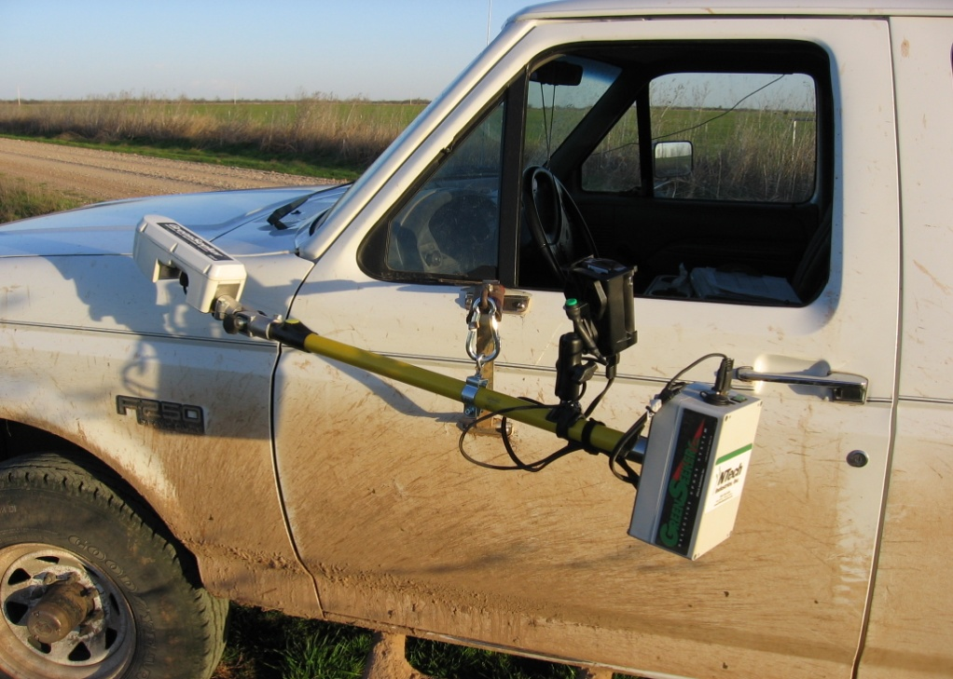
Green Seeker
5 years
Jimmy Wayne Kinder, Walters, OK
50 fields
Notes:
I am trying to use the Green Seeker to trim nitrogen cost

Slide 41
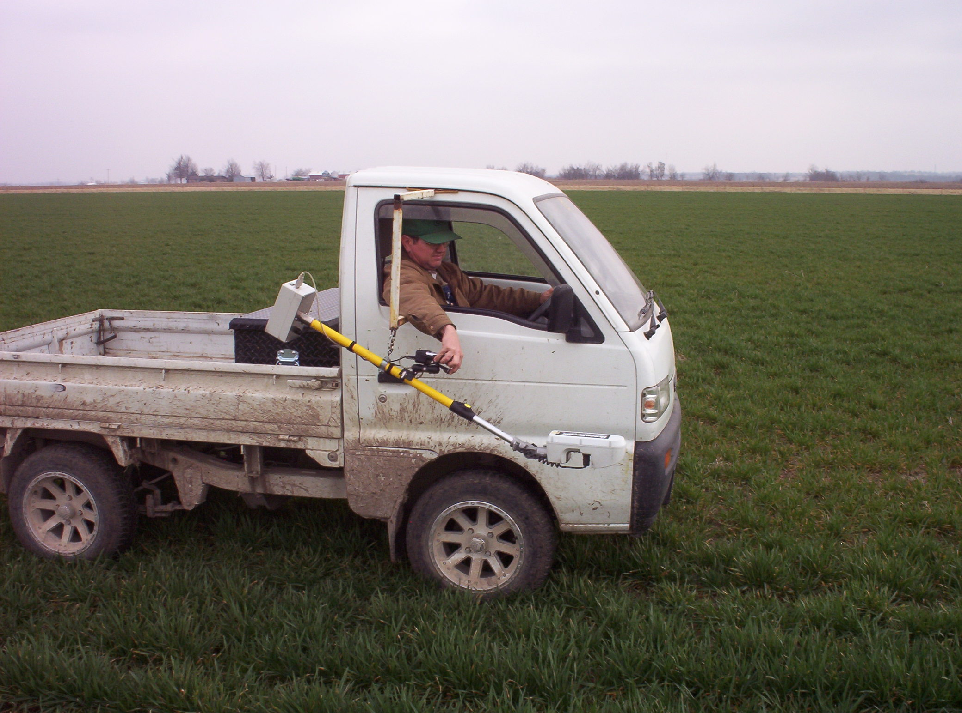
Ramp Sensing Upgrade
BrentRendel, Miami, OK

Slide 42

Paul Raymer
The FARM OFFICE, Ontario, Canada

Slide 43





Ciudad Obregon, Mexico
Modipuram, India

Slide 44





Slide 45


Ramp Applicators

Slide 46

Visual Confirmation

Slide 47
Late Season TOPDRESS Fertilizer N? N RICH STRIP

Slide 48

extension
SBNRC
Mexico
India
China
Kenya
Zimbabwe Argentina
Australia
Canada
Ethiopia
nue.okstate.edu

Slide 49

SBNRC
On Line Since 2002

Slide 50


Slide 51

SBNRC 2010
GA Phone App

Slide 52



Corn Research

Slide 53
2010 Regional Trials
Opt.N SBNRC 0-N Opt. N
N Rate N Rate Yield Yield
lb/ac lb/ac bu/ac bu/ac
Lahoma 50 50 25 38
Lake Carl Blackwell 25 39 40 55
Hennessey 75 51 38 56

Slide 54
What we have learned
Yield potential can be predicted in corn, wheat, and rice (biomass produced per day)
Response to applied N is variable from year to year and can be predicted
Nutrient removal is tied to yield level
Yield potential and N responsiveness are independent
Value of N Rich Strips

