Slide 1
Optimizing Winter Wheat Grain Protein
December 15, 2010

Slide 2
http://www.youtube.com/watch?v=THNPmhBl-8I

Slide 3
Kansas City—November 30, 2010— The members of the Kansas City Board of Trade in a special election held on November 30 approved amendments to the KCBT’s Hard Red Winter wheat futures contract by a vote of 115 to 36. The Board of Directors approved the amendments at a meeting on November 4.
6. Effective with the September 2011 futures contract, deliverable grades of HRW shall contain a minimum 11% protein level. However, protein levels of less than 11%, but equal to or greater than 10.5% are deliverable at a ten cent (10¢) discount to contract price. Protein levels of less than 10.5% are not deliverable;
7. Holders of outstanding warehouse receipts following the expiration of the July 2011 contract month will have five (5) business days (August 24-30, 2011) to present such warehouse receipts to the issuing warehouse for upgrading to reflect a deliverable protein level. The issuing elevator must comply with such request and shall, in its sole discretion, make the determination as to the minimum protein level to designate on receipts presented for upgrading. The issuing elevator may charge the holder twelve cents (12¢) per bushel to upgrade receipts with a designation of 11% minimum protein, or two cents (2¢) per bushel to upgrade receipts with a designation of 10.5% minimum protein. Warehouse receipts not upgraded shall not be deliverable against futures contracts from September 2011 forward;
The aforementioned changes will become effective with the September 2011 wheat futures contract month, subject to CFTC approval.

Slide 4
Dale Owens: Johnston Grain
Registered Delivery Warehouses
  Shuttle trains 110 cars, $0.30/bu cheaper vs boxcar
  Lower protein (SE Kansas, SW Missouri), areas where yields are expected to be higher
  10,000 bushel bin ($1.1 to 1.3/bu)

Slide 5
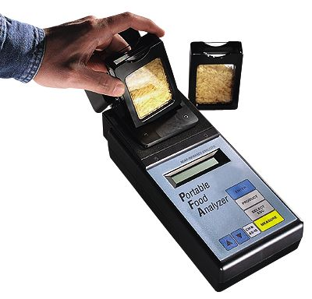
Cole-Parmer, NIR Analyzer $5950
50,000 bu,
Factory-set calibrations for HRS, HRW, SRW, protein and moisture in SWW, oats, corn, flax, milo, duram, canola, mustard, soybean, 2-row barley, 6-row barley, or long- and medium-grain rough rice. Oil calibration is included with corn, soybean, canola, mustard, and flax calibrations.

Slide 6
Review
Not much genetic variation in grain protein for winter wheat varieties grown in Oklahoma, Art Klatt, OSU
If you want to increase grain protein in winter wheat, apply ample amounts of N fertilizer, especially near flowering, Dave Worral, AGRIPRO
Limited G*E interactions for grain protein. Rankings among varieties won’t change a lot.
High protein: Karl, Tonkawa
Low protein: Custer, Endurance
High protein current: Centerfield, OK Bullet, TAM203, OK Rising, Jagger, Brett Carver, OSU

Slide 7
Literature
Oklahoma Winter Wheat:
UAN pre & post flowering, 30 lbs N/ac increased total grain N by 2.7 g/kg (1.54% protein) Woolfolk et al. 2002.
Over 2 years and 7 locations, Freeman et al. (2003) found no consistent relationship between NDVI and grain N or straw N at any stage of growth.

Slide 8
Literature
Montana Spring Wheat
N fertilizer rate + NO3-N, 0-3ft in the spring was positively correlated with grain protein
Producing spring wheat with 14% protein requires significantly more N than growing spring wheat for optimal yields.
On average, 3.3 lbs N/bu is required to grow spring wheat with 14% protein regardless of yield level.
Soil nitrate-N and, in some instances, organic matter (OM) are useful tools for making N fertilizer recommendations.

Slide 9
Colorado
Fields with grain protein less than 11.1 % have nitrogen deficiencies that limit yields and protein content. Apply more N
Fields with grain protein between 11.1 and 12.0 % may need additional nitrogen fertilizer.
Fields with grain protein >12.0 percent probably have adequate nitrogen for avg. grain production levels.
Goos, Westfall, Ludwick, 2008

Slide 10
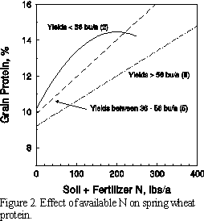
Grant Jackson, Montana State University

Slide 11
Idaho hard red spring wheat
>14% protein, 4-6 cent premium per 0.25% increase
<14% protein, 7-11 cent dockage per 0.25% decrease
48 lb N/ac applied topdress, increased protein 2% (from 12.43 to 14.43) note 14 benchmark
90 bu/ac, (2 quarter points*5cents*90)= $9/ac (premium)
if N applied
90 bu/ac, (6 quarter points*8cents*90)= $43/ac (dockage)
if no N applied

Slide 12
Oklahoma winter wheat, KCBT 2011
Aerial N application, $10-18/ac
10 gallons UAN/ac, $267/2000 lb, $0.48/lb N
28-0-0, 10.7lb/gal, 10 gal/ac = 30 lbs N/ac
= $14.4/ac N cost + ____ application cost
50 bu/ac, $0.10 discount = $5.00/ac (<11,>10.5)

Slide 13
1966-2010, OK long-term experiments
#222, #406, #407, #502, Magruder
Grain protein = -0.0521 (bu/ac) + 13.3 40 = 11.2 60 = 10.2
Grain protein = -0.0838 (year) + 180.7 1970 = 15.6 2010 = 12.2

Slide 15
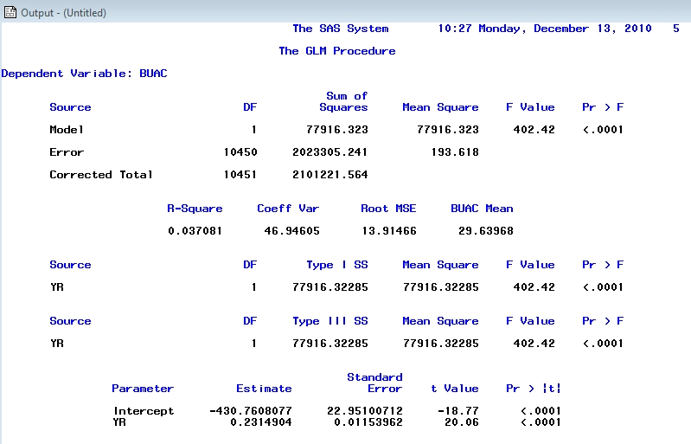
Yield vs. Year
n = 10452

Slide 16
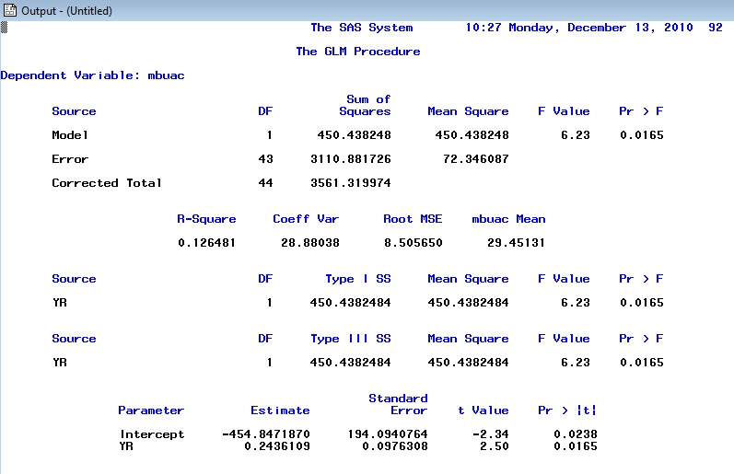
Avg. Yield vs Year
n = 45

Slide 17
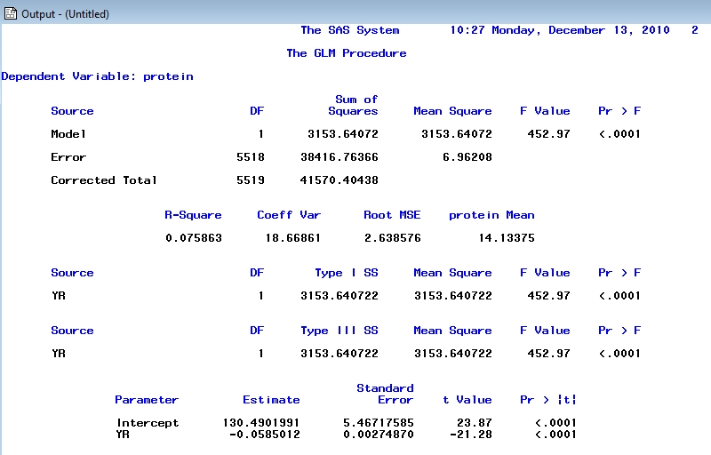
Protein vs Year
n = 5520

Slide 18
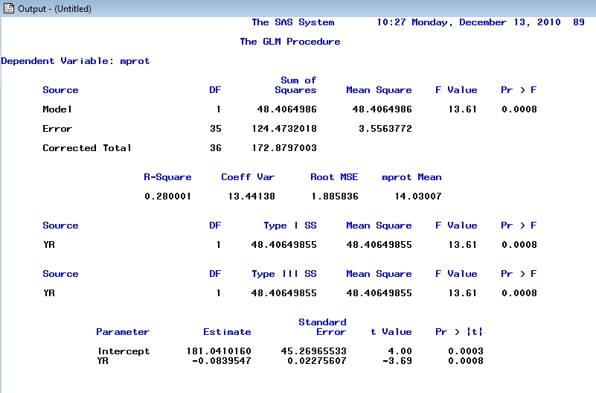
Avg. Protein vs. Year
n = 37

Slide 20
13.6 – 1SD = 9.07

Slide 21
2005-2008, Lahoma, Overley

Slide 28
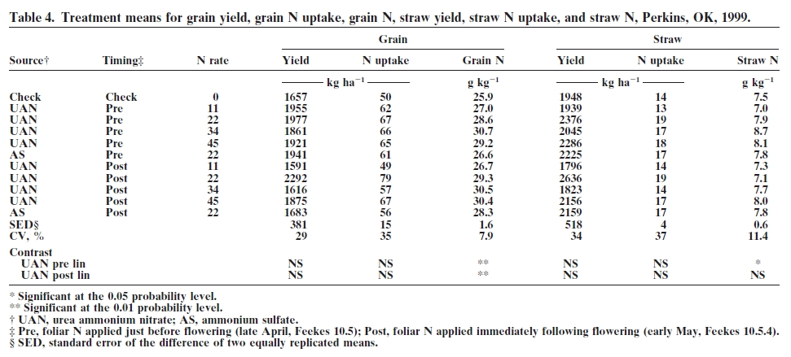
Woolfolk et al. (2002)

Slide 29
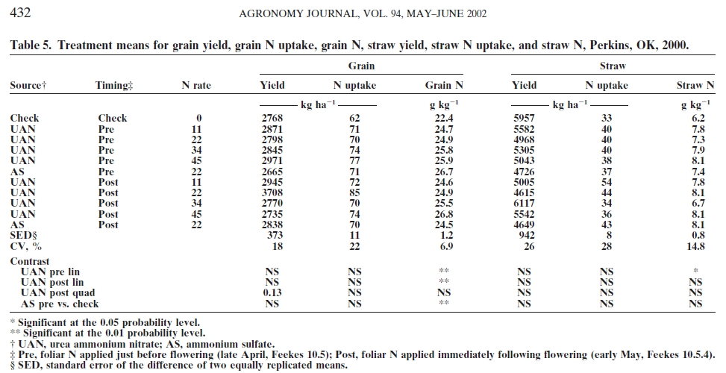
Woolfolk et al. (2002)

Slide 30
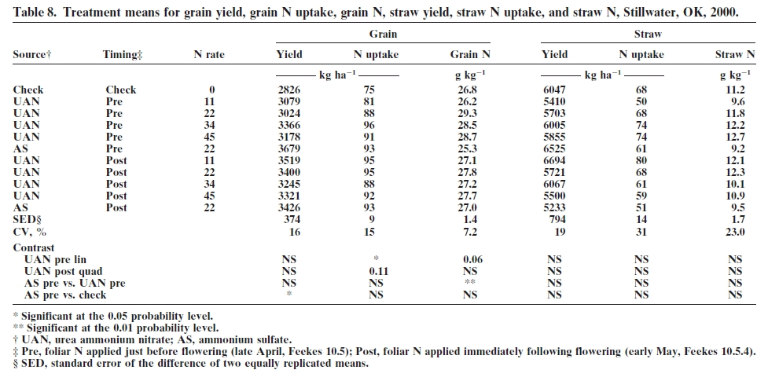
Woolfolk et al. (2002)

Slide 31
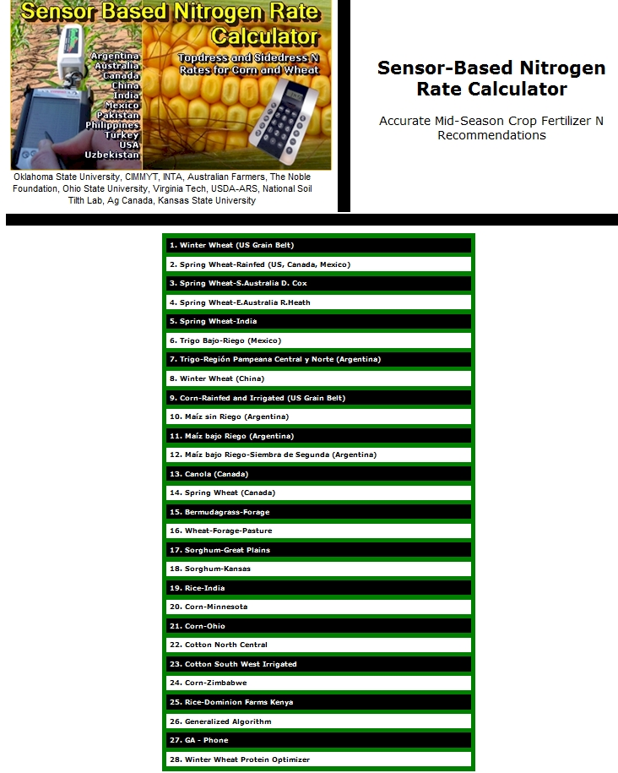
http://www.soiltesting.okstate.edu/SBNRC/SBNRC.php

Slide 32
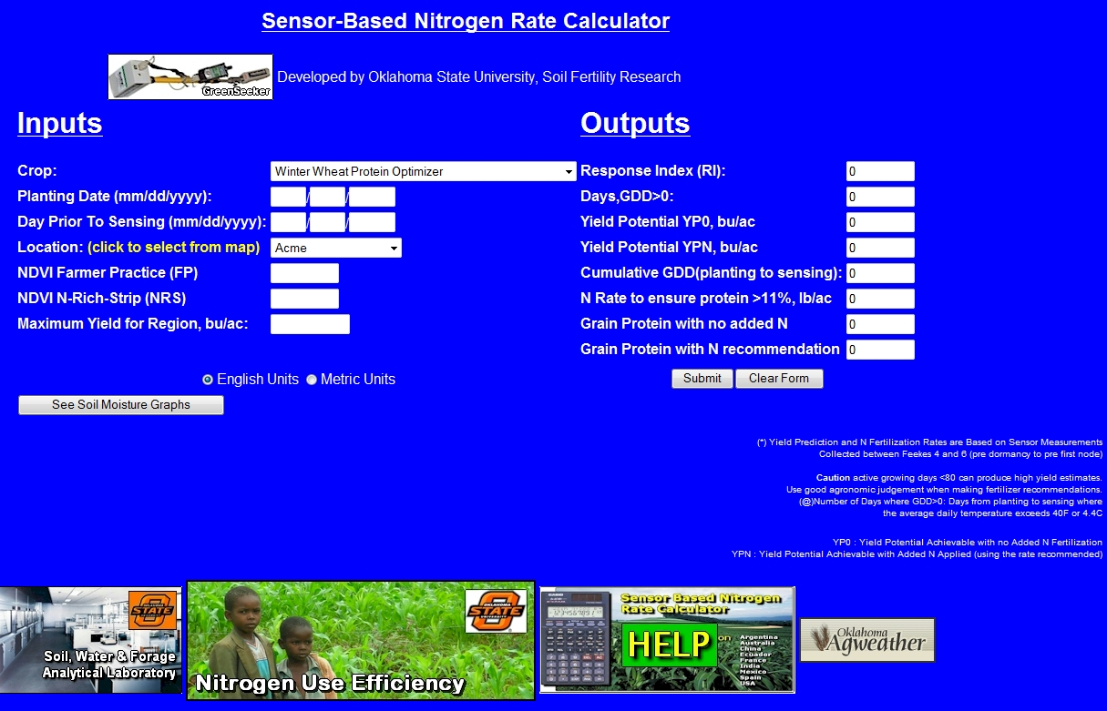
Winter Wheat Protein Optimizer

Slide 33
Summary
Increased yield levels are associated with low grain protein
30 lbs N applied pre or post flowering increased grain protein by 1.6%
Grain protein = -0.052*bu/ac+13.3
Rain in September/October necessary for extremely high yields
Yields have increased 50% since 1966
Grain protein levels have decreased by 20% since 1966
Nitrogen is being mined
Yield Potential expected to be >40 bu/ac, probability of decreased protein increases significantly.
Winter Wheat Protein Optimizer, now available

