Slide 1
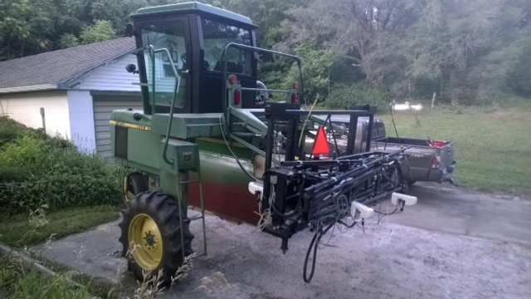
Solie Farm/Applied Research Variable Rate Fertilizer Applicator Fall 2014 Modifications
Add auxiliary fertilizer tank
Replace folding boom with fixed width tool bar
Move sensor to front of applicator to eliminate any concerns about “Lag”
The applicator is equipped and operating with a Trimble FmX monitor and control system
Weight and balance limitations inherent in the design of the JD 6000 self propelled sprayer will probably limit the applicator width to 8-30 inch rows
Add fertilizer coulter openers for no-till field conditions

Slide 2
