Slide 1
Development and Extension of an OSU Sensor-Based Technology for Nitrogen Fertilizer Management
A Case Study on Creating and Delivering a New Technology

Slide 2
What are we going to discuss?
The Problem
The Solution
The Story of the Evolution of the Invention, Science, and Product
  Sprinkled with observations on pitfalls, triumphs, failures, and skullduggery

Slide 3
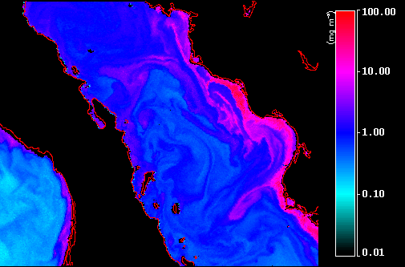
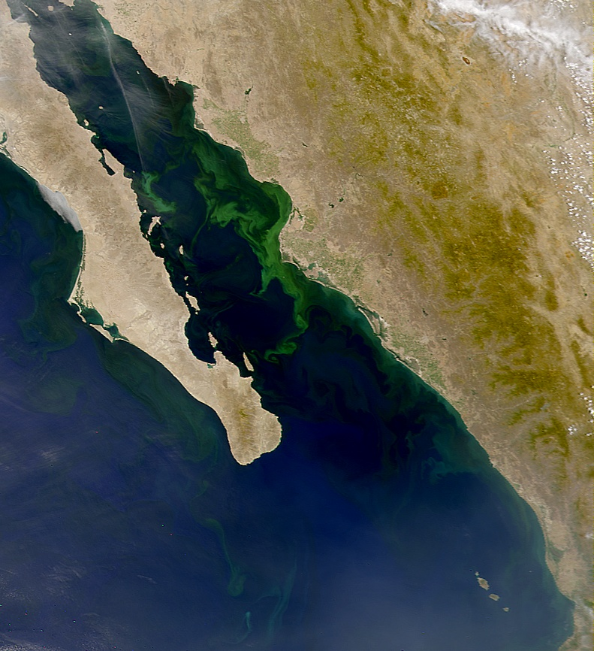
Environmental Impact of Misapplied Nitrogen Fertilizer
Misuse of Nitrogen Fertilizer is a World Wide Problem

Slide 4
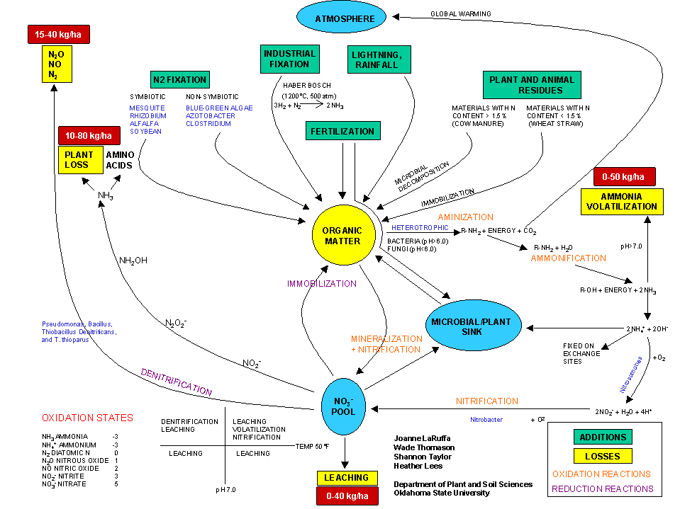
Multiple pathways of Nitrogen in the Soil
Raun and Johnson, Agron J. 91:357-363

Slide 5
Temporal Yield Variability and Nitrogen Demand - Wheat

Slide 6
Economic
Nitrogen fertilizer is the is the most expensive input after interest for cereal crop production.
  2008 fertilizer cost ranged from $54.00/ac to 95$/ac @ 100 lb actual N/ac

Slide 7
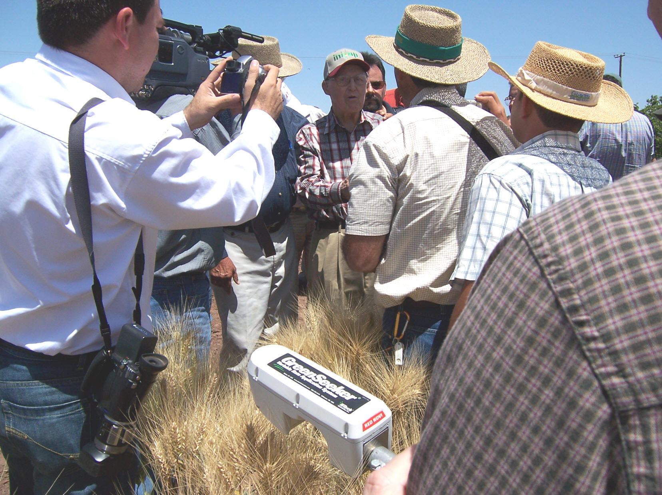
Judicious, prudent, and environmentally sound N fertilizer use
April 16, 2007
Dr. Norman Borlaug
Ciudad Obregon, MX

Slide 8
The Solution
Variable Rate
Spray Nozzle
Decision Making
And Agronomic Strategy
Computer and
Sensor
Assembly
Direction
of Travel
Plant

Slide 9
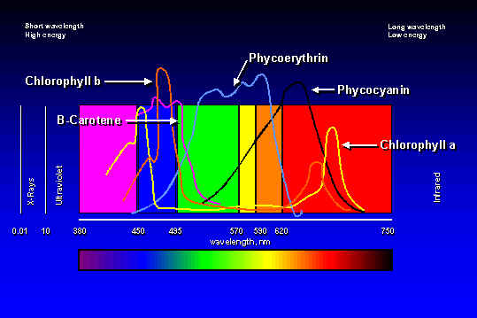
Physiological Basis for Spectral Sensing
Reflectance (%)
0.25
Wavelength (nm)

Slide 10
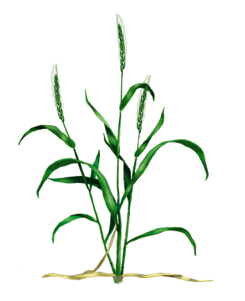
Normalized Difference Vegetative Index - NDVI
Calculated from the red and near-infrared bands
Equivalent to a plant physical examination
Correlated with:
  Plant biomass
  Crop yield
  Plant nitrogen
  Plant chlorophyll
  Water stress
  Plant diseases
  Insect damage

Slide 11
Greenseeker™ Sensing Technique
Light signal
?
Calculate NDVI
?
Lookup valve setting
Valve settings
Light
Light
?
Apply valve setting
detection
generation
?
Send data to UI
“Sensor”
Valves and
Nozzles

Slide 12
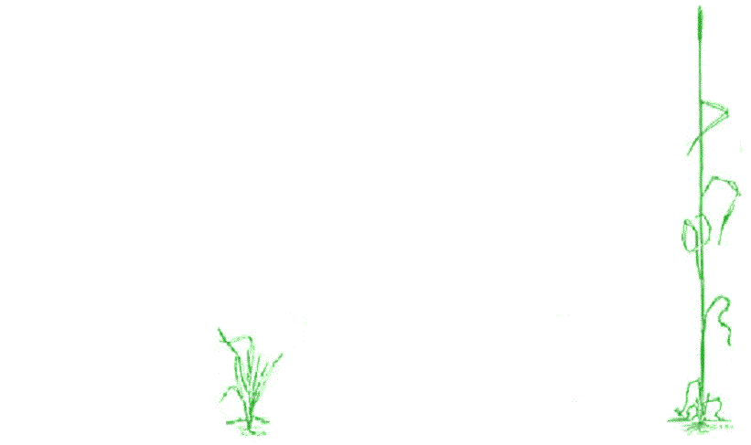
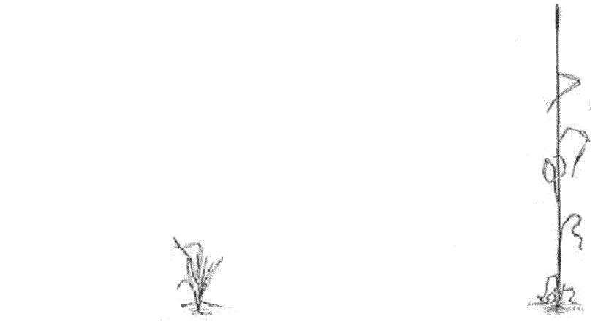
Greenseeker™ Nitrogen Fertilizer Rate Decision Algorithm?

Slide 13
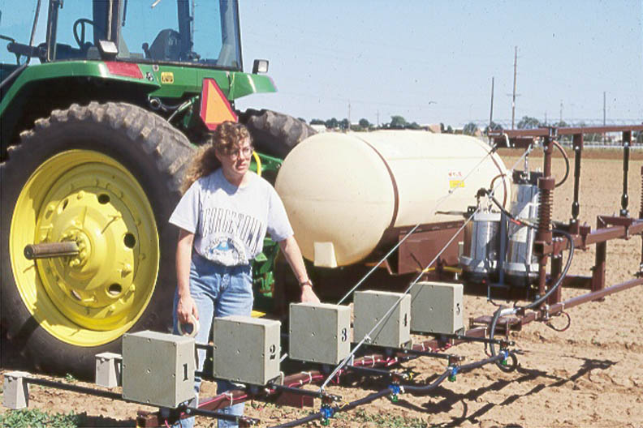
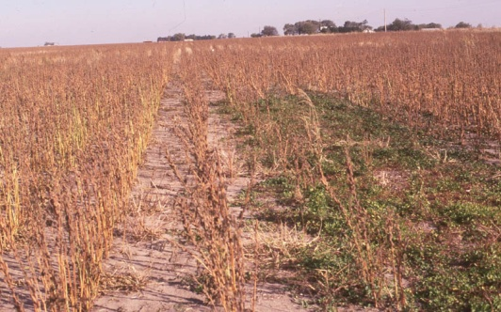
Evolution of the Science and Technology
1991

Slide 14
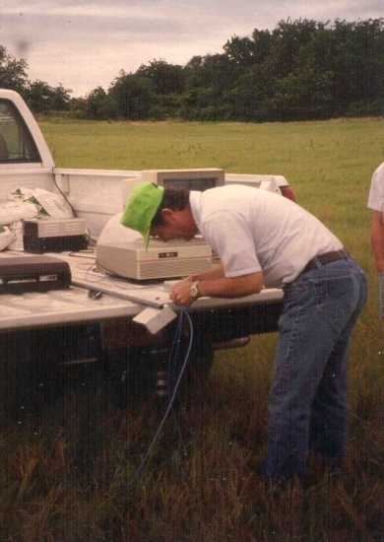
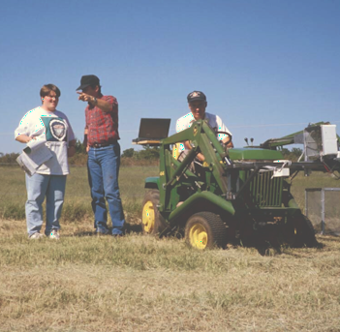
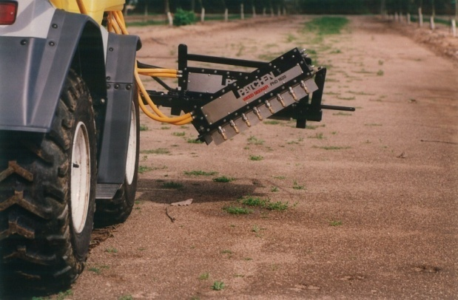
Evolution of the Science and Technology
First discussion between the Departments of Plant and Soil Sciences and Biosystems and Agricultural Engineering concerning the possibility of sensing biomass in wheat and bermudagrass. Biomass was to be used as an indicator of nutrient need (based on removal).
1992
1993

Slide 15
Evolution of the Science and Technology – The Original R&D Team
Bill Raun
John Solie
Marvin Stone

Slide 16
Evolution of the Science and Technology
1993

Slide 17
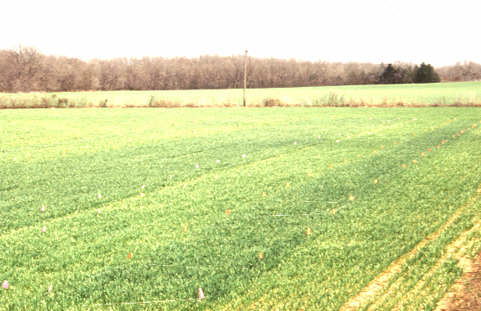
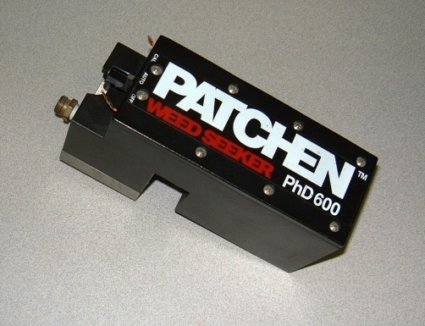
Evolution of the Science and Technology
1994

Slide 18
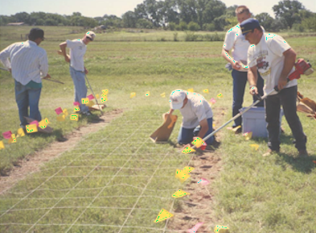
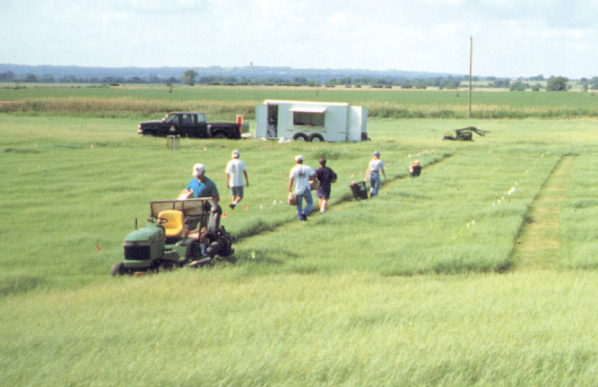
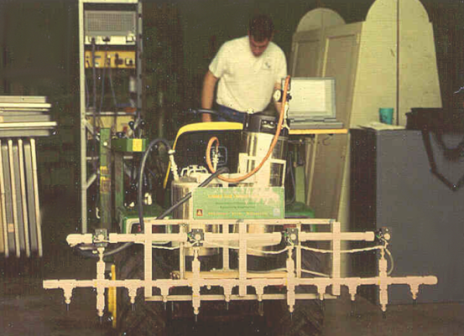
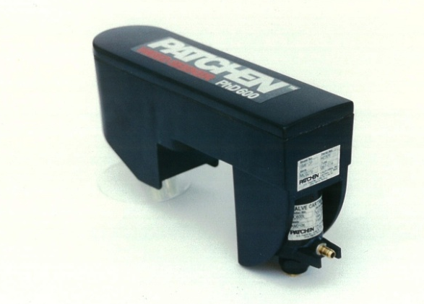
Evolution of the Science and Technology
1995

Slide 19
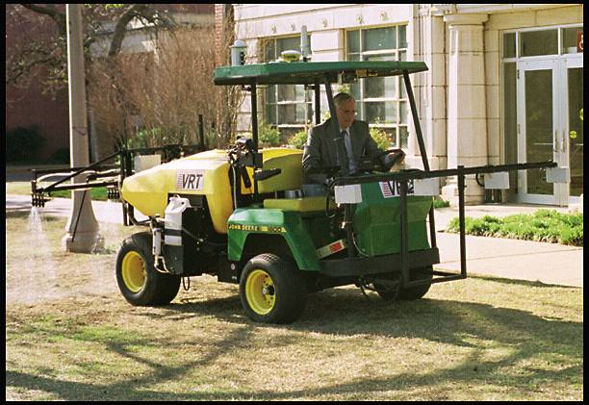
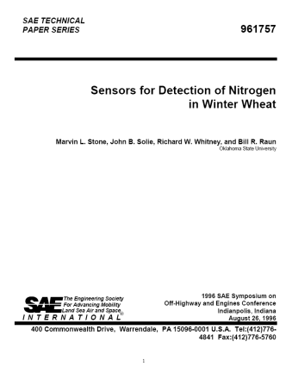
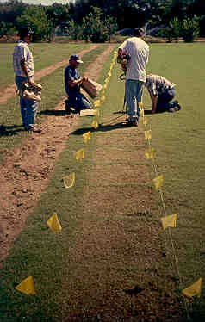
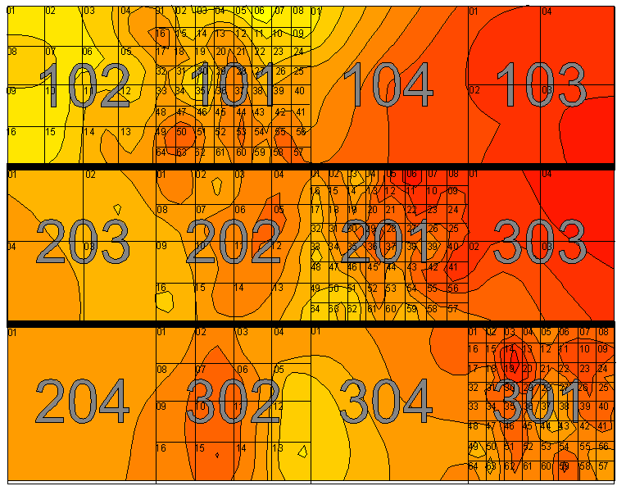
Evolution of the Science and Technology
OSU Signs R & D Agreement with John Deere, Inc – Commercial Turf Division
1996
Patchen, Inc. sold to John Deere, Inc.

Slide 20
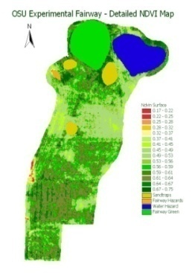
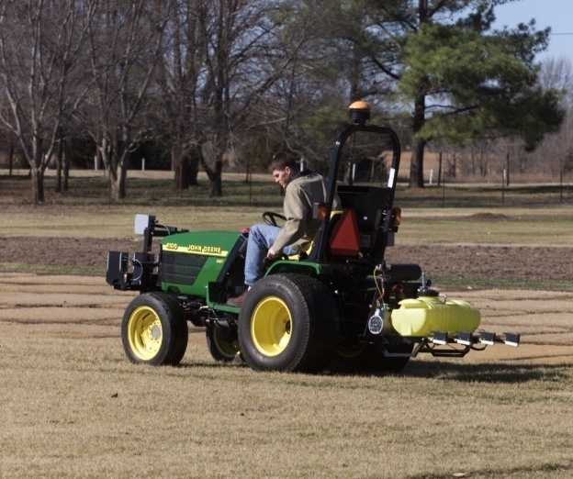
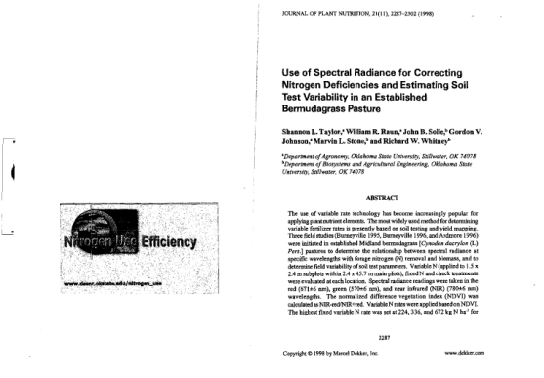
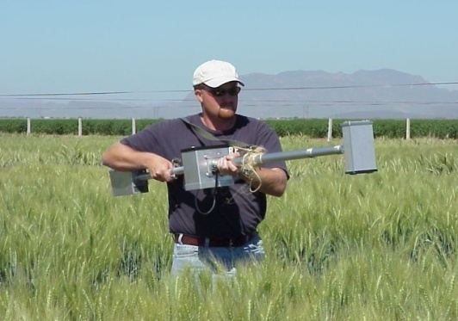
Evolution of the Science and Technology
1997
1998

Slide 21
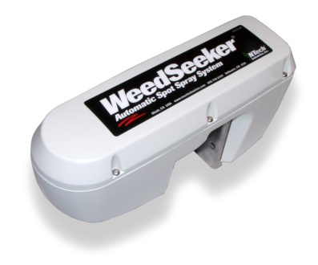
Evolution of the Science and Technology
1999
2000
John Deere sells Patchen to the Mayfield Family, Ukiah, CA

Slide 22
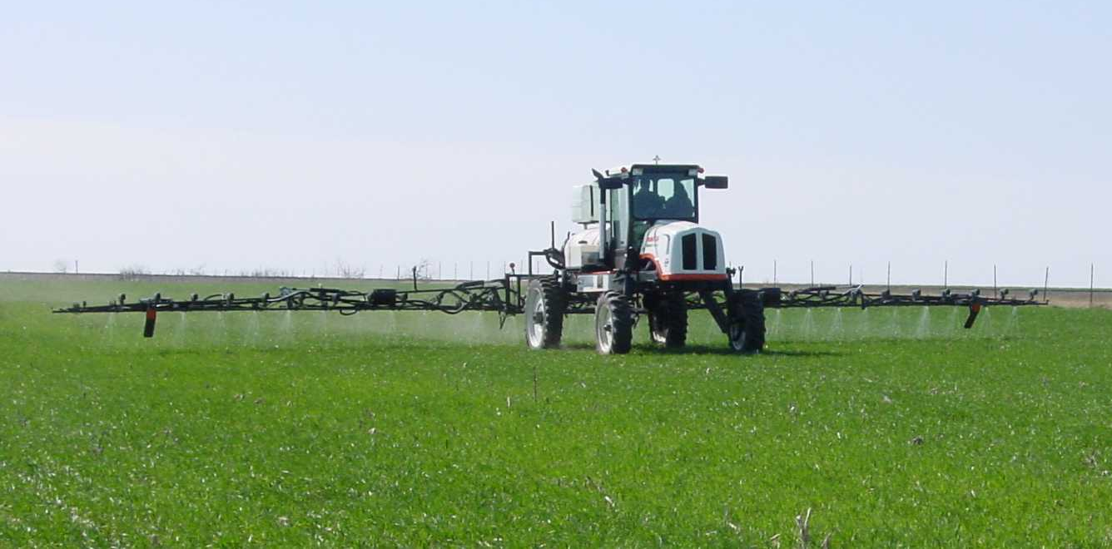
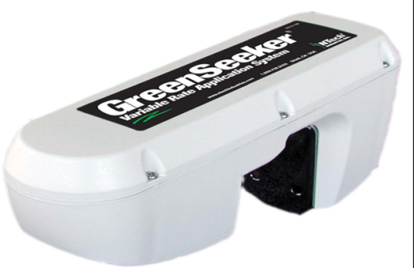

Evolution of the Science and Technology
Treatment | Pre-Trt. N, lb/ac | Trt. N, lb/ac | Total N, lb/ac | Yield, lb/ac | Net Rtn, $/ac
N-Rich Strip | 94 | 0 | 94 | 44.6 | 110
Var. Rate | 56 | 23 | 79 | 39.8 | 100
Fixed Rate A | 56 | 35 | 91 | 37.3 | 91
Fixed Rate B | 58 | 24 | 82 | 35.4 | 85
Field Rate | 73 | 20 | 92 | 34.6 | 82
 |  |  | SED | 3.1 | 9.5
Treated March 20 to April 10, 2002 Net Revenue = grain yield * $3.00 / bu – N Fertilizer * $0.25 / lb SED = Standard Error of the Difference
OSU and Ntech Industries Enter into an R&D agreement to develop a digital optical sensor based variable rate Nitrogen fertilizer applicator
2001
2002
The Mayfield Family forms Ntech Industries, Inc as the successor company to Patchen, Inc.

Slide 23
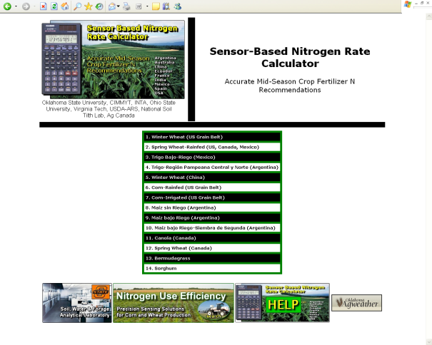
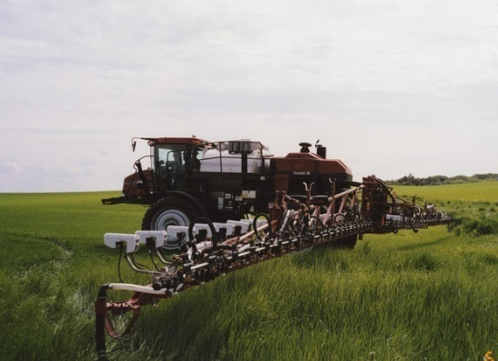
Bill’s Postulates
Crop yield potential can be predicted from NDVI
A Response Index exists that defines the response to additional fertilizer and varies from year to year.
YPN = RI * YPO
A maximum potential yield exists that is a function of the weather and soil type
3
1
Predict RI
Predict YP₀
Predict YP_{N} based on RI
Fertilizer N = GNUP_{YPN} –GNUP_{YP0}/0.7
2
2
3
4
1
4
OK MESONET
2002

Slide 24
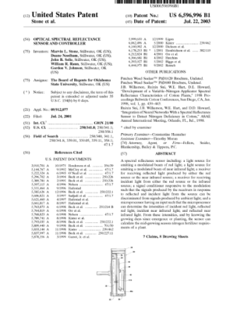
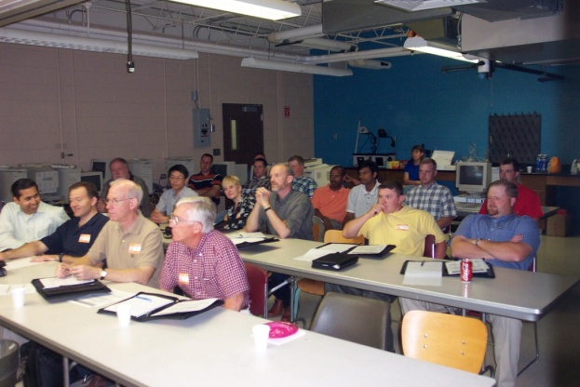
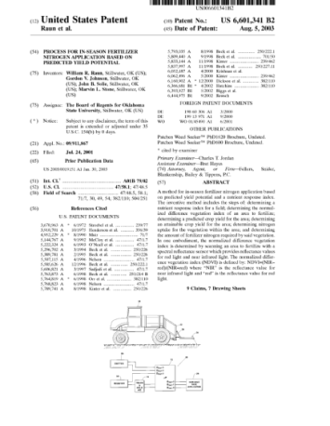
Evolution of the Science and Technology
2003

Slide 25
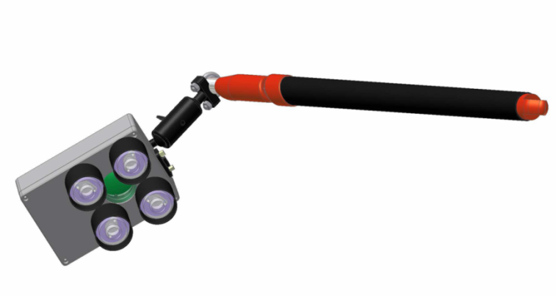
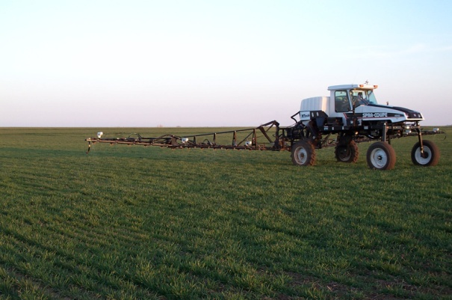
Evolution of the Science and Technology
2004
2007

Slide 26
Evolution of the Science and Technology – Formation of an R&D and Extension Team
OSU
Richard Whitney
Gordon Johnson
Eugene Krenzer
Roger Gribble
Greg Bell
Ken Conway
Art Klatt
Ron Elliott
Brian Arnall
Randal Taylor
Wade Brorson
Francis Epplin
Tom Peepr
Hailin Zhang
Ning Wang
Kefalu Desta
Stewart Reed
International
Fred Kanampiu-Kenya
Guy Lafond –Ag Canada
Bau Luo
Nicholas Trembay
Ivan Ortiz Monasterio CIMMYT, MX
Ken Sayre
Matthew Reynolds
Augustine Bianchi -Argentina
Ricardo Melchiori
Bill Raun
Robert Mullen Ohio St.
Wade Thomason - VPI
Brenda Subanna – LSU
Steve Phillips PPI
Josh McGrath, U of Md
Loyd Murdoch – U Ky
Greg Shwab
Jagadeesh Mossali-Noble
James Schpers – U of Nebr
Dennis Francis
John Shannahan
Richard Ferguson
John Solie
Marvin Stone
United States
Kyle Freeman - Monsanto
Paul Hodgen
Dave Mengel – KSU
Kent Martin
Newel Kitchen – U of MO.
Peter Scharf
Ken Suddeth

Slide 27
Corn Results University of Maryland

Slide 28
Corn Results - Virginia Polytechnic and State University
NS
160
140
120
21 % (21 lb/ac) less N with GS
100
STD
80
GS
60
40
20
0
Grain Yield, bu/ac
Sidedress N, lb/ac

Slide 29
Wheat Yield, Ciudad Obregon, Mexico
Sensor vs Conventional Fertilizer Rates
Wheat yield (kg/ha)
Difference
63 kgN/ha
57 dollars/ha

Slide 30
CIMMYT - Ciudad Obregon, MX
Wheat Yield
49 fields
49
77 dollars/ha
Wheat yield (kg/ha)
Difference
86 kgN/ha

Slide 31
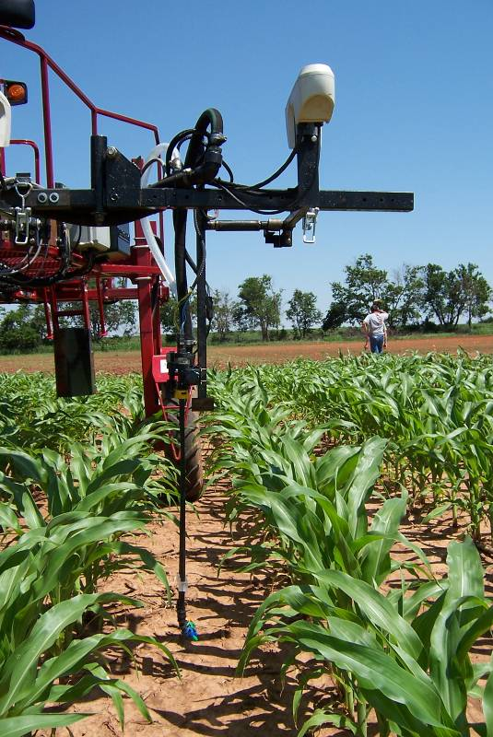
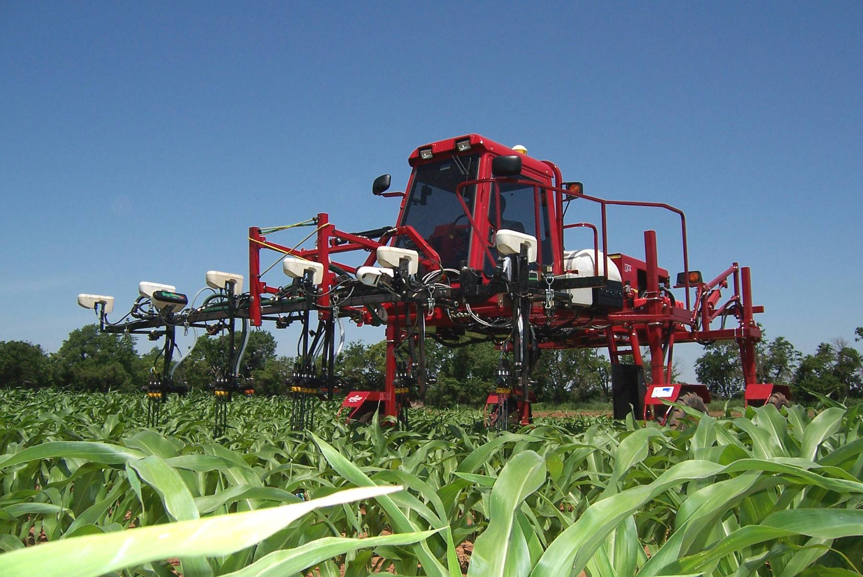

OSU on the Discovery Channel
Notes:
This is a current OSU applicator that can fertilize each individual corn plant.

Slide 32
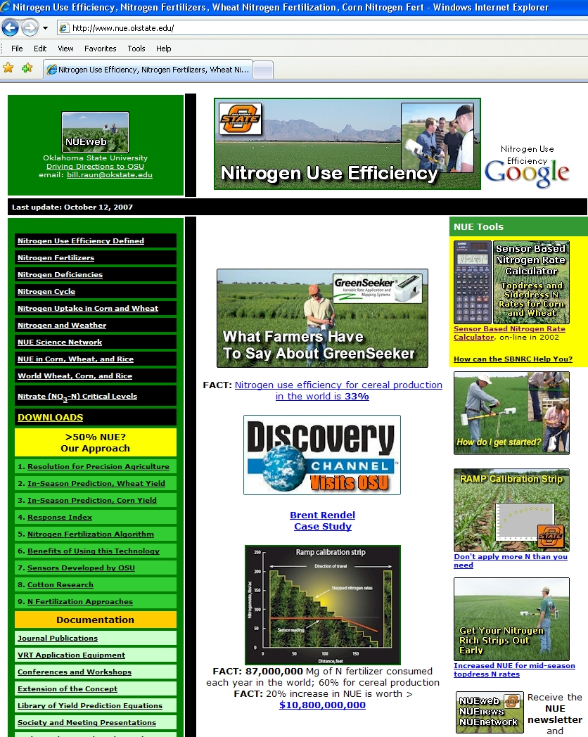
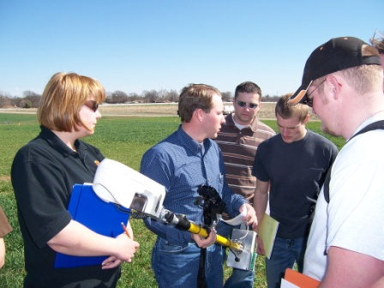
e-extension
Mexico
India
Turkey
China
Zimbabwe Argentina
Australia
Canada
Uzbekistan

Slide 33
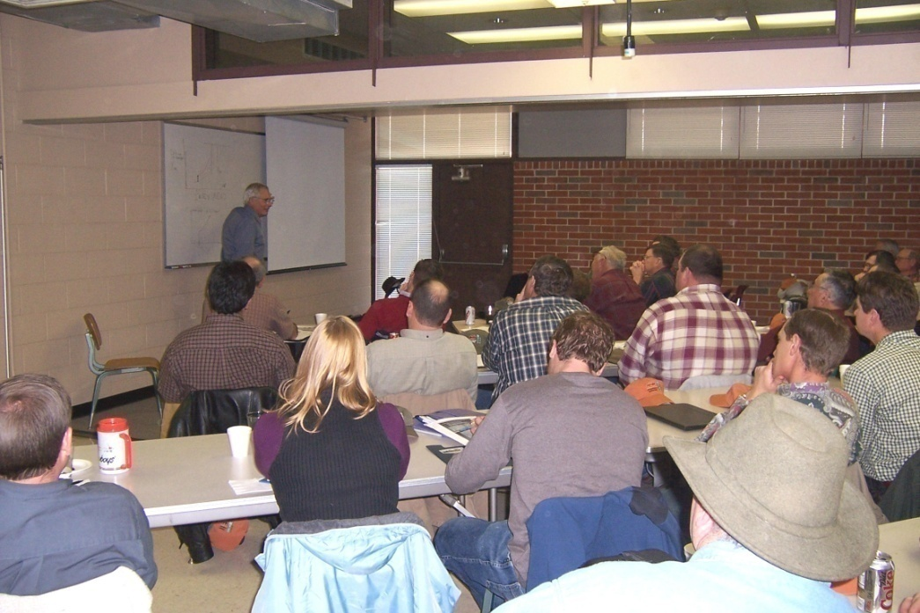
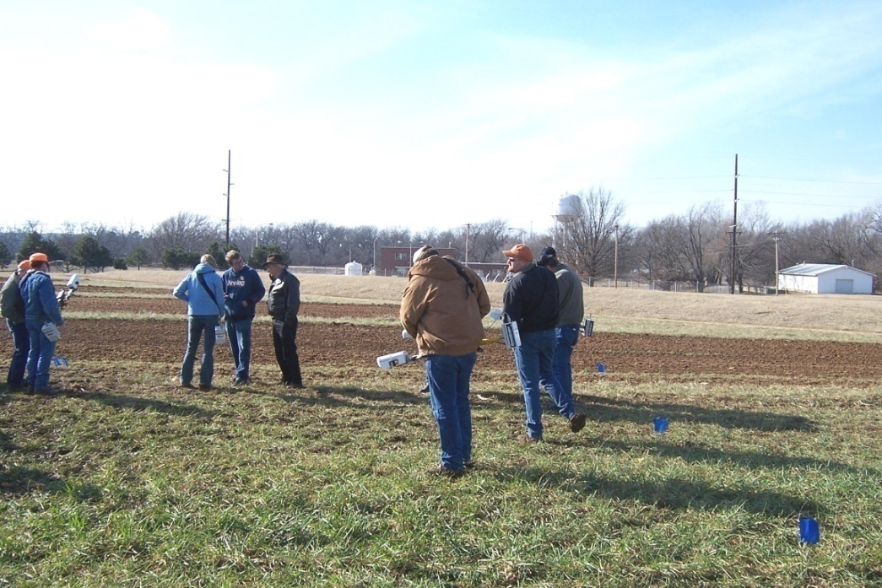

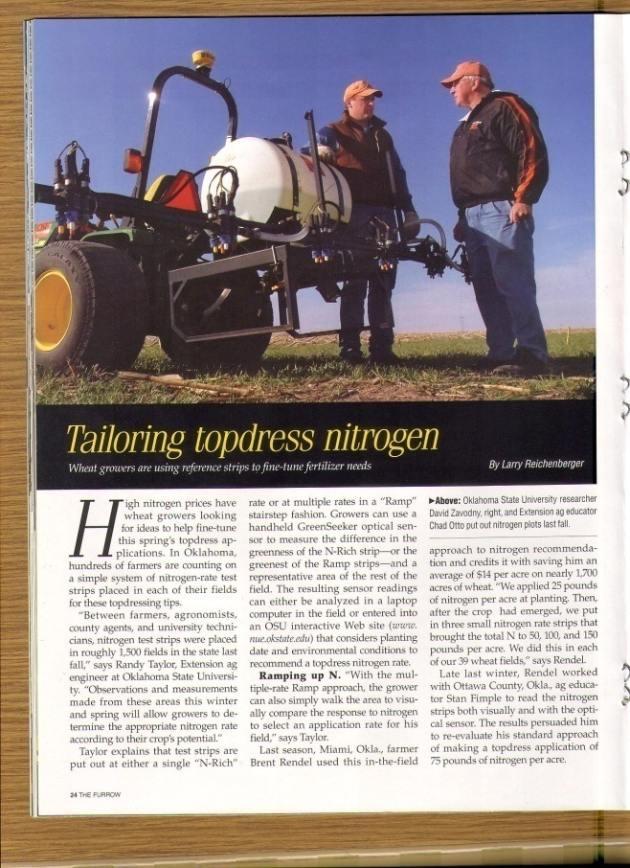
National Extension

Slide 34
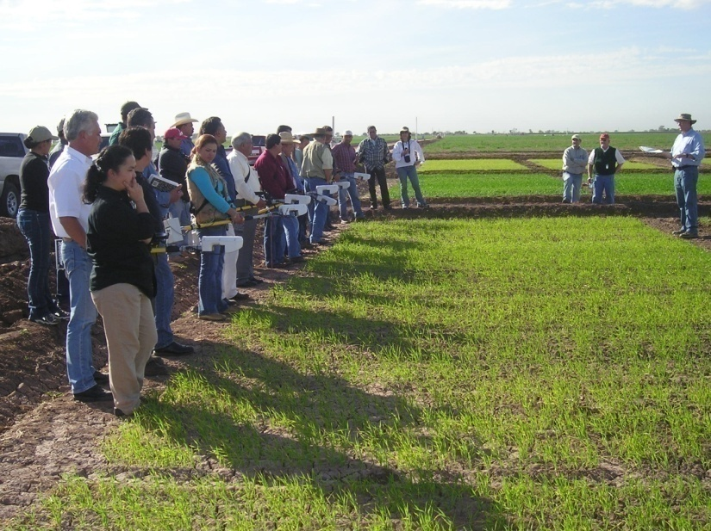
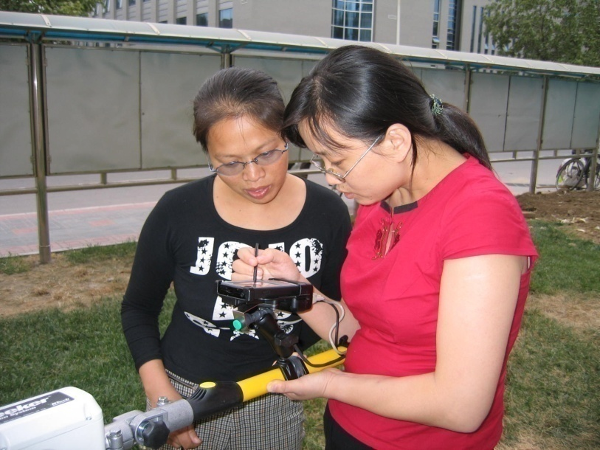
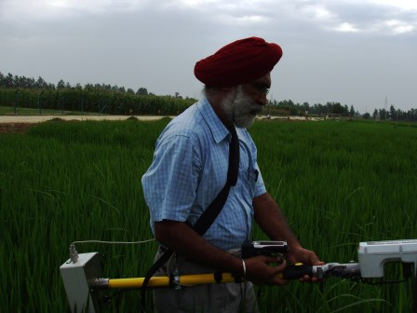
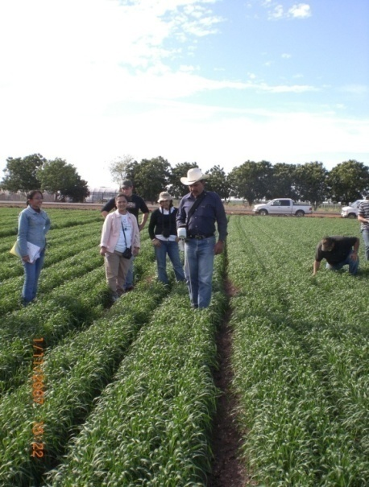
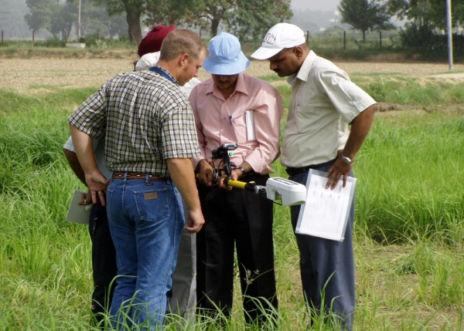
International Extension
Ciudad Obregon, Mexico
Notes:
34

Slide 35
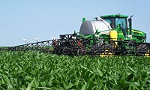

NTech Sales and Distribution

Slide 36

US GreenSeekerTM Adoption
27 States have multi-sensor commercial systems
Primary Crops:
  Corn, Spring & Winter Wheat, Cotton (pgr’s, harvest aids)
Secondary Crops:
  Sorghum, Barley, Potatoes, Canola, Oats, peanuts, etc.
Primary Markets
  Midwest, Delta, Central & Northern Plains, Eastern Corn Belt
Acres: ~250,000
Systems: 80+ GreenSeeker multi sensor systems
  Numerous single sensor systems
Applicators
  70% Drops/Streamers
  25% Liquid Nitrogen Bars
  5% Anhydrous or Dry Applicators

Slide 37


Evolution of the Science and Technology
Grand Unified Theory (GUT)
for N Fertilization
2009
NTech Files Patent Infringement Suit

Slide 38

Questions
Farmer training, Ciudad Obregon, Mexico, January 2007

