Slide 1
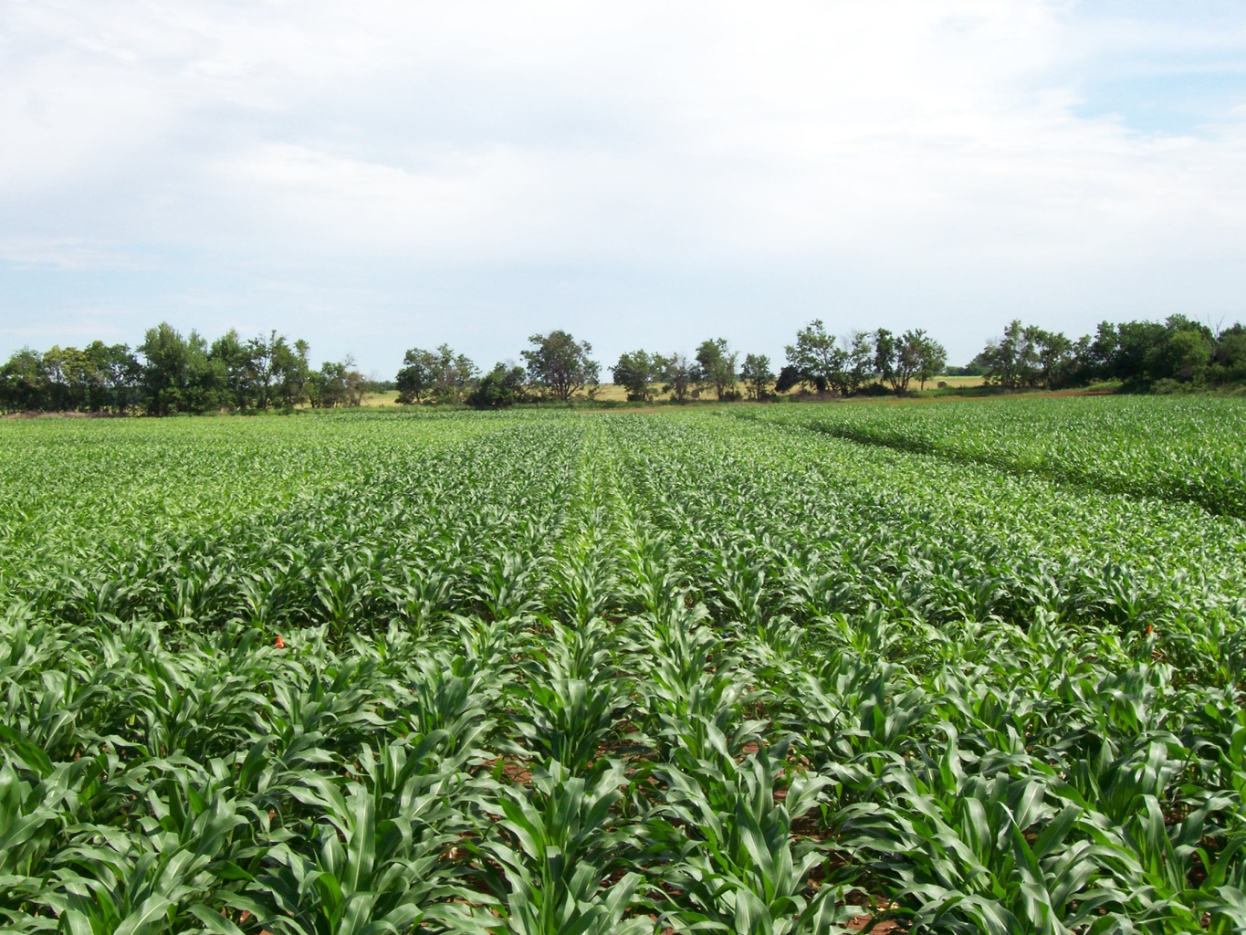
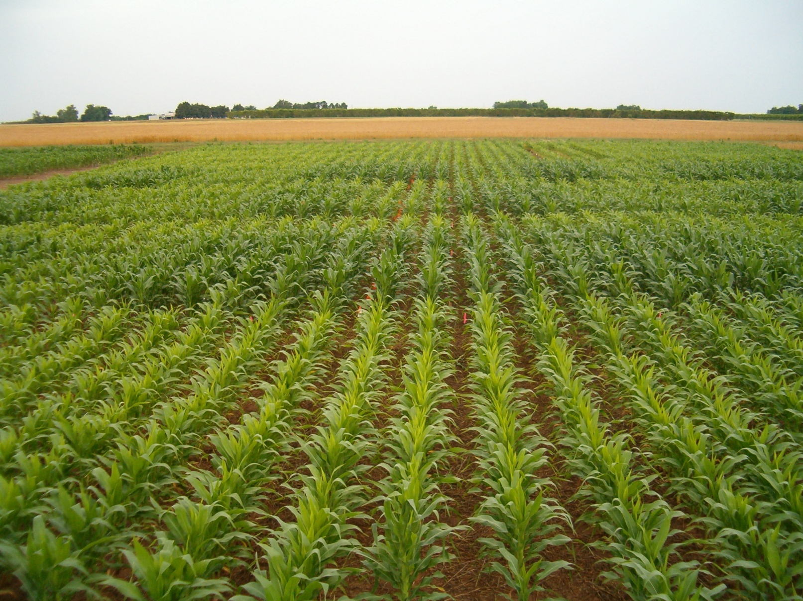
by-plant resolution

Slide 2
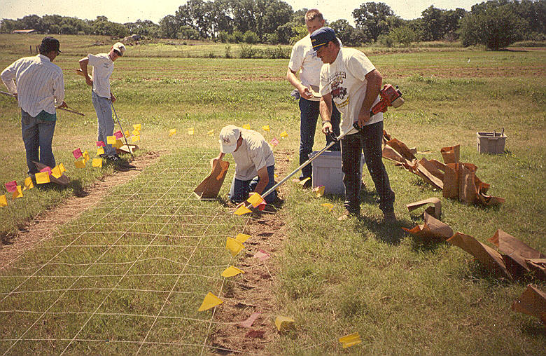
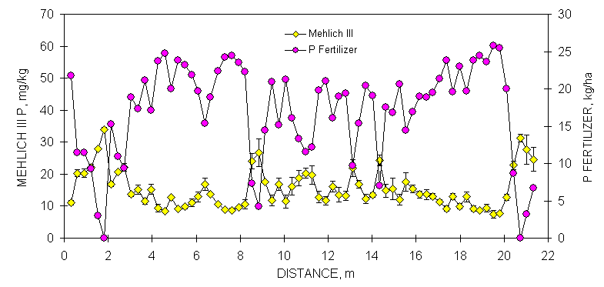
1992, At What resolution are there real biological differences

Slide 3
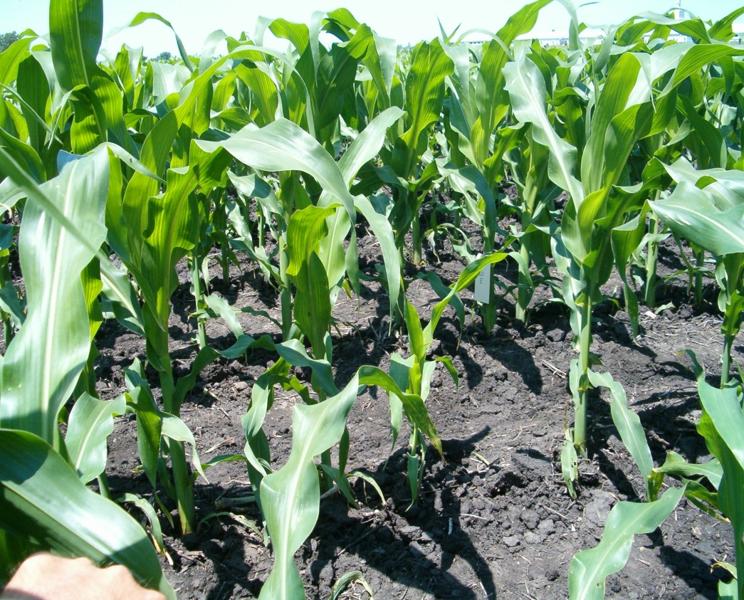
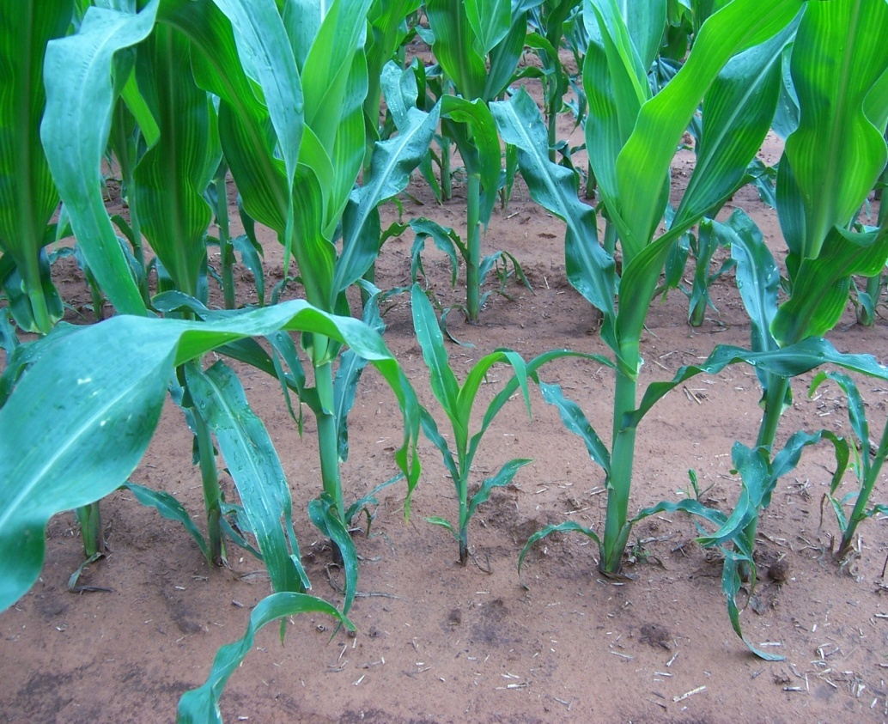
Plant-to-plant variation, avg. 45 bu/ac
Nebraska, Iowa, Virginia, Oklahoma,
Argentina, Mexico, Ohio (46 transects)
IOWA
OKLAHOMA

Slide 4
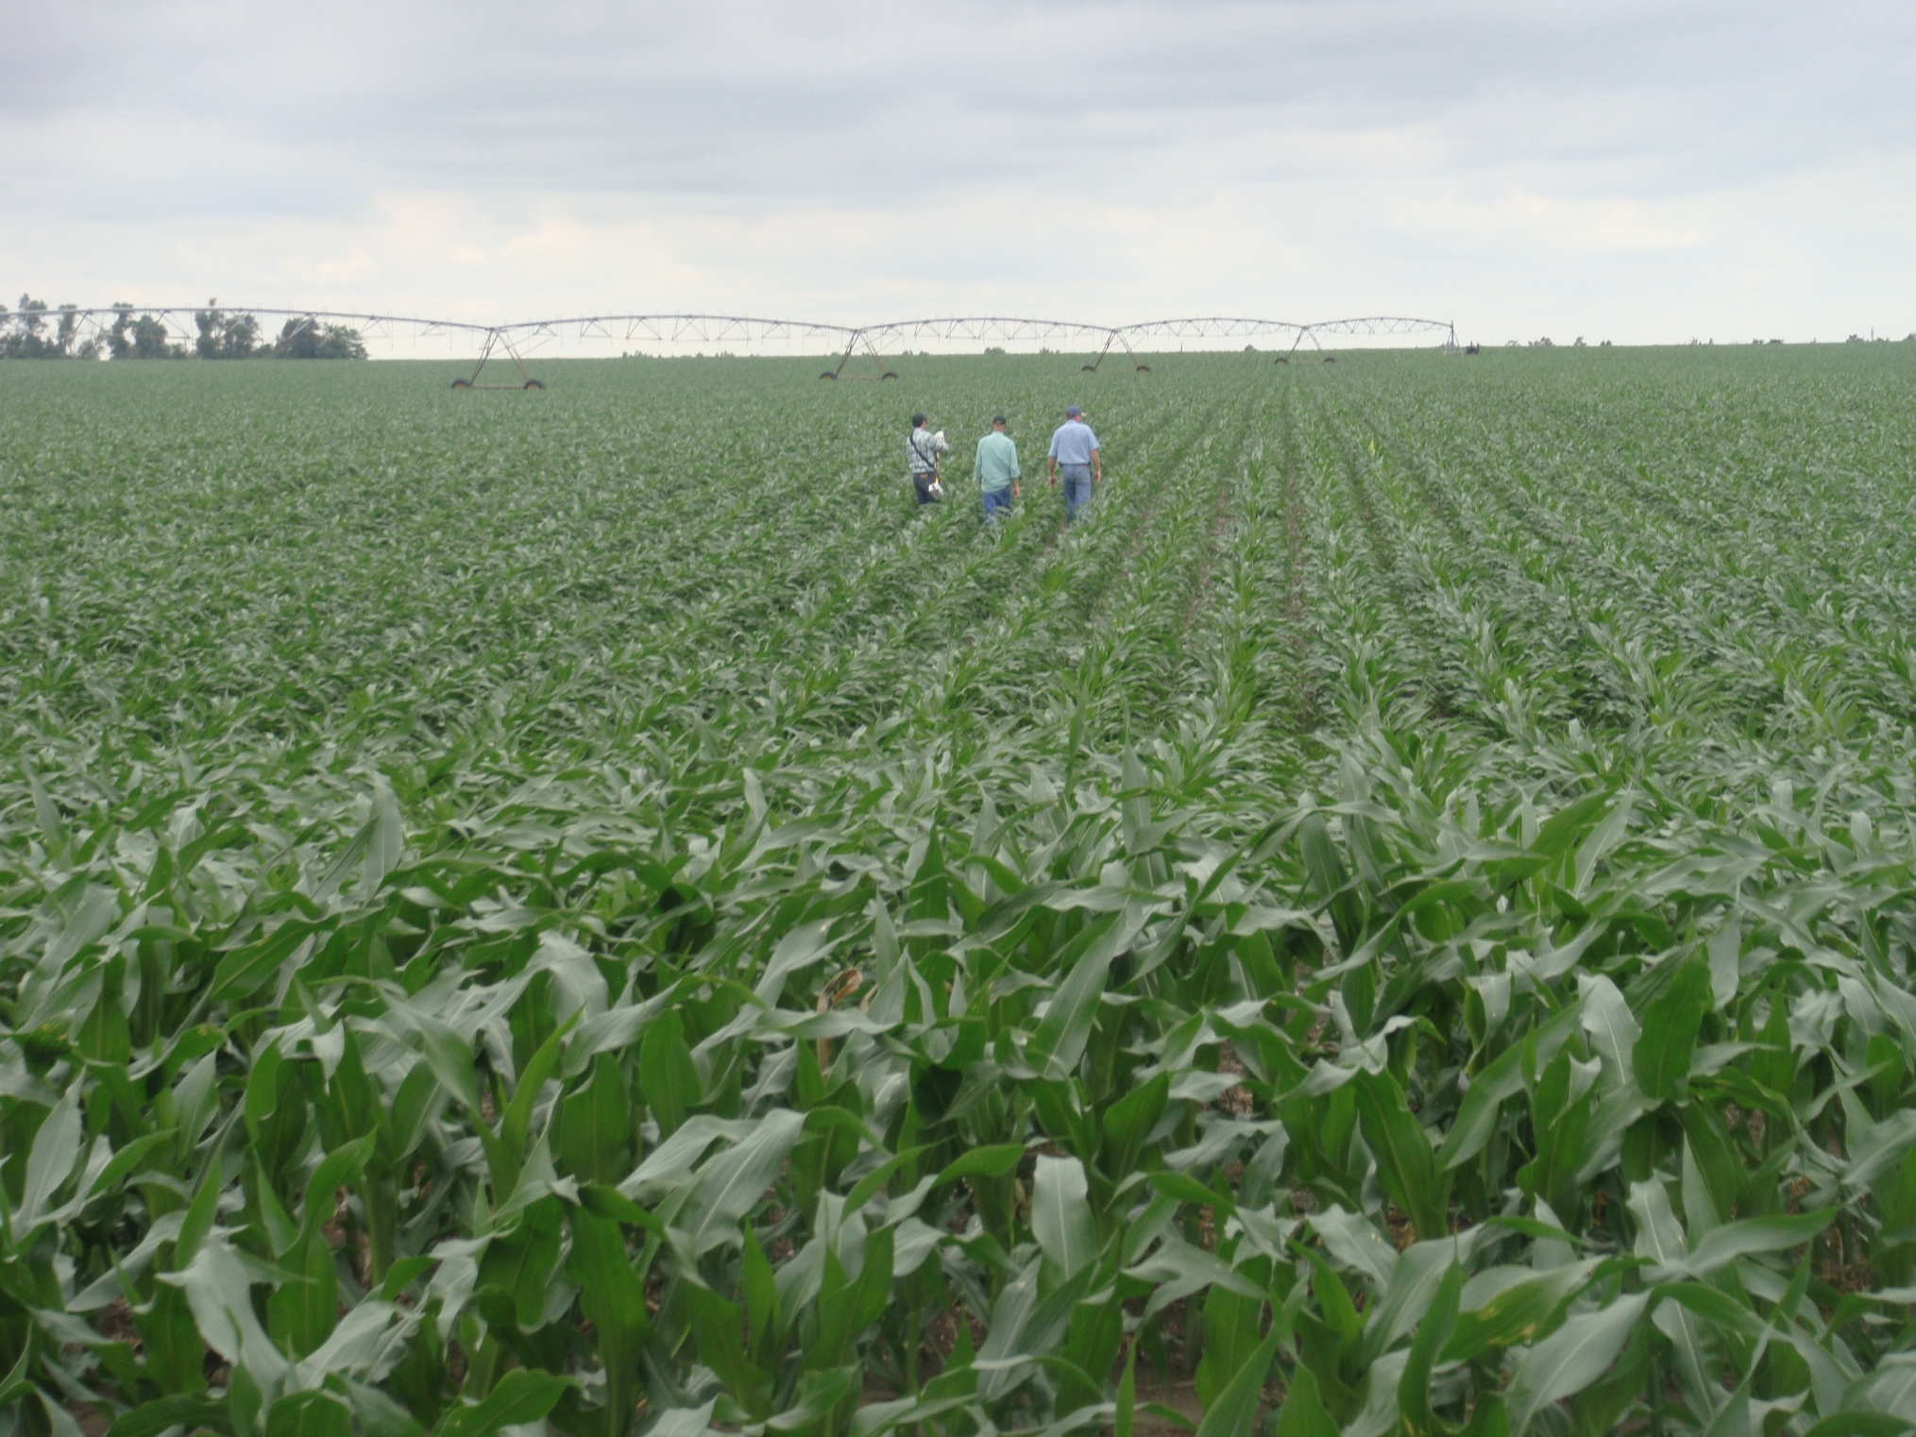
Holdrege silt loam, Minden, NE

Slide 5
Mean Yield vs Std. Dev.
318 bu/ac
Average corn grain yield plotted against the standard deviation from by-plant yield over 46 transects in Argentina, Mexico, Iowa, Nebraska, Ohio, Virginia, and Oklahoma.

Slide 6
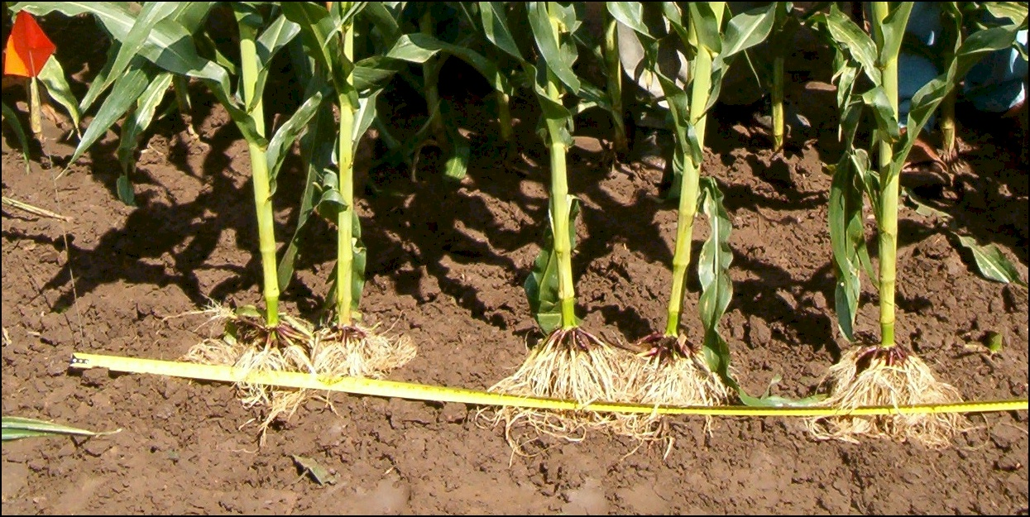

Slide 7
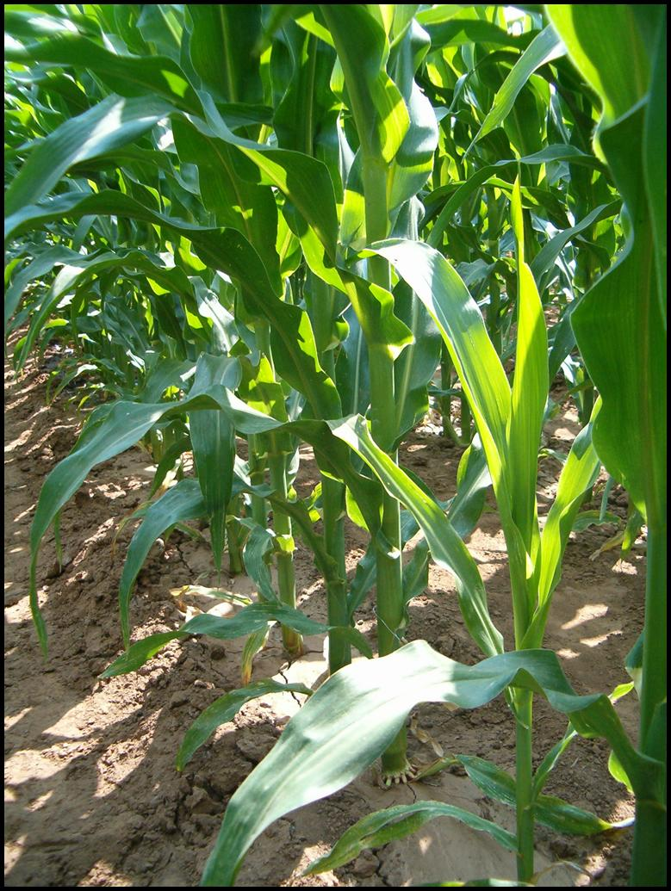

Slide 8
Paul Hodgen, Univ. Nebraska, Dissertation AA13271926, Jan 1, 2007
Target plant acquired over 70% of the total depleted 15N fertilizer that was taken up
data revealed an individual corn plant acquires most of its N from within a radius of less than 0.5 m.
Plants lose yield potential by emerging as little as three days after their neighbors.
Large doses of N fertilizer could not increase the yield of late emerging corn plants.

Slide 9
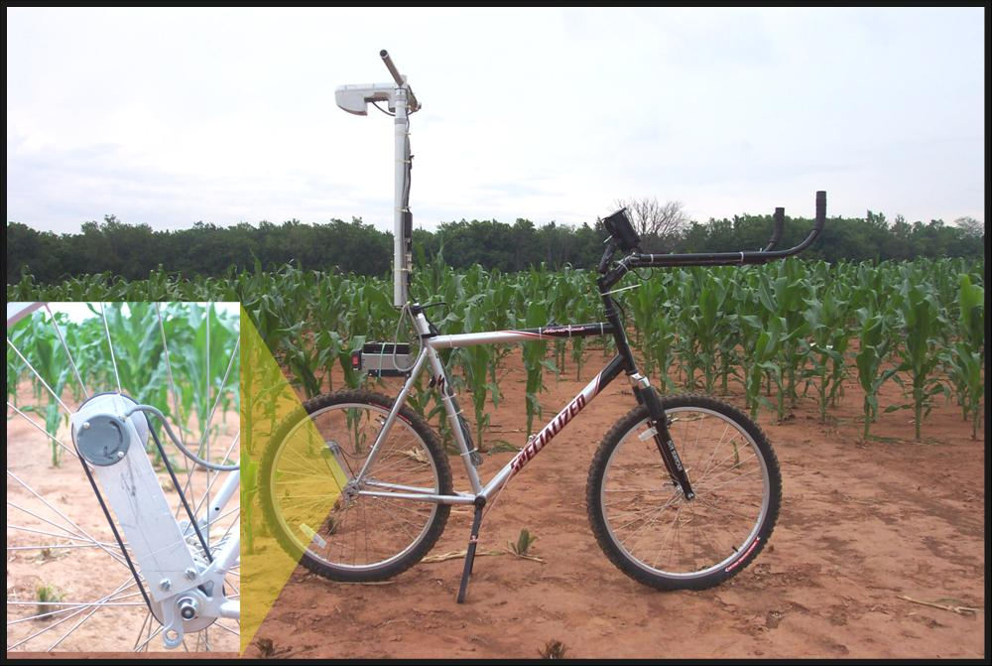
Sensors to detect each plant
GreenSeeker Sensor was mounted on a bicycle
Shaft encoder was used to assign distance to each sensor reading
Readings were taken once per centimeter

Slide 10
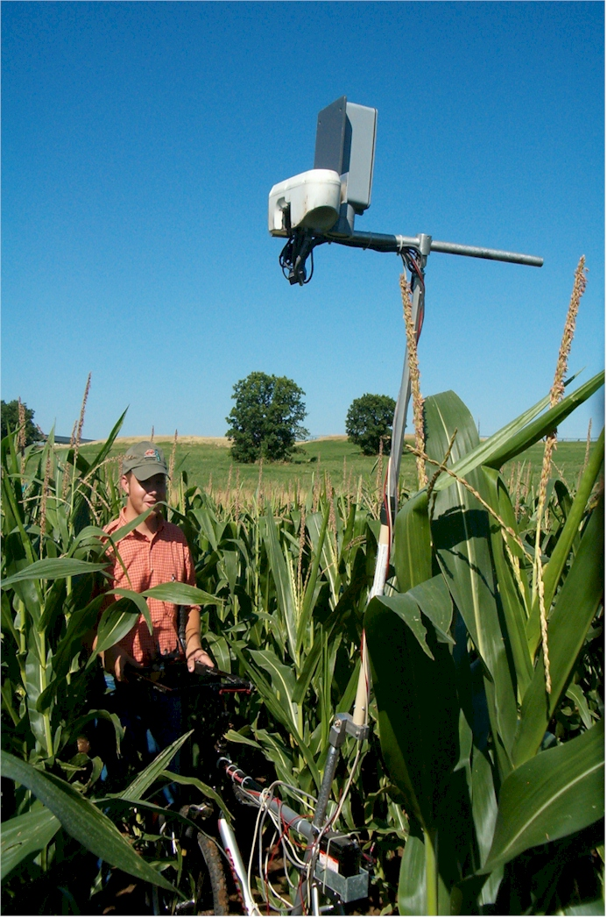
New by-plant yield prediction methods focus on a totally different approach

Slide 11
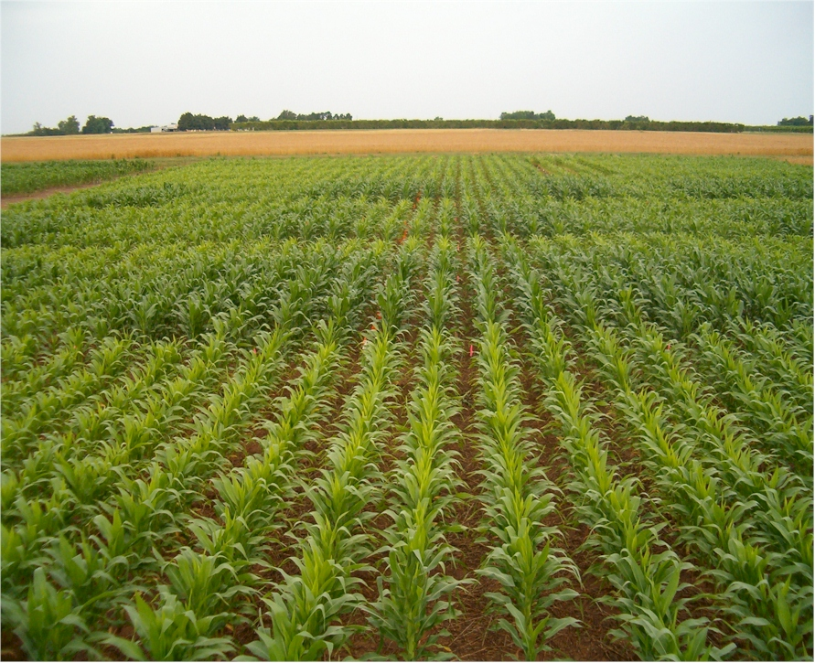
Can you recognize by-row differences in N response?
If the answer is yes, then the minimum resolution at which “precision agriculture” should operate is
30 inches (front/back, left/right)

Slide 12
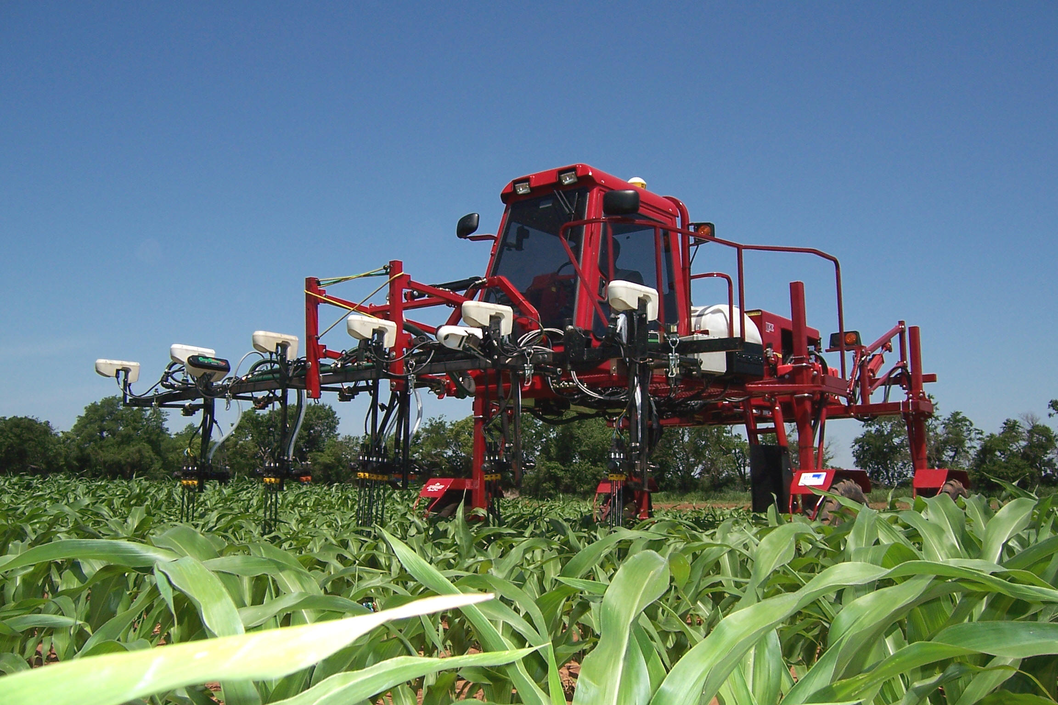
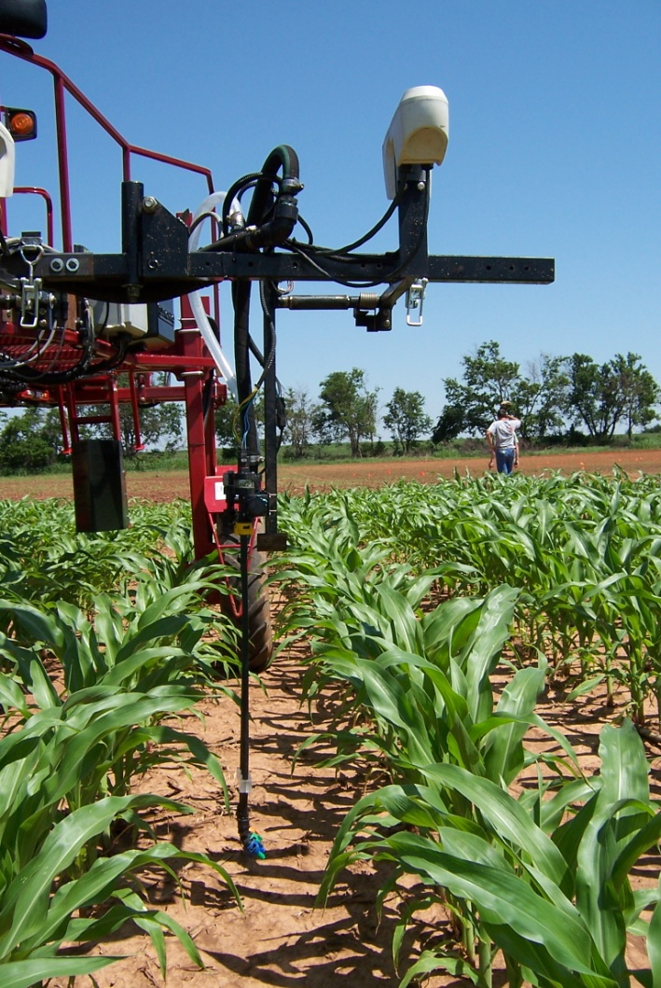
Variable Rate Technology
Treat Temporal and Spatial Variability
Wheat, 0.4m²
Corn, by plant

Slide 13
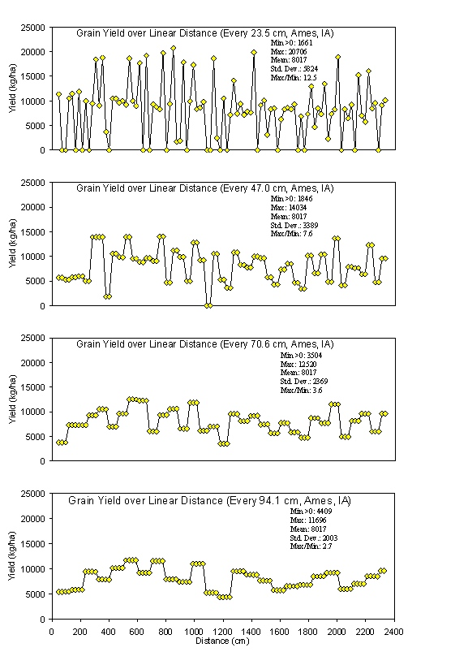
Causes for Delayed and uneven emergence
•variable depth of planting
•double seed drops
•wheel compaction
•seed geometry within the furrow
•surface crusting
•random soil clods
•soil texture differences
•variable distance between seeds
•variable soil compaction around the seed
•insect damage
•moisture availability
•variable surface residue
•variable seed furrow closure
•volunteer
early season root pruning (disease, insect)
The impact of uneven stands takes place prior to the time that irrigation is employed whether using surface/furrow or center pivot systems.

Slide 14
34 ± 5.3 bu/ac
37 ± 9 bu/ac

Slide 15
Summary
Farmer fields in the US, Argentina, and Mexico showed that plant-to-plant variation in corn grain yield averaged 2765 kg ha⁻¹ or 44.1 bu ac⁻¹ (Martin et al., 2005).
Current methods can predict by-plant yields
Plant to plant variability in yield exceeds the magnitude encountered for other agronomic variables
Adjusting multiple inputs by-plant is possible today

