Slide 1
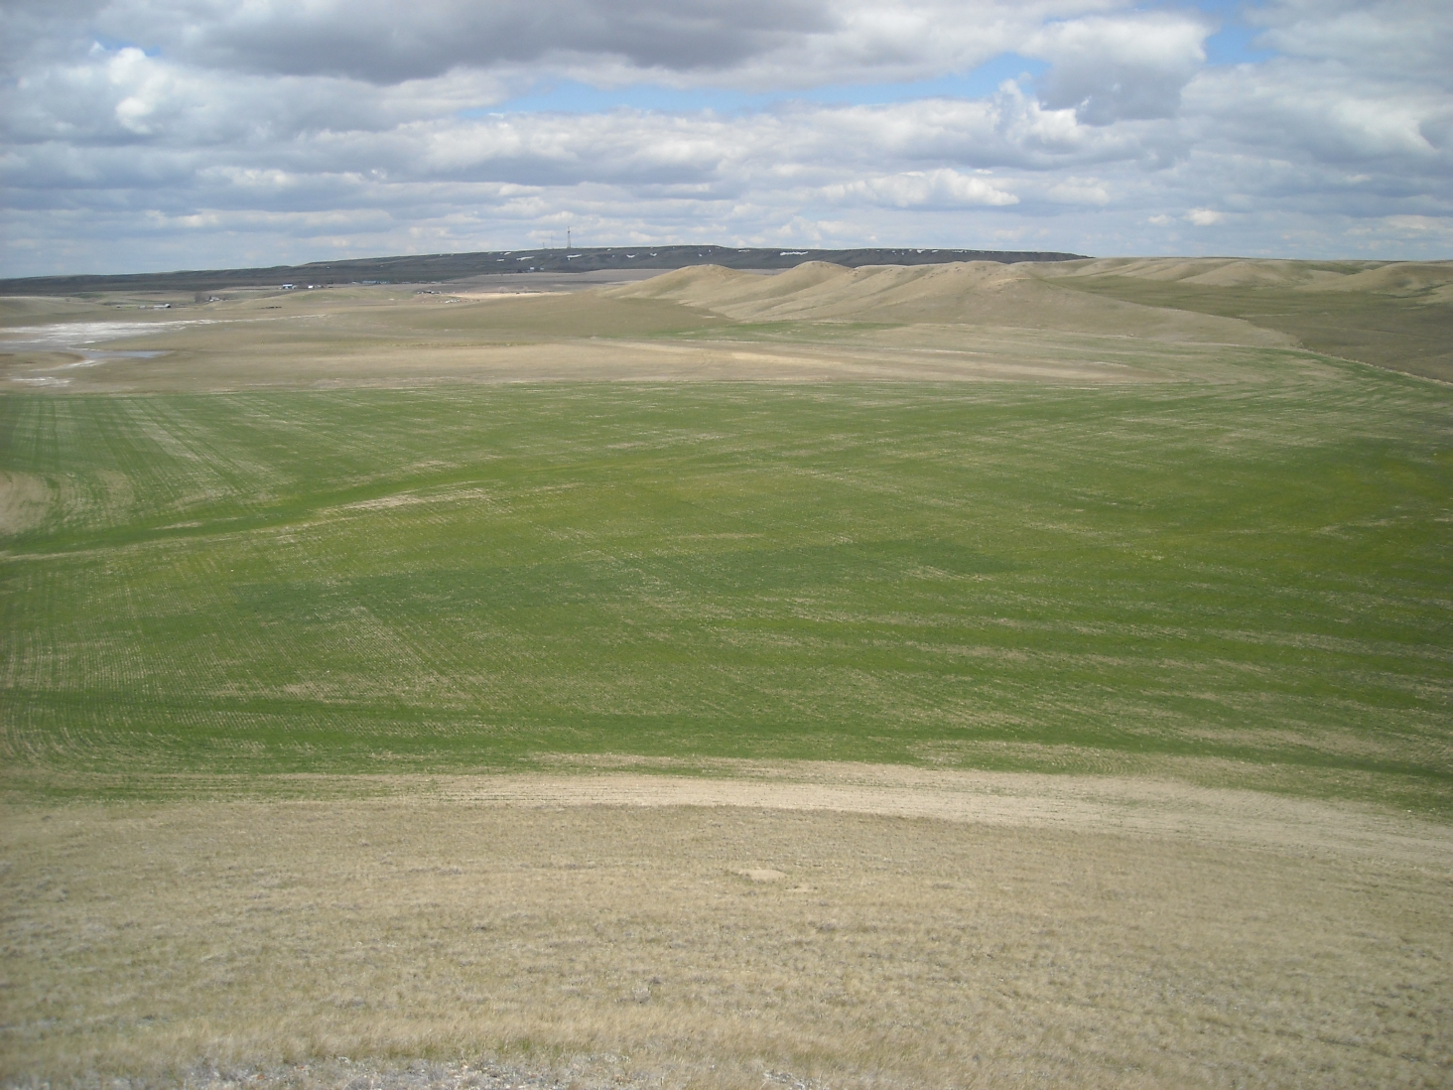


Application of Indirect Measures for Improved Nitrogen Fertilization
John Solie, Marvin Stone, Brian Arnall,
Ivan Ortiz-Monasterio, Bill Raun

Slide 2
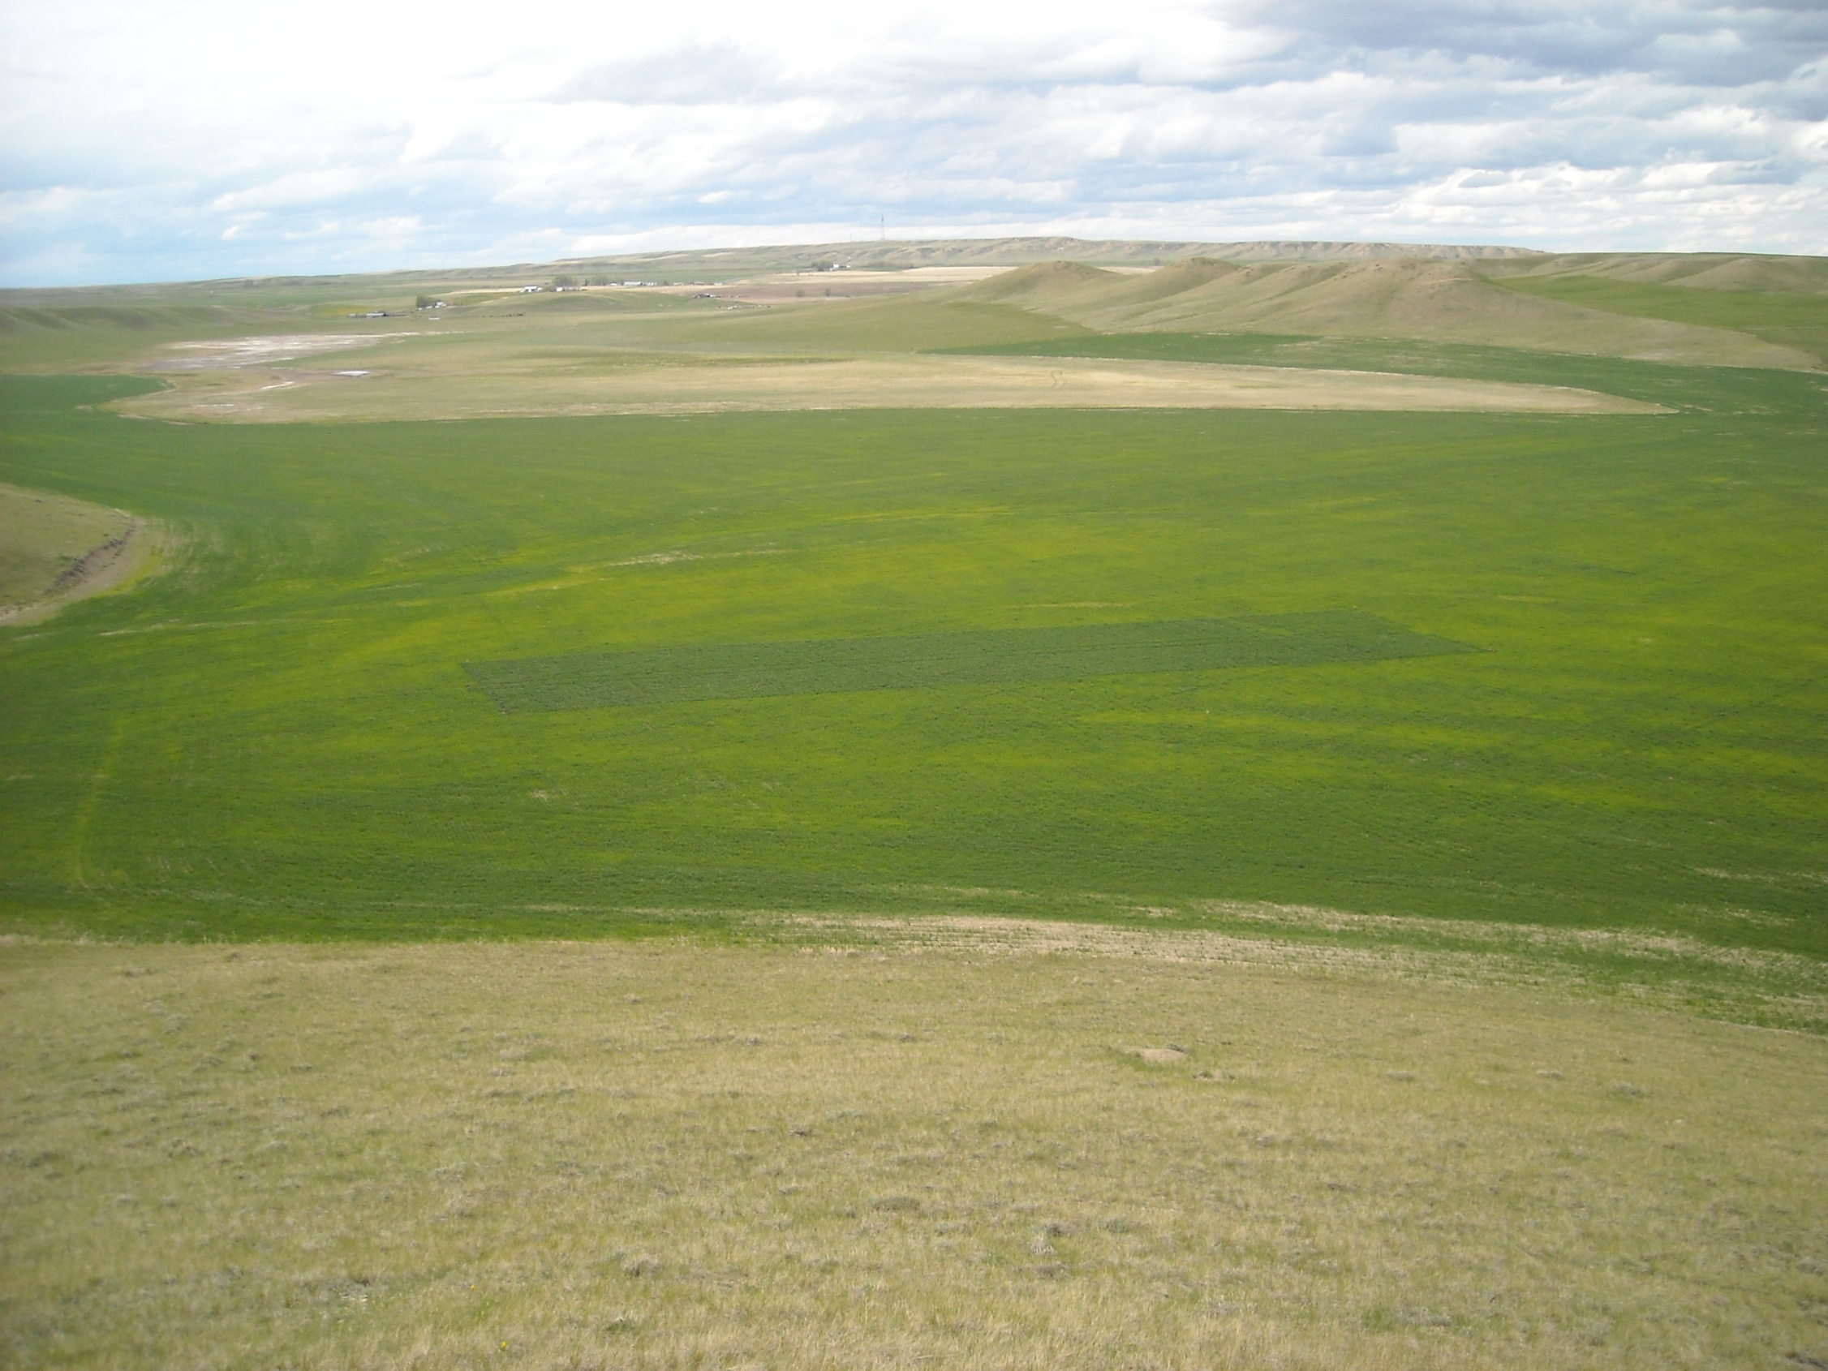
Rob Lightner
Conrad, Montana

Slide 3

N Sensors
1996, first passive, multi sensor variable N rate application system
1999, first active sensor based variable N rate application system
2001, Greenseeker-NTech, first active commercial sensor based variable nitrogen rate application system
2010, >500,000 acres, GreenSeeker sensors
>110,000 acres Europe

Slide 4
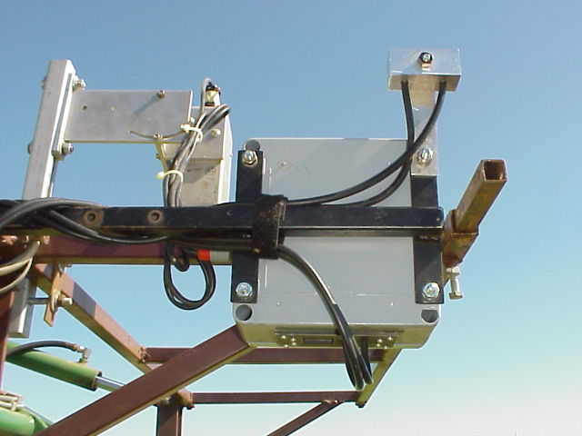
Passive Sensor Accounting for Incident Light
1994

Slide 5
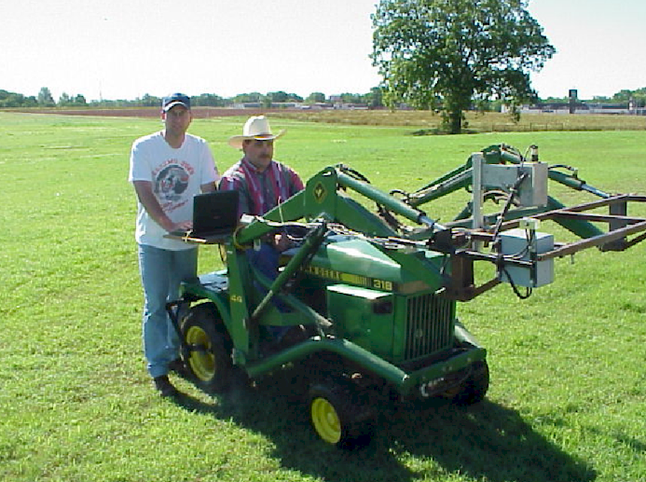
Notes:
Here is the optical sensor we used. It’s mounted on a John Deere tractor. It measures both solar irradiance and plant surface reflectance.

Slide 6
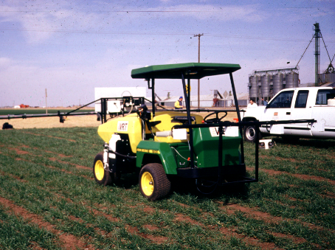
1996
Variable rate
spray nozzle
Sensor assembly
Sensed area
(treated area)

Slide 7
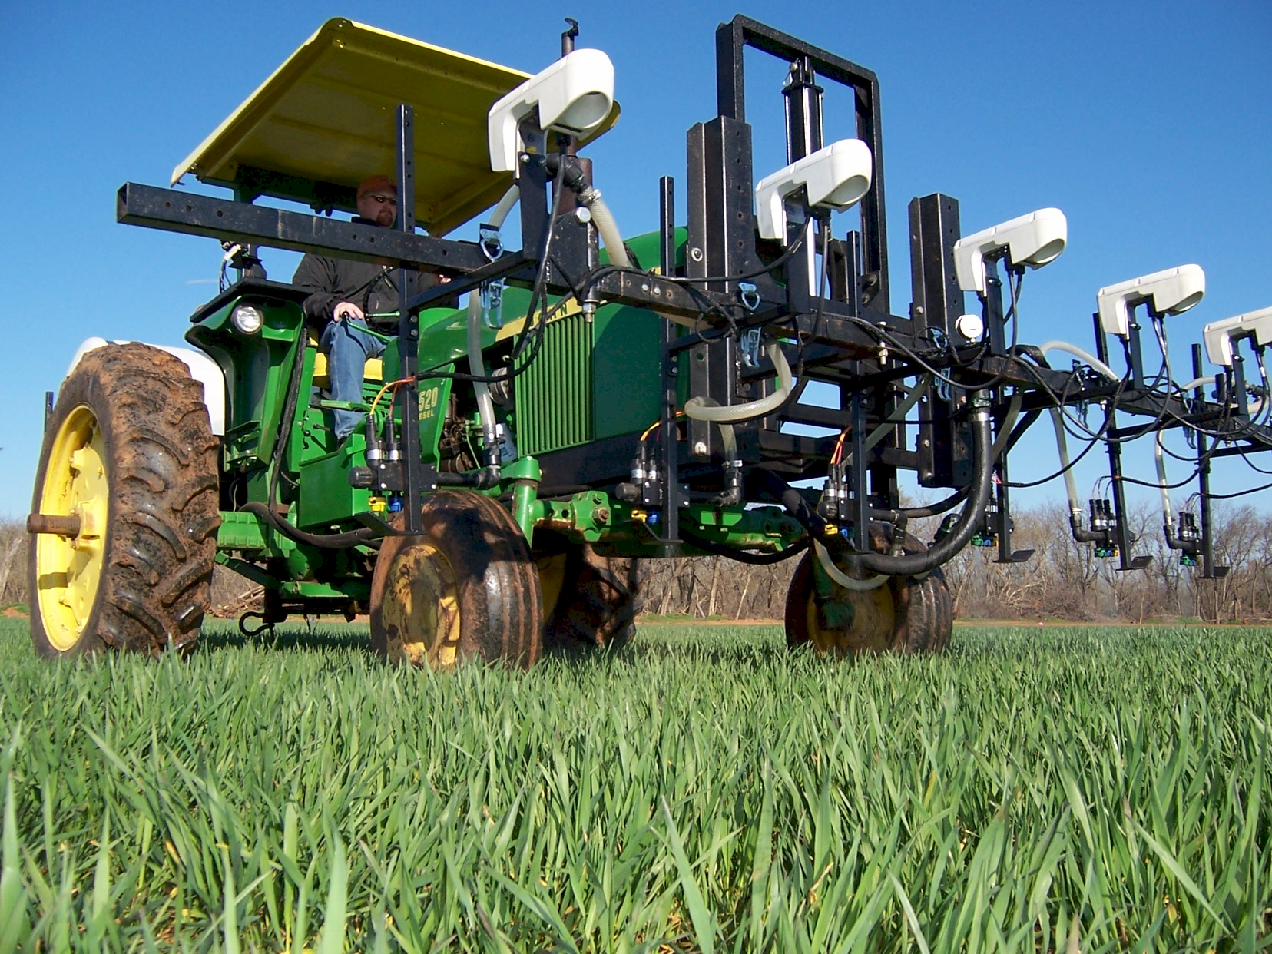
On the go sensing and fertilization

Slide 8
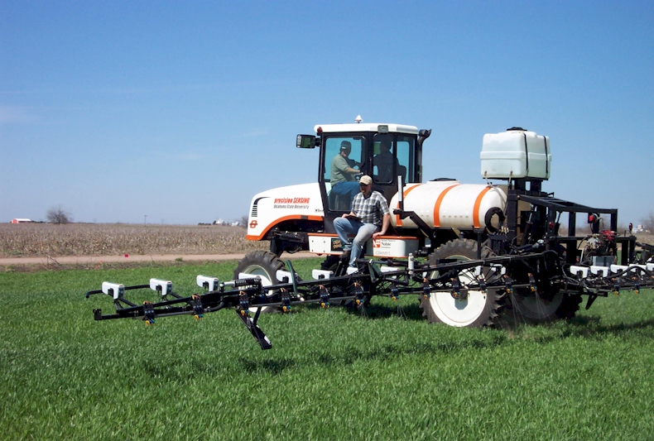

Active sensing/fertilizing
2001
precision SENSING

Slide 9
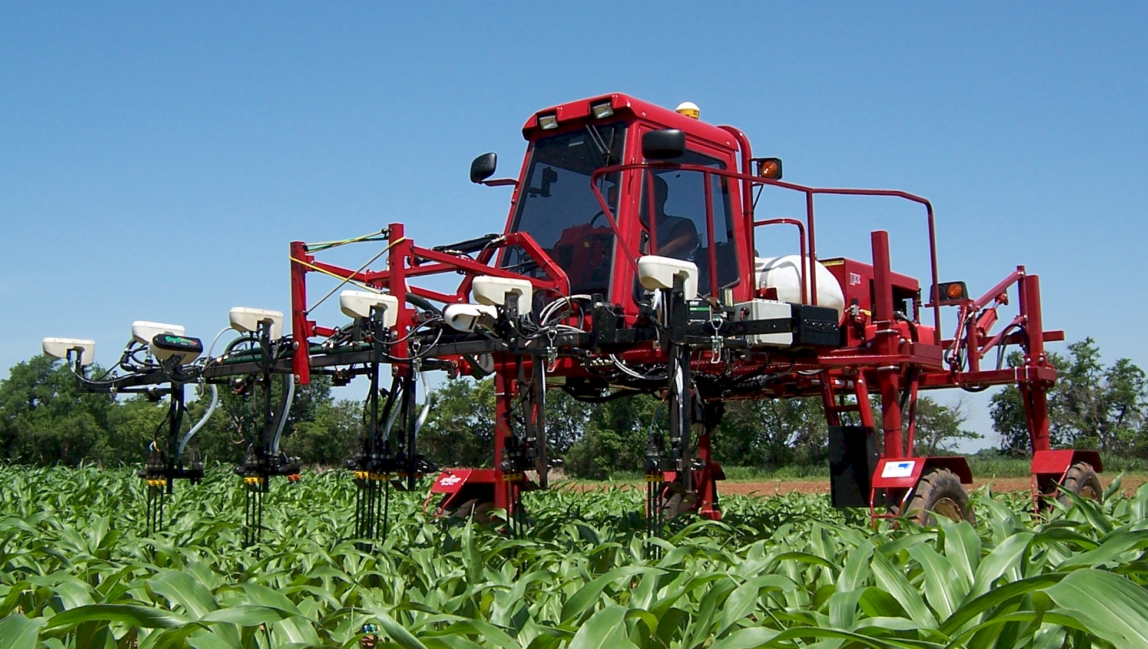
Sense and Fertilize by-plant
2006

Slide 10
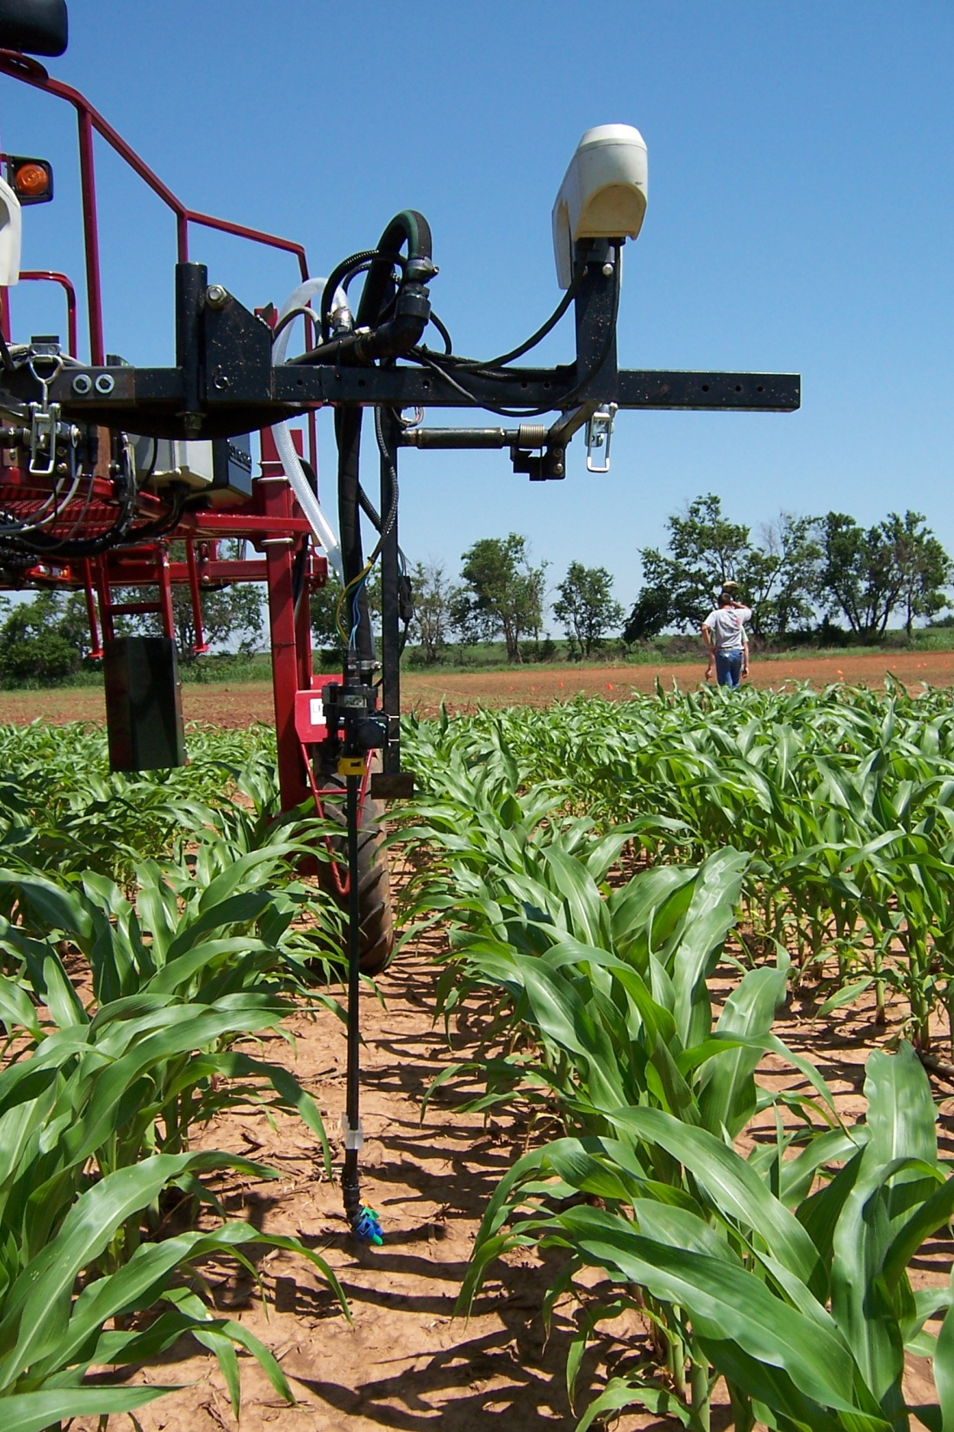

Slide 11
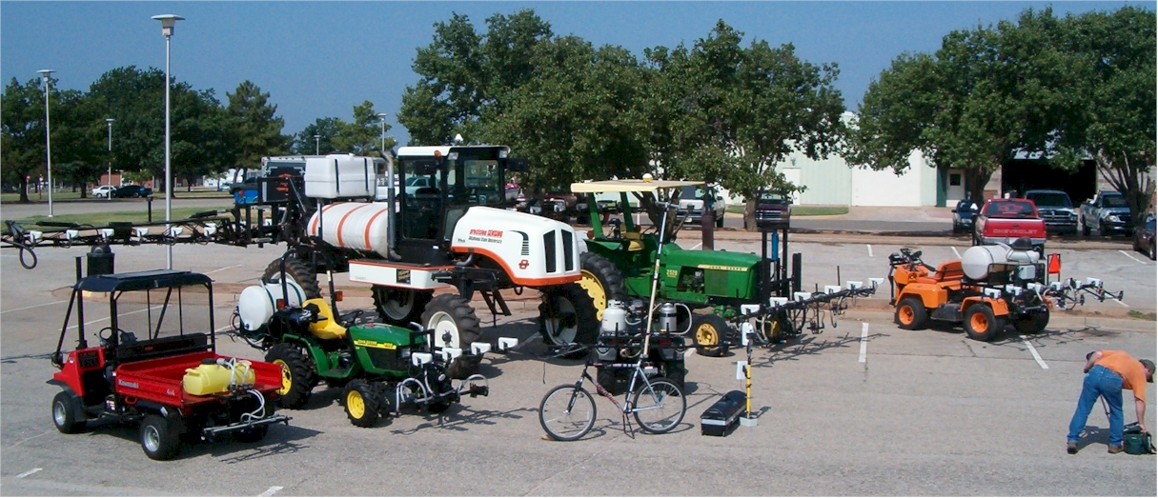

Slide 12
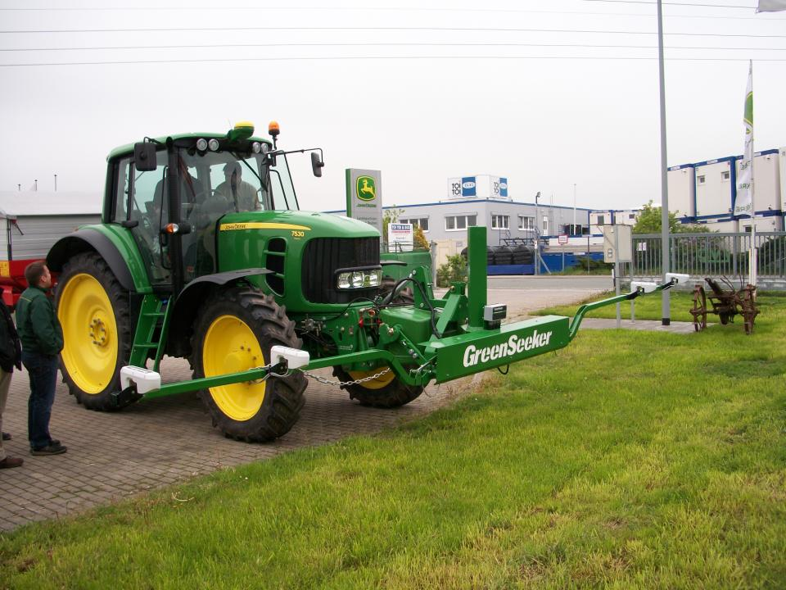

Slide 13
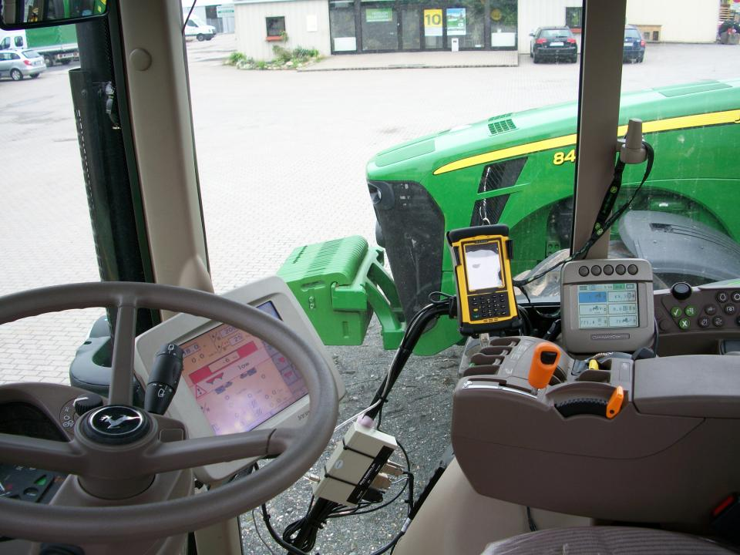
Intimidation of Precision Agriculture

Slide 14
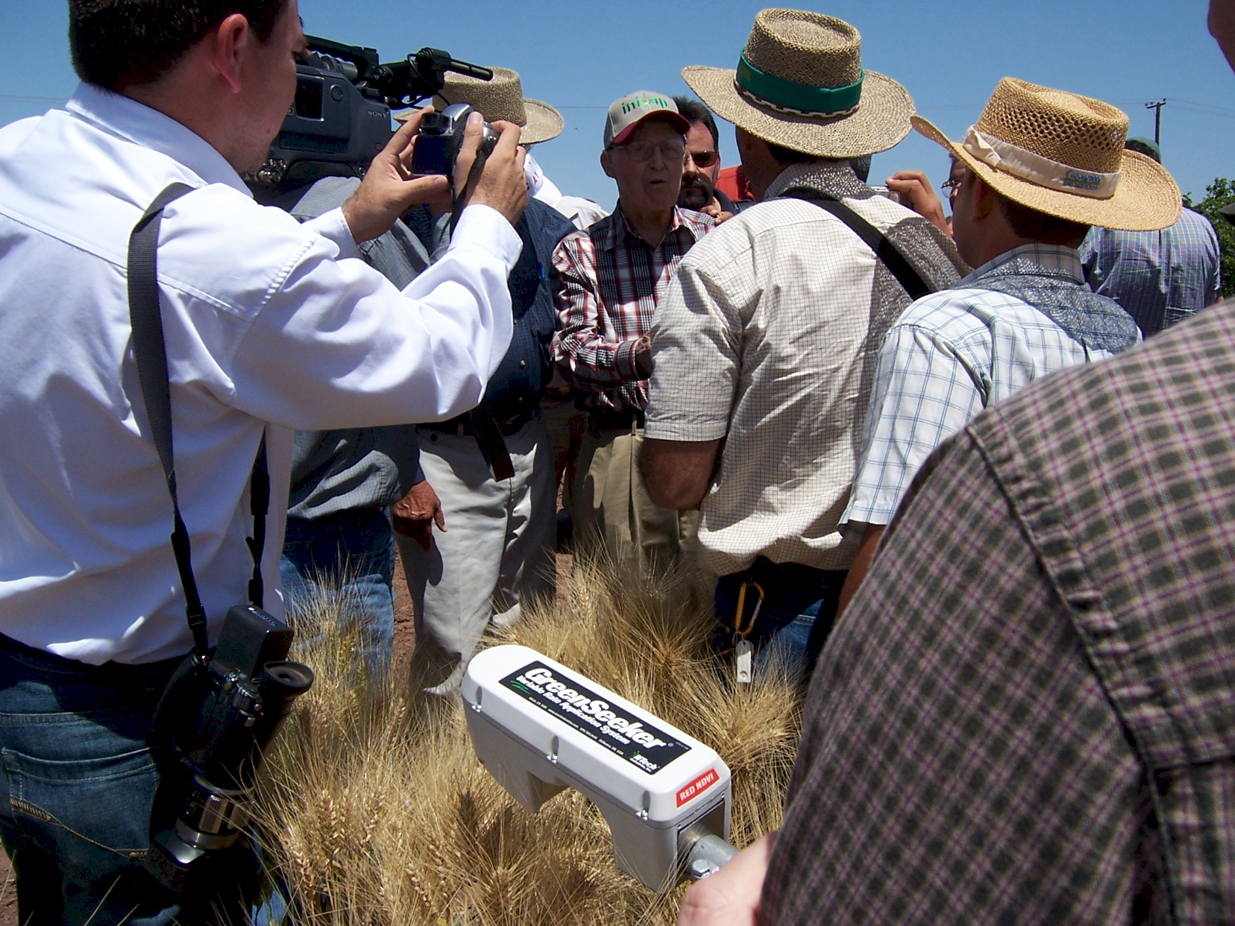
GreenSeeker sensing technology endorsed by Dr. Norman E. Borlaug, April 2007

Slide 15
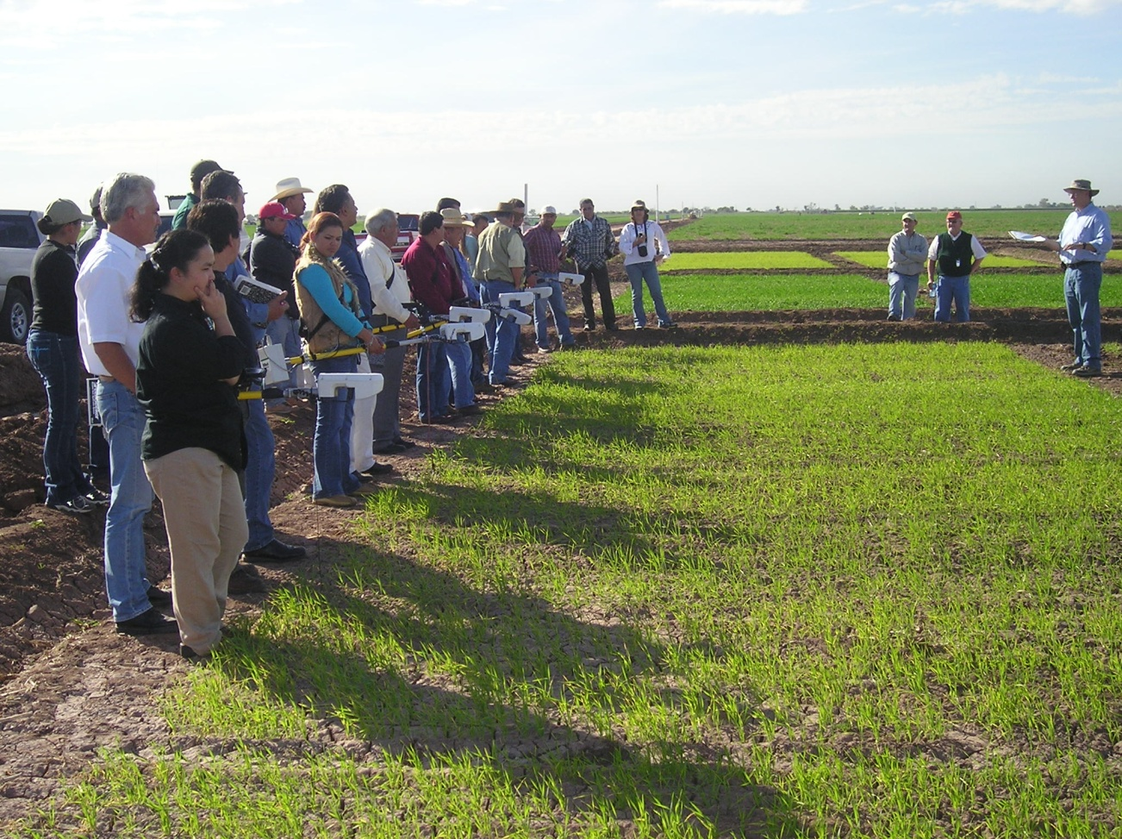
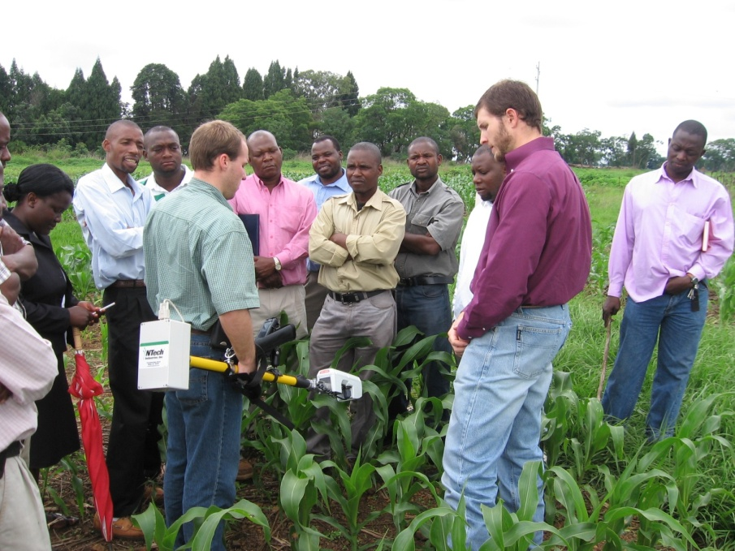
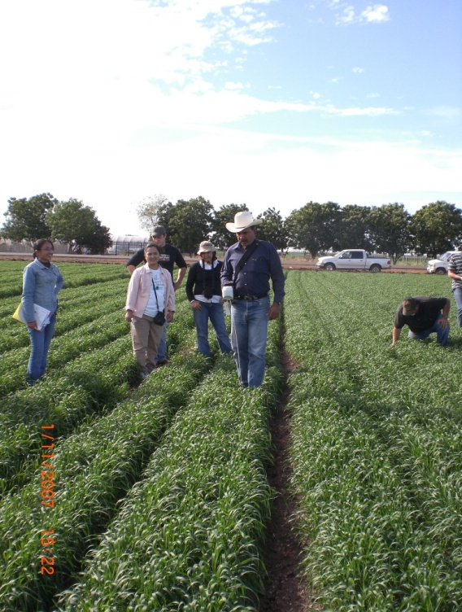
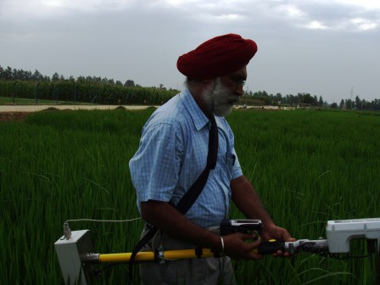
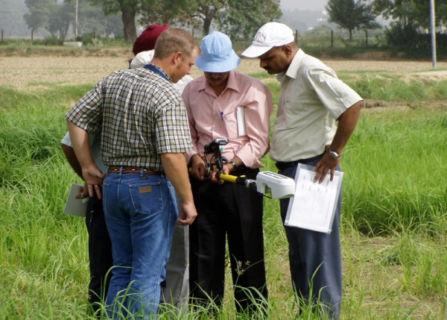
Ciudad Obregon, Mexico
Modipuram, India

Slide 16
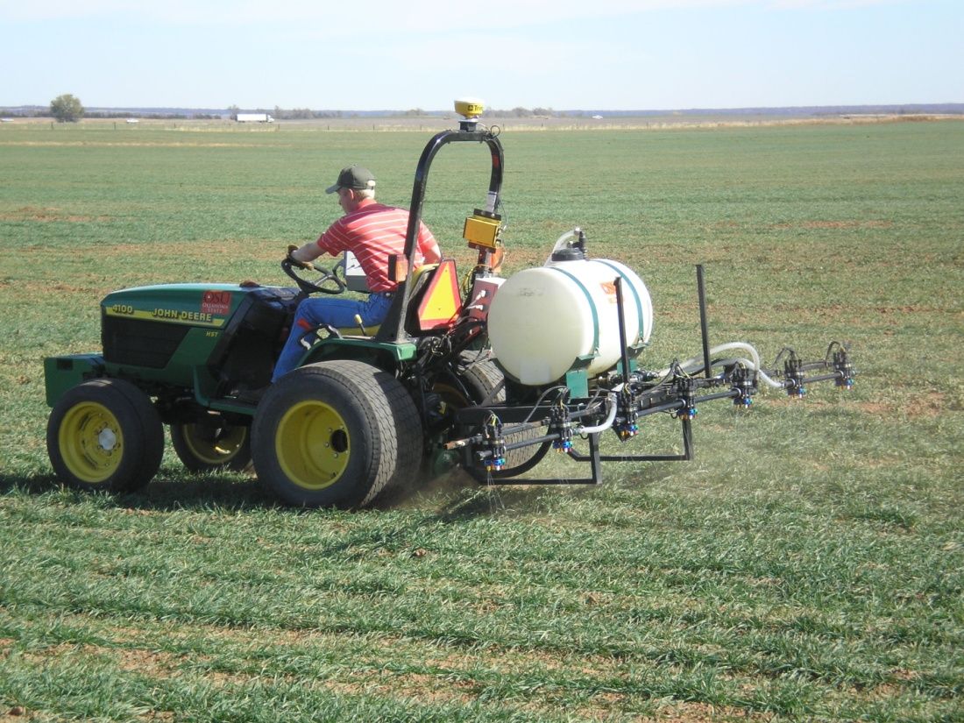
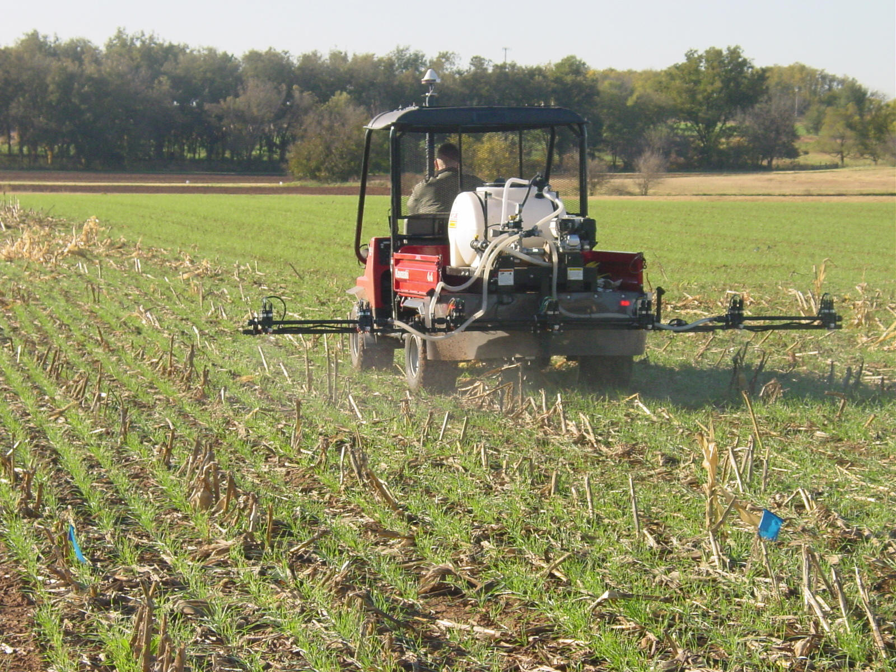
Ramp Applicators

Slide 17
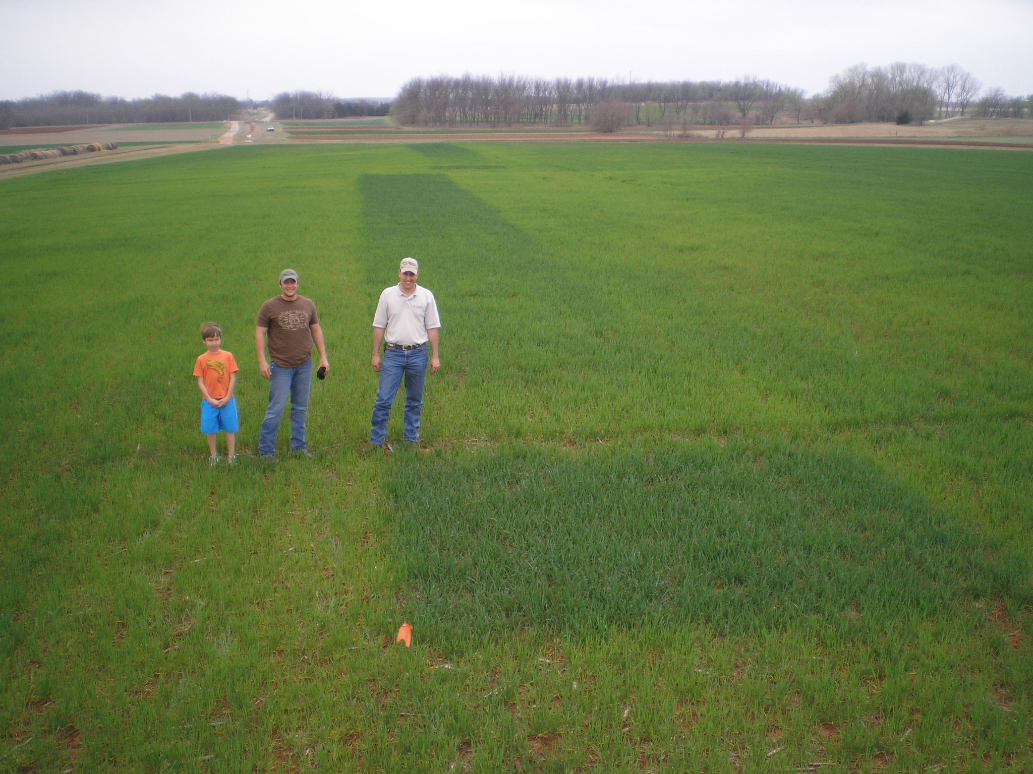
Visual Confirmation

Slide 18
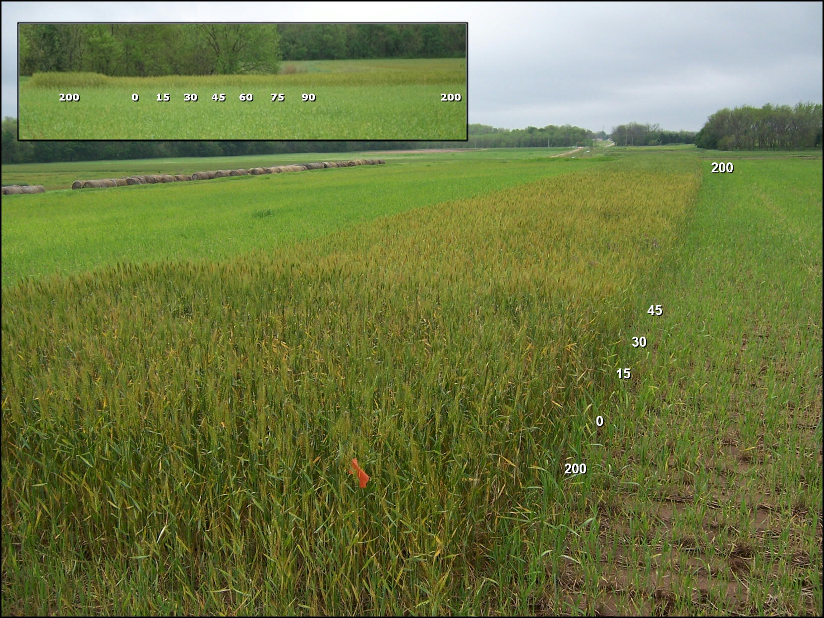
N Rich Strip, RAMP

Slide 19
Where do we stand?
Sub-Saharan Africa USA
Population, million 700 300
Cereals, million ha 88 56
Production, million tons 97 364
Yield, tons/ha 1.1 6.5
Fertilizer N, million tons 1.3 10.9
Avg. N rate, kg/ha 4 52
NUE >100* 35
% of world N consumed 1.4 13
% of world population 10 4
1 billon dollars in excess N flowing down the Mississippi River, annually **
*Edmonds, et al., 2009. Cereal nitrogen use efficiency in Sub Saharan Africa. J. Plant Nutr. 32:2107-2122

Slide 20
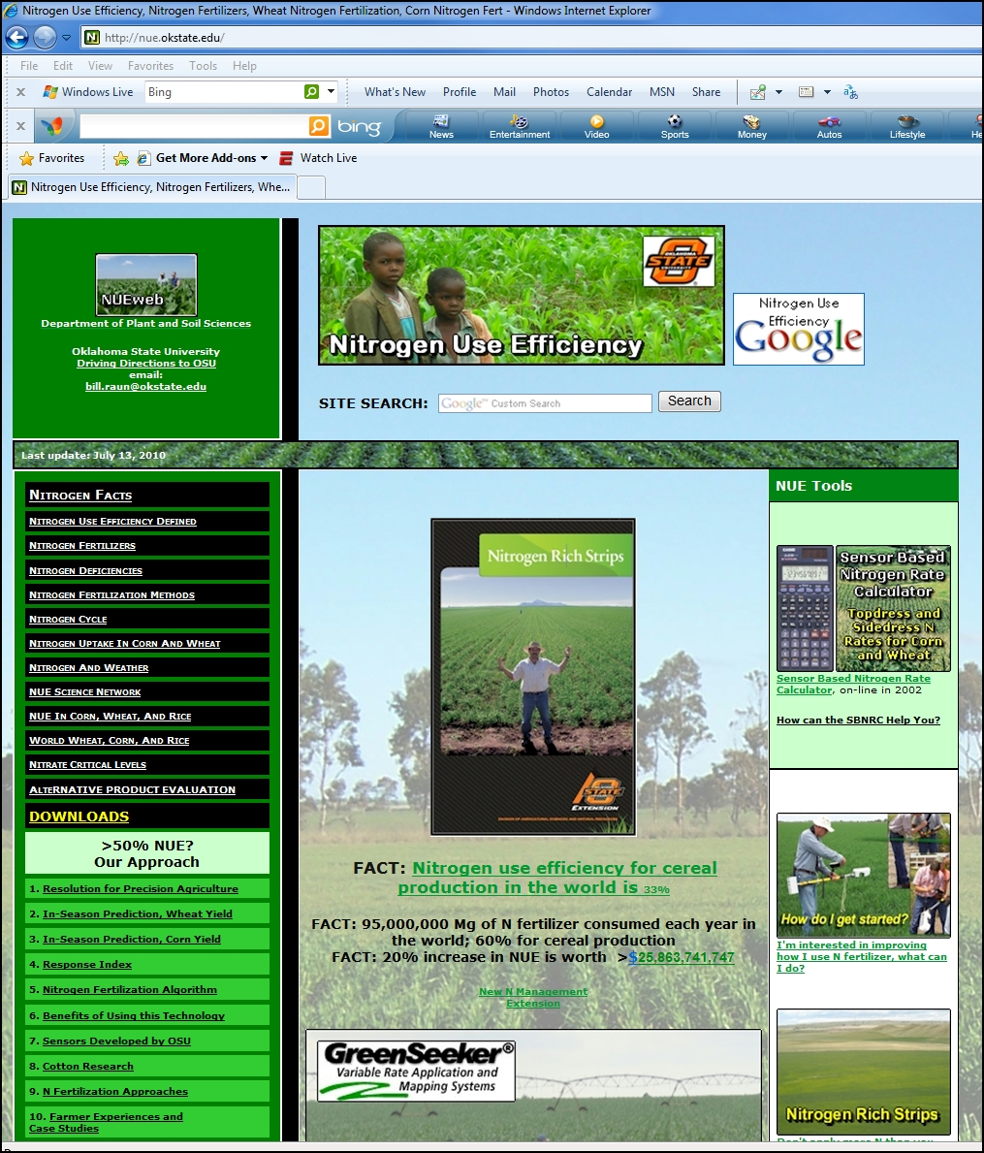
extension
SBNRC
Mexico
India
China
Kenya
Zimbabwe Argentina
Australia
Canada
Ethiopia
nue.okstate.edu

Slide 21
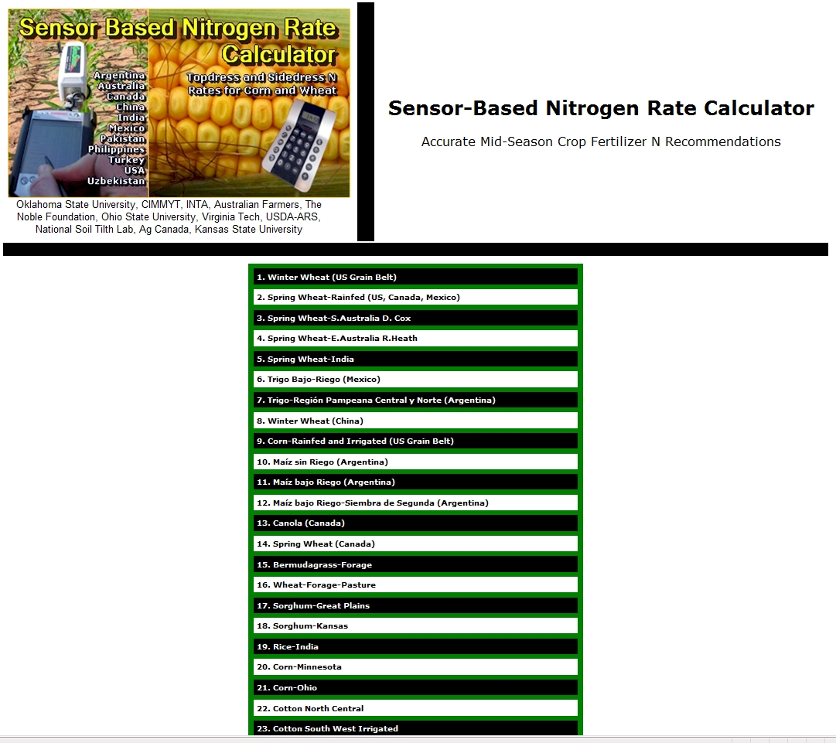

Slide 22
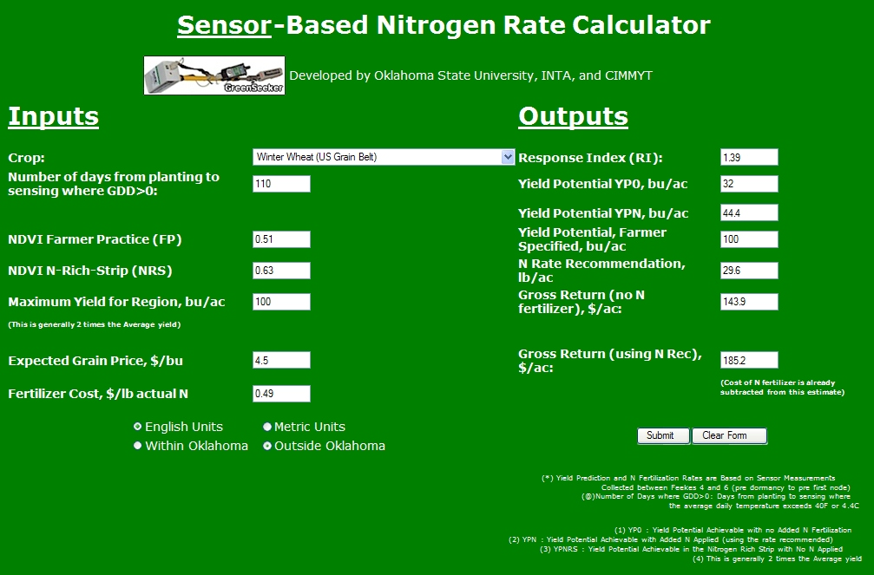

Slide 23
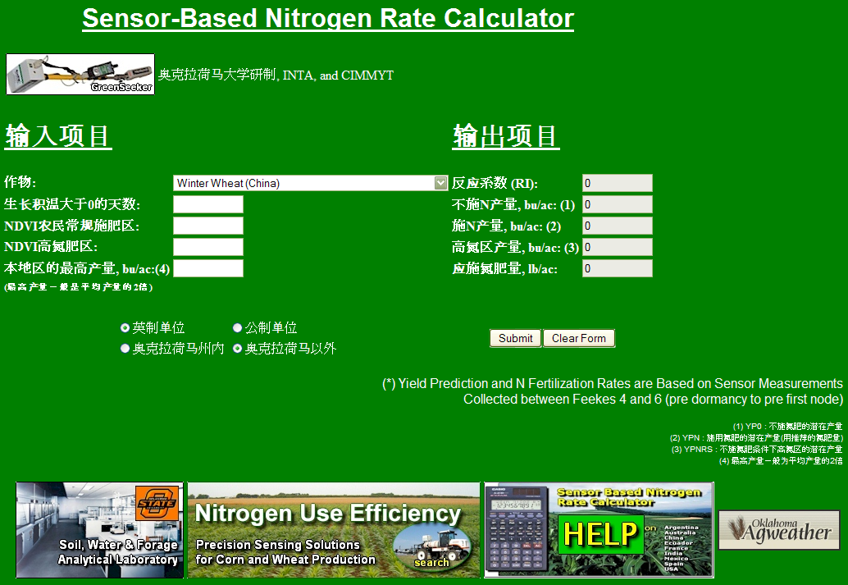


Slide 24
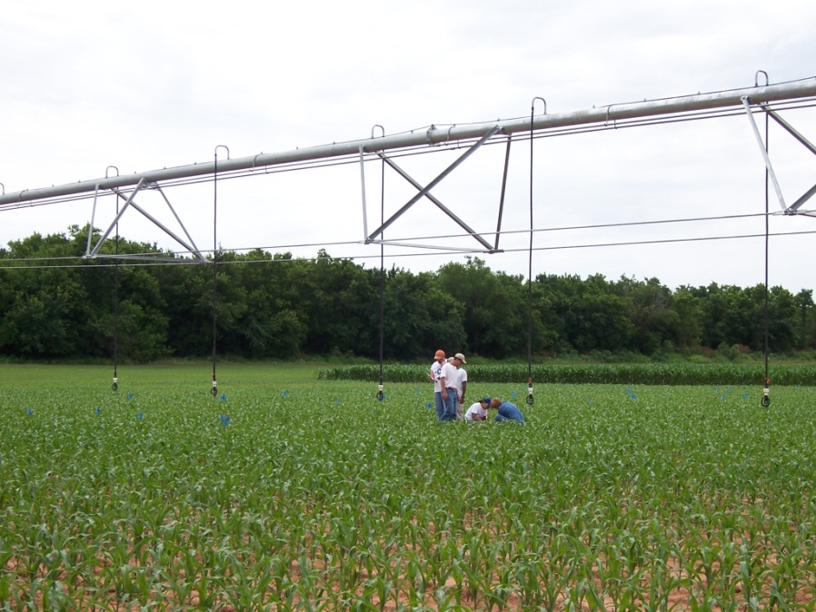
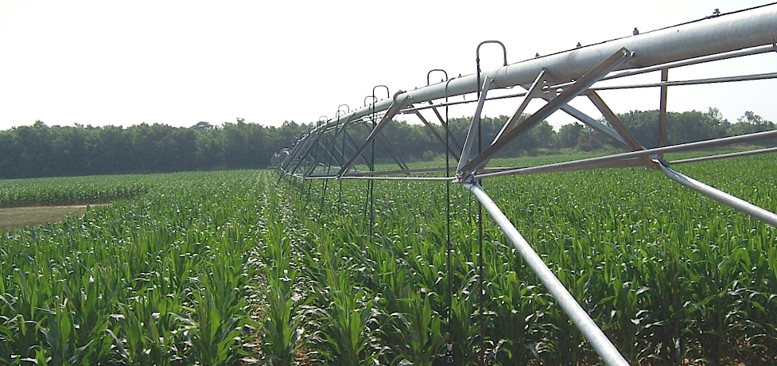

Corn Research

Slide 25
Importance of Using
Yield Goals (Yield Potential)
Nutrient removal can be reliably estimated for a given yield level in specific crops (IPNI)
Selected Yield Goal defines the risk the producer is willing to take
Yield Goal can define the limits in terms of economic inputs when considering herbicides, insecticides, etc.

Slide 26
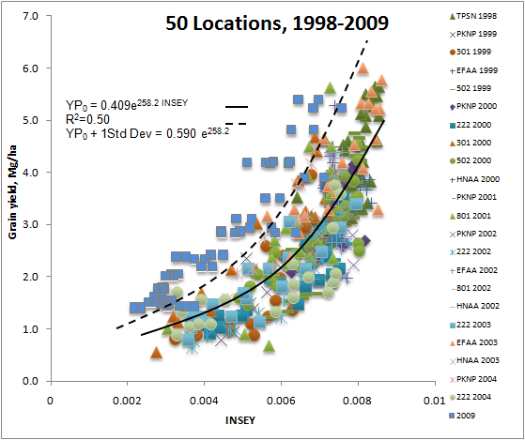
Yield Potential Prediction

Slide 27
Variable N Response

Slide 28
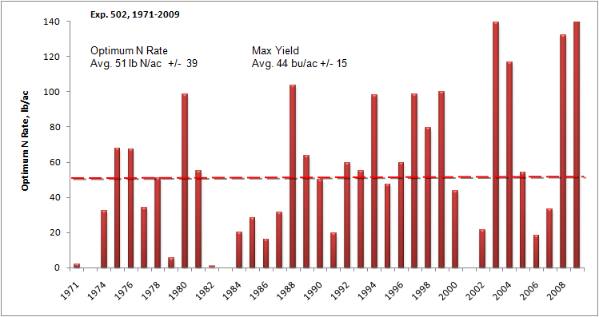
N Rate Temporally Dependent

Slide 29
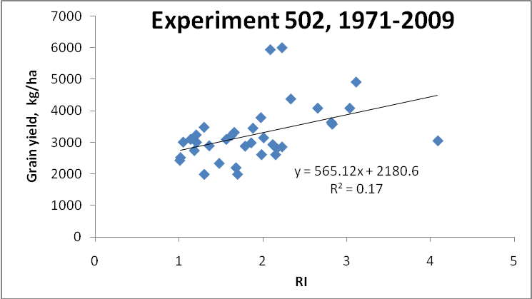
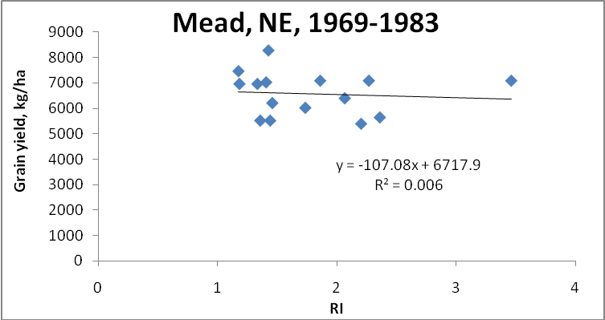
Independence of YP0 and RI

Slide 30
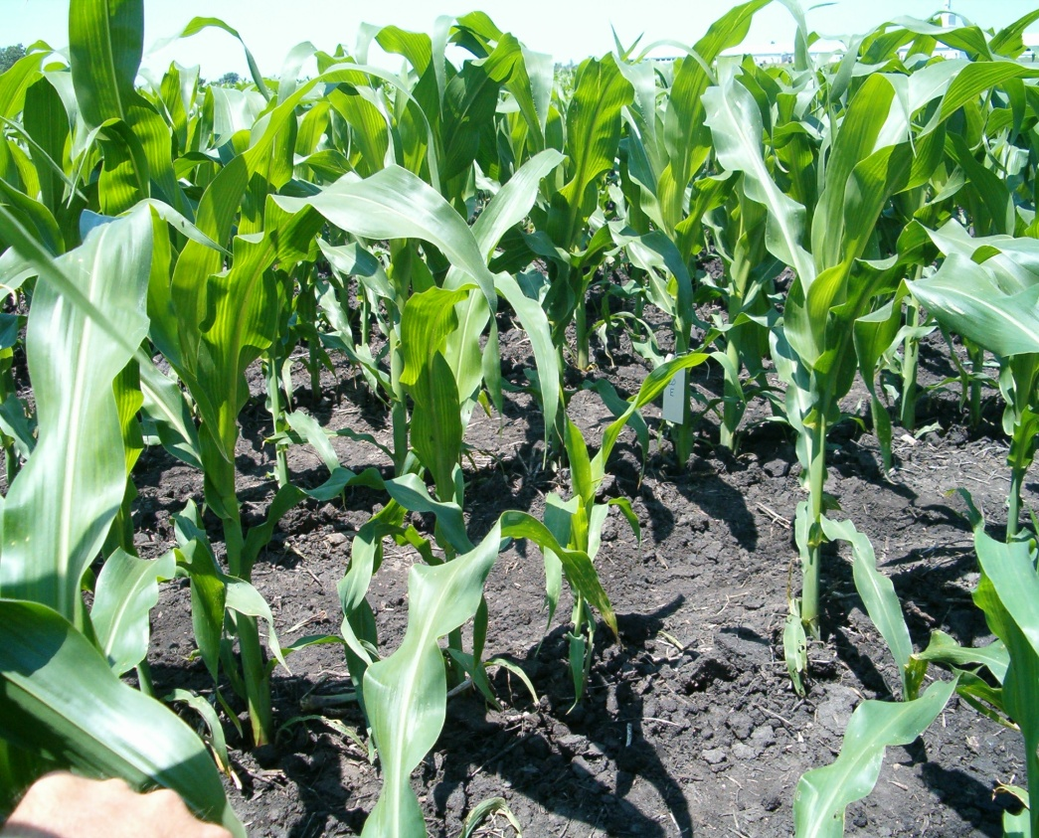
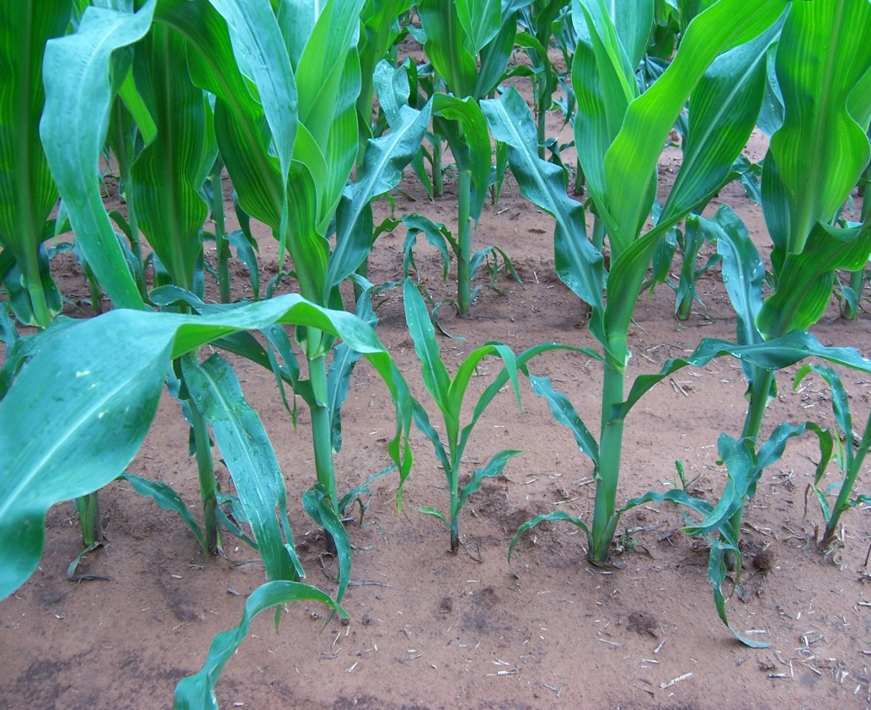
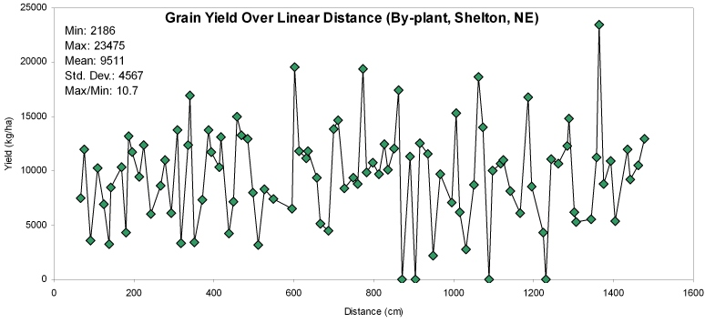
By-Plant N Management
IOWA
OKLAHOMA

Slide 31
Plant-to-plant variation, averaged 2765 kg/ha, or 45 bu/ac (Nebraska, Iowa, Virginia, Oklahoma, Argentina, Mexico, Ohio) 46 transects
0 4 8 12 16
Distance, m

Slide 33
5-Plant Sequence

Slide 34
RI-NFOA
YP_{N}=YP₀ * RI
YP_{N}
YP_{N}
YP₀
YP_{MAX}
RI=1.5
Grain yield
RI=2.0
A
INSEY (NDVI/days from planting to sensing)
YP₀ = (NDVI / Days, GDD>0)
YP₀ = INSEY
YP_{N} = (YP0*RI)
Nf = (YP₀*RI) – YP₀))/Ef

Slide 35
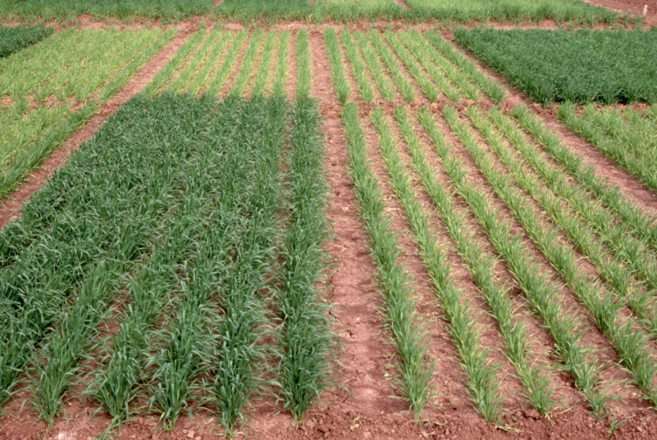
Max Yield-NFOA
YP₀
YP_{MAX}
Grain yield
B
INSEY (NDVI/days from planting to sensing)
Nf = (YP_{MAX}-YP₀)/Ef

Slide 36
RI=2.0
YP₀
YP_{N}
RICV-NFOA
YP_{MAX}
Grain yield
CV
CV
C
INSEY (NDVI/days from planting to sensing)
Nf = ((YP₀*RI)*(65-CV/65-CrCV)) – YP₀/Ef
65? Limit of CV data
Critical CV or CrCV, changes for different crops
Corn
Wheat

Slide 37

Extension/Training
Farmer training, Ciudad Obregon, Mexico, January 2007

Slide 38
2010 Regional Trials
Opt.N SBNRC 0-N Opt. N
N Rate N Rate Yield Yield
lb/ac lb/ac bu/ac bu/ac
Lahoma 50 50 25 38
Lake Carl Blackwell 25 39 40 55
Hennessey 75 51 38 56

Slide 40
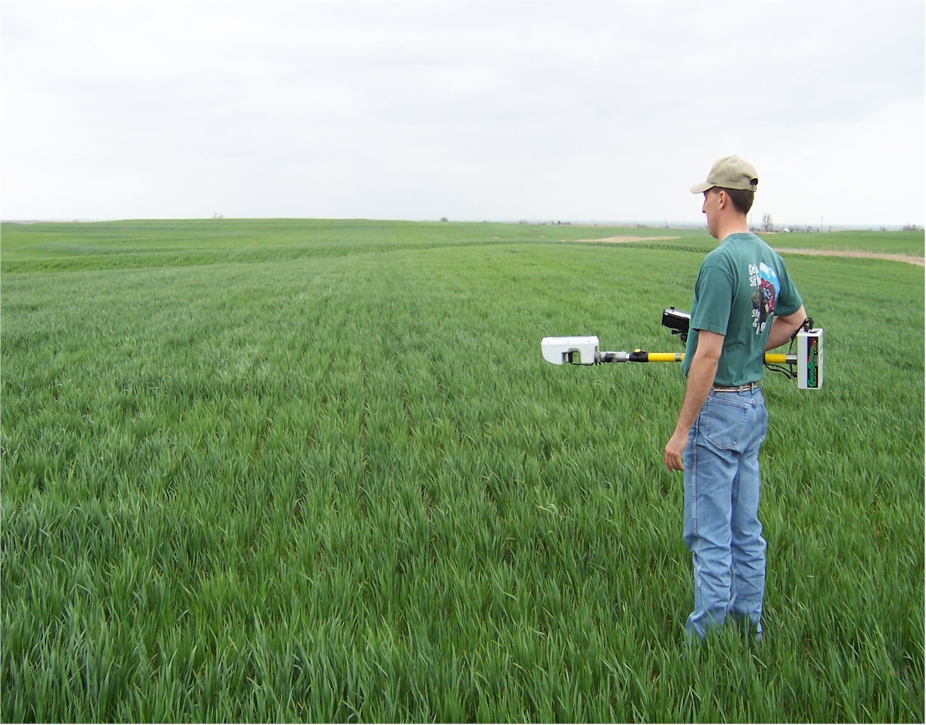
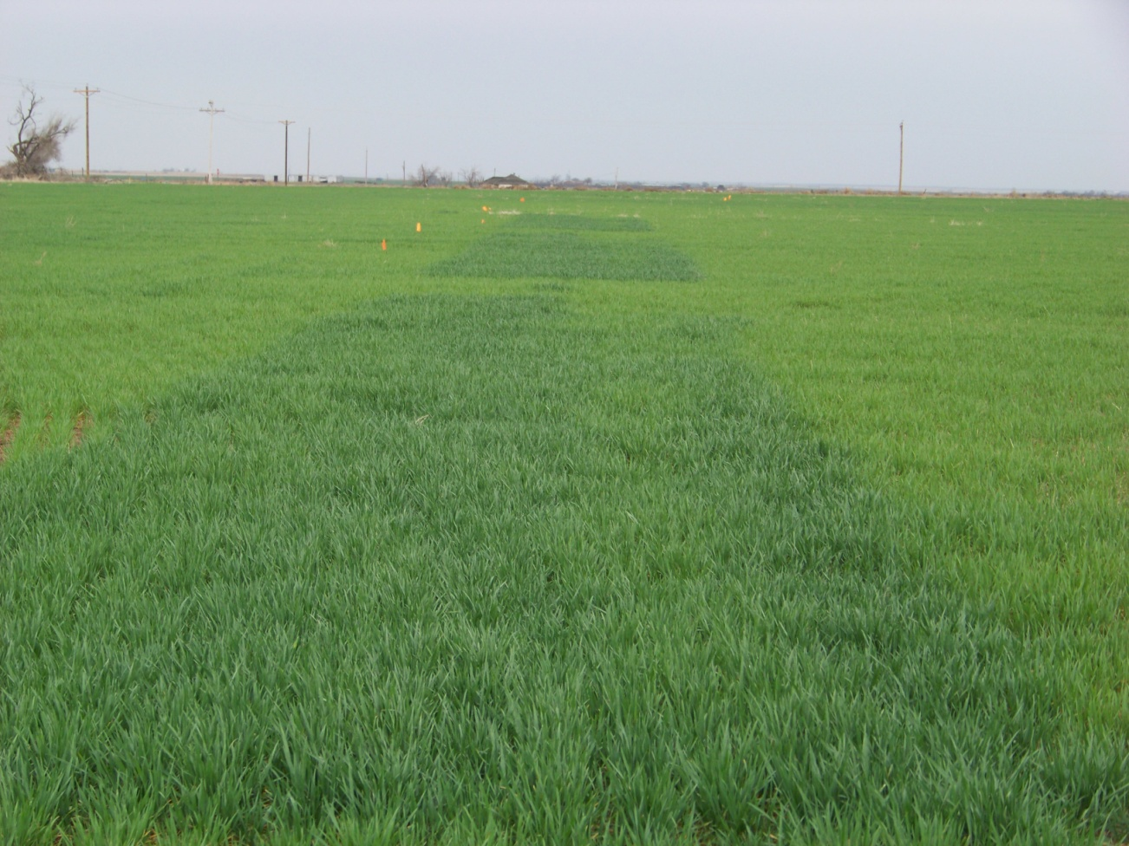
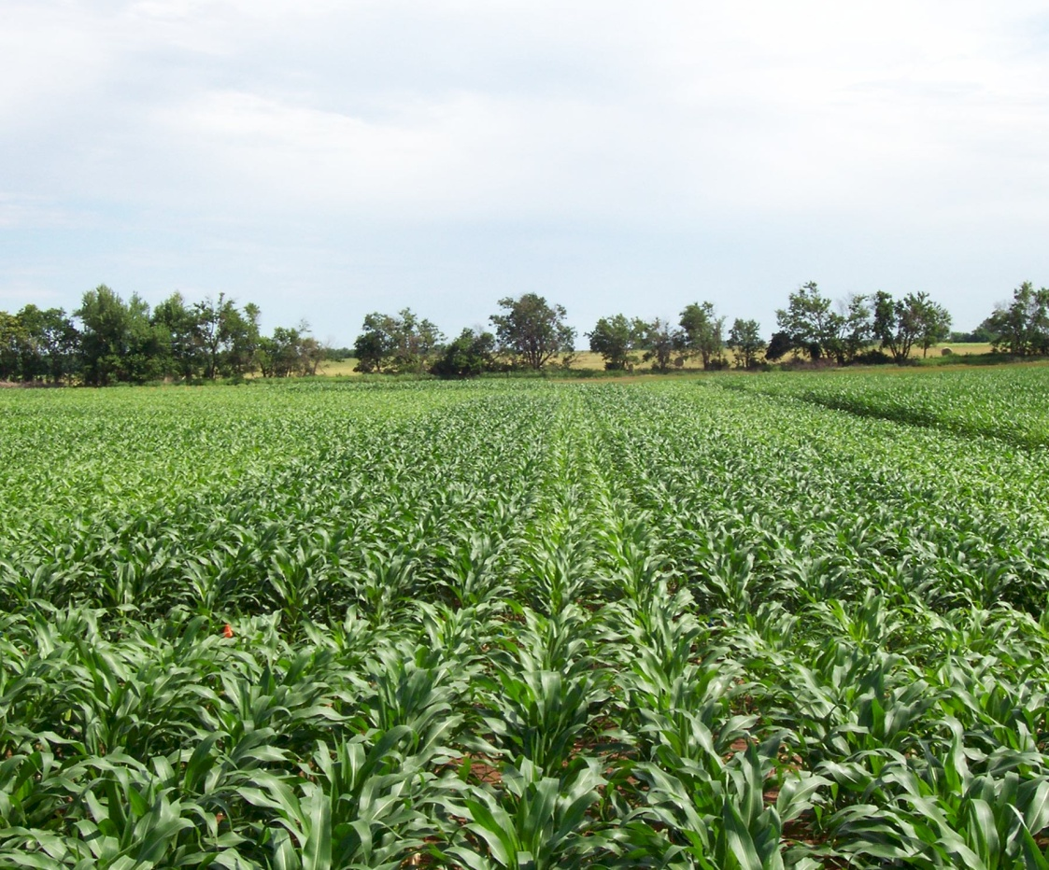
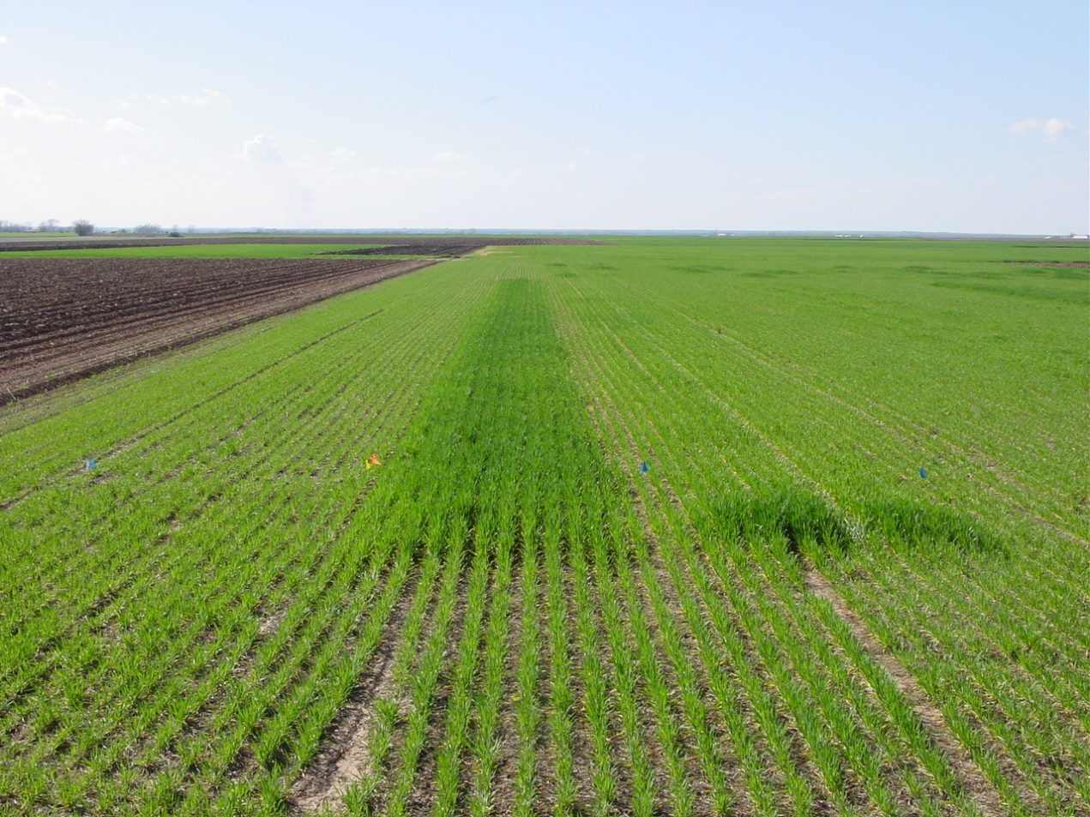

Slide 41
Value of the N Rich Strip
20 inches of rain prior to planting. Would an N Rich Strip help?
Assumed all N in the N Rich Strip lost due to denitrification and/or leaching
Use of manure in the system: Value of the N Rich Strip becomes even more valuable as the amount of N mineralization (manure plots) changes dramatically depending on the environment. How much N was available (dry vs wet year)? Can be determined by having an inorganic N Rich Strip.
Can we make any of these decisions without the N Rich Strip?

Slide 42
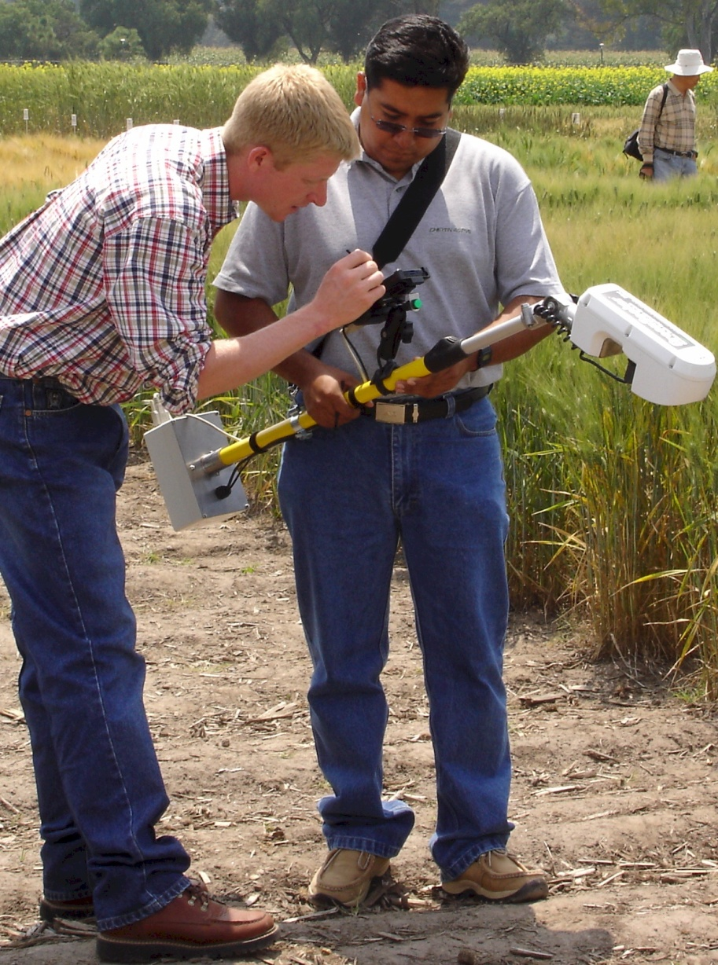
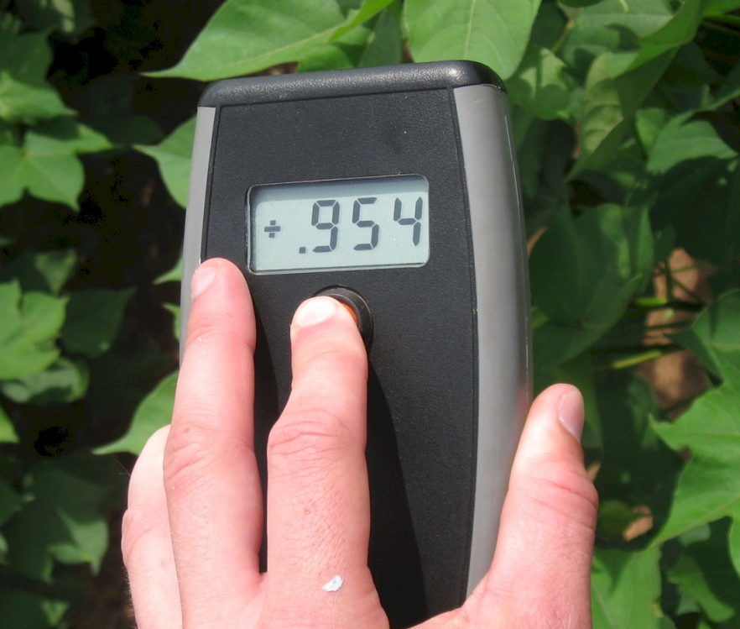
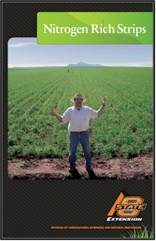
Current Work
Optical Pocket Sensor
  3rd world
  Common Farmer Tool
Pocket Sensor
Notes:
Economists: Profit is directly proportional to risk

Slide 43
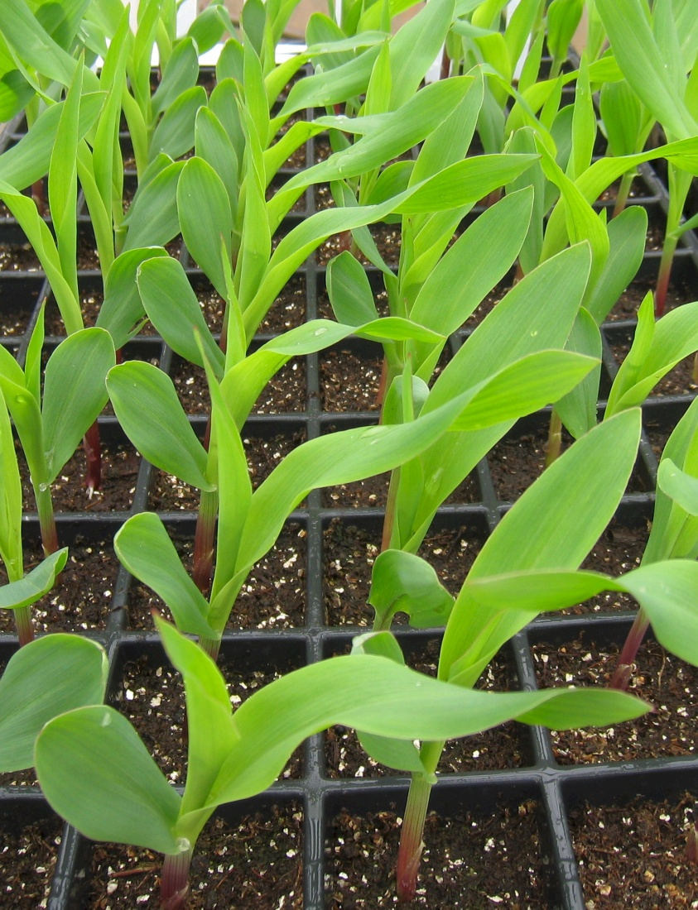
Current Work
Influence of seed placement on leaf orientation, increased light interception
Better prediction of yield potential using the MESONET
Use of soil profile moisture at sensing for improved prediction of yield

Slide 44
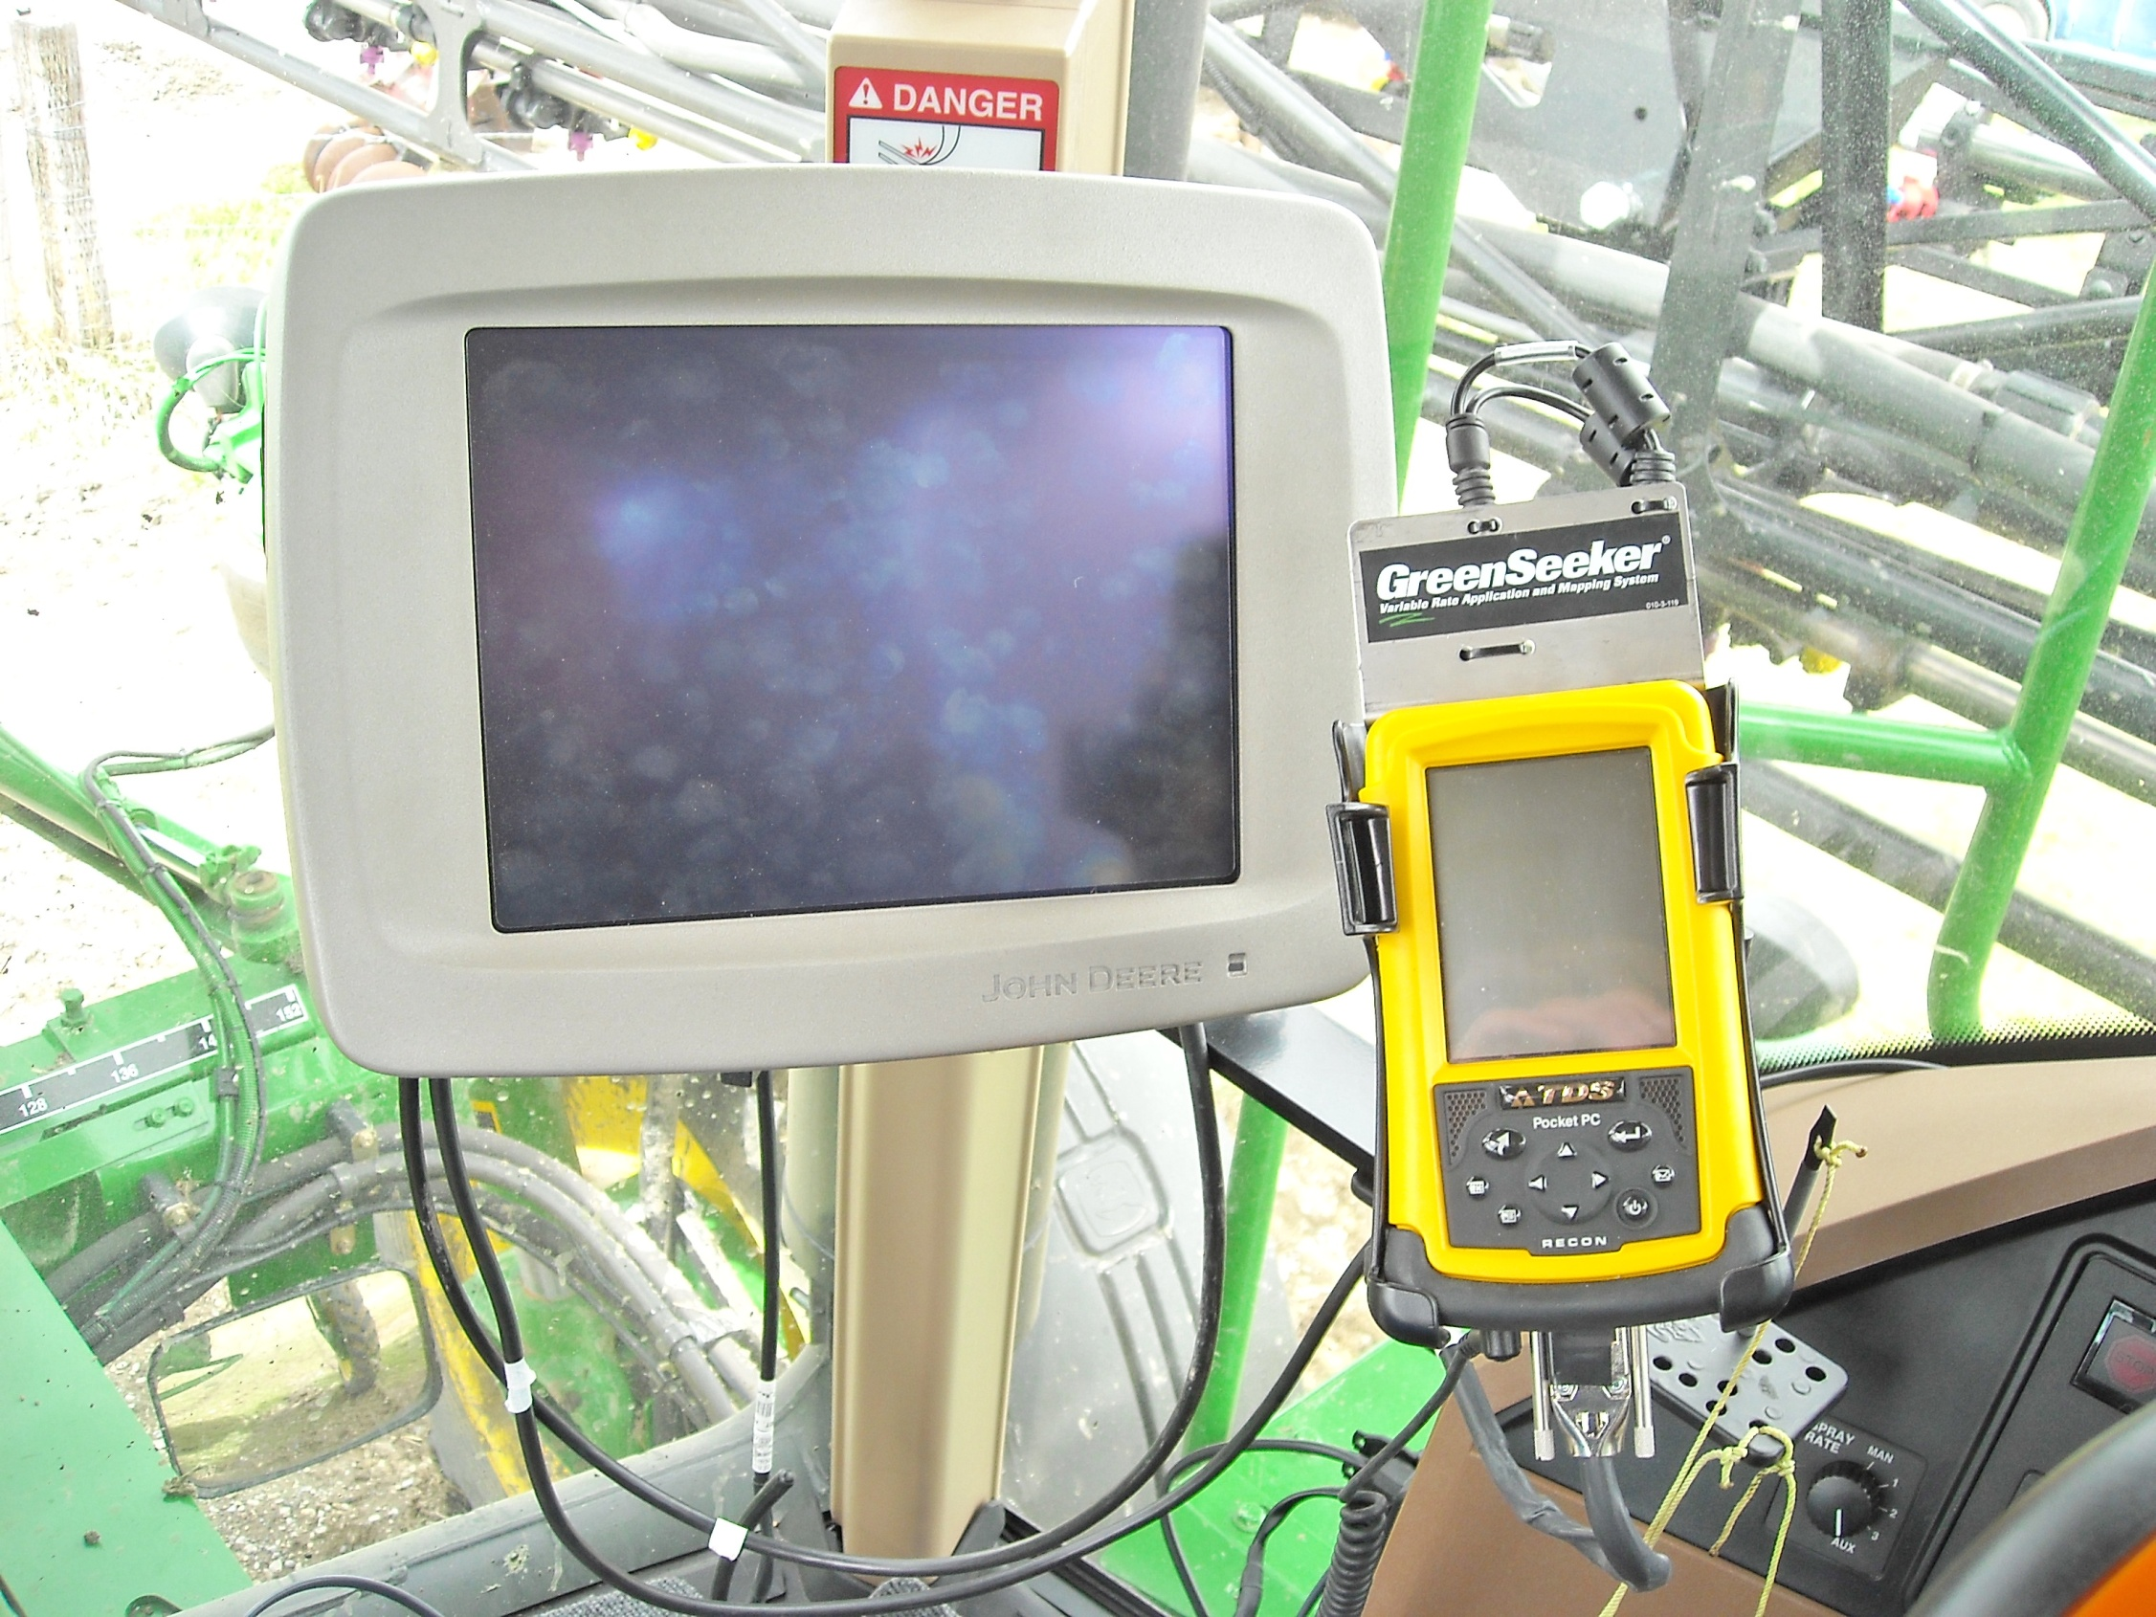
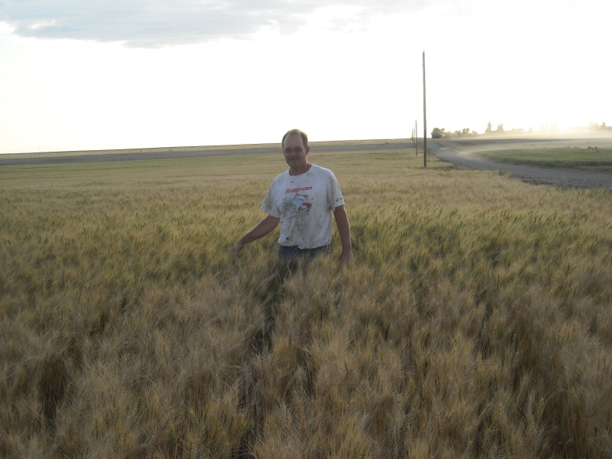

Slide 45
What we have learned
Yield potential can be predicted in corn, wheat, and rice (biomass produced per day)
Response to applied N is variable from year to year and can be predicted
Nutrient removal is tied to yield level
Yield potential and N responsiveness are independent
Value of N Rich Strips

Slide 46
Summary
Development of active sensors capable of collecting NDVI readings day or night has been advanced to highly affordable pocket sensors
Sensor technology has been expanded into applied functional algorithms that predict fertilizer N needs from mid-season data
On-the-go sensor based N management in cereals is commercially used to maximize farmer profits and minimize environmental risk via the judicious application of N fertilizers

Slide 47
Thank You
Jim Schepers Raj Khosla
John Solie Ted Mayfield
Marv Stone Brian Arnall
OSU Grad Students David Porter
Newell Kitchen Gyles Randall
Robert Mullen Steve Phillips
Brenda Tubana Kent Martin
Dave Mengel Kyle Freeman

