Slide 1
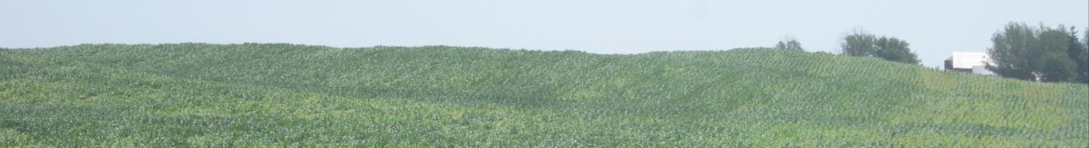

Adapt-N: A Tool for Adaptive Nitrogen Management in Corn
– Incorporating the Weather Component –
Hal Tucker (hal@iowaagconsulting.com)
Tucker Consulting Storm Lake, Iowa
Harold van Es, Jeff Melkonian, Bianca Moebius-Clune

Slide 2

Thanks to our Funders
New York Farm Viability Institute
USDA-NRCS Conservation Innovation Grants program
USDA-NIFA Agriculture and Food Research Initiative
USDA-NIFA Special Grant on Computational Agriculture (Rep. Maurice Hinchey)
Hatch – Smith Lever Funds
Northern NY Agricultural Development Program
International Plant Nutrition Institute

Slide 3
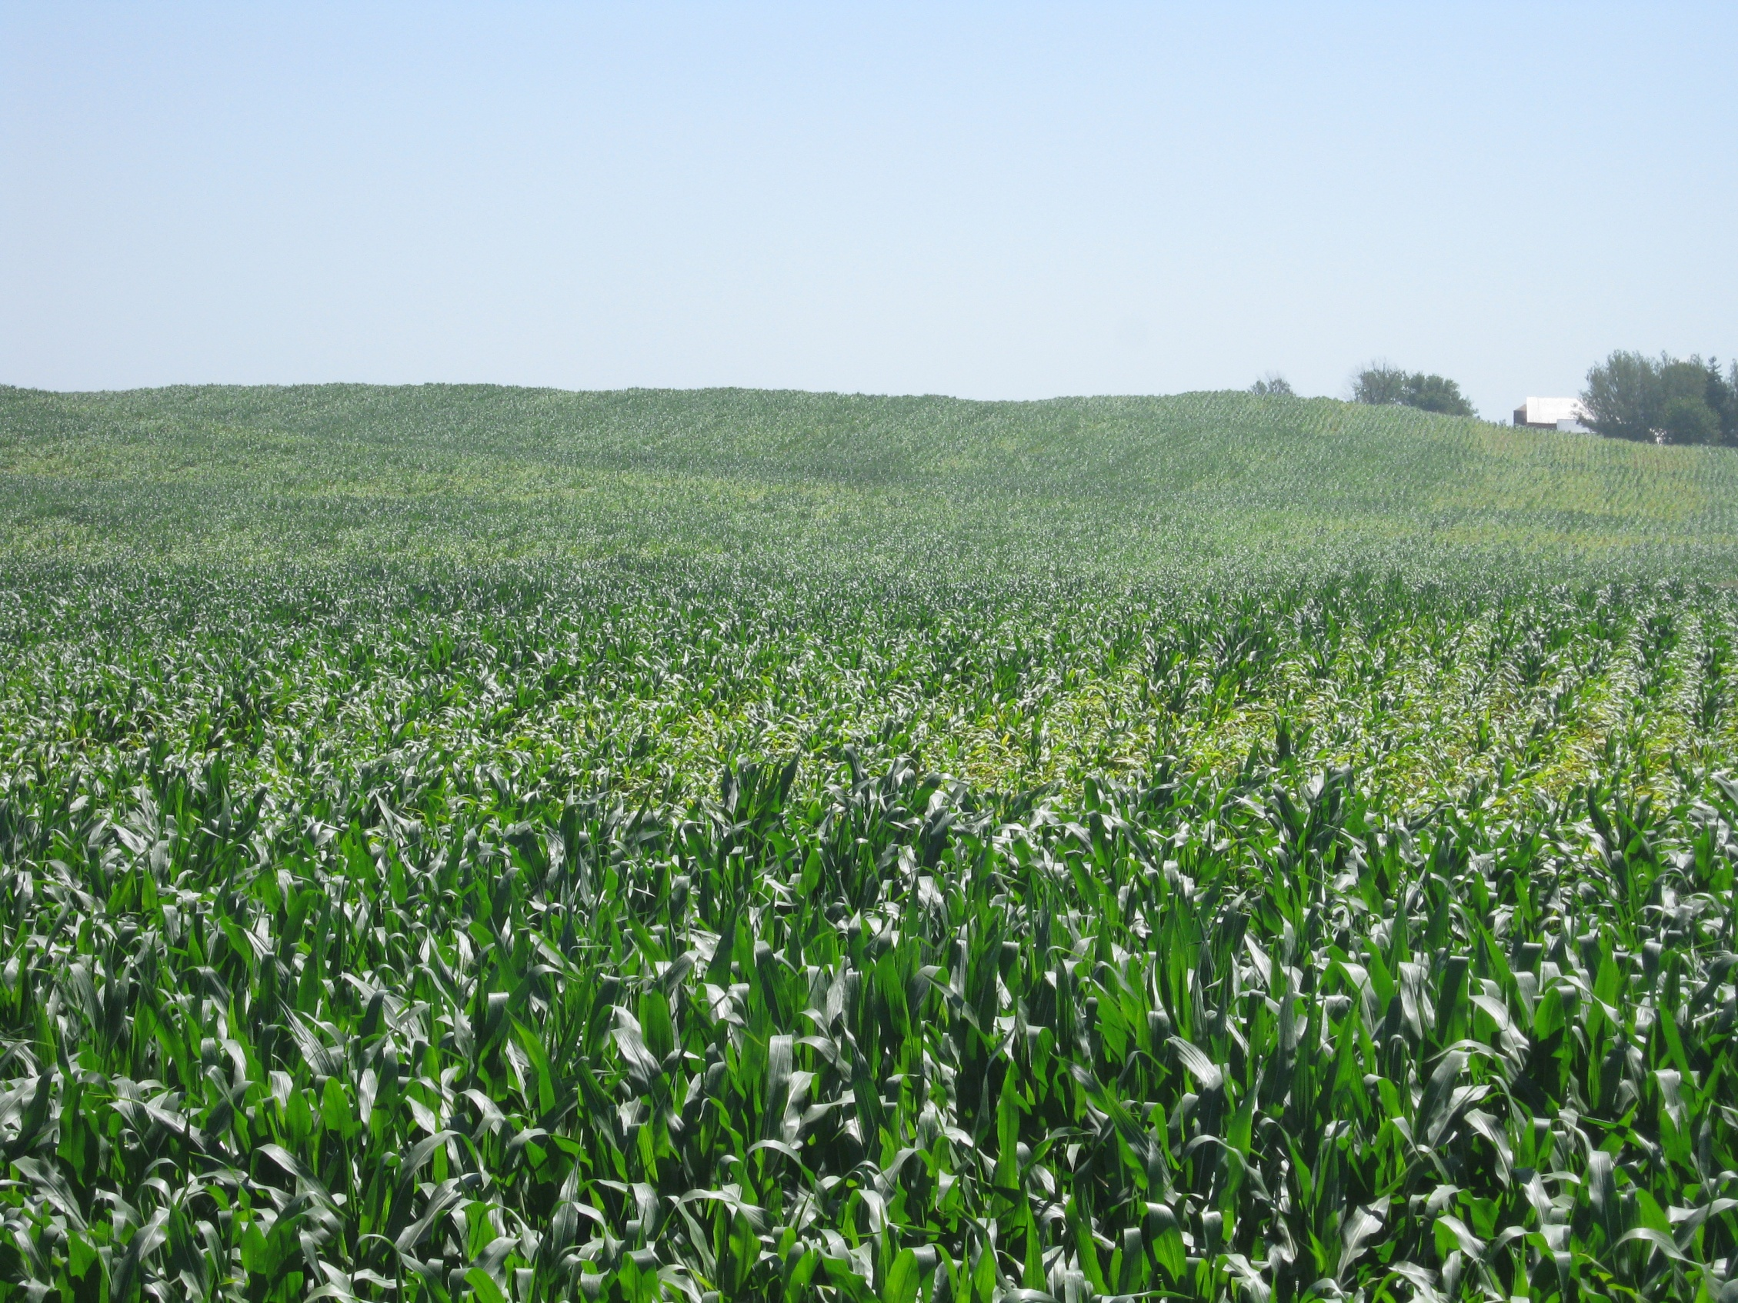
Overview
Why should we care? (N in Ag and Environment)
Where’d my N go? (Influences on N dynamics)
What is Adapt-N?
Beta-testing: 2011 On-Farm Results
Using Adapt-N effectively: a brief tutorial

Slide 4
Why should we care?
Nitrogen in
Agriculture and the Environment

Slide 5
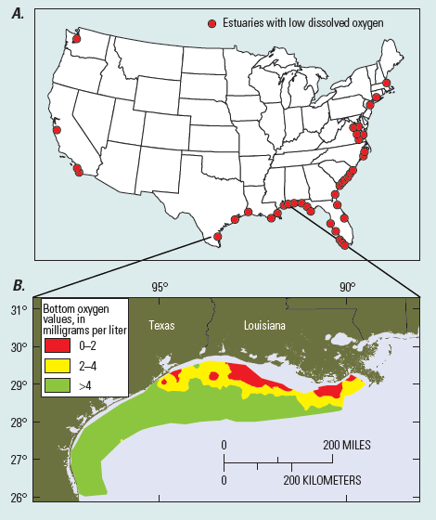
Corn Nitrogen Concerns:
Economic and Environmental
~ $5 billion/yr of N fertilizer applied to corn
N use efficiency very low (often less than 40%)
Largest energy input in cropping system
High groundwater nitrate levels
Hypoxia/anoxia in estuaries
Greenhouse gases
Sensitivity to climate change
From: Dubrovsky et al., 2010

Slide 6
How Does Agriculture Affect
Climate Change?
Agricultural Greenhouse Gas Emissions (2008)
Agriculture produces 8% of US GHG emissions, but only 1.2% of GDP.
N₂O emissions from corn fertilizer can be high, especially as a result of a major rainfall events
Source: EPA, 2010

Slide 7

How Does Agriculture Affect
Climate Change?
To put corn N₂O emissions in perspective:
GHG impact of 1 acre of corn N fertilizer use per year is guesstimated to be equivalent to the GHG impact of 4000 miles of driving a car.
For 100 acres, this would be equivalent to 400,000 miles
That’s ~16 times around the earth!
Opportunity to mitigate!

Slide 8
How Does Climate Change
Affect N Management?
More precipitation extremes
  Excess wetness: N shortages from denitrification and leaching → reduced yields
  Drought: water shortage and unattained yield potential → reduced yields & excess residual N
Higher temperatures
  Longer growing season: greater GDD → higher N needs?
  Greater potential for heat stress: → lower N needs?
We need to adapt!

Slide 9
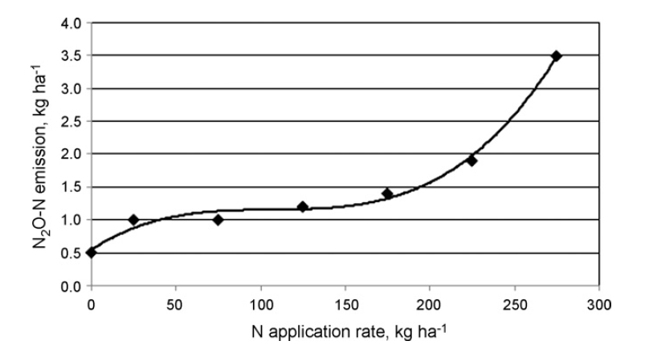
Precise Estimation of Corn N Fertilizer Needs?
NITROUS OXIDE (Greenhouse Gas)
There are Win-Win Opportunities!
Snyder et al., 2009, based on Bouwman et al., 2002
NITRATE LEACHING
(Water Pollution)
van Es et al., 2002

Slide 10
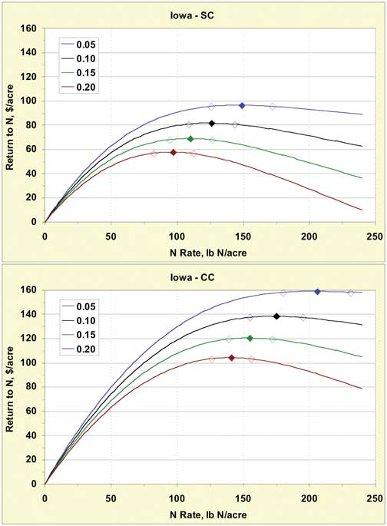
Precise Estimation of Corn N Fertilizer Needs?
NITROUS OXIDE (Greenhouse Gas)
There are Win-Win Opportunities!
Snyder et al., 2009, based on Bouwman et al., 2002
RETURN TO N (Profit)
NITRATE LEACHING
(Water Pollution)
Sawyer, 2005, Iowa State
van Es et al., 2002
**Large losses occur
AFTER crop demand is satisfied**

Slide 11
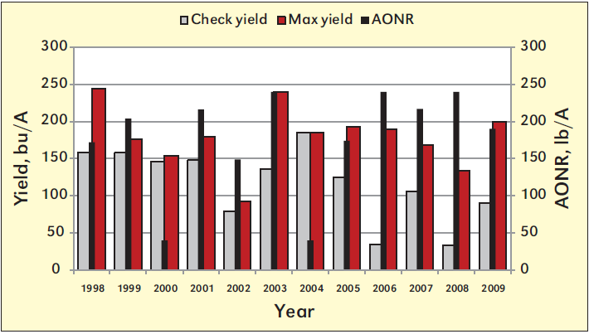
How Can We Precisely Estimate Seasonal Corn N Fertilizer Needs?
Maximum and Check Yields, and Agronomic Optimum N Rate
(corn after soybean, Ohio)
From: Mullen, LaBarge and Diedrick, 2010, Better Crops, Vol. 94 (3).

Slide 12
Where did my Nitrogen go?
Nitrogen Dynamics and
Sources of Variability

Slide 13
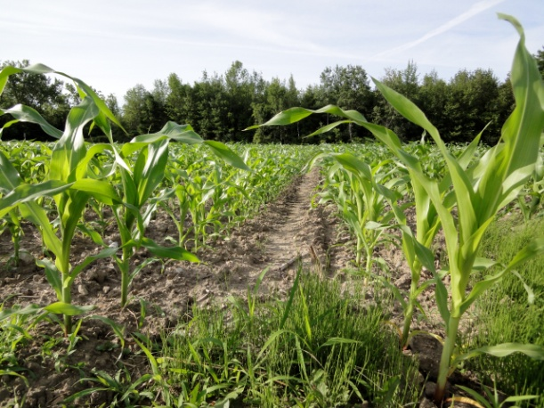
Many sources of variation in N availability
Soil type differences and organic matter contents
Organic amendments (manure, compost, etc.)
Crop rotations
Soil and crop management
…
Notes:
Bianca

Slide 14
Many sources of variation in N availability
→ interact in complex ways
Soil type differences and organic matter contents
Organic amendments (manure, compost, etc.)
Crop rotations
Soil and crop management
Temperature
Precipitation
Can affect your fertilizer needs by 100lb N or more from year to year!
→ Corn N needs CANNOT be accurately predicted at the beginning of the growing season
Notes:
Bianca

Slide 15
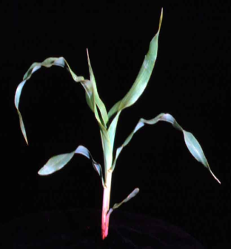
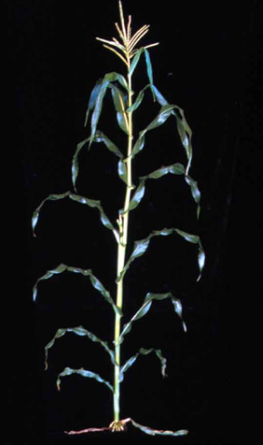
How Does Weather Generally Affect Optimum N Rate for Corn?
Early season:
  Excessive precipitation causes soil N losses through leaching and denitrification (when soil T is high), resulting in higher supplemental N fertilizer needs, and increased pollution
  manageable
Mid-Late Season:
  Leaching and denitrification losses are minimal
  Droughts cause unattained yield potential, reducing N fertilizer uptake
  not manageable
Photos from ISU Extension Publ. No. 48

Slide 16
Crop N uptake …
corn N uptake
Plant N
Spring Summer Fall

Slide 17
SOM mineralization occurs ahead of corn N uptake…
corn N uptake
Amount of Sidedress N Fertilizer Needed…
… in normal year
Soil or plant N
soil mineral N, normal year
Spring Summer Fall

Slide 18
SOM mineralization occurs ahead of corn N uptake…
Critical Time Period – N builds up in soil before corn uptake
corn N uptake
Amount of Sidedress N Fertilizer Needed…
… in normal year
Soil or plant N
soil mineral N, normal year
Spring Summer Fall

Slide 19
Need for supplemental N fertilizer depends on early season weather …
Critical Time Period – N builds up in soil before corn uptake
corn N uptake
Amount of Sidedress N Fertilizer Needed…
… in normal year
soil or plant N
soil mineral N, normal year
… in year with wet spring
soil mineral N,
wet spring
Spring Summer Fall
Determine precise N needs after Critical Time Period

Slide 20
Pre-plant application of N risks major losses
soil mineral N and pre-plant fertilizer, normal year, no manure
N excess “insurance”
corn N uptake
… in normal year
soil or plant N
Spring Summer Fall
N deficiency

Slide 21
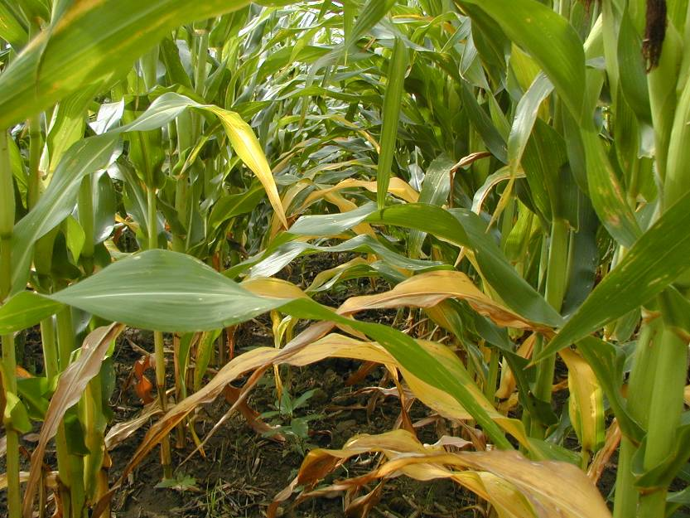
Pre-plant application of N risks major losses
soil mineral N and pre-plant fertilizer, normal year, no manure
N excess “insurance”
corn N uptake
… in normal year
N deficiency
… in year with wet spring
soil or plant N
soil mineral N,
wet spring
Spring Summer Fall
N deficiency

Slide 22
Predicting N Needs for Corn:
Precision for Different Times of Application
Main Factors:
snow
cover/melt
spring
rains
summer
drought
intervention
nonintervention
high
predictability
low
fall winter spring summer fall

Slide 23
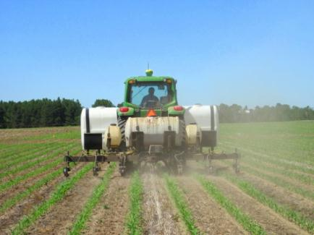
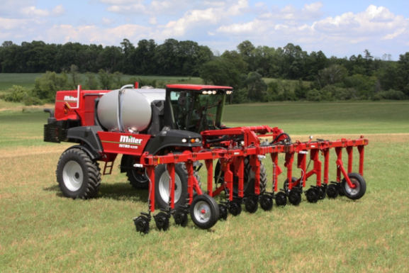
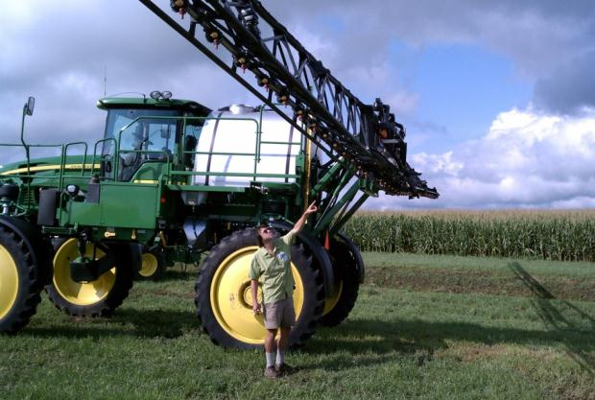
Equipment is Critical:
High-Clearance Provides Greater Sidedress Flexibility

Slide 24
Many sources of variation in N availability
Soil type differences and organic matter contents
Organic amendments (manure, compost, etc.)
Crop rotations
Soil and crop management
Temperature
Precipitation
Corn N needs CANNOT be accurately predicted at the beginning of the growing season
AFTER critical time period has past, there are opportunities for precision management
Notes:
Bianca

Slide 25
Why Computational Tools for
Nitrogen Management?
Move from generalized to site-specific recommendations
Allows for adaptive, real-time management
  Weather conditions
  Local soils and crop management
Universal process-based approach
  Incorporates system complexity
  through relevant processes
Low cost
Allows for progressive refinement
Notes:
The approach we have taken is to develop a calibrated/tested simulation model combined with near-real time location-specific weather data
Computational tool we use (PNM model) is a dynamic simulation model, which I’ll briefly describe in the next slide. MENTION THIS: Dynamic simulation models: Represent the behavior of an object/process/system, usually expressed mathematically. Mathematical modeling is an accepted scientific practice. Models are used for many different purposes. They are used in agriculture in a variety of applications, including applications related to soil and crop management..)]
Why did we use this approach?
Go through list above.
Disadvantages: Rigorous calibration and testing are required if these are to be used as management tools. Testing can be difficult due to the large number of variables in the model.
Can change parameters (soils, management, etc.) for local (field/farm level)
Can change or have different sets of forcing/driving variables (climate) that we can also obtain at the local level
Incorporates complexity, projects how complex system will ‘unfold’ or change; disadvantage is that we have limited knowledge of some of the processes, and their representation is relatively crude.
BACKGROUND
Dynamic:
In agriculture, we are most often interested in how things change over time: weather, crop growth, soil water availability, soil N; As mentioned, dynamic models integrate components of a complex system and can provide quantitative descriptions of how that system and its components change over time. In the past, such models were not typically used in ag management but, given these advances, we believe these can be useful.
Mechanistic: PNM model is [largely] a mechanistic model.
What is mechanistic? Describes the behavior of a system by mathematical representation of the component or underlying processes contributing to that behavior. Application to ag: Recent advances in our understanding of some of the key processes in the soil-crop-atmosphere system combined with greatly increased computational power have allowed us to explicitly (i.e mathematically) represent these with reasonable model performance, thereby making the use of mechanistic models as management tools possible.
Because the PNM model is a dynamic, mechanistic model, it gives an integrated (and dynamic) view of whole-system behavior, e.g. N losses and crop N uptake over time for different climates/soils/N management inputs. Why is such a model useful for estimating N availability in soils? Unlike other plant nutrients, inorganic N, as NH4-N but particularly as NO3-N is subject to multiple [factors?] which can lead to leaching/gaseous losses/plant N uptake/fixation. These are all dynamic processes: result of a complex and constantly changing physical, chemical and biological soil environment.
Advantages: Allows broad application, as opposed to ‘Empirical’ models which are certainly very useful (model is based on equations describing observed relationships among experimental data, e.g., calculating N response curves) but don’t give any information beyond the original data or about the mechanisms responsible for the response. This limits the applicability of such models to the particular location/management practice from which the data to develop the model were obtained.(for example, how would N response curves change from year to year or on different soil types).
Because of its much broader applicability (due to representation of the processes contributing to a system response, e.g. changes in soil N over time), mechanistic models offer more possibilities for manipulating and improving a system.
Disadvantages: Rigorous calibration and testing are required if these are to be used as management tools. Testing can be difficult due to the large number of variables in the model.
Note that these interact in complex way; argument for sophisticated tools like models if well-calibrated/tested.
Able to represent component processes/linkages/changes over time.
[More verbage from other talks?]

Slide 26
What is Adapt-N?

Slide 27
At the core:
A dynamic simulation model
What are models?
  Represent the behavior of an object/process/system, usually expressed mathematically;
The Precision Nitrogen Management (PNM) model is a ‘dynamic mechanistic’ simulation model.
  Why ‘dynamic’?
  Why ‘mechanistic’?
Notes:
Represent the behavior of an object/process/system, usually expressed mathematically. Mathematical modeling is an accepted scientific practice. Models are used for many different purposes. Mathematical models are used in agriculture in a variety of applications, including applications related to soil and crop management..)
Dynamic:
In agriculture, we are most often interested in how things change over time: weather, crop growth, soil water availability, soil N; Dynamic models provide a quantitative description of how a system/components change over time.
(integrate components of a complex system and can provide quantitative descriptions of how that system and its components change over time. In the past, such models were not typically used in ag management but, given these advances, we believe these can be useful. )
Mechanistic: PNM model is [largely] a mechanistic model.
What is mechanistic? Describes the behavior of a system by mathematical representation of the component or underlying processes contributing to that behavior. Application to ag: Recent advances in our understanding of some of the key processes in the soil-crop-atmosphere system combined with greatly increased computational power have allowed us to explicitly (i.e mathematically) represent these with reasonable model performance, thereby making the use of mechanistic models as management tools possible.
Because the PNM model is a dynamic, mechanistic model, it gives an integrated (and dynamic) view of whole-system behavior, e.g. N losses and crop N uptake over time for different climates/soils/N management inputs. Why is such a model useful for estimating N availability in soils? Unlike other plant nutrients, inorganic N, as NH4-N but particularly as NO3-N is subject to multiple processes which can lead to leaching/gaseous losses/plant N uptake/fixation. These are all dynamic processes: result of a complex and constantly changing physical, chemical and biological soil environment.
Advantages:
1)Allows broad application, as opposed to ‘Empirical’ models which are limited to the particular location /management practice from which the data used to develop the model were obtained.
Empirical models are certainly very useful (model is based on equations describing observed relationships among experimental data, e.g., calculating N response curves) but don’t give any information beyond the original data or about the mechanisms responsible for the response. This limits the applicability of such models to the particular location/management practice from which the data to develop the model were obtained.(for example, how would N response curves change from year to year or on different soil types).
2) Because of its much broader applicability (due to representation of the processes contributing to a system response, e.g. changes in soil N over time), mechanistic models offer more possibilities for manipulating and improving a system.
Disadvantages: Rigorous calibration and testing are required if these are to be used as management tools. Testing can be difficult due to the large number of parameters in the model. Can have substantial uncertainty about values of parameters.

Slide 28
PNM model:
The core of the Adapt-N tool
New model based on the linkage of two simulation models:
Crop growth/N uptake model
Soil processes model, LEACHN
Sinclair, T.R., and R.C. Muchow. 1995. Effect of nitrogen supply on maize yield: I. modeling physiological responses. Agronomy Journal 87:632-641.
Hutson, J.L., R.J. Wagenet, and M.E. Niederhofer. 2003. Leaching Estimation And Chemistry Model: a process-based model of water and solute movement, transformations, plant uptake, and chemical reactions in the unsaturated zone. Version 4. Dept of Crop and Soil Sciences. Research Series No. R03-1. Cornell University, Ithaca, NY, USA.
Notes:
This model (PNM), in turn, has been linked to weather data and the web interface Harold just described.

Slide 29
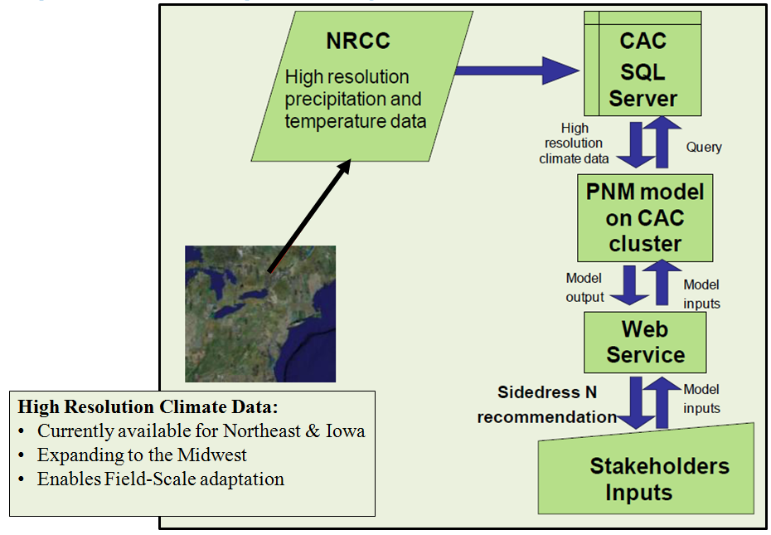
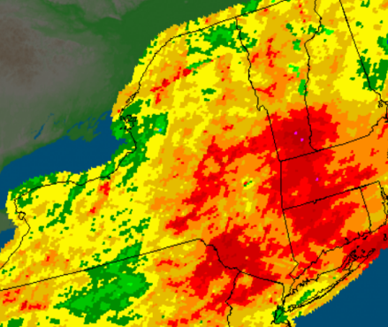
Adapt-N Infrastructure
Web-based mobile-accessible adaptive N management tool for corn
http://adapt-n.cals.cornell.edu/
User-friendly web interface
Model incorporates weather effects at individual field-scale with plant growth and soil processes
N sidedress recommendation and simulation details provided
Currently no cost
High-Resolution Climate Data (5x5 km)
High Res available to eastern USA in 2012
Daily updates
Enables field-scale adaptation
Notes:
Bianca

Slide 30
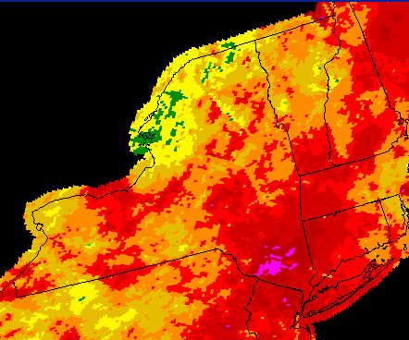
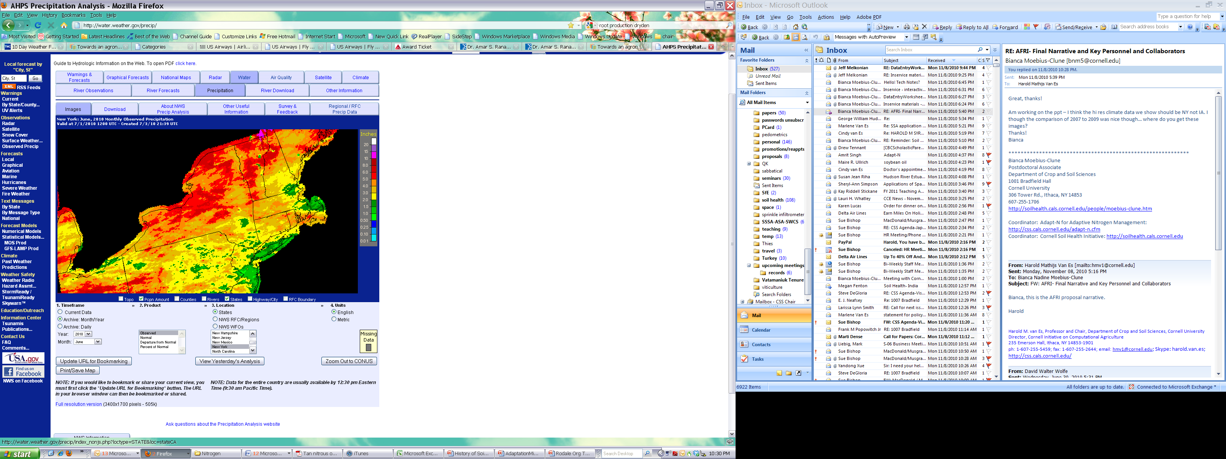

June Precipitation
Why high resolution weather data?
Precipitation is highly localized….
2009
2010
2011
Notes:
Bianca

Slide 31

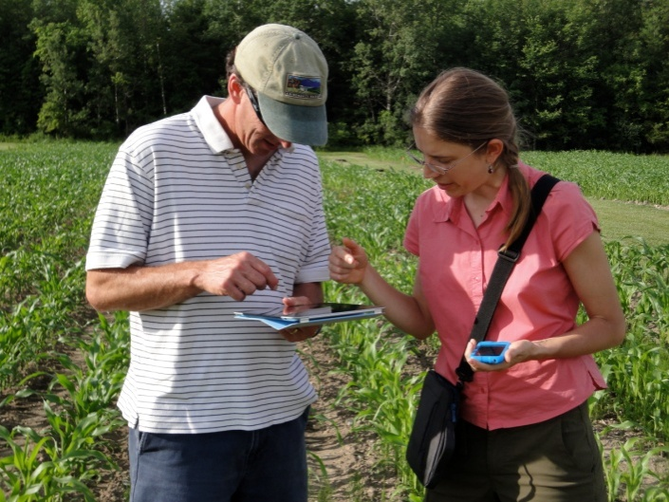

“Cloud” Computing
No software exchange with users, nor installation
Server-based, with universal access through Web
  Anywhere with internet access
  Many platforms and operating systems (incl. tablets and smart phones)
Easy and rapid updates
  Databases
  Software
Centralized processing and records

Slide 32
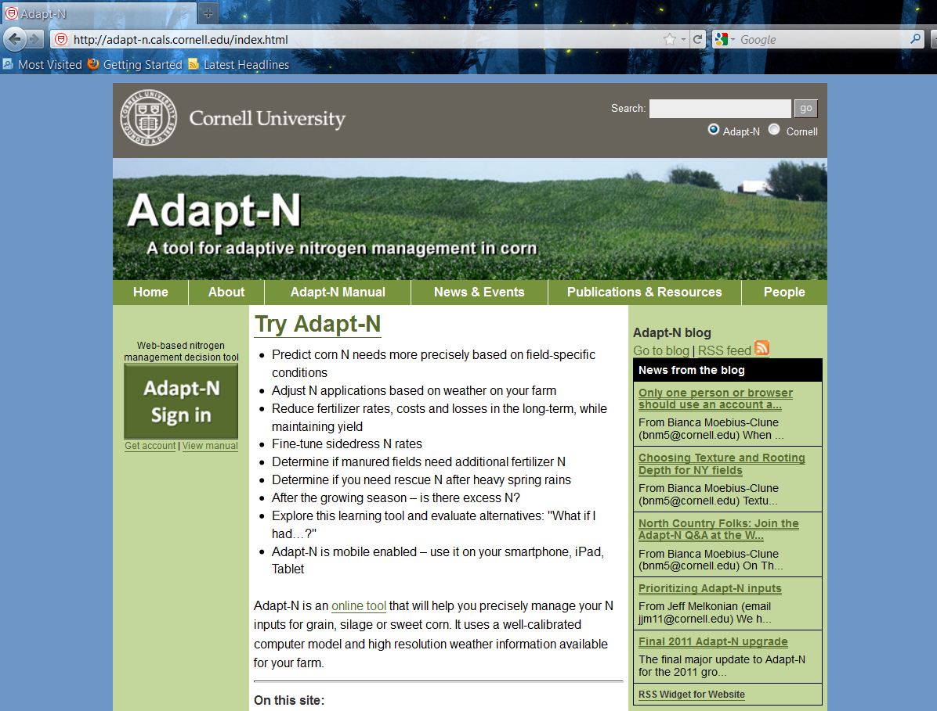
  Simply Log In On Our Website at: adapt-n.cals.cornell.edu

Slide 33
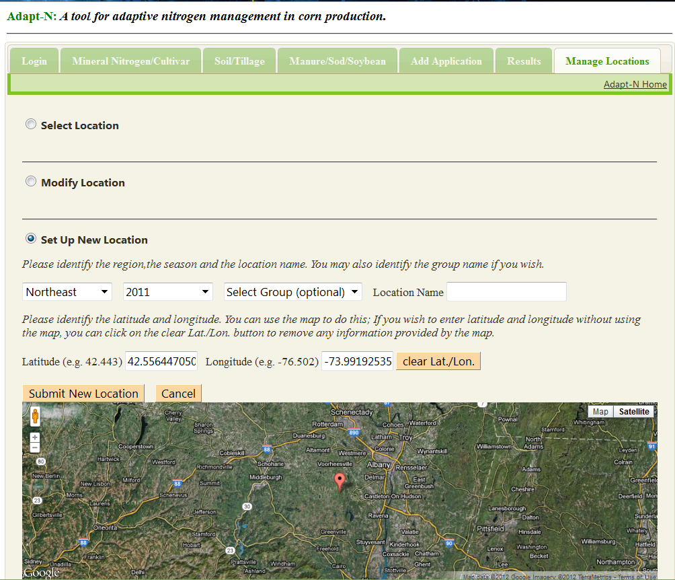

Slide 34
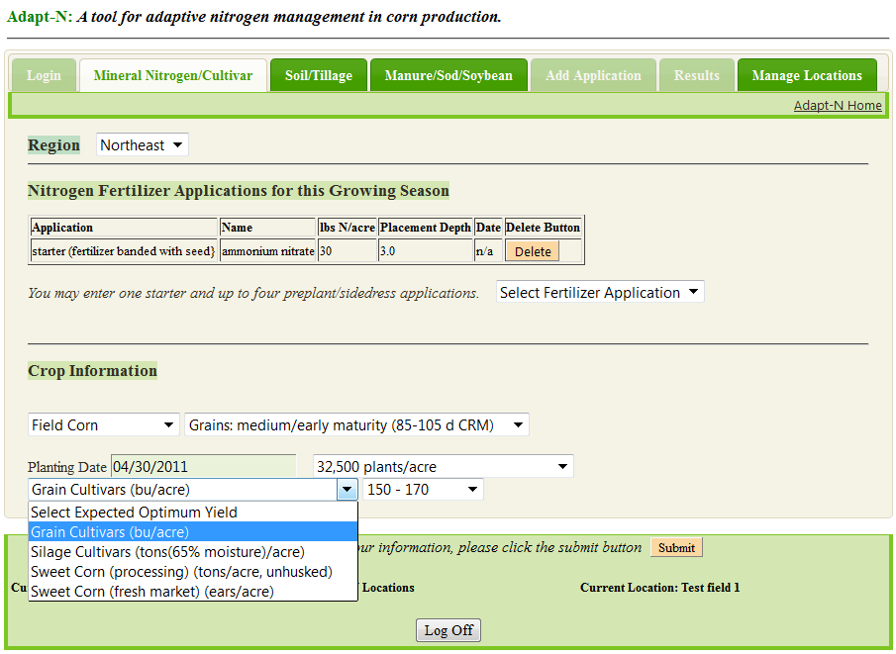
Adapt-N Interface:
entering Mineral N/Cultivar info
(2011 version)

Slide 35
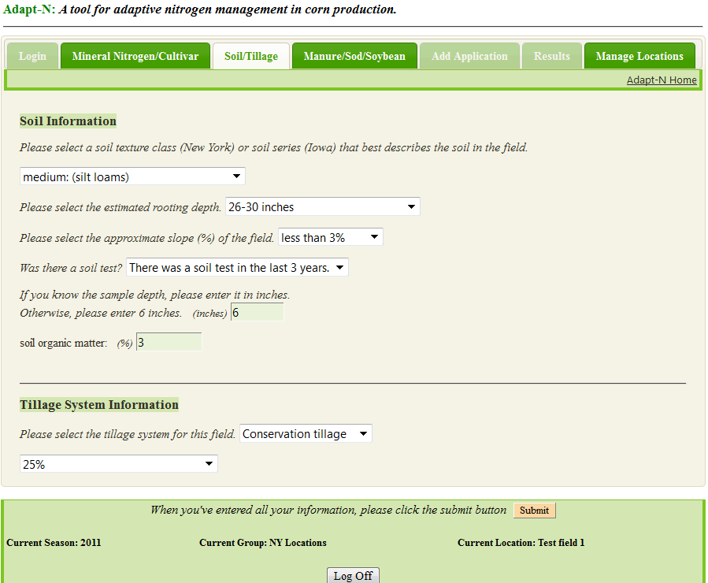
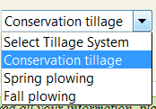
Adapt-N Interface:
entering Soil/Tillage info
(2011 version)

Slide 36
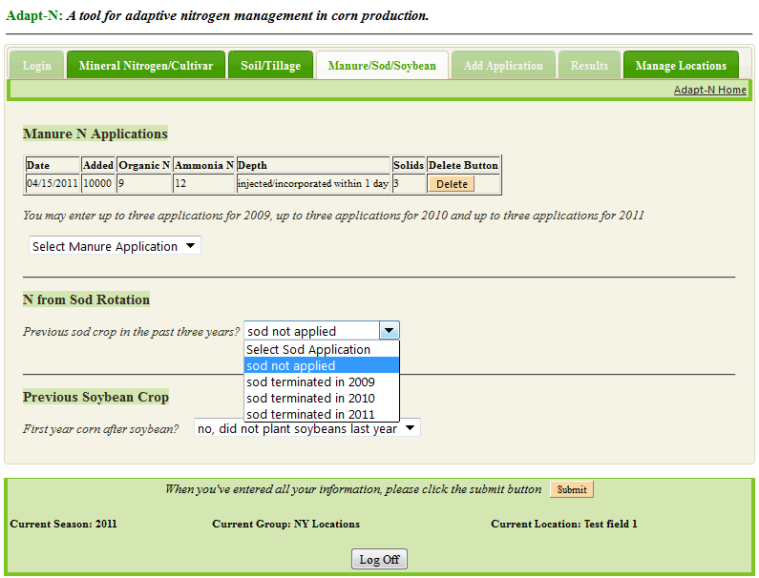
Adapt-N Interface:
entering Manure/Sod/Soybean info
(2011 version)
When done entering all field info, click ‘Submit’ to run the simulation.

Slide 37
N Recommendation Methodology:
Mass Balance Approach
SidedressNrate = CropN_{Harvest} - CropN_{Current} - SoilN_{Current} - SoilN_{postsidedress} - SoybeanN_{credit} + Loss_{postapplication} - Correct_{profit}
CropN_{Harvest} Total crop N uptake from planting to harvest, based on "Expected Yield" input.
CropN_{Current} Crop N uptake from planting to the current/simulated date.
SoilN_{Current} Crop-available N in the root zone on the current/simulated date, based on soil, organic inputs, previous soy or sod crops, crop uptake and weather effects.
SoybeanN_{Credit} Partial credit for a previous season soybean crop.
SoilN_{postsidedress} Estimated crop-available N (from mineralization/urea hydrolysis – estimated N losses) from the current date to harvest.
Loss_{postapplication} Estimated post-N recommendation losses from the Adapt-N recommended N application.
Correct_{profit} Combined correction for fertilizer-to-grain price ratio and prediction uncertainty.
(2012 version)

Slide 38
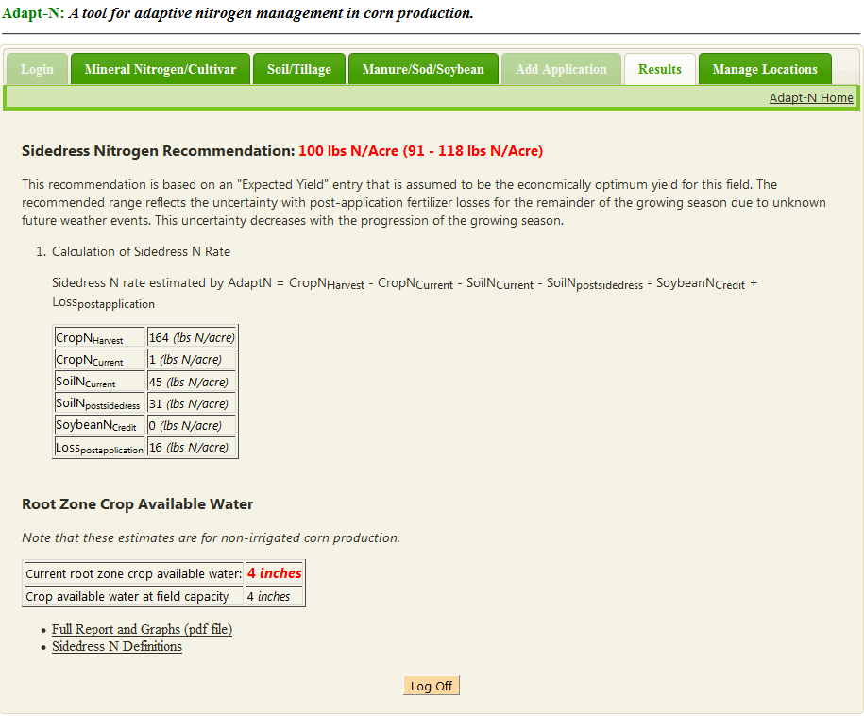
Adapt-N Results Page
Example with need for sidedress N
(2011 version)

Slide 39
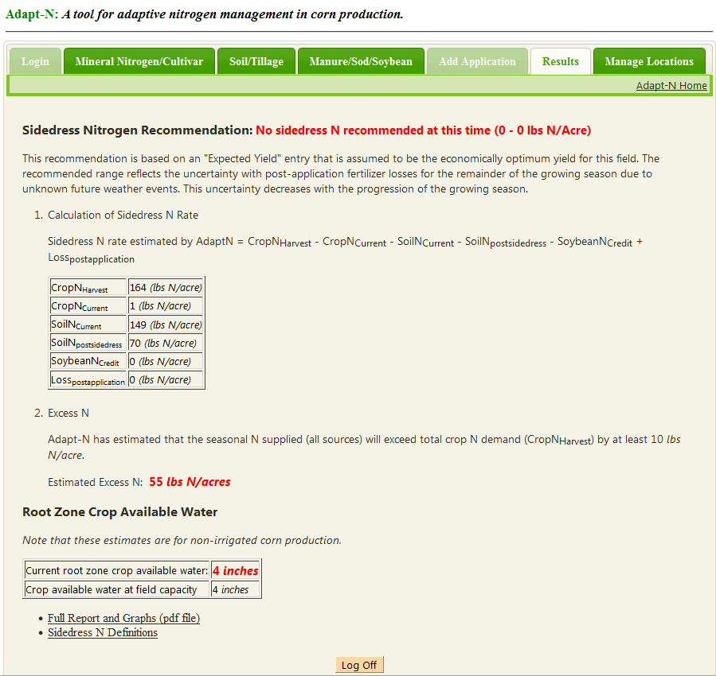
Adapt-N Results Page
Example with excess N in the system
(2011 version)
Downloadable pdf

Slide 40
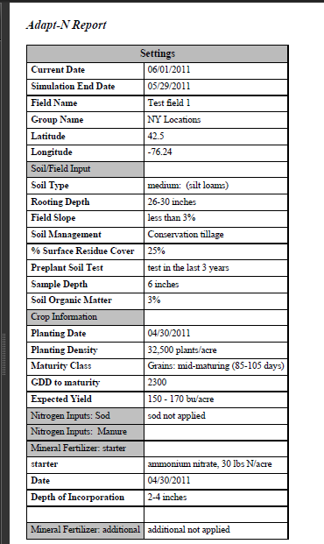
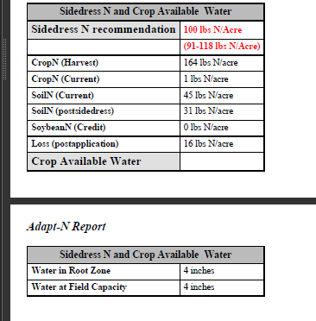
Adapt-N Results
Example Report
(2011 version)
A downloadable pdf file provides:
All user inputs listed for easy record keeping.
Recommendations from Results page on interface
Graphs describing N dynamics and relevant weather, soil water and plant parameters

Slide 41
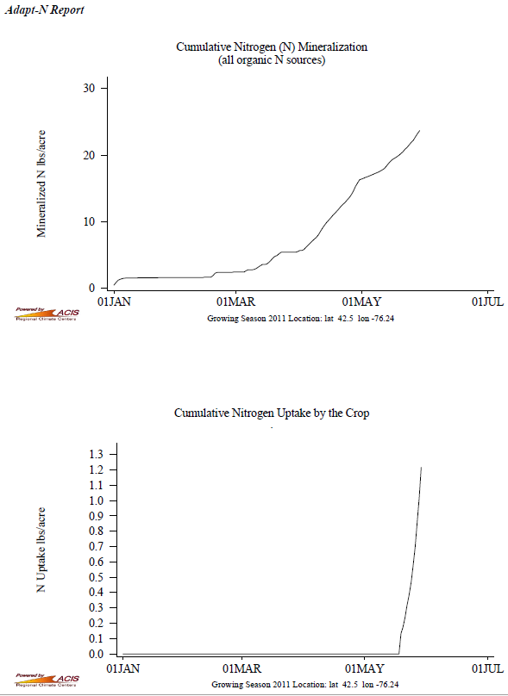
Adapt-N Graphs
(2011 version)

Slide 42
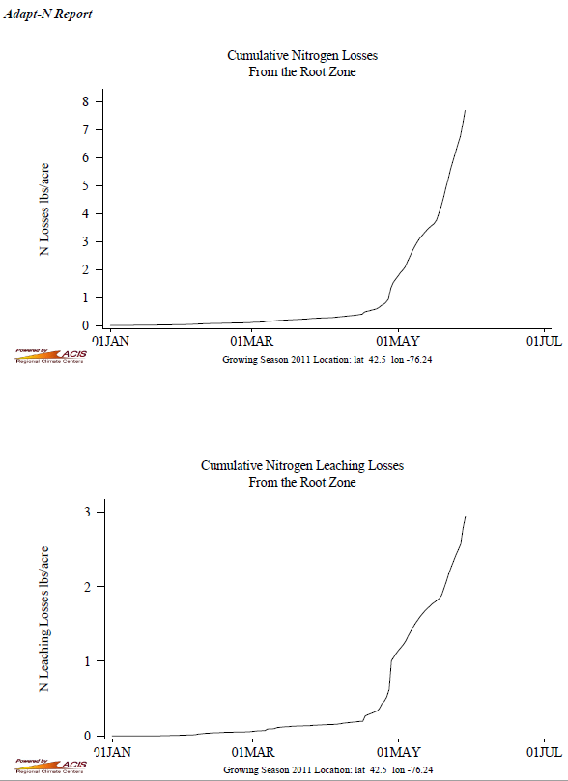
Adapt-N Graphs
(2011 version)

Slide 43
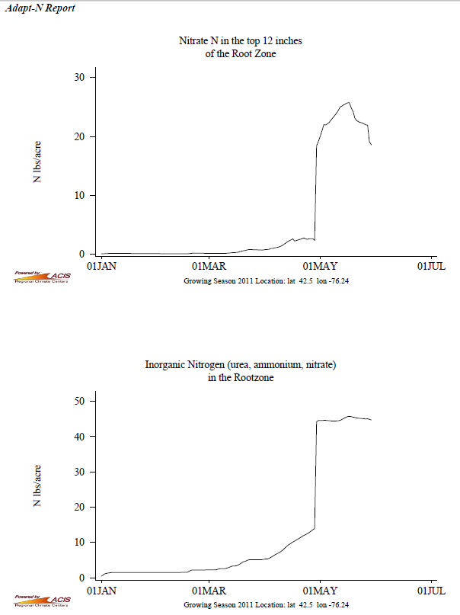
Adapt-N Graphs
PSNT value: divide by 4
Other graphs provided:
Growing Season Daily Rainfall
Cumulative Rainfall for Growing Season
Post-Emergence Growing Degree Days
Post Planting Day Leaf Number
Growing Season Daily Average Temperature
(2011 version)

Slide 44
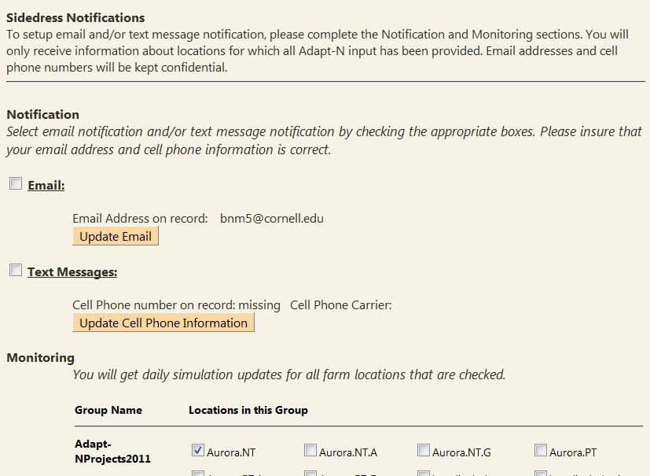
As of 2012: Email/text alert system for chosen fields
Notes:
Daily summaries; text/email alerts

Slide 45
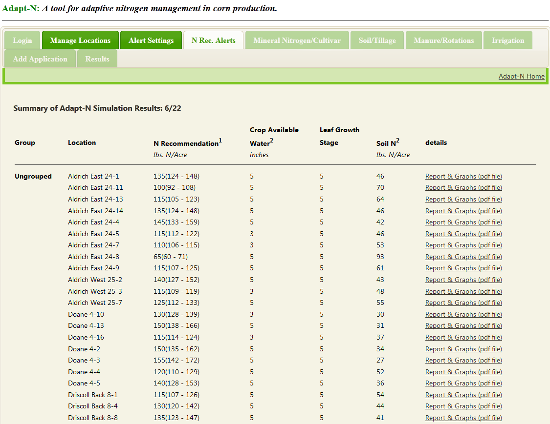
Daily N recommendations automatically available – here as implemented by management unit on 900 acres of grain corn in NY:
Notes:
Daily summaries; text/email alerts

Slide 46
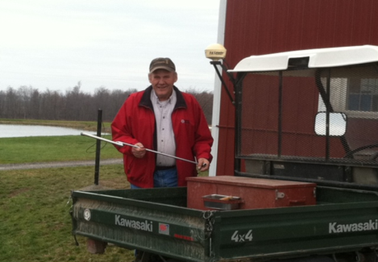
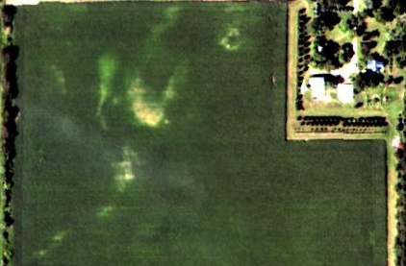
Adapt-N 2011
Case Studies and Strip Trial Results

Slide 47
A Case Study on the
Use of Adapt-N
How variable are recommendations on one farm? Opportunities?
James LaGioia, Harold van Es,
Jeff Melkonian and Bianca Moebius-Clune
Crop and Soil Sciences
David Shearing
WNYCMA

Slide 48
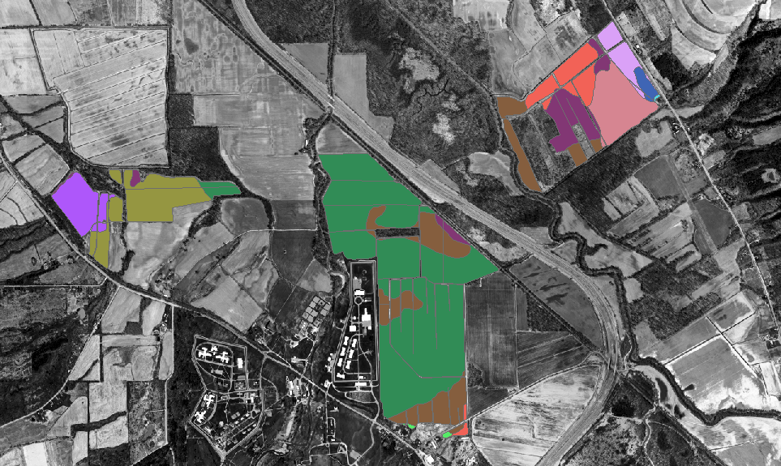
Study Farm
Western NY, 2011
Large grain farm in western New York
87 corn fields, nearly 1200 acres
76% mapped as silt loam, 23% as silty clay loam, and 1% as gravelly soil
Soil organic matter varied from 0.9% to 9.9%
Urea applied preplant/starter, totals around 190 lbs/ac.
58% of corn ground was planted early - before May 1 - and 42% was planted late in the season - after June 1
Yield goals 240 bu/ac (early plant) and 200 bu/ac (late plant)
Adapt-N tool was run every 5 days from June 6, 2011 until crop was too high for sidedressing

Slide 49
Results - N recommendations by date early (before May 1) and late (after June 1) planted corn
Negative recommendation = Excess N
Each point on the graph represents an individual field

Slide 50
Results
N recommendations as affected by soil organic matter content, soil type and planting period.

Slide 51
Conclusions
Main benefit in 2011: accounting for effect of early vs. late planted fields and variable soil OM
Early-planted corn required additional N to make up for post-planting losses from wet May weather, which would otherwise result in yield losses from N deficiencies.
Late-planted corn had considerable excess N, especially on soils with high organic matter. Fertilizer saving for the farm would have been $11,000.

Slide 52
2011-2012 Beta-Testing Questions:
Does Adapt-N provide an accurate N recommendation at sidedress time?
Can Adapt-N save growers money in comparison to their current practices?
What changes need to be made to the model and/or interface for improved 2012 performance?

Slide 53
NYFVI and NRCS-CIG projects
Strip Trial Collaborators
New York
Iowa
Keith Severson, Cayuga County
Kevin Ganoe, Central NY
Chuck Bornt, Capital Region
Sandy Menasha, Long Island
Eric Young, Miner Institute
Anita Deming, Michael Davis, and Eric Bever, and Mike Contessa, Lake Champlain Region
David Shearing, Nate Herendeen, Jason Post, and David DeGolyer, WNYCMA
MGT Envirotec:
Shannon Gomes, NE Iowa
Frank Moore, NE Iowa
Michael McNeil, NC Iowa
Hal Tucker, W Iowa
Iowa Soybean Association

Slide 54
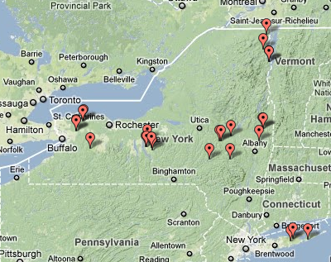
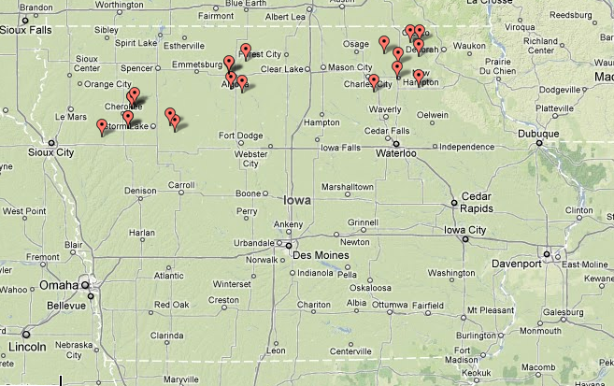
Strip Trials
NY: 30 strip trials, 18 with yield data
  Grain
    Corn – Corn
    Soybean/Clover – Corn
  Silage
  Sweet corn
IA: 25 trials, 19 with yield data
  All Grain
N Management
  Fall/Spring manure
  Spring fertilizer N
  IA: Fall anhydrous
  ammonia
Notes:
- Note that I will not be talking about sweet corn data
- Note that, in NY, silage corn is almost exclusively grown in dairy production systems, and virtually all silage corn receives manure as the primary N source.

Slide 55
Strip Trial Layout
Two N management practices:
  Conventional “Grower-N” rate
  Adapt-N recommended N rate
Spatially balanced design* with 4 replications:
(varied # reps)
C1
A1
A2
C2
A3
C3
C4
A4
*van Es et al. 2007. Spatially-Balanced Complete Block designs for field experiments. Geoderma 140: 346–352; Some trials were more or less replicated with some varied layouts.
Notes:
Mention statistical design: essentially the same as for ISA except 4 strips per treatment.
- Spatially balanced design.

Slide 56
Sidedress N treatments in New York and Iowa
Grower applications of N to silage, grain and sweet corn exceeded rates recommended by Adapt-N by 15 – 140 lb/acre in most cases.
In a few locations in IA where excessive rainfall occurred, Adapt-N recommended rates higher than those put on by grower

Slide 57
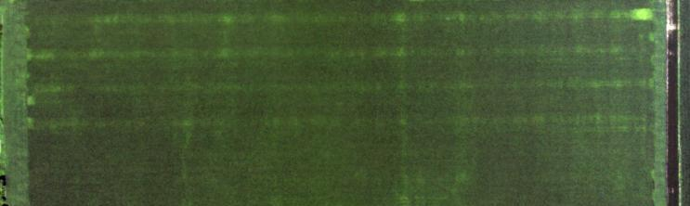
IA Trials
Model/Trial Implementation Lessons
Results from trials

Slide 58
Lesson:
Importance of accurate inputs
& appropriate simulation time
Organic matter input
Running the tool close to (on day of) sidedress time for Adapt-N recommendation
Implementing recommendation in the field (or management unit) it was created for
Good estimate of expected yield

Slide 59
IA: Agronomic Performance (Adapt-N trt in place)
Corn after soy
Corn Grain Yield (bu/ac)
(*)
*
*
*
Maybe do a quick economic analysis of these 9 trials
Sidedress Fertilizer N applied (lb/ac)

Slide 60
IA: Agronomic Performance (Adapt-N trt in place)
Corn after soy
Corn Grain Yield (bu/ac)
(*)
*
*
*
 | Adapt-N > Grower-N | Adapt-N < Grower- N
N fertilizer input (lb/ac) | 53 | -47
Yield (bu/ac) | 22 | -4
Change with Adapt-N
Sidedress
Fertilizer N applied (lb/ac)
 | Adapt-N > Grower-N | Adapt-N < Grower N
N fertilizer input (lb/ac) | 53 | -47
Yield (bu/ac) | 22 | -4
Profit ($/ac) | 87 | 8
+
+
+

Slide 61

NY Trial Results
Model/Trial Implementation Lessons
Results
  Grain (corn after corn, corn after soy)
  Silage

Slide 62
Lesson (again): Model requires accurate input information!
Users need to be well-trained.
2 trials: Simulated incorporated sod ≠ clover cover crop.
Result: low Adapt-N recommendation & substantial yield loss.
1 trial: Adapt-N manure inputs not ≠ real field applications.
Result: high Adapt-N recommendation (only 15lb below Grower-N) when less would have been needed based on PSNT (40ppm) and CSNT (> 6000ppm)
1 trial: Adapt-N fertilizer inputs > real field applications & N application made too late (after silking).
Result: low Adapt-N recommendation & yield loss.

Slide 63
NY: Agronomic Performance in Grain
Corn Grain Yield (bu/ac)
*
*
Fertilizer N applied (lb/ac)

Slide 64
NY: Agronomic Performance in Grain
Corn after soy
Corn Grain Yield (bu/ac)
*
*
Fertilizer N applied (lb/ac)

Slide 65
NY: Agronomic Performance in Grain
Substantial savings of unneeded N fertilizer
After corn: no significant yield loss
After soy: yield loss due to model inaccuracy for soybean N credit: 30 lb N credit AND no immobilization penalty for corn-corn rotation.
Good News: we can correct this!
Change with Adapt-N

Slide 66

NY: Environmental and Economic Performance in Grain
Leaching Losses (lb/ac)
Corn after soy
Profit from Adapt-N Use
($/ac)
(ns)

Slide 67
NY: Environmental and Economic Performance in Grain
Decreased leaching losses
After corn: profit gain
After soy: profit loss on average (1/3 trials) – to be corrected for 2012.
Change with Adapt-N
* Simulated estimates by Adapt-N
** $0.60/lb N, $5.50/bu corn ($6.50/bu - $1/bu for drying, storing trucking)

Slide 68
NY: Agronomic Performance in Silage
Silage Yield (T/ac)
Change with Adapt-N
Fertilizer N applied (lb/ac)
Savings of unneeded N fertilizer lower (most N from manure)
No significant yield loss. But yields were substantially below expectations. Hoping for a better 2012…

Slide 69
NY: Environmental and Economic Performance in Silage
Leaching Losses (lb/ac)*
Change with Adapt-N
Profit from Adapt-N Use
($/ac)**
* Simulated estimates by Adapt-N
** $0.60/lb N, $50/T silage

Slide 70
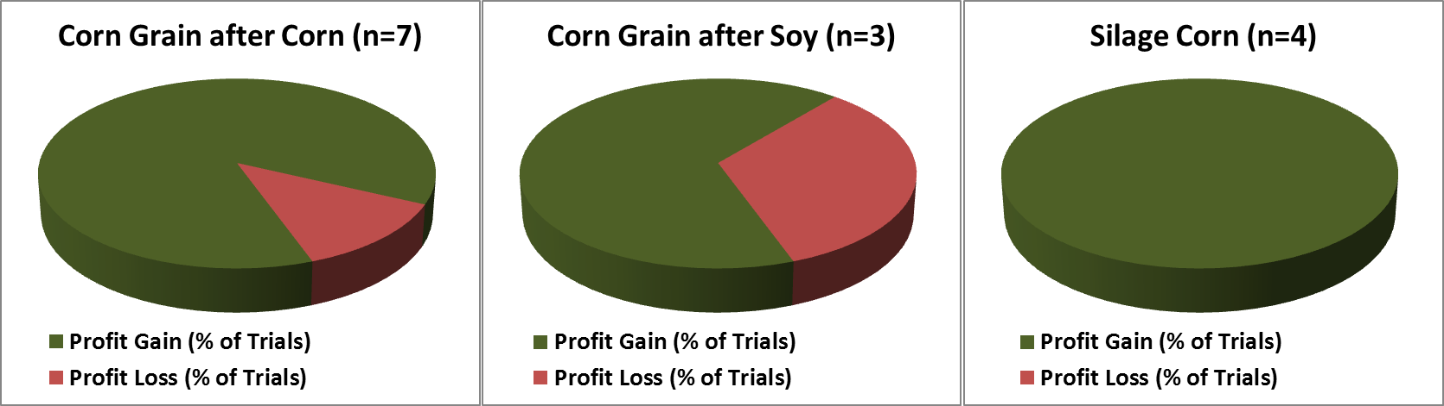
NY: Economic Impact of Adapt-N in 2011
Profit gains up to $85/ac (12/14 trials)
Profit loss up to $75/ac (2/14 trials)
Profits improved in 86% of trials with correct use of Adapt-N.

Slide 71
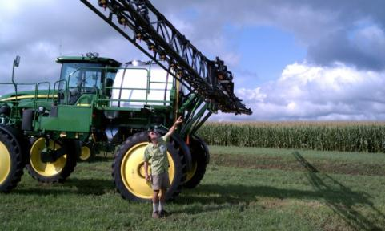
Summary: what did we learn in 2011?
Adapt-N…
requires accurate inputs
generally accurately estimated lower N needs, and in some cases higher N needs.
in a few cases, slightly under- or over-predicted N needs, usually explained by model input factors
increased most NY grower profits and N savings
reduced environmental losses considerably
will need minor adjustments for 2012
provides strong incentive to sidedress
Notes:
Post application loss probabilities: Will require education. Can allow users to accept more or less ‘risk’ in deciding on yield estimate for field based on their past experience/expectation of the growing season weather following in-season N application.
Still evaluating LSNT/stalk nitrate data.

Slide 72
What did we have learned in Iowa the last two years?
Adapt-N…
soil depth of Iowa are deeper then NY
assumptions on overwinter soil moisture capacity (dry winter – minimal leaching)
reduced over application of nitrogen
helps with manure management
Clients and consultants are starting warm up to using Adapt N to adjustment nitrogen in-season

Slide 73
Opportunities for 2012 Testing
Many ways to use Adapt-N
2011 retrospective analyses
Variable rate application opportunities
2012 Low-risk trials
2012 Low-risk adoption
2012 retrospective analyses

Slide 74
Many ways to use Adapt-N
Adapt-N can be used for a wide range of N management practices for corn (grain, silage, sweet):
  Sidedress N rate recommendation
  Rescue N application rate
  After pre-plant applications or applications at planting or in manured fields – Is additional N necessary, and how much?
  Hindcasting after growing season (Excess? Deficient? What-if?)
  Potential for use in variable rate application
  To get your own account: email Jeff Melkonian jjm11@cornell.edu

Slide 75
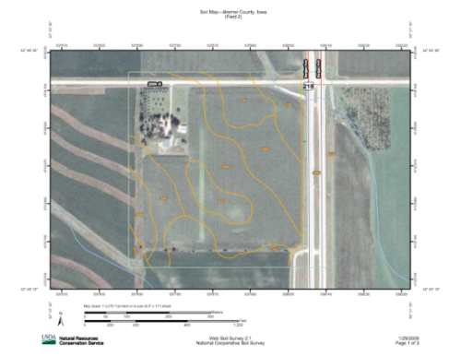
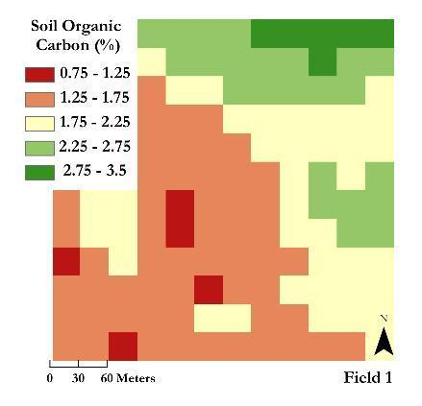
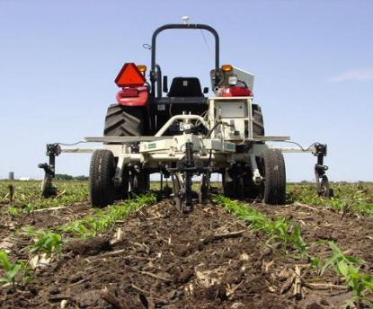
Organic Carbon Content (%) estimated with VIS-NIR Spectroscopy
(Veris Technologies)
Using Adapt-N for Site-Specific
Adaptive Management
NRCS Soil Survey
Notes:
Harold

Slide 76
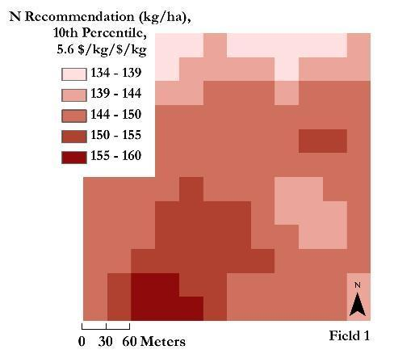
N Sidedress Recommendation (kg/ha)
wet spring
Graham, C.J., H.M. van Es, J. Melkonian, and D.A. Laird. 2010. Improved nitrogen and energy use efficiency using NIR estimated soil organic carbon and N simulation modeling. In: D.A. Clay and J. Shanahan. GIS Applications in Agriculture – Nutrient Management for Improved Energy Efficiency. pp 301-325, Taylor and Francis, LLC.
Notes:
Harold
Using the SOM data, and the soil series info, able to fine-tune recs for field.

Slide 77

Low Risk Trial on multiple fields:
Equipment needed:
Sidedress rig you can calibrate
Ability to measure yield (especially easy if you have a calibrated yield monitor)
Info to submit:
Adapt-N pdf report
Available soil data
Sidedress date, type, depth, rate
Yield for each strip
A = Adapt-N recommended sidedress rate in one strip that is the width of two combine passes
G = Grower-N. Your current N application rate.
G1
A1
A2
G2

Slide 78
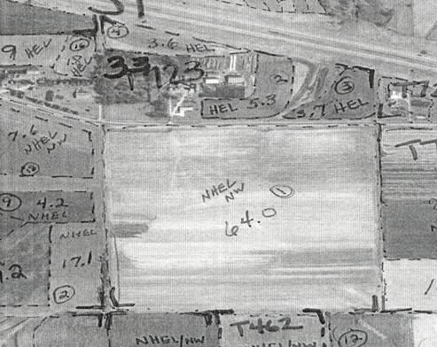
Try Adapt-N Risk Free
Check Strip
Farmer and crop advisor complete one-page application to try the practice on a field.
Crop advisor makes N recommendations, carefully places check strip following written protocol, oversees practice and harvest, sends results to Agflex.
Single check strip using farmer’s traditional practice: Yield in adjacent rows is highly correlated, > 90% when selected at random.
Agflex makes cash payment to farmer to replace any net income loss due to N insufficiency.
BMP Strips
Funding from USDA NRCS Conservation Innovation Grants, PA Dept. of Environmental Protection, Chesapeake Bay Foundation, others.
Contact for 2013 interest:
rebecca.ressl@bmpchallenge.org,
608 232-1425

Slide 79
  Using Adapt-N Effectively - 2013
  Model Inputs, Equipment & Timing

Slide 80
Accurate Model Inputs
Soil organic matter content (ideally > 6” sample)
Rooting depth default is okay unless you have subsoil compaction – use a penetrometer to assess this.
Manure: use representative analysis
Accurate records on timing of operations (applications, sod incorporation, planting, etc)
Accurate records of rates applied (N fertilizer & manure applications)
Soil type/texture
Historical yield records to help estimate expected yield

Slide 81
Understanding Model Inputs
Tillage
  choice of tillage accounts for effects on temperature, moisture, and residue effects on N immobilization
  % residue on surface = your best estimate of % of total residue that was not incorporated with any tillage operation. Example: a strip till system that incorporates 50% of soy stubble should be set at 50%, even if residue covers less than 50% of surface.
Sod option models a multi-year sod.
Cover crop credits are not yet well understood, and not yet modeled by Adapt-N. You may decide to use your own credit.

Slide 82
Using the Adapt-N Recommendation
Simulation Timing:
  use most recent recommendation (facilitated by new N-alert system)
  push sidedress time later if possible (depends on equipment and soil N status), but not too late. Sidedress N recommendations become more accurate as the crop canopy closes. Applications until ~ V15 okay, as long as root-zone N not limiting.
  Use estimated soil N status to ensure that N stress does not result from late application
Equipment: Calibrate N application/sidedress equipment and adjust to sidedress proper N rate.
Tool updates are posted on our blog in in our manual:
http://adapt-n.cals.cornell.edu/manual/index.html#enter

Slide 83
  Using Adapt-N Effectively - 2013
  Hands-on at: adapt-n.cals.cornell.edu

