Slide 1
OptRx Sensors
Experiences from the production ag front

Slide 2
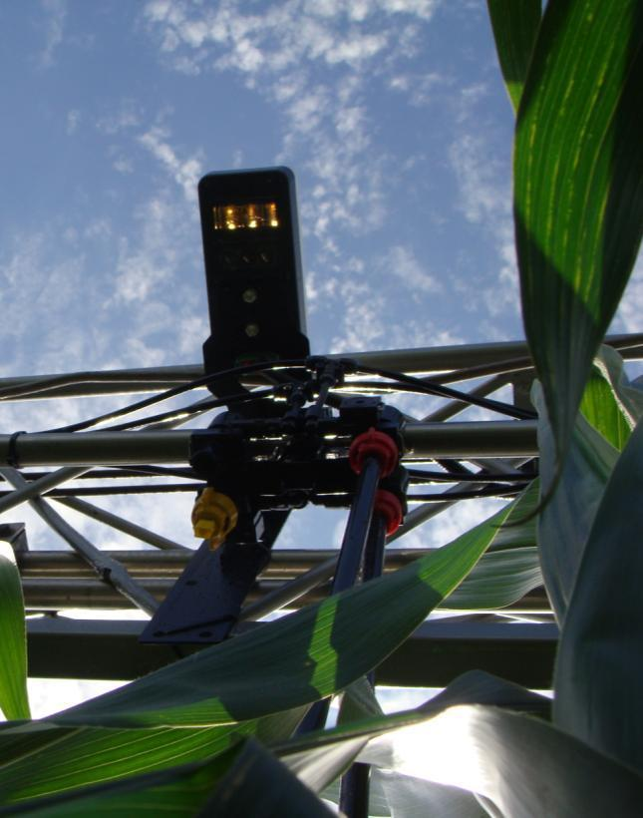
Sales Review
Increase in sales every year from year 1
Industries expectations not met for any sensor
Not one individual group responsible
Nor are we one improvement short either
All parties claim responsibility

Slide 3
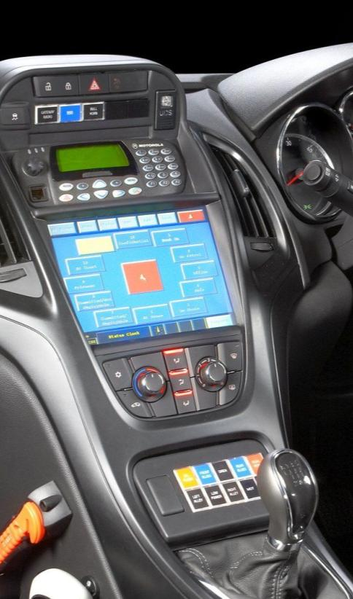
Sales Review
Two car analogies
70 year old with a new Mercedes
Too much technology for people not ready to adapt
Handing the keys to a sports car to a 14 year old
Customers were not trained for the power of the sensors
Customers need and want a person to show them how to use it all

Slide 4
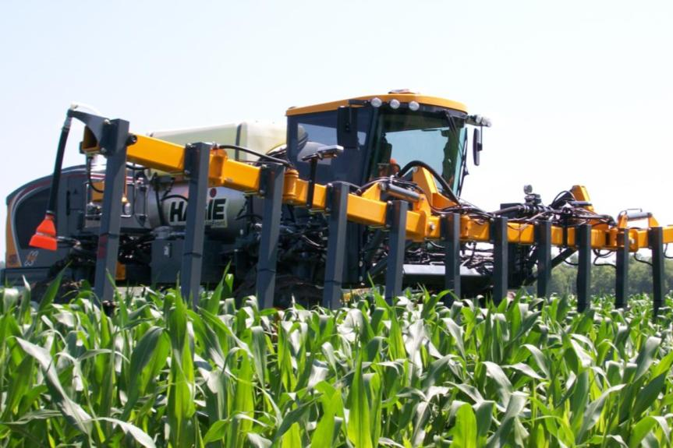
Challenges to Adaptation
Window of Application too small
Customer intimidated by technology
Does not know where to get agronomic support for sensors
Initial reaction to price

Slide 5
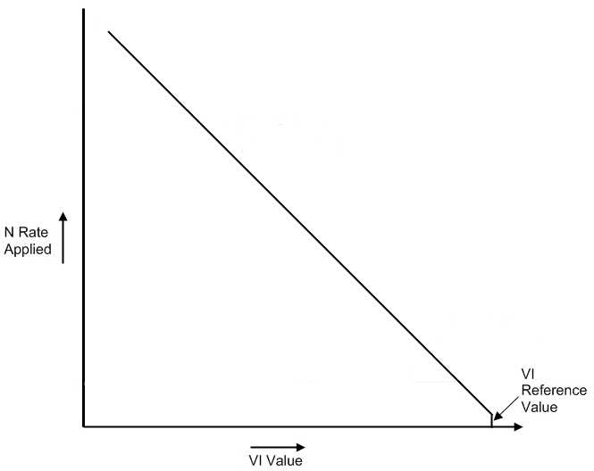
Evolution OF OptRx Sales
General response was sensors cannot work
Corn Customers did not agree with basic N model
Doubt about quality and reliability of product recommendations

Slide 6
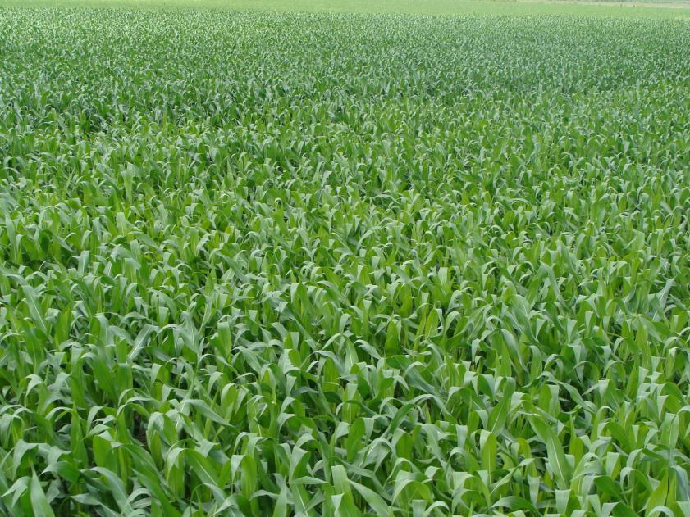
Evolution OF OptRx Sales
In 2009 all Customers having great success in wet conditions ($60/acre increases common)
Concerns about model reduce, concerns about varieties and their difference increase
Conflicting opinions on how to best use sensors is a concern for end users, leads to delayed adaptation

Slide 7
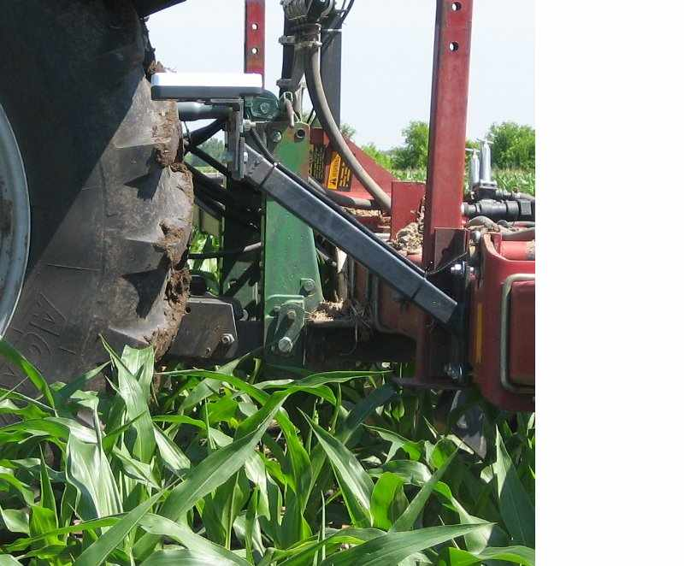
Evolution OF OptRx Sales
2012 Drought reduces the number of acres OptRx is used on. Still see small increases in profits when a crop is harvested (<$5/acre average)
Varieties still a concern, but sidedress window too narrow (not enough high clearance equipment)
Confidence in sensors high, just not sure how to incorporate them

Slide 8
FAQs from Users
How do I determine correct N rates?
How do I adjust the rates for the season (too wet or too dry)?
What should I do about varieties?
How do I calibrate confidently?

Slide 9
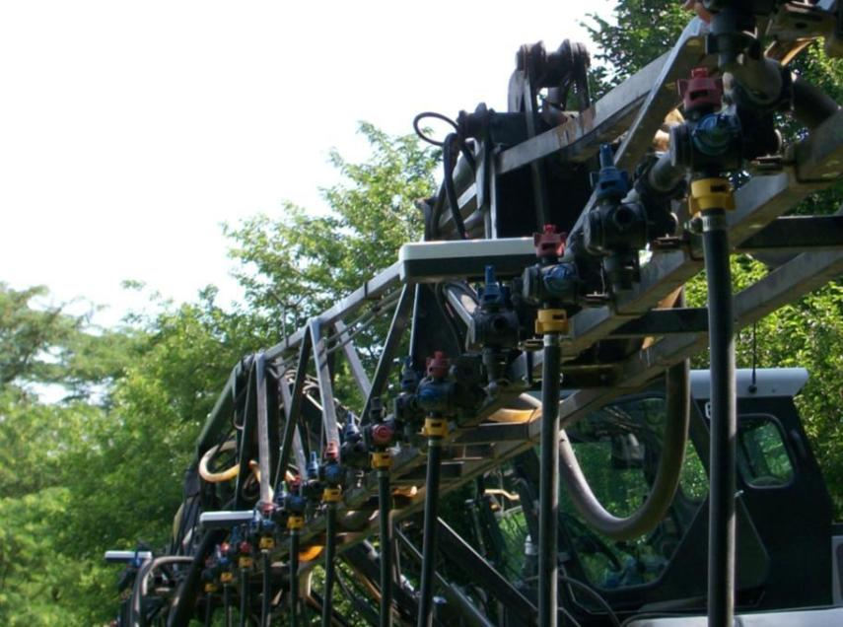
FAQs from Users
Can I use these on any other crop?
Can I use these for any other product?
Can we use sensors to apply multiple rates across the boom? By row?
What form of N should I use with OptRx?

Slide 10
Sensor Incorporation
Collaborative effort between hardware, seed, fertilizer and agronomic companies
Promote knowledge from research that is passed to agronomists to end users

Slide 11
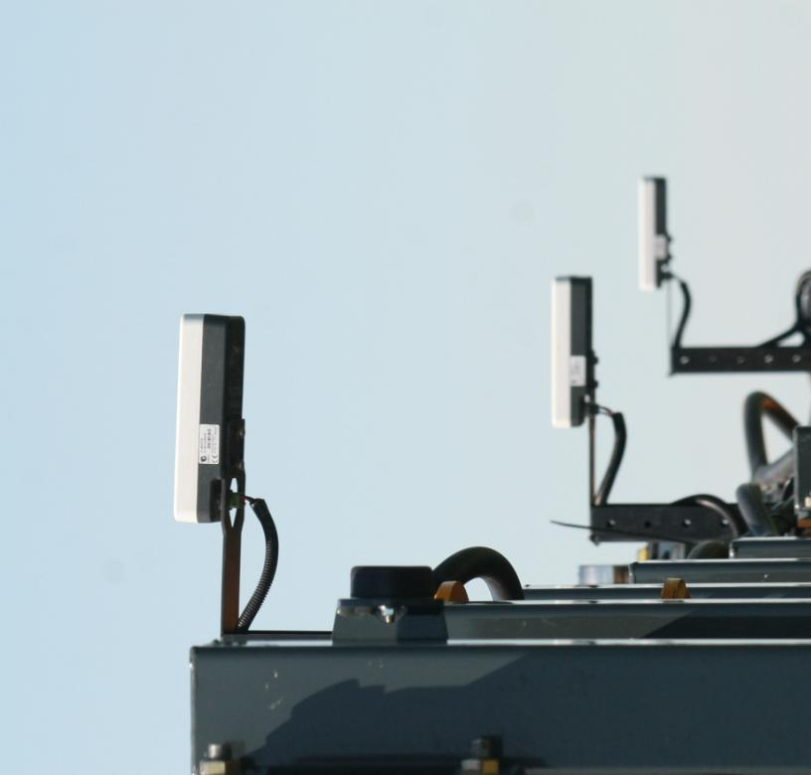
Thank you!

