Slide 1
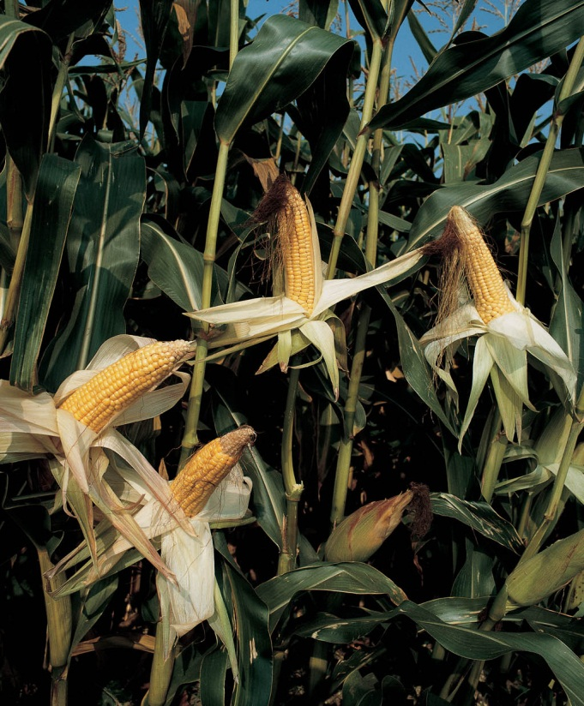
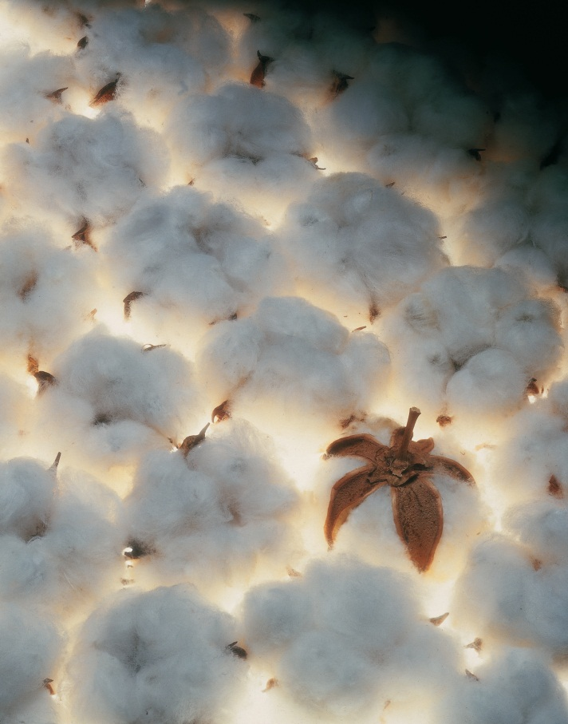
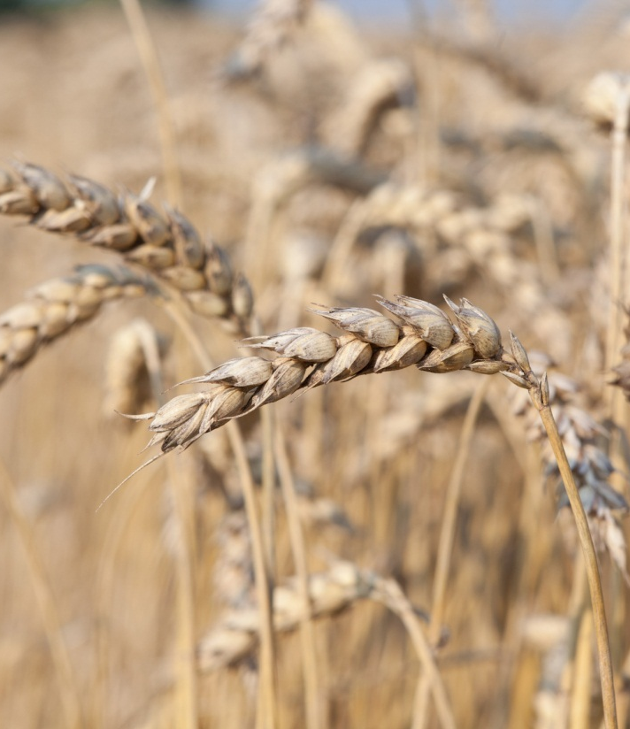
Crop Canopy Sensors for High Throughput Phenomic Systems
Dr. Mike Schlemmer, Agronomist/Wheat Trial Manager

Slide 2
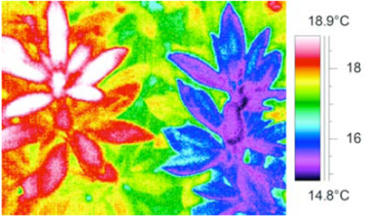
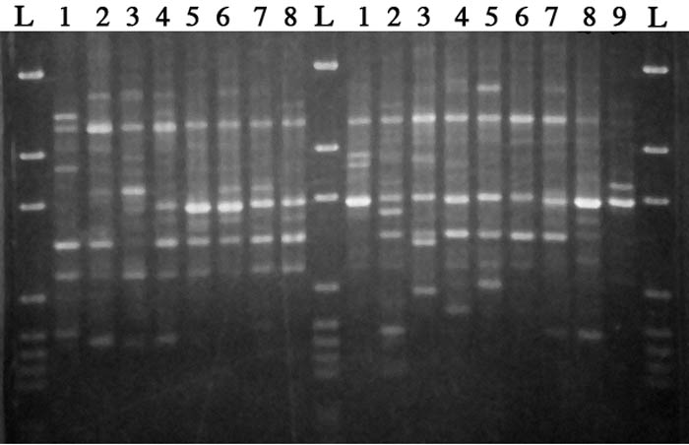
Bayer Field Phenomics Program
Scope
  Exploit the potential of phenomics to provide novel insights in plant response to genetic and environmental variation.
Intent
  Integrate phenomics with genomic marker assisted selection to create a more efficient marker based selection process.

Slide 3
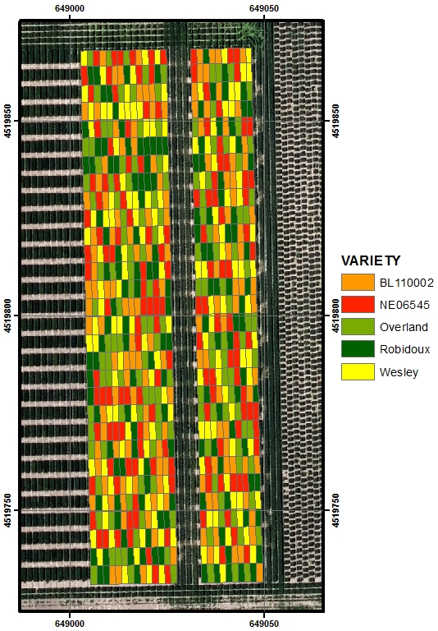
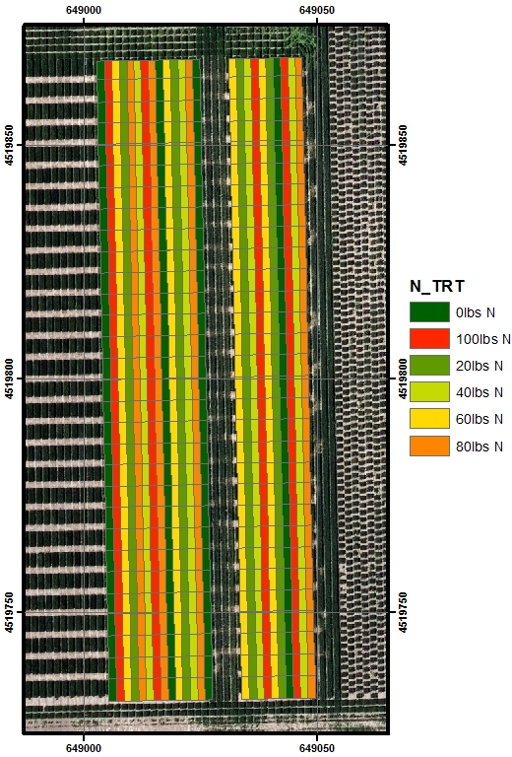
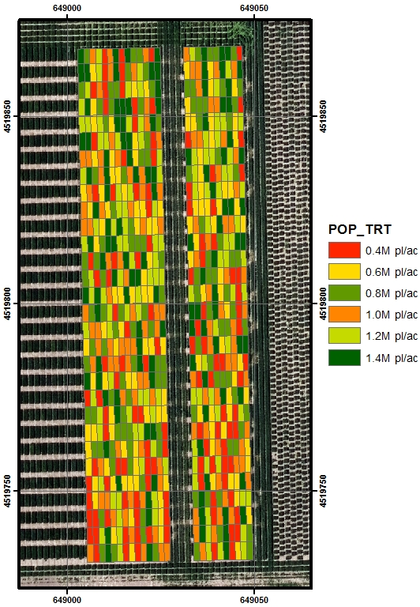
High Throughput Phenomic Sensor Suite Testing: Initial Phase
Genotype x Nitrogen x Plant Density

Slide 4
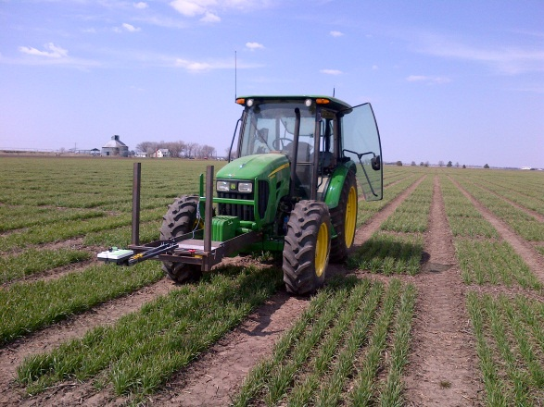
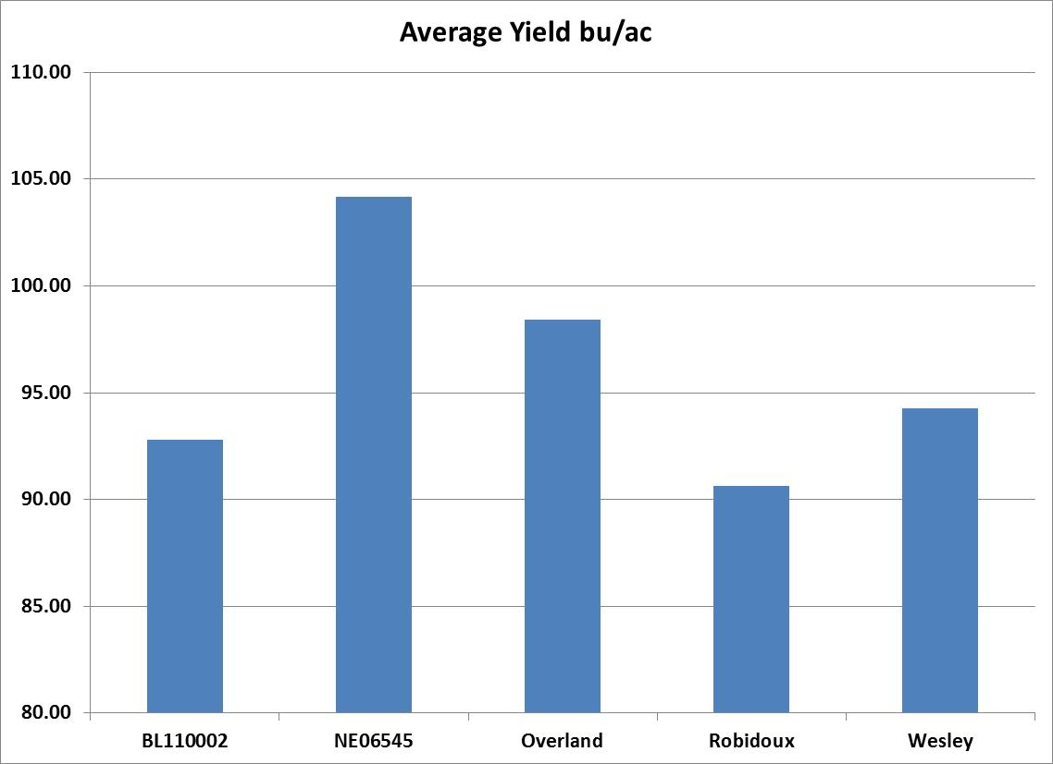
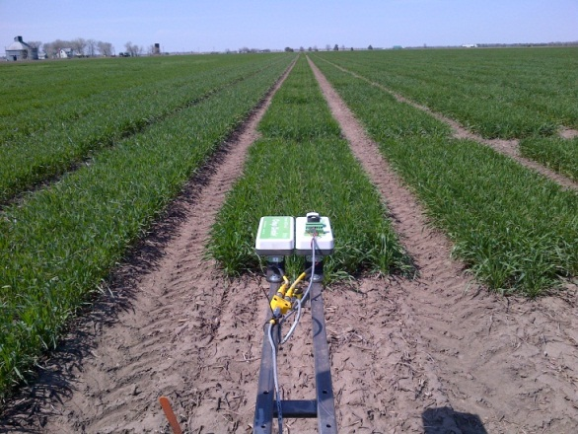
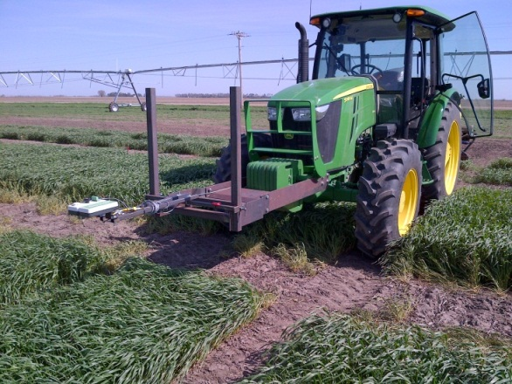
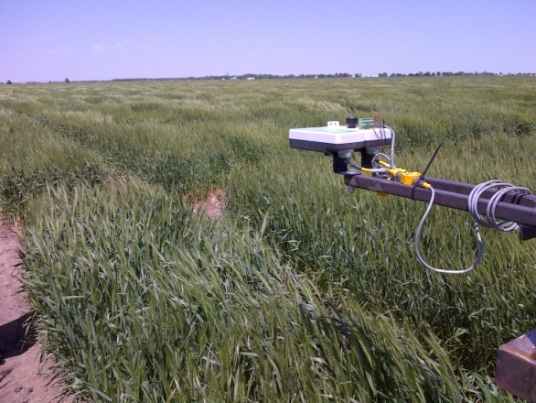
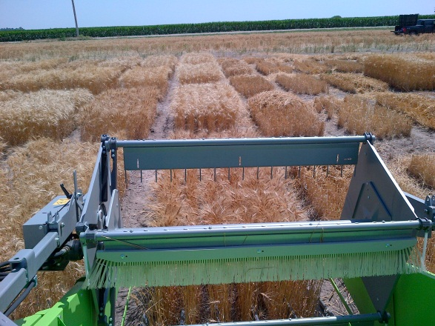
Data Collection
26 Apr
6 May
3 Jun
16 Jul
14 May

Slide 5
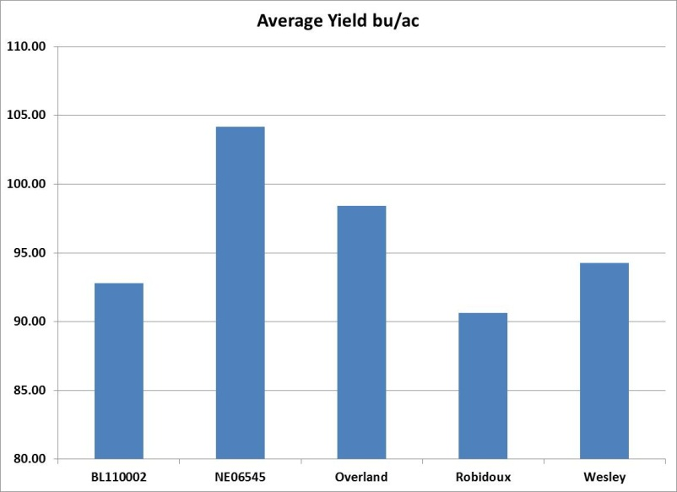
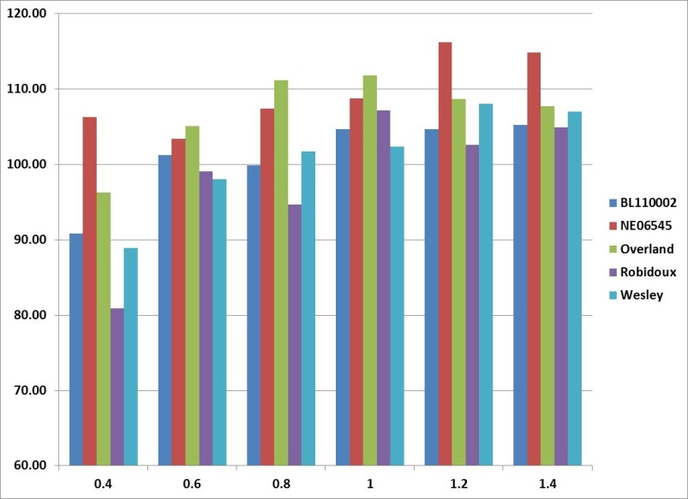
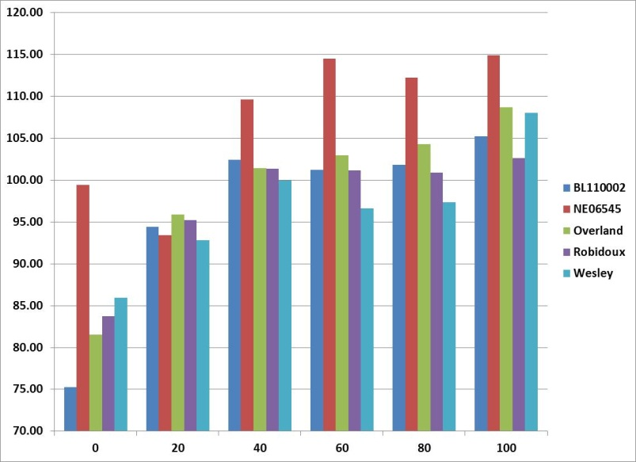
Yield Results
Yield Response plateaus, 40-60 lbs N ac⁻¹.
Yield Response plateaus, 0.8-1.2 M plants ac-1.

Slide 6
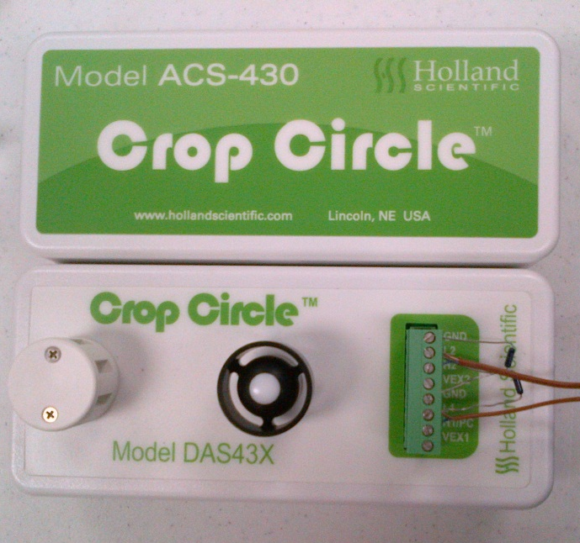
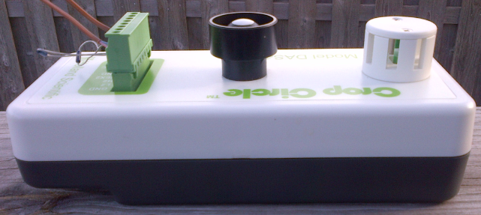
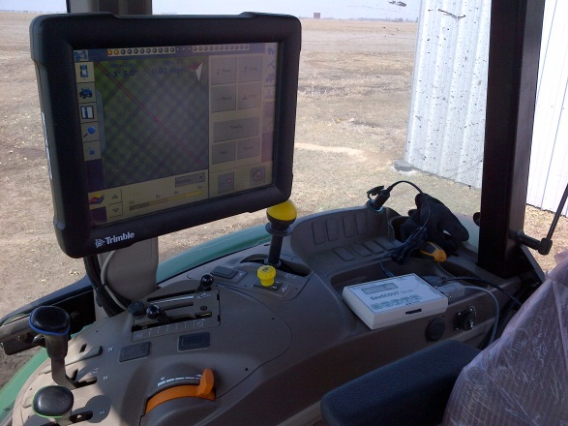
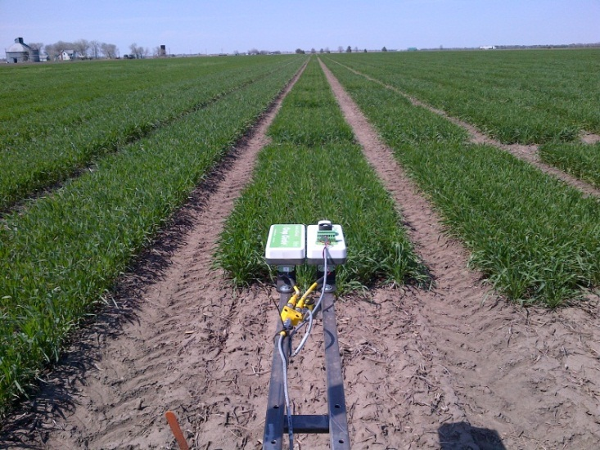
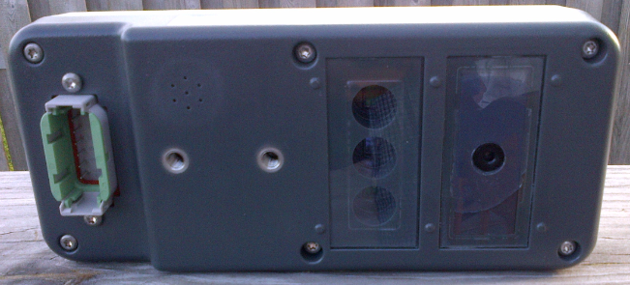
Rapid Field Phenomic Sensor Suite
Crop Circle DAS43X
Optical Sensor
Companion Sensor
2 Chan Voltage Input/
Pulse Counter
Humidity/Temp
Downwelling PAR
Upwelling PAR
IRT

Slide 7
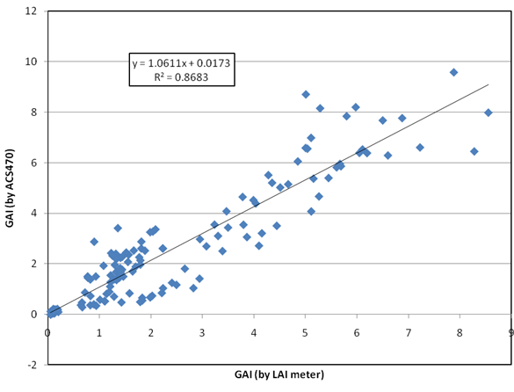
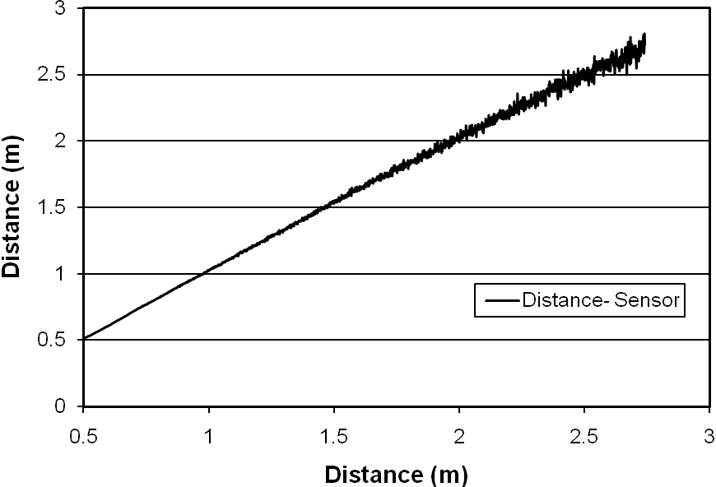
Rapid Field Phenomic Sensor Suite
Measured Variables
Reflectance from 3 bands, 10nm FWHM (Red, Red Edge(RE), NIR)
Select Optical Indices - Canopy Chlorophyll Index(RE), NDVI.
Canopy Chl Content.
Green Leaf LAI.
Canopy Height (via optical methods and ultra-sonic).
Downwelling PAR, Upwelling PAR = Fractional PAR (fPAR).
Relative Humidity.
Ambient Temperature, Canopy Temperature = Temperature Departure (DT).
Data Collection Rate: 5Hz

Slide 8
What spectral regions are most sensitive to Chlorophyll Content. Green and Red Edge
Coefficient of determination for the relationship between reflectance and chl content for each wavelength.
The peaks at 555 nm and 715 nm indicate these regions to be maximally sensitive to chl content.
Those peaks show a strong linear relationship to chl content where the blue and red absorbance regions do not.
Green-Refl.
Near IR-Refl.
Blue/Red - Absorb.
Palisade Cells
Chlorophyll
Upper and Lower Epidermis
Stoma
Air space
Spongy mesophyll

Slide 9
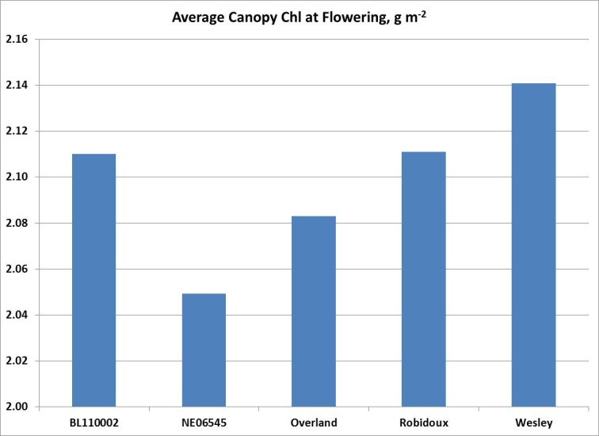

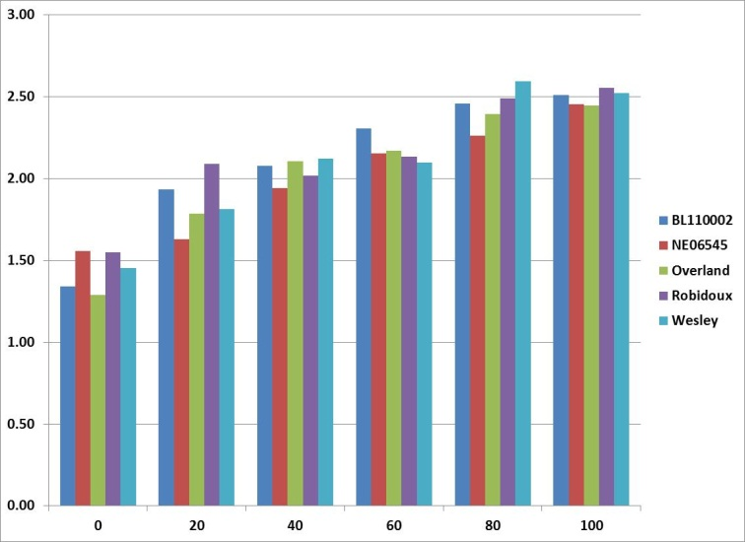

Canopy Chl Content as a function of the Red Edge Chl Index.
Canopy Chl at the time of flowering may reach a response plateau near 100 lbs N ac⁻¹.
Yield Response plateaus near 40-60 lbs N ac⁻¹.
N Partitioning / Translocation? Grain Protein Content?

Slide 10
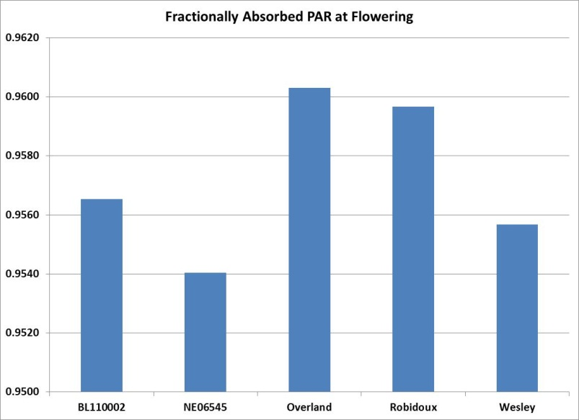
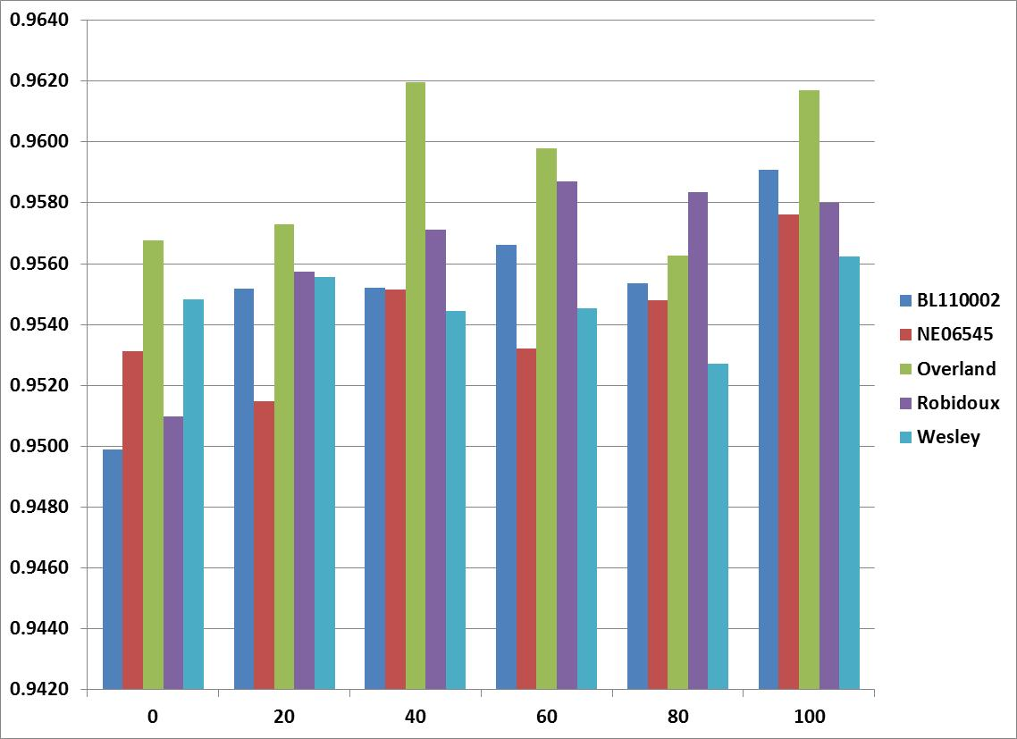
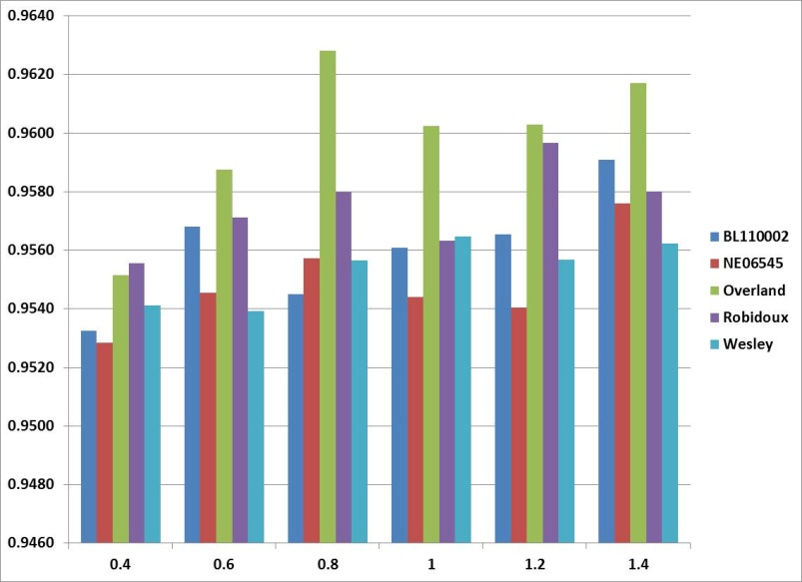
Fractionally Absorbed PAR (fAPAR).
fAPAR was derived by calculating the ratio of upwelling to downwelling PAR, both measured at the height of the sensor.
Provides an indication as to the efficiency of Photosynthesis and Net Primary Production.

Slide 11
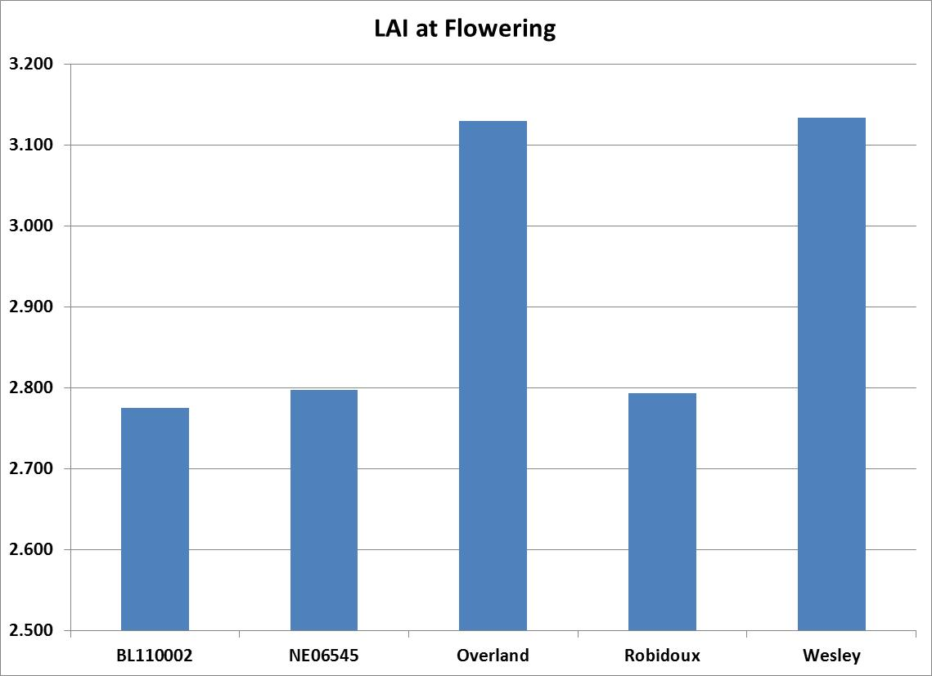
Leaf Area Index as a function of NDVI
Relationship between the NDVI function and leaf area index is not linear but reaches it’s limit more gradually at higher LAI’s.
Green LAI is an exponential function of NDVI linearly related to measured LAI.

Slide 12
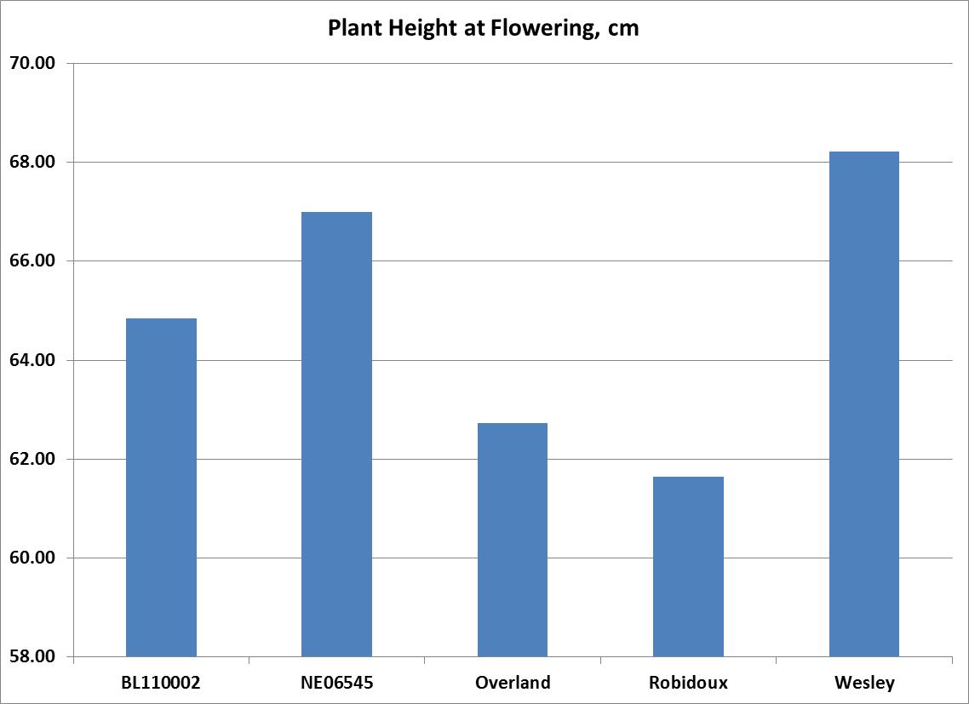
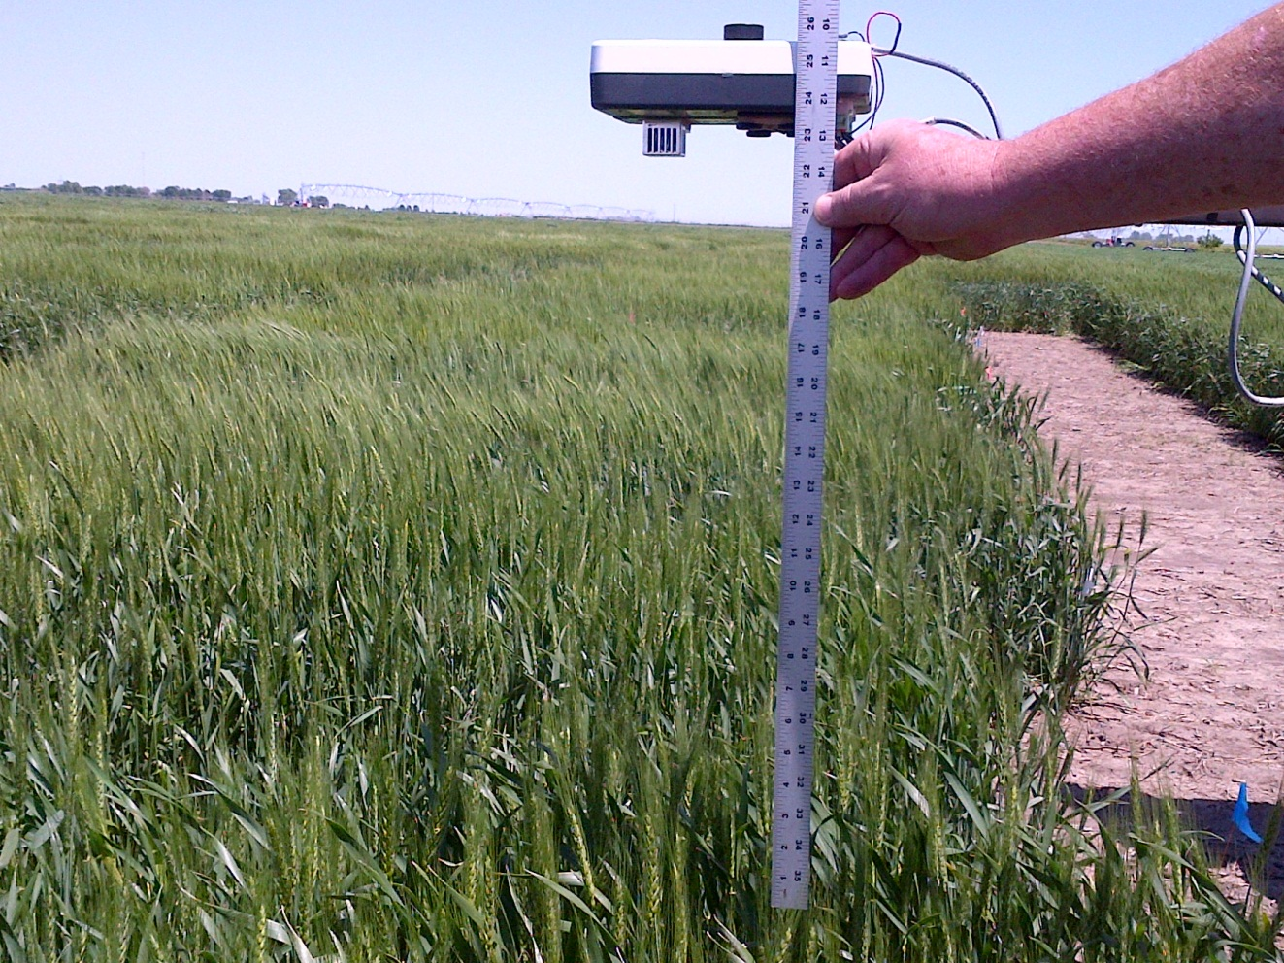
Canopy Height
Plant height was determined by subtracting calculated sensor to target distance from measured sensor height.
Sensor to target distance was calculated using square root of inverse NIR irradiance.
Holland et al., IEEE J. Sel. Topics Appl. Earth Observ. Remote Sens. (JSTARS) , V5, N6, 2012

Slide 13
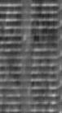
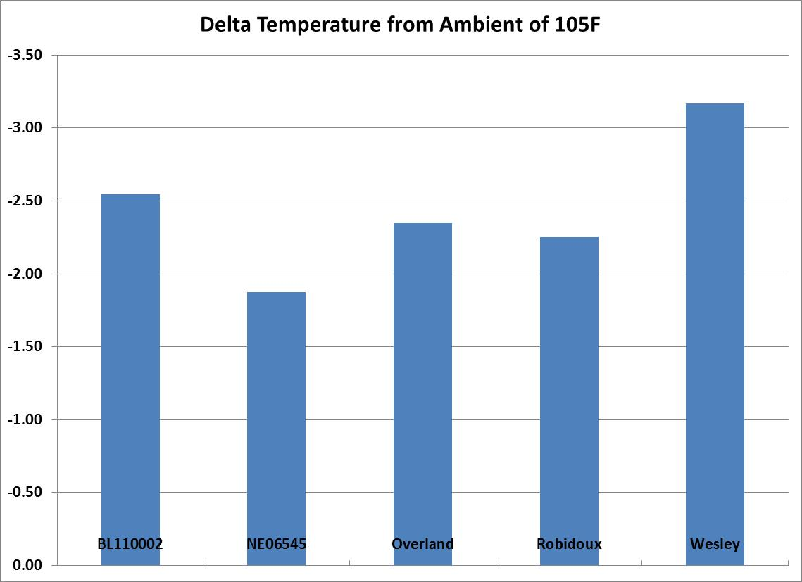
Canopy Temperature Departure
Delta Temperature was calculated by subtracting IRT measured canopy temperature from measured ambient temperature.
Aerial IR cameras were used to acquire late season imagery. Stay green and late season varieties are clearly identifiable.

Slide 14
Opportunities with Phenomic Sensor Systems in Precision Agriculture and Plant Breeding:
    Develop Phenomic markers to compliment Genomic markers that assist with efficient breeder selections.
    Utilize Greenhouse Lemnatec system to incorporate phenomic data into decision support system. Move this concept to the field scale.
    Future advances in high speed data capture, transfer, and analysis should enable on-the-go image based phenomic systems, providing more morphological information.
    UAV’s should be exploited to deliver both image and spectral sensor based systems to the field.

Slide 15
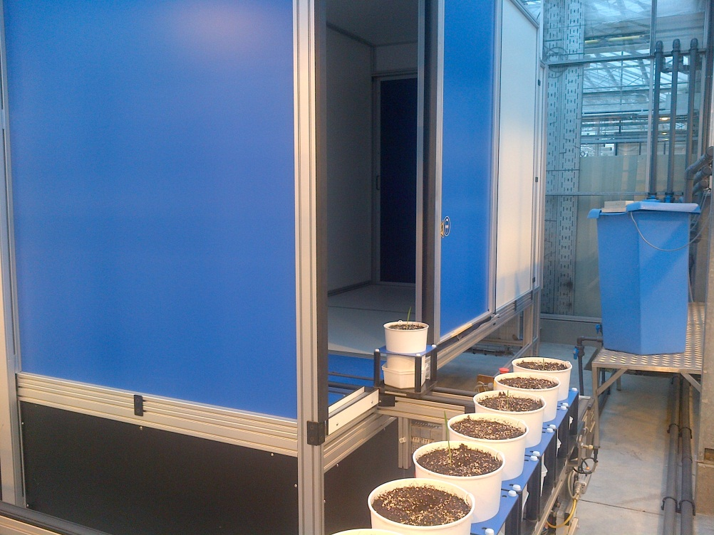
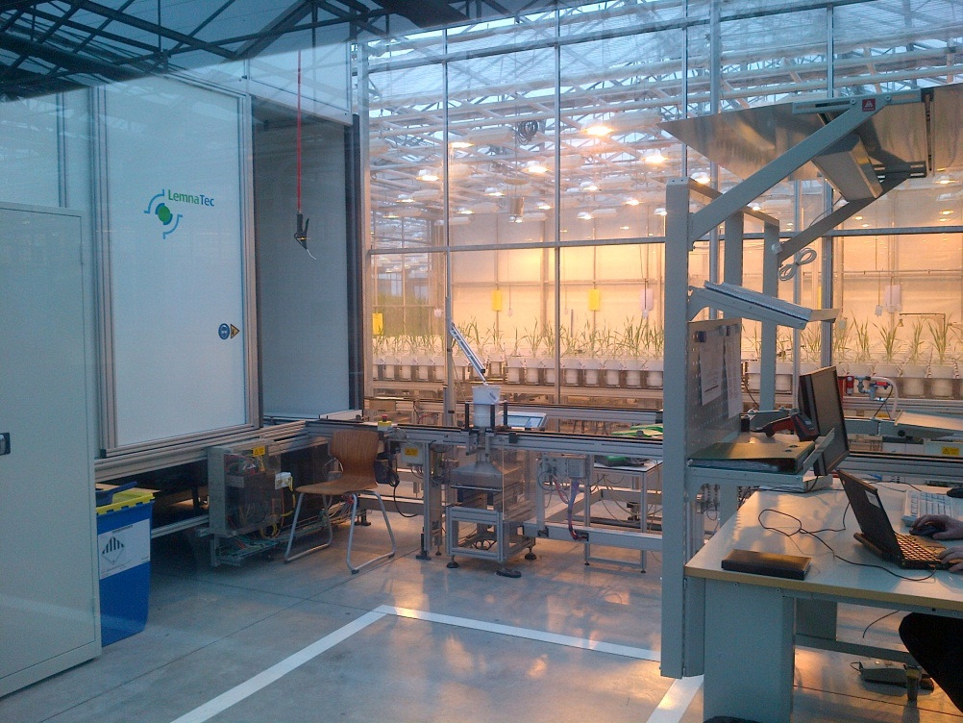
Parallel Phenomic Research within Bayer
Image Recognition Approach (Field and Greenhouse).
Lemnatec Greenhouse Activities.

Slide 16
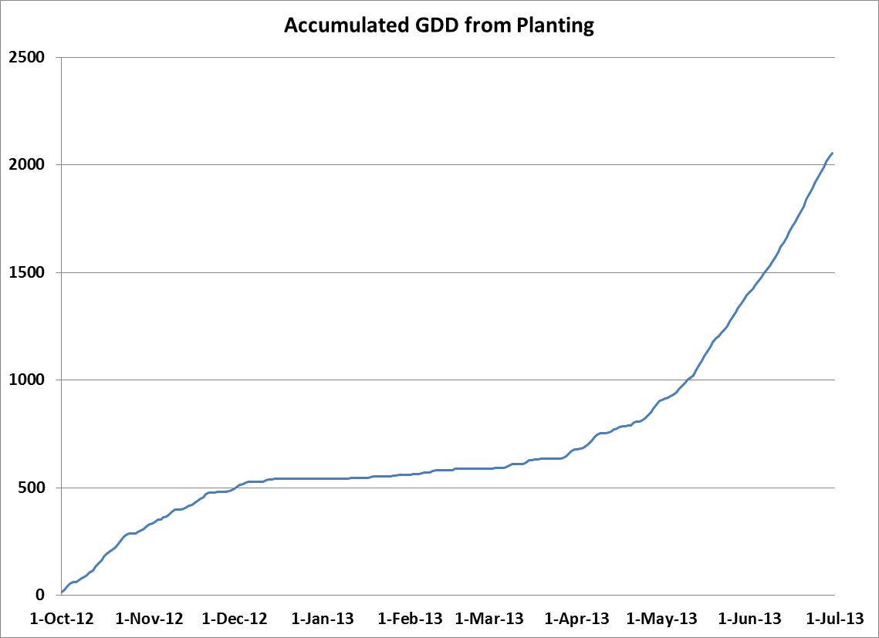
Additional Information
Sampling Date GDD:
26 Apr 12 – 835.7
6 May 12 – 944.3
14 May 12 – 1068.7
3 Jun 12 – 1441.9

