Slide 1
Integrating Weather and Soil Information With Sensor Data
Newell Kitchen
USDA ARS Cropping Systems and Water Quality Research Unit
Columbia, Missouri

Slide 2
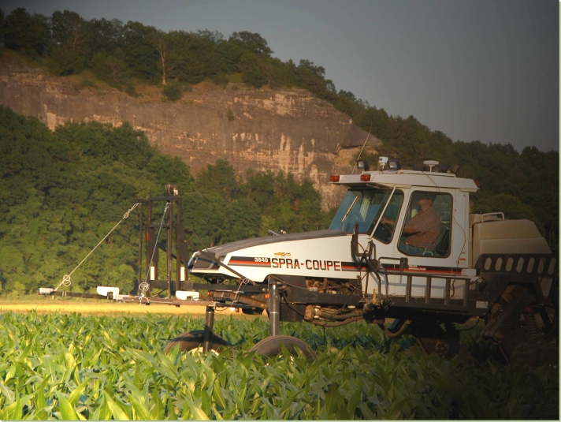
What factors should an algorithm account for when generating an N fertilizer recommendation?
Notes:
Jim’s matrix comparison
Raven’s strategy
Robustness

Slide 3
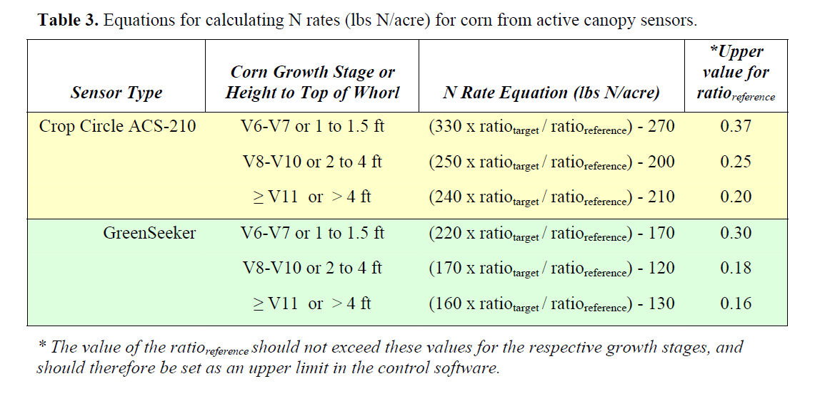
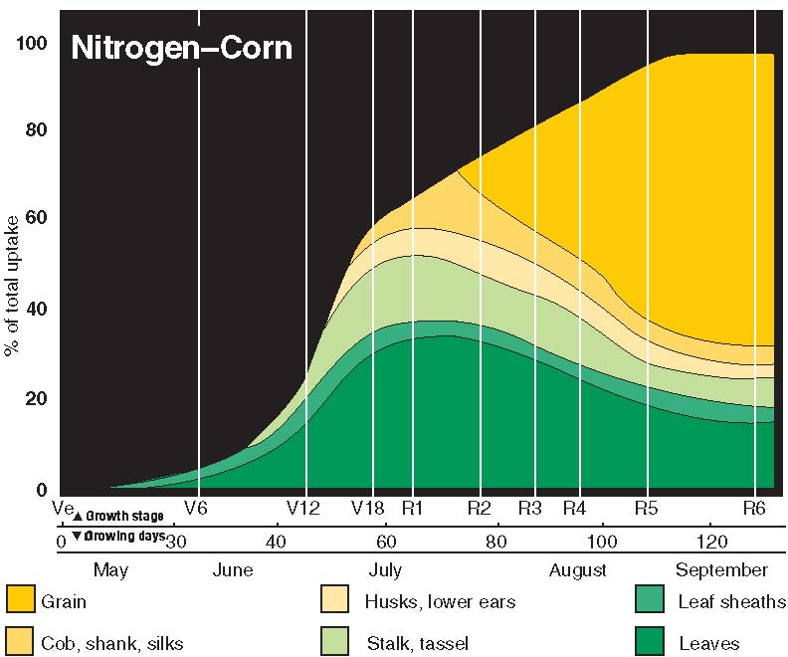
Calculation for N fertilizer Rate
4
2
3
1
Missouri NRCS Agronomy Technical Note MO-35: Corn
Variable-Rate Nitrogen Fertilizer Application for Corn
Using In-field Sensing of Leaves or Canopy

Slide 4
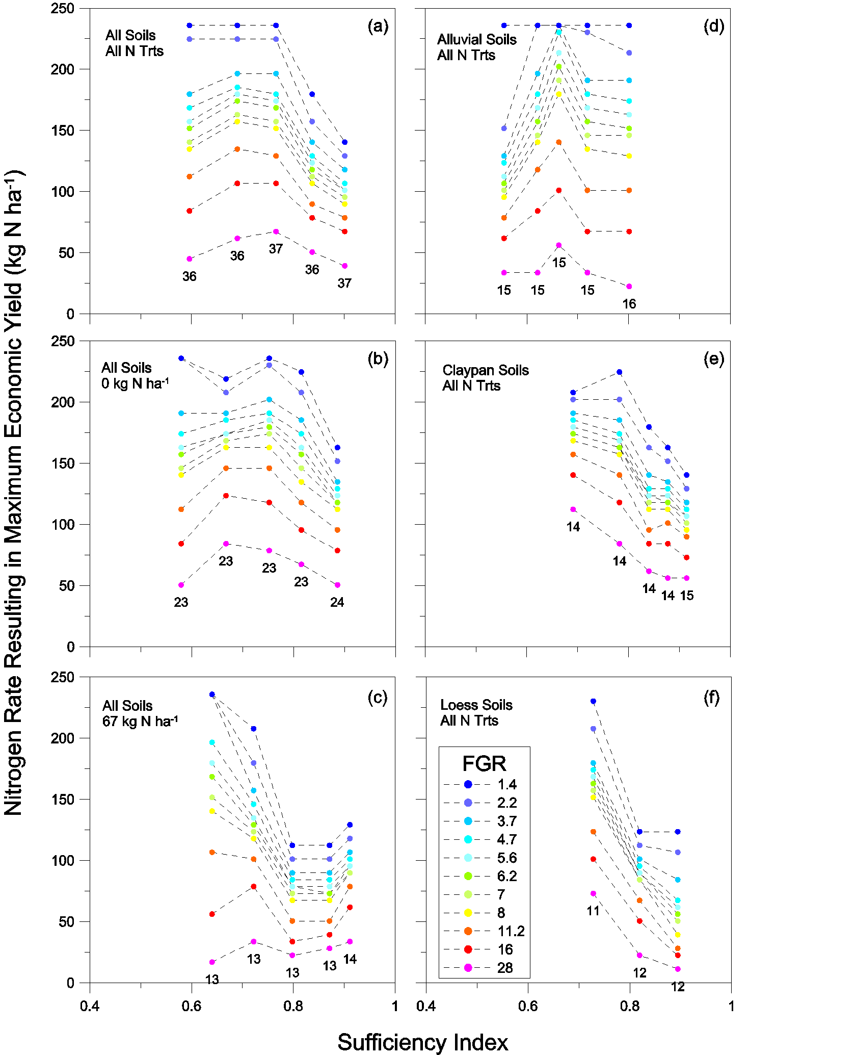
Optimal N Rate as a Function of Canopy Reflectance
1
N Rate for Max. Econ. Yield (kg N ha⁻¹)
3
2

Slide 5
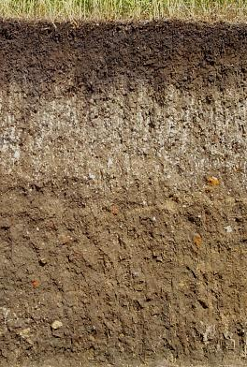
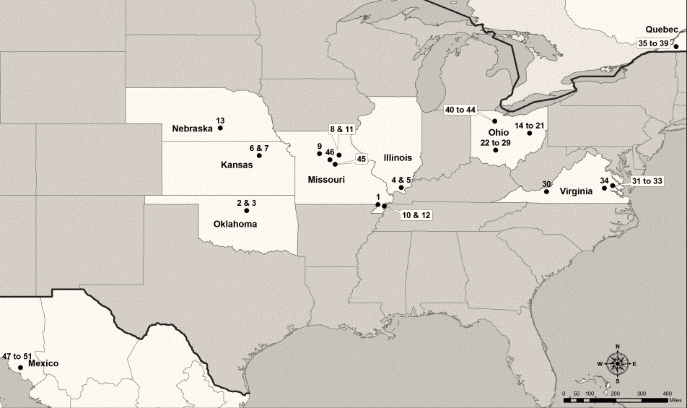
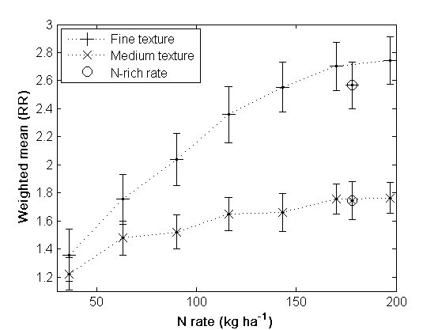
The Soil Factor

Slide 6
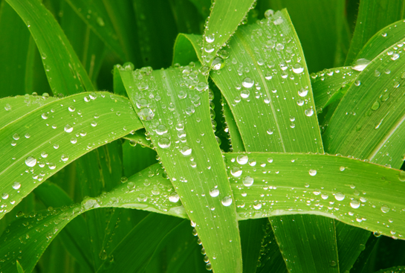
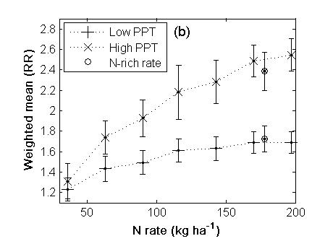
Precipitation

Slide 7
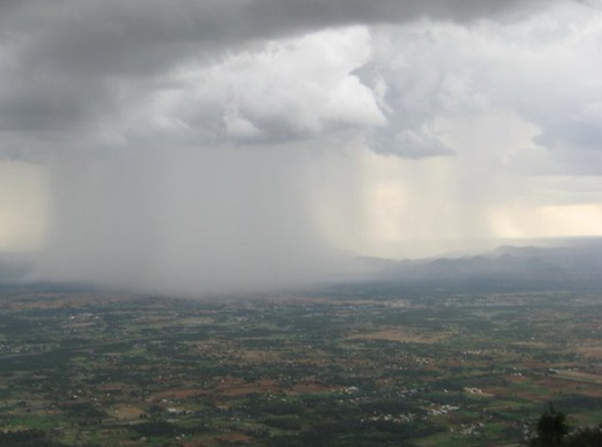
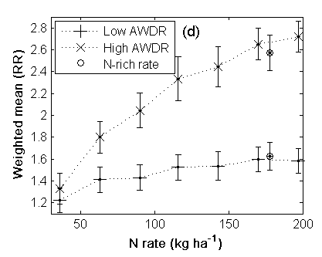
Abundant and
Well-Distributed Rainfall

Slide 8
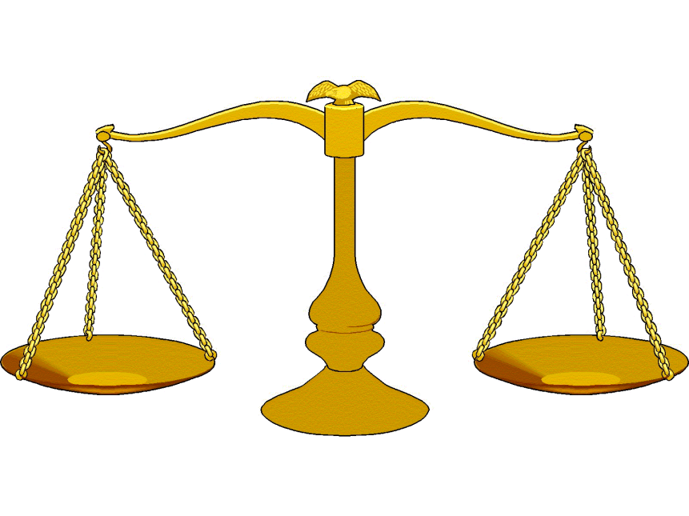
What Factors Should Be Considered?
Crop
Stage of crop
Sensor specific
Soil
  Soil water holding capacity
  Mineralizable N
  N Loss vulnerabilities
Weather
Poor health, poor stand, no stand
Hybrid
Farmer intuition (Max and Min)
Economics
Robustness
Ease of Use

Slide 9
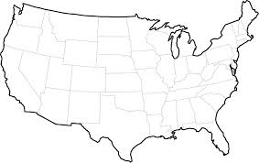
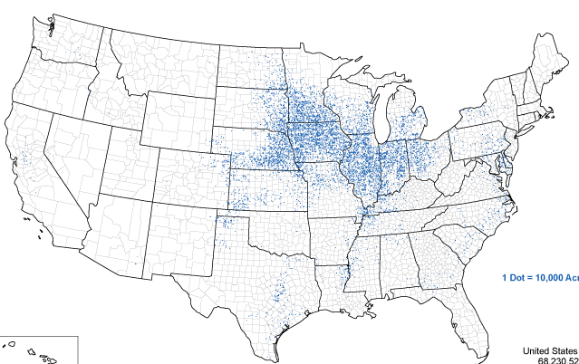
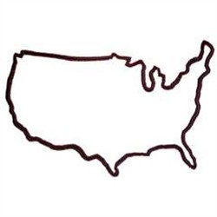
What Tool(s) and Supporting Algorithm(s) Captures the Important Factors and Performs Best?
Universal
Farm/Field Specific

Slide 10
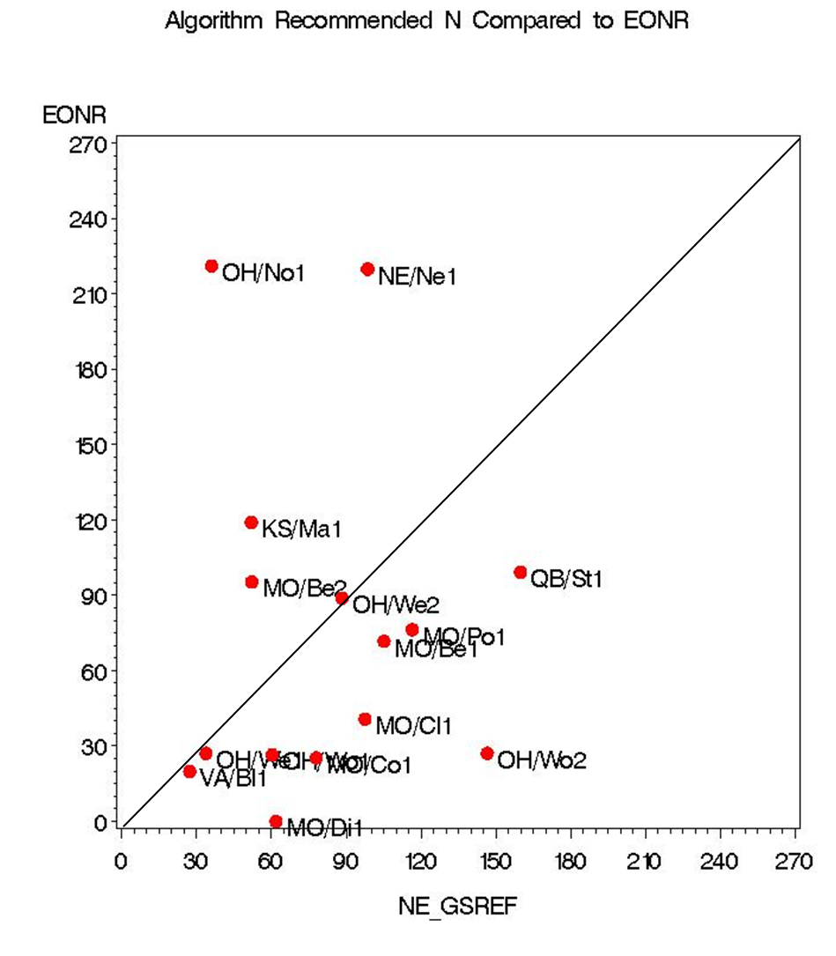
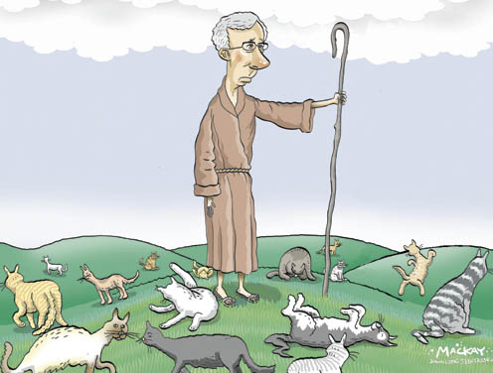
Regional NUE Project
Results confounded by
  Varied methods of sensing
  Varied N management practices
  Varied other cultural practices
Notes:
Meta-analyses on aggregated large datasets
Wide range in soil types, (textural classes) precipitation, distribution of precipitation, growing degree days

Slide 11
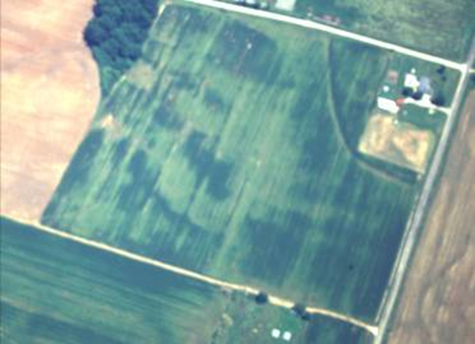
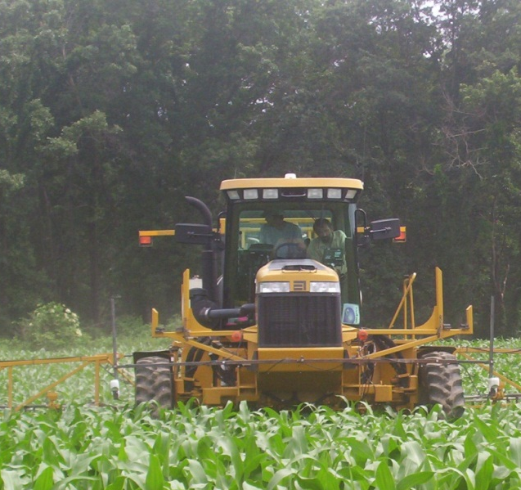
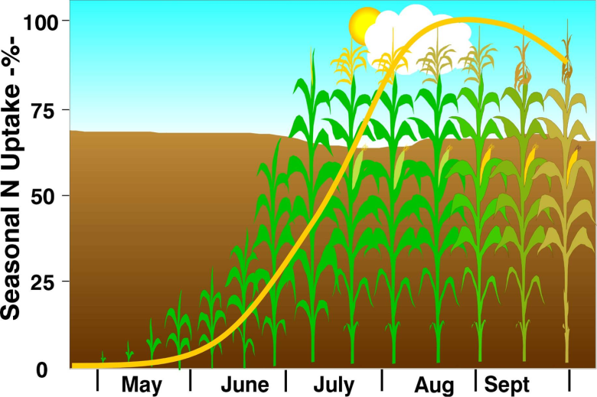
Needed:
Datasets for evaluation and validation, over a wide range of soil and weather scenarios, the yield and economic performance of model and plant sensing decision tools for determining the amount of N fertilizer to be applied to corn.

Slide 12





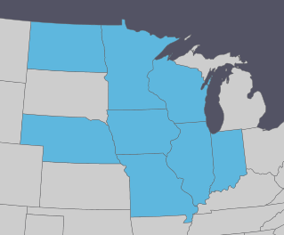




Performance and Refinement of In-season Corn Nitrogen Fertilization Tools

Slide 13



Data from Project
Performance and Refinement
of In-season Corn Nitrogen Fertilization Tools
University
Evaluate
DuPont Pioneer
proprietary products and decision aids
Evaluate public-domain decision aid tools, develop agronomic science for improved crop N management, train new scientists, and publish results

Slide 14
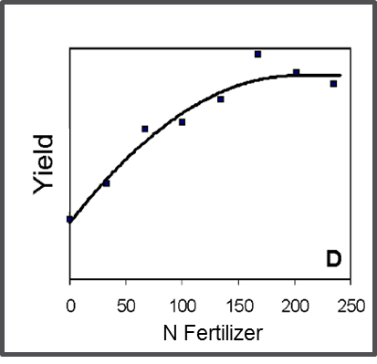
Tools Assessment
Yield and soil measurements from these plot studies will provide N response functions that will be used to reference each of the decision tool methods to be evaluated.
The N rate that would have been recommended by a tool will be matched with the optimal N-rate. Performance of the tool can be for yield, profitability, NUE, N loss, etc.

Slide 15
Standardized Protocols
Site Selection
Site characterization
Treatment implementation
Weather data collection
Equipment
Soil and plant sampling
Management notes
Data management

Slide 16
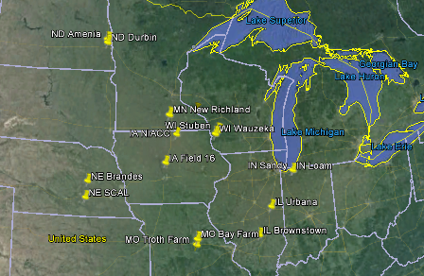
16 Sites in 2014

Slide 17
Integrating Weather and Soil Information With Sensor Data
Newell Kitchen
USDA ARS Cropping Systems and Water Quality Research Unit
Columbia, Missouri

Slide 18
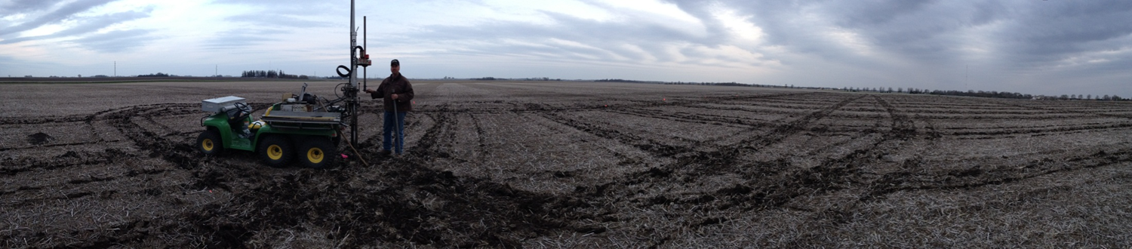
How might soil EC help characterize in-season corn N fertilizer rate both within field and across the cornbelt?

Slide 19
Infiltration good
PAWC good
Infiltration good
PAWC poor
Infiltration poor
PAWC poor
Relative Productivity
Sand
Loam
Clay
0 10 20 30 40 50 60 70
Soil Electrical Conductivity (mS/m)

Slide 20
Site Soil EC Maps

Slide 21
IL BRT
IL URB
NE BRD
NE SCAL
IN SAND
IN LOAM
IA AMES
IA MC
MN ST CH
MN New Rich
Relative Productivity
MO BAY
MO TRT
ND AMEN
ND DUR (+110)
WI STU
WI WAU
Sand
Loam
Clay
0 10 20 30 40 50 60 70
Soil Electrical Conductivity (mS/m)

Slide 22
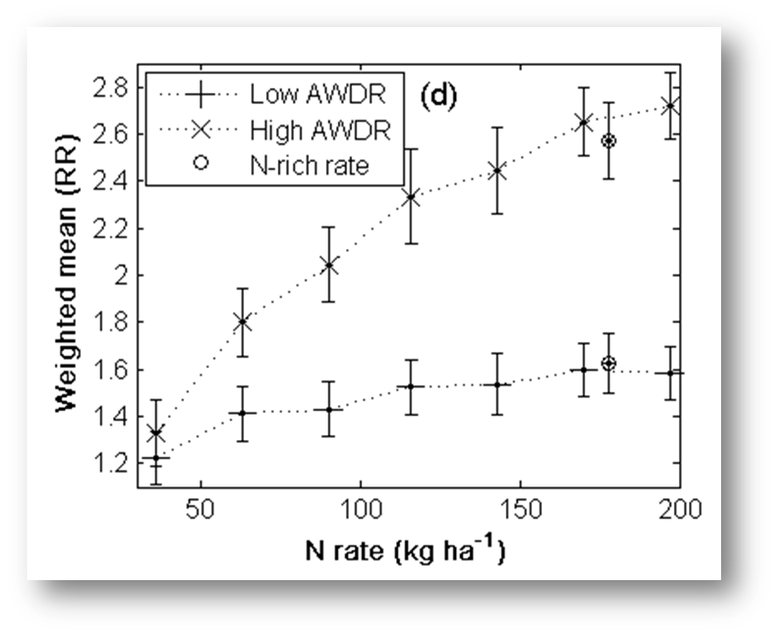
Infiltration good
PAWC good
Infiltration good
PAWC poor
Infiltration poor
PAWC poor
Relative Productivity
Sand
Loam
Clay
0 10 20 30 40 50 60 70
Soil Electrical Conductivity (mS/m)

Slide 23
Why Regional Investigation of this kind?
Breadth. More comprehensive story when a wider range of soil, weather, and cultural norms are included using standardized procedures
Balance. Build on the unique perspectives and strengths each investigator brings (both with critical and creative thinking), and perhaps also it helps neutralize individual’s biases
Strengthens and Weaknesses. Side-by-side testing of the tools will allow for better understanding of where and when they work best

Slide 24
