Slide 1
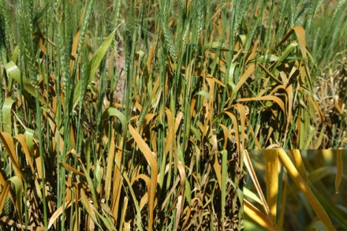
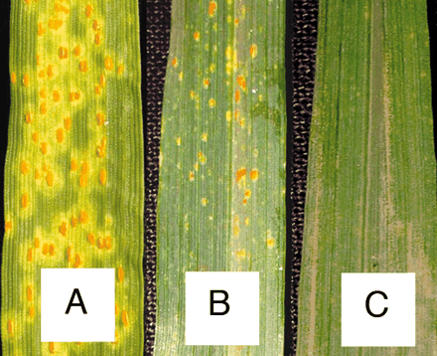
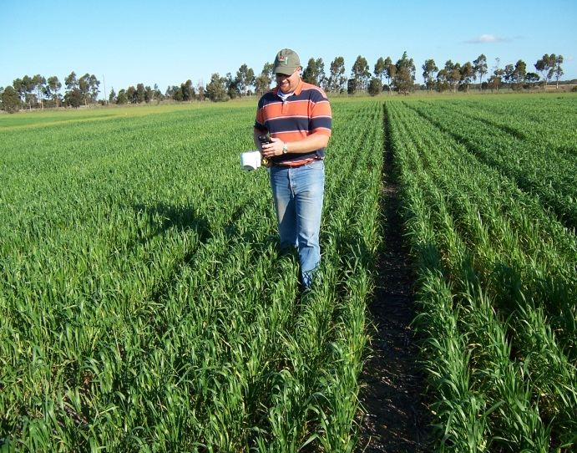
Developing a Sensor Based Algorithm for Economic Thresholds of Leaf Rust (Puccinia triticina L.) on Hard Red Winter Wheat (Triticum aestivum L.)
Ethan C. Wyatt
Oklahoma State University, Department of Plant and Soil Sciences, Stillwater, Oklahoma
Purpose: Developing a sensor based algorithm for determining economic thresholds for leaf rust, can increase the effectiveness of the fungicide by applying at the right timing and also increase potential yield by eliminating the disease before causing economic damage.
Background: Leaf rust is a common occurrence in the Midwestern United States’ wheat crop during the spring months, as the wheat plants switch from vegetative to reproductive stages. Although wheat breeders are continually breeding for better resistant traits against leaf rust, in some years leaf rust epidemics occur across the Midwest because of a new strain of the disease. In years when leaf rust is present yield losses up to 30% can be attributed to the disease. Fungicides are a great tool to eliminate the disease, but can be very expensive if having to treat the wheat more than once per season.
Other Contributions:
This research could also be used to further establish other algorithms for crops such as corn and soybeans where leaf rust and other foliar diseases can also be problematic.
Winter wheat heavily infested with leaf rust. This type of infestation can cause tremendous yield losses. Fungicides used early on leaf rust can slow down or eliminate the disease before yield is lost.
Source: ARS-USDA 2013
Different leaf rust severities, Leaf A shows heavy signs of the disease, Leaf B has light signs of the disease, and Leaf C shows no signs of leaf rust. The fewer pustules present on a leaf represents a less severe outbreak of the disease.
Source: www.PNAS.org
Benefits:
Increased yield potential
Greater effectiveness of fungicide
One sensor for N rate and fungicide recommendations
Increased producer profit margin
Most producers already own a GreenSeeker© which would also be used as the sensor in the project.
Source: www.nue.okstate.edu

