Slide 1
Determining the Optimum Growth Window for NDVI Sensing in Order to Predict Yield in Winter Wheat in the United States Grain Belt
Melissa Golden
April 23, 2015

Slide 2
Rationale
Many very valuable technologies designed specifically with producers in mind
Subject to poor adoption of said technologies
Number of reasons
Mistrust
Tradition
Price

Slide 3
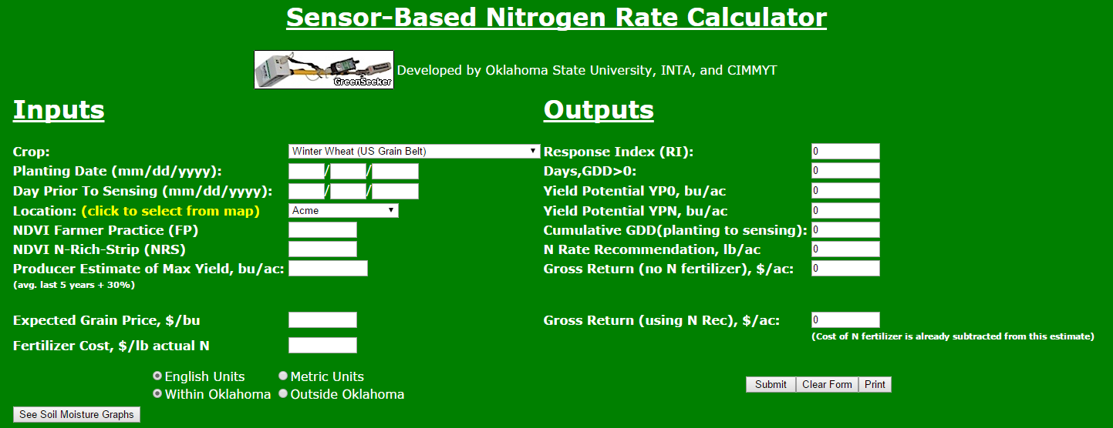
Objective
To analyze NDVI data from long term winter wheat trials to determine the perfect window in which to sense for the purpose of yield prediction for a number of agronomic purposes

Slide 4
Methods
Values for Rsquare of yield prediction from NDVI readings as a function of actual harvest yield will be compared to determine the optimum growth window for NDVI sensing in order to predict yield
Could be based on:
GDDs
Growth stage

Slide 5
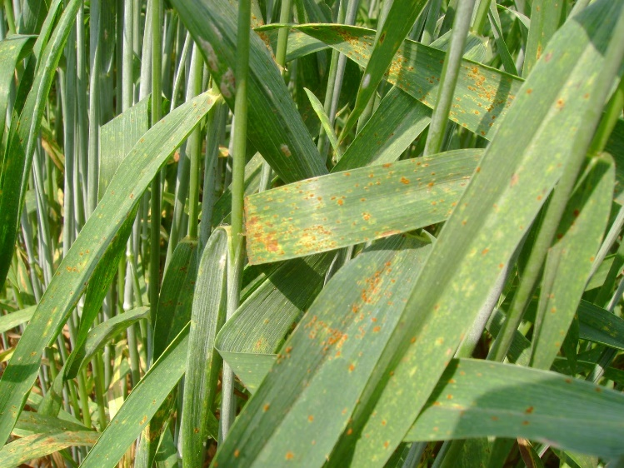
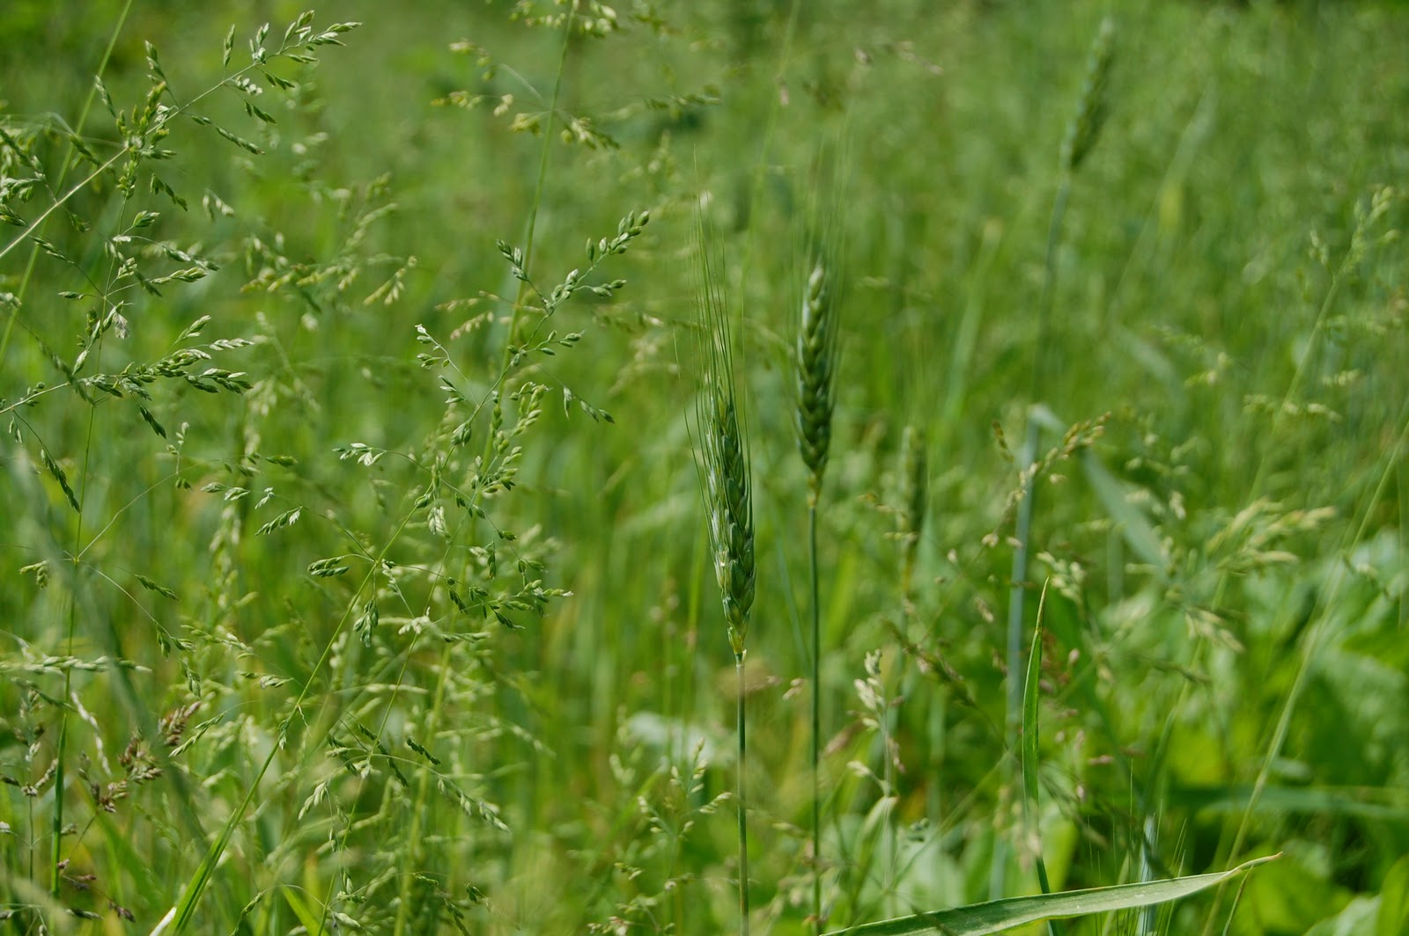
Practical Applications
Herbicides
Fungicides

Slide 6
Foliar Fungicides and Wheat Production in Oklahoma – April, 2015 (Dr. Jeff Edwards & Dr. Bob Hunger)
Table 1. Approximate percent loss of yield caused by
leaf rust at combinations of leaf rust severity and growth
stage of wheat.
Severity (%) of leaf rust on the flag leaf
10 25 40 65 100
Growth stage ------------------% yield loss---------------------
Flowering 10 15 20 30 35
Milk 2 5 8 14 20
Soft dough 1 3 4 7 10
Hard dough 1 1 1 3 5

Slide 8
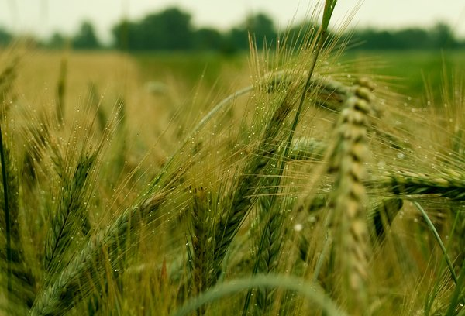
Fortunately
Oklahoma has seen no major rust outbreaks since 2011
However, optimistic for precipitation in the future!

