Slide 1
Getting N Rates Right
Shawntel Ervin

Slide 2
Present
Yield Goals
Same year after year
Doesn’t account for environment
Average yield from the last 5 yrs + 5-10%
2lbs N for every bushel wheat
Can over estimate yield by 15%

Slide 3
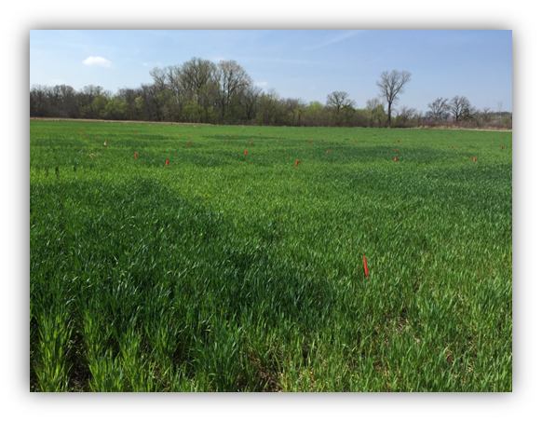
Why should we care?
N not used is usually lost = wasted $$
Ends up in places it shouldn’t be
Yield potential not met = economic loss for the producer

Slide 4
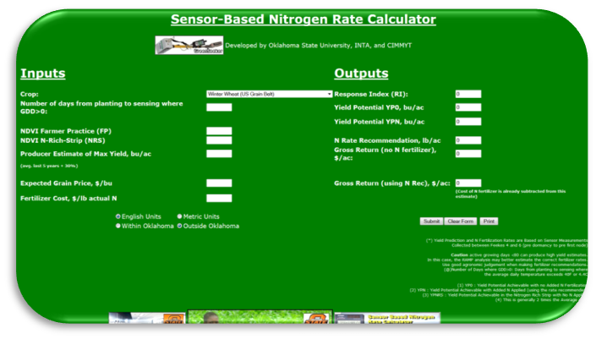
Future
N Rich Strips
Visual “Yes or No”
Greenseeker Sensor
Shown to increase NUE by 15%
Sensor Based N Rate Calculators
Available for many crops
Shown to decrease N by 20lbs/A

Slide 5
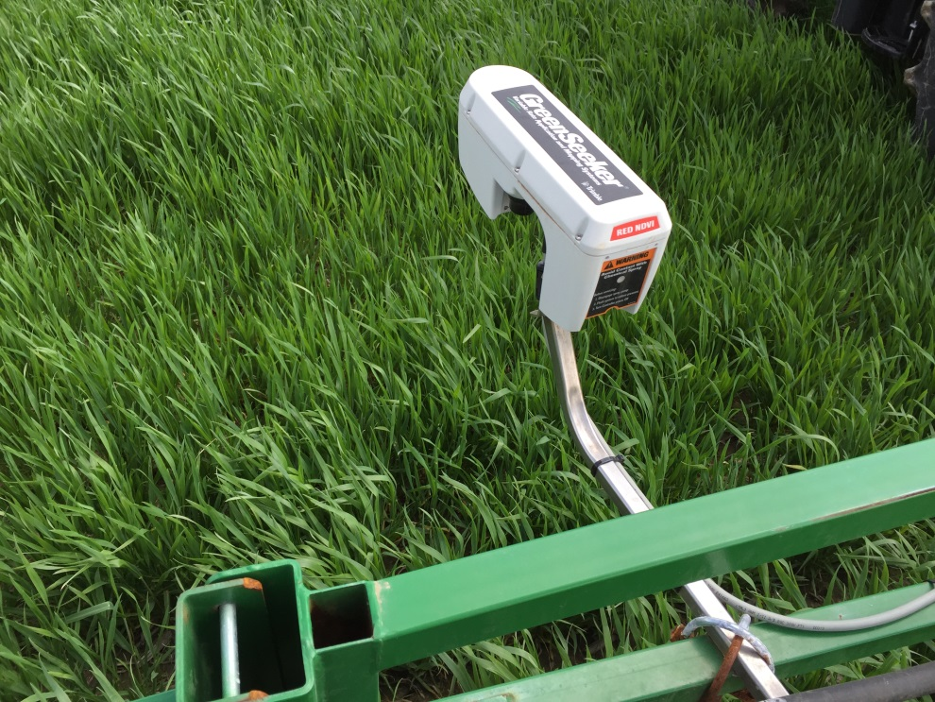
Capabilites
Variable Rate N Applications

Slide 6
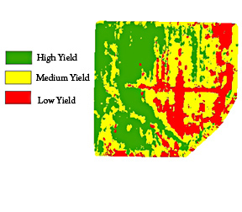
Thank you

