Slide 1
Reverse N lookup, sensor based N rates using Weather improved INSEY
Nicole Remondet

Slide 2
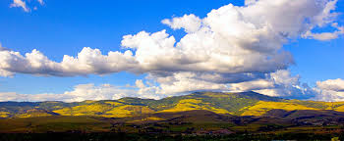
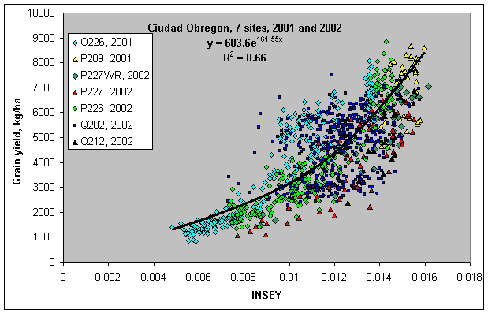
Rationale

Slide 3
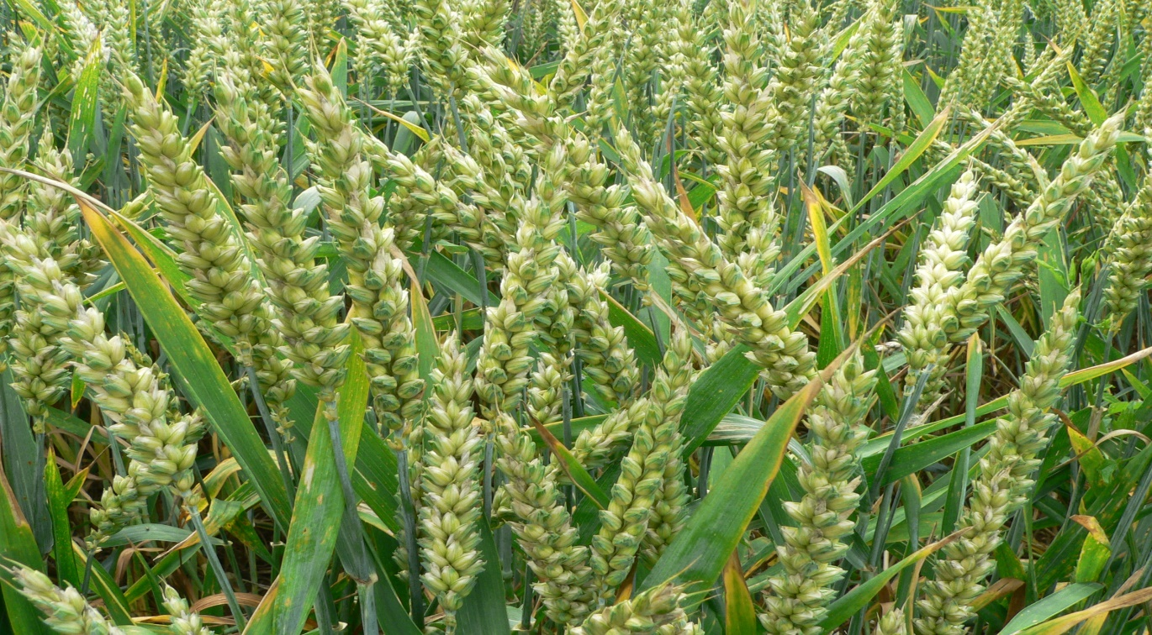
Objectives
One objective of this study is to develop a model that incorporates climatic parameters with NDVI measurements to increase the reliability of predicting wheat grain yield in-season. Using current and long term data, the current INSEY will be evaluated from five locations: Lake Carl Blackwell, Lahoma, Hennessey, Perkins, and Efaw. Another objective of this study is to compare the weather improved model with the current model.

Slide 4
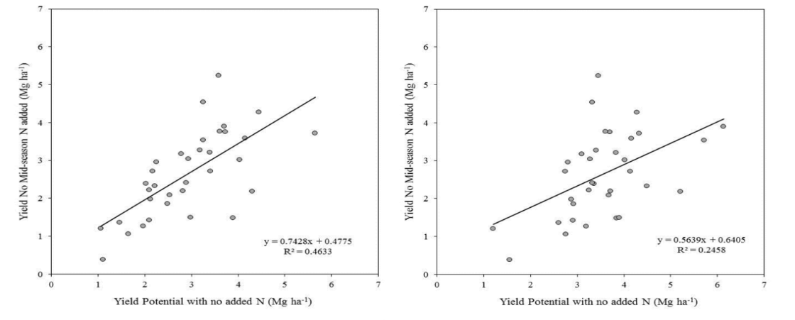
Methods
From Jake Bushog’s previous paper where he incorporated soil moisture into his yield calculator. Linear regression of measured grain yield of plots with no mid-season N fertilizer with estimates of yield potential
without added N derived from the Current N Fertilizer Optimization Algorithm (Left) and the Proposed N Fertilizer Optimization Algorithm (Right).

Slide 5
Conclusion
While the current yield predictor is efficient there is always a way to improve it by using accurate weather information in association with the yield estimation. The aspects of weather that one could include could be: cumulative Growing Degree Days, changing the maximum/minimum temperature utilized, or by altering the methods of calculating GDD. Using resources such as the Mesonet the weather information one can utilize will be accurate. Using less resources to grow our crops will be increasingly important in the coming years as the human population grows and the resources available begin to dwindle. Since weather has such a huge impact on the growth of crops it will be beneficial to incorporate such data into the current INSEY so that less resources could be used.

Slide 6
Questions?
Works Cited:
Development of an In-season Estimate of Yield Potential Utilizing Optical Crop Sensors and Soil Moisture Data for Winter Wheat ,Jacob T. Bushong^{*1}, Jeremiah L. Mullock¹, Eric C. Miller¹, William R. Raun¹, Arthur R. Klatt¹, and D. Brian Arnall¹
In-Season Prediction of Corn Grain Yield Potential Using Normalized Difference Vegetation Index R. K. Teal, B. Tubana, K. Girma, K. W. Freeman, D. B. Arnall, O. Walsh, and W. R. Raun*
https://www.mesonet.org/index.php/site/about

