Slide 1
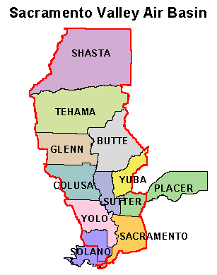
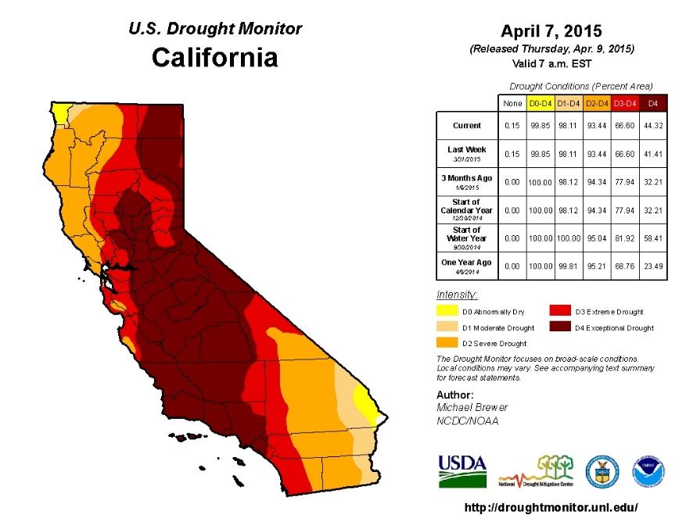
Economic Impacts due to irrigation water reductions in the Sacramento Valley
Ethan Driver
Abstract
California is currently facing its fourth consecutive year of drought. Due to the lack of water supply, production of many of the commodities that the region specializes in has become increasingly difficult. The Sacramento Valley provides a large portion of orchard, rice, and vegetable crops to California’s agriculture industry. This study depicts the impact the current drought is having on the region’s economy as well as how further water reductions would affect these economies.
Objective
The objective of this study is to use The Central Valley Project Model (CVPM) in order to analyze data and predict the affects irrigation water reductions would have in the current environment of the Sacramento Valley.
Methods
The primary step in the study is to collect data. This data pertains to crop production and irrigation, efficiency improvements, dependency of agriculture, and the economy of the Sacramento Valley. In order to analyze the data and compare with previous studies, the CVPM will be used.
Conclusions
The previous study that took place in 2001 used data from 1992 because it was the most recent drought year (Lee et al. 2001). They explored the scenario of 25% water reduction in 1992. In comparison, the current drought has been taking place over the past 4 years. In 2014, water use was reduced by 40% in the Sacramento Valley. The reduction in water supply raises a lot of concern with farmers in the area because of the commodities grown (rice, orchard crops, vegetables, alfalfa hay, etc.). Due to the large need for water in the production of these commodities, many farmers are faced with difficult decisions when allocating resources. The lack of resources results in less income generated in the Sacramento Valley.
Counties with the lowest personal incomes per capita, tend to be the counties that are impacted the most by water shortages. This is due to the dependencies of these counties on agriculture. Sacramento Valley agriculture relies on irrigation; water shortages will continue to have a large impact on rural economies.

