Slide 1
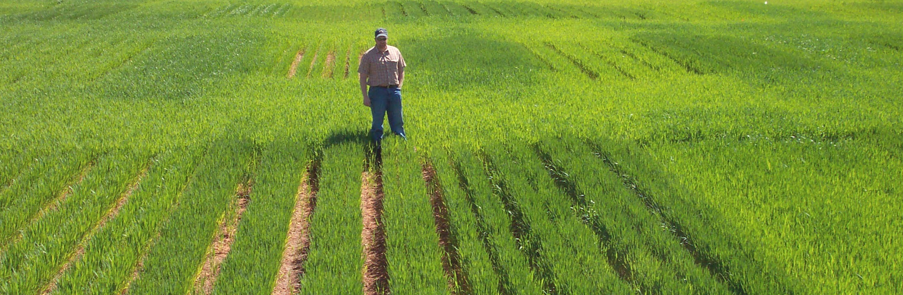
Nitrogen Use Efficiency, Realistic Opportunities for Improvement
E_{nue}
Symposium--Improving Water and Nitrogen Use Efficiencies in Dryland Farming Systems, Ignacio A. Ciampitti , Vara Prasad
ABSTRACT NUMBER: 125501
Password: 637951
Give me 1 billion dollars (price of 1 B2 bomber) could develop N fixing corn
Dr. Kyle Freeman,
Office Chérifien des Phosphates

Slide 2

http://nue.okstate.edu/N_Fertilizers/NUE_definition.html
1.The Difference Method (Varvel and Peterson,1990, Agron. J. 82:935-938)
= Yield N Fertilized Plot * %N grain – Yield 0N-check * %N grain/ Rate of N Fertilizer Applied
or = PFR = (NF)-(NC) / R
NF = (Yield * %N grain + stover, fertilized plot)
NC = (Yield * %N grain + stover, unfertilized plot)
R = rate of fertilizer applied
https://doi.org/10.2134/agronj1990.00021962008200050019x
2. Macro Statistics (Raun and Johnson, 1999, Agron J. 91:357-363)
= (Yield * %N grain – est. N from soil/rainfall) / N fertilizer applied
https://doi.org/10.2134/agronj1999.00021962009100030001x
3. NUE Isotopic Recovery (plant N derived from fertilizer) (Hauck and Bremner, 1976, Adv. Agron. 28:219-266
https://doi.org/10.1016/S0065-2113(08)60556-8
= (Nu – Nt)/(Nu – (Nf/n))
Nu = atom % 15N in unfertilized plants
Nt = atom %15N in fertilized plants
Nf = atom%15N in the fertilizer (example 0.006%)
4. Mass Balance (Davis et al., 2006, J. Plant Nutr. 26:1561-1580) (https://doi.org/10.1081/PLN-120022364)
account for all N applied
Yield * %N to account for N removed in the grain
Yield * estimated plant N loss as NH3 (% loss based on Yield level)
account for denitrification, nitrate leaching
account for non-symbiotic N fixation, N applied in the rainfall
estimate of total soil N (0-30 cm) beginning and end of the experiment

Slide 3
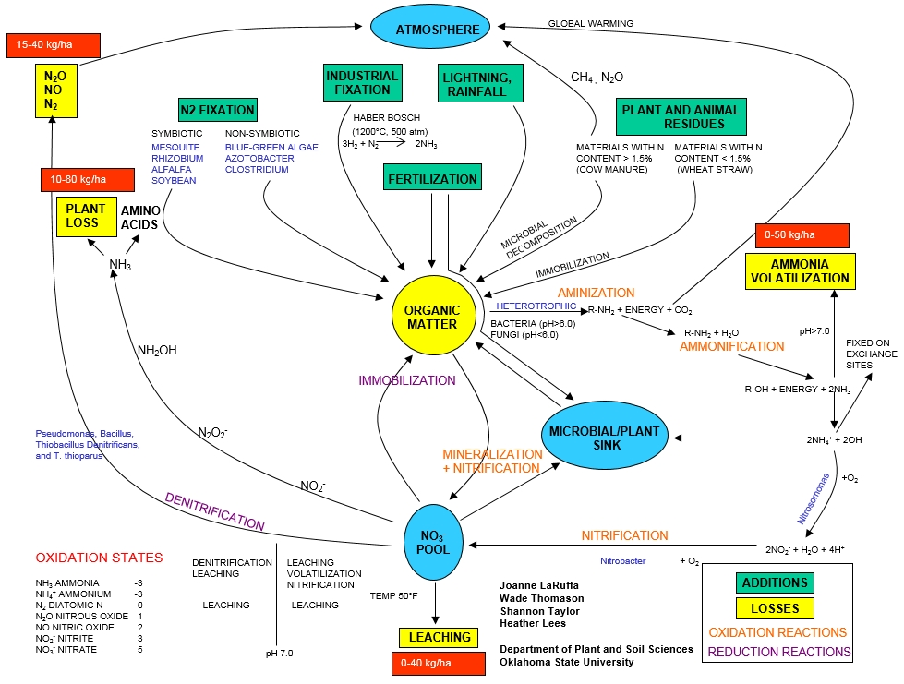

We know exactly where the holes are in this boat

Slide 4
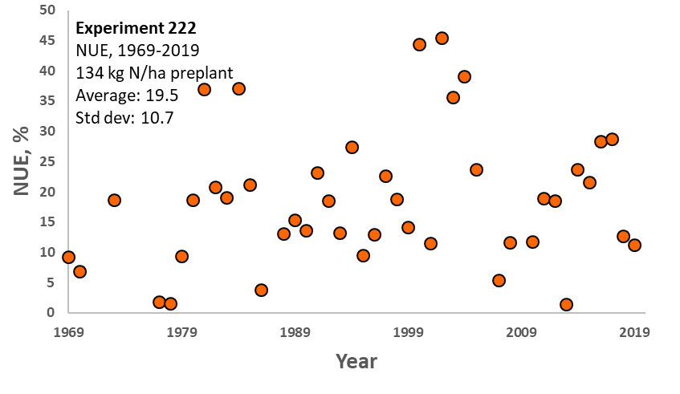
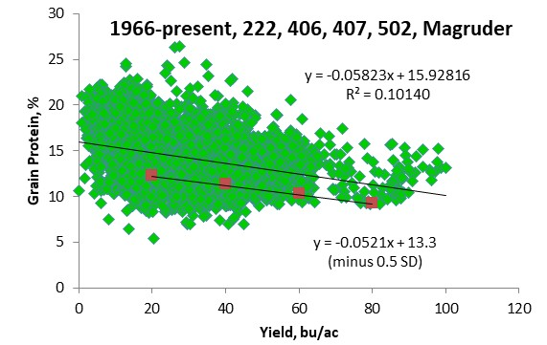
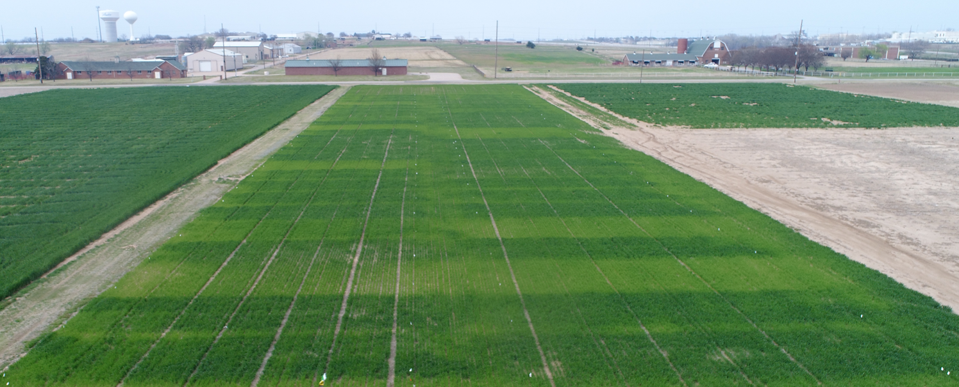

E₂₂₂

Slide 5
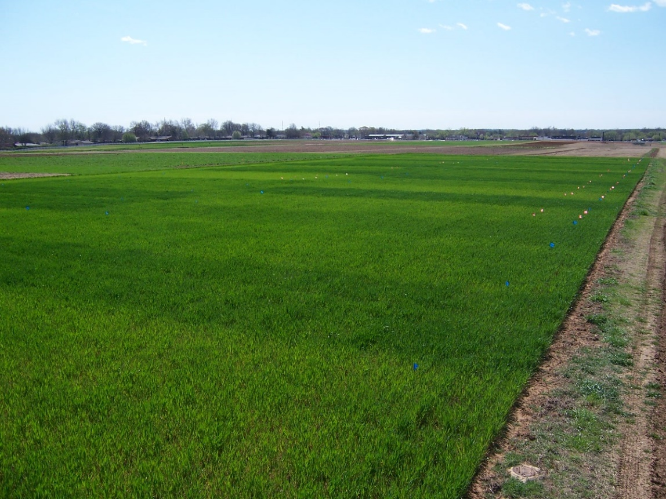

E₂₂₂

Slide 6
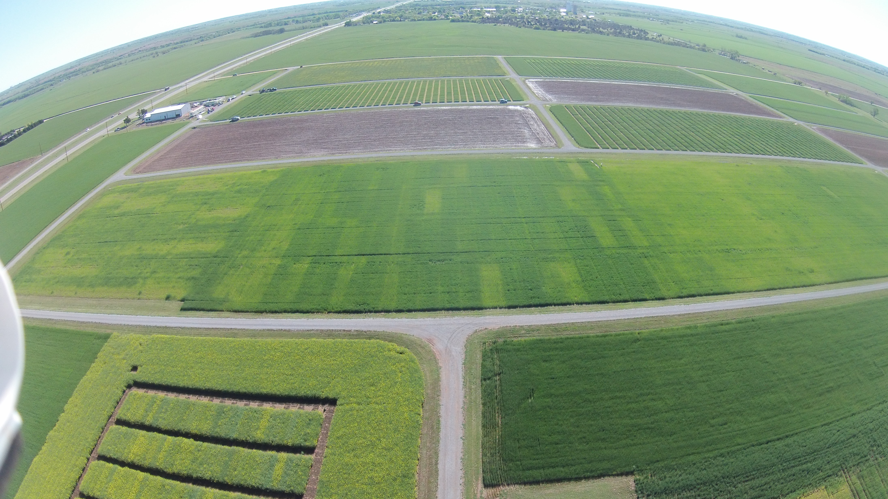
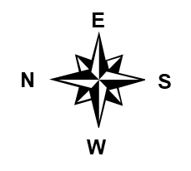
E₅₀₂
Plant losses, denitrification, surface runoff and leaching, volatilization
Nitrogen Use Efficiency (NUE)
Relative balance between amount of fertilizer taken up and used by the crop versus amount of fertilizer lost (Nielsen, 2006)
Grain dry weight or grain nitrogen as a function of N supply (Van Sanford & MacKown, 1986)
World cereal grain NUE estimated at 33% (Raun and Johnson, 1999)

Slide 7
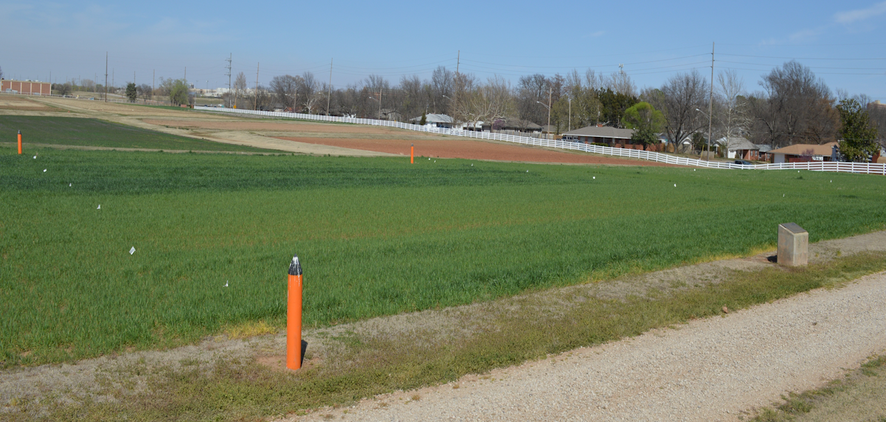

E_{Magruder}
www.nue.okstate.edu
Established, 1892
Manure
Check
P
NP
NPK
NPK-Lime

Slide 8
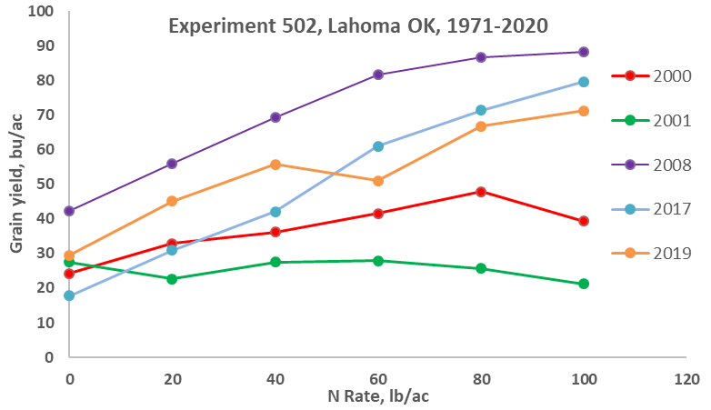

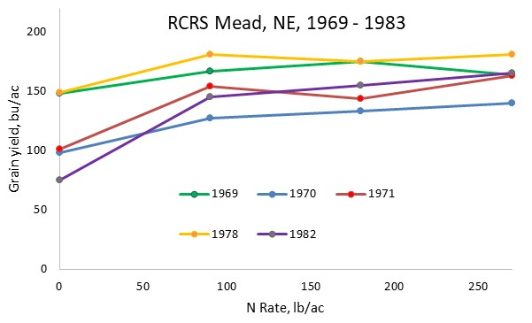
49 years Later
E_{RCRS}

Slide 9

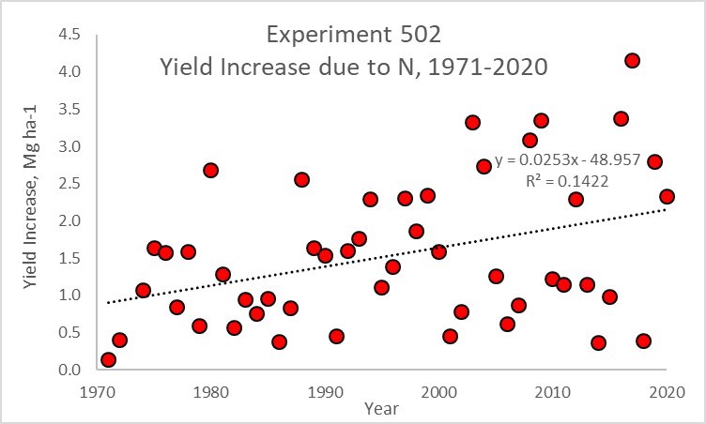

Slide 10

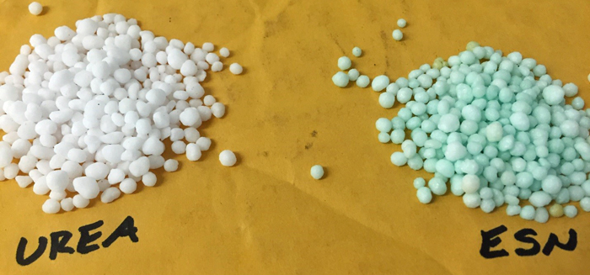

https://www.smartnitrogen.com/
Environmentally Smart Nitrogen (ESN) is a polymer-coated urea formulated as 44-0-0. N release is temperature dependent (increased temp, increased release)
Arbuscular mycorrhizal fungi (AMF) It penetrates the root cells of vascular plants, extends to the area outside the rhizosphere and connects roots with the surrounding soil microhabitats thereby increasing root surface area for better absorption of nutrients such as phosphorus (Yao et al., 2001; Vassilev et al., 2001) and promotes tolerance to abiotic stresses such as salinity (Santander et al., 2019) and drought (Aalipour et al.,
2019). Arbuscular mycorrhizal fungi induced NO3 and NH4 transporters improved N uptake in several plants

Slide 11
Fertilizer Additives
CENTURO™ nitrogen stabilizer (6/11/2020)
“nitrification inhibitor for anhydrous ammonia and UAN offers highly effective below-ground nitrogen protection and unequaled flexibility in an easy-to-use solution”
Koch Industries
NSERVE

Slide 12
Synchrony of N supply with crop demand is essential in order to ensure adequate quantity of uptake and utilization and optimum yield.
Fageria https://doi.org/10.1016/S0065-2113(05)88004-6

Slide 13
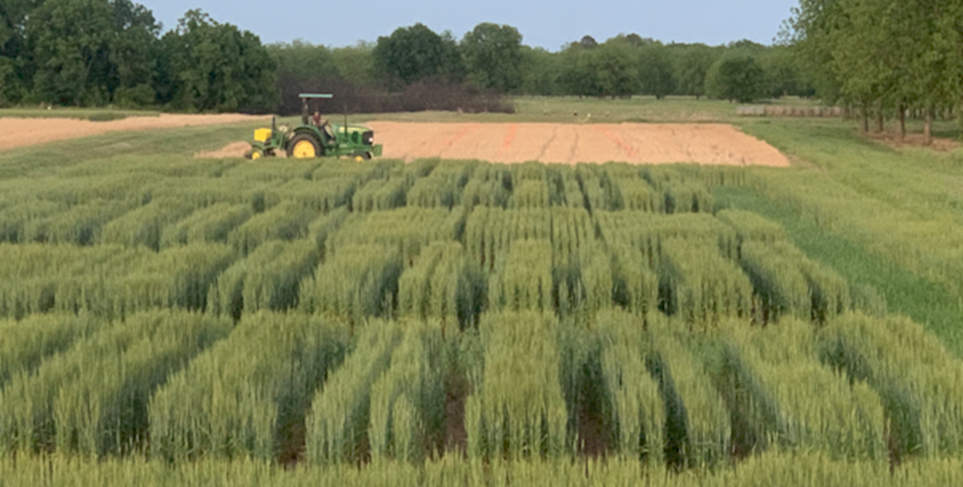
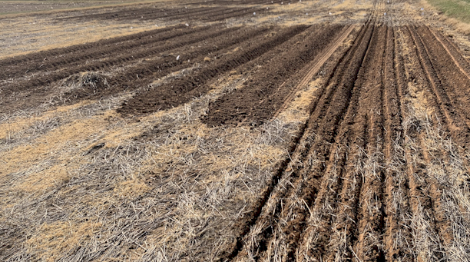

Slide 14
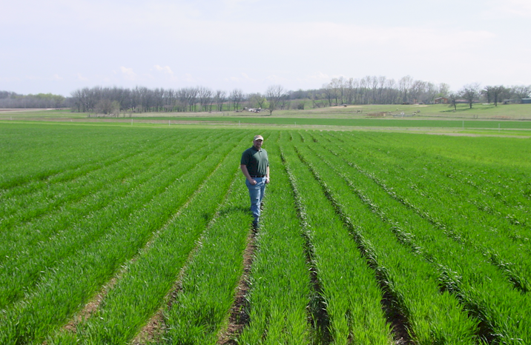

Slide 15
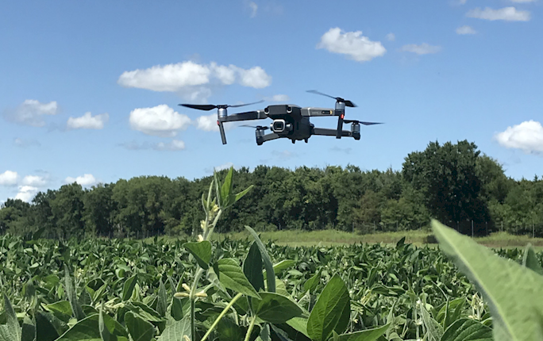
Increasing NUE, Drones
Easiest way to increase Nitrogen Use Efficiency is to use a different formula
NUE meeting, MO
“At economically optimal N rates in our 8 field-scale experiments, N efficiency was high: more N was removed in grain than was applied as fertilizer (>100% efficient!)”

Slide 16
NUE Results
Isotopic Discrimination, Mass Balance,
Difference Method, Apparent Recovery
In C:\NUE\
E_{nue}

Slide 17
Bidwell
(1979), Plant Physiology, 2nd Ed.
Metabolism associated with nitrate reduction
photosynthesis
carbohydrates
respiration
reducing power
carbon skeletons
NADH or NADPH
NO
NO
NH
3
amino
3
2
nitrite
acids
nitrate
reductase
reductase
ferredoxin
siroheme
Francis, D.D., J.S. Schepers, and M.F. Vigil. 1993. Post-anthesis nitrogen loss from corn. Agron. J. 85:659-663. (up to 82 kg N/ha)
Lees, H.L., W.R. Raun and G.V. Johnson. 2000. Increased plant N loss with increasing nitrogen applied in winter wheat observed with ¹⁵N. J. Plant Nutr. 23:219-230. (up to 42 kg N/ha)

Slide 18
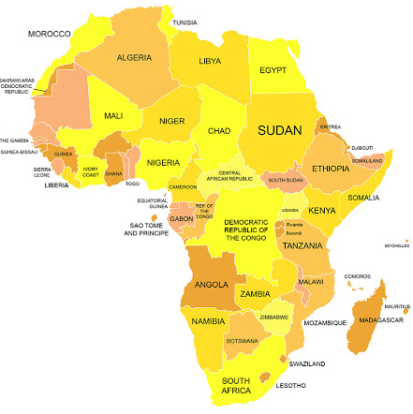
E_{SSA}
Cereal production in SSA is inadequate for supporting the nutritional demands of a rapidly growing population.
Nutrient mining, particularly nitrogen (N), has taken place in virtually all areas where cereals are produced in SSA.
Estimated NUE’s for SSA exceed 100%.
This suggests that SSA is doing a remarkable job in managing fertilizer N
Reality is that so little fertilizer N is used that estimates of NUE are grossly exaggerated

Slide 19
Sub-Saharan Africa vs. USA
SAA USA
Population, million 1100 328
Cereals, million ha 88 56
Production, million tons 97 364
Yield, tons/ha 1.1 6.5
Fertilizer N, million tons 1.3 10.9
Avg. N rate, kg/ha 4 52
% of world N consumed 1.4 13
% of world population 10 4

Slide 20
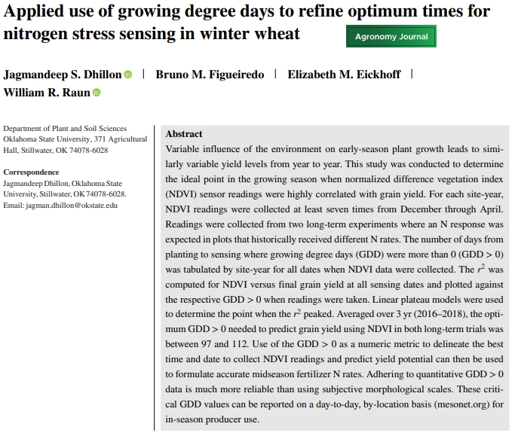

Slide 21
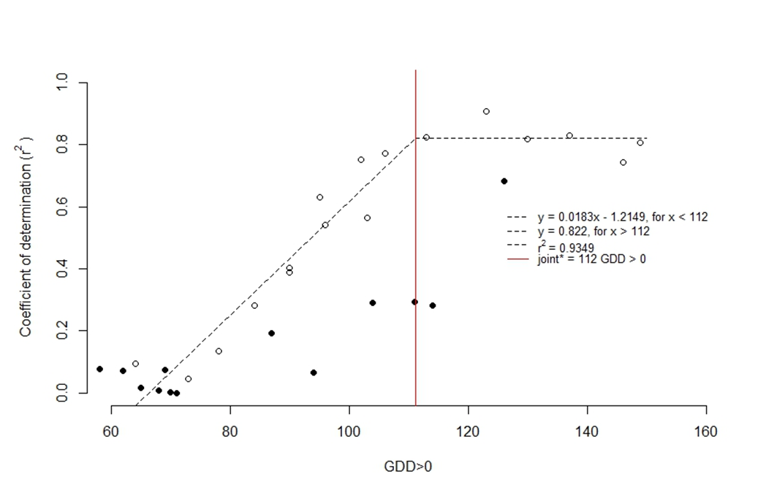
Dr. Jagmandeep Dhillon
Mississippi State University
Correlation of NDVI versus winter wheat grain yield, for readings collected over the season where the number of days from planting to sensing (GDD>0)
Averaged over three years and two sites, the optimum GDD>0 needed to accurately predict yield potential was between 97 and 112 GDD>0

Slide 22
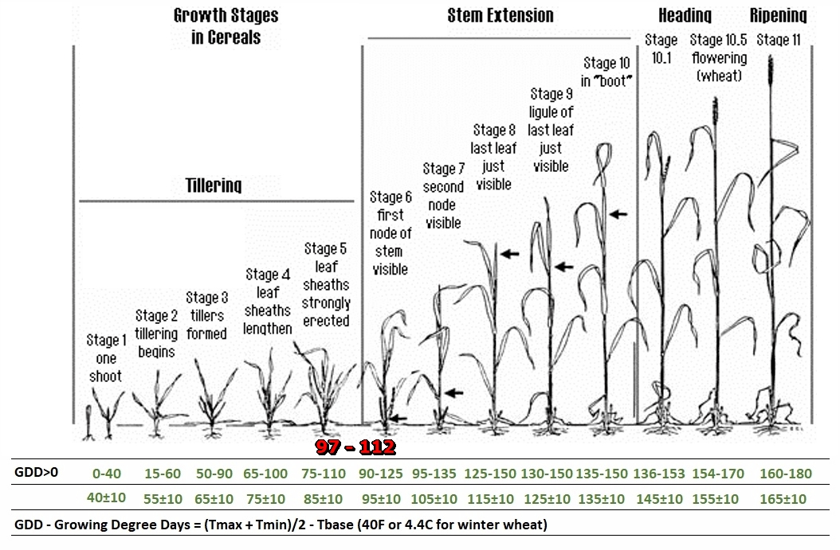

Slide 23




YP0 (yield potential)
GDD (growing degree days)
RI (response index, N Rich Strip)
YPN (yield possible with added N)
N rate (N uptake YPN- N uptake YP0)/efficiency factor
Independence of YP0 and RI (need independent estimates)
Variability in N rates over time/location
Increased Randomness with time
Soil Moisture at the time of NDVI sensing
“avoiding the pursuit of academic butterflies” Dr. N.E. Borlaug

Slide 24
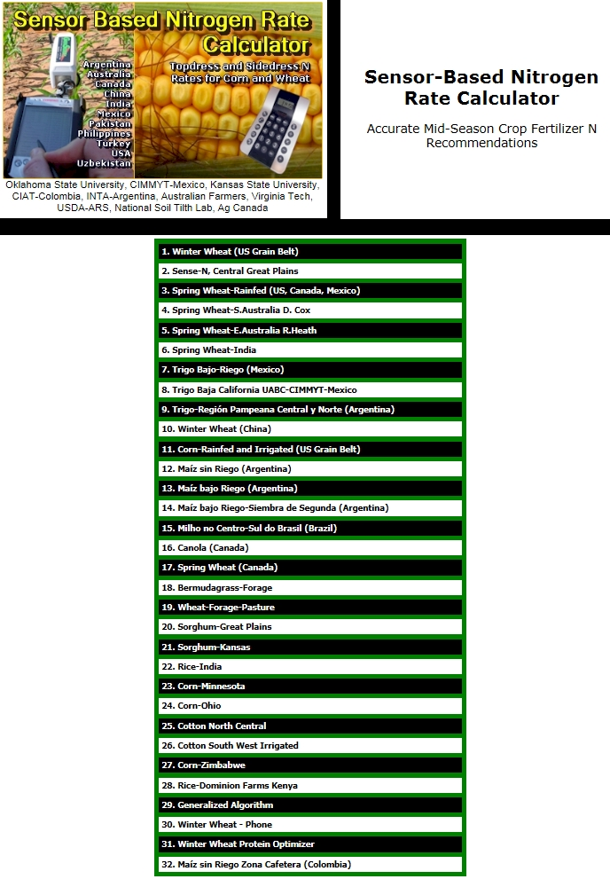
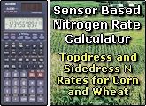
#1 Winter Wheat US Grain belt
nue.okstate.edu

Slide 25
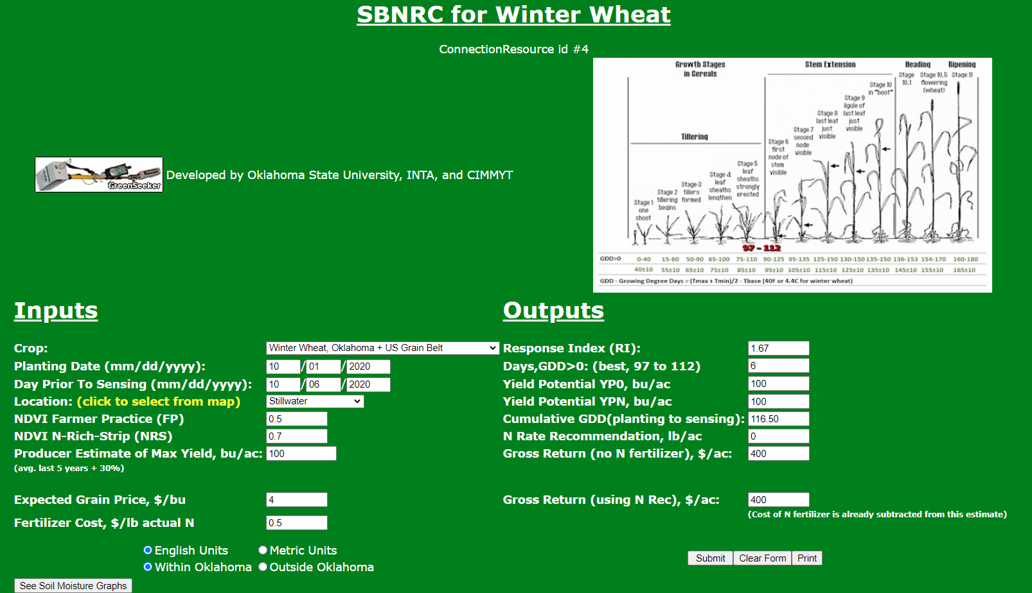
www.nue.okstate.edu

Slide 26
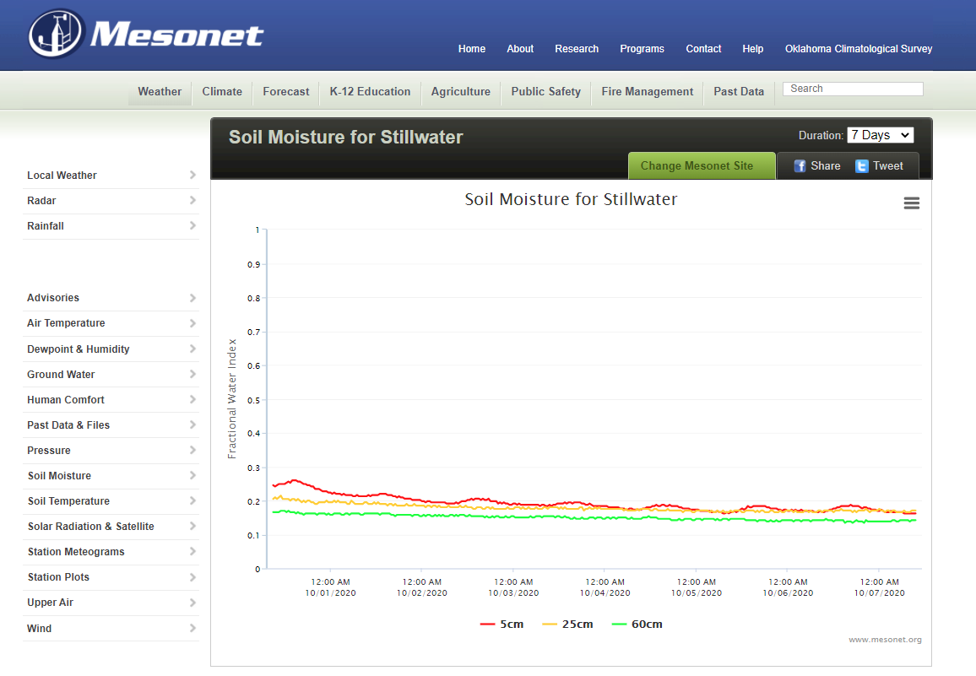

Slide 27
Regional Yield Prediction Equations

Slide 28
Source | Location | Years | Time period | (0-N) Yield Range | High N Yield Range | Opt. N rate kg ha⁻¹
 |  |  |  | Mg ha⁻¹ | Mg ha⁻¹ | Min | Max | Avg. | SD
Bundy et al. (2011) | WI | 21 | 1958-1983 | 1.6-7.6 | 4.3-8.8 | 50 | 233 | 130 | 53
Bundy et al. (2011) | WI | 9 | 1984-1997 | 2.7-5.6 | 5.7-9.96 | 58 | 235 | 179 | 51
Mallarino and Torres (2006) | IA | 20 | 1979-2003 | 0.8-5.9 | 5.1-12.4 | 81 | 237 | 165 | 49
Mallarino and Torres (2006) | IA | 14 | 1985-2010 | 1.4-6.2 | 5.3-12.8 | 134 | 239 | 197 | 32
Varvel et al. (2007) | NE | 5 | 1995-2005 | 6.6-10.9 | 10.4-13.3 | 73 | 193 | 131 | 49
Jokela et al.(1989) Carroll | MN | 3 | 1982-1984 | 5.5-7.3 | 7.1-9.1 | 5 | 131 | 84 | 69
Jokela et al.(1989) Webster | MN | 3 | 1982-1984 | 1.7-5.6 | 1.8-8.7 | 70 | 113 | 91 | 21
Fenster et al. (1976) Waseca | MN | 5 | 1970-1975 | 3.2-7.4 | 7.1-10.6 | 60 | 199 | 135 | 50
Fenster et al. (1976) Martin | MN | 7 | 1970-1976 | 3.8-8.2 | 4.0-9.6 | 23 | 126 | 69 | 36
Fenster et al. (1976) Martin | MN | 6 | 1971-1976 | 6.2-11.3 | 6.2-12.0 | 0 | 37 | 18 | 15
Al Kaisi et al.(2003) | CO | 3 | 1998-2000 | 5.6-10.2 | 8.3-10.8 | 66 | 111 | 91 | 23
Ismail et al.(1994) NT | KY | 20 | 1998-2000 | 2.1-7.4 | 5.2-10.9 | 35 | 230 | 128 | 46
Ismail et al.(1994) CT | KY | 20 | 1970-1990 | 1.9-9.5 | 3.5-10.4 | 0 | 203 | 98 | 52
Rice et al.(1986) NT | KY | 15 | 1970-1985 | 3.1-4.9 | 5.7-9.2 | 102 | 178 | 144 | 30
Rice et al.(1986) CT | KY | 15 | 1970-1985 | 1.9-6.1 | 5.0-8.8 | 69 | 204 | 124 | 47
Stecker et al.(1993)Columbia | MO | 3 | 1988-1990 | 3.3-5.6 | 6.0-10.1 | 99 | 194 | 153 | 49
Stecker et al.(1993)Novelty | MO | 3 | 1988-1990 | 4.5-7.2 | 6.7-9.9 | 45 | 182 | 103 | 71
Stecker et al.(1993) Corning | MO | 2 | 1989-1990 | 5.0-6.0 | 8.2-8.5 | 90 | 117 | 104 | 20
Peterson et al.(1989) | NE | 4 | 1983-1986 | 2.1-6.4 | 3.9-10.0 | 11 | 218 | 104 | 88
Eck (1982) | TX | 2 | 1977-1978 | 2.7-4.4 | 5.6-5.9 | 59 | 116 | 88 | 40
Shapiro et al.(2006) RS 51cm | NE | 3 | 1996-1998 | 6.2-8.9 | 9.4-11.1 | 69 | 96 | 83 | 13
Shapiro et al.(2006) RS76cm | NE | 3 | 1996-1998 | 5.0-8.9 | 7.1-11.0 | 13 | 114 | 75 | 54
Meisinger et al. (1985) MT | MD | 4 | 1974-1977 | 1.8-2.6 | 5.8-8.2 | 127 | 233 | 183 | 45
Meisinger et al. (1985) PT | MD | 4 | 1974-1977 | 2.7-4.2 | 5.1-8.1 | 36 | 196 | 142 | 75
Gehl et al.(2005) Rossville | KS | 2 | 2001-2002 | 6.4-7.9 | 11.3-12.6 | 182 | 204 | 193 | 15
Gehl et al.(2005) Scandia | KS | 2 | 2001-2002 | 2.7-7.4 | 3.8-11.5 | 51 | 160 | 105 | 77
Olson et al. (1986) | NE | 15 | 1969-1983 | 2.6-9.4 | 7.3-11.4 | 90 | 270 | 174 | 79
Total |  | 213 |  |  | average | 63 | 177 | 122 | 46
 |  |  |  |  | stdev | 43 | 57 | 43 | 21

Slide 29
Results
ONR ranged from 0-458 kg ha⁻¹ for 213 site-years.
ONR fluctuated from year to year at all locations
ONR not highly correlated with the high N rate yield (R²=0.20) or zero-N check yield (R²=0.16)
RI-0N fluctuated at all sites
The wide range in optimum N rates suggests the need to adjust N rates by year and location
A potential solution is to employ mid-season sensor based technologies that can accurately predict yield potential and simultaneously encumber N responsiveness known to be independent of yield

Slide 30
Fertilizer recommendations that ignore yield entirely are limited to explaining less than 50% of the variation in the economic optimum N rate for maize (Lory and Scharf, 2003, Agron. J. 95:994-999)
Research conducted over locations and years in Missouri noted that economically optimum fertilizer N rates vary widely from year to year, field to field, and from place to place within a field (Scharf et al., 2005, Agron J. 97:452-461)
Because yield level and N responsiveness are independent, and both impact N demand, using both will assist in formulating more accurate fertilizer N recommendations (Arnall et al., 2013, Agron J. 105:1335-1344)

Slide 31
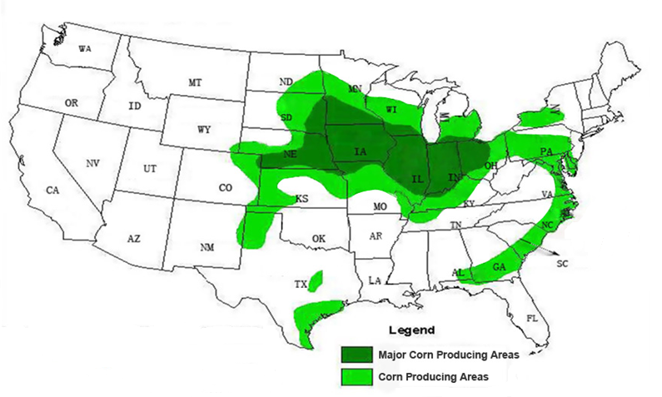
Ohio
Illinois
Missouri
Mississippi

Slide 32
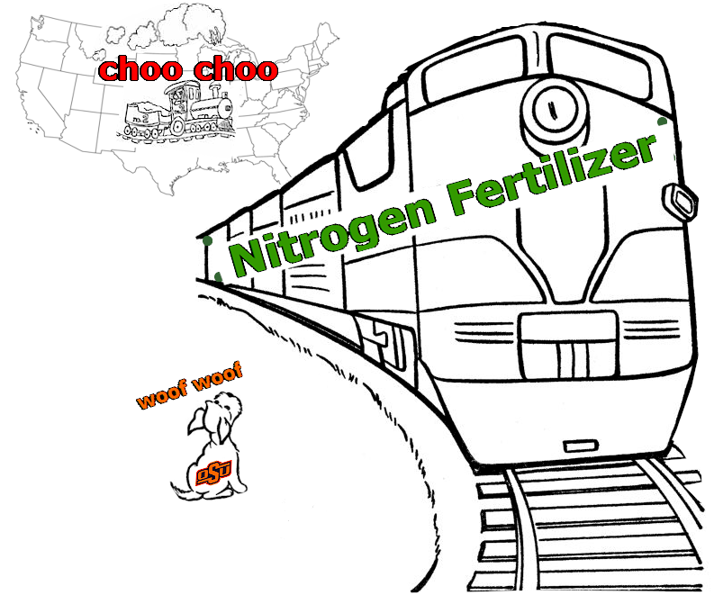



Colossal

Slide 33
Nitrogen Use Efficiency
Malakoff (Science, 1998)
  $750,000,000, excess N flowing down the Mississippi River
Africa expenditure on fertilizer N, cereals
  $706,000,000
Nitrogen Use Efficiency (NUE) World 33%
  Developed, 42%
  Developing, 29%
20% increase
  Worth $25.8 billion US annually

Slide 34
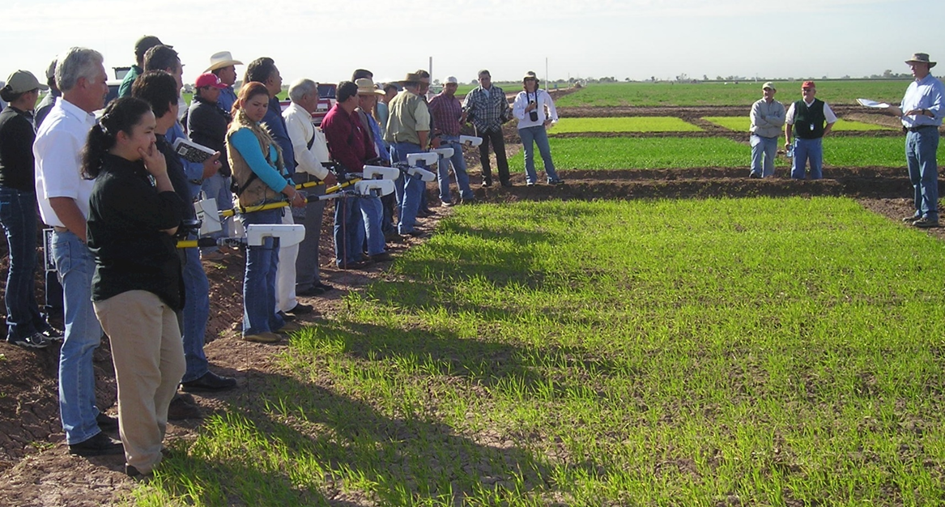
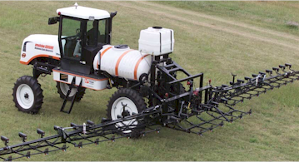
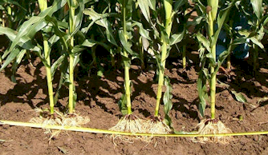
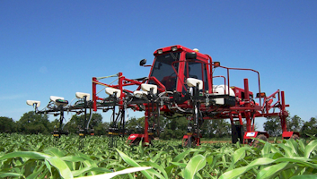
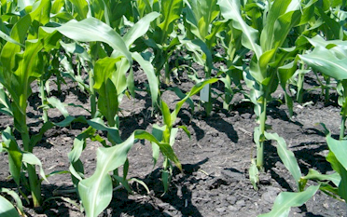
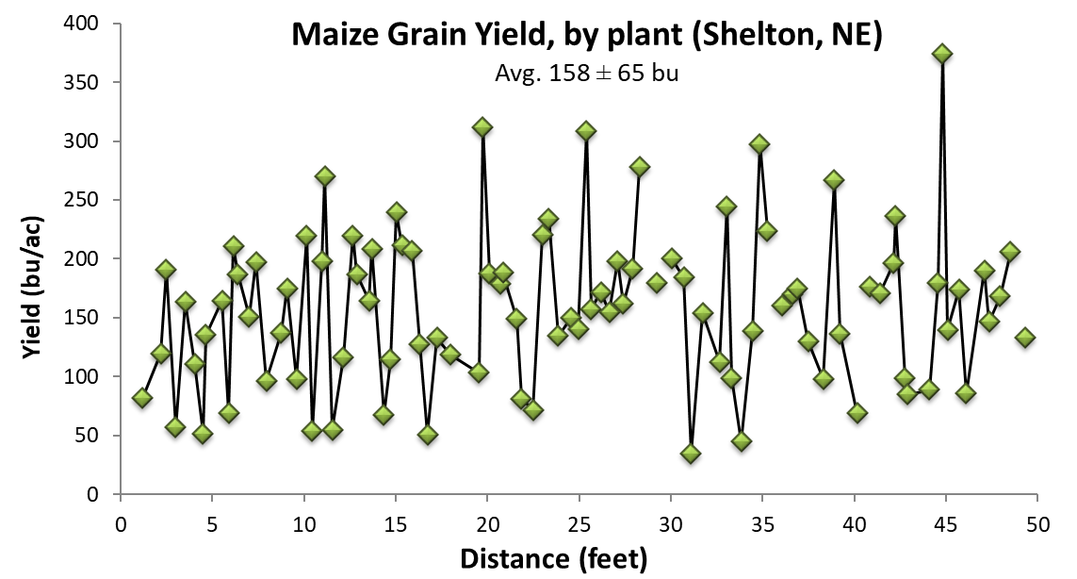
Promising Technologies to Improve NUE
44 Transects (30m) Argentina, Mexico, Iowa, Nebraska, Ohio, Oklahoma
Plant-to-plant variation in corn grain yield averaged 43.8 bu/ac
Mid-season proximal and aerial sensing
Improved N Sources
VRT, if, then (look up table)
Localized, if, then, else
Localized N Placement
Variable Rate N Application
By Plant N Application

Slide 35



Slide 36

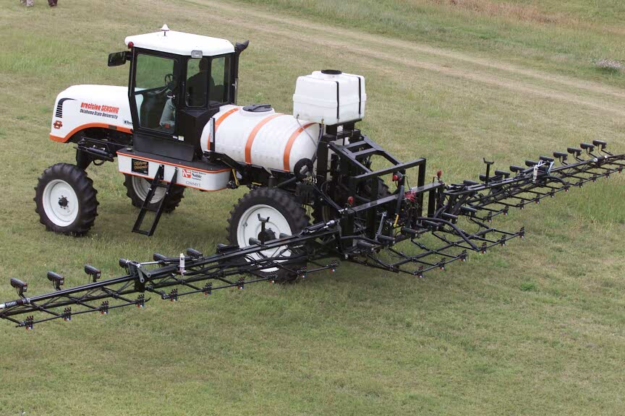
precision SENSING
Oklahoma State University 2001

Slide 37
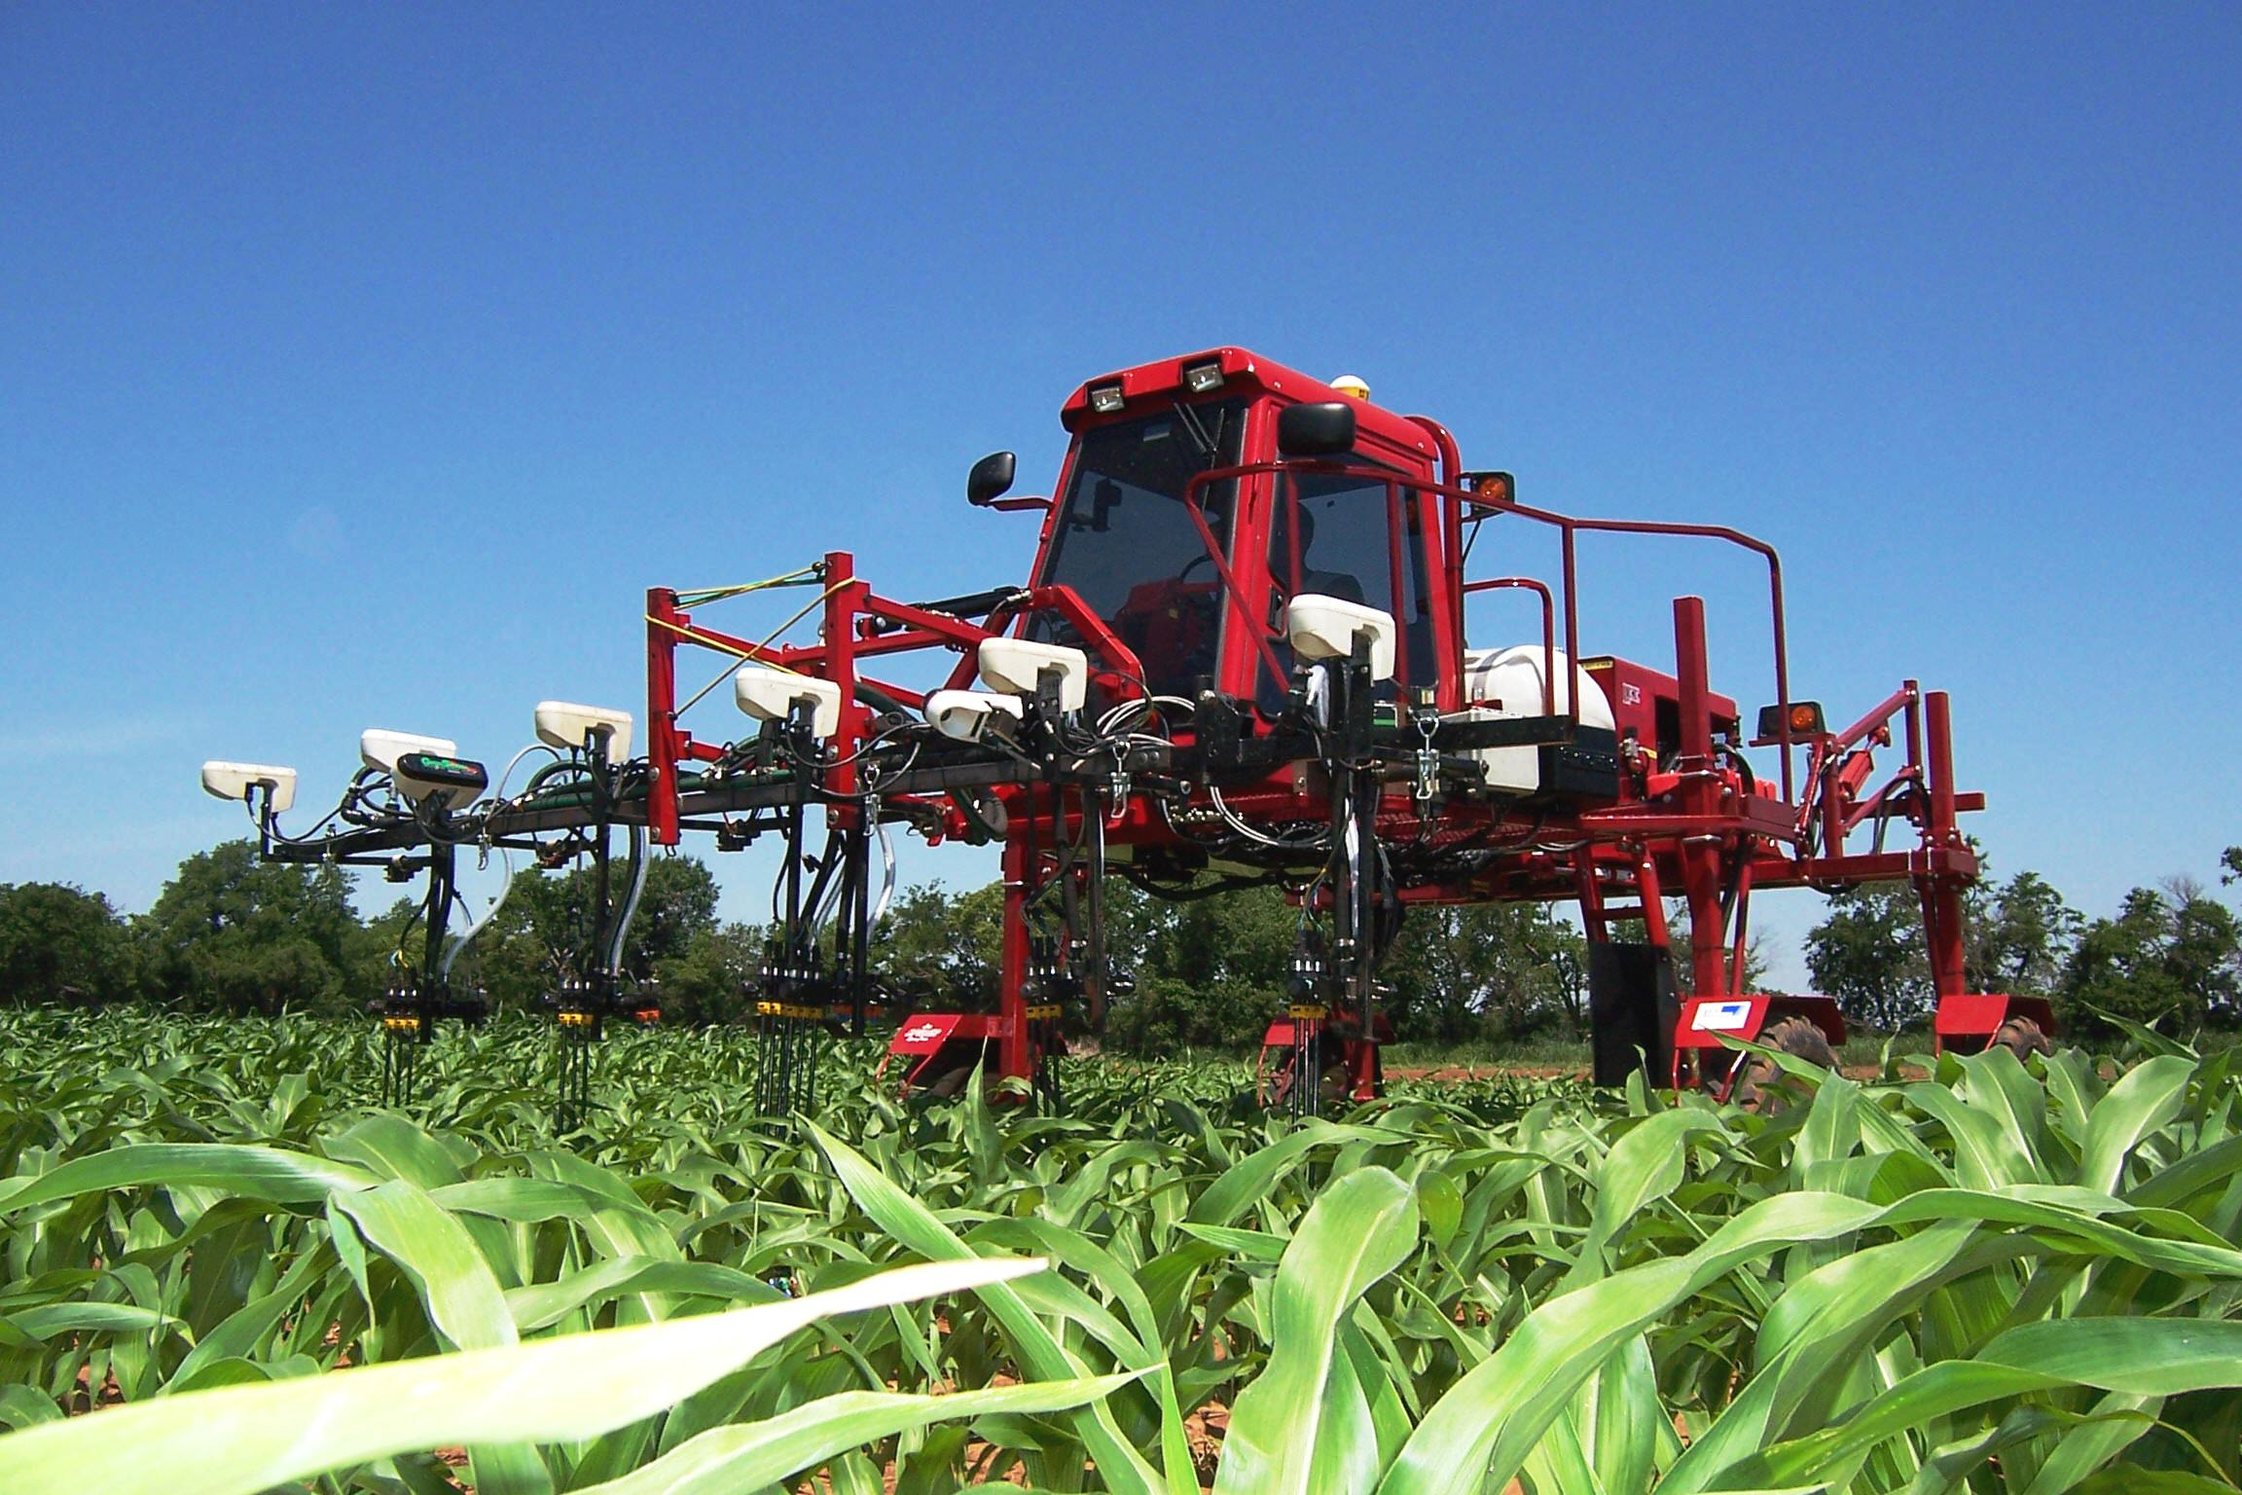
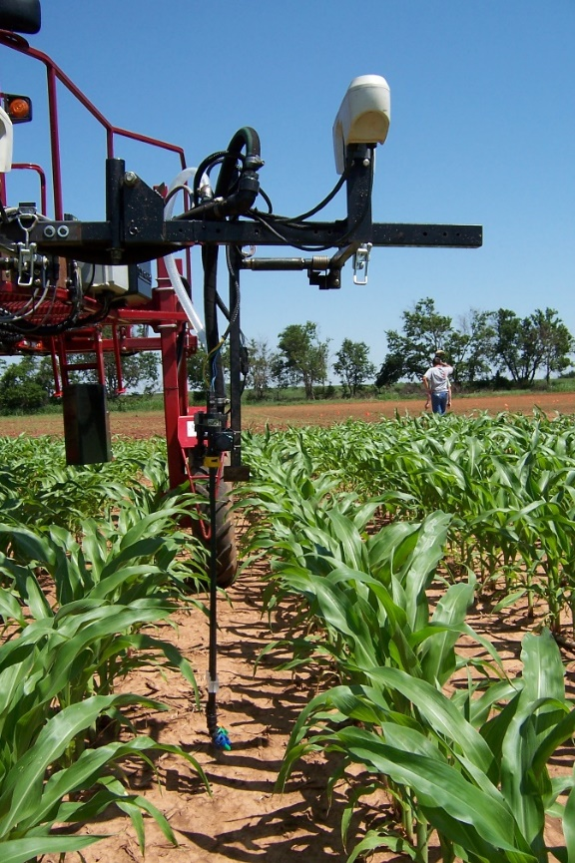
By-plant N Fertilization 2007
By plant statistical properties

Slide 38
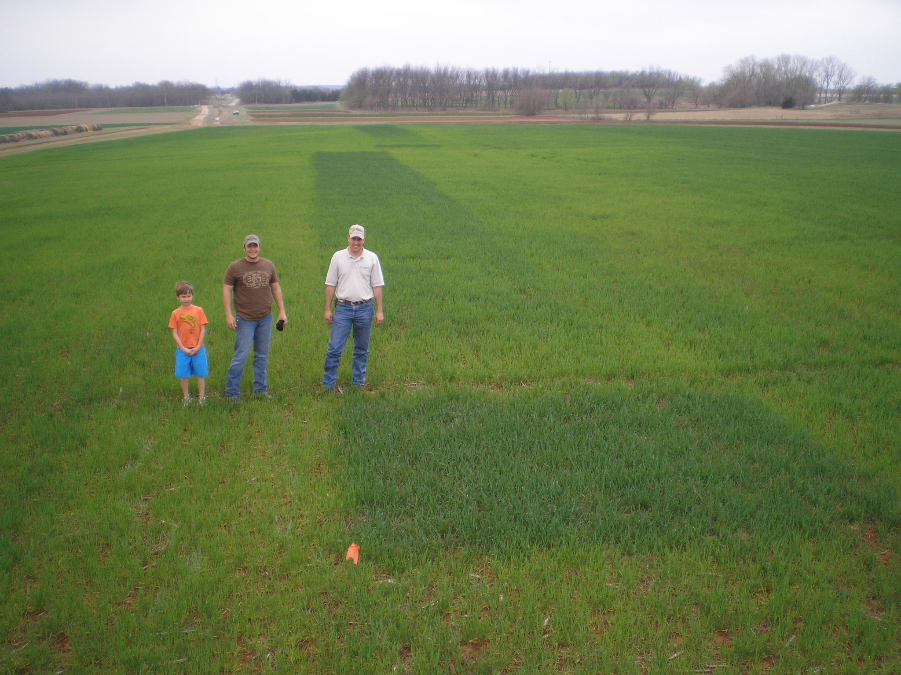
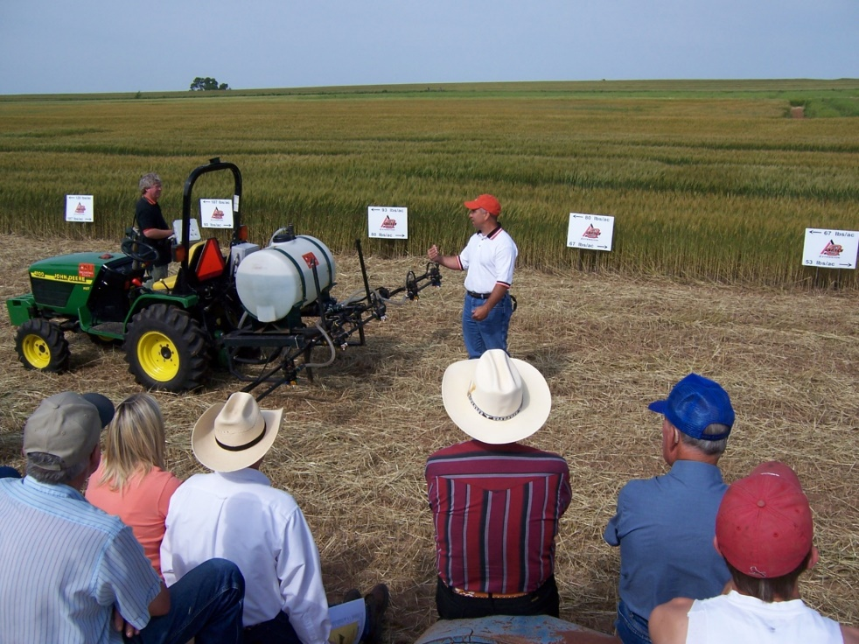

Slide 39
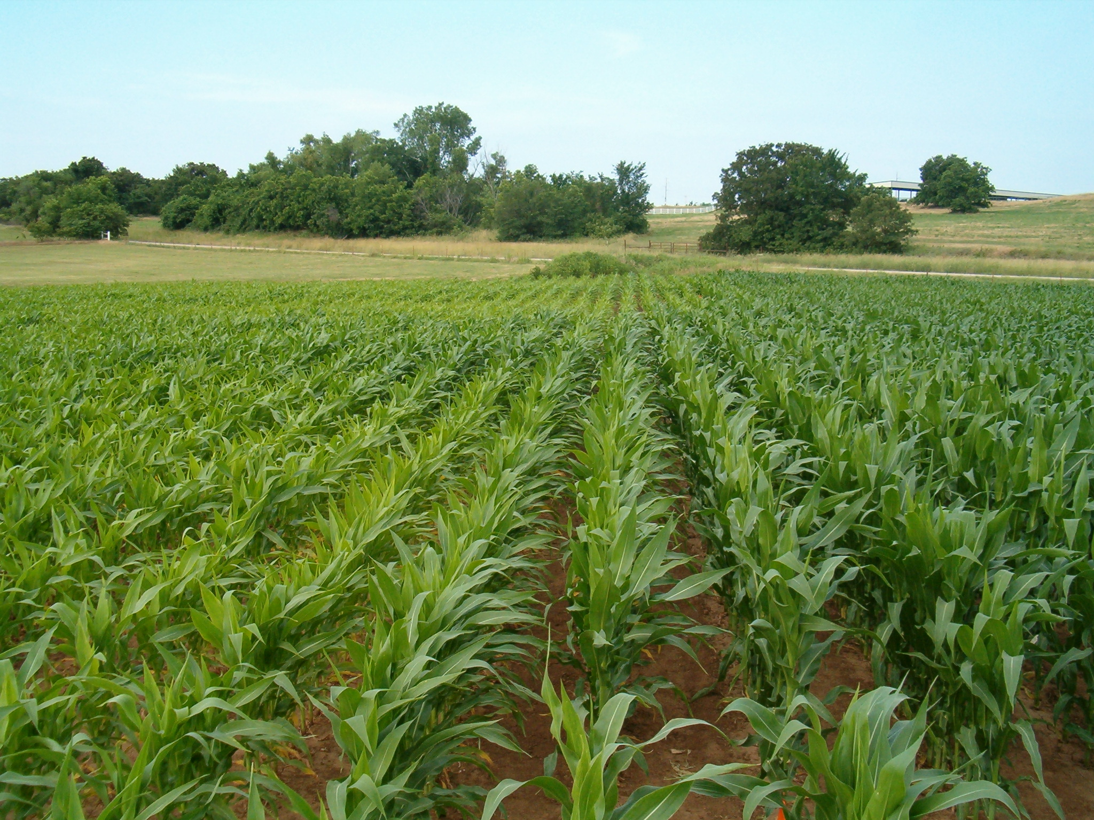
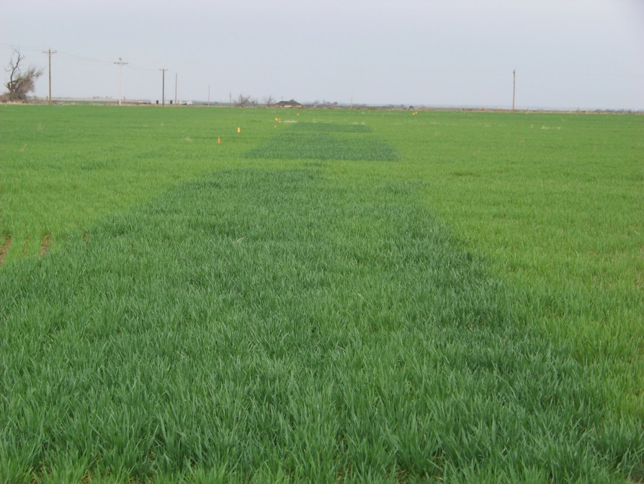

Slide 40
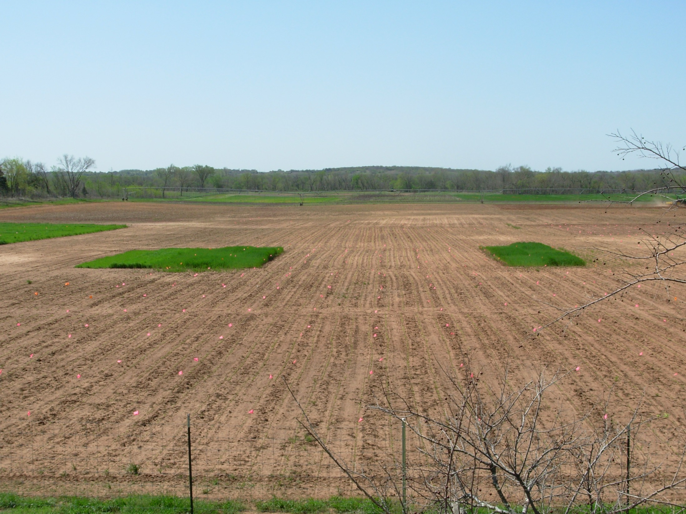
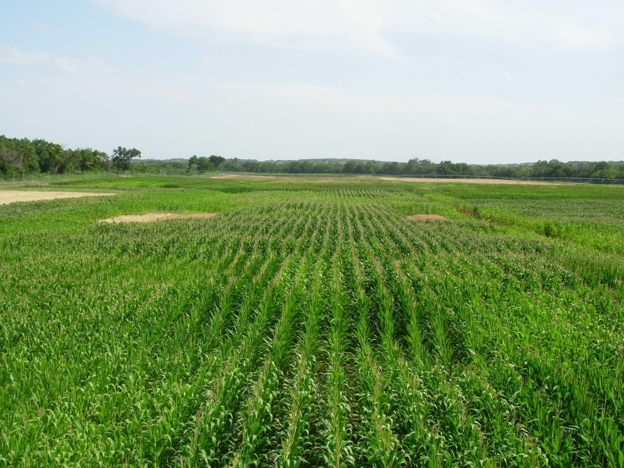
Indicator Crops

Slide 41
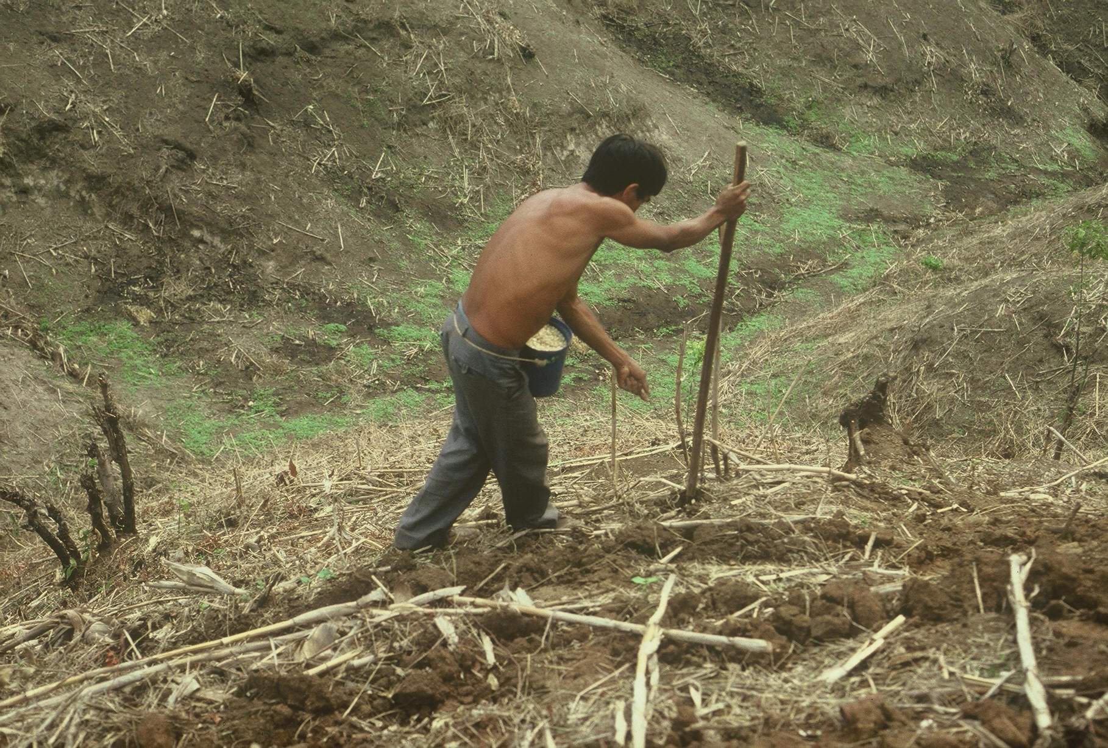


30,000,000 hectares in the Developing World

Slide 42

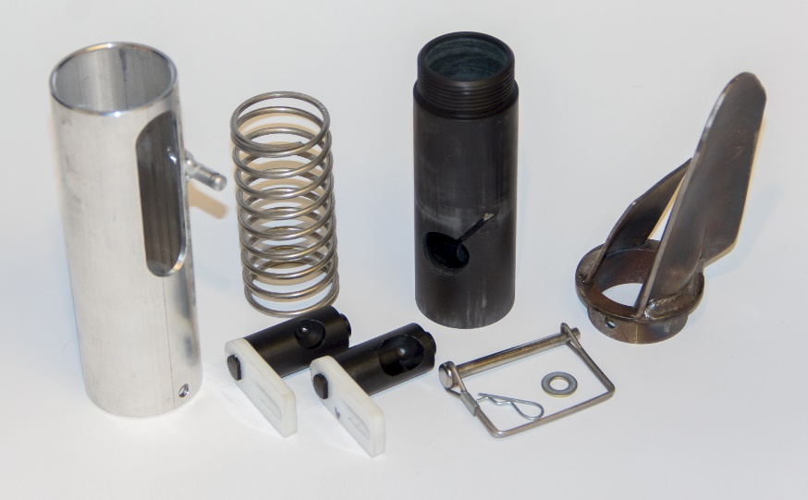
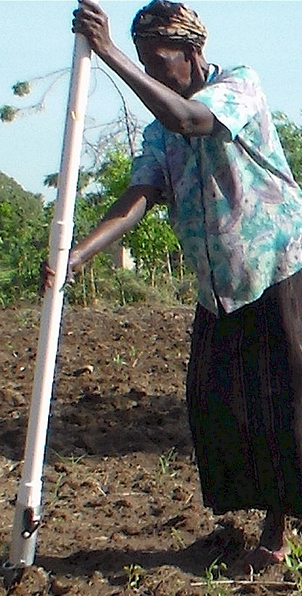
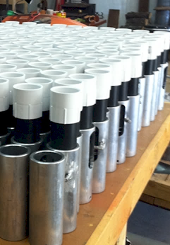
If they are going to apply fertilizer we need to give them a method that gets them the most out of their investment
Drums

Slide 43
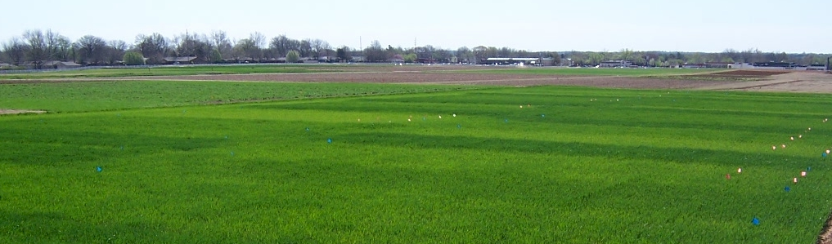
Present State of Sensor Based Nitrogen Algorithms
Yield influences N demand
Lory and Scharf (2003), Agron. J.
Spiertz and DeVos (1983), Plant and Soil
Arnall et al. (2009), Agron. J.
Fowler (2003), Agron. J.
N response (N demand) changes each year
Mullen et al. (2003), Agron. J.
Varvel et al. (1997), SSSAJ.
Bundy and Andraski (2004), Agron. J.
YP0 and RI are independent
Arnall et al. Agron. J. (2013)
Raun et al. Prec. Agric. (2011)

Slide 44


Slide 45
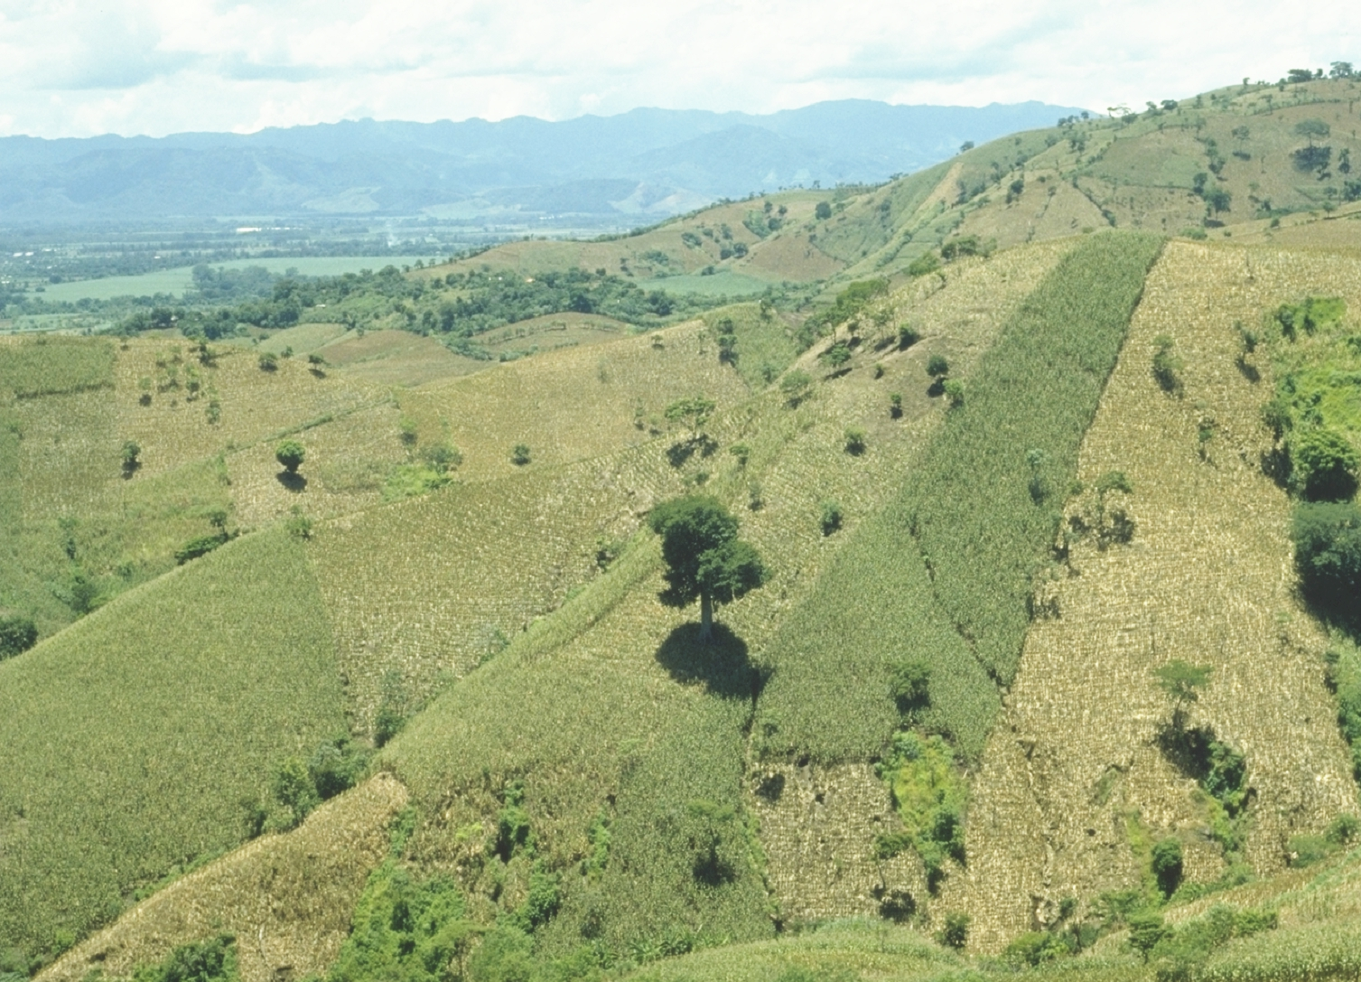

NUE Conferences (2002 – present)
Challenging each other
2016 Boise Idaho

Slide 46
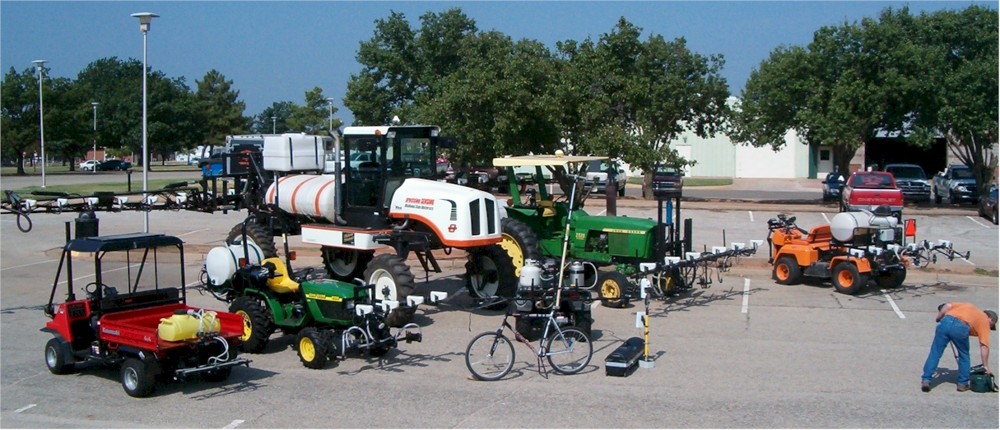


John Solie, 1946-2019
Marvin Stone, 1950-2015

Slide 47
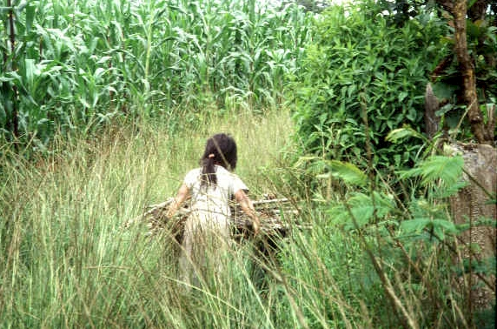

Slide 49
At some sites the 0-N check plot yielded the same as the high N rate plot after years of continuous maize production.
Growers need to consider that the demand for fertilizer N changes from year to year.
Conclusion
Static N recommendations do not account for the variability in soil available N and maize N uptake as influenced by environment (temperature/rainfall)

Slide 50
Increasing N efficiency
We’re already doing a pretty good job
But there is room for improvement
Role of sensors: identify areas where the soil is supplying a substantial proportion of the crop’s N requirement
  In these areas, efficiency of fertilizer N use is low
  Cutting back on N in these areas will increase field-average N efficiency
Also, N timing with sensors is close to period of rapid crop uptake—the chance of N loss to air or water is reduced
NUE Conference 2005

Slide 51

Worldwide, nitrogen use efficiency (NUE) for cereal production is approximately 33%
Raun, W.R., and G.V. Johnson. 1999. Improving nitrogen use efficiency for cereal production. Agron. J. 91:357-363.

Slide 52
OSU Corn Algorithm
YP₀=1291*(EXP(NDVI/Sum of GDD*2649.9) V8 to V12
RI = NDVI- N Rich Strip/ NDVI – Farmer Practice
YPN = YP0 * RI
N Rate = ((YPN – YP0)* 0.0125)/expected fertilizer use efficiency

Slide 53


E_{what did you get for free?}
E_{what will you have to pay for?}

Slide 54
What is the highest N efficiency we can achieve ? Newell Kitchen, 2005 NUE Conference
With corn, N removal is about 0.75 to 0.8 lb N/bu
We’re applying 1 lb fertilizer N per bu to supply that 0.75 to 0.8 lb
    i.e., 75 to 80% of what we apply as fertilizer equals grain removal
    If we ignore manure and forage legumes, this would imply 75 to 80% efficiency of our N fertilizer
Maximum efficiency is:
  1 / 0.8 = 1.25 to 1 / 0.75 = 1.33 bu/lb N supplied
NUE Conference 2005

Slide 55
Summary
At economically optimal N rates in our 8 field-scale experiments, N efficiency was high: more N was removed in grain than was applied as fertilizer (>100% efficient!)
Variable-rate N that matches or approaches EONR patterns can increase efficiency relative to conventional uniform N rates
NUE Conference 2005

Slide 56



Centeotl, Aztec maize deity
17% of the worlds maize production takes place on marginal landscapes
(33M / 185M)
Domestication 9000 years ago
21 % of human nutrition
http://nue.okstate.edu/Crop_Information/World_Wheat_Production.htm

Slide 57









Slide 58
YP0
N Rate
Randomness
Environment
GDD
YP0 (yield potential)
GDD (growing degree days)
RI (response index, N Rich Strip)
YPN (yield possible with added N)
N rate (N uptake YPN- N uptake YP0)/efficiency factor
Independence of YP0 and RI (need independent estimates)
Variability in N rates over time/location
Increased Randomness with time
Soil Moisture at the time of NDVI sensing
Inclusion of mathematical Metric for environment
Soil Moisture
RI
Highly variable N rates
Independence of YP0 and RI

Slide 59
Title: Nitrogen Use Efficiency Review, Realistic Opportunities for Improvement
Raun, W.R., J. Dhillon, E. Eickhoff, L. Aula, T. Carpenter, P. Omara, E. Nambi, F. Oyebiyi, A. Benzing,
Rationale: Estimates of crop nitrogen use efficiency (NUE) differ significantly and are heavily dependent on the method employed.
Various methods have been developed to determine the exact amount of applied fertilizer that is used by the plant/crop, hence the term nitrogen use efficiency (NUE). Some of these methods deliver very similar results, notably the difference method and isotopic recovery. Other methods suffer from their failure to account for the amount of N assimilated in the check plot where no additional N was applied. Common denominators present in the literature surrounding NUE is the need for knowing exactly how much N was applied, the harvested yield, and the percent N present in the grain or forage that was removed. Understanding how much N is provided by the environment via rainfall and/or atmospheric deposition, and that remaining in the soil in inorganic fractions remains important. Estimates of plant N loss as ammonia coming from plants’ inability to incorporate all of the N assimilated into grain protein is also important when attempting to holistically understand NUE. Methods that are expected to increase NUE include mid-season proximal and aerial sensing, localized N placement, and improved N fertilizer sources.
Outllne:
1. Methods of estimating NUE
2. Importance of yield for NUE calculations
3. NUE in rainfed systems, NUE values recorded in trials all around the world, NUE differences by crop
4. Opportunities for improving NUE, problem areas and potential solutions
https://acsess.onlinelibrary.wiley.com/doi/full/10.2134/agronj2017.02.0112 (Morris, Murrell, Strengths and Limitations of Nitrogen Rate Recommendations for Corn and Opportunities for Improvement, Agron. J.
Can yield goals be predicted? Raun, 2017. “Failure of the yield goal concept to predict current‐year yields is due to the unpredictable influence of environment. Mid‐season prediction of yield potential using active sensors is a viable alternative for improved in‐season cereal fertilizer N recommendations.”

Slide 60
Abstract ID# 125501 (password: 637951) Submitted to ASA SECTION: AGRONOMIC PRODUCTION SYSTEMS
Title: Nitrogen Use Efficiency, Realistic Opportunities for Improvement
Author(s): Bill Raun, Oklahoma State University, Stillwater, OK
link to learn how to prerecord the presentation
https://scisoc.confex.com/scisoc/extra.cgi
Added link that might help as well
https://www.acsmeetings.org/submit/presenterfaq

Slide 61

1.1 billion

Slide 62
Structural evidence for a dynamic metallocofactor during dinitrogen reduction by Mo-nitrogenase
N Fixing Corn (New Seed Treatment)
https://www.agprofessional.com/article/nitrogen-fixing-corn-future#:~:text=Different%20Delivery.,all%20parts%20of%20the%20root
https://www.agweb.com/article/nitrogen-fixing-corn-seed-treatment-pipeline

Slide 63

Corn consumes 37-51% of the total annual N fertilizer (Snyder, 2012)
In 2014, 15 States used 5 million tons of fertilizer that cost 2.5 billion US dollars (USDA- NASS, 2015)
USDA–NASS. 2015a. 2014 Agricultural chemical use survey corn. NASS highlights No. 2015-1. USDA–NASS, Washington, DC.
Snyder, C.S. 2012. Are mid-west maize farmers over-applying fertilizer N? Better Crops Plant Food 96:3–4.
Source: IFA, Fertecon, PotashCorp, 2014

Slide 64
Summary
US maize consumes 37-51% of total annual Nitrogen (N) fertilizer (Snyder, 2012).
In 2013, 354 million MT were produced on 38.6 million hectares, (USDA, 2014).
Drainage systems allow nitrate deposition to water bodies (Cooper, 1993).
Nutrient runoff from agriculture has contributed to the hypoxic zone in the Gulf of Mexico. (Rabalais et al ., 1999)
Illinois, Iowa and Indiana produce 15% of the world’s maize and have impacted N and Phosphorus (P) loading in the Gulf of Mexico (Dale et al., 2010).
Inability to estimate year to year, field to field optimum N rates has decreased nitrogen use efficiency (Shanahan, 2011).
Use of Static N rates over time in the ‘Corn Belt’ has led to N loss via various pathways.

