Slide 1
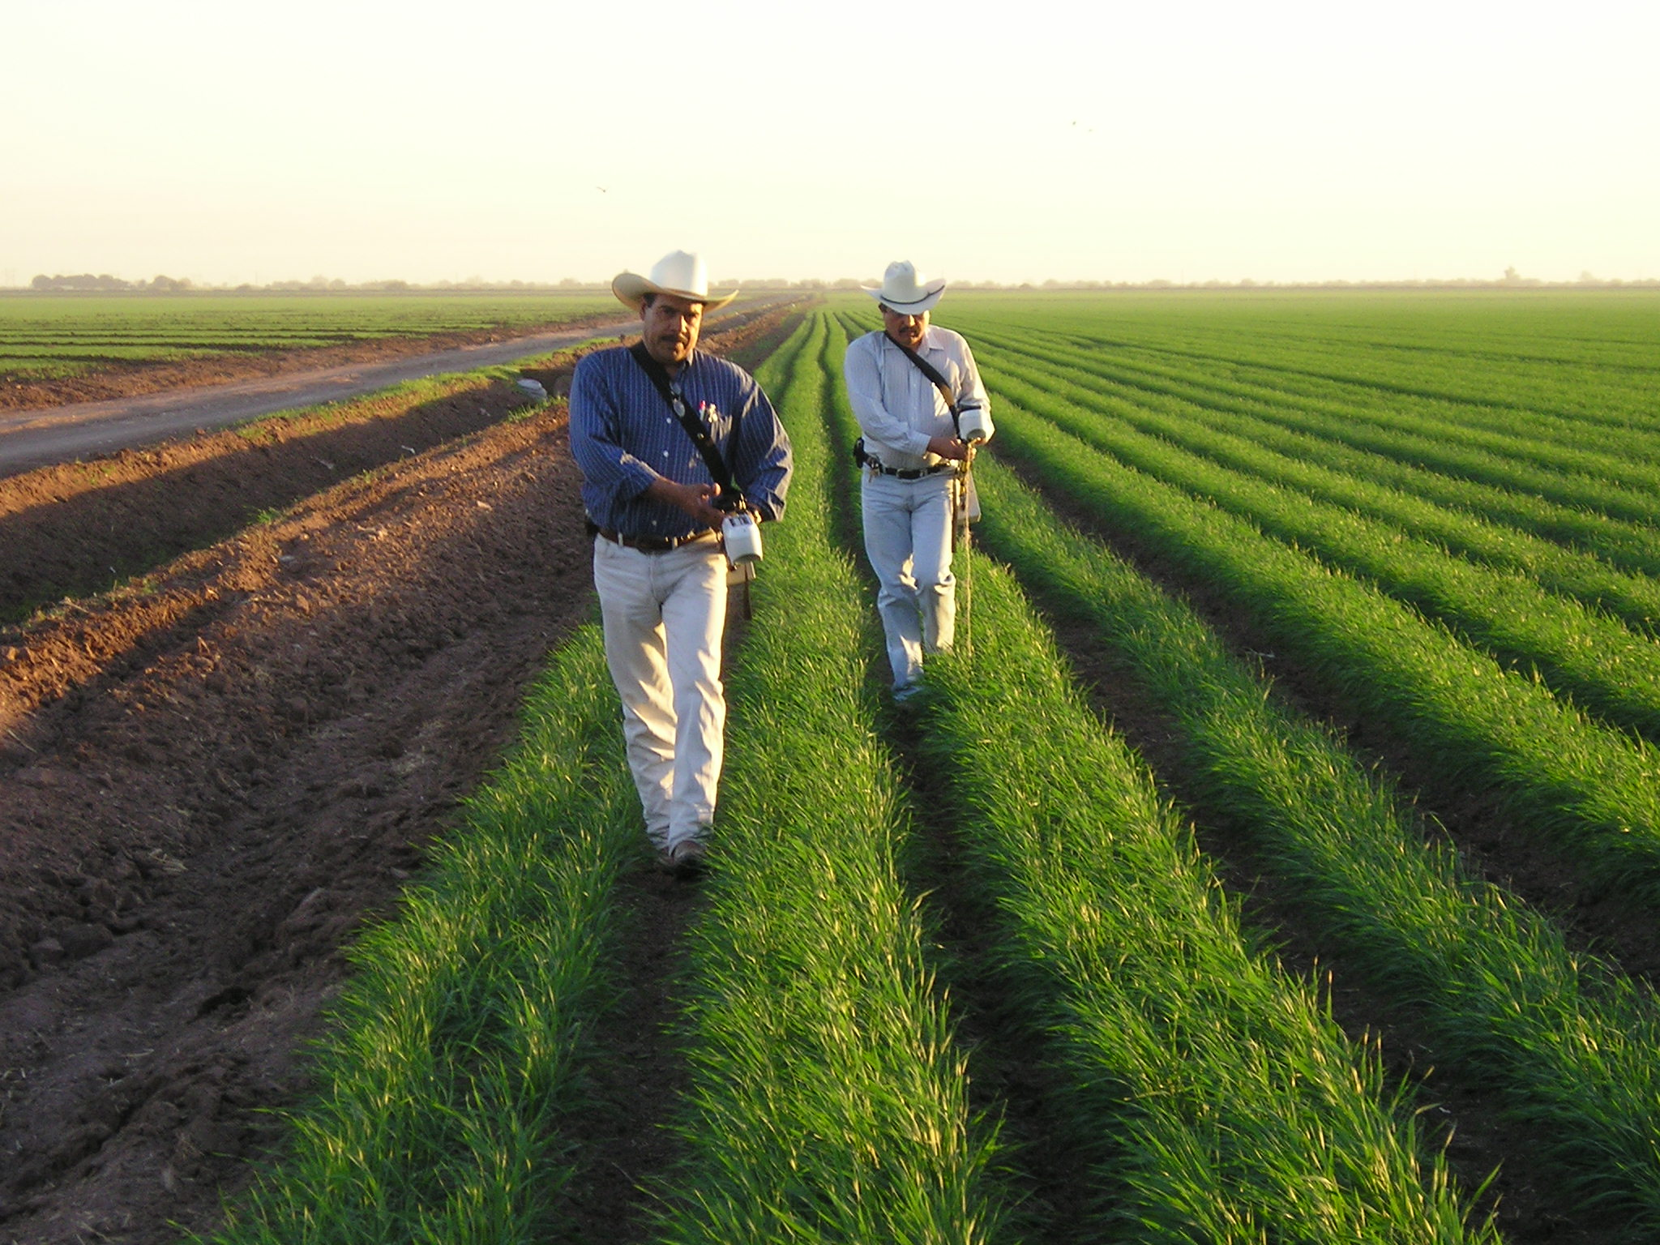
Sensor Based N Management in the Yaqui Valley
CIMMYT
Oklahoma State University

Slide 2
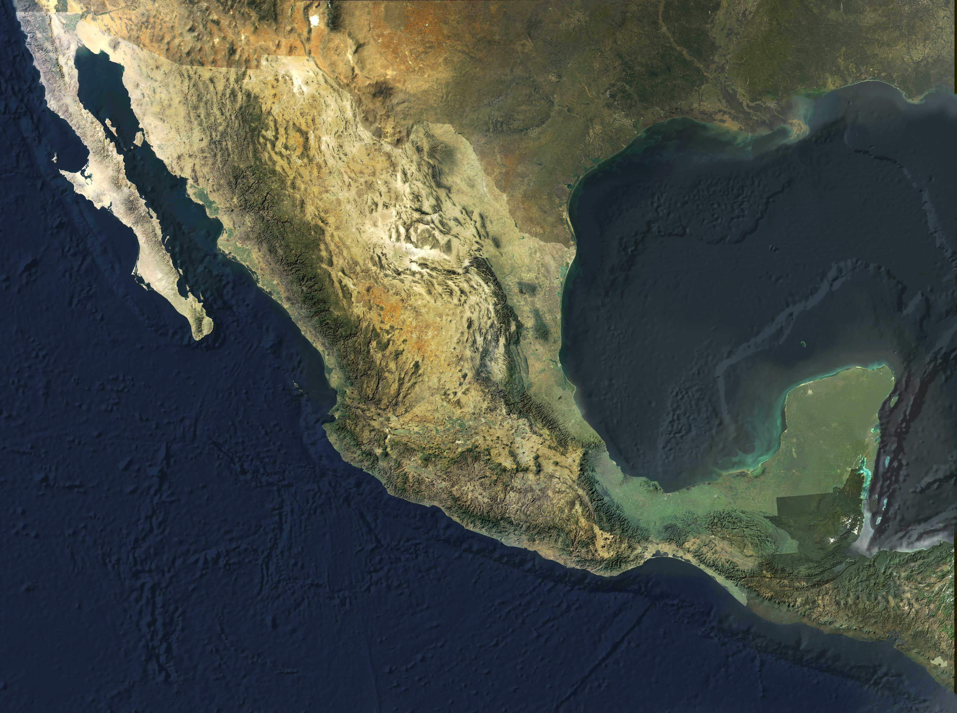
Yaqui Valley

Slide 3
Percentage Nitrogen Recovery in
Wheat in the Yaqui Valley
(average of 30 fields)
Recovery by
the plant
Losses

Slide 4
Losses to the environment
NH₃
NOx
N₂O
N₂
Urea
NH₄⁺
NO₃⁻
Organic
Matter
NH₄⁺
NO₃⁻
N₂O
N₂
Nitrification
Denitrification

Slide 5
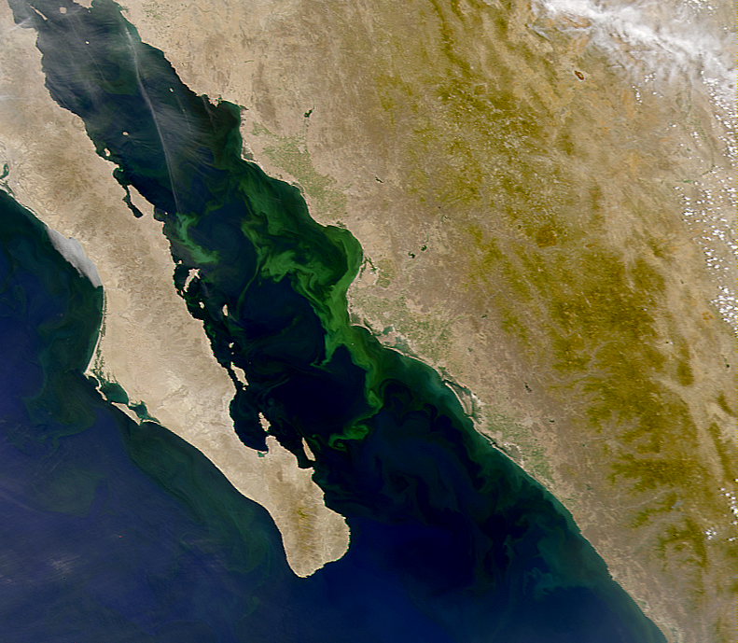
Beman et al. 2005
Nature

Slide 6
Costs of Production Wheat Cycle 2009-2010
Soil preparation | $1,470 | 11%
Planting | $1,267 | 9%
Fertilization | $3,654 | 26%
Irrigation and Drainage | $1,753 | 13%
Pest control | $3,612 | 26%
Harvesting | $1,370 | 10%
Other | $720 | 5%
Total | $13,846 | 100%
*Does not include interest Exchange rate 1 USD= 12.5 Mex peso Source: AOASS 2009

Slide 7
Nitrogen Management in Wheat in the Yaqui Valley

Slide 8
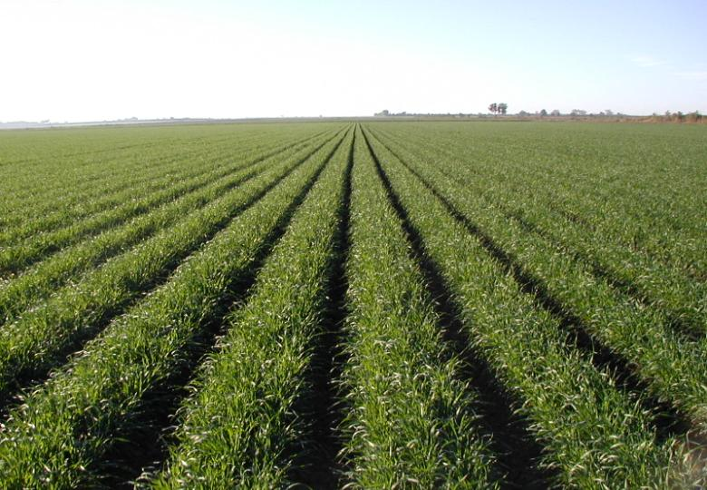
Yaqui Valley
Ten Year Average
Wheat Yield
6.0 t/ha
(~90 bushels/acre)

Slide 9
Cumulative nitrogen absorption curve in wheat
250 kgN/ha
0%
25%
Farmer’s management
75%
Fertilization

Slide 10
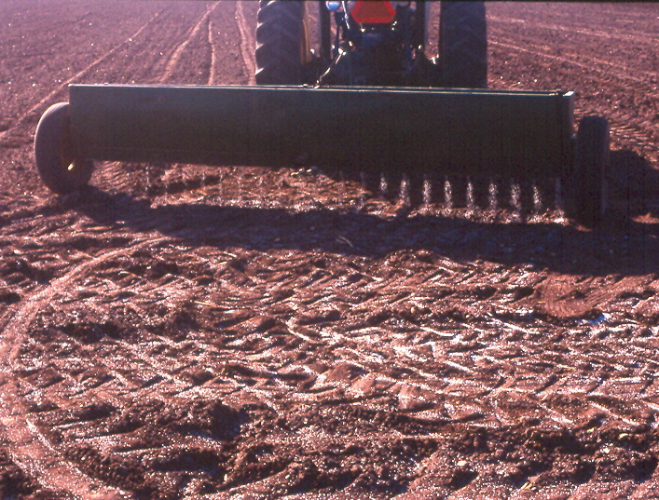
Urea or NH₃
180 kg N /ha
Pre-plant

Slide 11
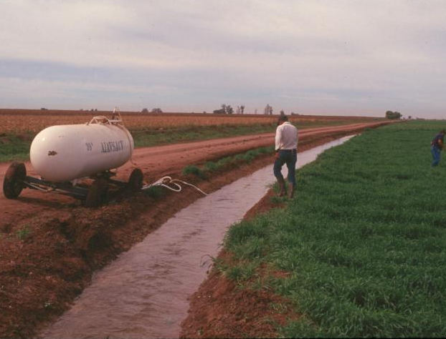
NH₃
70 kg N /ha
First post-plant irrigation
45-55 days after planting
NH3
Total 250 kgN/ha

Slide 12
Soil residual nitrogen in Farmers’ Fields in the
Yaqui Valley Crop cycle 96-98
soil
Farmers’ Fields

Slide 13
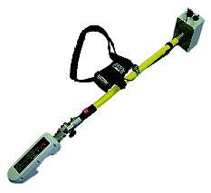
Sensor Technology
GreenSeeker
Diagnostic tool that allows you to identify the optimum N rate for each individual farmer’s field

Slide 14
Technology Components
Establishment of an N rich strip
NDVI reading in the N rich strip and farmer’s field that will be diagnosed
Use of a crop algorithm to derive N recommendations

Slide 15
N Rich
Strip
Apply pre-plant or
at planting
20 has
10 meters

Slide 16
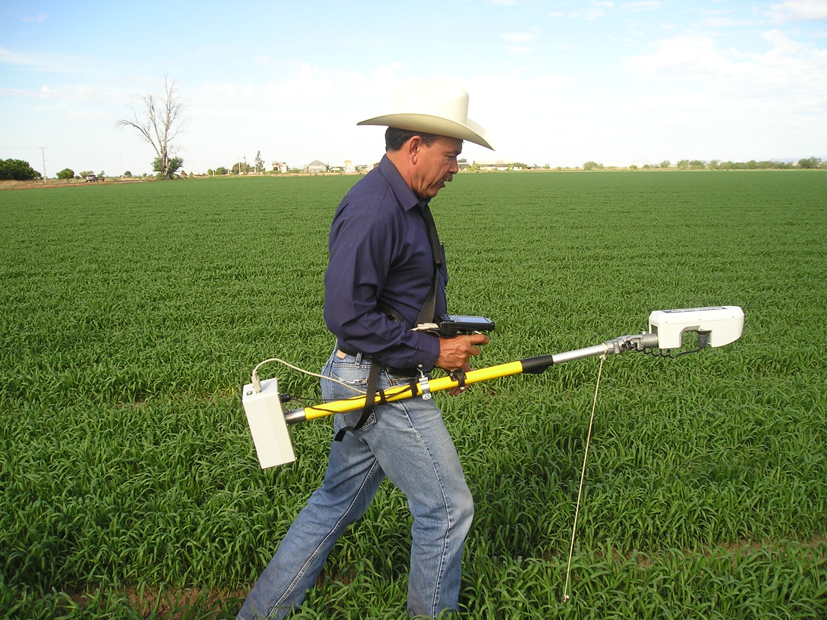
2. NDVI reading in the N rich strip and the farmer’s field that will be diagnosed
Measurement: As close as possible to the first post plant
irrigation but 40 days after planting.

Slide 17
3. Use of the Crop Algorithm to derive a N recommendation

Slide 18
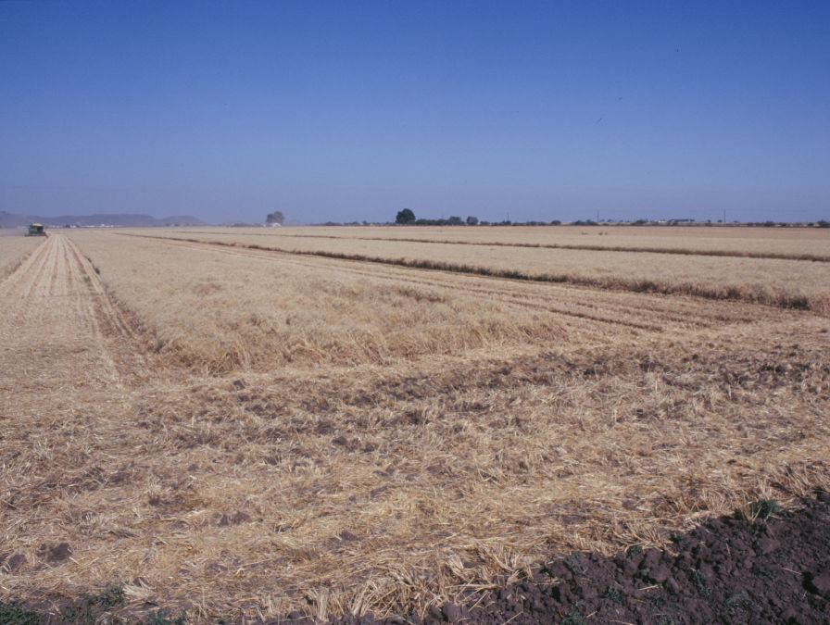
RESULTS
2009-2010

Slide 19
TECHNOLOGY TRANSFER IN SONORA
CIMMYT
Oklahoma State University
AOASS
PIEAES
FUNDACION PRODUCE SONORA / COFUPRO
FIRA
SAGARPA
CONACYT
Uniones de Agricultores

Slide 20
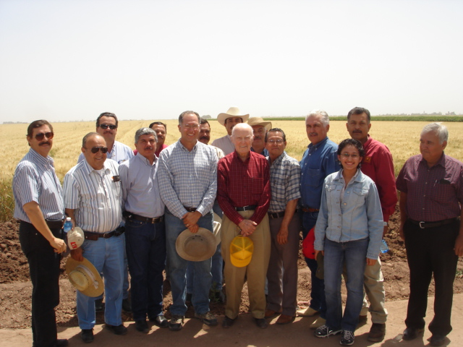
TECHNICAL TEAM
COOPERATIVE AOASS | FARM ADVISERS Ing. Arturo Muñoz Cañez (coordinador)
UCAC | Ing. Emilio Acosta M. Ing. Julio Galaz Gil
UCAY | Ing. Ramón Gil Cota.
UCAH | Ing. Julio C. Espinoza.
AAVYAC | Ing. Carlos Remy M.
UCAYVISA | Ing. Raúl Salinas G.
USPRUSS | Ing. Carlos Rodríguez P Ing. Manuel Ferra M. Ing. Carlos Quiñones.
UCAMAYO | Ing. Manuel H. Alcántar
APRONSA | Ing. Ignacio Miranda I.
CIMMYT
Dr. Ivan Ortiz-Monasterio
Ing. Maria Elena Cardenas

Slide 21
N Rich
Strip
Sensor
Management
Sensor Management
107 fields

Slide 22
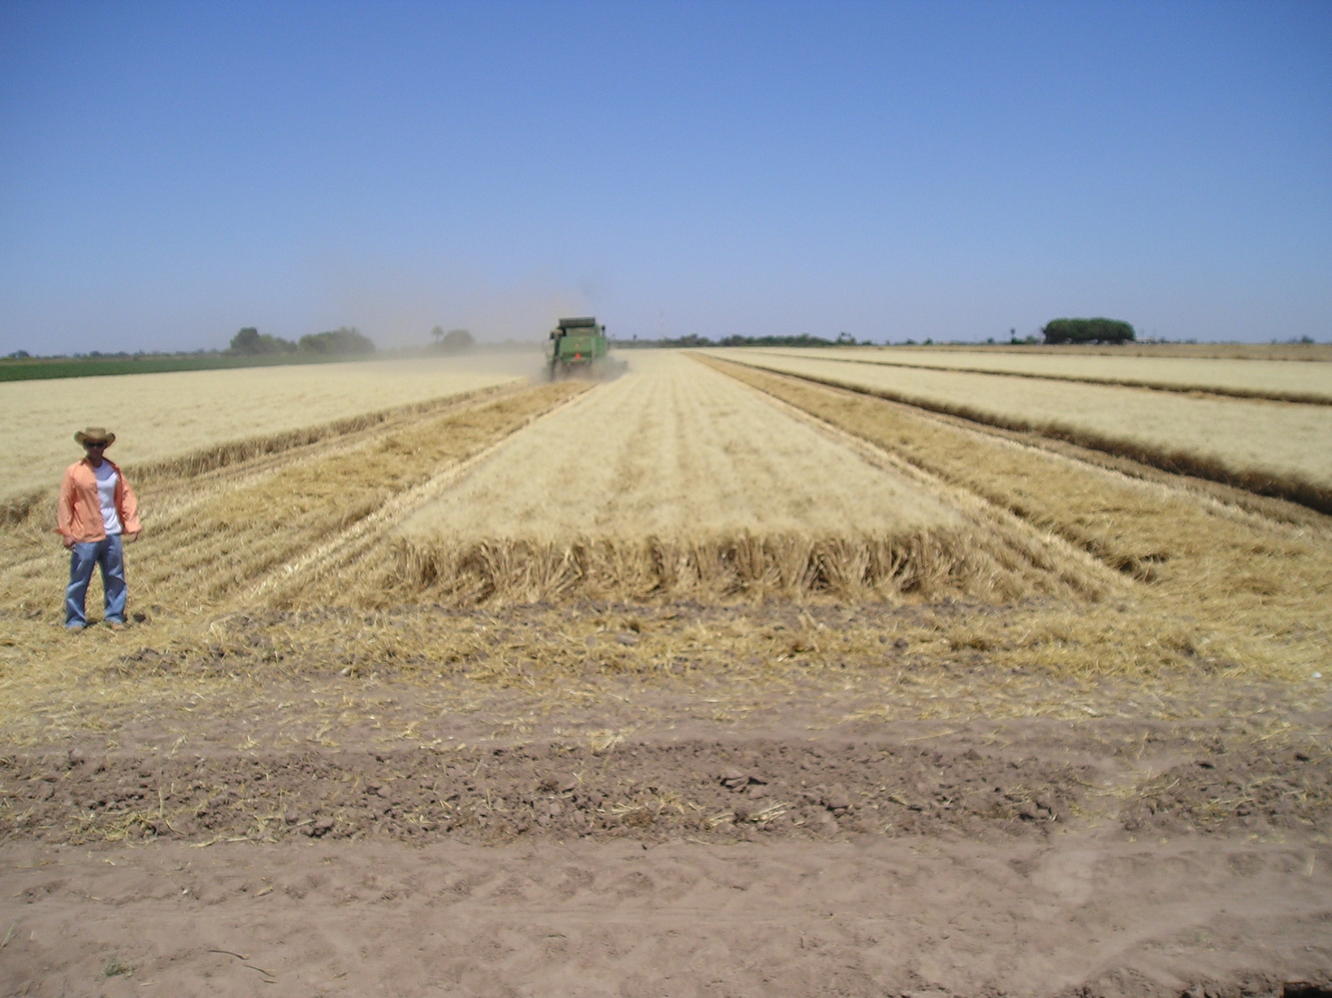

Slide 23
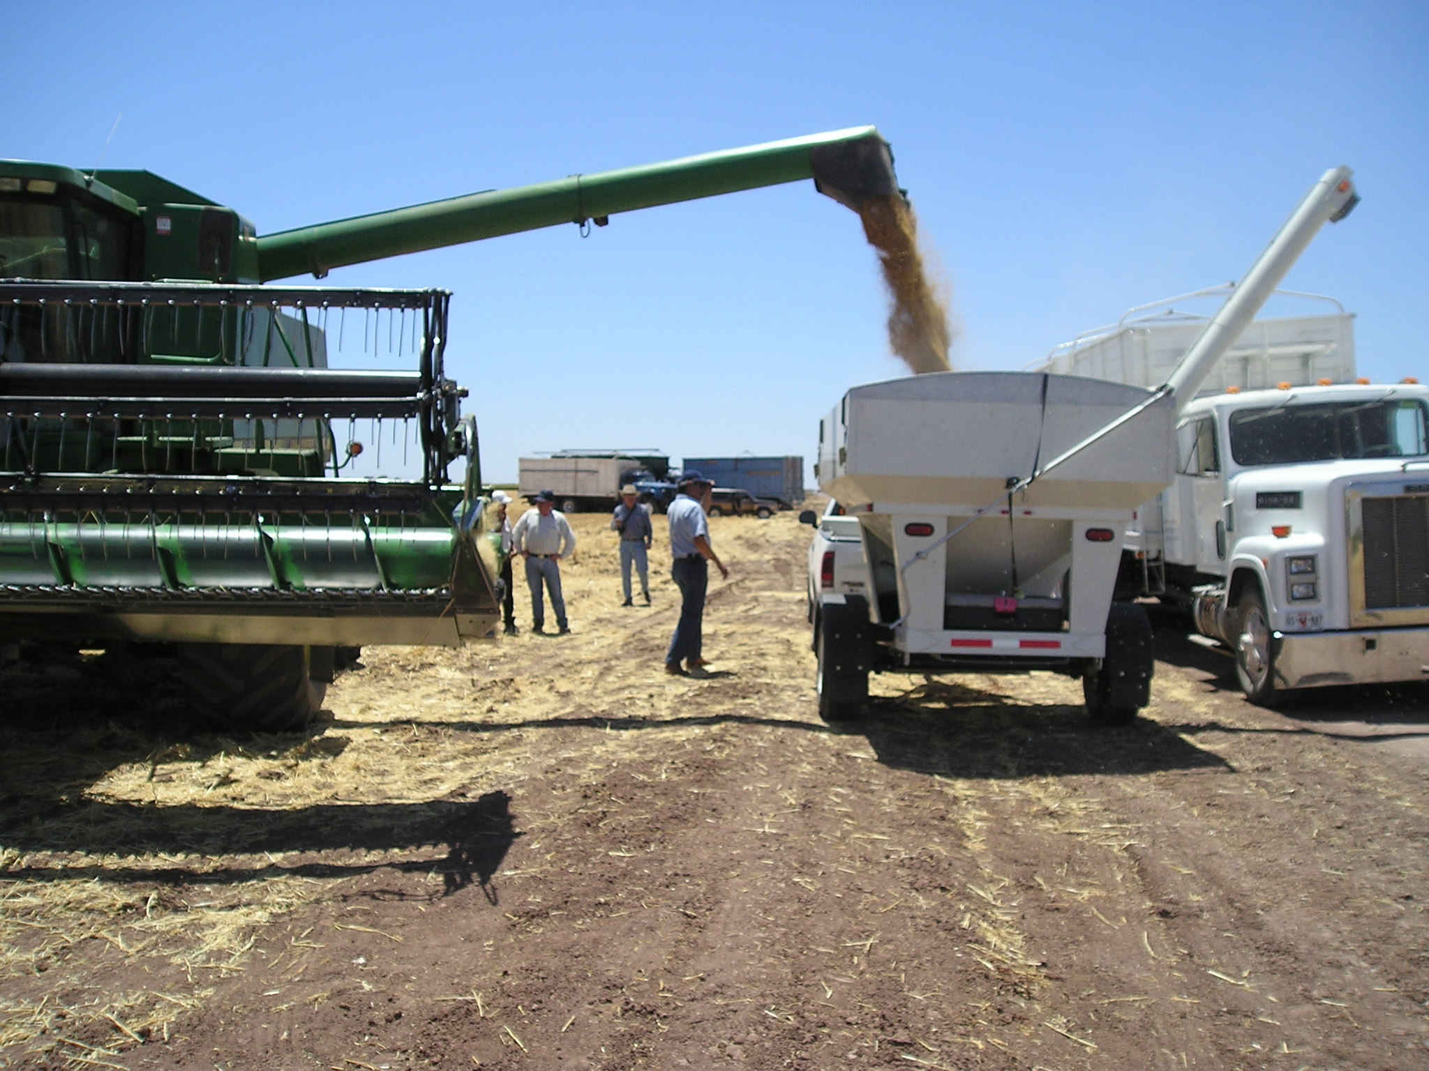

Slide 24
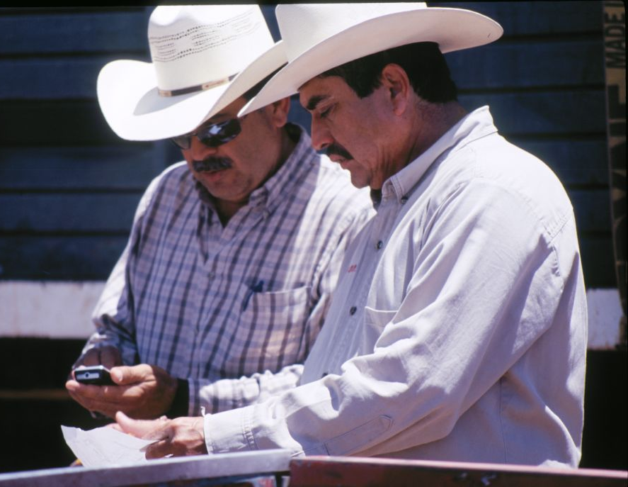
PROGRAM 2009-2010
7363 hectares
38% tested
105 participating
farmers
316 field with an
N rich strip

Slide 25
107 Fields
Difference
85 kg N/ha
64kgN/ha

Slide 27
60-68 kgN
86
60
101
107
fields

Slide 32
N Saving Using the GreenSeeker
2007-2008
60 kgN/ha
1.00 USD/kgN = 60 USD/ha
2008-2009
68 kgN/ha
1.30 USD/kgN = 88 USD/ha
2009-2010
64kg N/ha
1.00 USD/kgN = 64 USD/ha

Slide 33
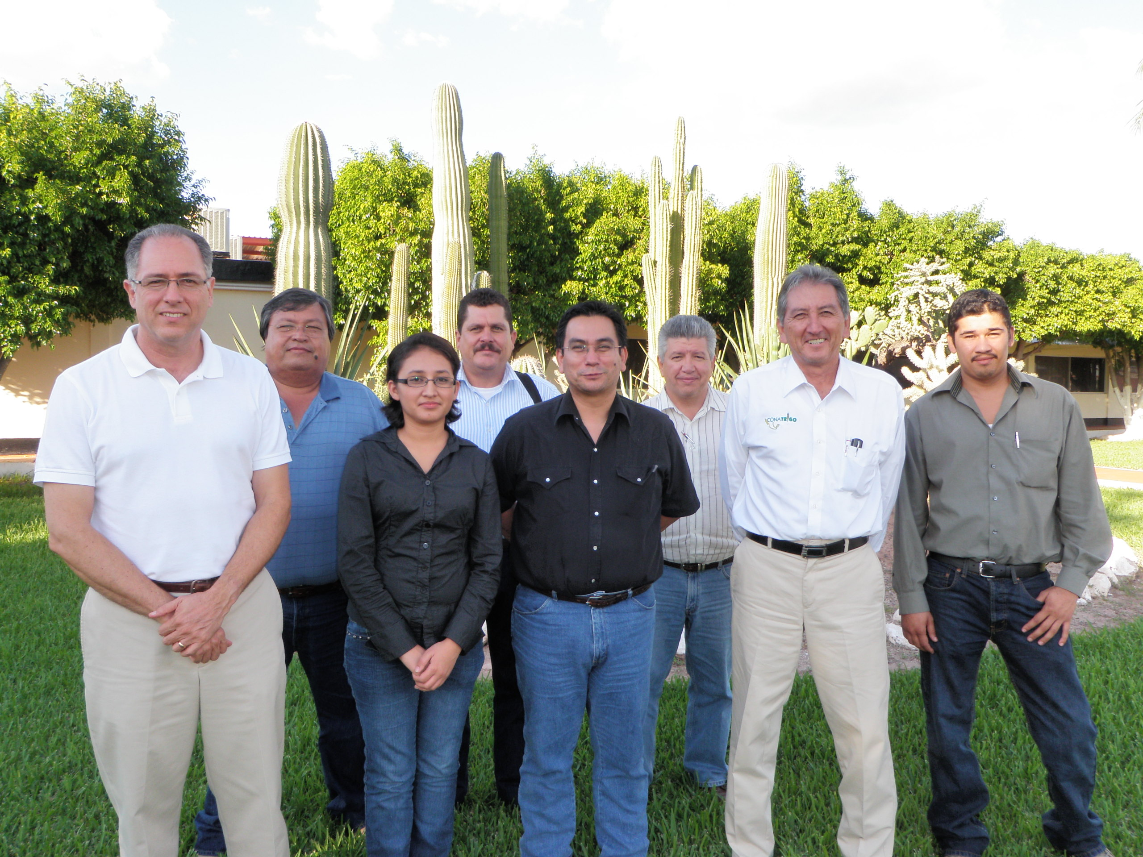
NATIONAL SENSOR PROGRAM

Slide 34
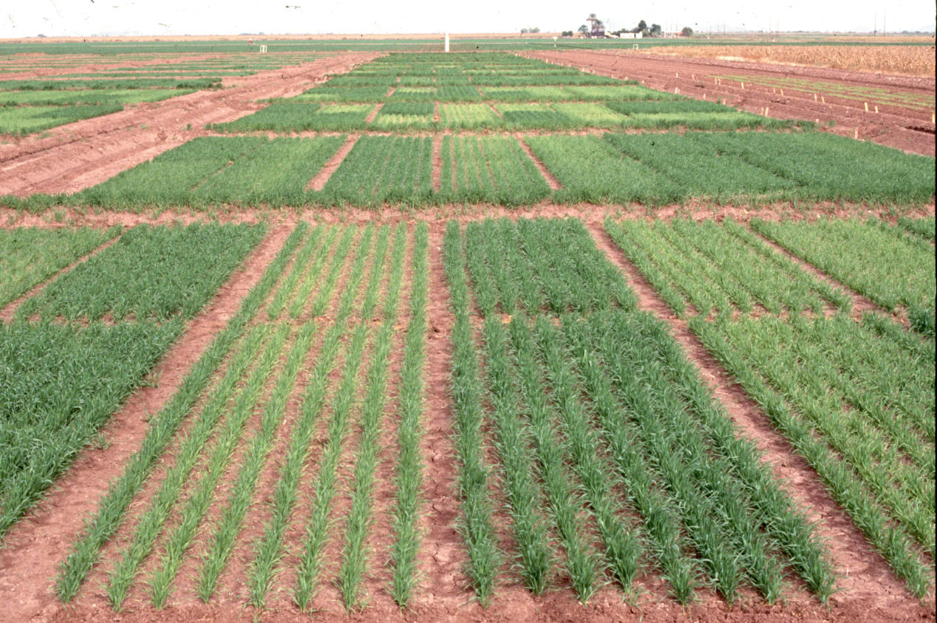
Calibration Experiments

Slide 35
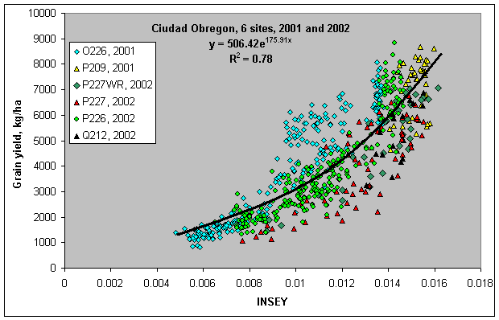
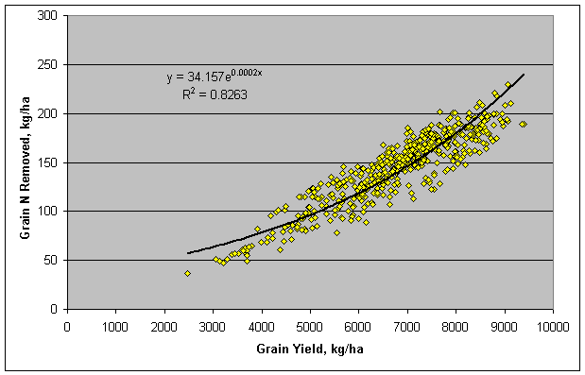
CALIBRATION

Slide 36
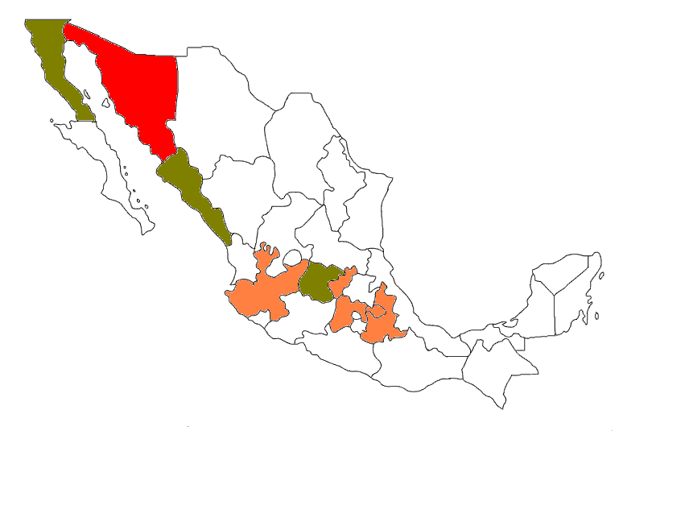
1
WHEAT
2
3
5
7
4
6
8
9
1: B.C.
2: Sonora
3: Sinaloa
4: Jalisco
5: Guanajuato
6: Edo. México
7: Querétaro
8: Tlaxcala
9: Puebla

Slide 37
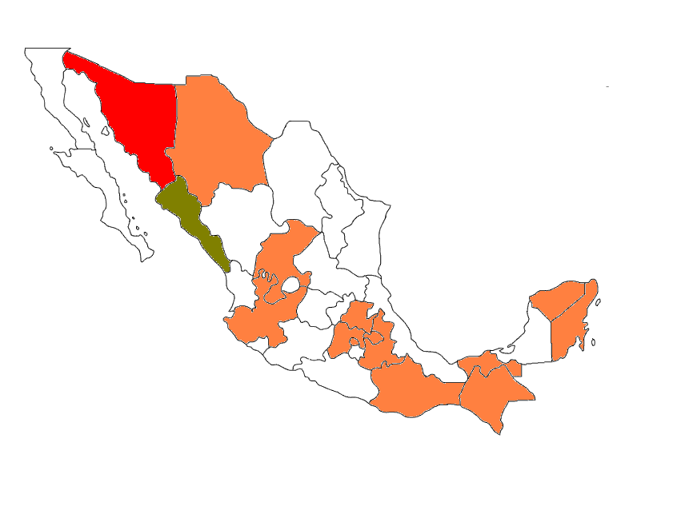
MAIZE
1
3
2
5
7
14
1: Sonora
2: Sinaloa
3: Chihuahua
4: Jalisco
5: Zacatecas
6: Edo. México
7: Hidalgo
8: D.F.
9: Tlaxcala
10: Puebla
11: Oaxaca
12: Chiapas
13: Tabasco
14: Yucatán
15: Quintana Roo
4
15
6
9
8
10
13
11
12

Slide 38
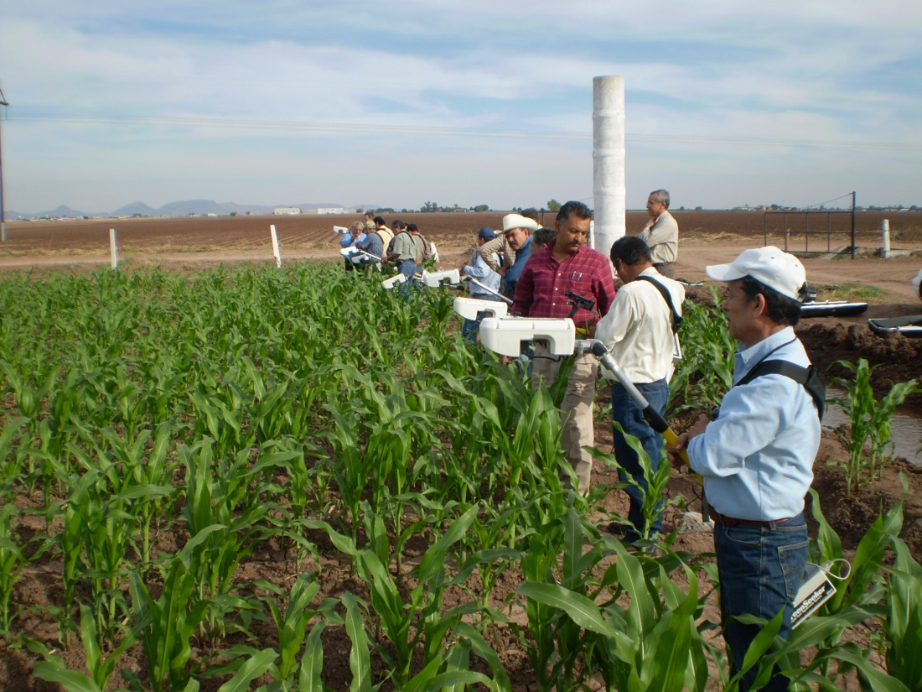
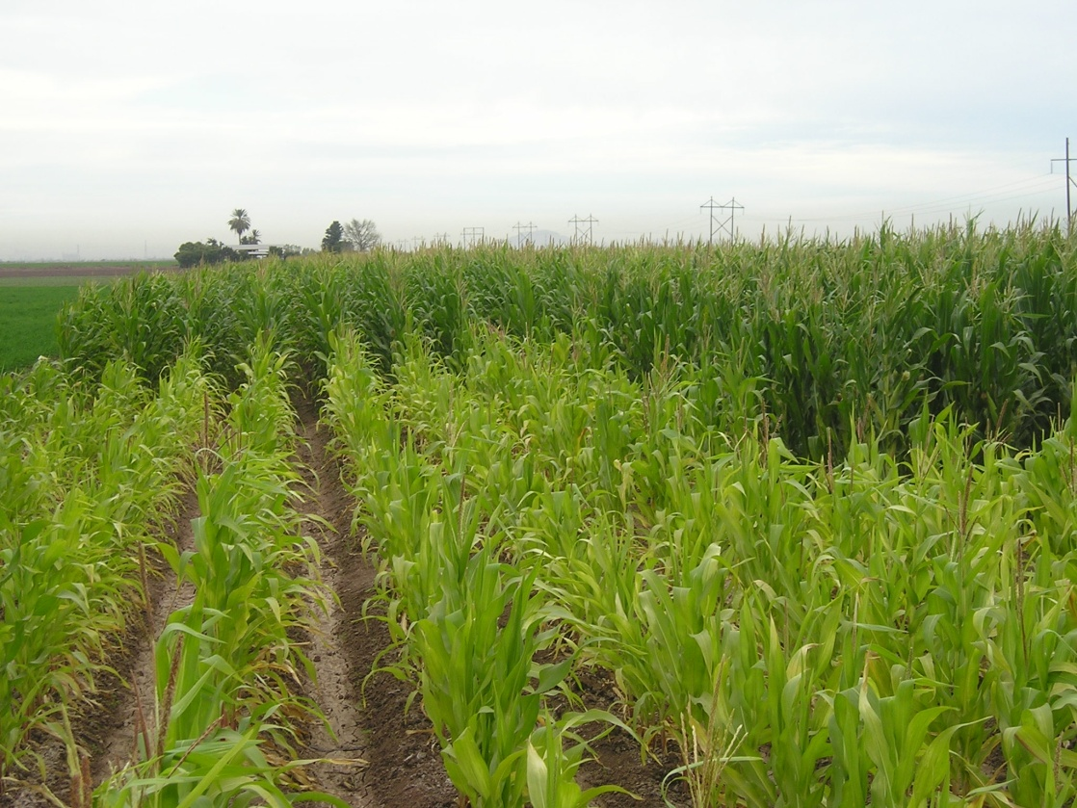
GreenSeeker in Maize

Slide 39
Ten nitrogen experiments over four years
Treatment Preplant N (kg/ha) Starter N (kg/ha) Sidedress N (kg/ha) V6
1 0 0 0
2 200 0 0
3 0 40 0
4 0 40 30
5 0 40 60
6 0 40 90
7 0 40 120
8 0 40 150
9 0 40 180

Slide 40
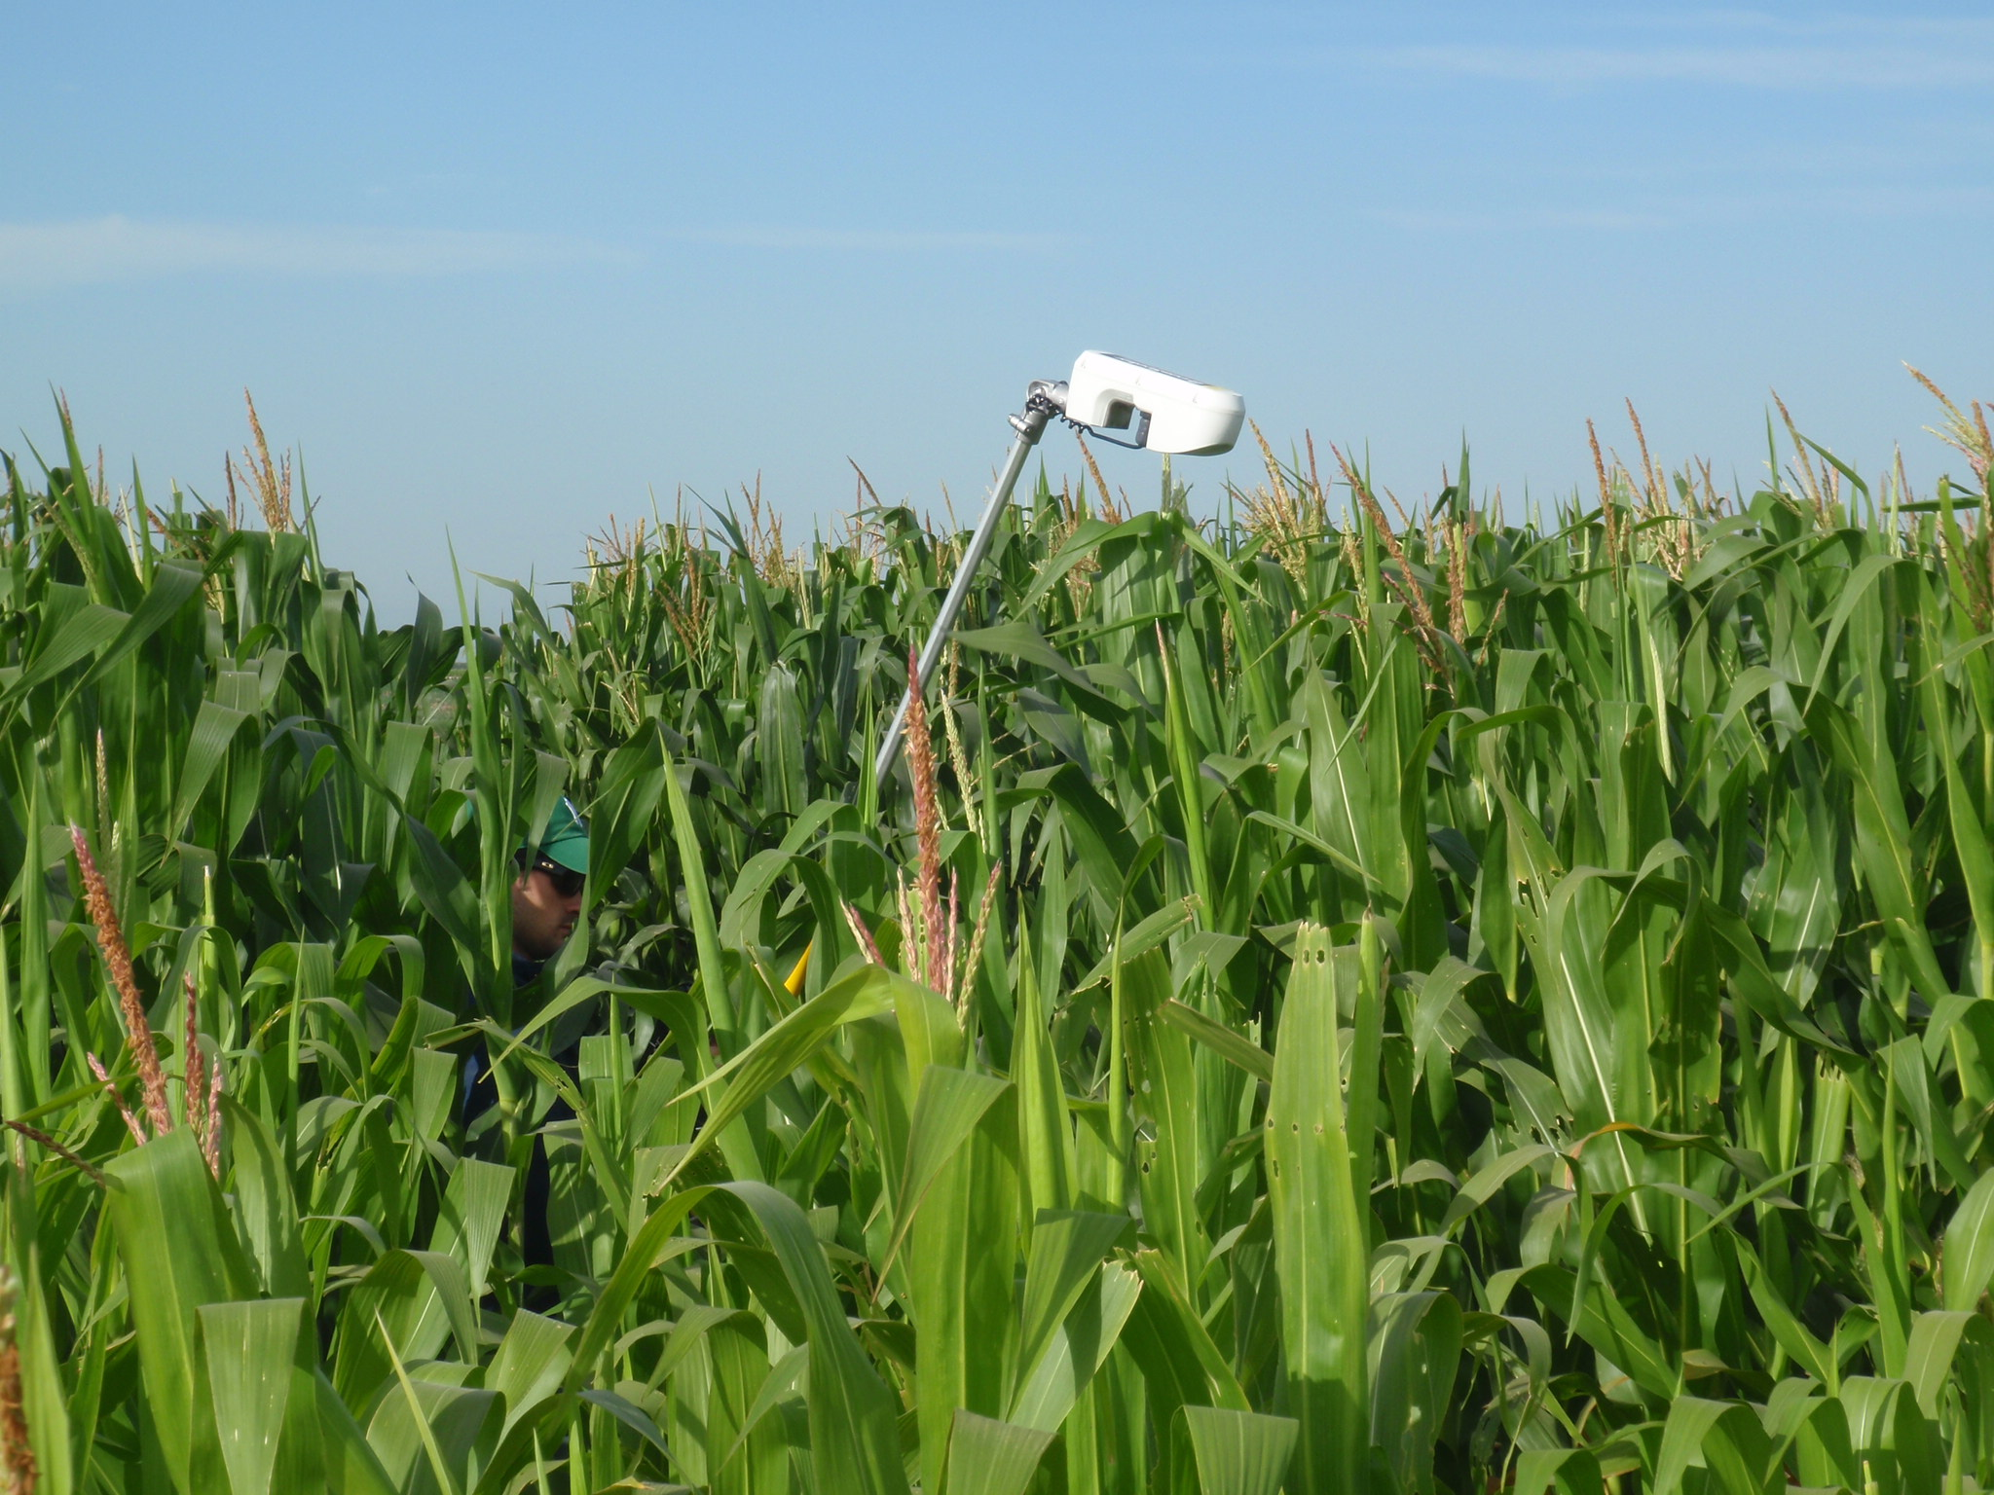
INSEY Data from seven Experiments

Slide 41
Sensor Work in Asia

Slide 42
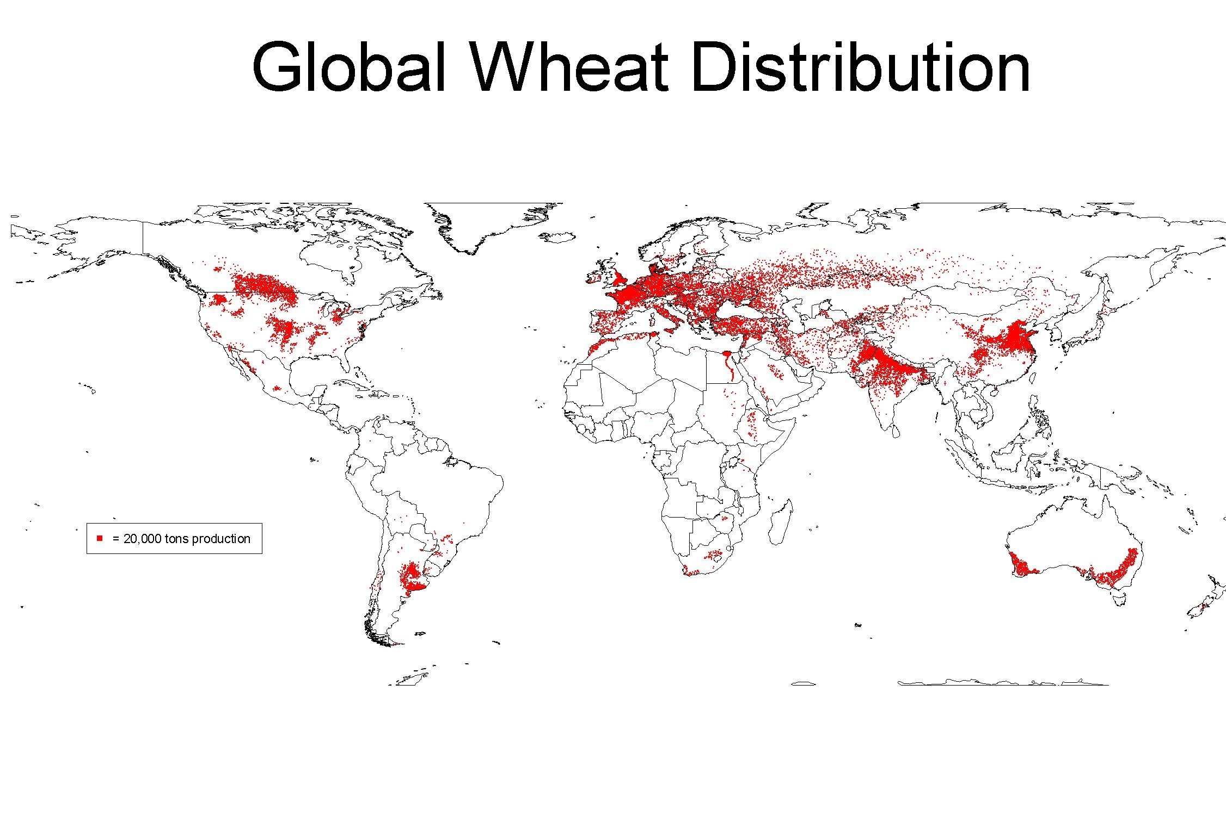
China
Pakistan
India
Source: D. Hodson

Slide 43
Spring wheat INSEY Yaqui vs Pakistan
Pakistani data: Dr. Imtiaz Husain

Slide 44
Spring wheat INSEY Yaqui vs India
Indian data: Dr. Ramesh K. Sharma

Slide 45
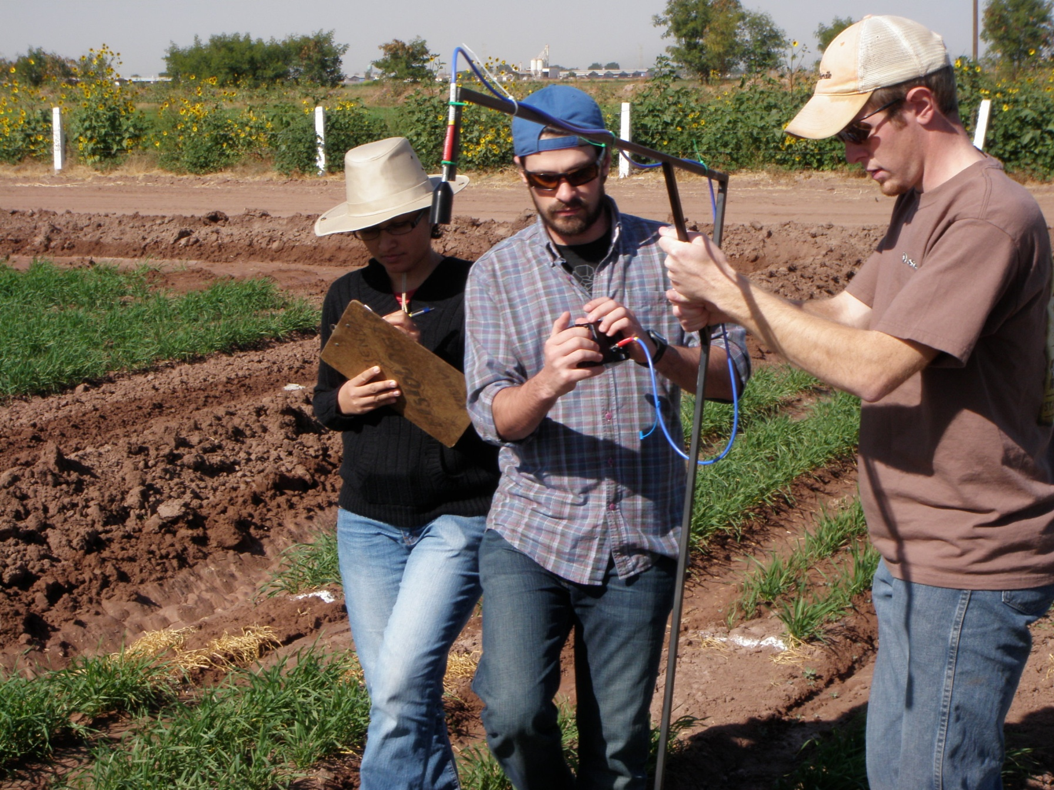
Thank you

Slide 46
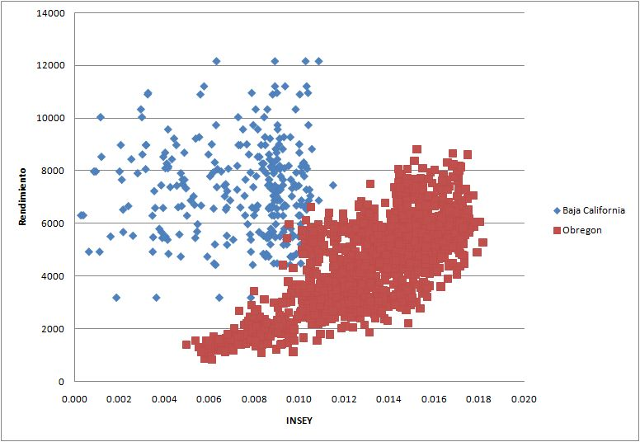
Spring wheat INSEY Yaqui vs Mexicali
Mexicali Data: Dr. Jesus Santillano

