Slide 1
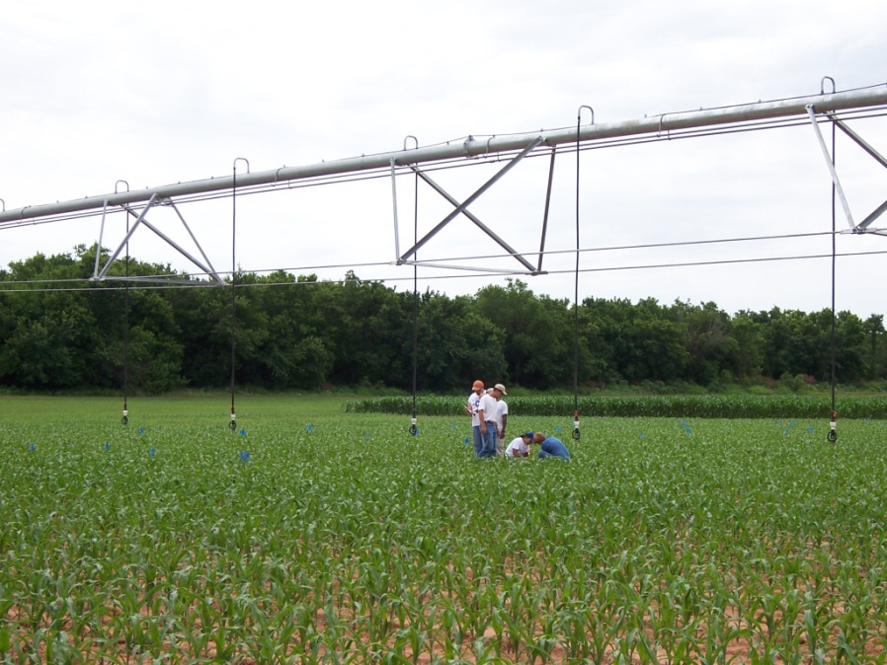

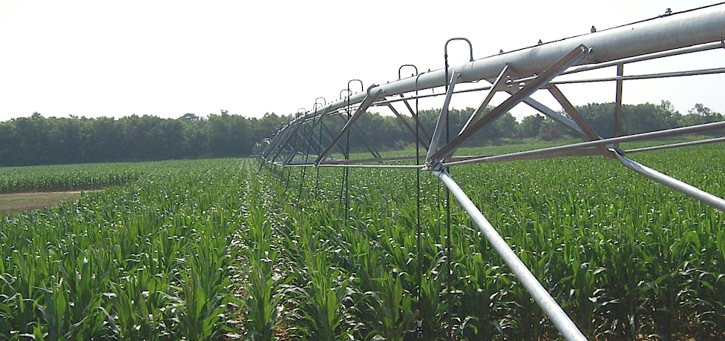

Fundamentals of the OSU Algorithm

Slide 2
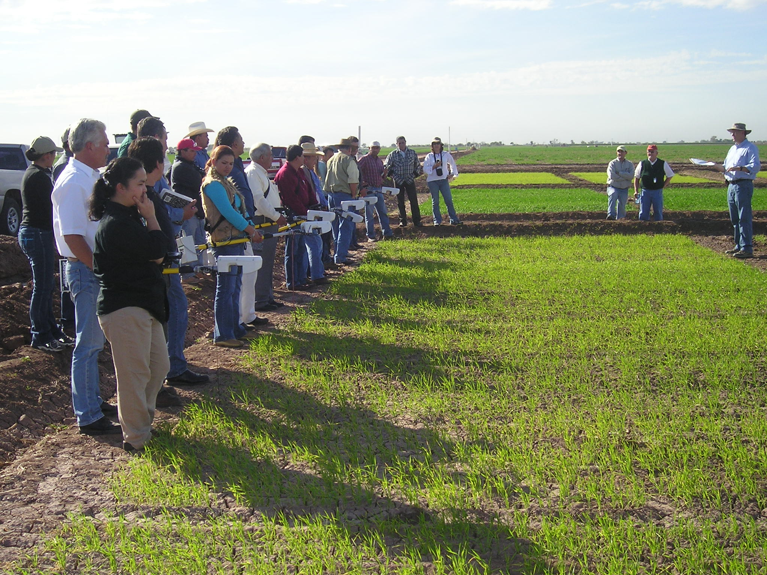
Training
Farmer training, Ciudad Obregon, Mexico, January 2007

Slide 3
Variable N Response

Slide 4
Global Importance of Fertilizer N
Malakoff (Science, 1998)
  $750,000,000, excess N flowing down the Mississippi River
Africa expenditure on fertilizer N, cereals
  $706,000,000
Nitrogen Use Efficiency (NUE) World 33%
20% increase
  Worth $10.8 billion US annually

Slide 6
Sub-Saharan Africa
SAA USA
Population, million 700 300
Cereals, million ha 88 56
Production, million tons 97 364
Yield, tons/ha 1.1 6.5
Fertilizer N, million tons 1.3 10.9
Avg. N rate, kg/ha 4 52
% of world N consumed 1.4 13
% of world population 10 4

Slide 7
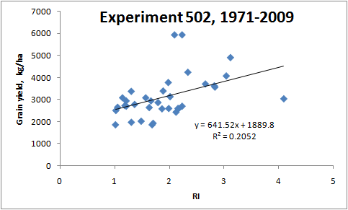

Slide 8
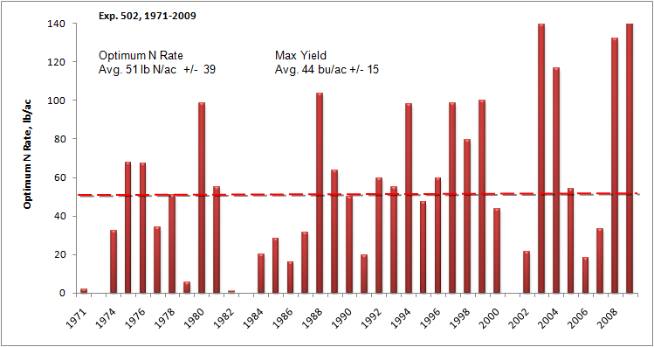

Slide 9
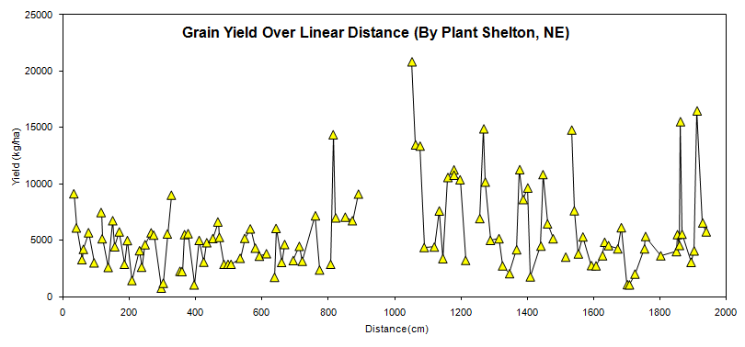
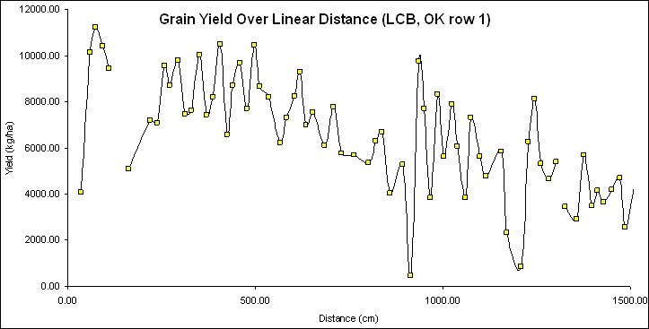

Slide 10
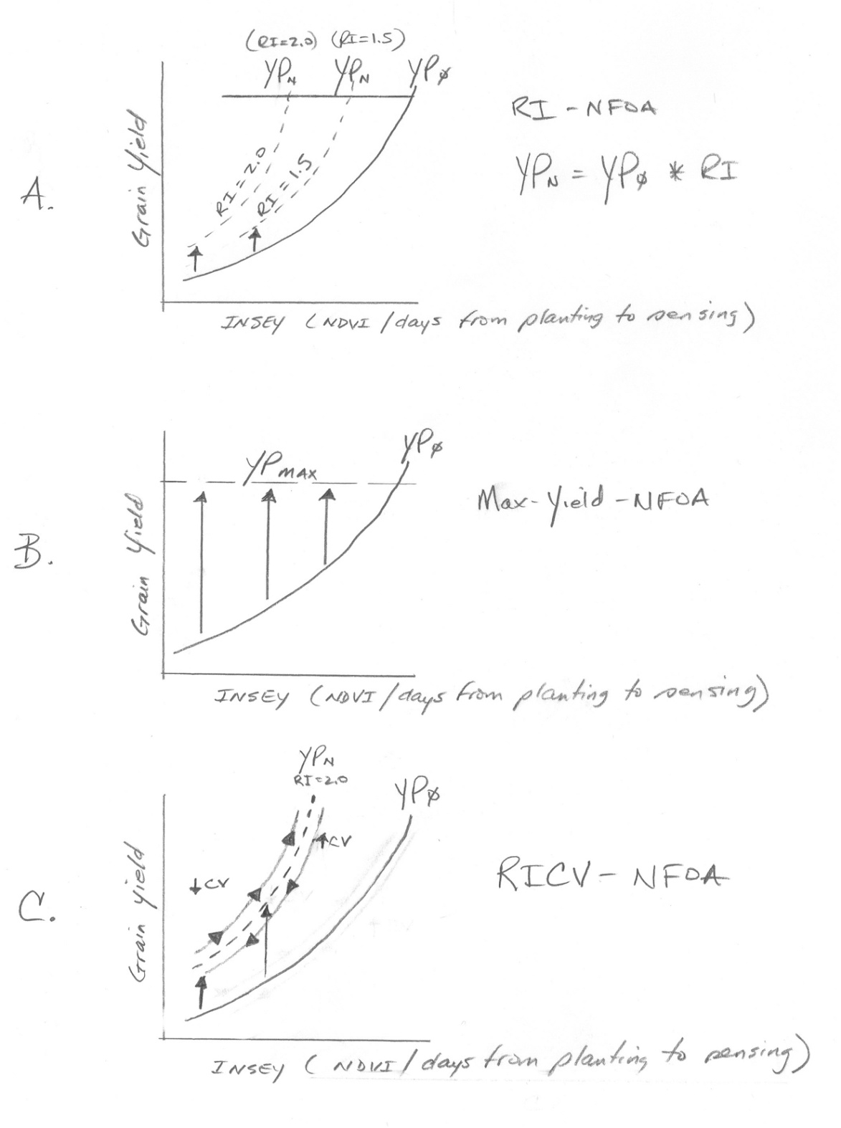

Slide 11
YP_{N}
YP_{N}
YP₀
YP_{MAX}
RI=1.5
Grain yield
RI=2.0
A
RI-NFOA
YP_{N}=YP₀ * RI
INSEY (NDVI/days from planting to sensing)
YP₀ = (NDVI / Days, GDD>0)
YP₀ = INSEY
YP_{N} = (YP0*RI)
Nf = (YP₀*RI) – YP₀))/Ef

Slide 12
YP₀
YP_{MAX}
Grain yield
B
Max Yield-NFOA
INSEY (NDVI/days from planting to sensing)
Nf = (YP_{MAX}-YP₀)/Ef

Slide 13
RI=2.0
YP₀
YP_{N}
YP_{MAX}
Grain yield
CV
C
RICV-NFOA
CV
INSEY (NDVI/days from planting to sensing)
Nf = ((YP₀*RI)*(65-CV/65-CrCV)) – YP₀/Ef
65? Limit of CV data
Critical CV or CrCV, changes for different crops
Corn
Wheat

Slide 14
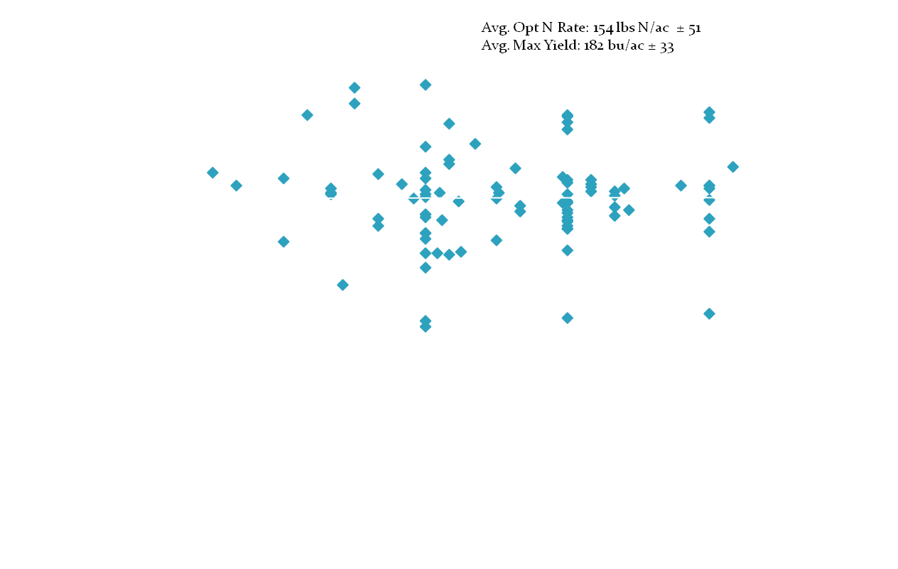
Data compiled by Dr. Robert Mullen, The Ohio State University

Slide 15
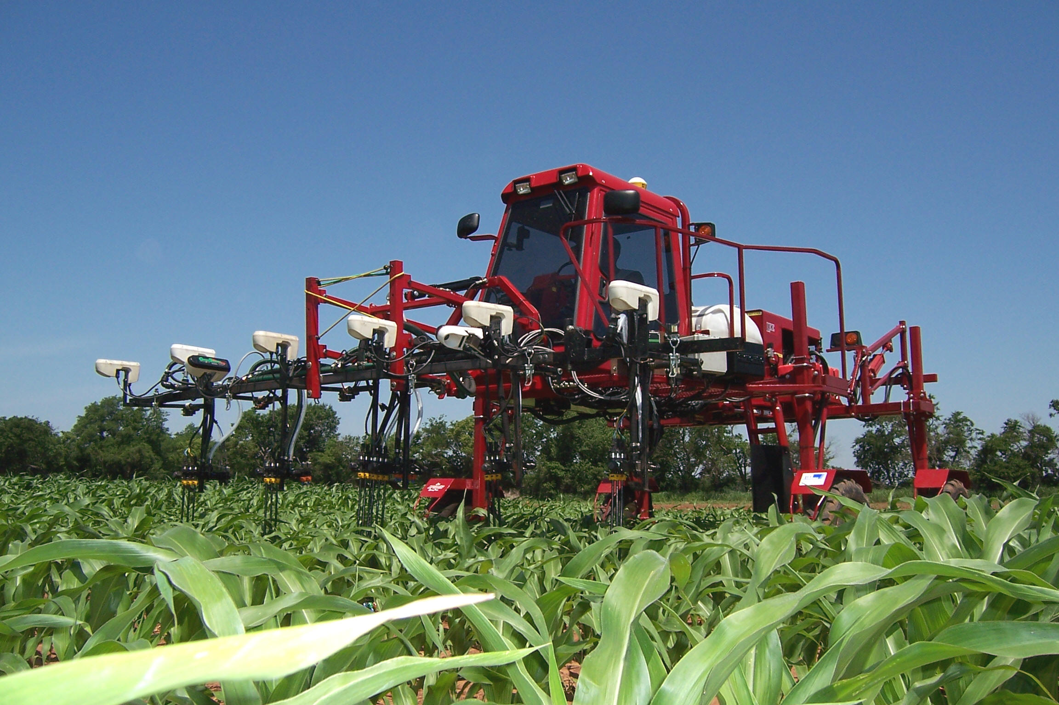
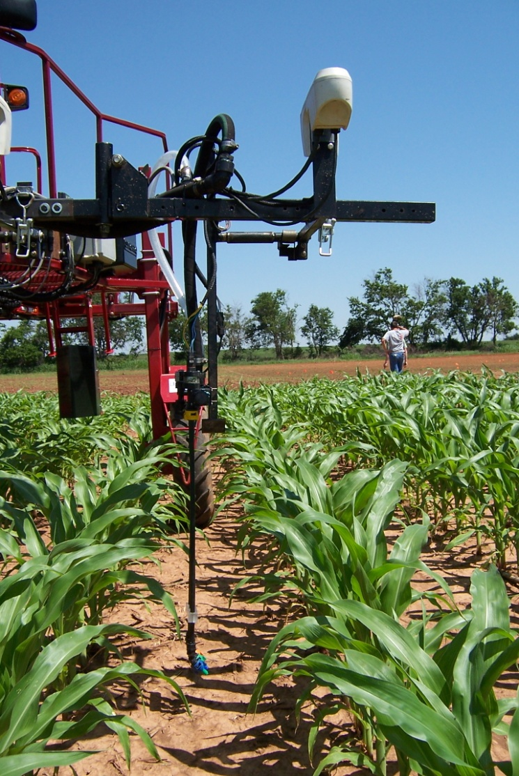
Variable Rate Technology
Treat Temporal and Spatial Variability
Returns are higher but require larger investment

Slide 16
Yield Potential Prediction, Corn, Ohio

Slide 17
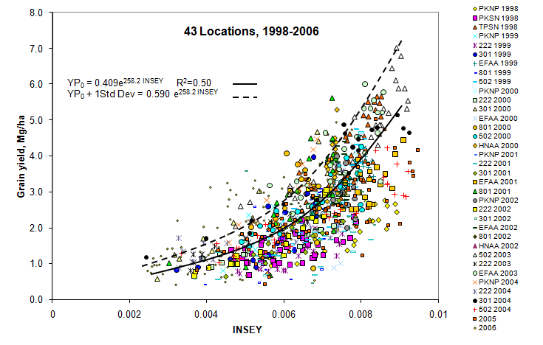
Yield Potential Prediction, Winter Wheat, Oklahoma

Slide 18
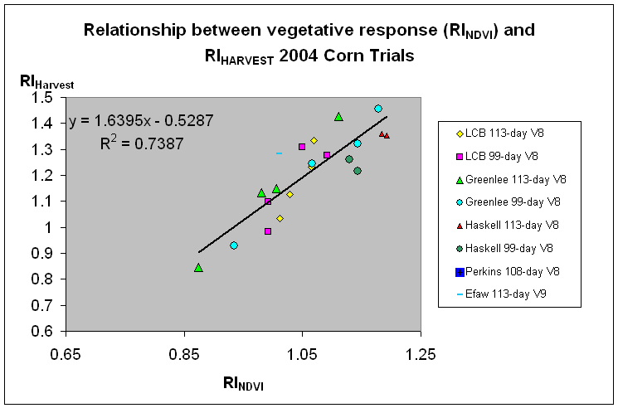
Predicting N Responsiveness

Slide 19
Response Index Theory for Fertilizer N Response

