Slide 1

Applications of
Aerial Imaging for Specialty Crops in Idaho
Esteban Cano
Ryan Horton
Dr. Duke Bulanon
Dr. Esmaeil Fallahi
9 August 2016
2016 Robotic Vision, Northwest Nazarene University
1

Slide 2

Overview
1. Background: Precision Agriculture
2. Peach Application
3. Apple Application
4. Onion Application
5. Acknowledgements
6. Questions
9 August 2016
2016 Robotic Vision, Northwest Nazarene University
2

Slide 3
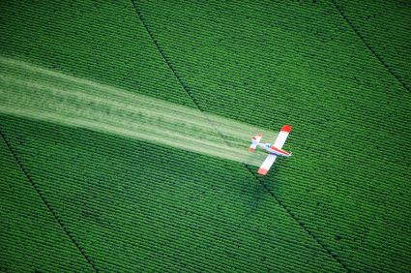
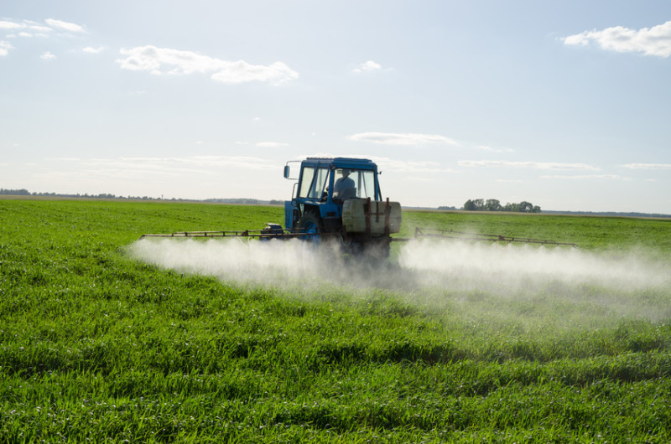
Background: Precision Agriculture
“Doing the right thing, at the right place, at the right time, in the right way.”
Images from google images
9 August 2016
2016 Robotic Vision, Northwest Nazarene University
3

Slide 4
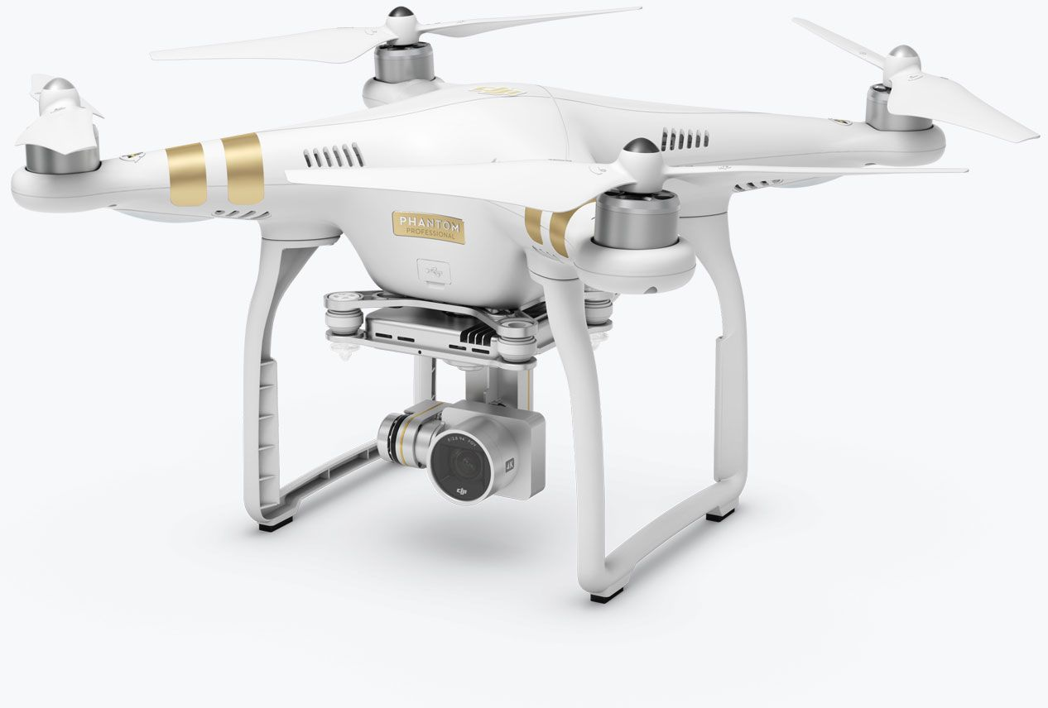
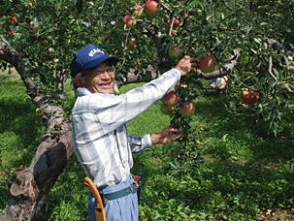
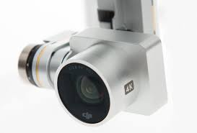
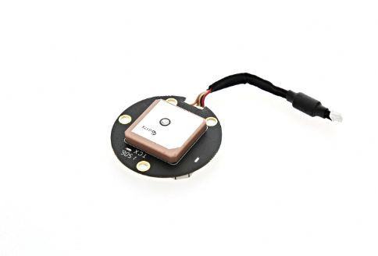
Background: Precision Agriculture
GPS receiver
4K Camera
Images from google images
9 August 2016
2016 Robotic Vision, Northwest Nazarene University
4

Slide 5
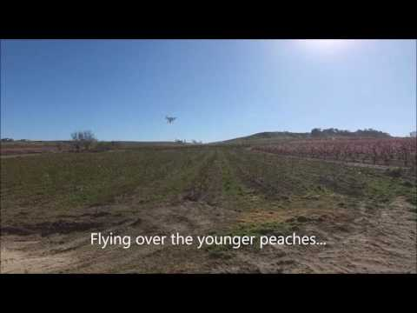
Precision Farming: Data Acquisition
Images from google images
9 August 2016
2016 Robotic Vision, Northwest Nazarene University
5

Slide 6
Overview
1. Background: Precision Agriculture
2. Peach Application
3. Apple Application
4. Onion Application
5. Acknowledgements
6. Questions
9 August 2016
2016 Robotic Vision, Northwest Nazarene University
6

Slide 7
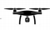
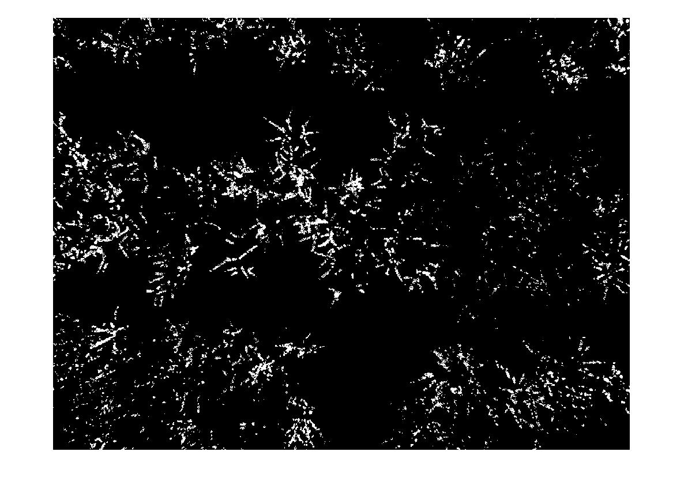
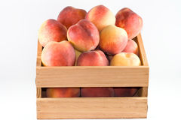

Precision Farming: Peaches
Aerial Orchard Image
Image processing
Correlate to yield and crop management
Images from google images
9 August 2016
2016 Robotic Vision, Northwest Nazarene University
7

Slide 8
Benefits of Knowing Yield
What to plan for at the end of the season
  What to expect to sell
  How many people are needed to harvest the peaches
  Knowing how many resources are needed
  Accurate representation of profit
Trends can be established
  Year to year blossom to yield
  Long term blossom to yield
  Learn and know more about the crop
    Tailored caretaking can be established
Images from google images
9 August 2016
2016 Robotic Vision, Northwest Nazarene University
8

Slide 9
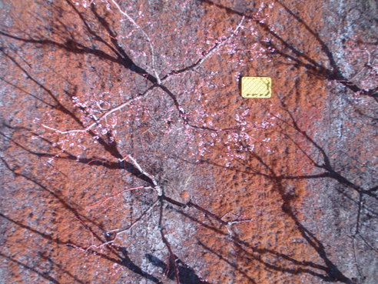
Image Acquisition
Images from google images
9 August 2016
2016 Robotic Vision, Northwest Nazarene University
9

Slide 10
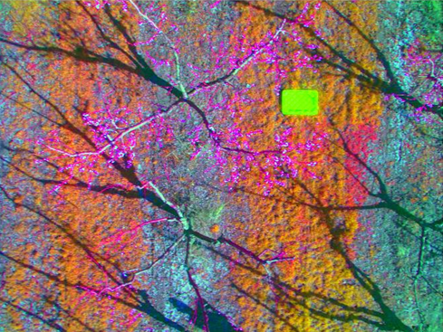
Image Processing
9 August 2016
2016 Robotic Vision, Northwest Nazarene University
10

Slide 11
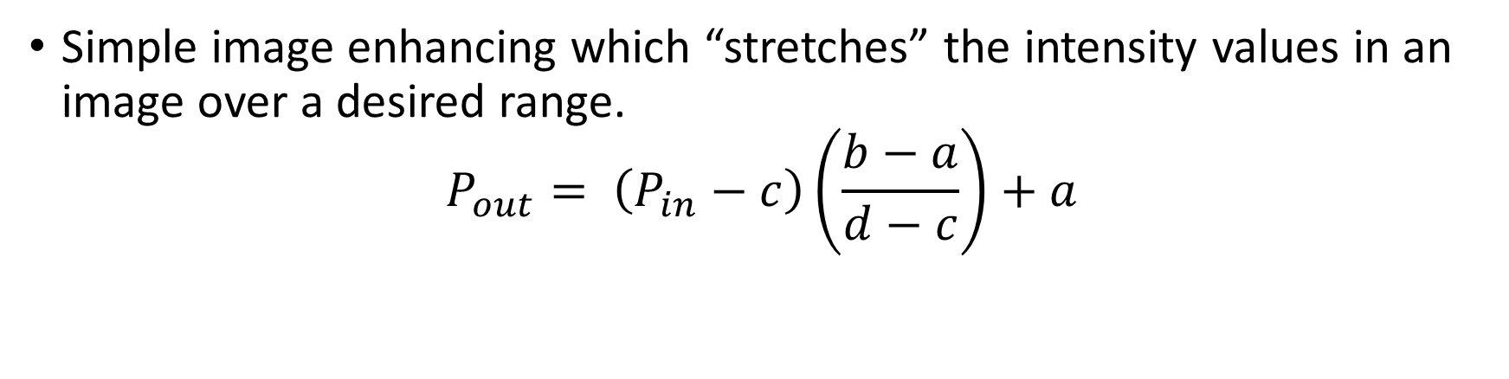
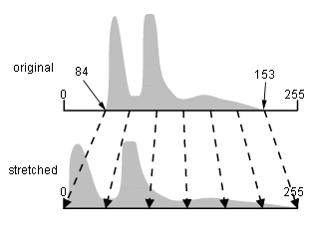
Contrast Stretch
P = Individual pixel
a = Lower scaling limit (0 in this case)
b = Upper scaling limit (255 in this case)
c = Lowest pixel value in image
d = Highest pixel value in image
9 August 2016
2016 Robotic Vision, Northwest Nazarene University
11

Slide 12
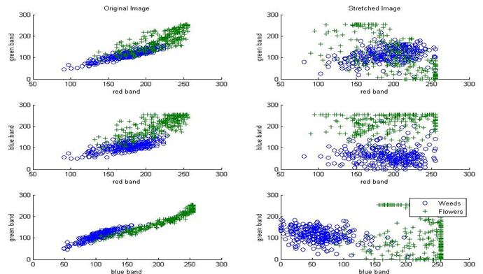
Original Image Vs. Stretched Image
9 August 2016
2016 Robotic Vision, Northwest Nazarene University
12

Slide 13
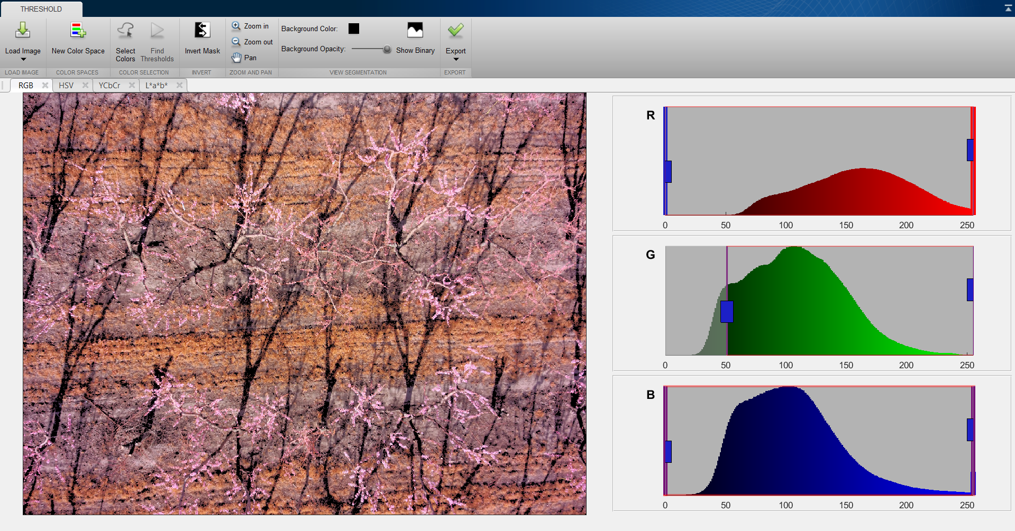
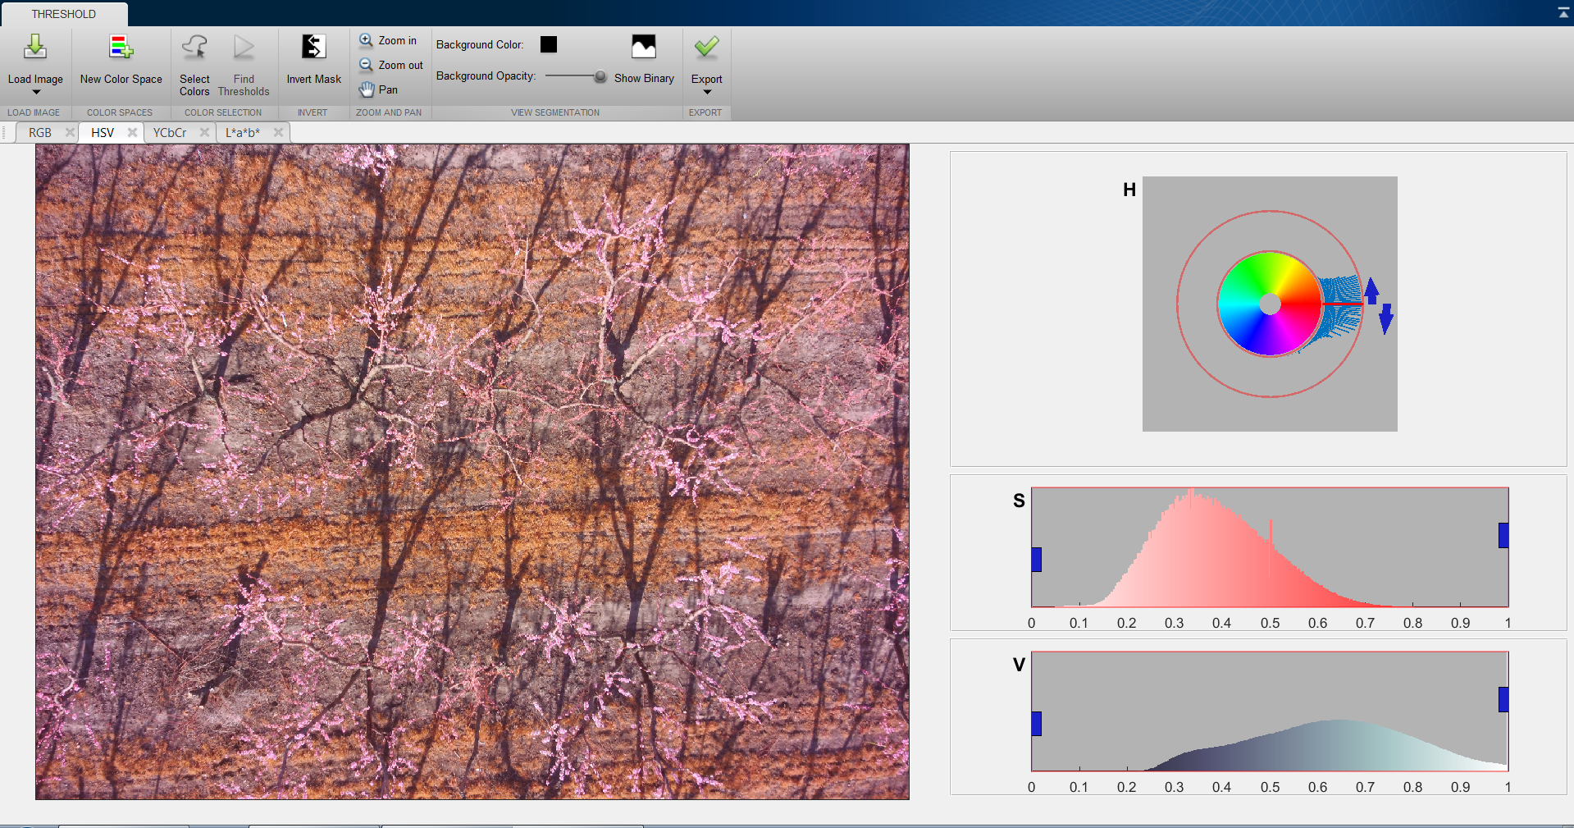
MATLAB Color Threshold Manipulation
9 August 2016
2016 Robotic Vision, Northwest Nazarene University
13

Slide 14
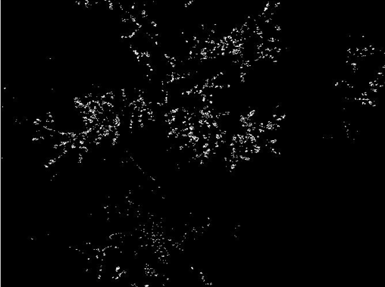
Blossom Segmentation
9 August 2016
2016 Robotic Vision, Northwest Nazarene University
14

Slide 15
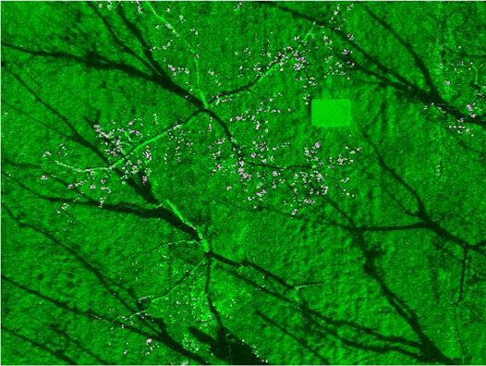
Blossom Segmentation Overlay
9 August 2016
2016 Robotic Vision, Northwest Nazarene University
15

Slide 16
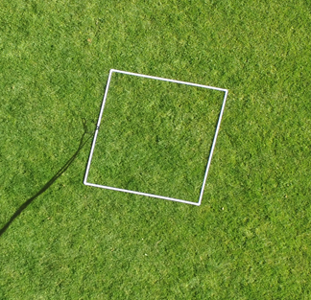
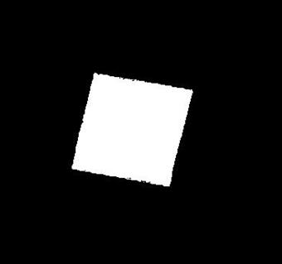
Blossom Density Calculation
2m
2m
9 August 2016
2016 Robotic Vision, Northwest Nazarene University
16
Notes:
Add dimension to color pictureb

Slide 17
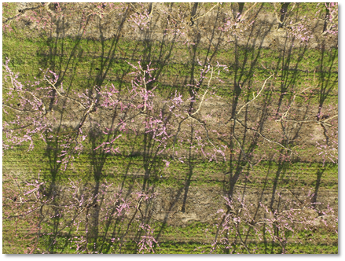
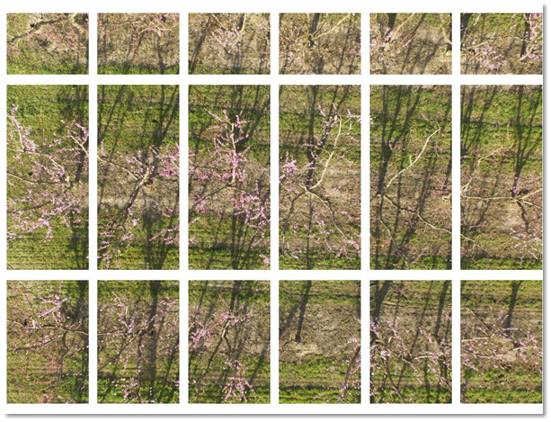
Tree Separation With Grid
9 August 2016
2016 Robotic Vision, Northwest Nazarene University
17

Slide 18
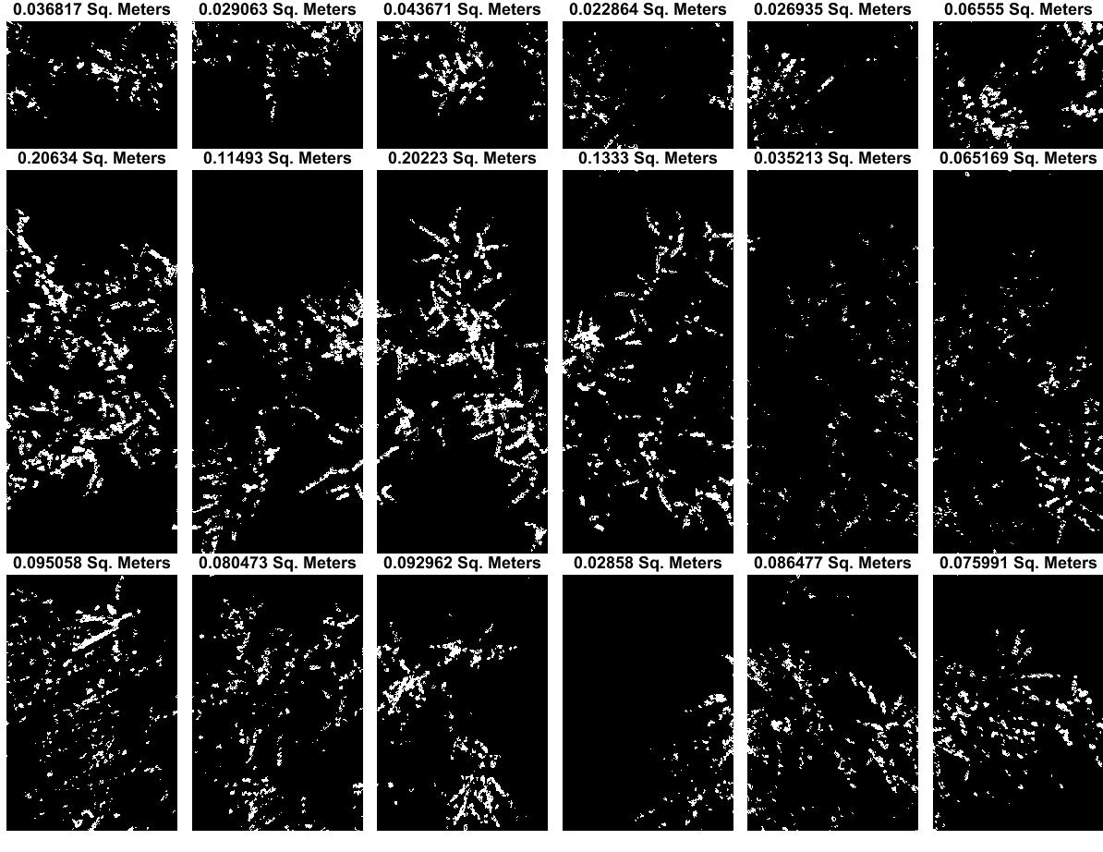
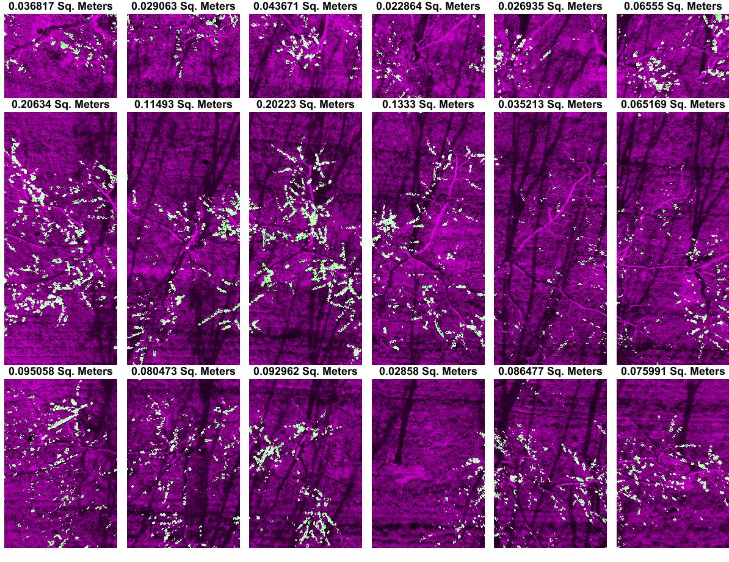
Tree Separation With Grid
9 August 2016
2016 Robotic Vision, Northwest Nazarene University
17

Slide 19
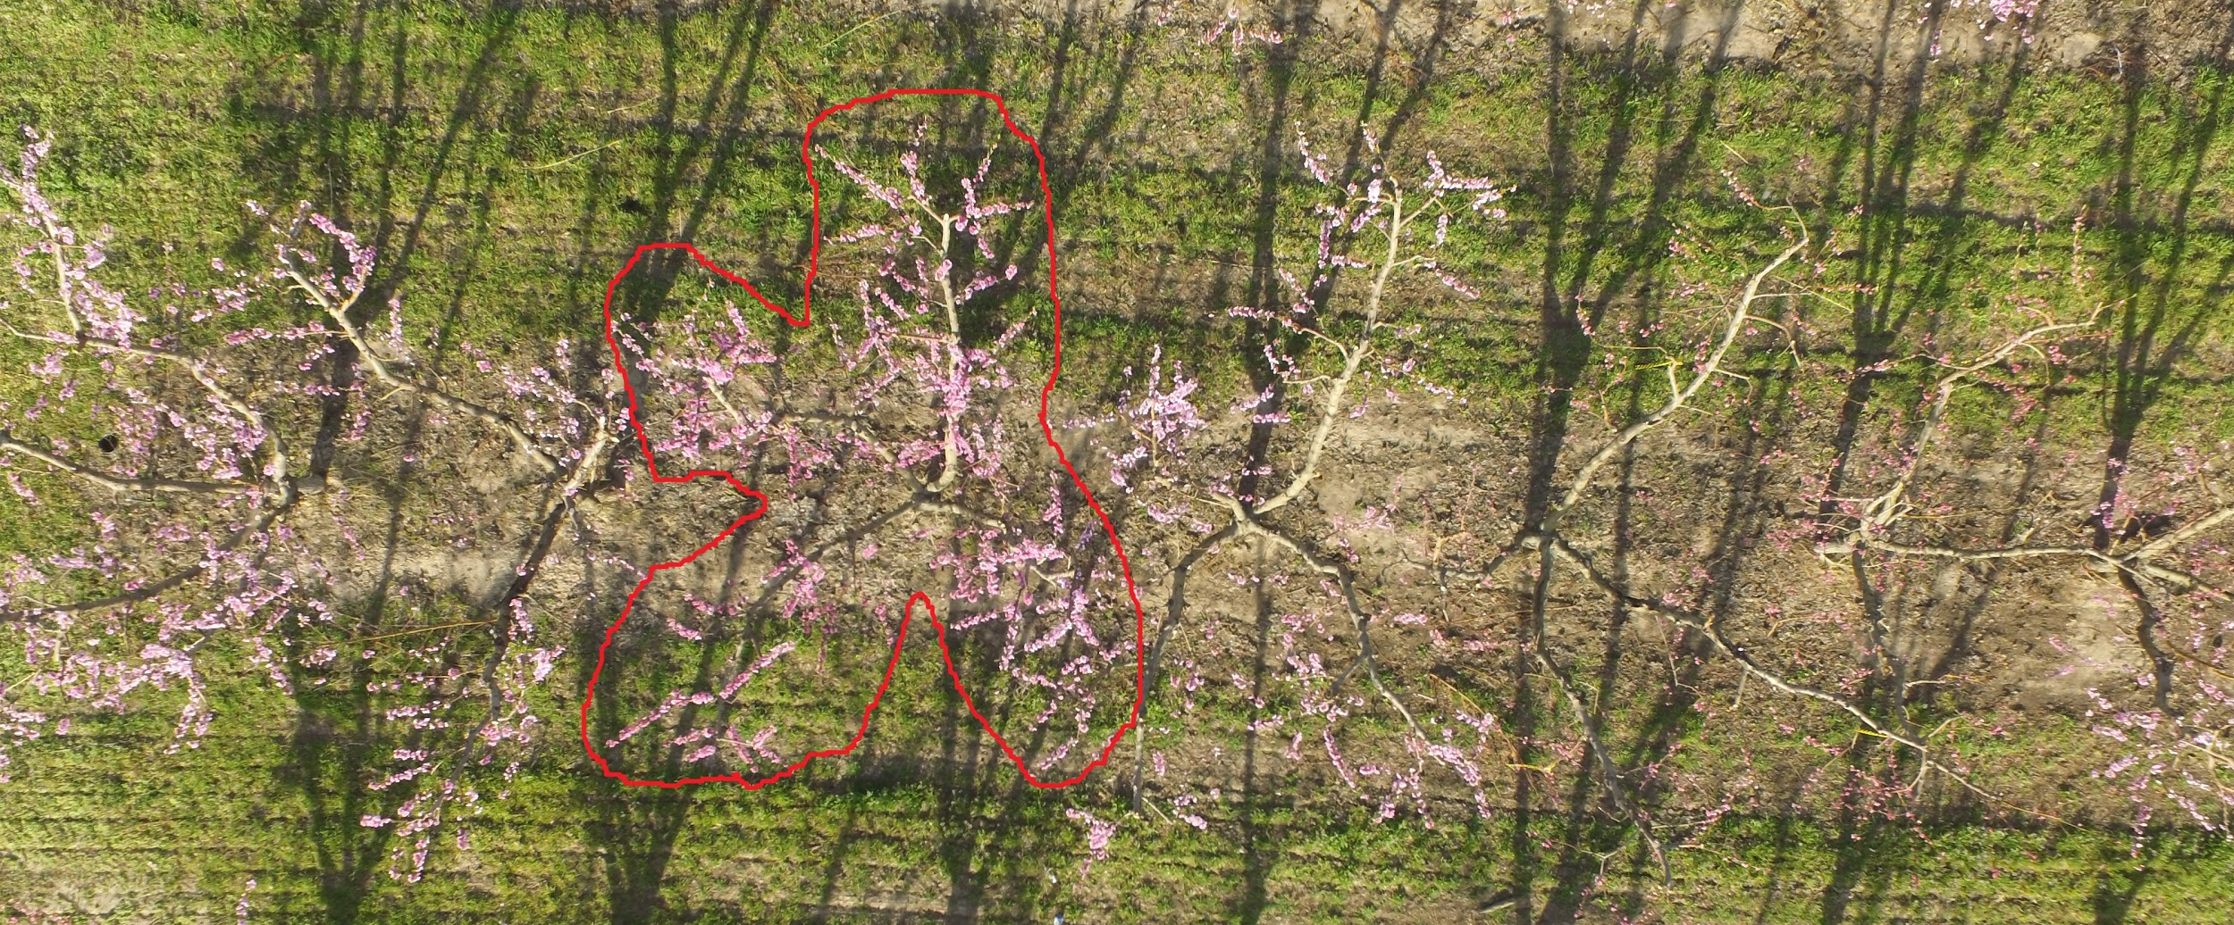
Future Tree Separation Algorithm
9 August 2016
2016 Robotic Vision, Northwest Nazarene University
19

Slide 20
Overview
1. Background: Precision Agriculture
2. Peach Application
3. Apple Application
4. Onion Application
5. Acknowledgements
6. Questions
9 August 2016
2016 Robotic Vision, Northwest Nazarene University
20

Slide 21
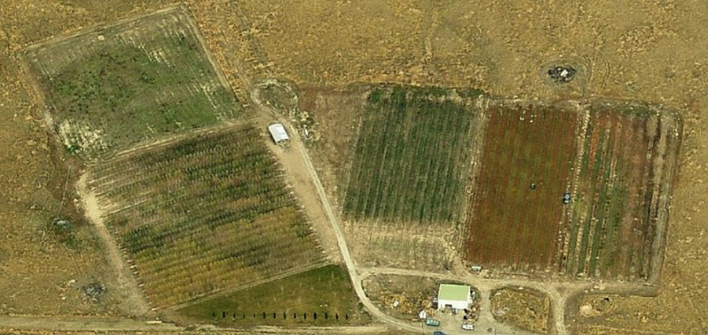
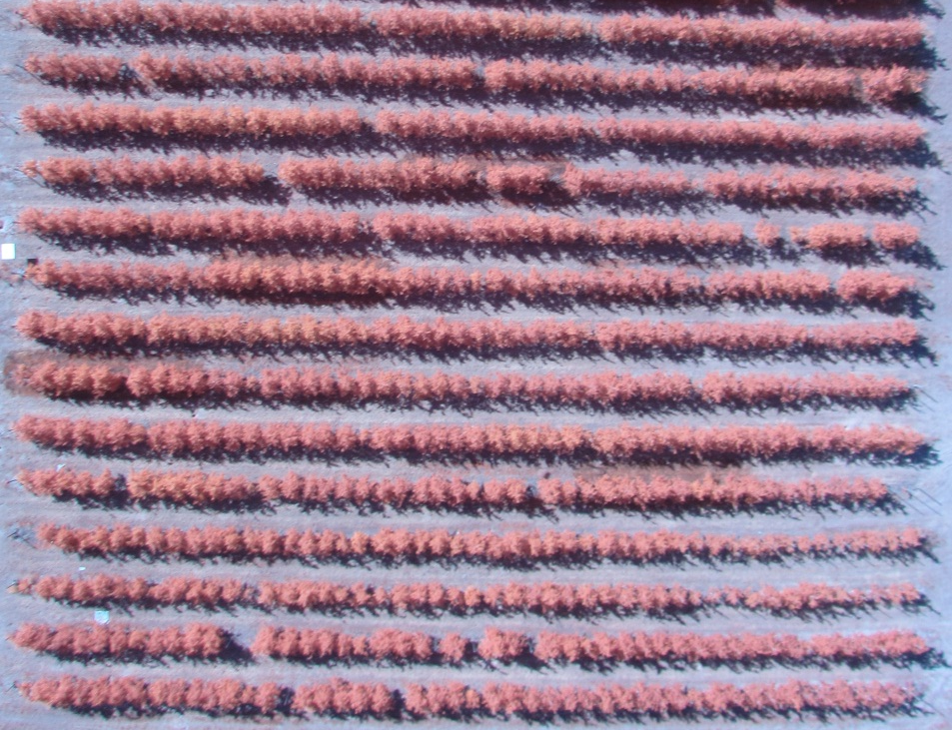
Precision Farming: Apples
University of Idaho Parma Research & Extension Center
Apple Orchard
  Autumn Rose Fuji
  23 x 49 trees
  Irrigation data (Sprinkler and Drip)
  Imaging at 400 feet
9 August 2016
2016 Robotic Vision, Northwest Nazarene University
21

Slide 22
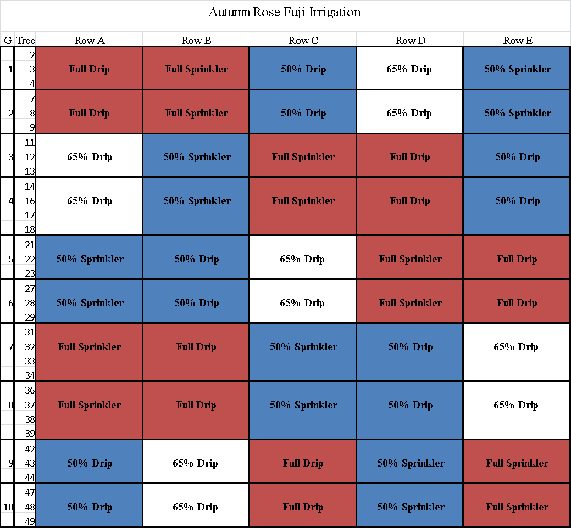
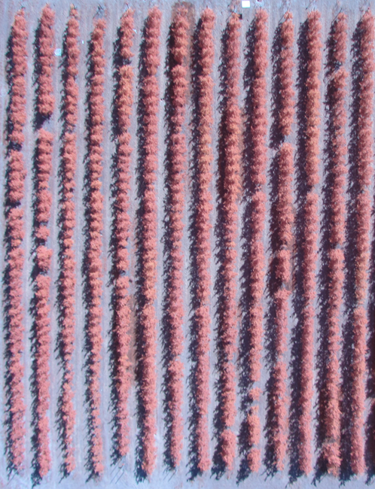
Apple Row Treatment Data
A
B
C
D
E
9 August 2016
2016 Robotic Vision, Northwest Nazarene University
22

Slide 23
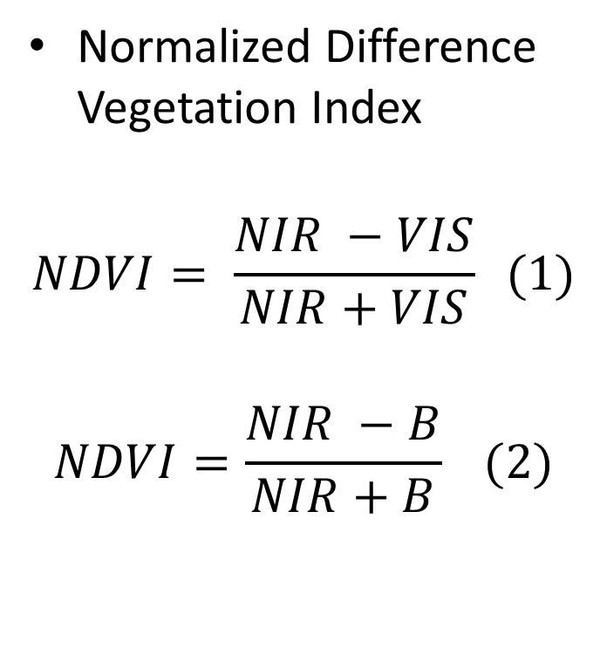
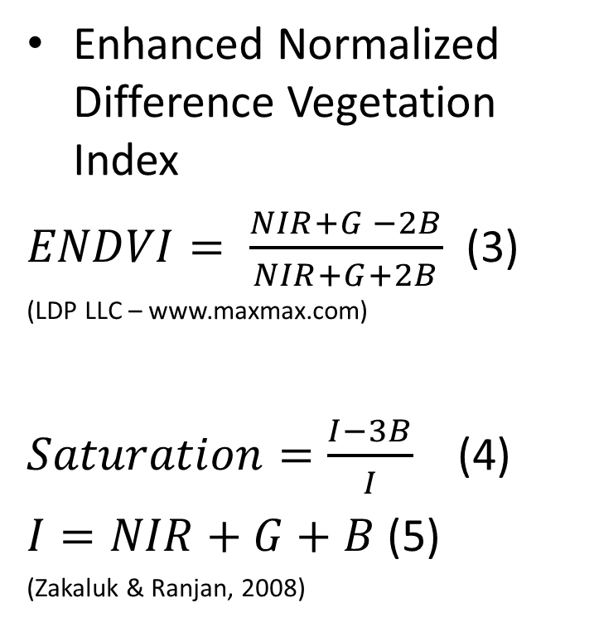
Vegetation Index
9 August 2016
2016 Robotic Vision, Northwest Nazarene University
23

Slide 24
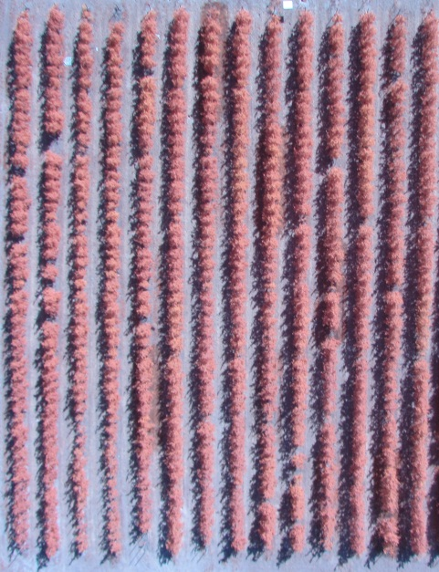
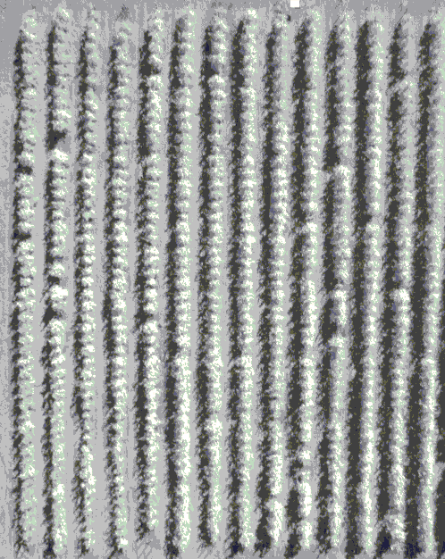
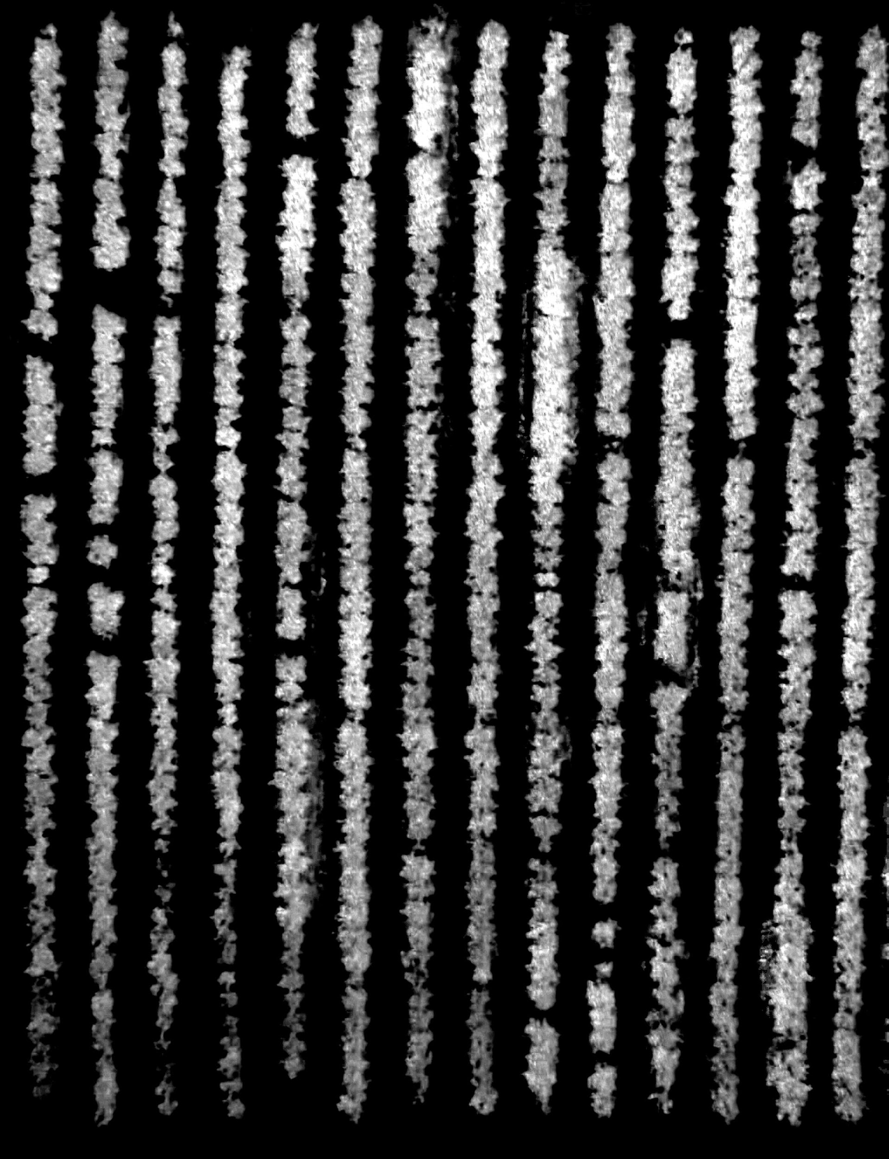
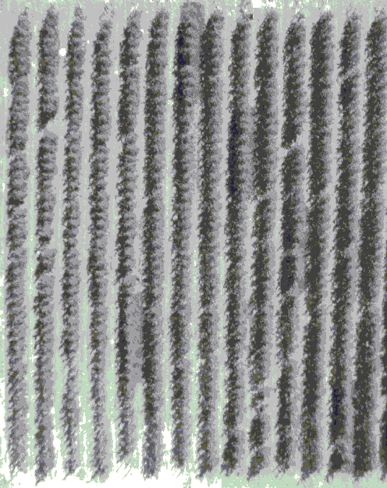
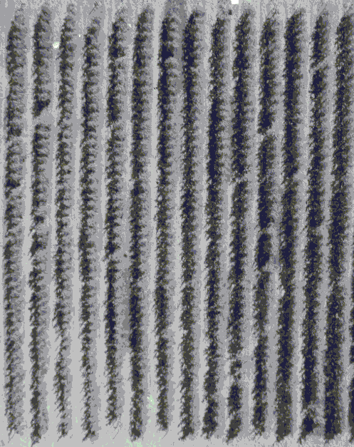
Sample ENDVI Processing
NIR
Green
Blue
Original Image
ENDVI
Image Planes
9 August 2016
2016 Robotic Vision, Northwest Nazarene University
24

Slide 25
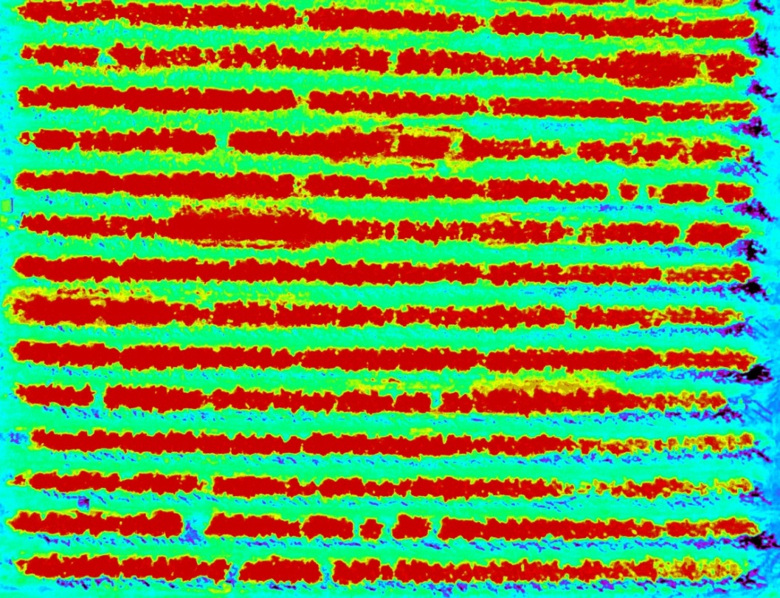
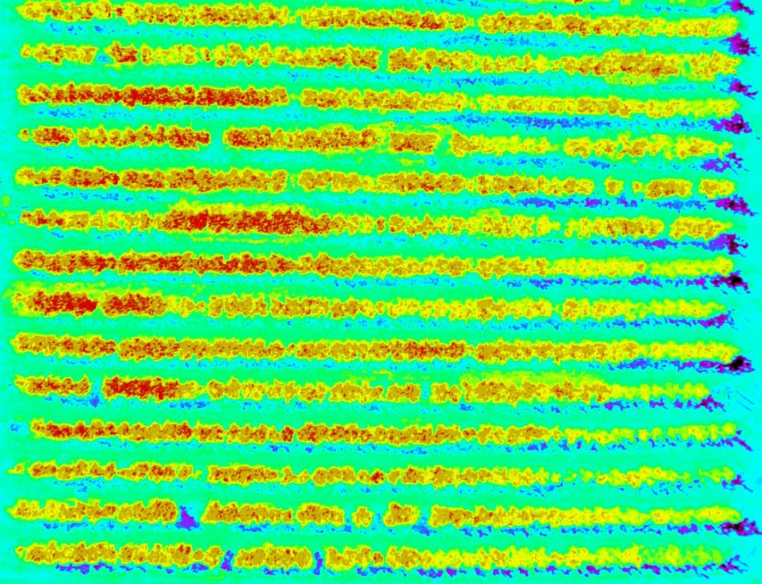
NDVI vs ENDVI
(a) NDVI
(b) ENDVI
9 August 2016
2016 Robotic Vision, Northwest Nazarene University
25

Slide 26

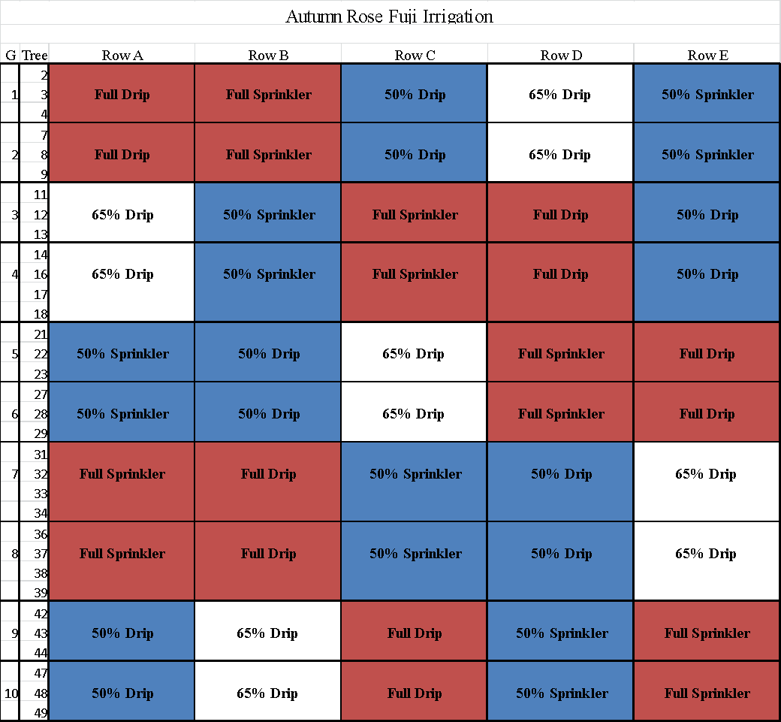
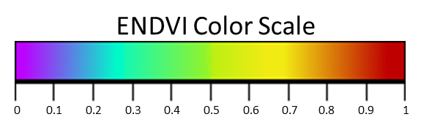
ENDVI Analysis
A
B
C
D
E
9 August 2016
2016 Robotic Vision, Northwest Nazarene University
26

Slide 27
Tree Detection
1) Original Row Image
2) Concavity Detection
3) Regional Maxima
4) Row Division
5) Watershed
45 out of 49 trees are detected (92%)
9 August 2016
2016 Robotic Vision, Northwest Nazarene University
27

Slide 28
Overview
1. Background: Precision Agriculture
2. Peach Application
3. Apple Application
4. Onion Application
5. Acknowledgements
6. Questions
9 August 2016
2016 Robotic Vision, Northwest Nazarene University
28

Slide 29
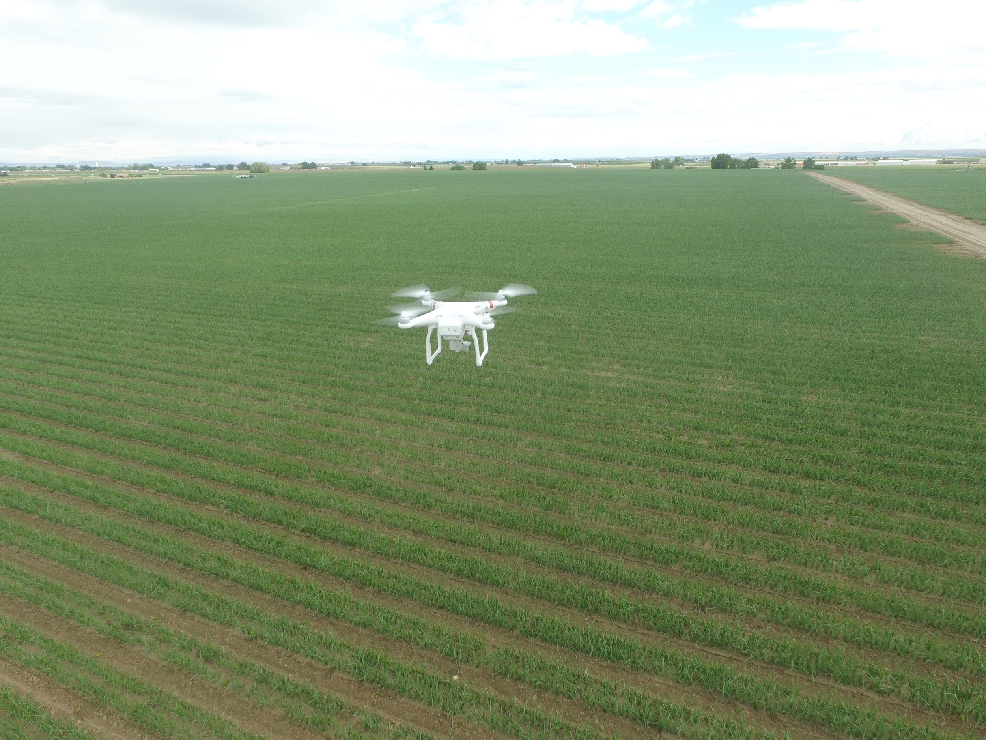
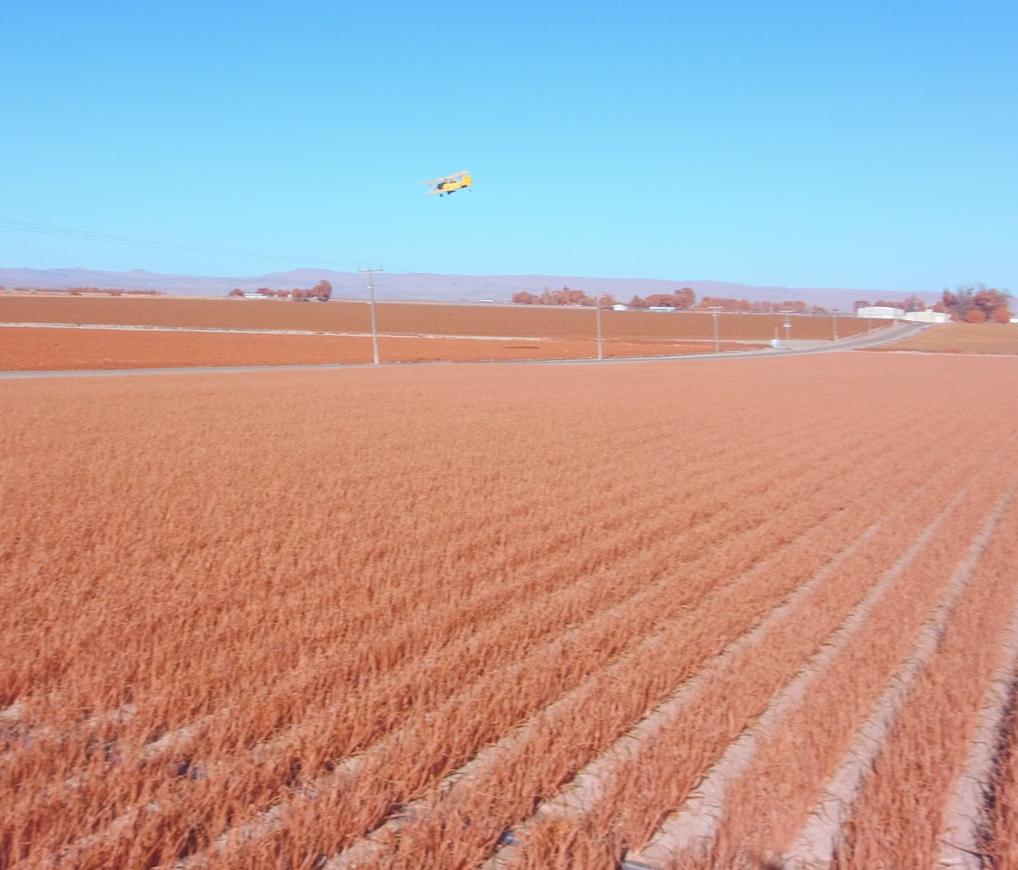
Onion Soil Moisture
9 August 2016
2016 Robotic Vision, Northwest Nazarene University
29
Notes:
JC Watson

Slide 30
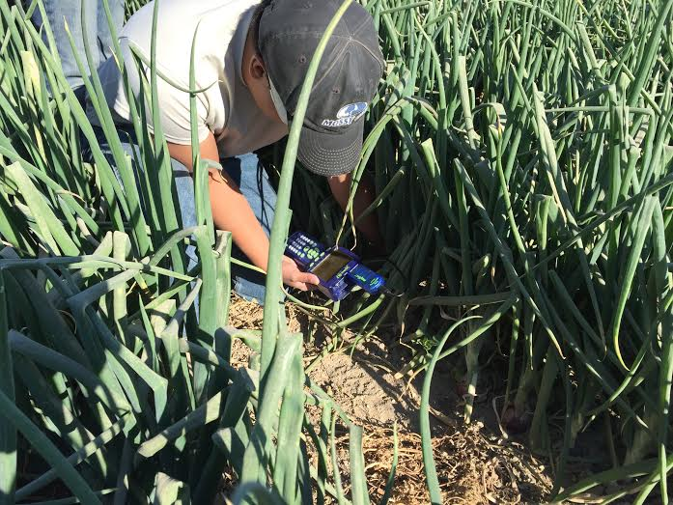
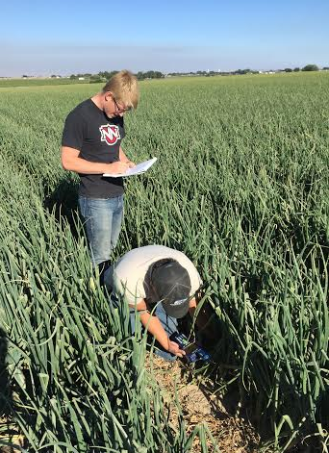
Onion Soil Moisture
9 August 2016
2016 Robotic Vision, Northwest Nazarene University
30

Slide 31
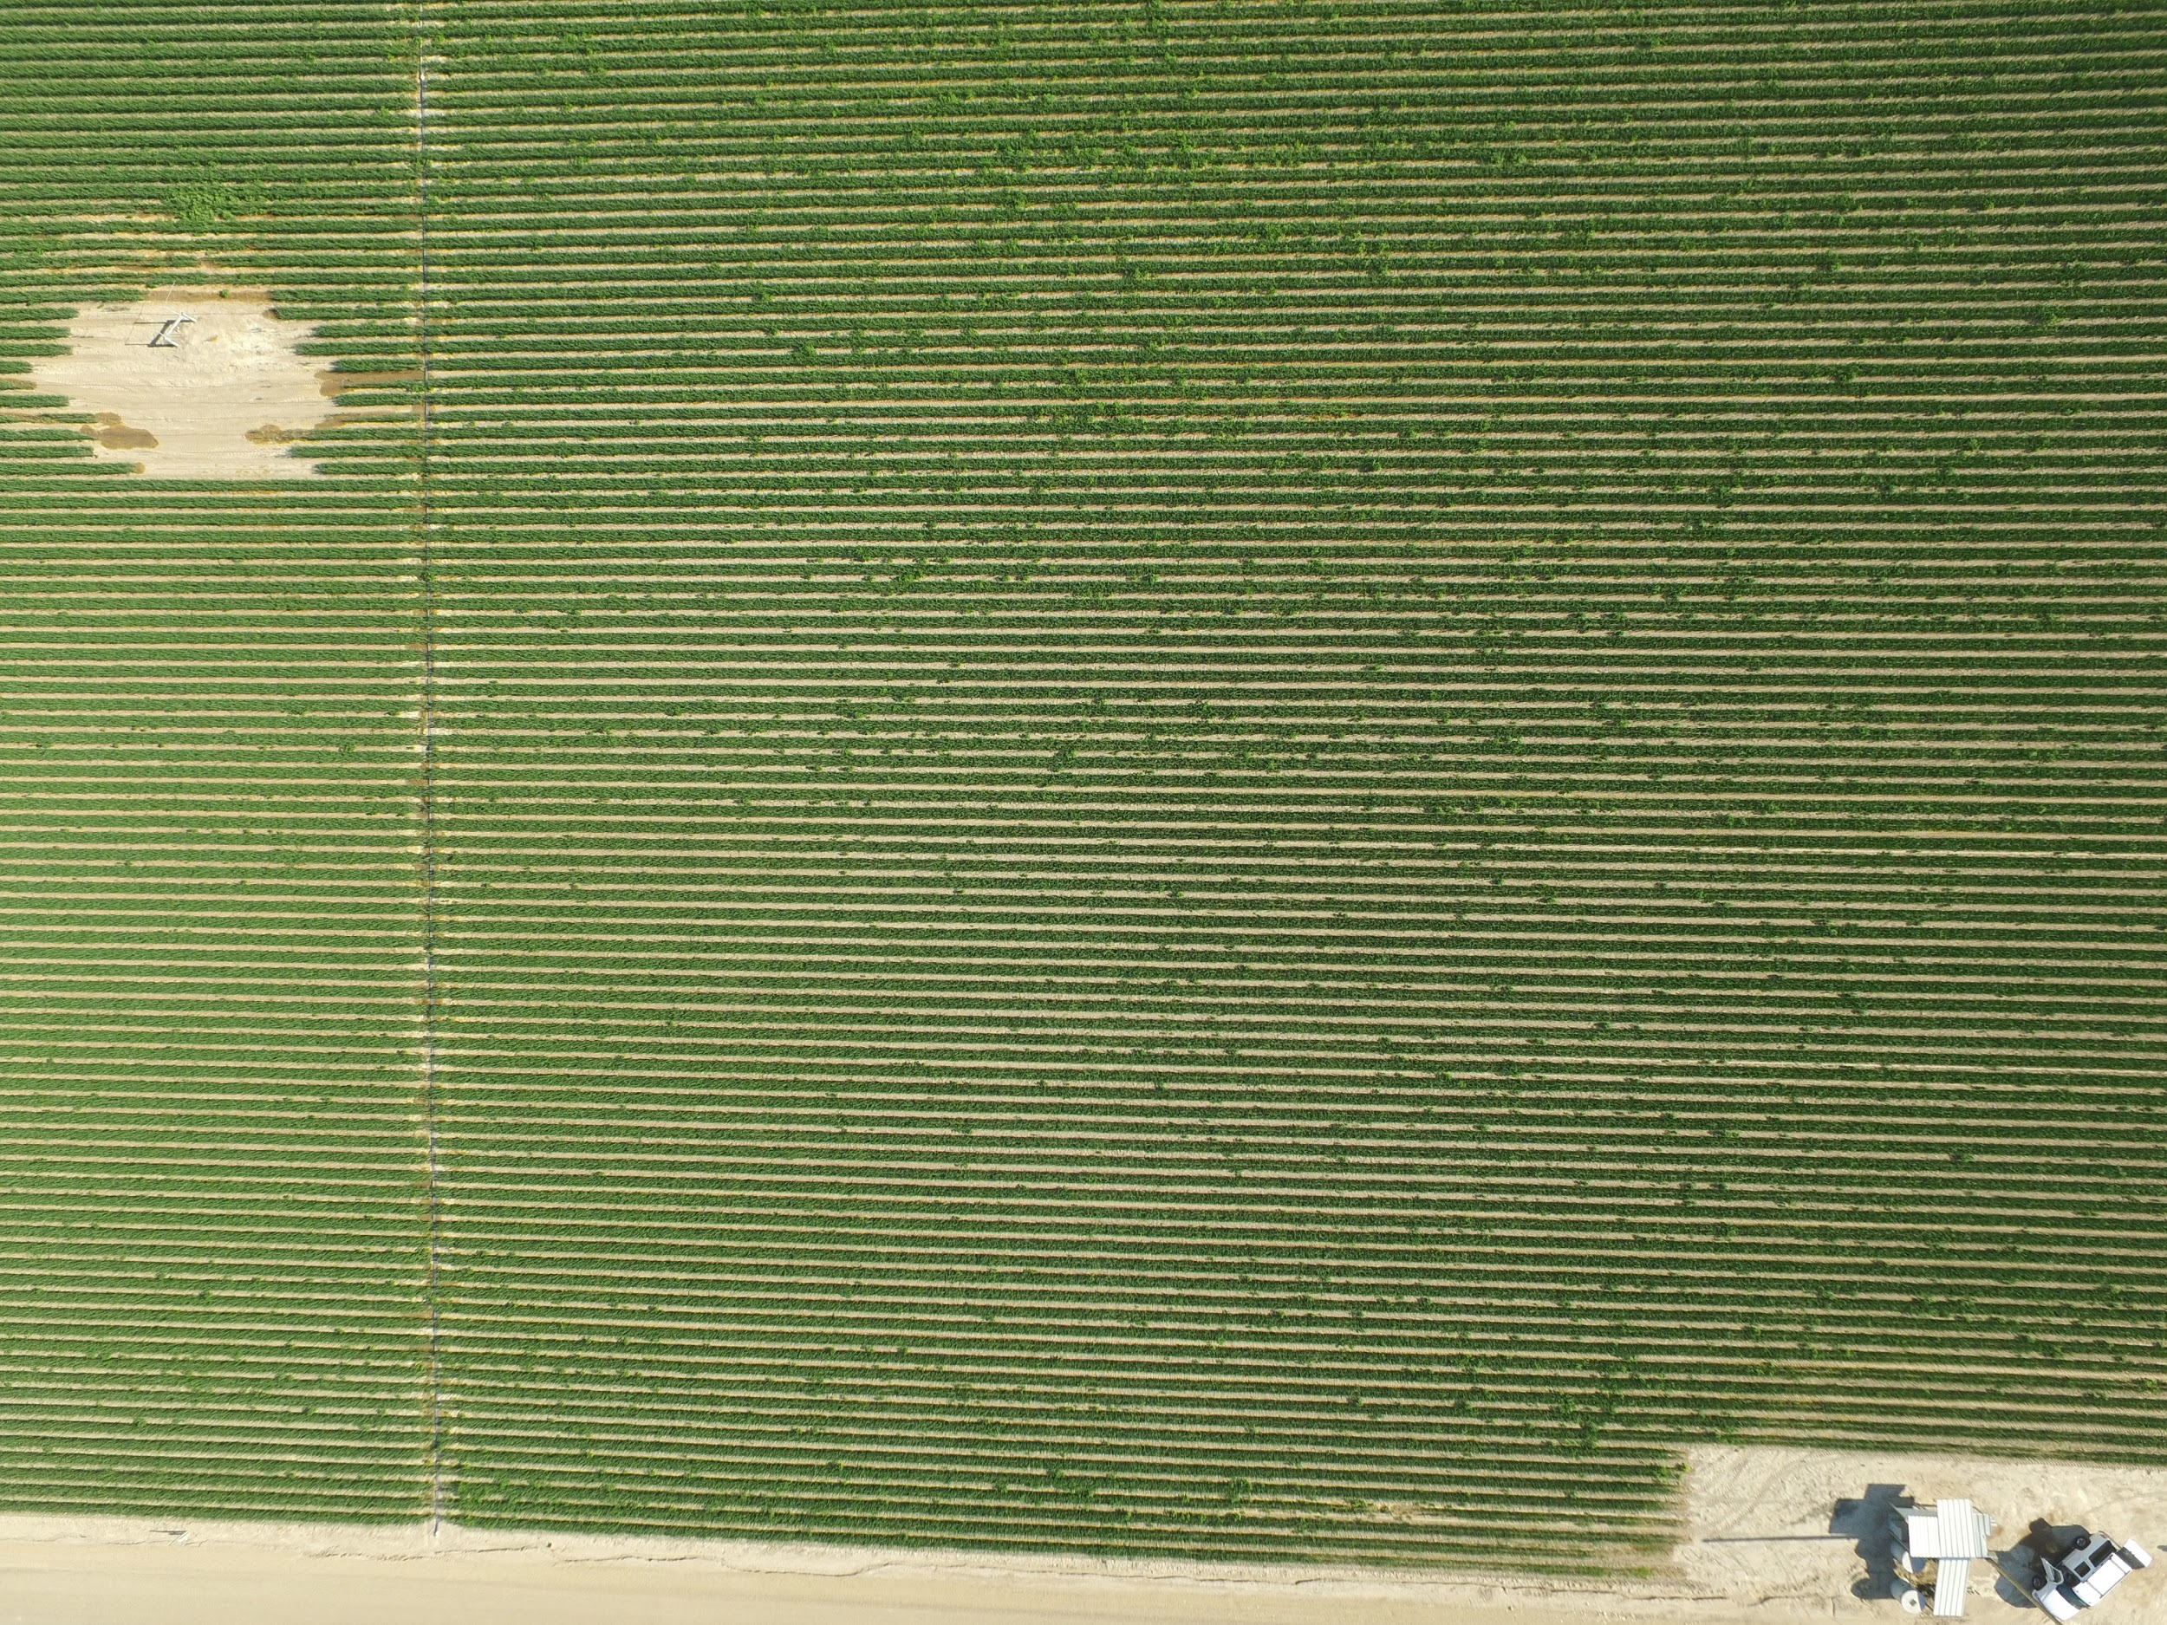
Soil Moisture Sampling Grid
12
11
10
9
5
6
7
8
4
3
2
1
9 August 2016
2016 Robotic Vision, Northwest Nazarene University
31

Slide 32
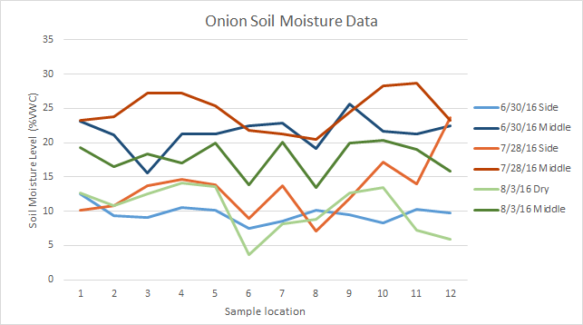
Soil Moisture Data
9 August 2016
2016 Robotic Vision, Northwest Nazarene University
32

Slide 33
Soil Moisture Future Processing
12
11
10
9
5
6
7
8
4
3
2
1
9 August 2016
2016 Robotic Vision, Northwest Nazarene University
33

Slide 34
Summary
Peach Orchard Blossoms
  Working blossom detection algorithm
  Working blossom density algorithm
  Future: tree detection separation algorithm
  Future: blossom density to yield correlation
Onion Ground Crop
  First ground crop survey images
  Soil moisture data collected
  Future: Health and moisture correlation
  Future: Identify individual plant stressor(s)
12
11
10
9
5
6
7
8
4
3
2
1
9 August 2016
2016 Robotic Vision, Northwest Nazarene University
34

Slide 35




Acknowledgements
Idaho Department of Agriculture – Specialty Crop Block Grant
NASA – Idaho Space Grant Consortium
University of Idaho – Parma Research Center
Northwest Nazarene University
http://www.nnu.edu/blogs/robotics-vision/
9 August 2016
2016 Robotic Vision, Northwest Nazarene University
35

Slide 36
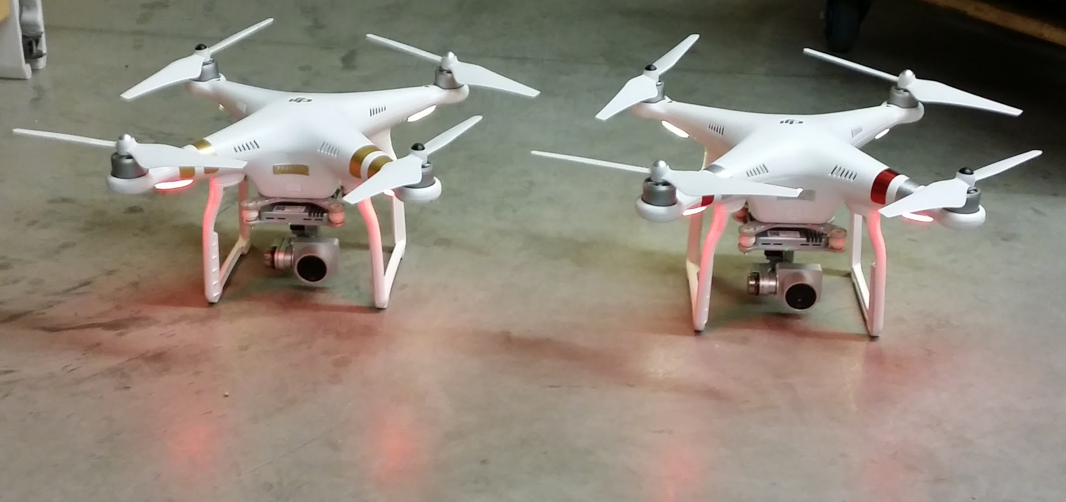
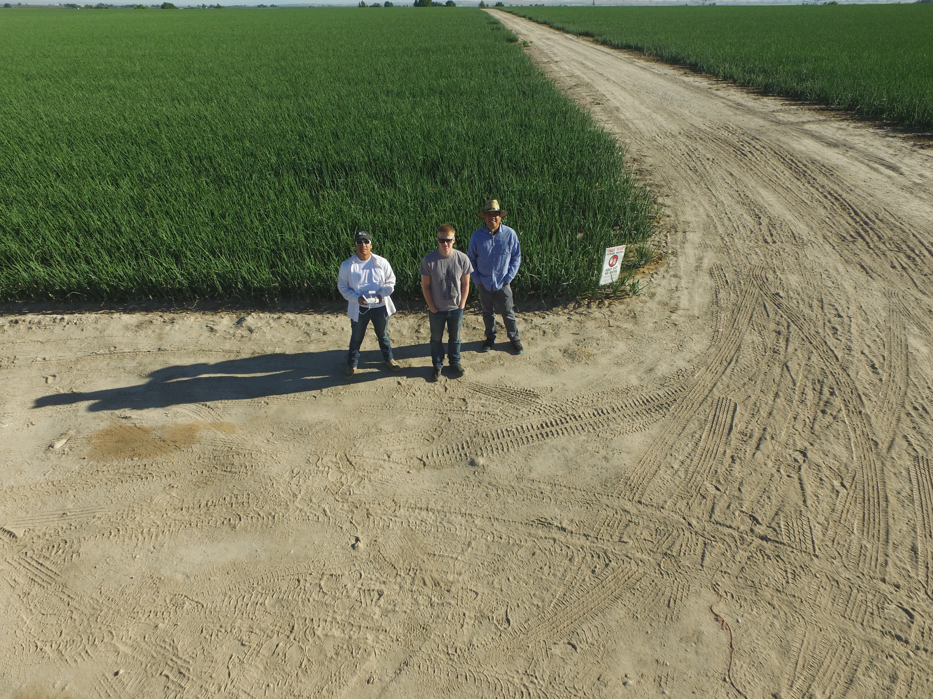
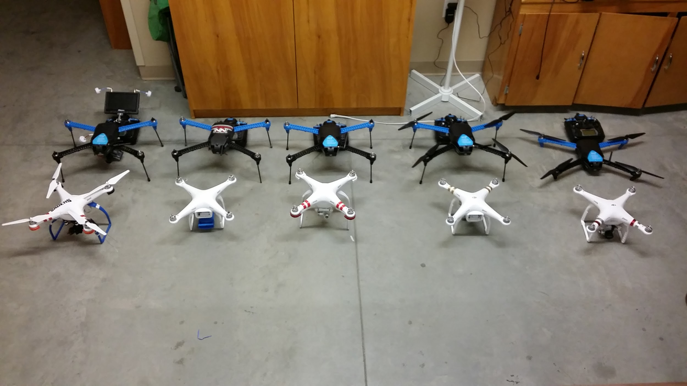
Questions
9 August 2016
2016 Robotic Vision, Northwest Nazarene University
36

