Slide 1
Nitrogen Use Efficiency Conference August 2016
Dr. Terry Tindall and Dr. Galen Mooso
—J.R. Simplot Co—Boise ID

Slide 2
Who is Simplot
Farms, feedlots, and ranches
Nutrients
Plant & Animal Sciences
Turf, industrial and feed markets
Food Production
Retail

Slide 5
The Case for FŪSN
Notes:
Prior United States Government use or demonstrated substantial utility and effectiveness. 2. Availability of the technology for immediate deployment in public and private settings. 3. Existence of extraordinarily large or unquantifiable potential third-party liability risk exposure to the Seller or other provider of the technology. 4. Substantial likelihood that the technology will not be deployed unless SAFETY Act risk management protections are extended. 5. Magnitude of risk exposure to the public if the technology is not deployed. 6. Evaluation of scientific studies that can be feasibly conducted to assess the capability of the technology to substantially reduce risks of harm. 7. Effectiveness of the technology in facilitating the defense against acts of terrorism.

Slide 6
Ammonium Nitrate and Calcium Ammonium Nitrate===Death and Destruction
“The significant growth of homemade explosives in Afghanistan has become our greatest concern. More than 80 percent of the IEDs used against Coalition forces in Afghanistan, which cause 90 percent of the casualties, have HME (home made explosives) as the main charge, and the majority is derived from calcium ammonium nitrate fertilizer. Let me repeat, more than 80 percent of the IEDs used against Coalition forces in Afghanistan are CAN-based homemade explosives — which are causing 90 percent of casualties. Dismounted operations and CAN-based IEDs are a lethal combination.”—D0D--2011

Slide 7
Fertilizer Industry and Academics can help!!
The IED is perhaps the most formidable weapon in any terrorist arsenal: low-cost, low-maintenance, constructed by willing or intimidated proxies. When armed and well sited it is a weapon that never sleeps.

Slide 8
Fertilizer Industry Mandate:
First, for academia and industry, I need you to explore ways we can change the formulation to either reduce the detonable characteristics of ammonium nitrate-based fertilizer or make it too difficult to or too volatile to convert to HME.
· How can we make these fertilizers non-detonable, less volatile and more stable?
· How can we dilute the compound to an amount that would require either too much fertilizer or too long of a process to yield the amounts that it would take to make explosive impact? DOD--2011

Slide 9
Oklahoma City Bombing--IED

Slide 10
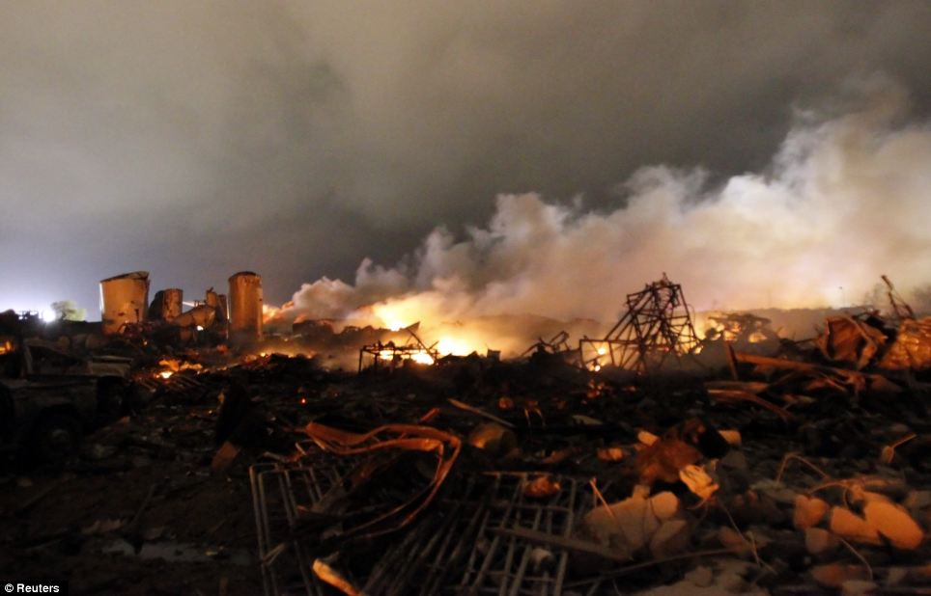
West Texas—Ammonium Nitrate Explosion

Slide 11
Chaos and Destruction of Human Life—IED of AN and CAN
Pakistan Lawyer Bombing—August 9, 2016—IED??

Slide 12
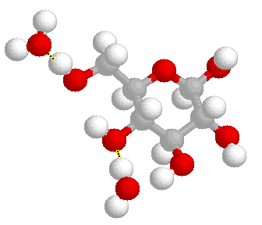
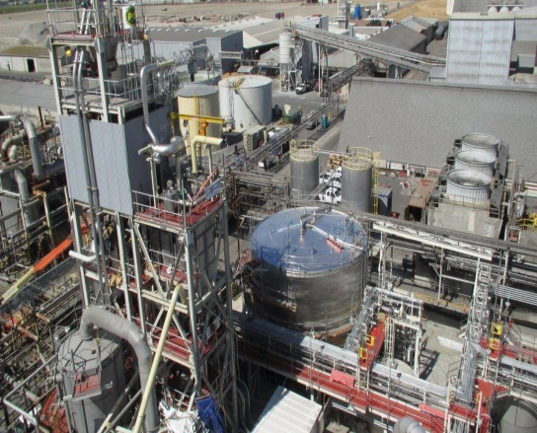
+
Technology
Lathrop Manufacturing
Notes:
Reminder of relationship between HON and JRS

Slide 13
How Safe is FŪSN?
FŪSN (Sulf-N 26) expends significantly less energy than other common ammonium nitrate containing fertilizers

Slide 14
Now on Sale— Summer 2016 Primary Distribution Goal—100,000 + tons-

Slide 15
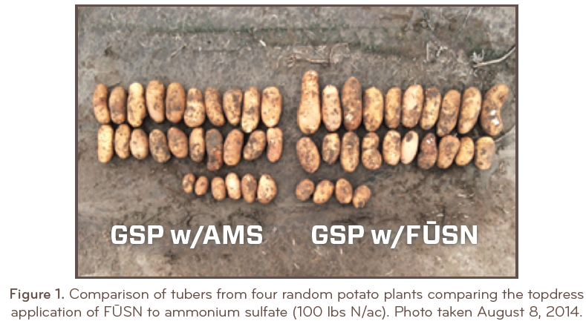
Potatoes—Changes in Yield/Quality

Slide 16
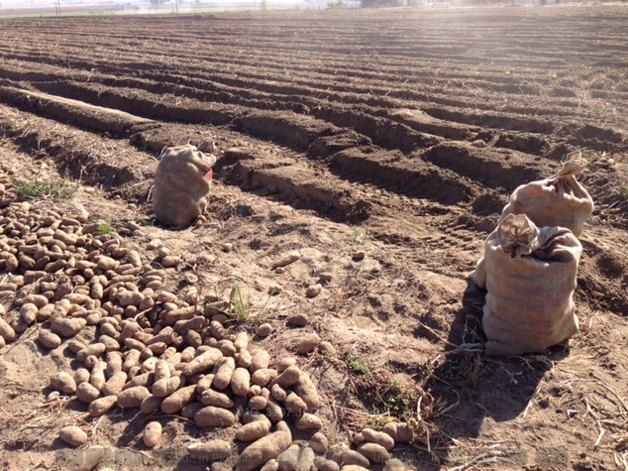
Harvesting Samples

Slide 18
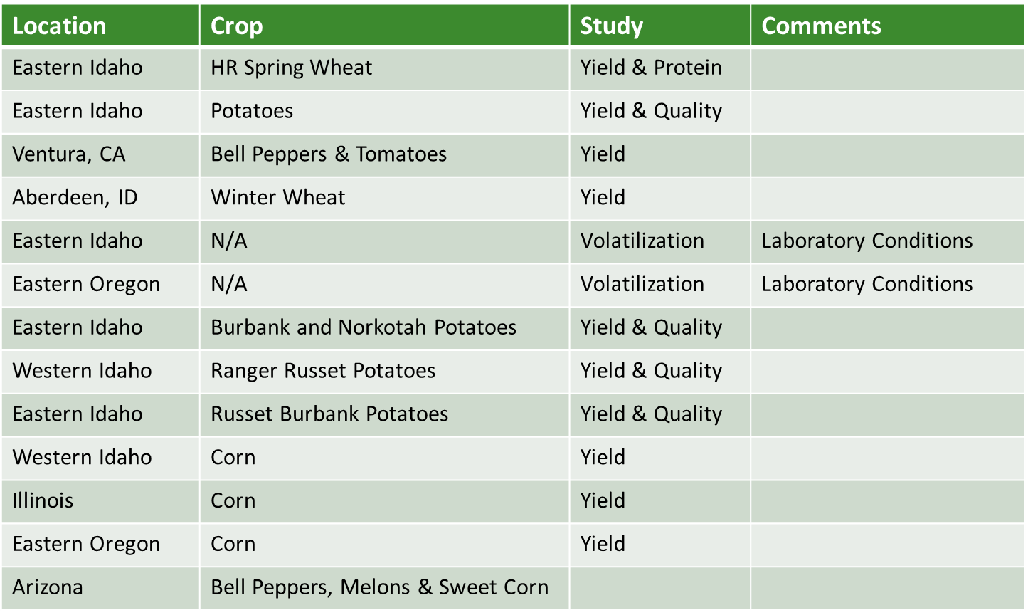
Field Trials

Slide 19
Fūsn Trials
Location | Crop | Study | Comments
Eastern Idaho | HR Spring Wheat | Yield & Protein | Stark
Eastern Idaho | Potatoes | Yield & Quality | Williams/Hopkins/Stark
Ventura, CA | Bell Peppers & Tomatoes | Yield | Holden
Aberdeen, ID | Winter Wheat | Yield | Stark
Eastern Idaho | N/A | Volatilization | Williams
Eastern Oregon | N/A | Volatilization | Del Moro/Horneck
Eastern Idaho | Burbank and Norkotah Potatoes | Yield & Quality | Hopkins
Western Idaho | Ranger Russet/Umatilla Potatoes | Yield & Quality | Tindall/Mooso
Eastern Idaho | Russet Burbank Potatoes | Yield & Quality | Stark
Western Idaho | Corn | Yield | Tindall/Mooso
Illinois | Corn | Yield | Elberhard
Eastern Oregon | Corn | Yield
Arizona | Bell Peppers, Melons & Sweet Corn | Yield & Quality | Sanchez
AgriBusiness

Slide 20
WHAT DOES IT TAKE TO MOVE NEW FERTILIZER TECHNOLOGY FORWARD WITHIN SIMPLOT ORGANIZATION?

Slide 21
Fused Ammonium Sulfate Nitrate ( Fūsn) —What is so special about this new formulation— Agronomy:
Improves Environmental Stewardship by decreasing volatilization losses of Ammonia into atmosphere—GHG
Improves agronomic responses across Simplot’s western geography
Preferred form of N for many crops (two parts of ammonia one of nitrate)
Decreases Sulfate from being leached under irrigation and rainfall

Slide 22
Table 1. Cumulative ammonia volatilization (mg/m²) of 7 nitrogen sources surface applied to 3 different soil pH levels over an 8 day incubation period (lower case letters denote differences for an N fertilizer source on a soil pH level (row) and upper case letters denote differences for an N fertilizer source across soil pH levels using Turkey’s mean separation alpha – 0.05)
Soil pH | Untreated control | ASN-26 (26-0-0-14) | AMS (21-0-0-24) | Urea w/ Agrotain | Urea w/ Eclipse-N | Urea + AMS (26-0-0-14) | Amidas (40-0-0-5) | Urea (46-0-0) | Mean
pH 5.9 | 3 a A | 28 a A | 35 a A | 153 a A | 205 a A | 135 a A | 732 bc A | 1048 c A | 292 a
pH 7.0 | 0 a A | 46 a B | 61 a B | 142 a A | 231 a A | 659 b B | 1085 cd AB | 1231 d A | 432 b
pH 7.8 | 0 a A | 54 a B | 74 a B | 96 a A | 145 a A | 522 b B | 1334 b B | 1501 c A | 465 b
Mean | 1 A | 43 A | 56 A | 130 AB | 194 ABC | 450 BC | 1050 D | 1260 D
Egin bench sandy loam soil
Williams, BYUI 2015

Slide 23
Why Fūsn
Mean cumulative ammonia volatilization of seven nitrogen fertilizer sources surface applied to three different pH soils over an eight day incubation period
AgriBusiness

Slide 24
Mean cumulative ammonia volatilization of seven nitrogen fertilizer sources surface applied to three different pH soils over an eight day incubation period
Ammonia mg/m²
Williams, BYUI 2015

Slide 25
Figure 2. Mean cumulative ammonia volatilization by soil pH of seven surface applied nitrogen fertilizer sources on three soil pH levels over an eight day incubation period
Ammonia mg/m²
Williams, BYUI 2015

Slide 26
Figure 3. Cumulative ammonia volatilization of seven nitrogen fertilizer sources surface applied to three different pH soils over an eight day incubation period
Ammonia mg/m²
Williams, BYUI 2015

Slide 27
Fūsn Decreases Sulfate Losses compared to AMS/urea
FIG. 4. Cumulative SO4-S leached from fused ASN, granulated ASN, and check during the leaching period in Lakeland sandy soil.
Cumulative values of SO4-S at the end day (Day 73) with the same letters are statistically not different from each other at P G 0.05 based on the pairwise contrast test.

Slide 28
Fūsn Decreases Sulfate Losses compared to AMS/Urea
10 % more SO₄ within the soil profile compared to granulated AMS/urea (sandy loam soil).
Release of Sulfur from the Fūsn appears to be decreased compared to AMS/urea.
This may benefit crops that are higher users of S (Canola, onions, garlic etc.) by allowing more available sulfur with less immobilization (tie up) within a given soil.
More research with these high S demand crops are needed!

Slide 29
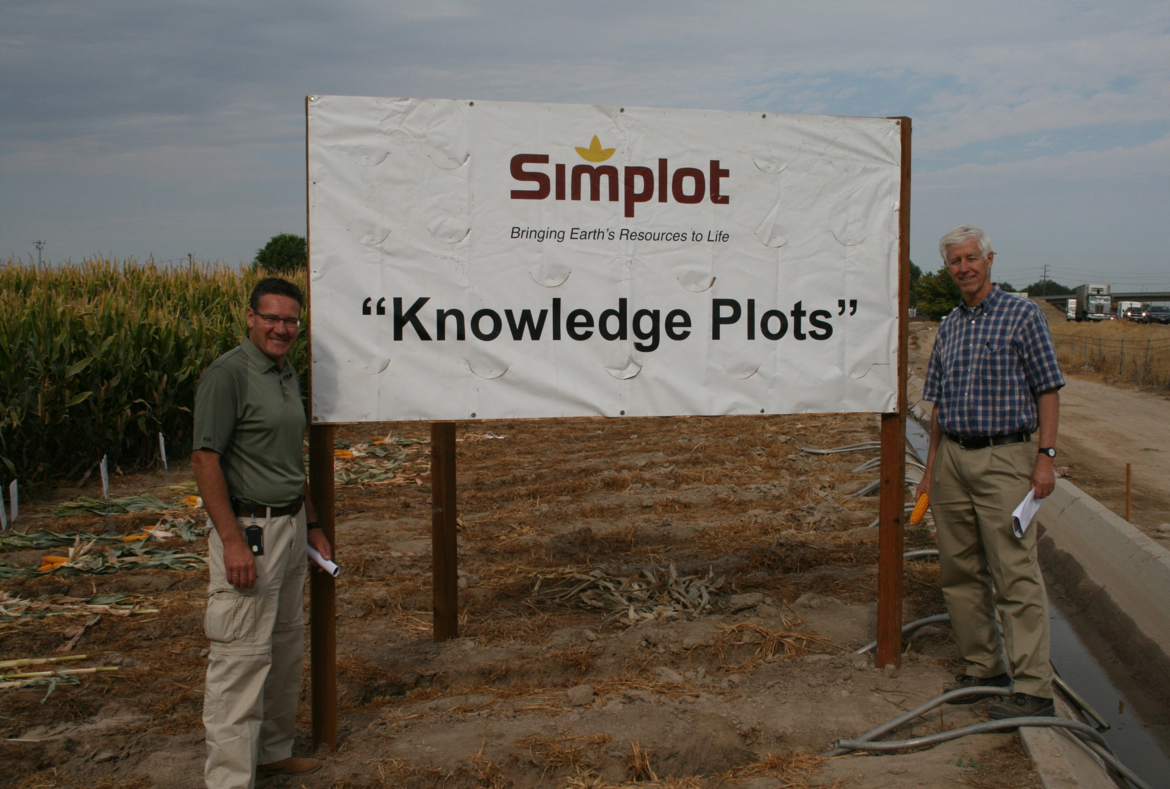
Simplot Agribusiness Fertilizer Technology Evaluation

Slide 30
AMX 1151
Planted 4-28-15
42,000 seeds /ac

Slide 31
Effect of Nitrogen source on corn yields at Nampa, Idaho
Corn yield, bu./ac*
a
*adjusted to 15% moisture
All plots received 100 lb/ac/yr of P₂O₅ as MAP w/ AVAIL
LSD_{.1}= 16 bu/ac
Each data point represents the mean of 2 approximately .5 acre plots/year for 3 years

Slide 32
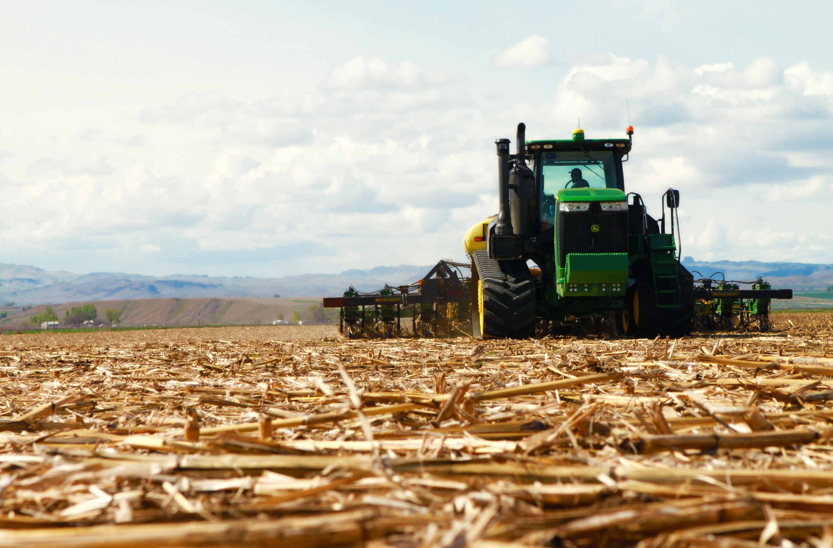
N Source-- Field Trials—Arena Valley--Idaho

Slide 33
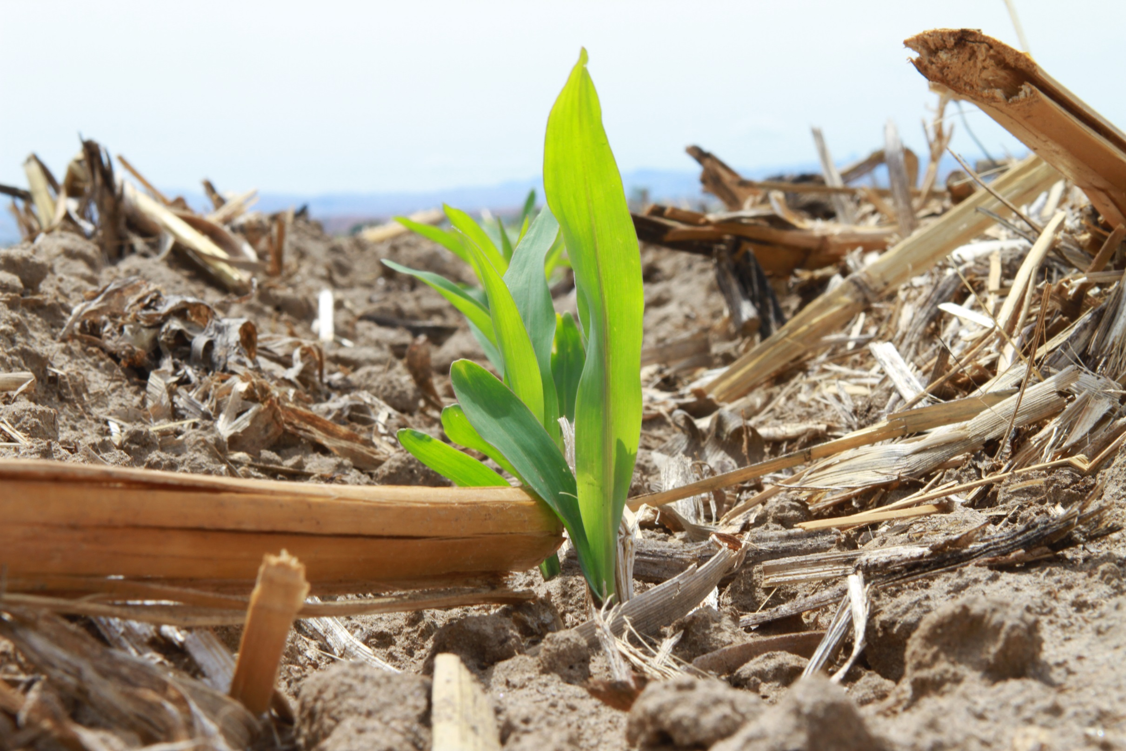

Slide 34
Composite photosynthesis satellite image June 8 2015
Near Wilder, Idaho

Slide 35
Effect of Nitrogen Source on Corn Yields
Yield, bu/ac
Nitrogen treatments were broadcast applied at 200 lb N/ac. Plots were approximately 0.5 ac/plot. Replication=6.

Slide 36
Figure 4. Effect of N Source and Irrigation on Corn Yields
Yield, bu/ac
Nitrogen treatments were broadcast applied at 200 lb N/ac on 4-3-15. Pivot irrigated field was planted with a strip till planter on 4-13-15. Furrow irrigated field was planted on 4-28-15. Pivot was harvested on 9-14-15. Furrow irrigated field was harvested on 9-22-15. Plots were approximately 0.5 ac/plot. Replication=2.

Slide 37
Figure 5. Effect of N Source, Starter and Irrigation on Corn Yields
Yield, bu/ac
Nitrogen treatments were broadcast applied at 200 lb N/ac on 4-3-15. Pivot irrigated field was planted with a strip till planter on 4-13-15. Furrow irrigated field was planted on 4-28-15. Half the pivot plots received 10 gpa 6-24-6 /w AVAIL (0.5 % v/v) + TakeOff (VLS 2000-02) at 12 oz/ac in a 2 x 4 application. Half the furrow irrigated plots received 5 gpa 6-24-6 in furrow at planting. Pivot was harvested on 9-14-15. Furrow irrigated field was harvested on 9-22-15. Plots were approximately 0.5 ac/plot. Replication=2.

Slide 39
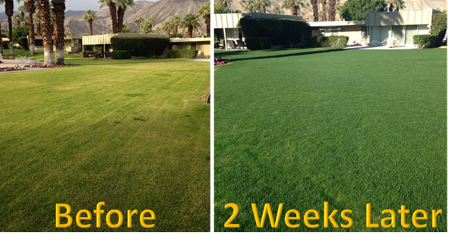
More Photosynthate—higher NDVI
Notes:
As a personal testimonial, Wayne Welter put some down on his own lawn and experienced the same results within a week. Wayne’s wife, who begrudgingly mowed the lawn in his absence, commented the lawn was so thick it felt like mowing shag carpet.

Slide 40
Summary
Fūsn (Fused Safe Nutrients)—Low Detonable fertilizer recognized by Homeland Security
Decreases N losses compared to top dress urea
Decreases Sulfate losses compared to granular AMS
Increased handling options
Provides N in both the nitrate and ammonium forms
Increased NUE compared to Urea and NBPT treated urea
MORE RESEARCH NEEDED!!

Slide 41
Questions--

