Slide 1
In-season Nitrogen Applications: How Late is Too Late?
Fabián Fernández,
Jared Spackman and Gabriel Paiao
Department of Soil, Water, and Climate
fabiangf@umn.edu
14th Annual International Nitrogen Use Efficiency Conference
8-10 Aug 2016, Boise, ID

Slide 2
Why This Study?
Nitrogen loss results in diminished profitability and environmental degradation
Can’t afford either
Split N applications are being proposed as an improved N management practice

Slide 3
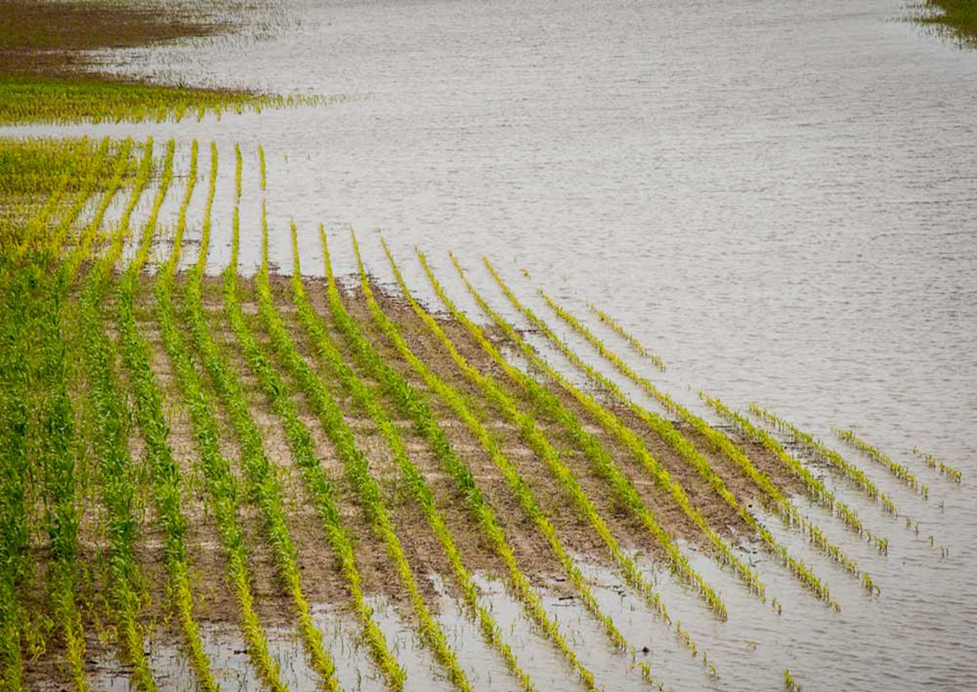
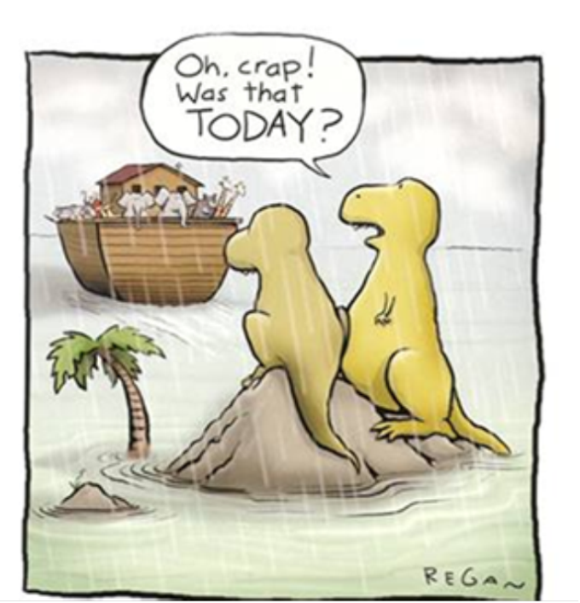
N Loss Susceptibility is Greatest Early in the Growing Season
Key is to have little nitrate during Apr-Jun
How Dinosaurs Became Extinct
71% of annual subsurface drainage during Apr-Jun Apr-Jun 77% of nitrate load (54% during corn crop)
Apr-Jun 73% of nitrate load (46% during soy crop)
May-June 75% of drainage and 73% of nitrate load

Slide 4
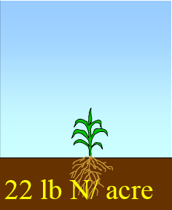
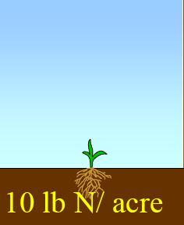
Physiological maturity
R6
Milk
Silking
R3
Sidedress time (late May-early June)
R1
V12
V6
100%
V3
80%
60%
30%
10%
4%
May
Jun
Jul
Aug
Sep

Slide 5
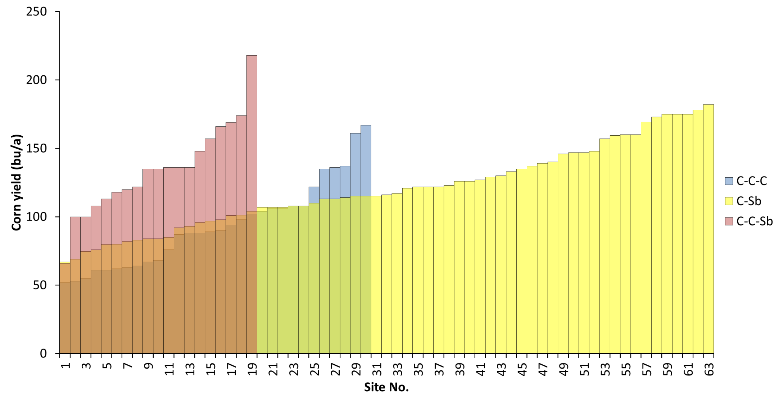
How Much Yield Can We Get Through Mineralization in MN?
Percent of Corn Yield at EONR Obtained from the 0-N Check 53% C-C, 71% C-S
Ave:116 bu/a
130 lb N/a
218 bu/a
244 lb N/a
52 bu/a
58 lb N/a

Slide 6
Study Details
12 site-years C-C + 3 more in 2016
N rates to develop response curve
Single rate N Source & Application Time
Whole plant measurements
  Tissue N and canopy sensing at V4, V8, V12, R1, tissue N at R6
  ¹⁵N of selected treatments
Soil measurements
  NH₄⁺ and NO₃⁻ at V4, V8, V12, R1 0-1’, 1-2’, post harvest also 2-3’
  ¹⁵N of selected treatments

Slide 7
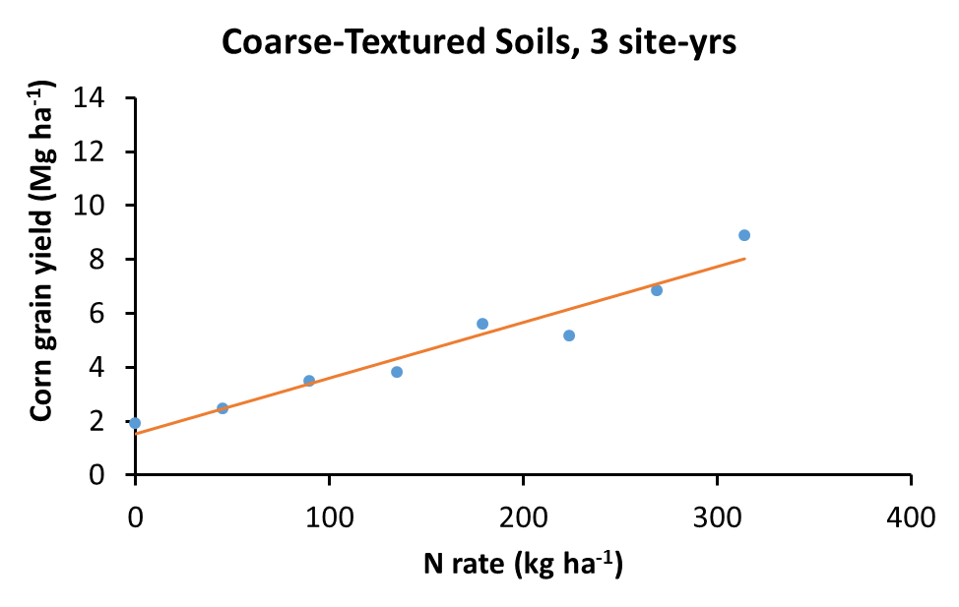
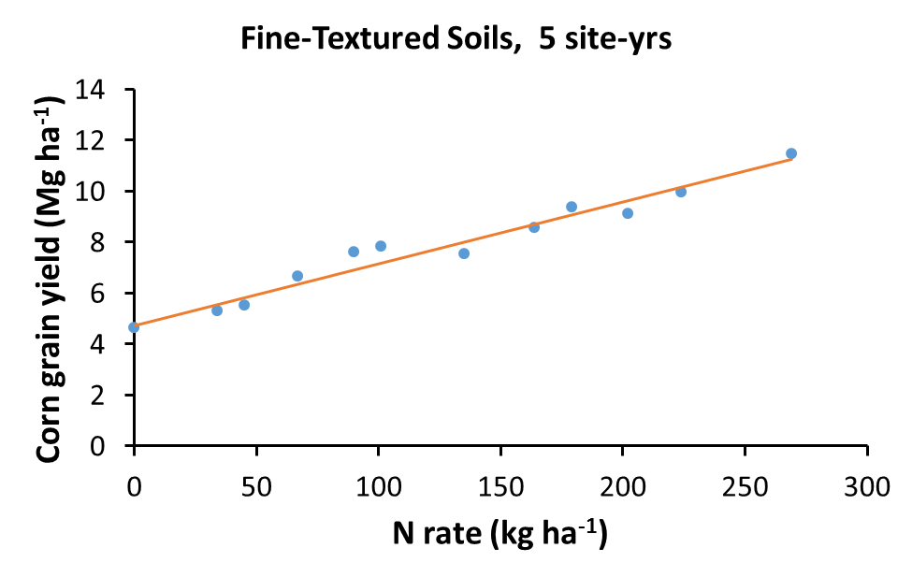
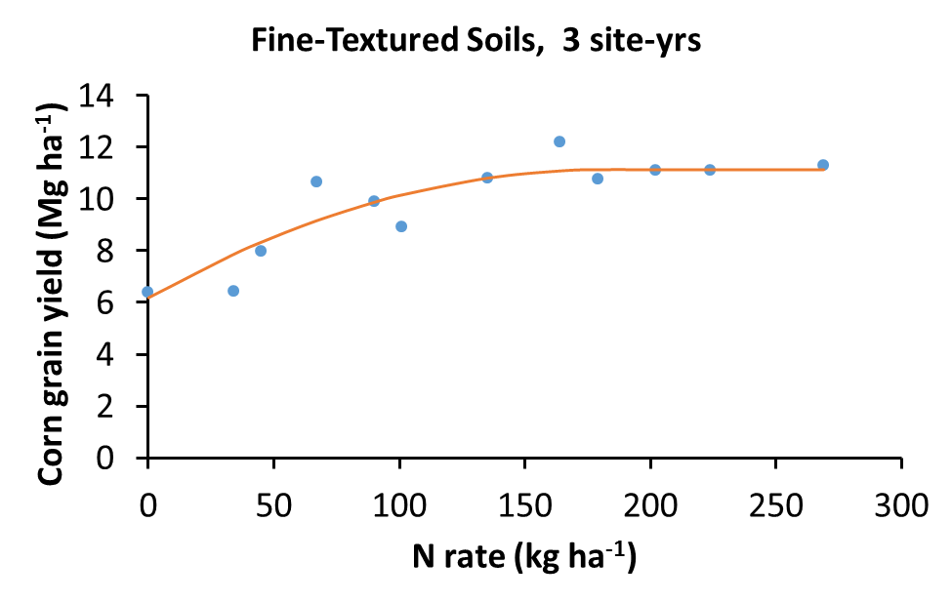
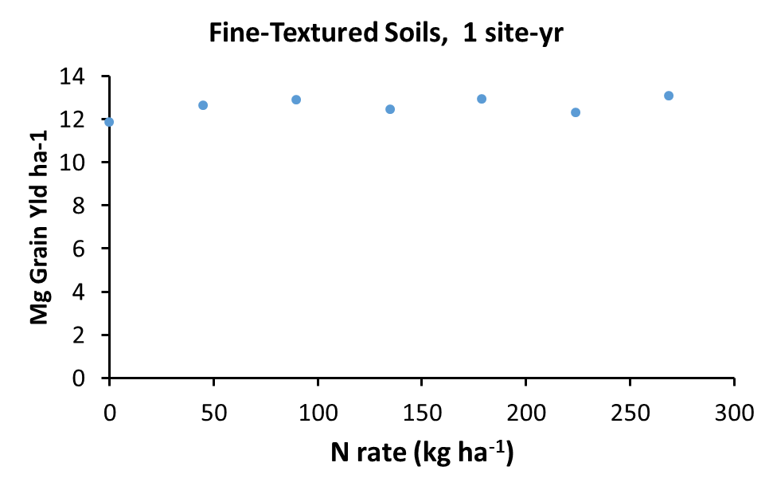
Becker 2014; 2015a,b
Clara City 2014; Waseca 2014 a,b; Waseca 2015 a,b
Clara City 2015; Lamberton 2014; Theilman 2014
Lamberton 2014

Slide 8

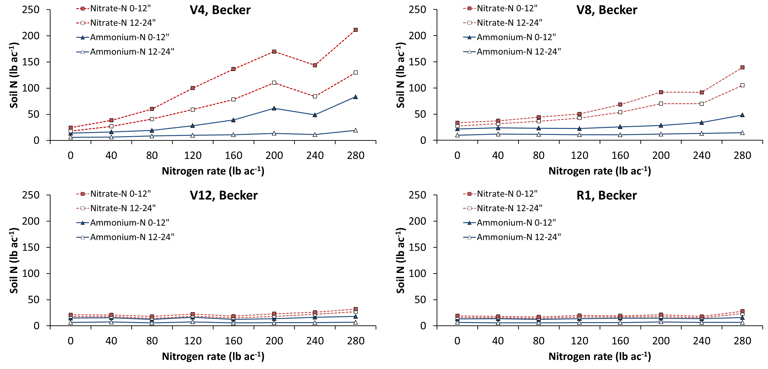

Slide 9
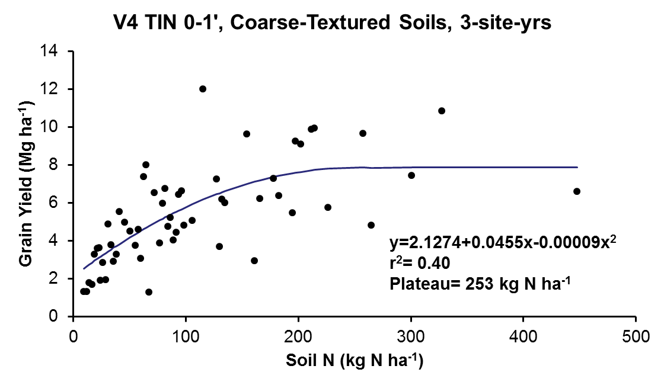

Slide 10
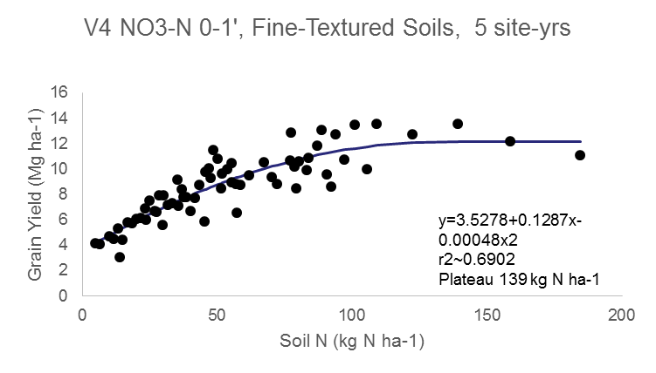
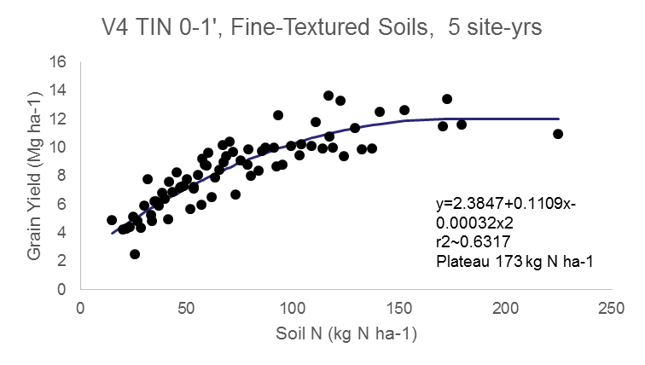
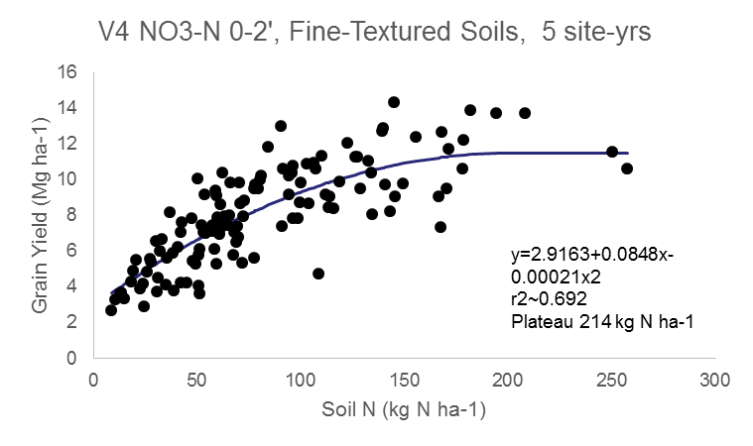
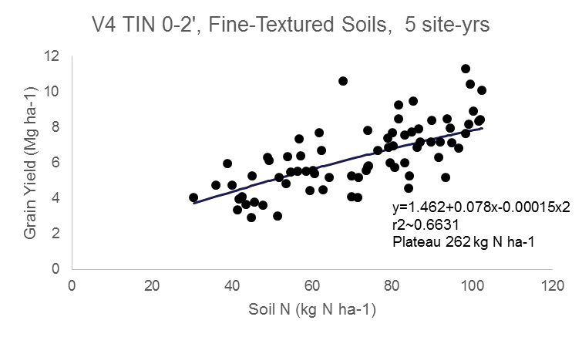
Nitrate
V4
TIN

Slide 11
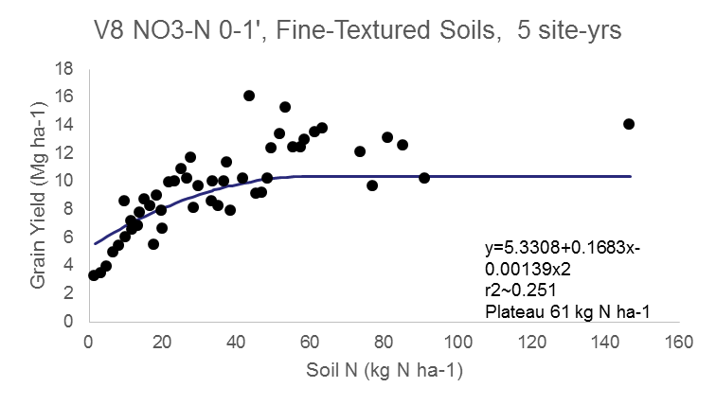
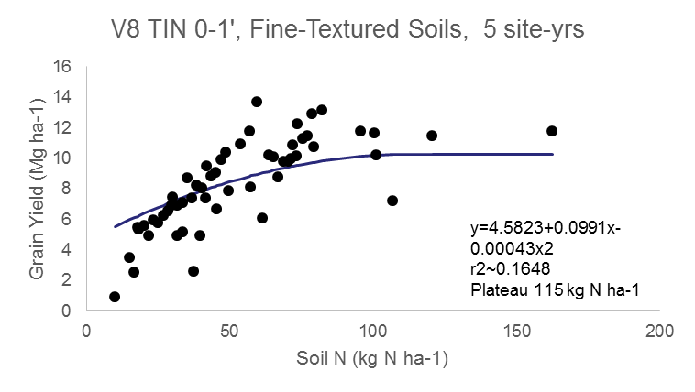
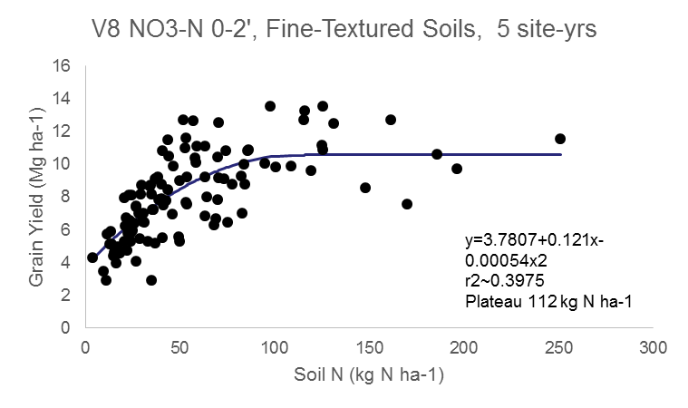
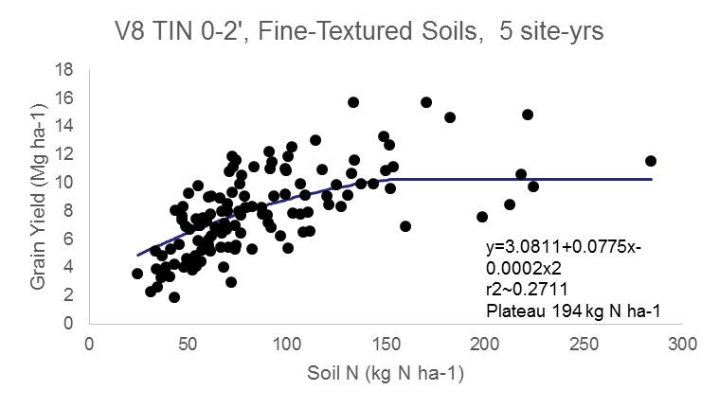
V8
Nitrate
TIN

Slide 12
V4 soil N (kg ha⁻¹) corn yield prediction
Soil | Grouping | NO₃ |  |  |  | TIN
 |  | 0-1' |  | 0-2' |  | 0-1' |  | 0-2'
 |  | R² | Plateau | R² | Plateau | R² | Plateau | R² | Plateau
Coarse-Textured | 3 Site-yrs | 0.31 | 126 | 0.38 | 301 | 0.40 | 253 | 0.36 | ---
Fine-Textured | 5 Site-yrs | 0.69 | 139 | 0.69 | 214 | 0.63 | 173 | 0.66 | ---
 | 3 Site-yrs | 0.27 | 122 | 0.33 | 135 | 0.20 | 162 | 0.26 | 188
 | 1 Site-yrs | 0.06 | 83 | 0.15 | 134 | 0.12 | 95 | 0.13 | 159
V8 soil N (kg ha⁻¹) corn yield prediction
Soil | Grouping | NO₃ |  |  |  | TIN
 |  | 0-1' |  | 0-2' |  | 0-1' |  | 0-2'
 |  | R² | Plateau | R² | Plateau | R² | Plateau | R² | Plateau
Coarse-Textured | 3 Site-yrs | 0.32 | 65 | 0.42 | --- | 0.30 | 133 | 0.40 | ---
Fine-Textured | 5 Site-yrs | 0.25 | 61 | 0.40 | 112 | 0.16 | 115 | 0.27 | 194
 | 3 Site-yrs | 0.20 | 69 | 0.25 | 94 | 0.14 | 103 | 0.19 | 135
 | 1 Site-yrs | 0.12 | --- | 0.13 | --- | 0.26 | --- | 0.38 | ---

Slide 14
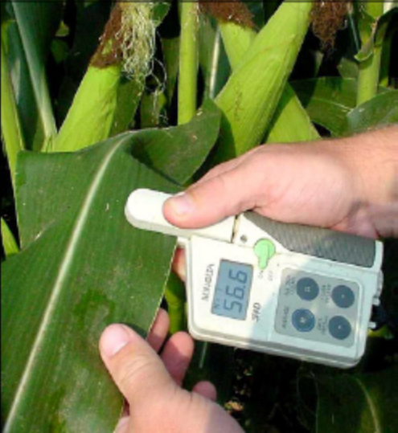
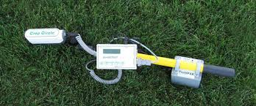

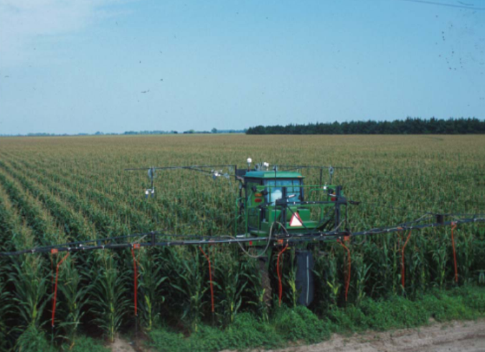
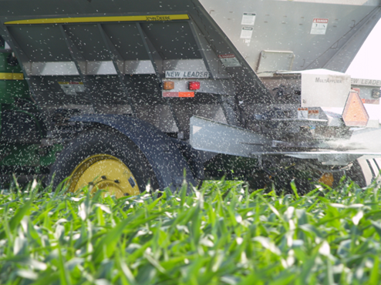
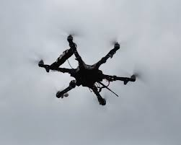
Can We Use Crop Sensors To Improve N Management?

Slide 15
12 Site-Year Sensor-Based Yield Correlation
Stage | Sensor/Index | Regression model | R² | AIC† | P
V4 | SPAD | y = -1.626 + 0.293x | 0.65 | 975 | <0.001
 | GS-NDVI | y = 0.291 + 22.926x | 0.57 | 1,033 | <0.001
 | RS-NDVI | y = -0.703 + 29.810x | 0.62 | 1,008 | <0.001
 | RS-NDRE | y = -1.972 + 74.740x | 0.63 | 1,007 | <0.001
V8 | SPAD | y = -7.181 + 0.344x | 0.85 | 791 | <0.001
 | GS-NDVI | y = -10.688 + 25.623x | 0.75 | 902 | <0.001
 | RS-NDVI | y = -11.200 + 26.637x | 0.77 | 883 | <0.001
 | RS-NDRE | y = -4.712 + 42.239x | 0.83 | 797 | <0.001
V12 | SPAD | y = -3.676 + 0.270x | 0.85 | 771 | <0.001
 | GS-NDVI | y = -26.301 + 41.699x | 0.61 | 1,022 | 0.026
 | RS-NDVI | y = -49.184 + 71.022x | 0.83 | 824 | <0.001
 | RS-NDRE | y = -9.500 + 53.573x | 0.92 | 677 | <0.001
R1 | SPAD | y = -4.319 + 0.288x | 0.85 | 773 | <0.001
 | GS-NDVI | y = -4.469 + 19.664x | 0.68 | 1,002 | 0.063
 | RS-NDVI | y = -32.073 + 55.567x | 0.79 | 923 | 0.001
 | RS-NDRE | y = -7.876 + 59.777x | 0.87 | 767 | <0.001
†Akaike Information Criterion (Mg corn ha⁻¹). Lower AIC values mean better fit.

Slide 16
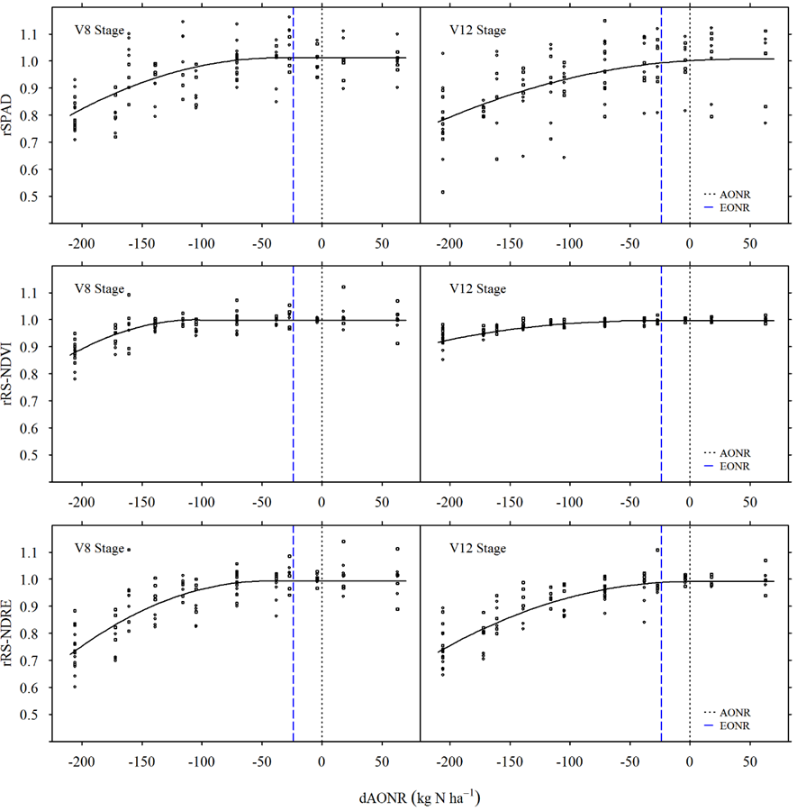
SPAD
Rapid Scan NDVI
Rapid Scan NDRE
N rate difference from AONR

Slide 17
Sensor/ Index | Stage | Joint-point from§ |  | CI¶ | dAONR at | R² | RSR at
(5 site-yrs) |  | AONR | EONR |  | 0.95 RSR# |  | Plateau | AONR | EONR
SPAD | V8 | -33 | -9 | 51 | -127 | 0.70 | 1.01 | 1.01 | 1.01
 | V12 | 34 | 58 | 122 | -86 | 0.39 | 1.01 | 1.00 | 0.99
 | R1 | 6 | 30 | 66 | -91 | 0.69 | 1.00 | 1.00 | 1.00
GS-NDVI | V8 | -94 | -70 | 29 | -166 | 0.68 | 1.00 | 1.00 | 1.00
RS-NDVI | V8 | -102 | -78 | 27 | -166 | 0.66 | 1.00 | 1.00 | 1.00
 | V12 | -58 | -34 | 30 | -183 | 0.76 | 1.00 | 1.00 | 1.00
RS-NDRE | V8 | -46 | -22 | 33 | -112 | 0.80 | 0.99 | 0.99 | 0.99
 | V12 | -2 | 22 | 41 | -86 | 0.84 | 0.99 | 0.99 | 0.99
 | R1 | 45 | 69 | 87 | -73 | 0.58 | 1.00 | 0.99 | 0.98
§ Joint-point from N rate difference from AONR (dAONR=0) and EONR (dAONR=-24 kg/ha).
¶ Approximate 95% confidence interval for the join-point.
# Nitrogen rate differential from AONR at 0.95 relative sensor reading (RSR).

Slide 18
Predicted N Rate Variability

Slide 19
Yield Prediction with Sensors + Soil Variables
Tool | Sensor | Stepwise | TIN@V4 | Sensor | Stepwise | TIN@V4
 | ------------V4------------ |  |  | ------------V8------------
SPAD | 0.39 | 0.68 | 0.67 | 0.68 | 0.77 | 0.76
GS-NDVI | 0.31 | 0.68 | 0.68 | 0.59 | 0.75 | 0.69
RS-NDVI | 0.37 | 0.71 | 0.68 | 0.61 | 0.75 | 0.72
RS-NDRE | 0.37 | 0.71 | 0.69 | 0.69 | 0.77 | 0.75
 | ------------V12 ------------ |  |  | ------------R1 ------------
SPAD | 0.64 | 0.77 | 0.77 | 0.72 | 0.81 | 0.79
GS-NDVI | 0.42 | 0.79 | 0.75 | 0.41 | 0.76 | 0.71
RS-NDVI | 0.72 | 0.82 | 0.78 | 0.59 | 0.80 | 0.77
RS-NDRE | 0.83 | 0.85 | 0.83 | 0.75 | 0.83 | 0.82
R² values obtained with the regression considering:
Sensor: Sensor + rep
Stepwise: Best stepwise regression (2’ soil N at various Dev. stages, and O.M.)
TIN@V4: sensor + rep + 2’ TIN @ V4 as covariate

Slide 20
AONR Prediction with Sensors + Soil Variables
Tool | Sensor | Stepwise | TIN@V4 | Sensor | Stepwise | TIN@V4
 | ------------V4------------ |  |  | ------------V8------------
SPAD | 0.37 | 0.79 | 0.79 | 0.60 | 0.88 | 0.85
GS-NDVI | 0.17 | 0.76 | 0.76 | 0.50 | 0.84 | 0.80
RS-NDVI | 0.23 | 0.76 | 0.76 | 0.50 | 0.84 | 0.79
RS-NDRE | 0.22 | 0.77 | 0.77 | 0.60 | 0.86 | 0.82
 | ------------V12 ------------ |  |  | ------------R1 ------------
SPAD | 0.57 | 0.88 | 0.84 | 0.60 | 0.86 | 0.82
GS-NDVI | 0.33 | 0.87 | 0.78 | 0.30 | 0.85 | 0.79
RS-NDVI | 0.54 | 0.85 | 0.81 | 0.39 | 0.85 | 0.80
RS-NDRE | 0.76 | 0.89 | 0.85 | 0.61 | 0.86 | 0.83
R² values obtained with the regression considering:
Sensor: Sensor + rep
Stepwise: Best stepwise regression (2’ soil N at various Dev. stages, and O.M.)
TIN@V4: sensor + rep + 2’ TIN @ V4 as covariate

Slide 21
Using Canopy Sensors
The earlier the sensing the greater the flexibility to apply nitrogen, BUT
The earlier the sensing the lesser the predictive power
The later the sensing the greater the predictive power, BUT
The later the sensing the lesser the flexibility to apply nitrogen and greater potential for yield loss
Adjustments with soil N show promise

Slide 22
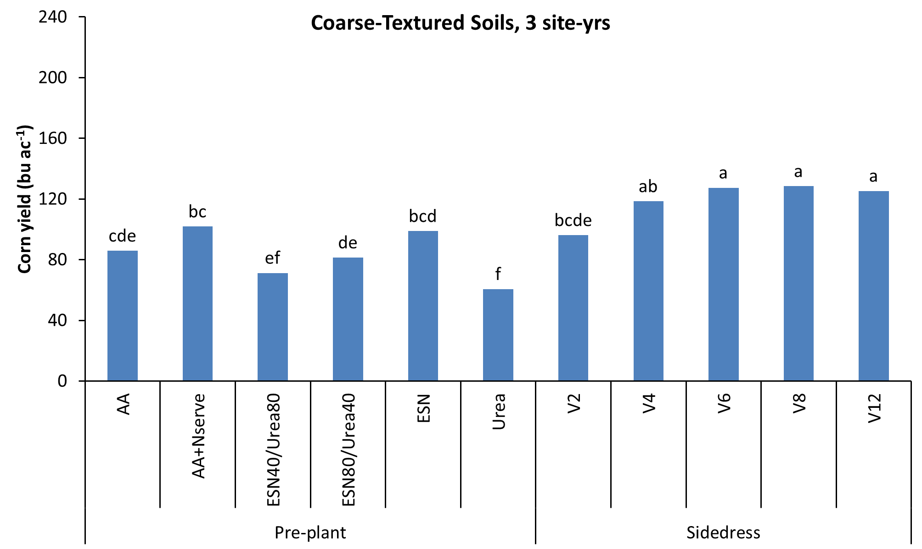

Slide 23
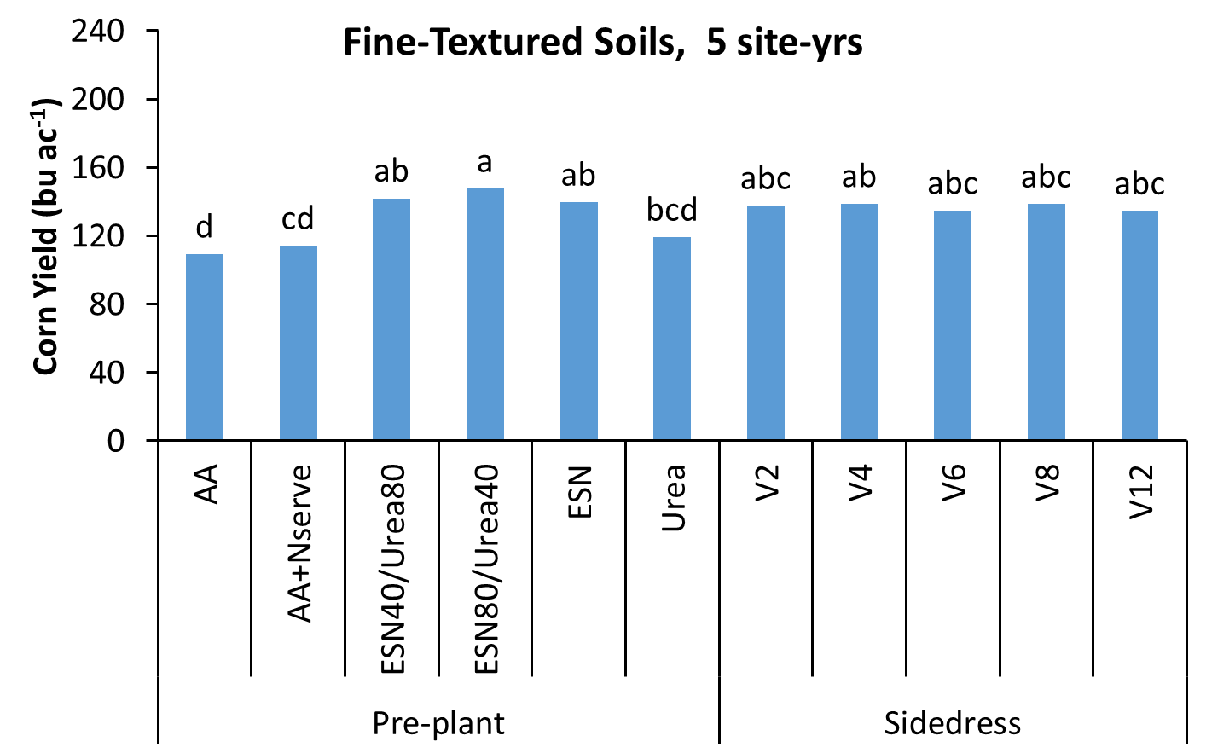
Problems with AA application

Slide 24
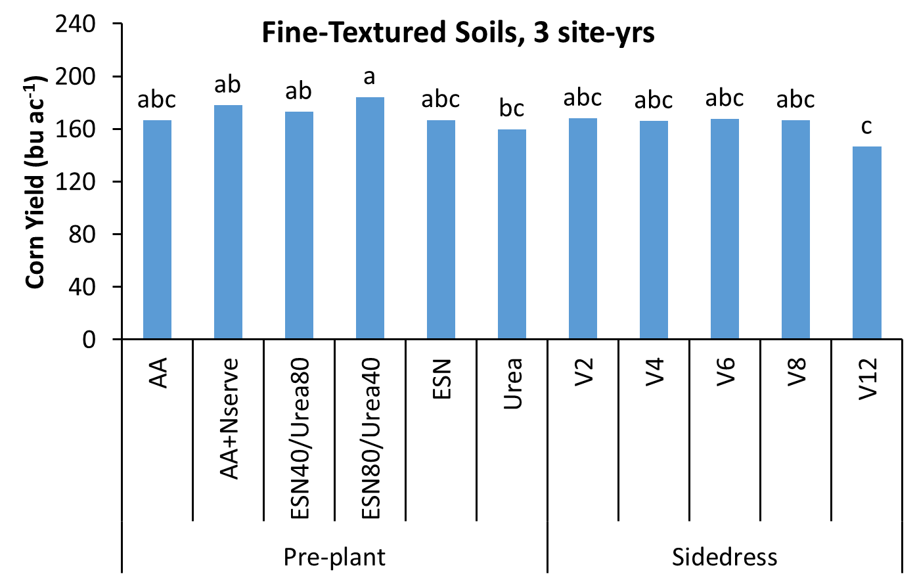

Slide 25
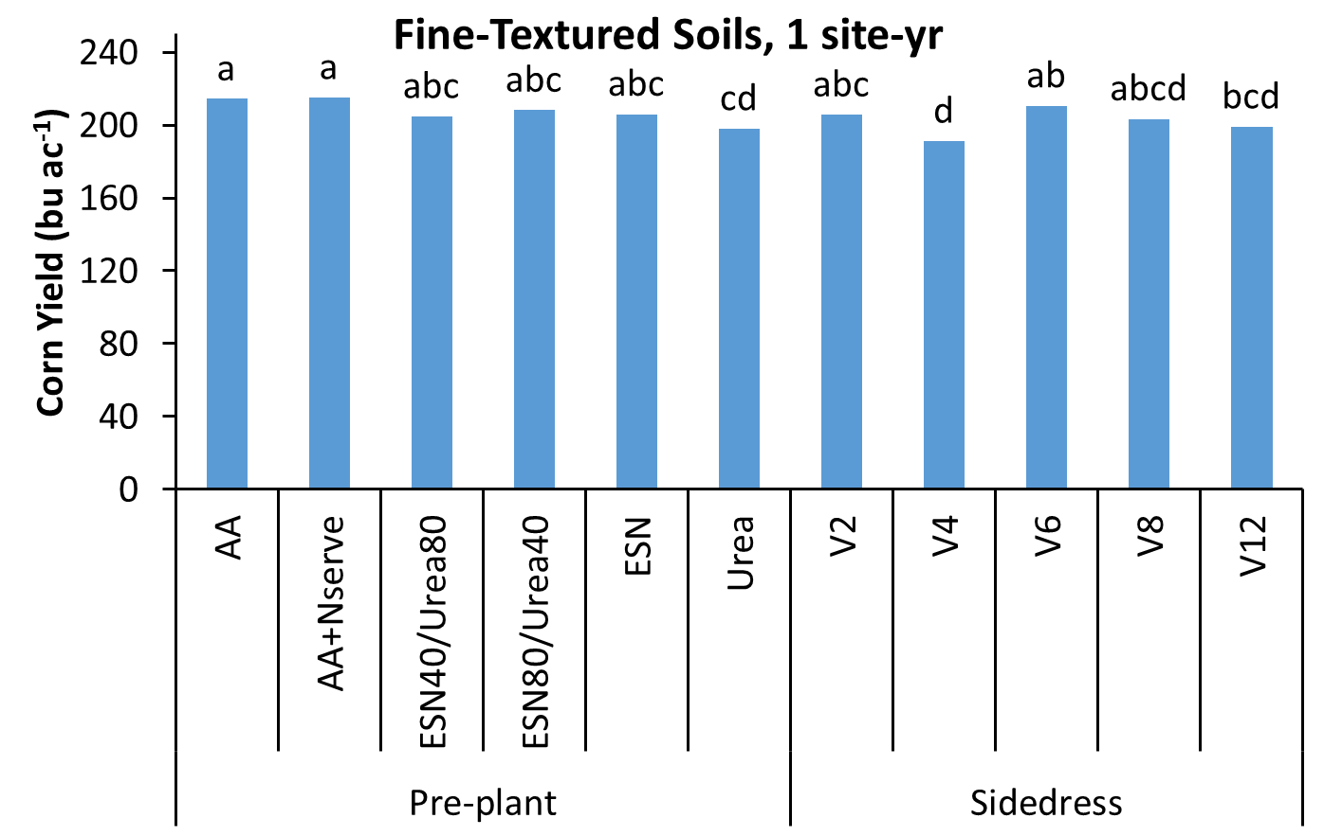

Slide 26
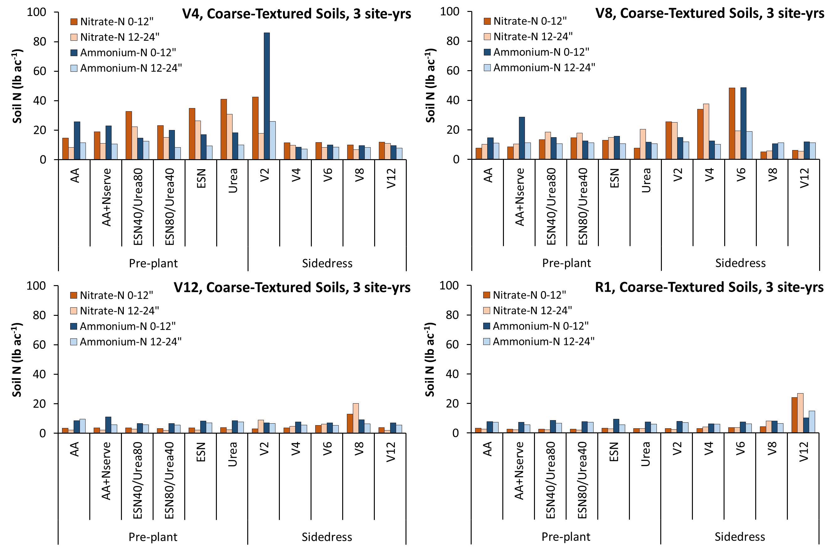

Slide 27
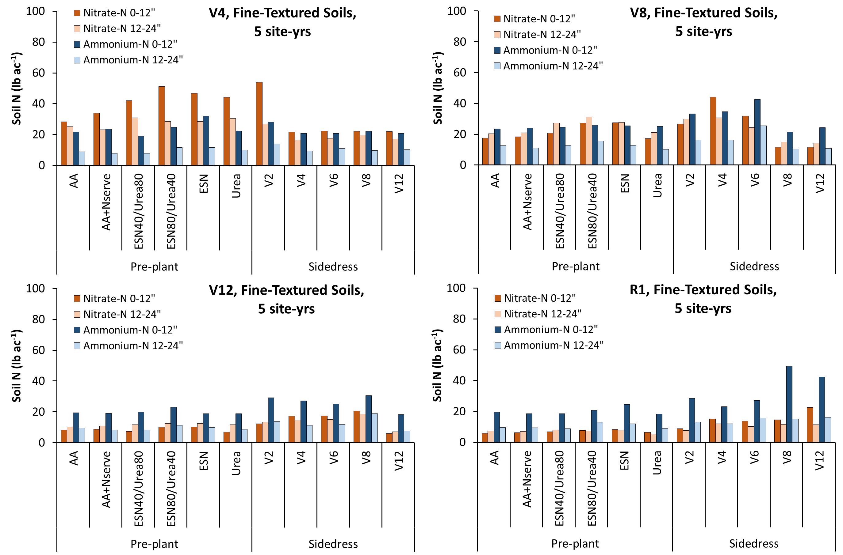

Slide 28
Overall Yield, 12 site-yrs
Treatment | Normal Precipitation | High Precipitation
 | ----------------Bu/a----------------
PP | 143ab | 91c
V2 | 155a | 131b
V4 | 151a | 132ab
V6 | 148ab | 147ab
V8 | 148ab | 150a
V12 | 135b | 148a

Slide 29
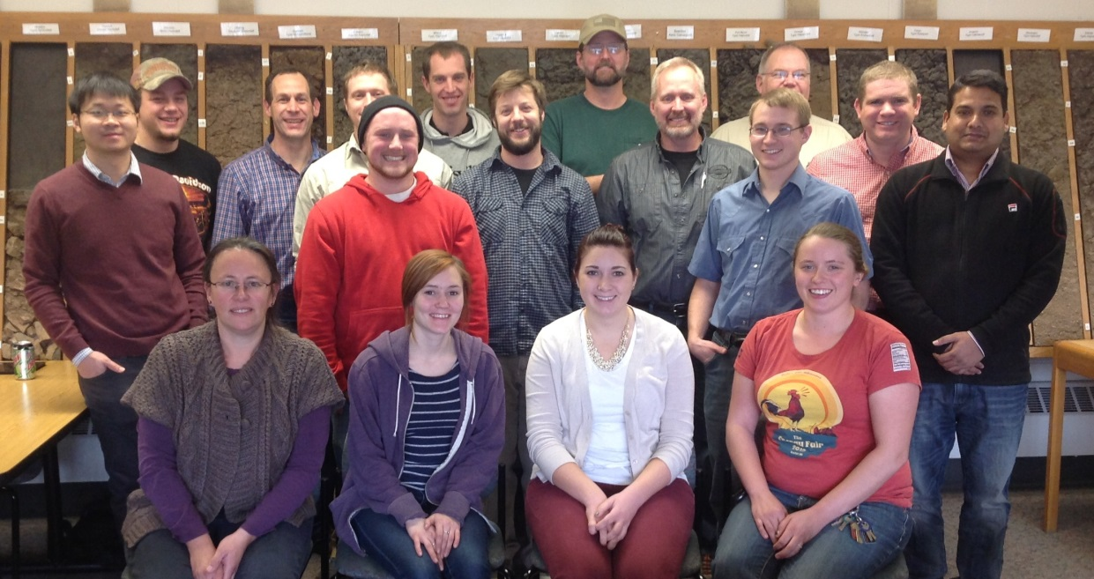


Thank You!
U of M Nutrient Management Group
Graduate & Undergraduate Students, post Docs
Research Center Personnel and Farmers
Funding entities:

Slide 30
http://z.umn.edu/Nconference
Feb. 16 Mankato, MN

