Slide 1
Nitrogen Use Efficiency in Long-term No-till Wheat-Fallow Dryland Systems
Hero Gollany
USDA-ARS
Pendleton, OR
NUE Conference - August 8-10, 2016
Notes:
Thank you for the invitation to talk about our new project on NUE in LTE at Pendleton.

Slide 2
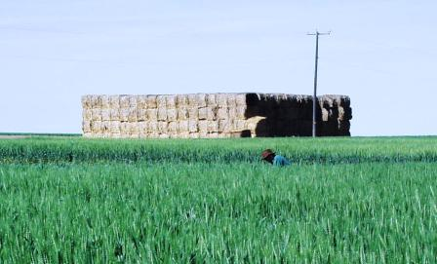
Introduction
Nitrogen (N) and water are major limiting factors for crop yields in dryland cropping systems.
Conventional intensive tillage with residue removal are the predominant practices in dryland winter wheat-summer fallow systems.
This system reduces soil fertility through loss of soil organic matter (SOM), while increasing erosion and CO₂ emissions.
Notes:
Plant available N and water are major limiting factors for sustaining crop yields in dryland cropping systems. CT W-F cropping system and residue removal are predominant practices around Pendleton, but this system reduces soil fertility through loss of SOM, and associated SOC & SON, destroy soils structure, while increasing erosion & CO2 emissions.

Slide 3
Synchronize N supply from decomposition of SOM with N demand by the crop to optimize yield and reduce N fertilizer use and fossil-fuel energy input.
N supply
N demand
Notes:
We need to synchronize N supply from decomposition of SOM with N demand by the crop to optimize yield and N use efficiency. Improving estimates of inorganic N required for economically optimum crop yield reduces N fertilizer use and fossil-fuel energy inputs, and could reduce production cost and increase profitability.

Slide 4
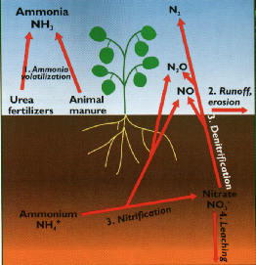
Objective
Quantify the impact of an alternative management (inclusion of pea) in winter wheat-fallow under no-till(NT ) on N use efficiency, grain yield & quality, and CO₂, N₂O, NH3, and CH₄ emissions.
N2
NH₃
N2O
Denitrification
NO3
Ammonium
Nitrification
NH₄⁺
Leaching
Notes:
Our objective is to quantify the impact of alternative agriculture management practices such as inclusion of pea as a cover crop, in winter wheat under direct-seed cropping systems on N fertilizer use, yield, N cycling & gas emissions.

Slide 5
Experiment Design
Two LTEs will be evaluated:
NTA plots established in 1982
NTB plots established in 1997, changed to wheat-pea in 2010.
The experimental design is randomized split block with four replications and five N treatments (0, 40, 80, 120, 160 lb N/acre).
¹⁵N micro plots (1 m²).
Notes:
We will use two long-term experiments, NTA has been in wheat-fallow since 1982. NTB was established in 1997 and the rotation was changed from wheat-fallow to wheat-pea in 2010. We have 4 replication of 5 fertilizer rates. This is a graph of our average winter wheat yield response to fertilizer since 1998. 15N micro plots will be established within plots.

Slide 6
Procedure
Quantify harvest index, N uptake, and N use efficiency in conventional and intensified wheat production systems under several N fertilizer rates.
Field data needed:
  Grain and straw yield
  N concentration of grain and straw
Harvest Index
grain yield
grain yield
HI =
straw yield
grain + straw yield
Notes:
Grain & straw yield will be determined to quantify harvest index. N uptake and N use efficiency will be determined from N concentration of grain & straw.

Slide 7
N Use Efficiency Parameters
Grain N yield = grain N × grain yield
Straw N yield = straw N × straw yield
Biomass N yield (BNY) = Grain N yield + Straw N yield
N harvest index = Grain N yield / BNY
Applied N recovery fraction =
BNY at given N rate – BNY at zero N rate
Applied fertilizer N
Notes:
N harvest index, and NUE can be calculated using the basic data measured in the field or laboratory. The calculation of the applied N recovery fraction involves the difference in biomass produced under a given amount of applied N and zero N divided by N applied.

Slide 8
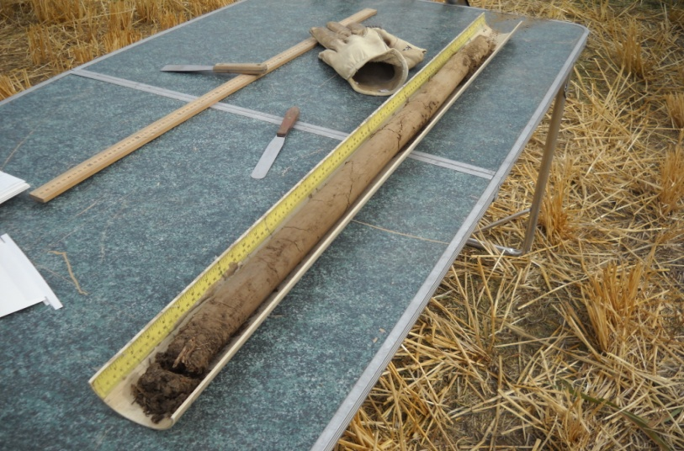
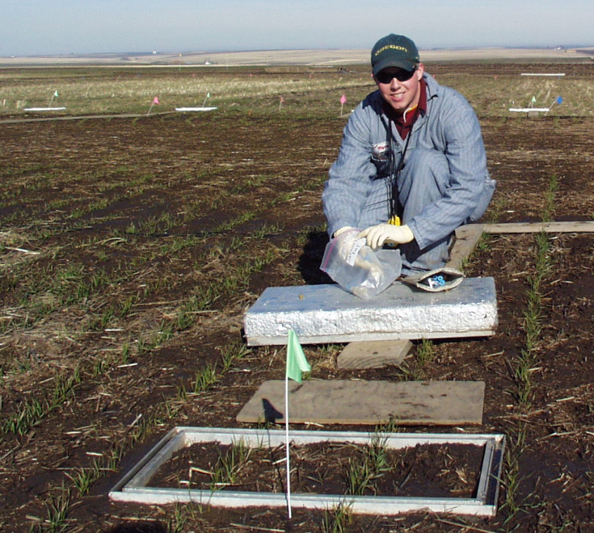
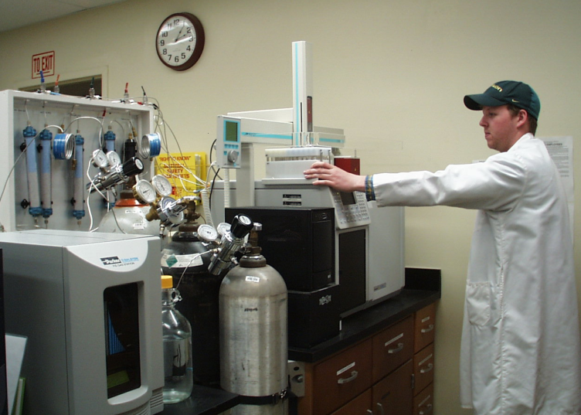
Procedure (cont.)
Monitor and quantify soil profile N
concentrations and determine
leaching below the root zone.
    Incremental soil sampling- 6 ft
    NO3-N leaching
Monitor and quantify CO₂, N₂O, and CH₄ and NH₃ in relation to fertilizer rate and replacement of fallow with pea in the cropping system.
Notes:
Incremental soil samples will be taking and nitrate leaching to 6 ft will be determined. CO2, CH4, N2O & NH3 emission will be monitored throughout the growing season using static chambers and GHG emission in the two cropping system will be determined using a GC.

Slide 9
Expected Outcomes and Anticipated Impacts
Best management practices for: N use efficiency; reducing N leaching and N₂O, NH₃ and CO₂ emissions; and nutrient cycling.
Recommendations will be shared with producers, NRCS personnel, and researchers to provide guidance for best management of Inland PNW soils & environmental quality.
Notes:
These outcomes will enable us to make sound management recommendations for more cost savings while providing environmental benefits.

Slide 10
Expected Outcomes and Anticipated Impacts
Results will be disseminated via: onsite demonstrations, factsheets, extension publications (Conservation Tillage Update article), scientific journals, and the world wide web.
Notes:
Results will be disseminated via onsite demonstration and extension publications, and the web.

Slide 11
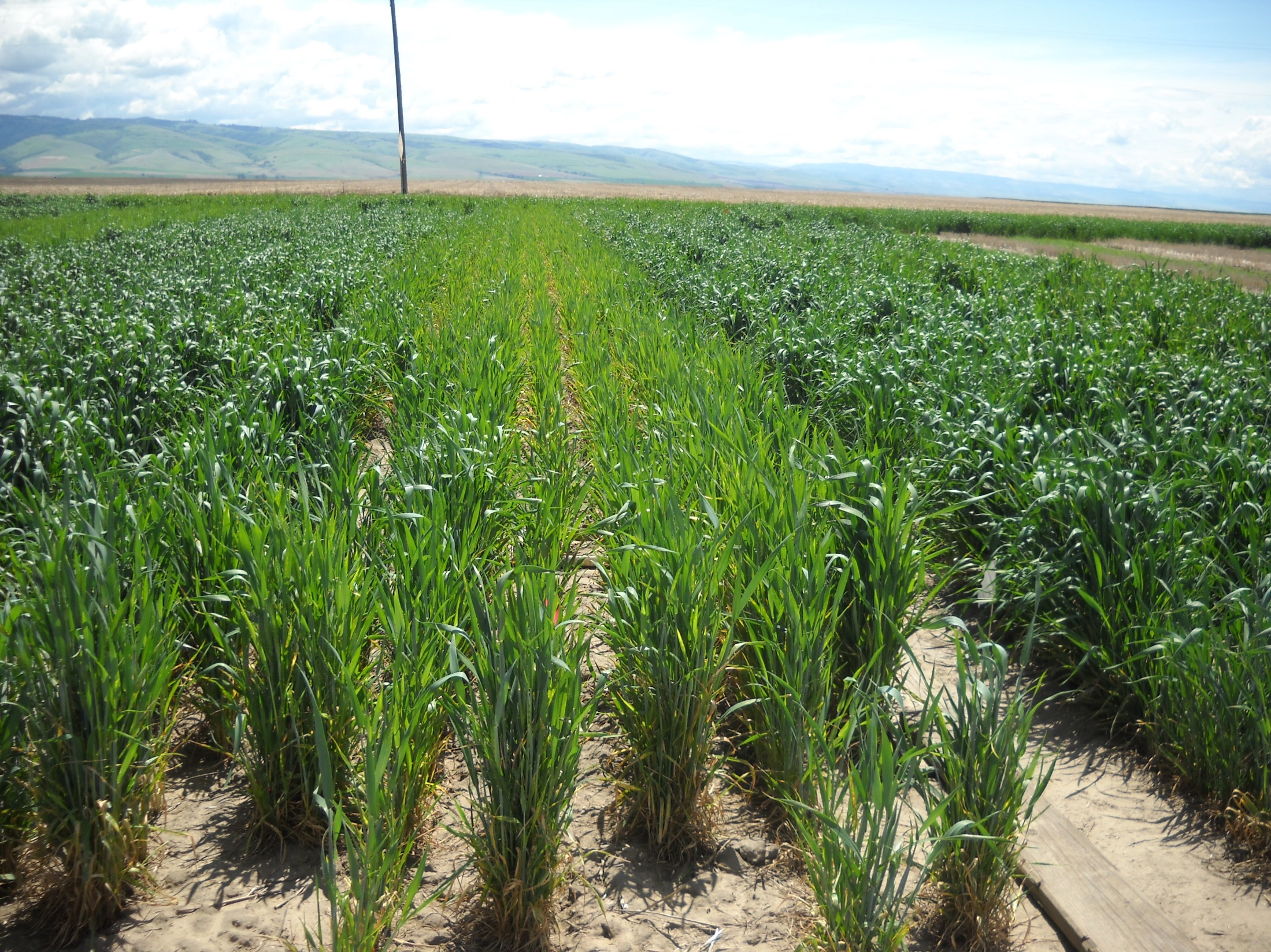
Thank you
?

