Slide 1
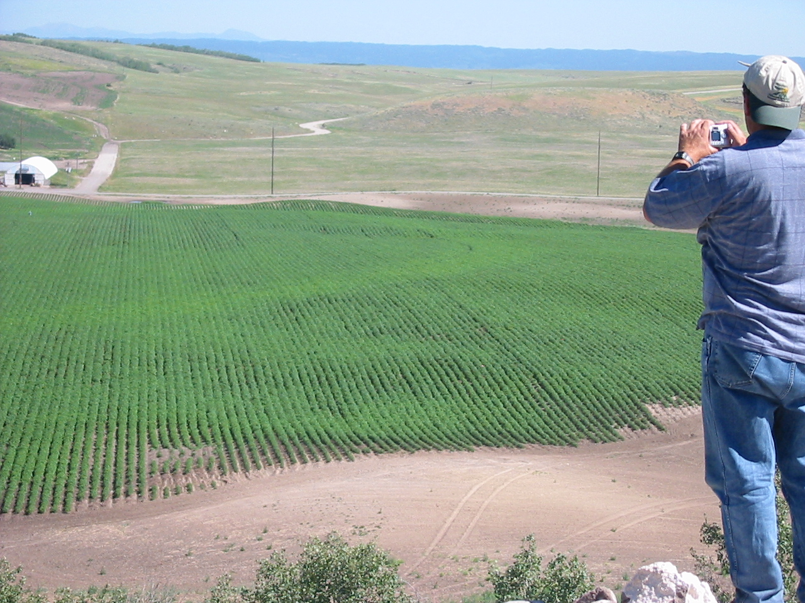
NUE and Aerial Assessment Strategies in Potato-Grain Cropping Systems
Bryan Hopkins, Ph.D., Professor,
Brigham Young University, Provo, UT, USA

Slide 2

Maybe we can learn some facts. . .

Slide 3
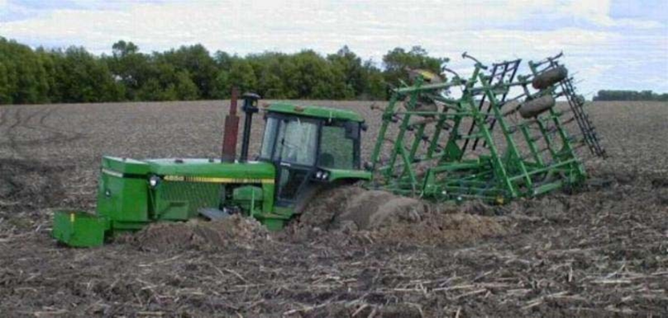

Slide 4
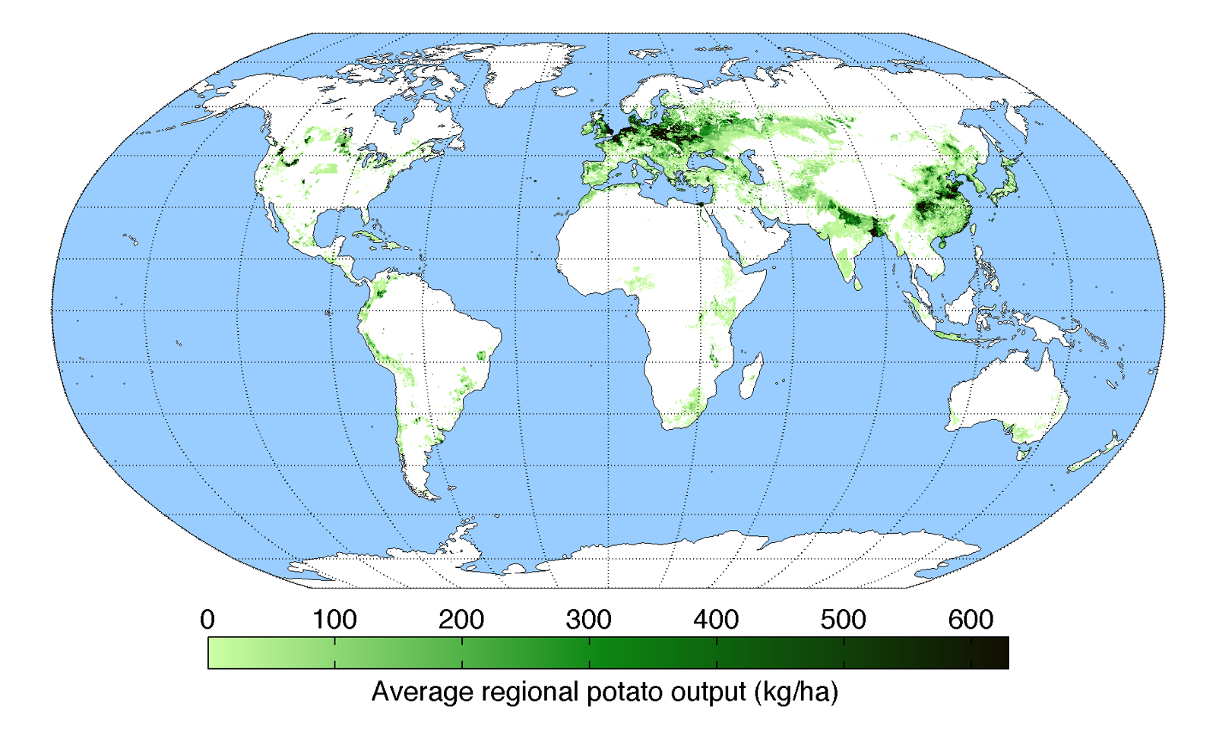

Slide 5
Potato is a vital world food crop

Slide 7
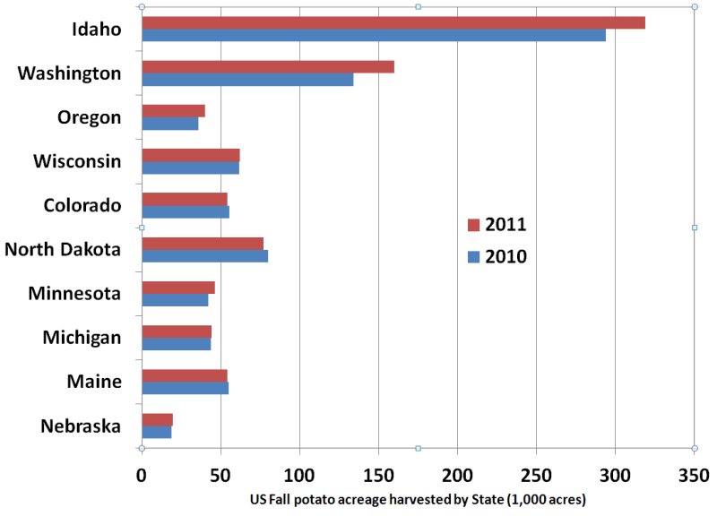
Potatoes in the U.S.

Slide 8
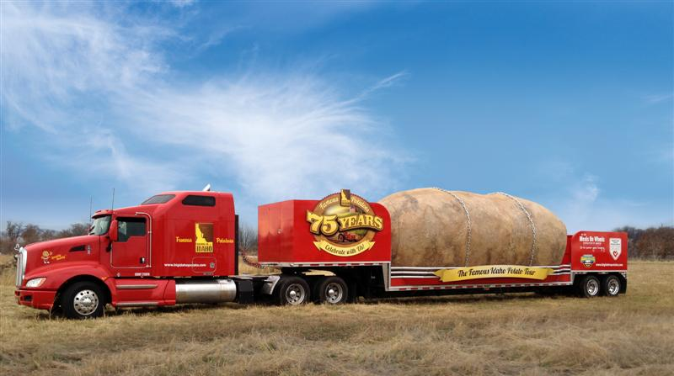
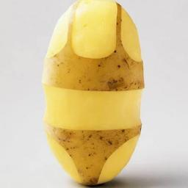
Potato (spud) is unique
Growing tubers below ground
Shallow and inefficient roots
Susceptible to Disease
Extremely sensitive to water and nutrient (especially N) fluctuations
High water and fertility requirements

Slide 9
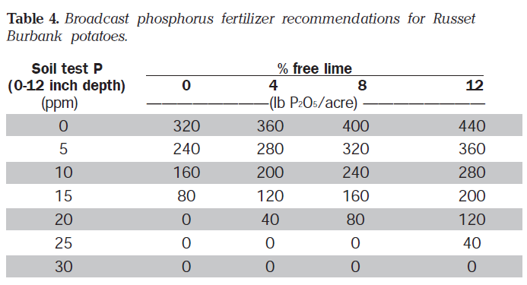

Slide 10
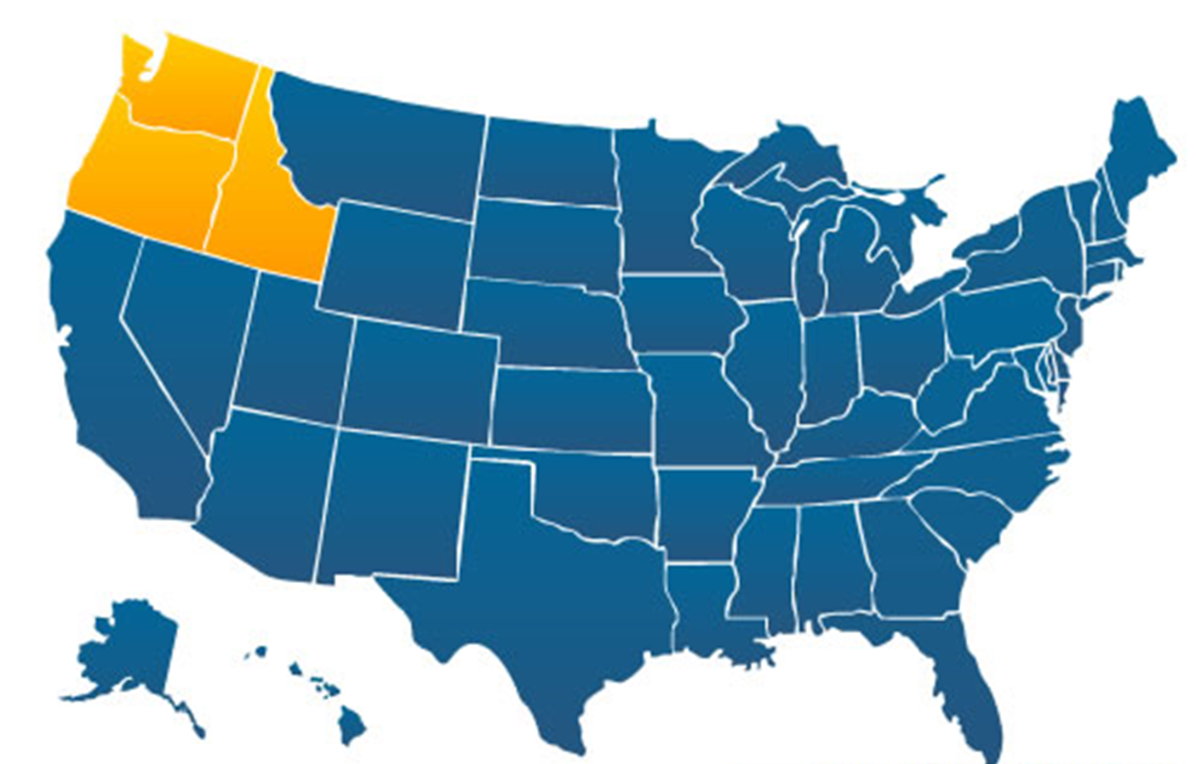
Pacific Northwest
Potato-Grain (wheat, barley, and corn); also sugarbeets, dry beans, etc.
Warm Days, Cool Nights (>30ºF differential)
High Sun (few clouds)
Low Rainfall (5-12 inches – mostly in winter) & Vegetation
Volcanic sands, calcareous alkaline, low OM
Low humidity
Irrigation
Potato susceptible to disease (Irish potato famine)

Slide 11
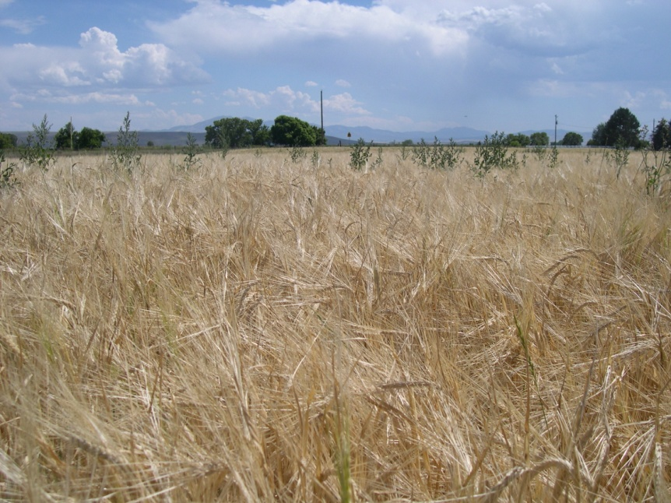
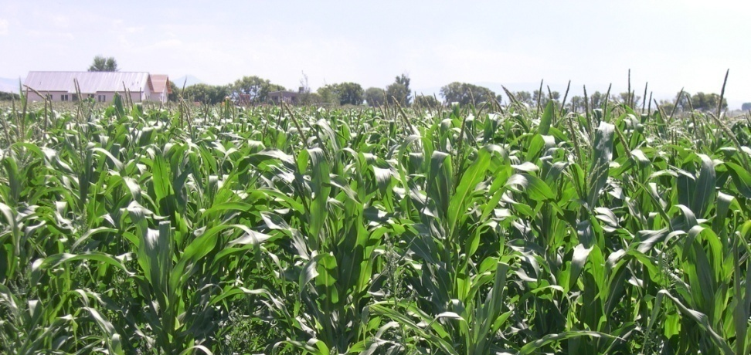
Crop Rotation
Years between potatoes depends on altitude
  High = 2-3 year rotation (small grains)
  Medium = 3-4 year (small grains, corn, sugarbeet)
  Low = 4+ year (nearly crop possible)

Slide 12
Quest to Improve NUE and Reduce N Loss
When granpa was farmin’ . . .
  Very high N (>500 lb/ac) and water rates (over water by >20%)
  Developed high nitrate groundwater contamination

Slide 13
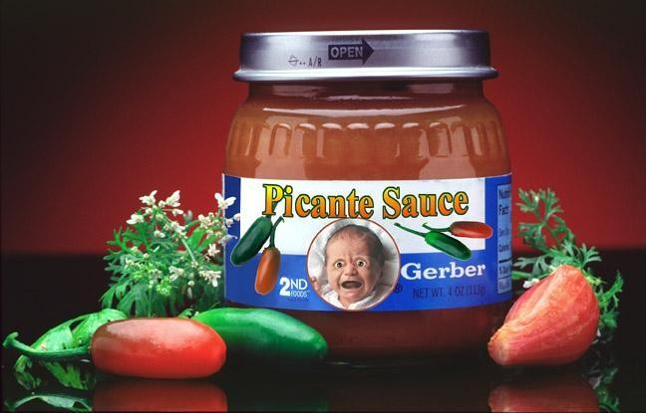
Not every idea is a good one.

Slide 14
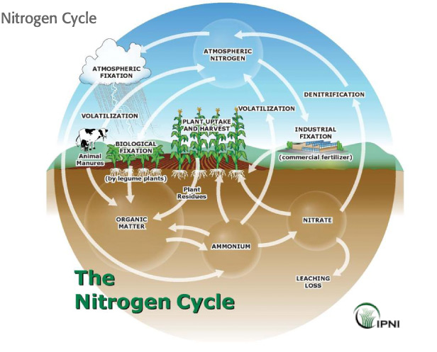
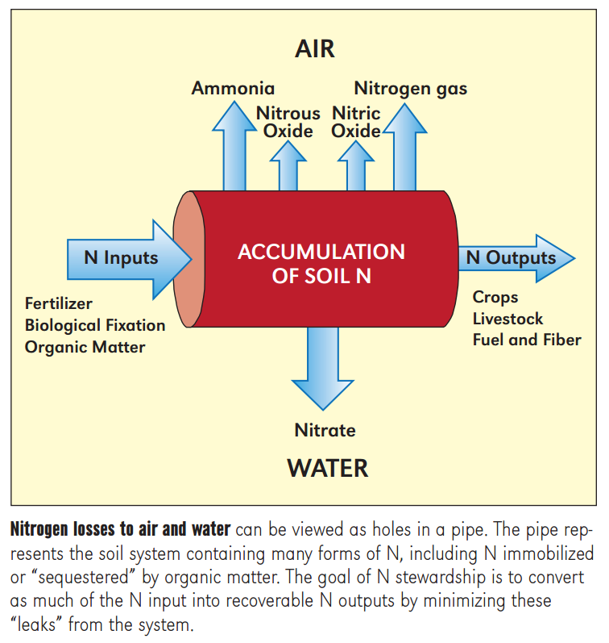
Managing nitrogen, IPNI

Slide 15
Quest to Improve NUE and Reduce N Loss
When granpa was farmin’ . . .
  Very high N (>500 lb/ac) and water rates (over water by >20%)
  Developed high nitrate groundwater contamination
Efforts to simultaneously reduce N and irrigation
Split applications of N (standard to apply 25-50% early and the rest fertigation)

Slide 16
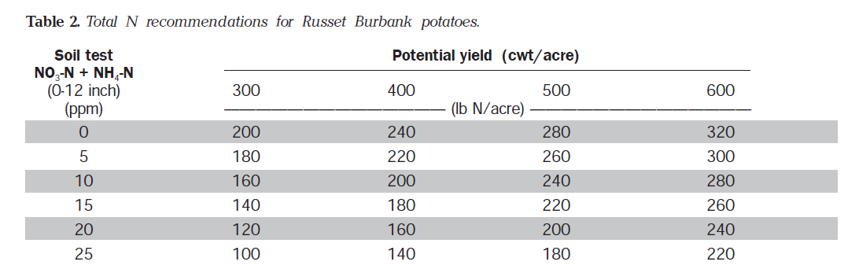
Our data for potato in PNW shows that yield potential impacts optimum N rate

Slide 17
Quest to Improve NUE and Reduce N Loss
When granpa was farmin’ . . .
  Very high N (>500 lb/ac) and water rates (over water by >20%)
  Developed high nitrate groundwater contamination
Efforts to simultaneously reduce N and irrigation
Split applications of N (standard to apply 25-50% early and the rest fertigation)
Petiole analysis

Slide 18
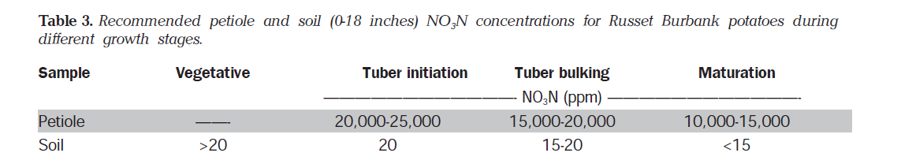
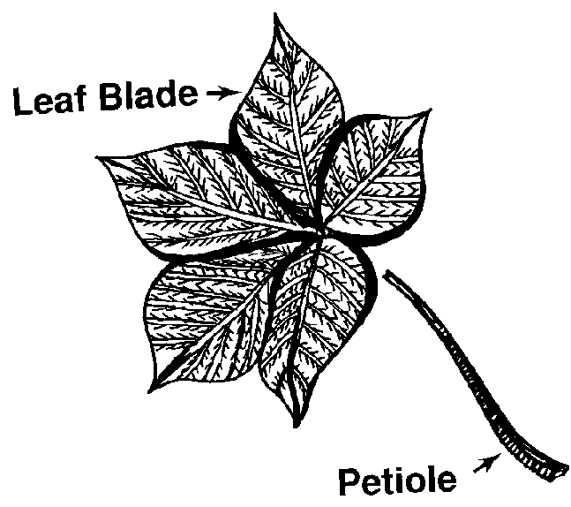

Slide 19
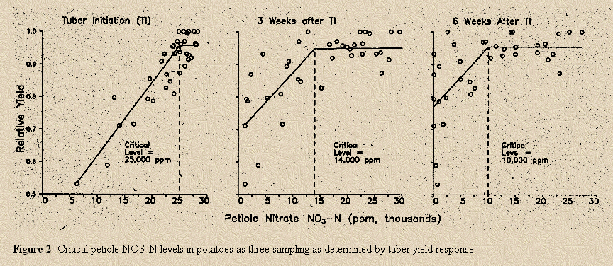
Courtesy Univ. of Manitoba

Slide 20
FIELD ONE
Soil N – 7.4 ppm
Preplant N – 219
Inseason N – 185

Slide 21
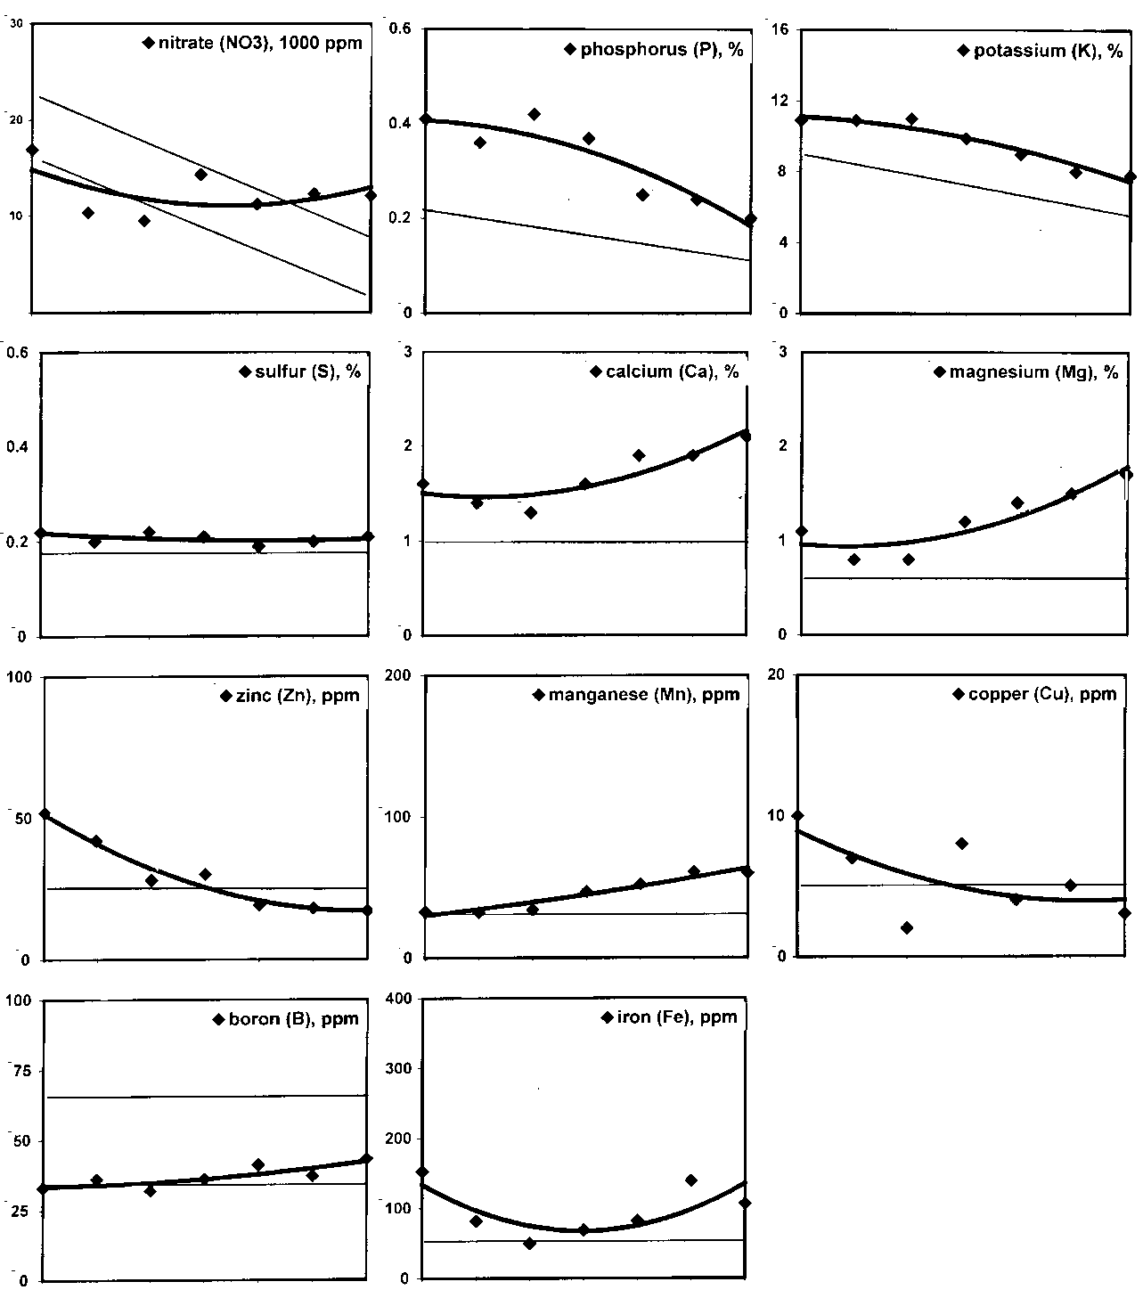
Growers have learned the value of in-season trend analysis.
Trying to get them to understand the value of yearly comparisons as well.

Slide 22
Quest to Improve NUE and Reduce N Loss
When granpa was farmin’ . . .
  Very high N (>500 lb/ac) and water rates (over water by >20%)
  Developed high nitrate groundwater contamination
Efforts to simultaneously reduce N and irrigation
Split applications of N (standard to apply 25-50% early and the rest fertigation)
Petiole analysis
Control and Slow Release Fertilizers

Slide 23
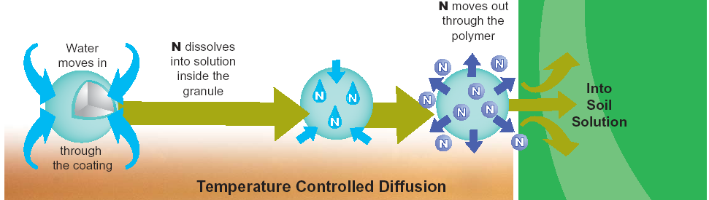
ESN Technology
Agrium U.S. Inc. 2005

Slide 24
Generalized Potato N Uptake and Growth
100
80
60
Vine
% Total N Uptake or Growth
Tuber
40
Total N
20
0
0
20
40
60
80
100
120
140
Days After Planting
Carl Rosen, University of Minnesota, 2005.
Vine kill

Slide 25
Irrigated Spring Wheat Yield
Parma, 2005
Source: Dr. Brad Brown, Univ of idaho
Notes:
Source: Dr. Brad Brown, Univ of idaho, Parma, ID
Irrigated hard spring wheat. All N applied pre-plant and incorporated. Protein % not changed by treatments. Total protein harvested in grain follows grain yields. Better for ESN than urea. ESN/urea blends and some split applications also included in the study, but data are omitted for simplicity. Generally, 100% ESN performed better (not statistically significant) than blends. 100% ESN all pre-plant also better (again not statistically significant) than splits.
Yield reduction from excessive N available during vegetative growth is not unusual in this production system, and is unrelated to lodging (which was absent) and occurs when there is no apparent foliar disease. There was significant stripe rust in this trial that may have exacerbated excessive N effects
Protein concentration treatment averages ranged no more than 1.0% in this trial despite N rates differing by 120 lb N/A. This isn't surprising given the amount of residual N available initially. Others have demonstrated that protein is more difficult to change above the 14% level. We learned of the high residual N in this trial after the trial was established. If lower available N were present initially, the range in protein concentrations likely would have increased.

Slide 26
2011 Data – Increase in US No. 1 Yield over Control

Slide 27
Quest to Improve NUE and Reduce N Loss
When granpa was farmin’ . . .
  Very high N (>500 lb/ac) and water rates (over water by >20%)
  Developed high nitrate groundwater contamination
Efforts to simultaneously reduce N and irrigation
Split applications of N (standard to apply 25-50% early and the rest fertigation)
Petiole analysis
Control and Slow Release Fertilizers
Variable Rate N

Slide 28
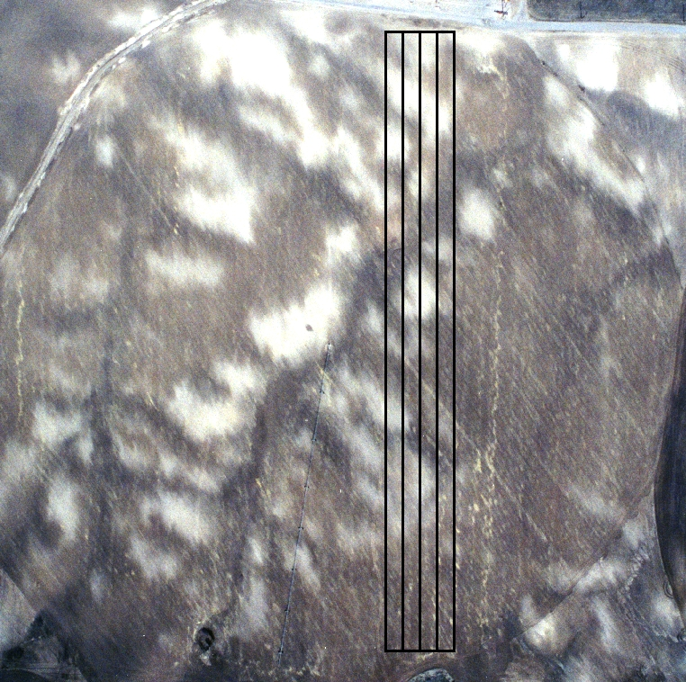
Variable Rate N in Potato-Grain Systems
Predominate situation
  Highly calcareous vs. moderate or none
  Need more P (and often micros as well) as lime % increases
  However, N need often inverse to this

Slide 29
Fertilizer Recommendations
 | Calcareous (White) Soil |  | Deep, Dark Soil
Yield Goal | 300 cwt/a |  | 500 cwt/a
 | Soil Test | Fertilizer Rec. | Soil Test | Fertilizer Rec.
Nitrogen | 10 ppm | 165 lb/a | 10 ppm | 275 lb/a
Phosphorus | 10 ppm (8% lime) | 240 lb/a | 15 ppm (0% lime) | 105 lb/a

Slide 30
Fertilizer Recommendations
 | Calcareous (White) Soil |  | Deep, Dark Soil
Yield Goal | 300 cwt/a |  | 500 cwt/a
 | Soil Test | Fertilizer Rec. | Soil Test | Fertilizer Rec.
Nitrogen | 10 ppm | 165 lb/a | 10 ppm | 275 lb/a
Phosphorus | 10 ppm (8% lime) | 240 lb/a | 15 ppm (0% lime) | 105 lb/a

