Slide 1
Recommendations
All BMPs to give a healthy crop, especially . . .
  Pre-season irrigation system maintenance
  IPM for pathogen management
    Increase length of time between potato crops
    Fungicides
    Etc.

Slide 2
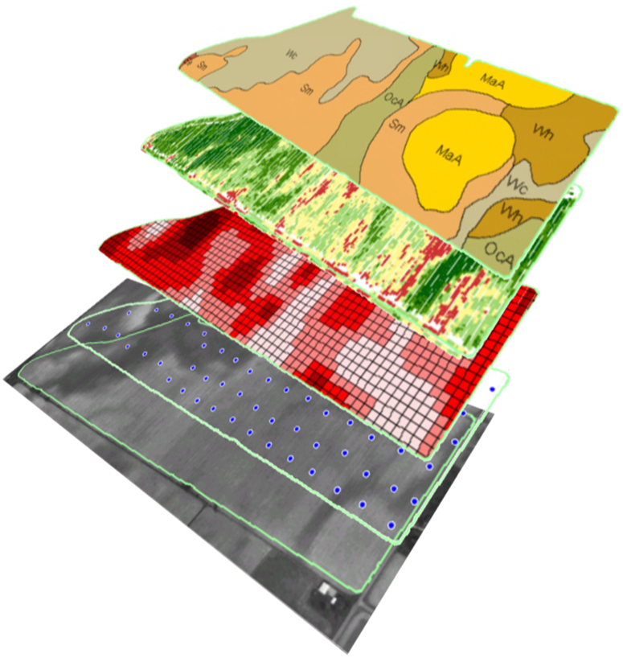
Recommendations
Variable rate for zones in each field with large variability
  Seed spacing
  Pesticides
  Fertilizers
    N
      Yield Goal
      Soil Properties (esp. texture)
    P
      Yield Goal? (no)
      Soil Test P
      Soil Test Lime (CaCO₃)

Slide 3
Recommendations
Base N Rate
  Yield Goal
  Soil Test
  Previous Crop/Residue/Manure
Apply 20-40% of Base Rate by emergence, rest fertigate
  Early season N not as important as other crops (40 lb N/ac seed piece)
  Some success with in-season N application based on NDVI, but difficult due to narrow plateau of sufficiency.

Slide 4
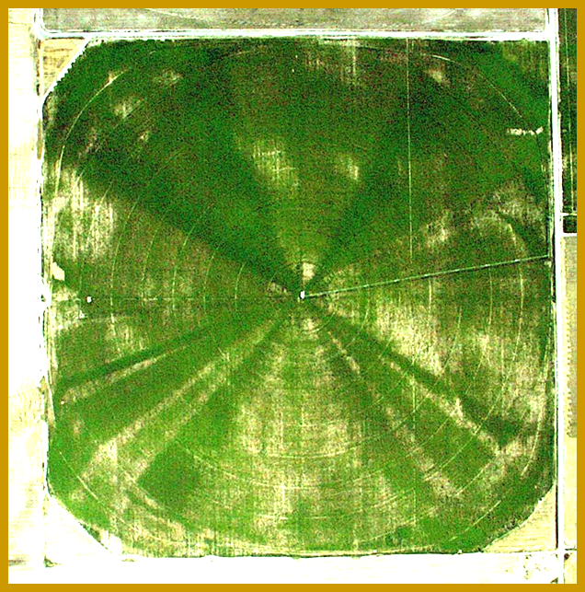
Recommendations
In season aerial imagery to scout for:
  Nutrition
  Water
  Disease
  Other

Slide 5
In contrast to the optimum

Slide 6
N lost in contrast to the “optimum” (lb/ac)
Blanket N Application | Excess Irrigation | Deficit Irrigation | Early Die Pathogen
35 | 110 | 70 | 65

Slide 7
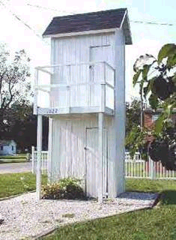
There are situations where knowing how nutrients are applied and placed, may be in your personal best interest.
The End
Thanks for your attention.

Slide 8
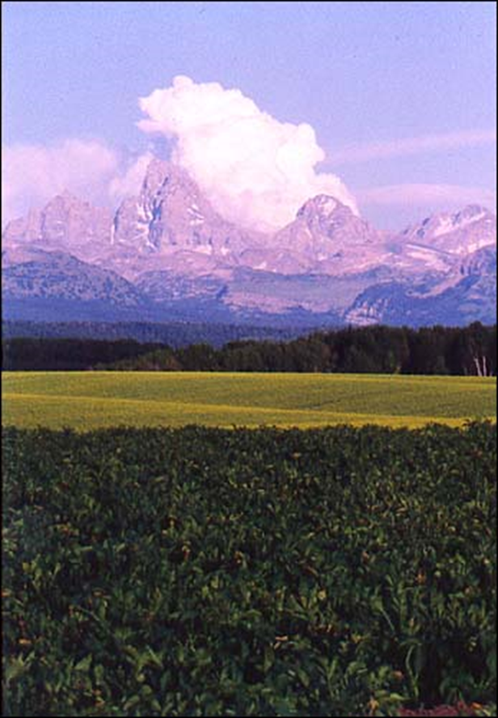
Questions

Slide 9
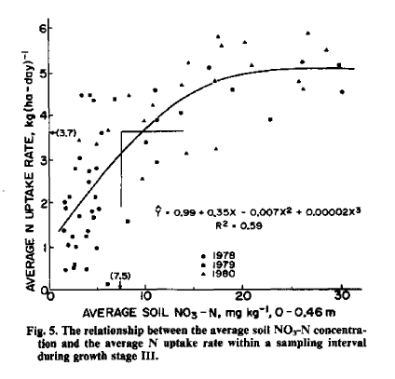
Soil Analysis Good Enough?

Slide 10
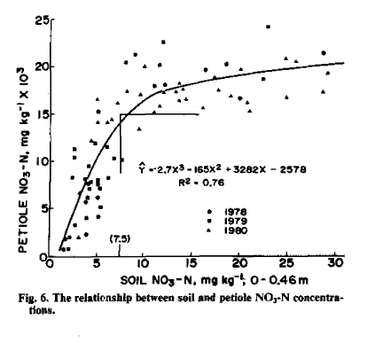
Relationship between petiole and soil nitrogen

Slide 11
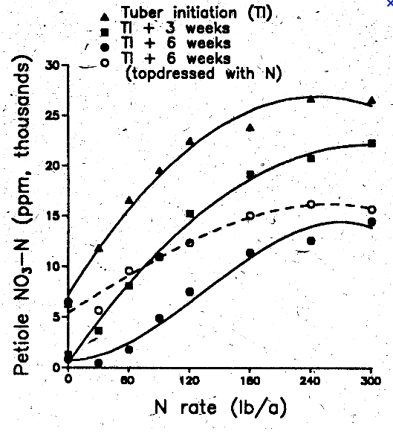
Fertilization timing can impact nutrient status in petioles
Courtesy Univ. of Manitoba

Slide 12
Relationship between Large No. 1 yields, post-harvest soil NO₃-N and total available N for 44 commercial potato fields in southeastern Idaho in 1994.
400
350
300
250
7-14 oz U.S. No Yields (cwt/acre)
200
Post-harvest Soil NO₃-N (lb N/acre)
150
100
50
0
Total Available N (lb/acre)

Slide 14


