Slide 1
Strategies for Managing Yield and Protein in Spring Wheat
Joel Ransom, Extension Agronomist for Cereal Crops

Slide 2
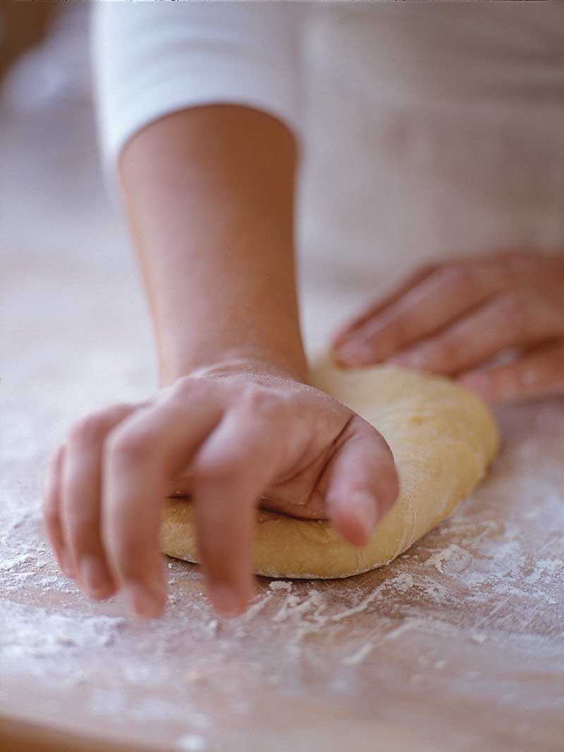
Nitrogen management impacts both yield and protein
Yield is a function of variety, management and environment
Protein is a function of variety, management, environment and yield
Why the need for protein?
Hard spring wheat market demands high levels
14% is standard but many of our costumers purchase 15%
Used in applications that requires high levels of functionality
Relatively small production of high protein wheat in the world when compared to wheat production in general

Slide 3
Why the yield and protein balancing act
Protein is expensive to produce, both for the plant and the producer
There is a negative relationship between the yield potential of a variety and protein content
Environment plays such a large role in yield, it is hard to predict yield at time of planting and therefore difficult to plan nitrogen amounts that would be adequate for needed protein levels, economically.

Slide 4
The relationship between yield and protein across varieties is strong and negative, (data from Langdon 2013 as example).
Linkert
Brennen

Slide 5
Environment impact can be significant for both yield and protein.

Slide 6
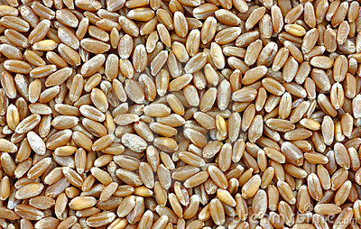
Protein premiums and discounts can be substantial and not easy to predict
Factors that impact premiums and discounts
Protein levels in winter wheat regions
Average protein levels from the spring wheat region
High yielding crops usually have lower protein, so years with high yields usually result in lower protein levels and higher discounts for low protein

Slide 7
Protein premiums and discounts can be substantial and hard to predict.

Slide 8
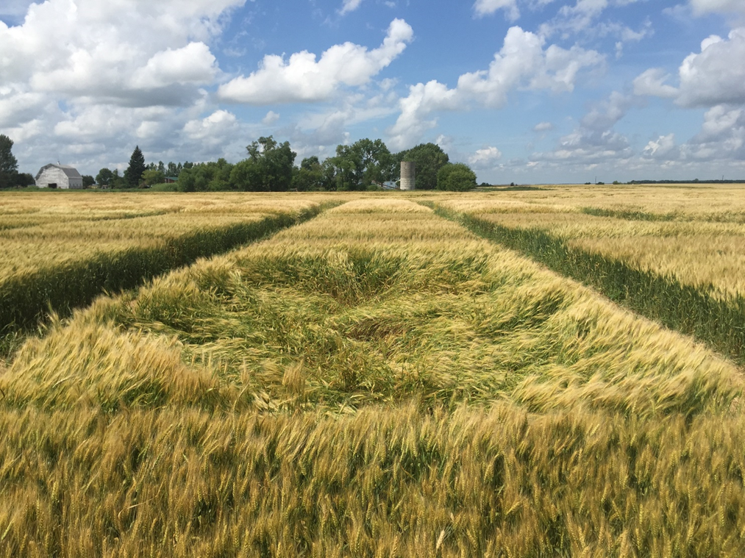
Strategies for balancing yield and protein
Select an appropriate variety
Options
High yield lower protein
Lower yield, higher protein
Balanced for yield and protein

Slide 9
Varieties with yields > mean, northern Minnesota, 2015
Starred varieties have protein > mean of trial

Slide 10
Impact of variety on gross revenue using $4.69/bu and $0.475 discount and $0.30 premium per point protein, 2015 yield trial data.
Top Five for Gross Revenue
Eastern ND | NW Mn
Linkert (2, 6) | HRS3530 (16, 2)
Rollag (5, 2) | Bolles (1, 27)
Prevail (17, 1) | Linkert (3, 28)
Bolles (1, 22) | SY Valda (21, 5)
Vantage (3, 11) | Samson (22, 6)
(Rank [protein], [yield]) | (Rank [protein], [yield])
Out of 29 | Out of 35
Yield 70.8-53.2 | Yield 81-103

Slide 11
Impact of variety on gross revenue using $5.77/bu and $1.125 discount and $1.625 premium per point protein, 2014 yield trial data.
Gross Revenue for Eastern ND 2014
Top Five | Bottom Five
Vantage (1, 26) | MS Chevelle (26, 8)
Rollag (2, 14) | Samson (23, 28)
Linkert (3, 21) | LCS Albany (28, 4)
SY Ingmar (5, 15) | LCS Iguacu (29, 5)
Glenn (4, 29) | MS Stingray (30, 2)
(Rank [protein], [yield]) | (Rank [protein], [yield])
Out of 30 | Out of 30
Protein 11.7-15.4 | Yield 79.2-99.9

Slide 12
Strategies for balancing yield and protein
Select an appropriate variety
Ensure that sufficient N is applied to meet the extra requirement for both yield and protein
Target availability of N when need is critical
Post anthesis applications?
N application timing strategies

Slide 13
Part A: Protein changes very little
Part B: Protein change begins to increase, yield begins to slow
Part C: Protein changes rapidly, grain yield very little
Adapted from Mason, 2007

Slide 16
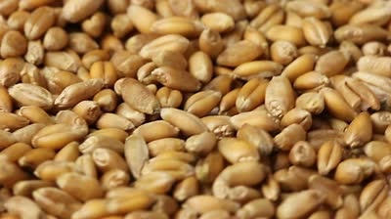
Rate recommendation
In a high yield potential environment, perhaps 60 lbs additional N would be required to achieve protein levels of high protein varieties
Adjust according to recently grown varieties and protein level desired

Slide 17
N rate and timing on yield, average of two locations, MN.

Slide 18
N rate and timing on protein, average of two locations, MN, 2015.

Slide 19
Strategies for balancing yield and protein
Select an appropriate variety
Ensure that sufficient N is applied to meet the extra requirement for both yield and protein
Target availability of N when need is critical
Post anthesis applications?
N application timing strategies

Slide 20
Fertilizer timing – ensuring N is available when needed for protein formation
Period of greatest uptake
Application
Day 1 Day 30 Day 60 Day 90
80% of N used in protein formation translocated from vegetative tissue
30 days exposure to losses
from leaching/denitrification
Spring Wheat N timeline

Slide 21
Effect of additives and split applications on yield, all treatments and all location, 2012.

Slide 22
Effect of additive on protein, all treatments and all location, 2012.

Slide 23
Effect of additive on yield, averaged over rates and locations, 2013

Slide 24
Effect of additive on protein, average of rates and locations, 2013

Slide 25
Effect of N type and timing on yield, combined locations, 2015.

Slide 26
N source and timing on protein, combined, 2015

Slide 27
What are the costs of N strategies
UAN $295/ton = $0.52/lb N
Urea $375/ton = $0.41/lb N
ESN $540/ton = $0.61/lb N
SuperU $505/ton = $0.54/lb N

Slide 28
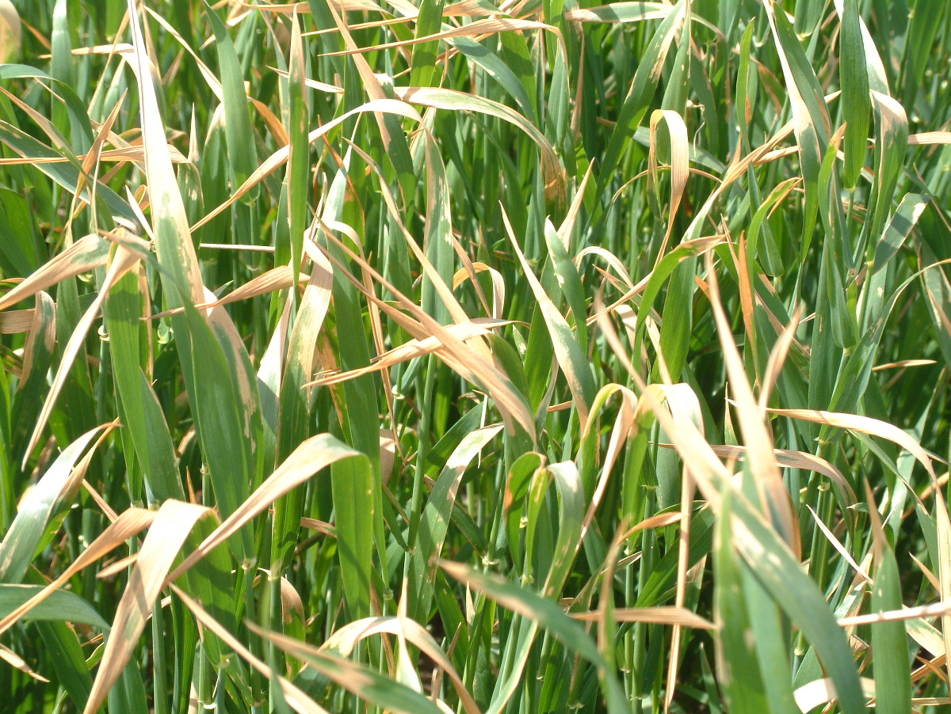
Applying UAN to leaves post anthesis N
Rainfall not needed to activate the fertilizer
Apply after flowering is complete
Don’t mix with fungicide
30 lbs N optimum (10 gals UAN plus 10 gals water)
Use regular flat fan nozzles
Spray in the cool of the day
Data suggest that more efficient for protein than 30 lbs extra at planting
Leaf burning is possible so don’t create protein at the expense of yield!

Slide 31
Did post anthesis N pay?
Comparison of returns (farmer experience 2015)
Protein from 13.56 to 14.5
Cost per acre $33.35 (application and material $24.71 plus lost of wheat to wheel tracks)
Premium/discount $.05 per fifth ($.25 per %)
Price/bu @13.5 protein (71.1 bu/a x $4.55=$323.51)
Price/bu @14.5 protein (71.1 bu/a x $4.80=$341.28)
Gross benefit of $17.77 per acre
Net returns -$15.58

Slide 32
When does it post anthesis application pay (assuming a 1% protein bump)?
Protein Premium ($/point) | Yield (bu/acre)
 | 50 | 70 | 90
 | ---Return per acre ($)---
0.25 | -$20.85 | -$15.85 | -$10.85
0.50 | -$8.35 | $1.65 | $11.65
0.75 | $4.15 | $19.15 | $34.15
1.00 | $16.65 | $36.65 | $56.65

Slide 33
Can yield and need for extra nitrogen be predicted
Weather data
Days to reach 4 lf stage
Days to reach flowering
Sensor data
Greenseeker
SPAD
Color Charts
Tissue sampling

Slide 37
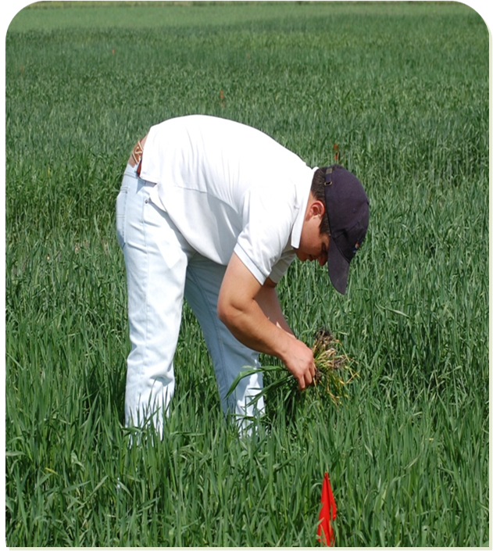
In-season measurements/tools
Notes:
Greenseeker Model 505 handheld optical sensor
Emits its own light source which measures how green or healthy the plant is. Higher the number value the healthier the plant is
Held a consistent 32-48“ above crop canopy

Slide 38
Chlorophyll Meter
Notes:
used to calculate the chlorophyll concentration index (CCI) or the actual chlorophyll content of the leaf.
The higher the CCI value the greener (healthier) the plant is.
Take 30 samples randomly from field.

Slide 39
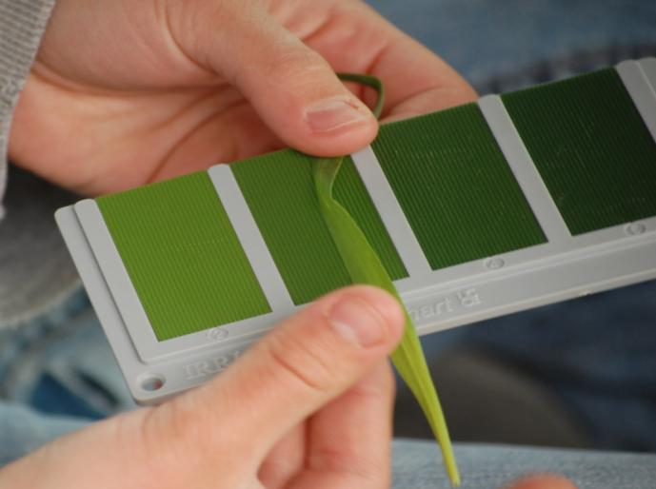
Leaf Color Chart
Notes:
rapid evaluation of leaf N status by visually estimating the color composer of the leaf and by comparing it to four color schemes of green
Readings are affected by shine light intensity, so it is best not to expose the LCC directly into the sunlight during readings
15-20 throughout field

Slide 40
Combined Correlation Between Measures and Protein in Faller and Vantage

Slide 41
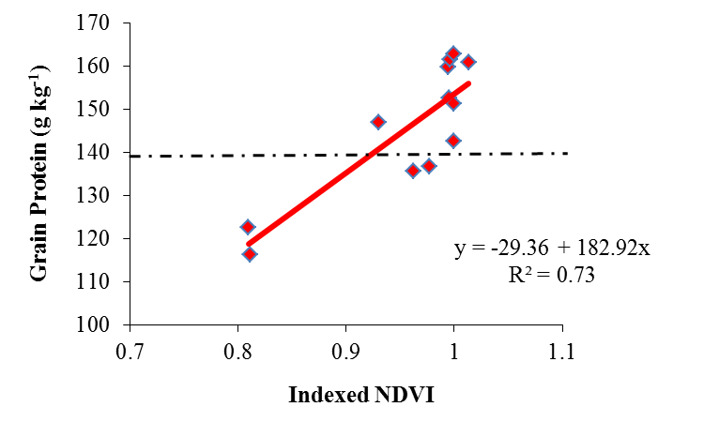
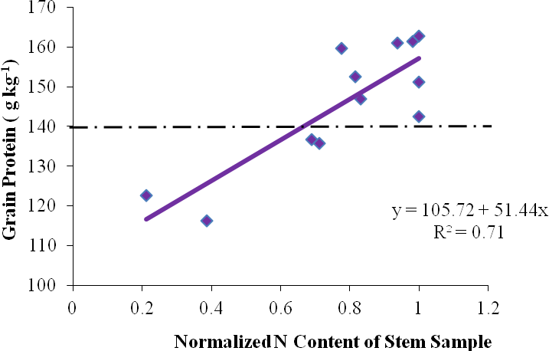
Relationship between NDVI and protein, 2011-12.
Relationship between N in stem and protein, 2011-12.

Slide 42
Can we predict protein content in a wide range of cultivars treated similarly?

Slide 48
Conclusions
Managing for both yield and protein content are critical to profitable HRSW production
Varieties that are balanced for yield and protein offer the least risk
Adding additional N to higher yielding varieties helps, but expensive
Additives/ESN can help improve protein in certain years, not likely yield
Foliar application of UAN produces the greatest increase in protein per unit of N, but profitability depends on premium/discount and yield of crop
Modelling and sensors may help inform growers of the profitability of this late season application

