Slide 1
Precision Sensing for Improved Wheat Production
Olga Walsh, Cropping Systems Agronomist & Extension Specialist, UI Parma R&E Center
Juliet Marshall, Cereal Agronomist & Pathologist, UI Aberdeen R&E Center
-with Chad Jackson, Tod Shelman, Kelli Belmont, Jordan McClintick-Chess,
Arjun Pandey, and Take Flight LLC
Idaho Wheat Commission Research Review
February 17, 2016

Slide 2

Presentation Outline:
Review 2015 Objectives
2015 Methods/data collection
2015 Findings/Proposed 2016 work

Slide 3
2015 Objectives
To establish a UAV-based methodology for:
  in-season prediction of wheat yield potential –to developing N fertilizer rates, and
  detection and monitoring of wheat disease (Fusarium head blight)

Slide 4
UAV – FAA regulation compliance
In May 2015, Take Flight UAS LLC received:
    Section 333 Exemption and
    Certificate of Wavier or Authorization (COA)
Vendor agreement with UI

Slide 5
2015 Methods
4 locations in Eastern ID:
    3 irrigated – Aberdeen (03/31-08-17), Ashton (04/16-08-27), Rupert (03/20 – 08/13),
    1 dryland - Soda Springs (05/01-08/25)
Nitrogen:
    Time: at seeding
    5 Rates: 0, 75, 150, 225, and 300 lb N/ac
    Source: granular urea (46-0-0)

Slide 6
2015 Data Collection (ground)
June 20-21:
    Plant height (in)
    Plant stand (%)
    Chlorophyll content (SPAD)
May 30-31 and June 20-21:
    NDVI (hand-held GreenSeeker sensor)

Slide 7
2015 Data Collection (ground)
At harvest (August)
    Grain yield (bu/ac)
    Grain test weight (lb/bu)
    Grain protein content (%)

Slide 8
2015 Data Collection (UAV)
June – August: Take Flight conducted >90 UAV flights
Tested:
    altitudes, wind and heat effects
    image quality & resolutions
    field of view & flight line overlap

Slide 9
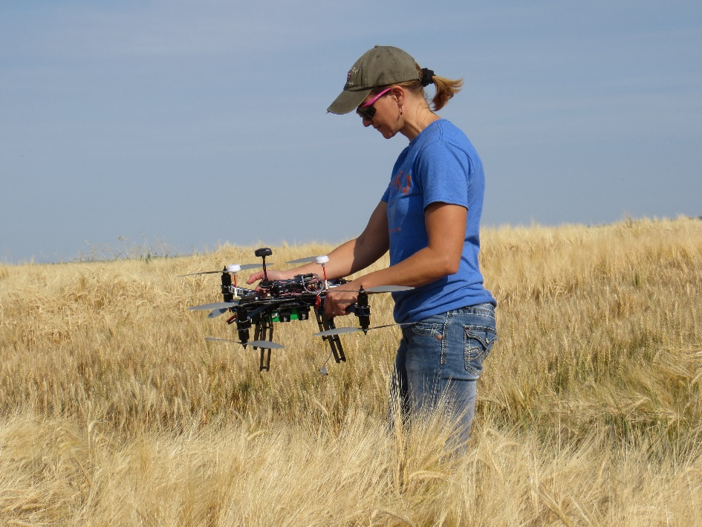
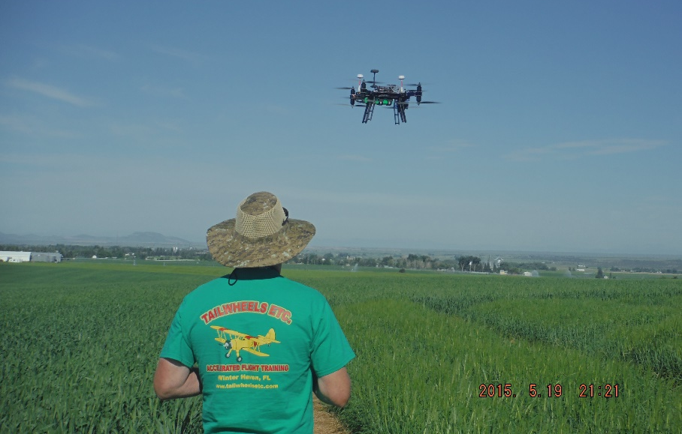

Slide 10
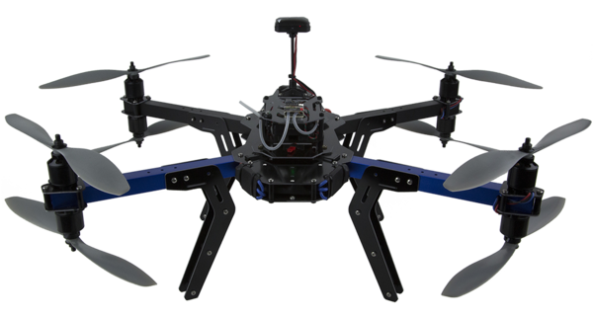
2015 Data Collection (UAV)
3D Robotics 8X+ (quad-copter) UAV equipped with:
  natural color cameras (Canon S100 and SX260)
  a NIR camera (converted Canon SX260)
  Forward Looking Infrared thermal camera (TAU 2)

Slide 11
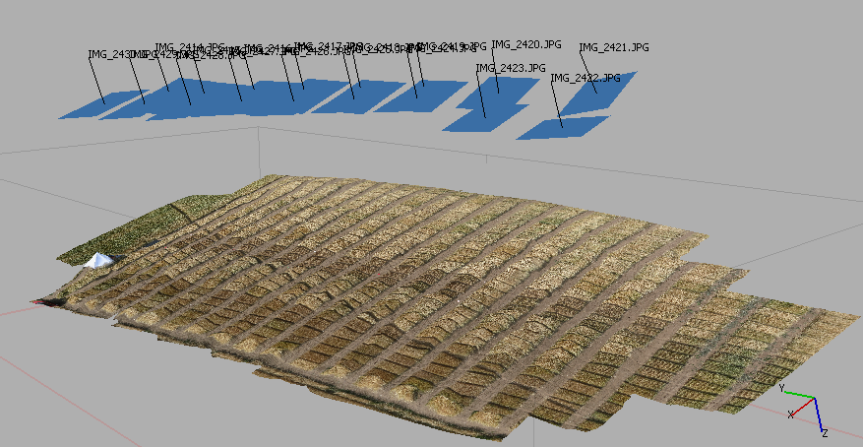
3-D Mosaic displaying Image Capture Altitude & Angle Panels*

Slide 12
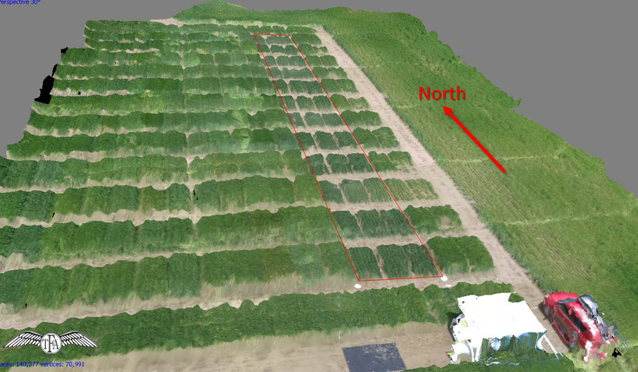
3-D view of wheat plots, Rupert, ID

Slide 13
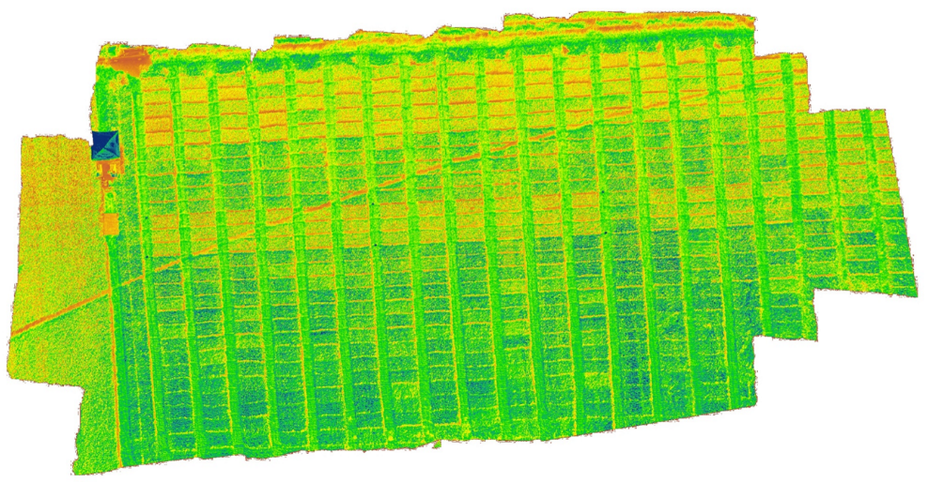
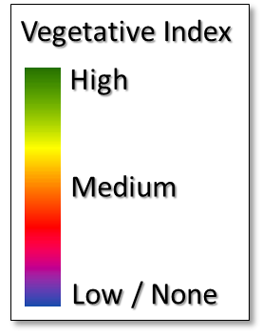
NDVI data collected with UAV

Slide 14
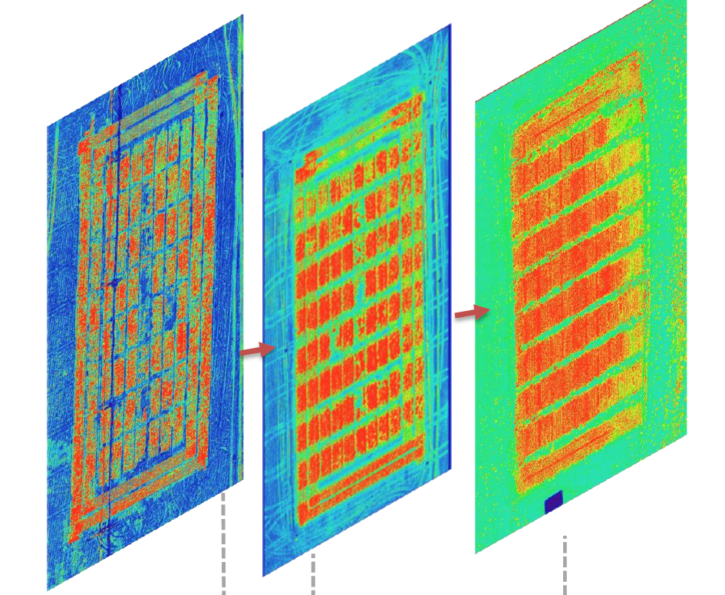
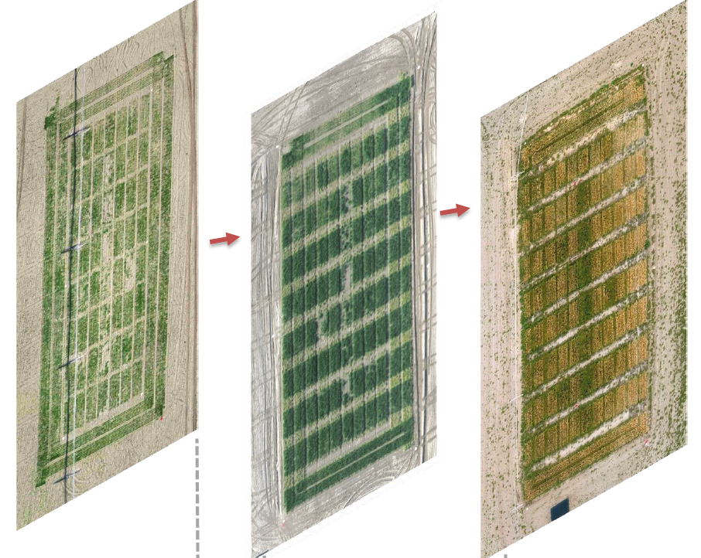
Seasonal image progression, Aberdeen, ID
NDVI imagery
natural color imagery
→Early June
→Late June
→Mid August

Slide 15
2015 Findings and 2016 Proposed Work

Slide 16
Optimum N rates
UI recomm. => optimum N rate should have been ~ 215 lb/ac
2015→Observed relationship between N rate and yield=> 120-145 lb/ac:
  75 lb/ac (applied) + 45 to 70 lb/ac (residual) is close to optimum for Eastern ID
2016→Need to update N fertilizer guidelines

Slide 17
Disease monitoring
2015 lessons:
  Requires much larger/longer plots
  Suitable for larger expansive project
  More labor/expertize in pathology
2016 → Focus on nutrient management
  Research/other projects/technologies
  Bring on-board newly hired plant pathologist, James Woodhall (Parma)

Slide 18
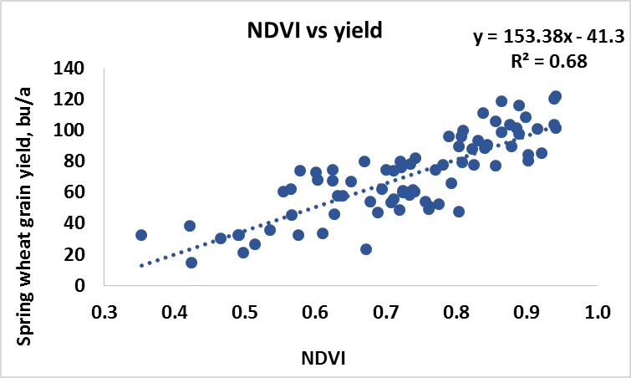
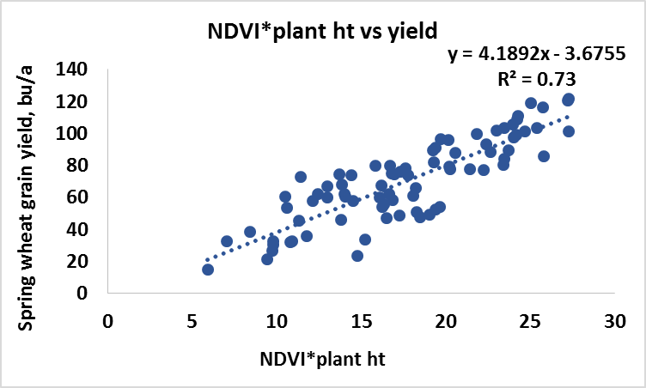
GreenSeeker NDVI vs yield
GreenSeeker NDVI explained 68% of variation in wheat yield.
NDVI + plant height increased accuracy of yield prediction to 73%.

Slide 19
YP Prediction & N recommendations
2015→Established one initial YP prediction equation:
  for dryland and irrigated conditions
  73% accuracy
2016→Improve YP prediction ability:
  additional data →more accuracy
  add Parma location
  develop initial N fertilization recommendations (NDVI→N rate)

Slide 20
UAV methodology
2015: Identified best flight methods:
  Altitude: 100 feet; Speed: 2.5m/s; Wind: 10 knots max
  Airframe: stay with multicopter, stable
  Image capture/processing: switch to multi-spectral sensor with Green, Red and NIR + software for multi-band images
  Battery: increase supply of batteries
2016→ Follow developed methodology for best image capture and processing
Quantitatively compare GS NDVI maps vs UAV NDVI maps

Slide 21
PUBLICATIONS:
Olga S. Walsh. 2015. Nitrogen Management in Field Crops with Reference Strips and Crop Sensors. BUL 896.
Olga S. Walsh and Kelli M. Belmont. 2015. Improving Nitrogen-Use Efficiency in Idaho Crop Production. BUL 899.
Olga S. Walsh, Juliet Marshall, and Arjun Pandey. 2015. Precision Sensing for Improved Wheat Production. ASA/CSSA/SSSA International Annual Conference, Minneapolis, MN, November 15-18, 2015.
Olga S. Walsh. 2015. Precision Nitrogen Management. Idaho Grain Magazine. Summer 2015.

Slide 22
Acknowledgements
Idaho Wheat Commission
Craig Thompson and Kristin Swoboda, Take Flight UAS, LLC.
Juliet Marshall, Cereals Pathologist and Agronomist
Arjun Pandey, Ph.D. student
Chad Jackson, Research Specialist
Kelli Belmont, Research Technician
Jordan McClintick-Chess, Agricultural Technician

Slide 23

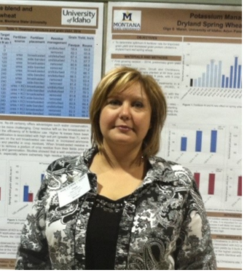
Thank you!
Questions?
Olga Walsh owalsh@uidaho.edu
University of Idaho, Parma R&E Center
Tel: (208)722-6701
Web: IDCrops (http://idcrops.blogspot.com/) Twitter: @IDCrops

