Slide 1
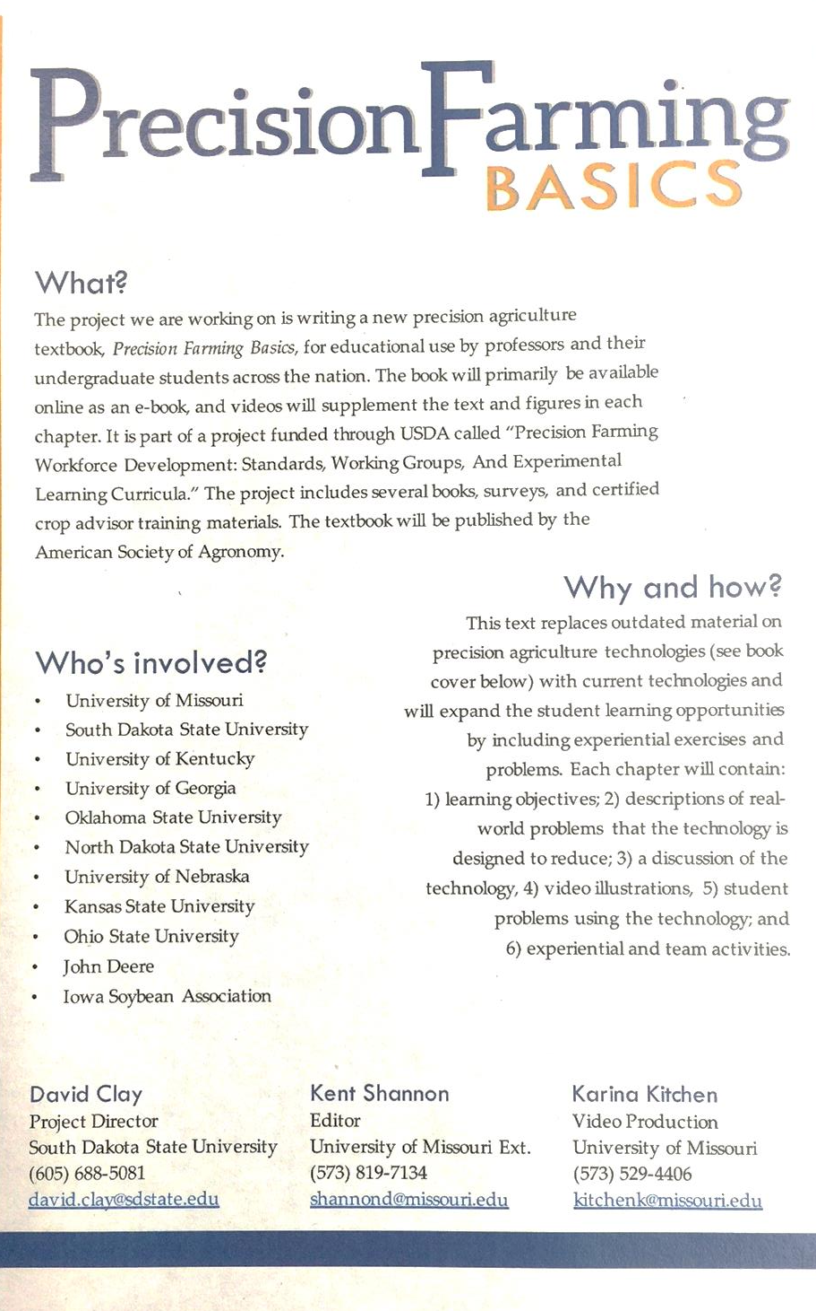
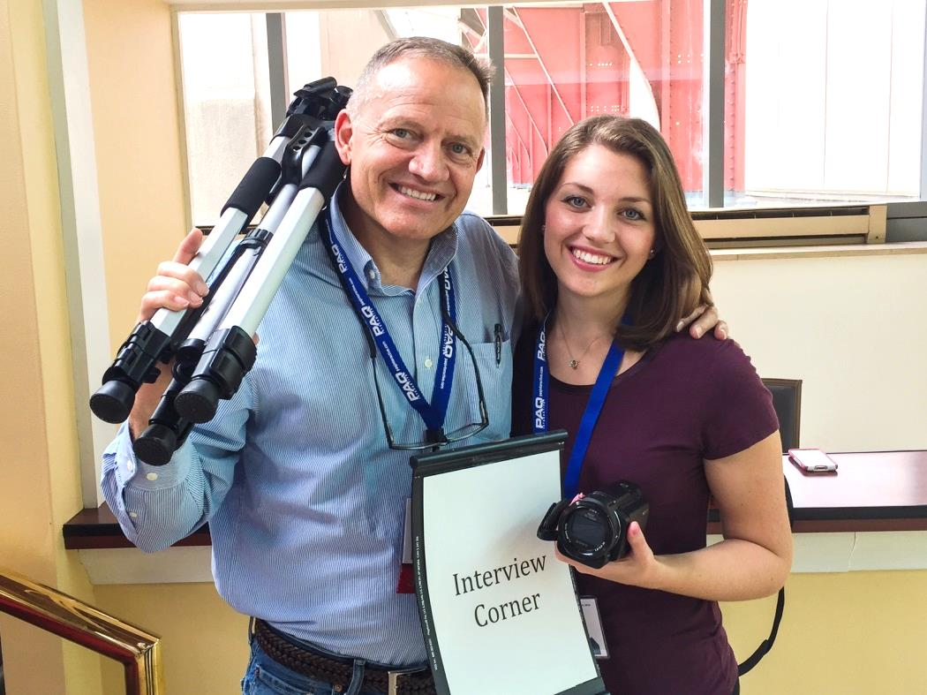

Slide 3
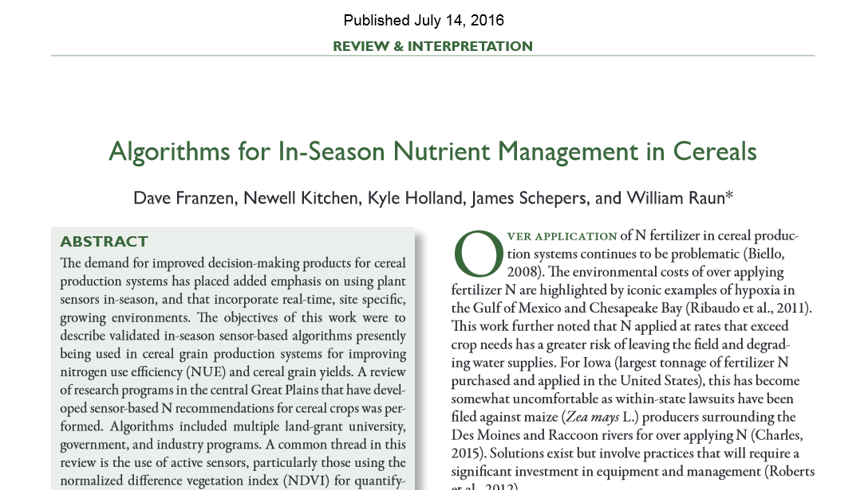

Slide 4
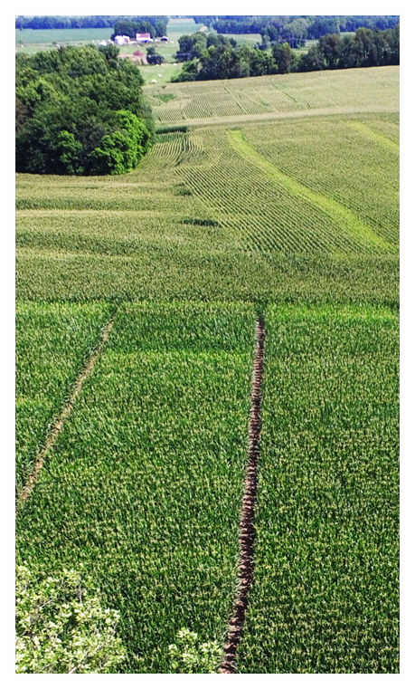
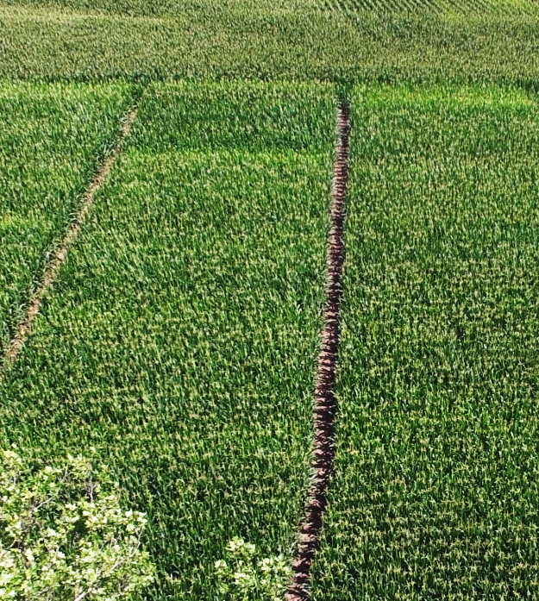
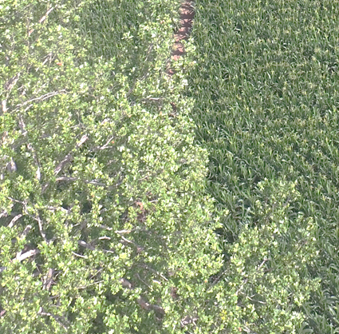
Improving Canopy Sensor Algorithms with Soil and Weather Information
Newell R. Kitchen, USDA-ARS
G. Mac Bean, University of Missouri
Ken A. Sudduth, USDA-ARS
Scott T. Drummond, USDA-ARS
Matt A. Yost, USDA-ARS
Notes:
Animated title moves behind picture
(Intermediate)
To reproduce the shape effects on this slide, do the following:
On the Home tab, in the Slides group, click Layout, and then click Blank.
On the Home tab, in the Drawing group, click Shapes, and then under Rectangles click Rectangle (first option from the left). On the slide, drag to draw a rectangle.
Select the rectangle. Under Drawing Tools, on the Format tab, in the Size group, do the following:
In the Shape Height box, enter 3.17”.
In the Shape Width box, enter 9.5”.
Drag the rectangle slightly above the middle of the slide.
Select the rectangle. On the Home tab, in the Drawing group, click Arrange, point to Align, and then do the following:
Click Align to Slide.
Click Align Left.
Under Drawing Tools, on the Format tab, in the Shape Styles group, click the next to Shape Outline, and then click No Outline.
Under Drawing Tools, on the Format tab, in the Shape Styles group, click the Format Shape dialog box launcher. In the Format Shape dialog box, click Fill in the left pane, select Gradient fill in the Fill pane, and then do the following:
In the Type list, select Linear.
In the Angle box, enter 0.
Under Gradient stops, click Add gradient stops or Remove gradient stops until two stops appear in the slider.
Also under Gradient stops, customize the gradient stops as follows:
Select the first stop in the slider, and then do the following:
In the Position box, enter 0%.
Click the button next to Color, and then under Theme Colors click Orange, Accent 6, Darker 50% (fifth row, 10th option from the left).
Select the next stop in the slider, and then do the following:
In the Position box, enter 100%.
Click the button next to Color, and then under Theme Colors click Orange, Accent 6, Darker 25% (fourth row, 10th option from the left).
To reproduce the “heading” text box on this slide, do the following:
On the Insert tab, in the Text group, select Text Box. On the slide, drag to draw a text box.
Enter the heading text, and then select text. On the Home tab, in the Font group, do the following:
In the Font list, select Calibri.
In the Font Size box, enter 38.
Click Bold.
Click the arrow next to Font Color, and then under Theme Colors click Orange, Accent 6, Darker 25% (fourth row, 10th option from the left).
On the Home tab, in the Paragraph group, click Align Text Left.
Drag the text box just above the rectangle, in the right half of the slide.
To reproduce the second text box on this slide, do the following:
On the Insert tab, in the Text group, click Text Box. On the slide, drag to draw a text box.
Enter three lines of text with paragraph breaks, and then select the text. On the Home tab, in the Font group, do the following:
In the Font list, select Calibri.
In the Font Size list, select 28.
Click Bold.
Click the arrow next to Font Color, and then under Theme Colors click White, Background 1 (first row, first option from the left).
On the Home tab, in the Paragraph group, click the Paragraph dialog box launcher. In the Paragraph dialog box, do the following:
On the Indents and Spacing tab, under General, select Left in the Alignment box.
Under Spacing, select 12 in the After box.
Drag the second text box onto the rectangle, below the “heading” text box.
To reproduce the full-color picture on this slide, do the following:
On the Insert tab, in the Images group, click Picture. In the Insert Picture dialog box, select a picture, and then click Insert.
On the slide, select the picture. Under Picture Tools, on the Format tab, in the Size group, click the Size and Position dialog box launcher. In the Format Picture dialog box, resize or crop the image so that the height is set to 5.08” and the width is set to 2.61”. To crop the picture, click Crop in the left pane, and in the right pane, under Crop position, enter values into the Height, Width, Left, and Top boxes. To resize the picture, click Size in the left pane, and in the right pane, under Size and rotate, enter values into the Height and Width boxes.
Also in the Format Picture dialog box, click Glow and Soft Edges in the left pane, and then, in the Glow and Soft Edges pane, do the following:
Under Glow, click the button next to Presets, and then click Blue, 5 pt glow Accent color 1 (first row, first option from the left).
Click the button next to Color, and then under Theme Colors click White, Background 1 (first row, first option from the left).
Drag the full-color picture on top of the rectangle, to the left of the text boxes.
On the Home tab, in the Drawing group, click Arrange, point to Align, and then do the following:
Click Align to Slide.
Click Align Top.
To reproduce the second picture on this slide, do the following:
On the Insert tab, in the Images group, click Picture. In the Insert Picture dialog box, select the same picture, and then click Insert.
On the slide, select the picture. On the slide, select the picture. Under Picture Tools, on the Format tab, in the Size group, click the Size and Position dialog box launcher. In the Format Picture dialog box, resize or crop the image so that the height is set to 2.44” and the width is set to 2.61”. To crop the picture, click Crop in the left pane, and in the right pane, under Crop position, enter values into the Height, Width, Left, and Top boxes. To resize the picture, click Size in the left pane, and in the right pane, under Size and rotate, enter values into the Height and Width boxes.
On the slide, drag the new picture directly below the first one, and then, in the Format Picture dialog box, in the Crop tab, under Picture Position, adjust the Offset X and Offset Y settings to align the content of the two images so that they appear continuous.
Also in the Format Picture dialog box, click Picture Corrections in the left pane, and in the Picture Corrections pane, under Brightness and Contrast, do the following:
In the Brightness box, enter 70%.
In the Contrast box, enter -70%.
Select the smaller picture. On the Home tab, in the Drawing group, click Arrange, point to Align, and then do the following:
Click Align to Slide.
Click Align Bottom.
Press and hold CTRL, and then select both pictures. On the Home tab, in the Drawing group, click Arrange, point to Align, and then do the following:
Click Align Selected Objects.
Click Align Center.
To reproduce the animation effects on this slide, do the following:
On the slide, select the “heading” text box. On the Animations tab, in the Advanced Animation group, click Add Animation, and then under Entrance click Fade.
On the Animations tab, in the Timing group, in the Start list, select With Previous.
On the Animations tab, in the Timing group, in the Duration box, enter 2.
On the Animations tab, in the Timing group, in the Delay box, enter 1.5.
On the slide, select the “heading” text box. On the Animations tab, in the Advanced Animation group, click Add Animation, and then under Motion Paths click Lines.
On the Animations tab, in the Timing group, in the Start list, select With Previous.
On the Animations tab, in the Timing group, in the Duration box, enter 2.
On the Animations tab, in the Animation group, click Effect Options, and then click Left.
On the Animations tab, in the Animation group, click Effect Options, and then click Reverse Path Direction.
On the slide, select the motion path for the “heading” text box, point to the starting point (green arrow) of the motion path until the cursor becomes a two-headed arrow. Press and hold SHIFT, and then drag the starting point about 1.5” off the left edge of the slide. (Note: If your lines of text are longer than in the example above, you may need to further increase the length of the motion path. )
On the slide, select the second text box. On the slide, select the “heading” text box. On the Animations tab, in the Advanced Animation group, click Add Animation, and then under Entrance click Fade.
On the Animations tab, in the Animation group, click the Show Additional Effect Options dialog box launcher. In the Fade dialog box, do the following:
On the Effect tab, in the Animate text list, select By Letter.
In the % delay between letters box, enter 5.
On the Timing tab, in the Start list, select After Previous.
In the Duration list, select 0.5 seconds (Very Fast).
On the Text Animation tab, in the Group text list, select By 1st Level Paragraphs.
To reproduce the background on this slide, do the following:
One the Design tab, in the Background group, click Background Styles, and then click Format Background. In the Format Background dialog box, click Fill in the left pane, select Gradient fill in the Fill pane, and then do the following:
In the Type list, select Radial.
Click the button next to Direction, and then click From Center (third option from the left).
Under Gradient stops, click Add gradient stops or Remove gradient stops until three stops appear in the slider.
Also under Gradient stops, customize the gradient stops as follows:
Select the first stop in the slider, and then do the following:
In the Position box, enter 0%.
Click the button next to Color, and then under Theme Colors click White, Background 1 (first row, first option from the left).
In the Transparency box, enter 0%.
Select the next stop in the slider, and then do the following:
In the Position box, enter 40%.
Click the button next to Color, and then under Theme Colors click White, Background 1 (first row, first option from the left).
In the Transparency box, enter 0%.
Select the next stop in the slider, and then do the following:
In the Position box, enter 100%.
Click the button next to Color, click More Colors, and then in the Colors dialog box, on the Custom tab, enter values for Red: 232, Green: 227, and Blue: 216.

Slide 5
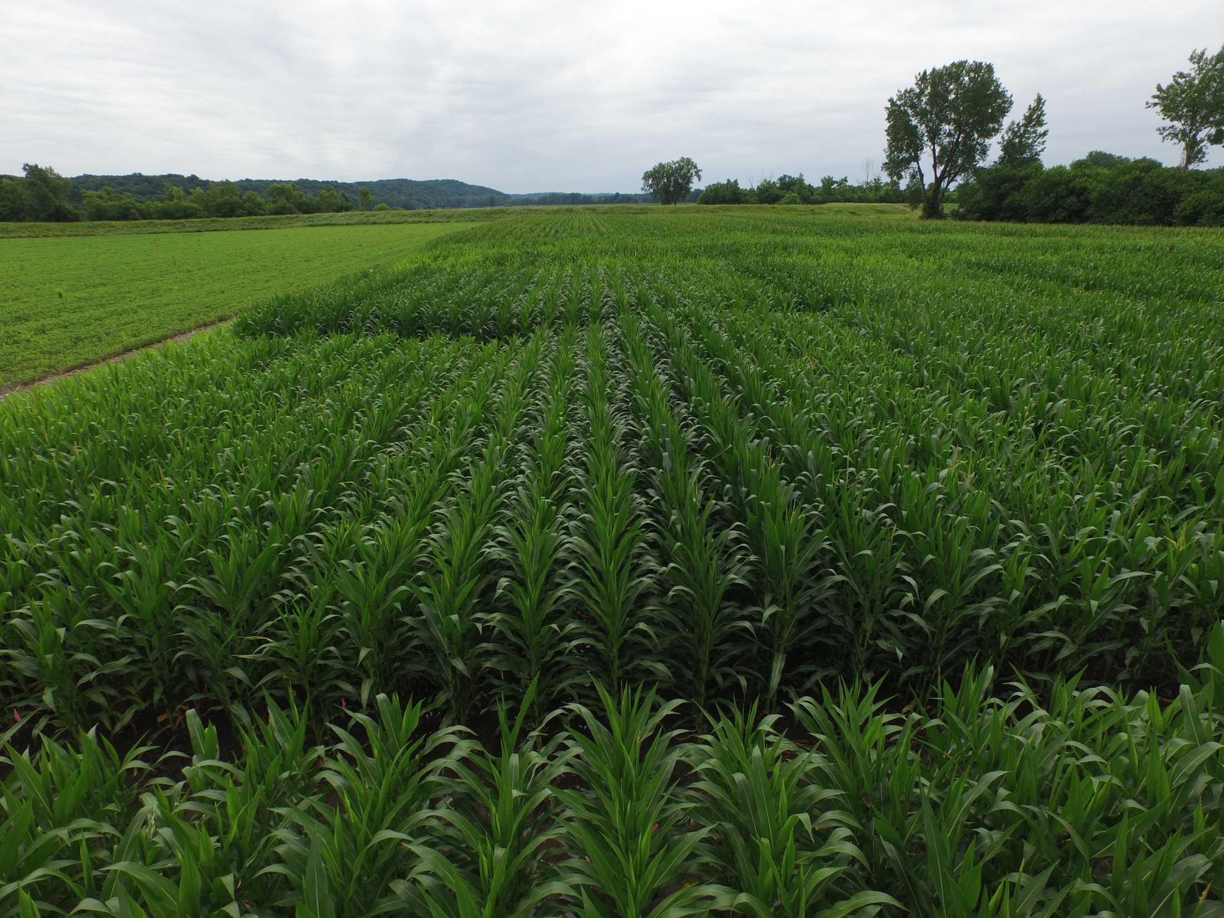
Several canopy sensor algorithms are available
University of Missouri (MU)
Nrec = 250 * (ISR_{target} / ISR_{reference}) - 200
Holland Scientific (HS)
Nrec = (N opt - N cred) * SQRT((1 - SI)/∆SI)
Oklahoma State Univ. (OSU)
YP₀ = 1.291*(EXP(NDVI/Sum of GDD * 2649.9))
RI = NDVI_{N-rich}/NDVI_{Target}
YP_{N} = YP₀ * RI
  Nrec = ((YPN - YP0)* 0.0125)/expected NUE

Slide 6
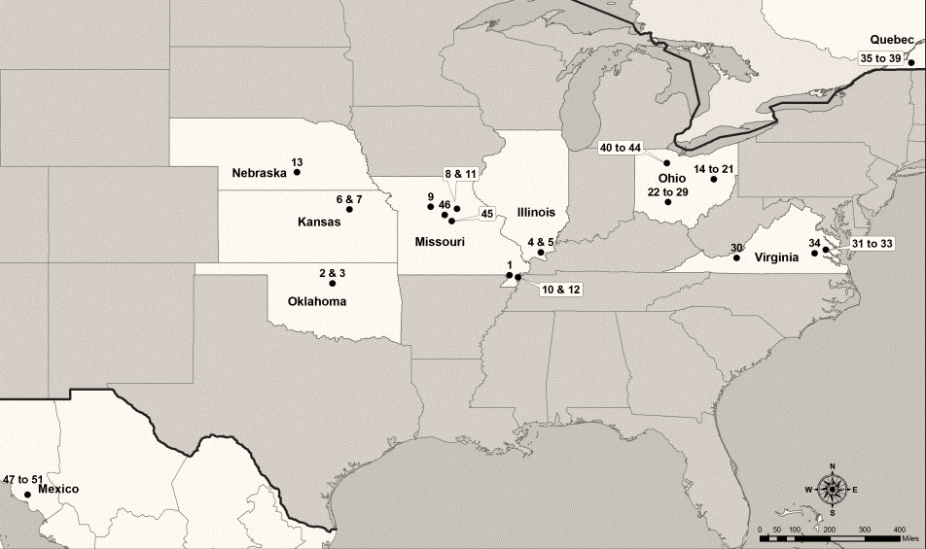
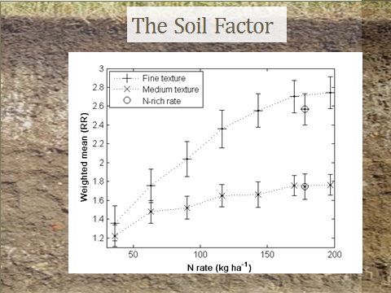
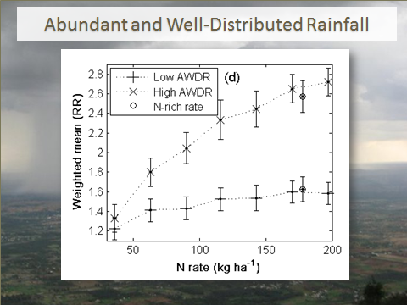
National/International NUE Project
(Tremblay et al., 2012)
Notes:
Meta-analyses on aggregated large datasets
Wide range in soil types, (textural classes) precipitation, distribution of precipitation, growing degree days

Slide 7
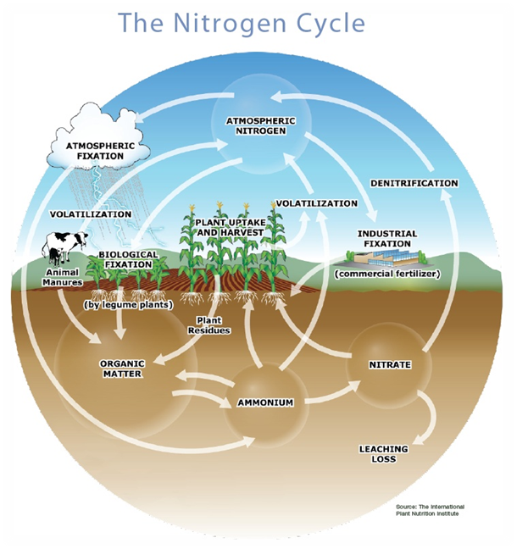
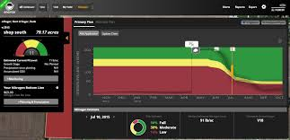

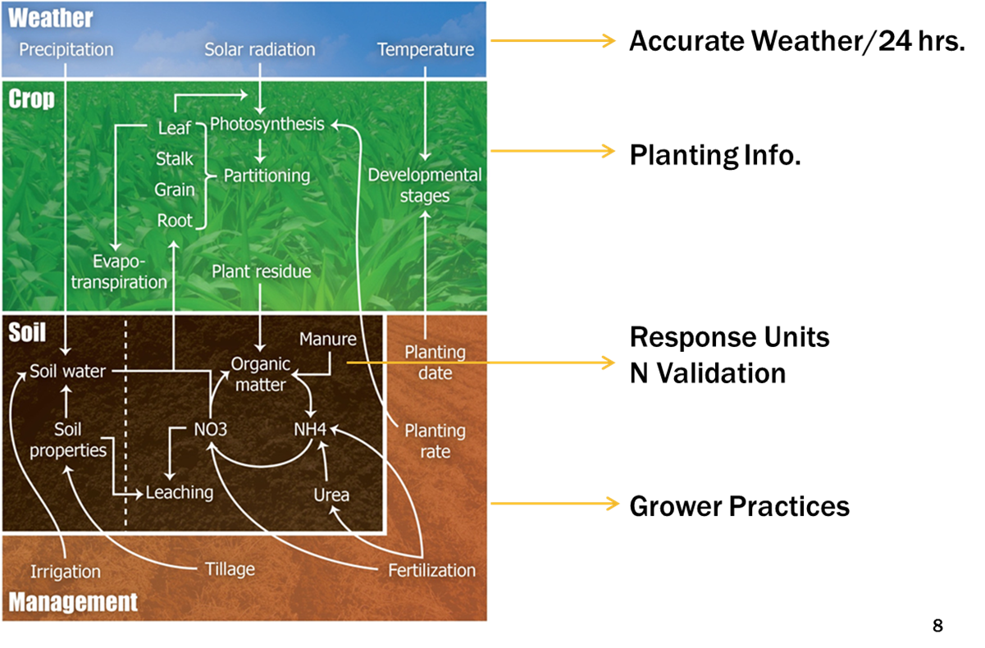
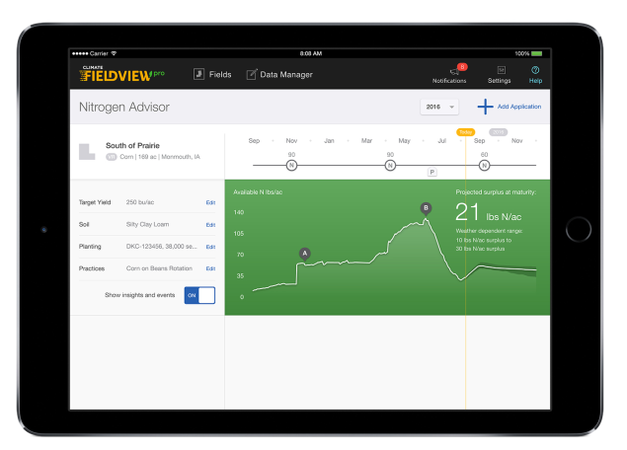

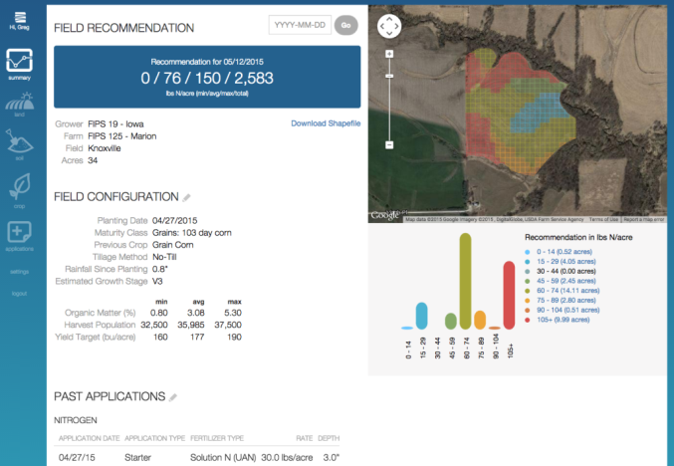

Crop Growth Modeling
Courtesy of DuPont Pioneer

Slide 8
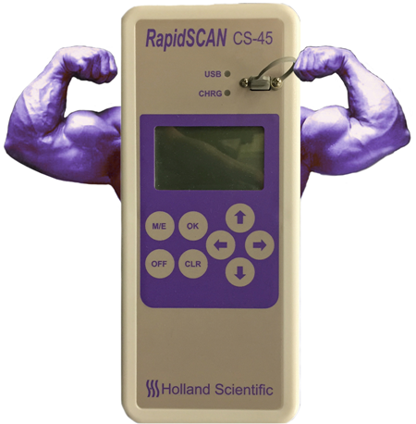
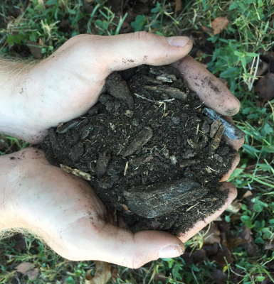

Objectives
Evaluate the performance of the University of Missouri corn algorithm
Use soil and weather information to improve in-season algorithm recommendations
Test with an independent dataset
+
=

Slide 9
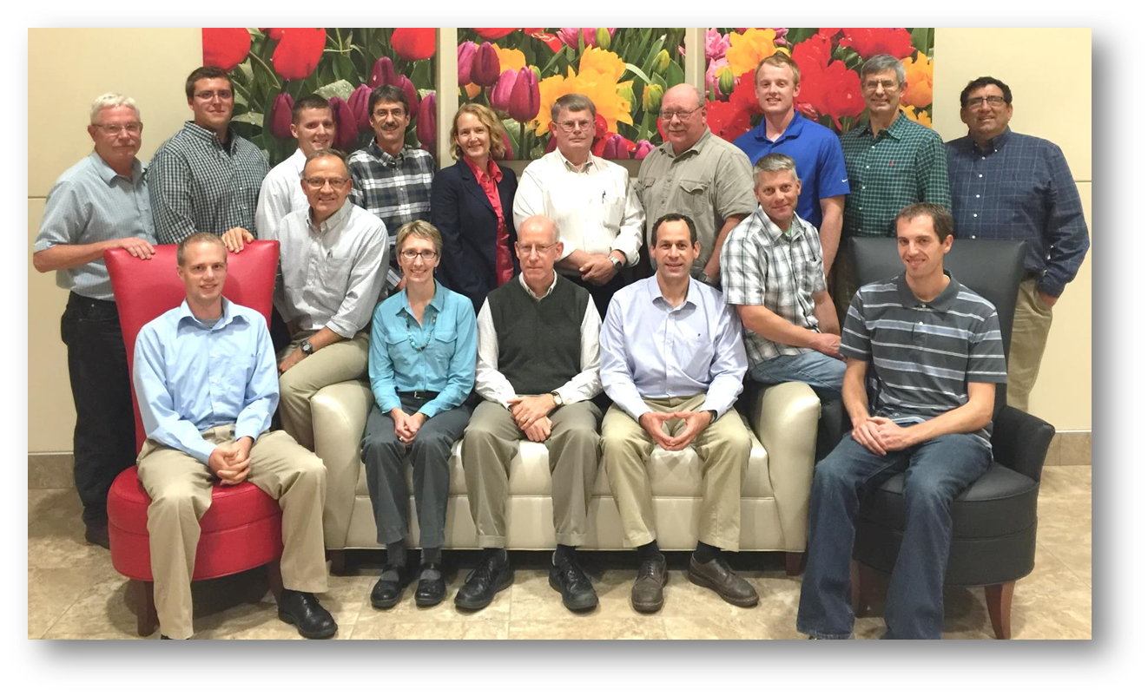


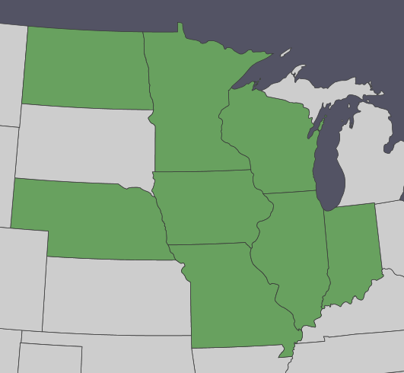







Performance and Refinement of
In-season Corn Nitrogen
Fertilization Tools
David Franzen
North Dakota St. University
Fabián Fernández
University of Minnesota
John Sawyer
Iowa State University
Carrie Laboski
University of Wisconsin
Richard Ferguson
University of Nebraska
Emerson Nafziger
University of Illinois
Newell Kitchen
USDA-ARS
University of Missouri
James Camberato
Purdue University
Paul R. Carter
John Shanahan

Slide 10
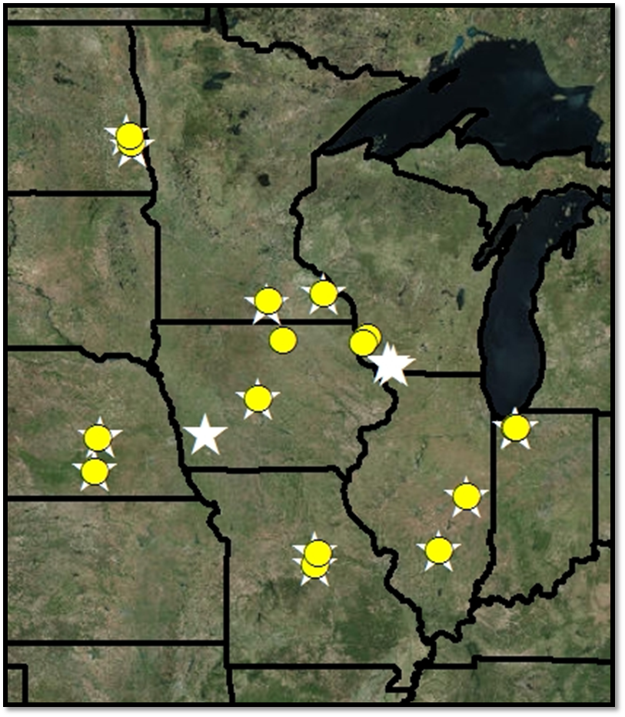

Materials and Methods
  32 sites over 8 states (4 from each) from the 2014 and 2015 growing seasons used in the analysis
Yellow circles = 2014 sites
White stars = 2015 sites

Slide 11
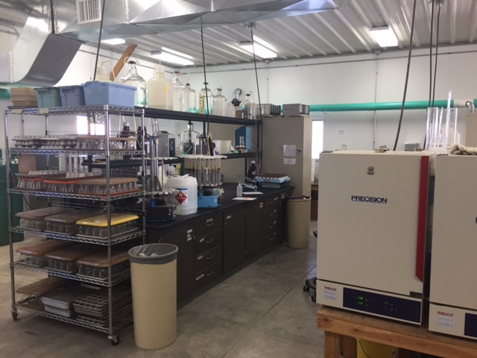
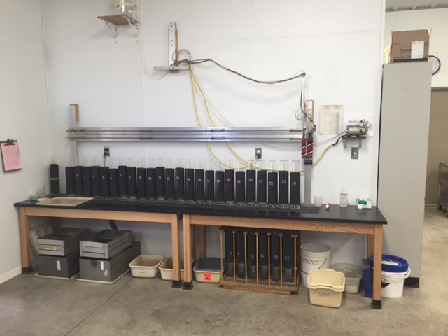
Soil Information
SSURGO obtained from NRCS USDA
  % clay, % Organic Matter (OM), Plant Available Water (PAWC)
Field measured soil properties collected with hydraulic probe and sent to University of Missouri Soil Health Assessment Center for analysis
    - % clay, % OM, PAWC

Slide 12
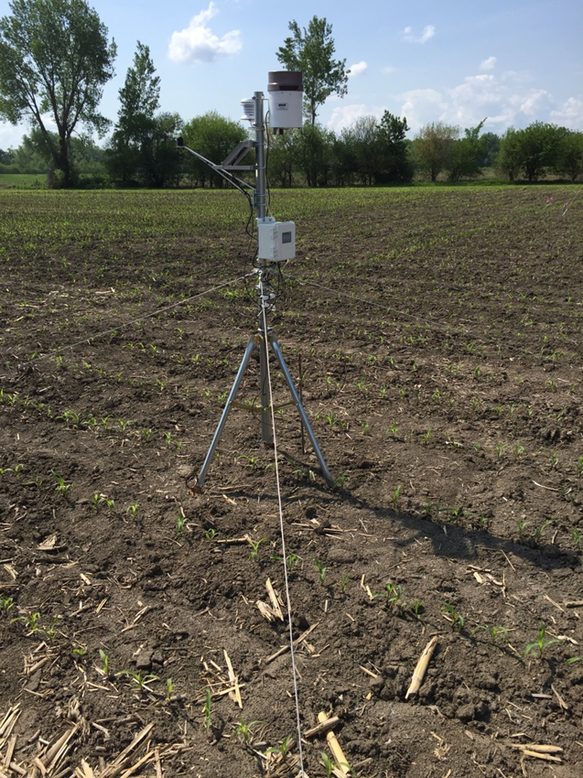
Weather Information
  Weather data from planting to canopy sensing were analyzed, including:
  - Growing degree days
  - Total precipitation
  - Shannon Diversity Index (SDI) of precipitation
  - Abundant and Well Distributed Rainfall (AWDR)
  SDI * Total Precipitation
  - Tremblay et al., 2012

Slide 13
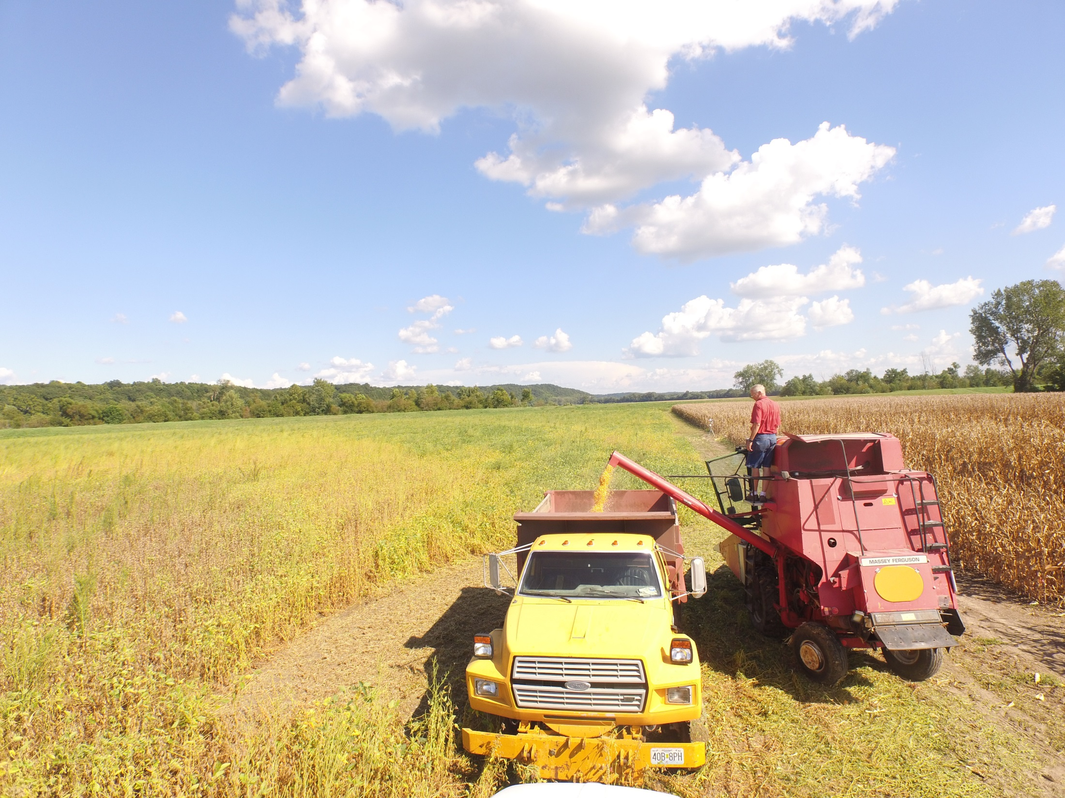
Results

Slide 14
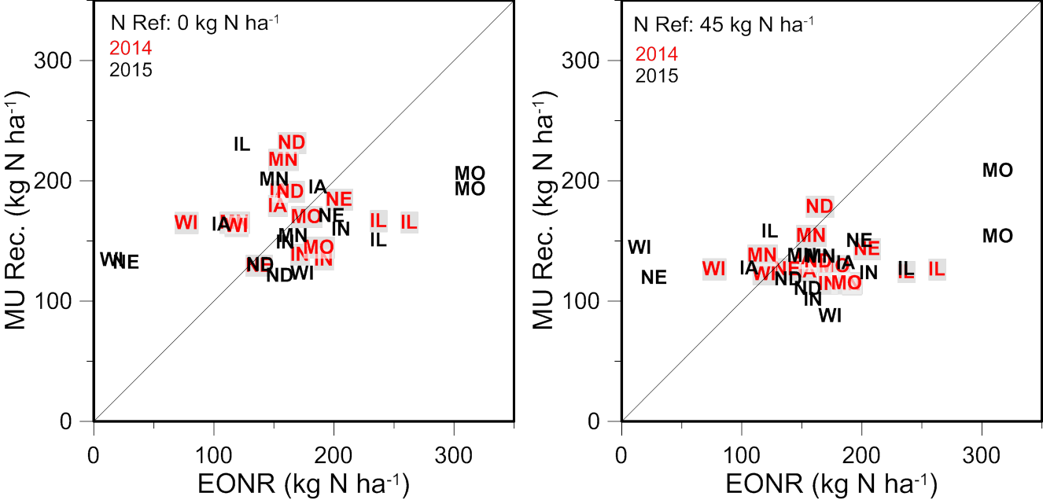
University of Missouri
Overestimated
Overestimated
Underestimated
Underestimated

Slide 15
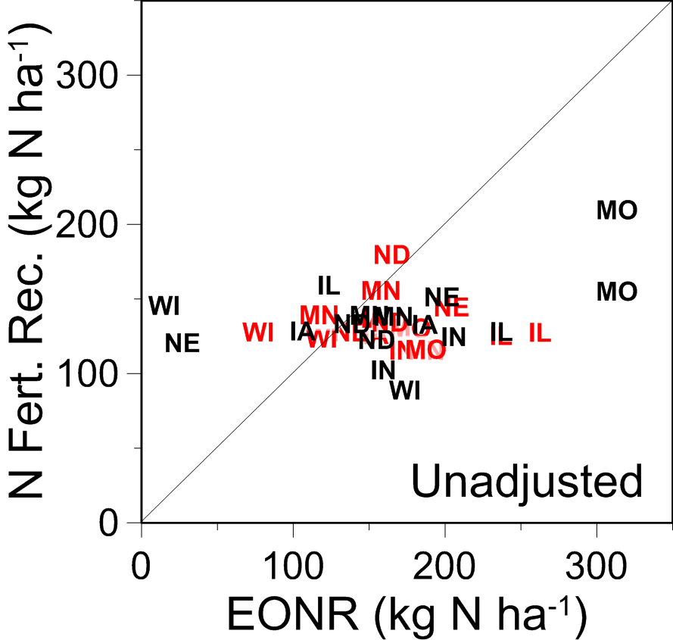
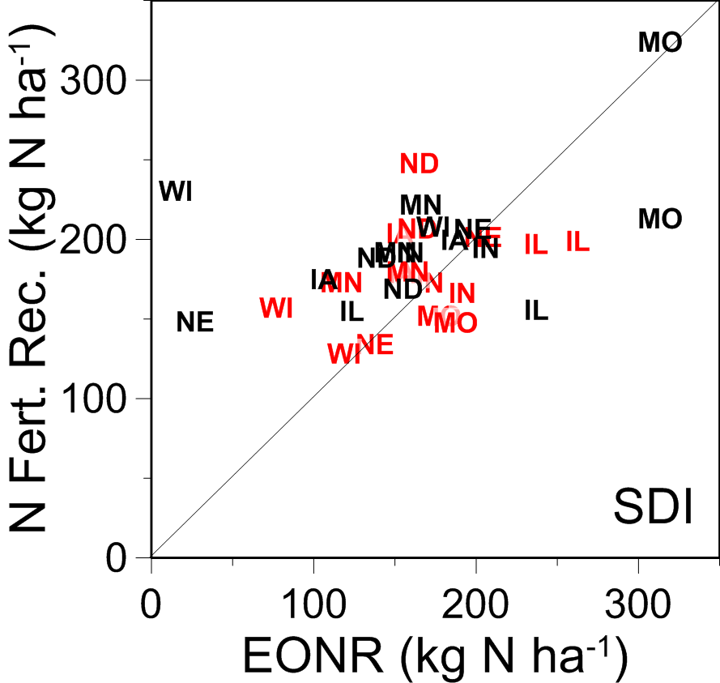
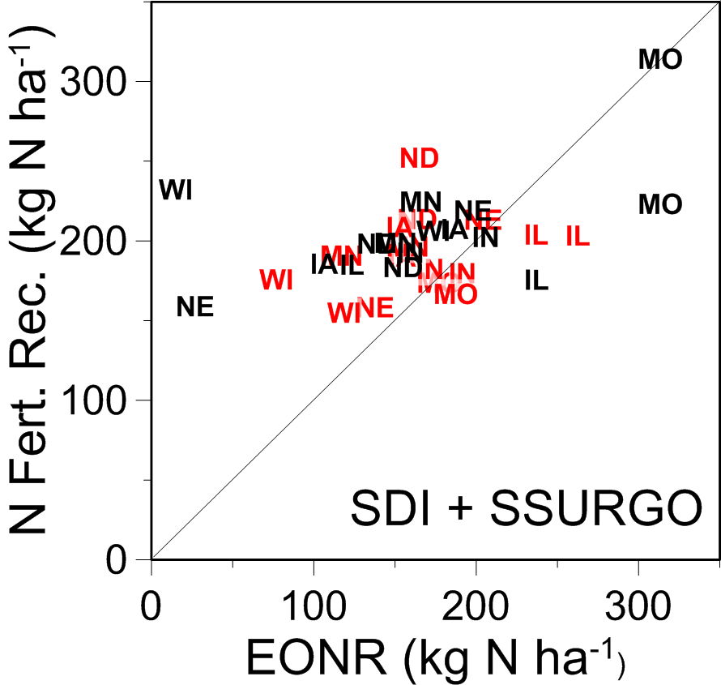
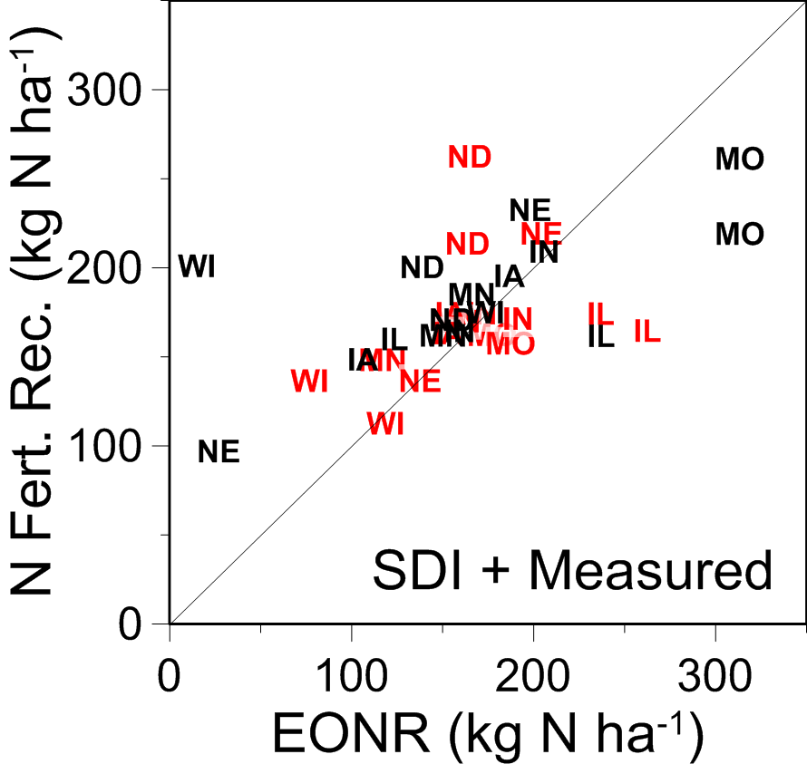
45 kg N ha⁻¹
RMSE: 76
RMSE: 60
RMSE: 61
RMSE: 54

Slide 16
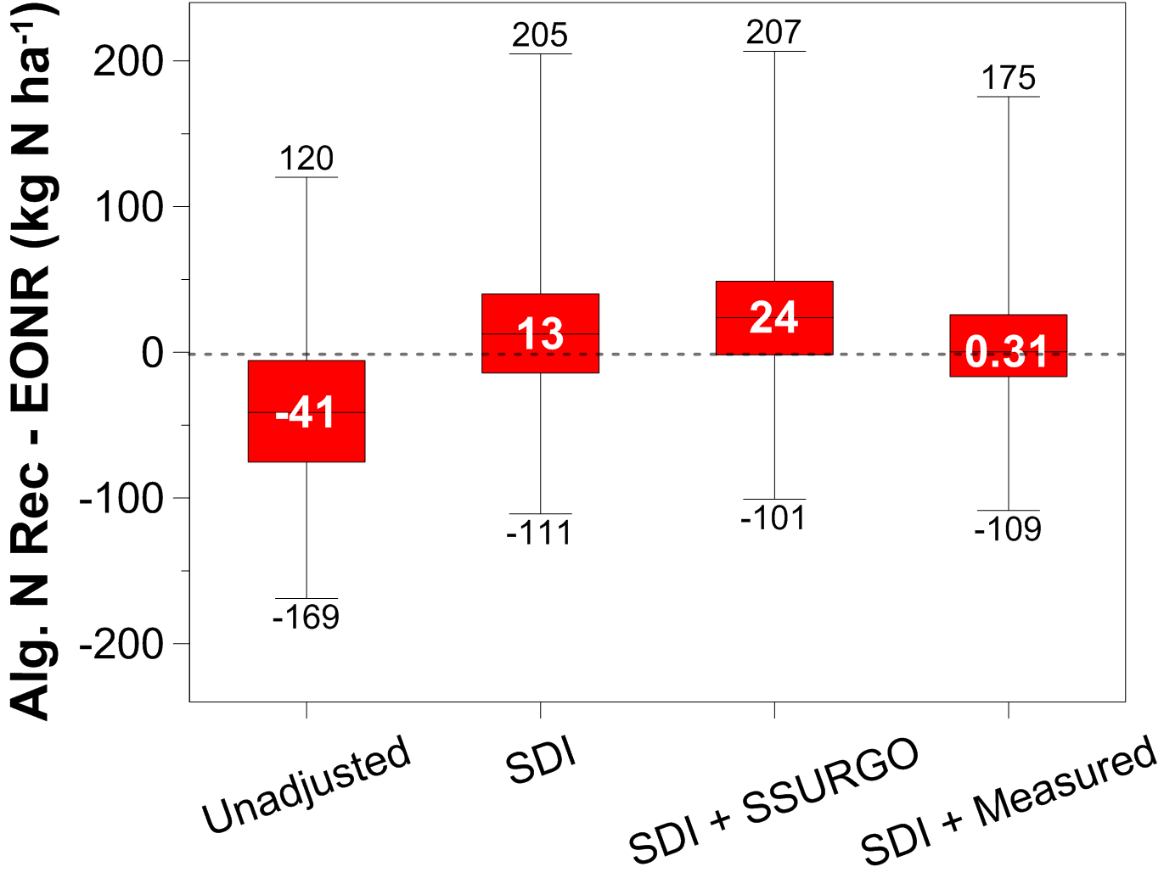
45 kg N ha⁻¹

Slide 17
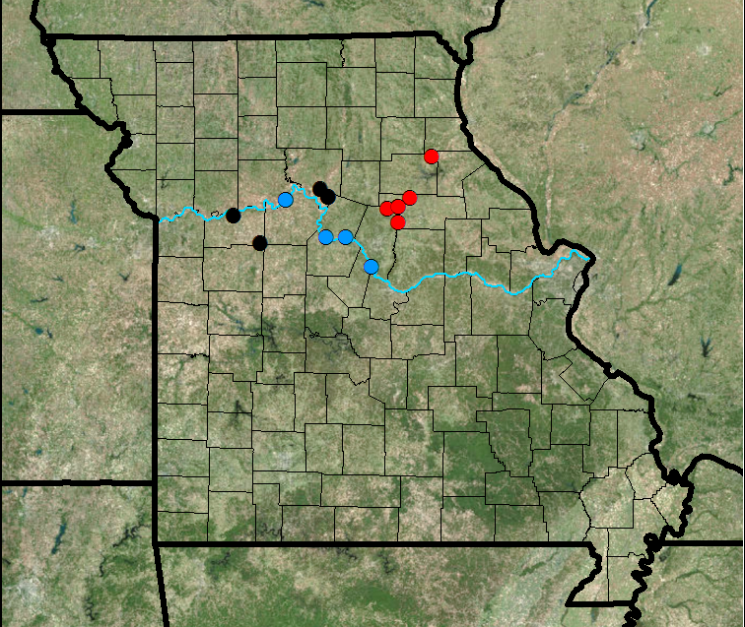
Test with independent dataset
Ground-Based Canopy Reflectance Sensing for Variable-Rate Nitrogen Corn Fertilization Agronomy J. (Kitchen et al., 2010).
16 field-scale (400-800 m) N response studies were conducted in 2004-2007.
182 response blocks.

Slide 18
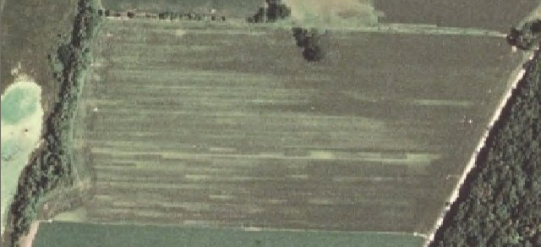
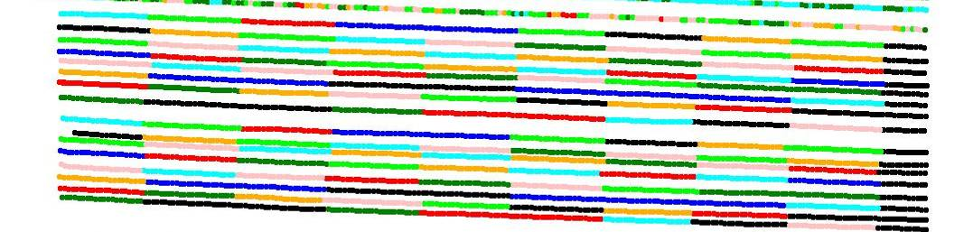
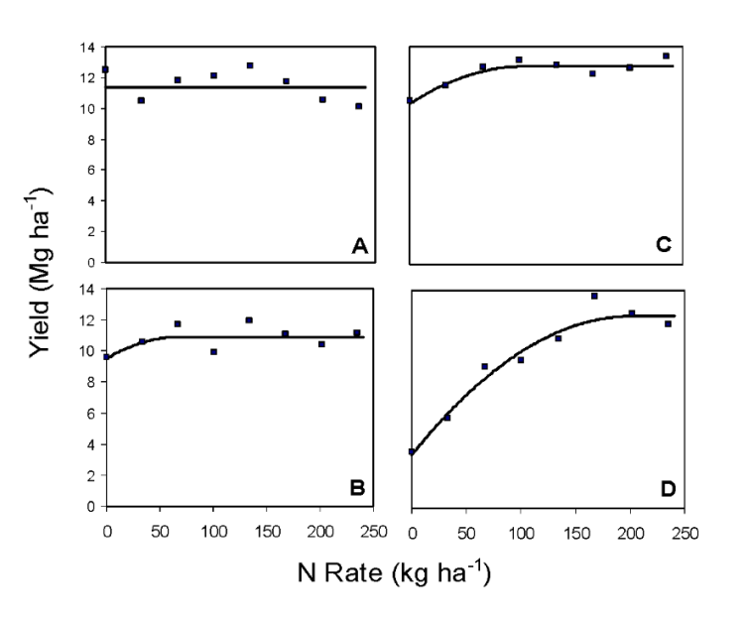
Each block consisted of 8 N treatments from 0 to 235 kg N ha⁻¹ on 34 kg N ha⁻¹ increments, side-dressed sometime between V7 and V11.

Slide 19
Nitrogen Recommendation vs EONR
By Each Response Block

Slide 20
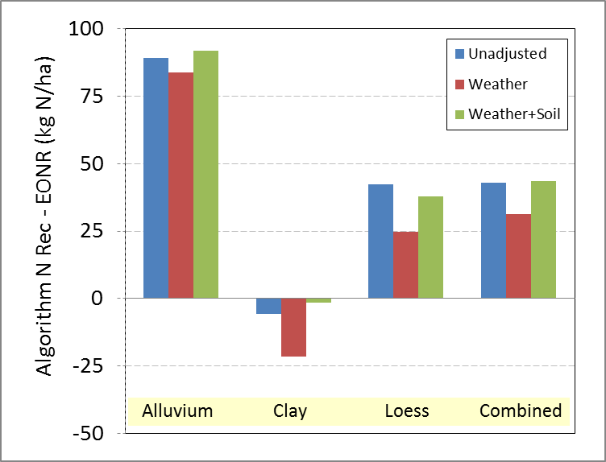

Slide 22
Nitrogen Recommendation vs EONR
By Field

Slide 23
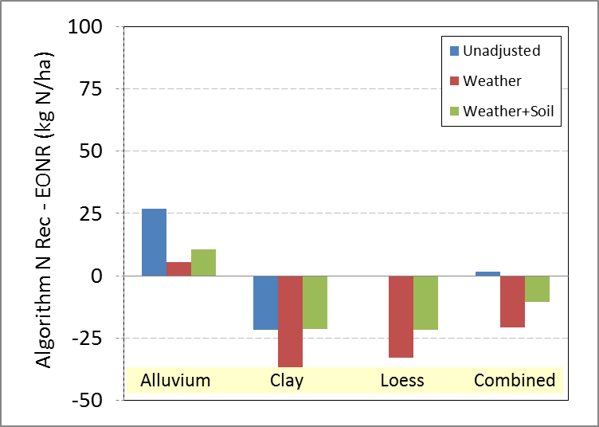

Slide 24
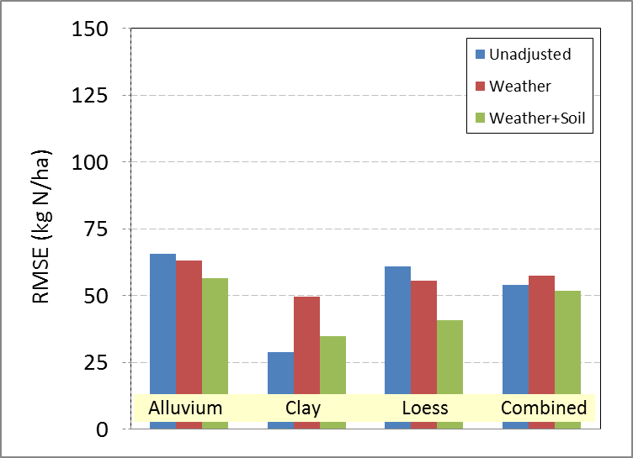

Slide 25


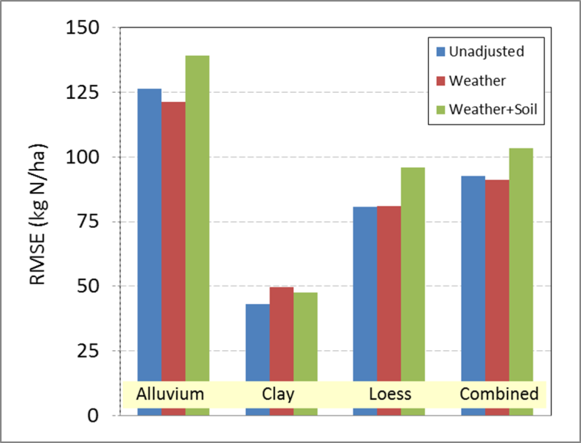

By Response Block
By Field
Accuracy
Precision

Slide 26
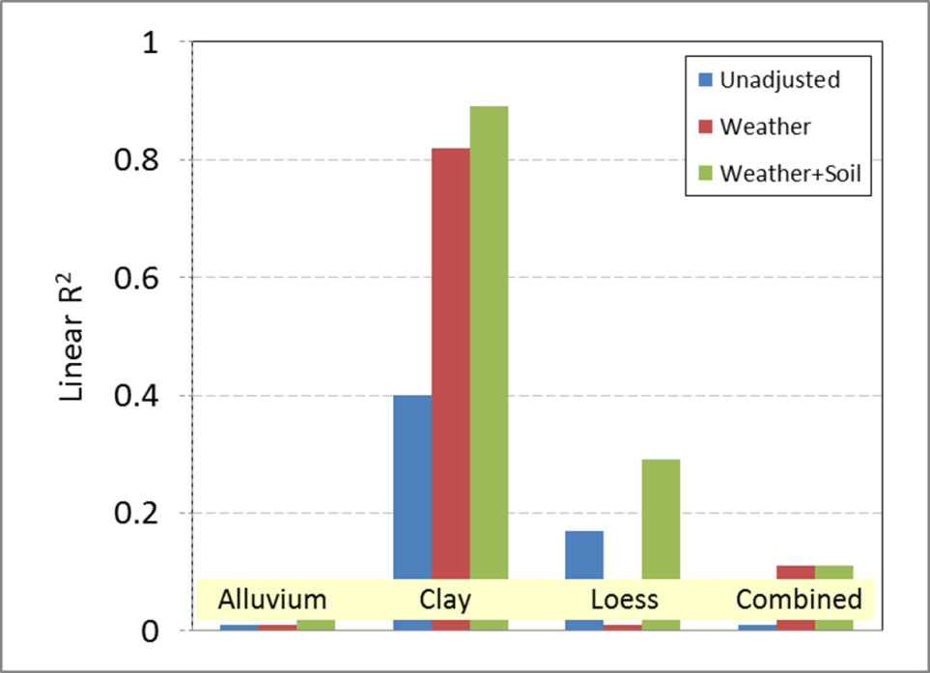

Slide 27
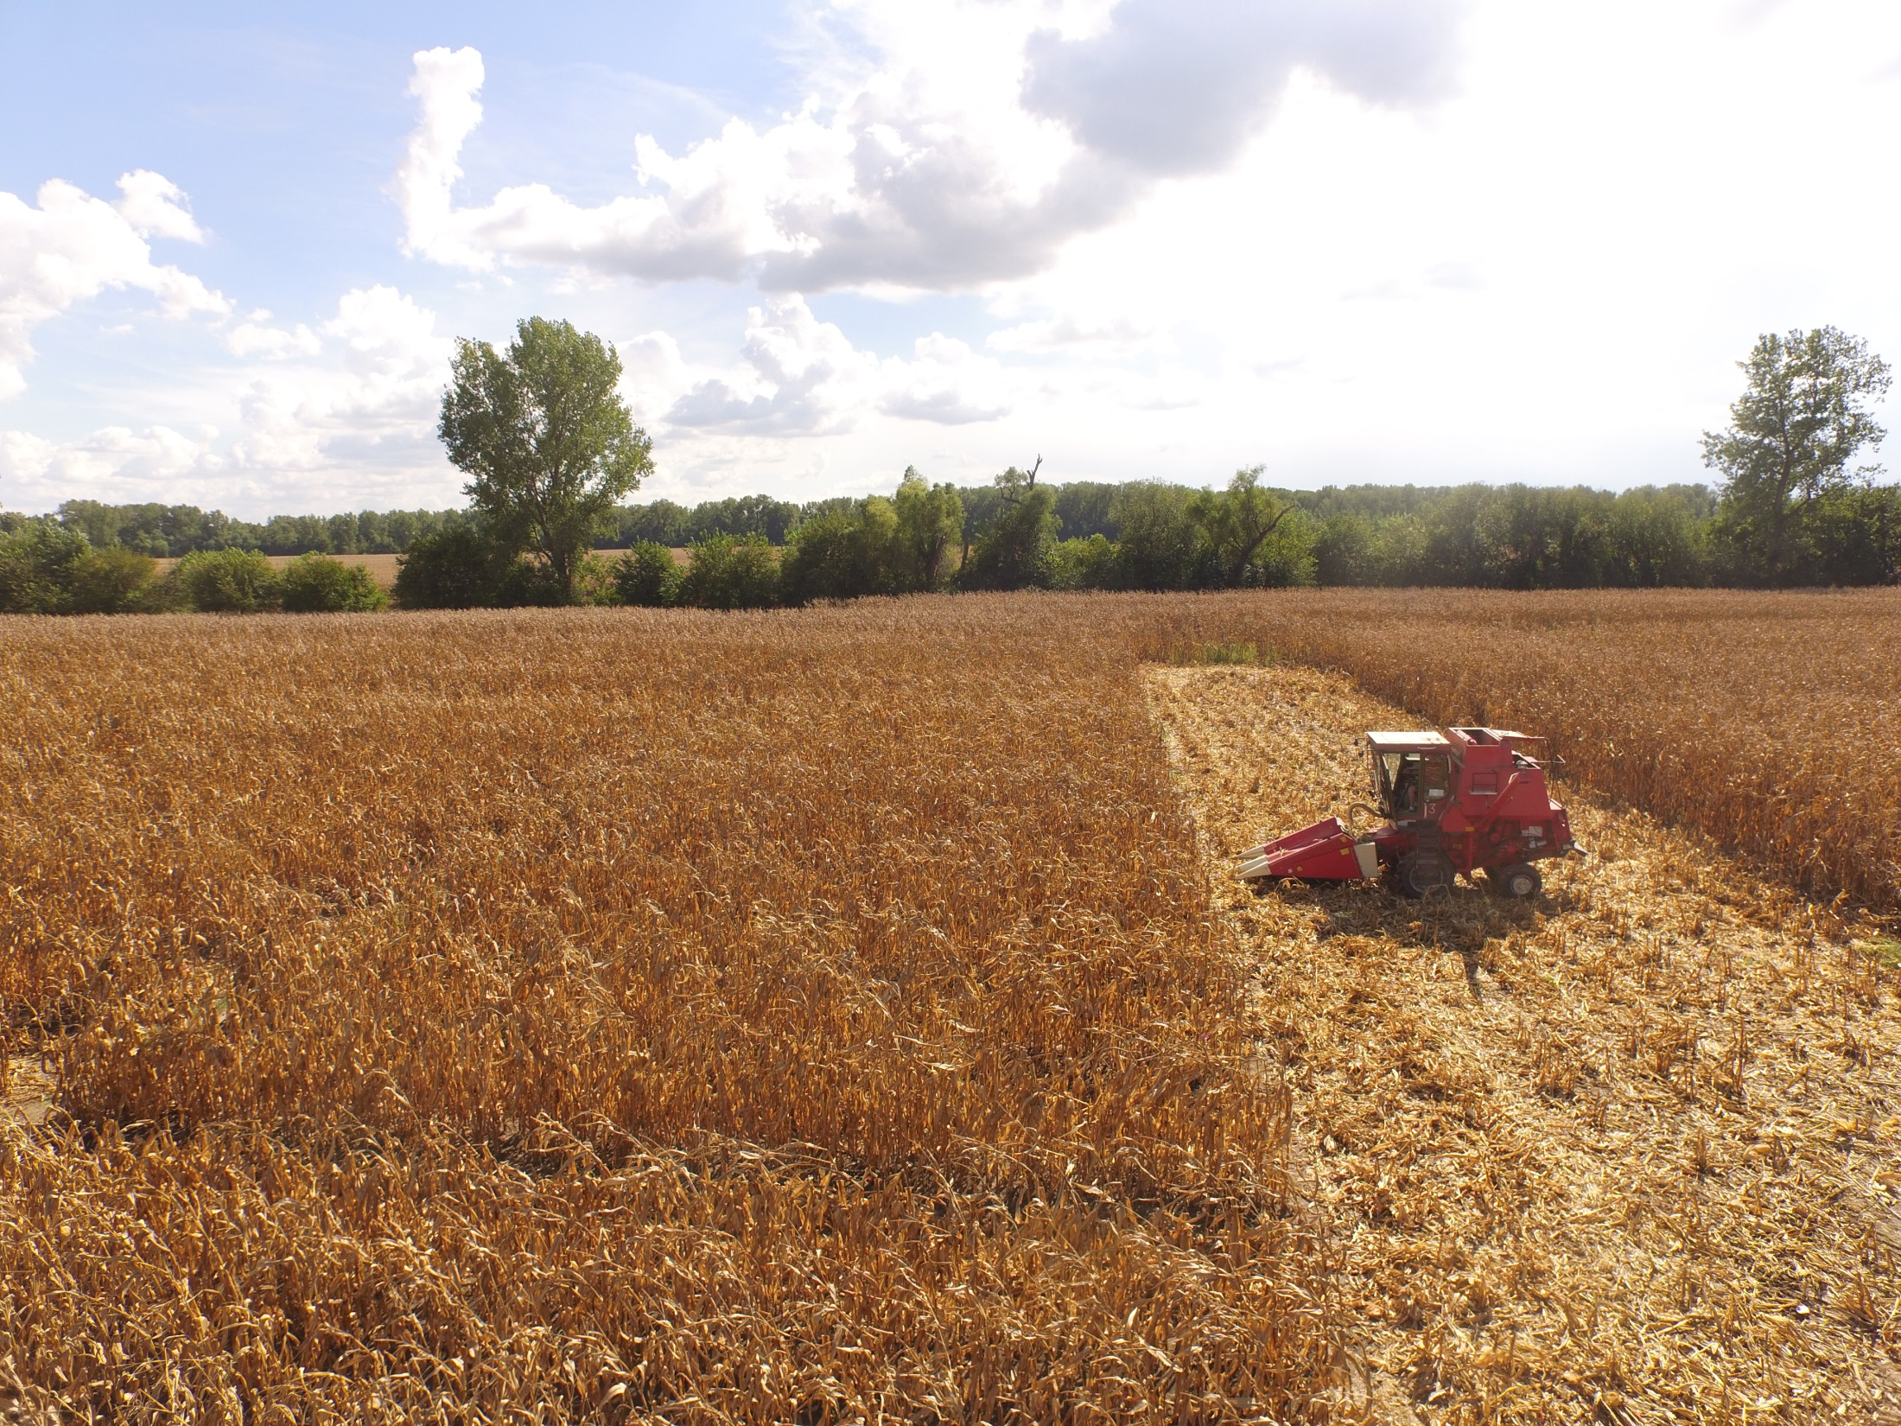
Conclusions
The algorithm alone was mediocre in predicting an EONR equivalent in-season N fertilizer recommendation
The algorithm performed better on plots that received 0 kg N ha⁻¹ at-planting
Performance is best when soil and weather variables are combined and added
Most measured soil variables improved the algorithm more so than SSURGO soil variables

Slide 28
Conclusions (cont.)
Better weather data will be needed to fairly evaluate the modified canopy sensor algorithms on independent dataset.
Soil and weather information, in some cases, improved N recommendations, as seen by the shifting of the data along the 1:1 lines of the scatterplot graphs.
Including field-level soil information for modifying canopy sensor algorithms is more important than including within-field soil variation.
We theorize performance of canopy sensor algorithms can be improved using soil and weather information, but algorithms may need to include site-specific weather and soil information during development.

Slide 29
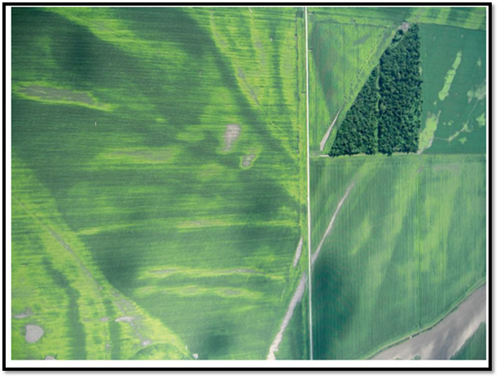

Tool’s Strengths are at
Different Scales
Macro
Micro
Photo courtesy of Henrietta Christensen

Slide 30
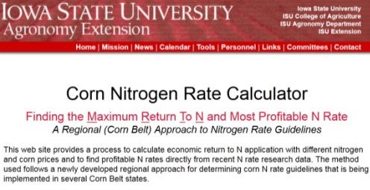
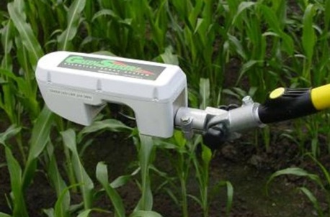
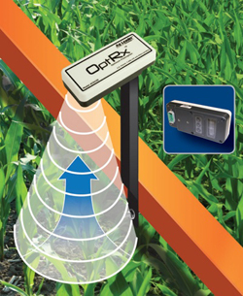
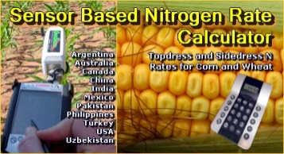
Crop Growth Models
Empirical-Based Models
Encira
Maize-N
Climate: Nitrogen Advisor
Adapt-N
Tool
Fusion
Proximal Canopy Sensing
Soil Tests
PPNT Pre-Plant Soil Nitrate Test
SDNT Side-Dress Soil Nitrate Test
Notes:
There are many new tools, to go along with some tools that have been in place for some time, for performing N fertilizer rate recommendations? The question looms: (slide)

Slide 31
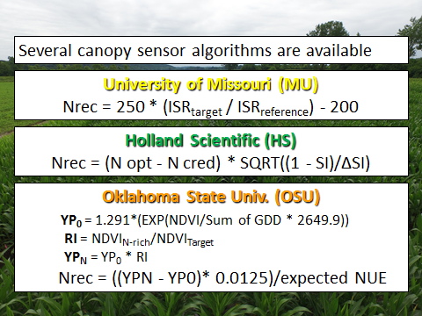
Might the word
“Algorithm”
be a barrier to adoption?

