Slide 1
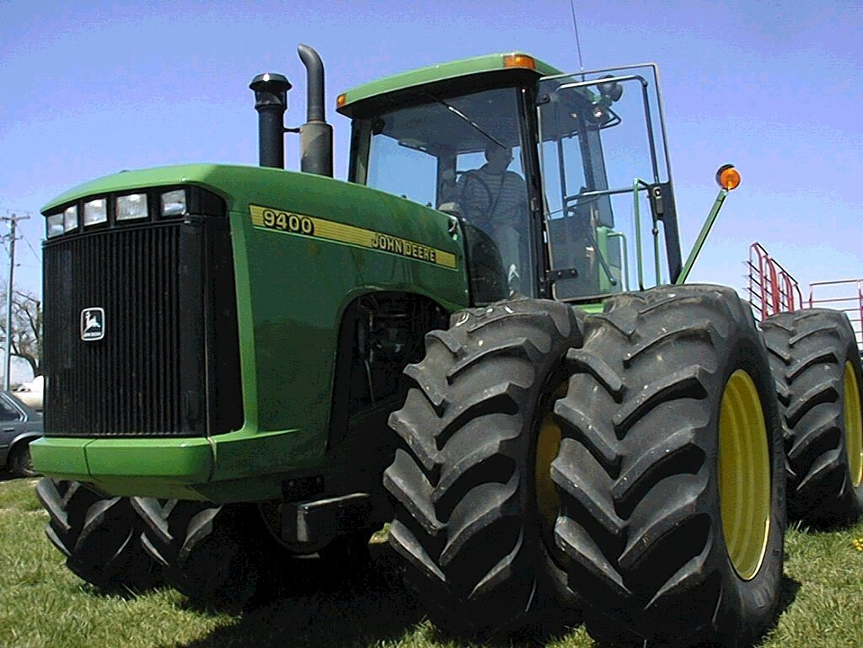
Agronomic Mythbusters
Jeff Edwards
Small Grains Extension Specialist
Presented By: Jacob P. Vossenkemper

Slide 2
Agronomic Myths
Soil testing is infallible
Yield potential is the same as yield
The SBNR system is perfect
All farmers will embrace new technology

Slide 3
Myth #1: Infallibility of soil testing

Slide 4
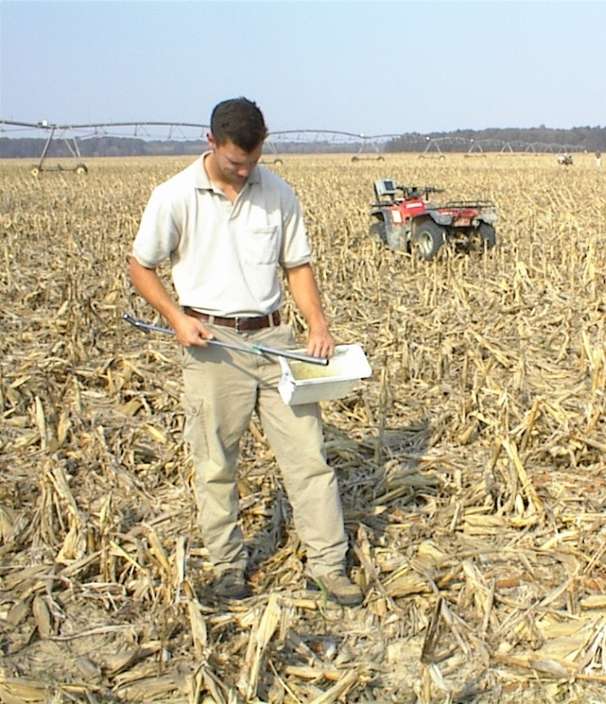
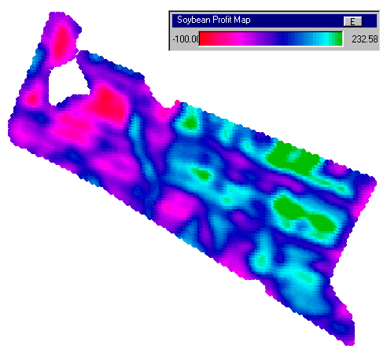
Variation in soil testing
Almost infinite spatial variation
Manage for the average

Slide 5
Spatial variation
management may or may not be profitable
does added accuracy result in increased profit
ability to measure 1 m² or less
where is good enough?
new car example
add on for $1,000 will increase fuel economy 60%
add on for $5,000 will increase fuel economy 5%

Slide 6
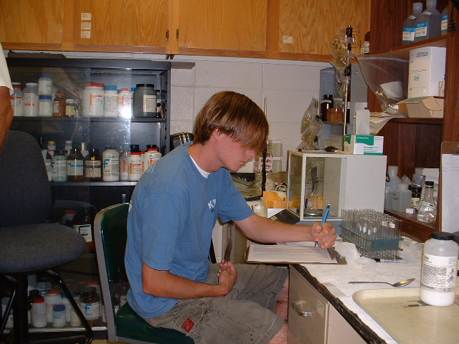
Temporal Variation
Variation between sampling dates
Lab variation
small amt. of soil used
still the best we have

Slide 7
Soil testing only works if a test is taken
11 % every year
17 % every 2 yr
32% every 3 yr
37 % never

Slide 8
Myth #2: Yield potential is the same as yield, or that thing said I would make 55 bu and I only made 45!

Slide 9
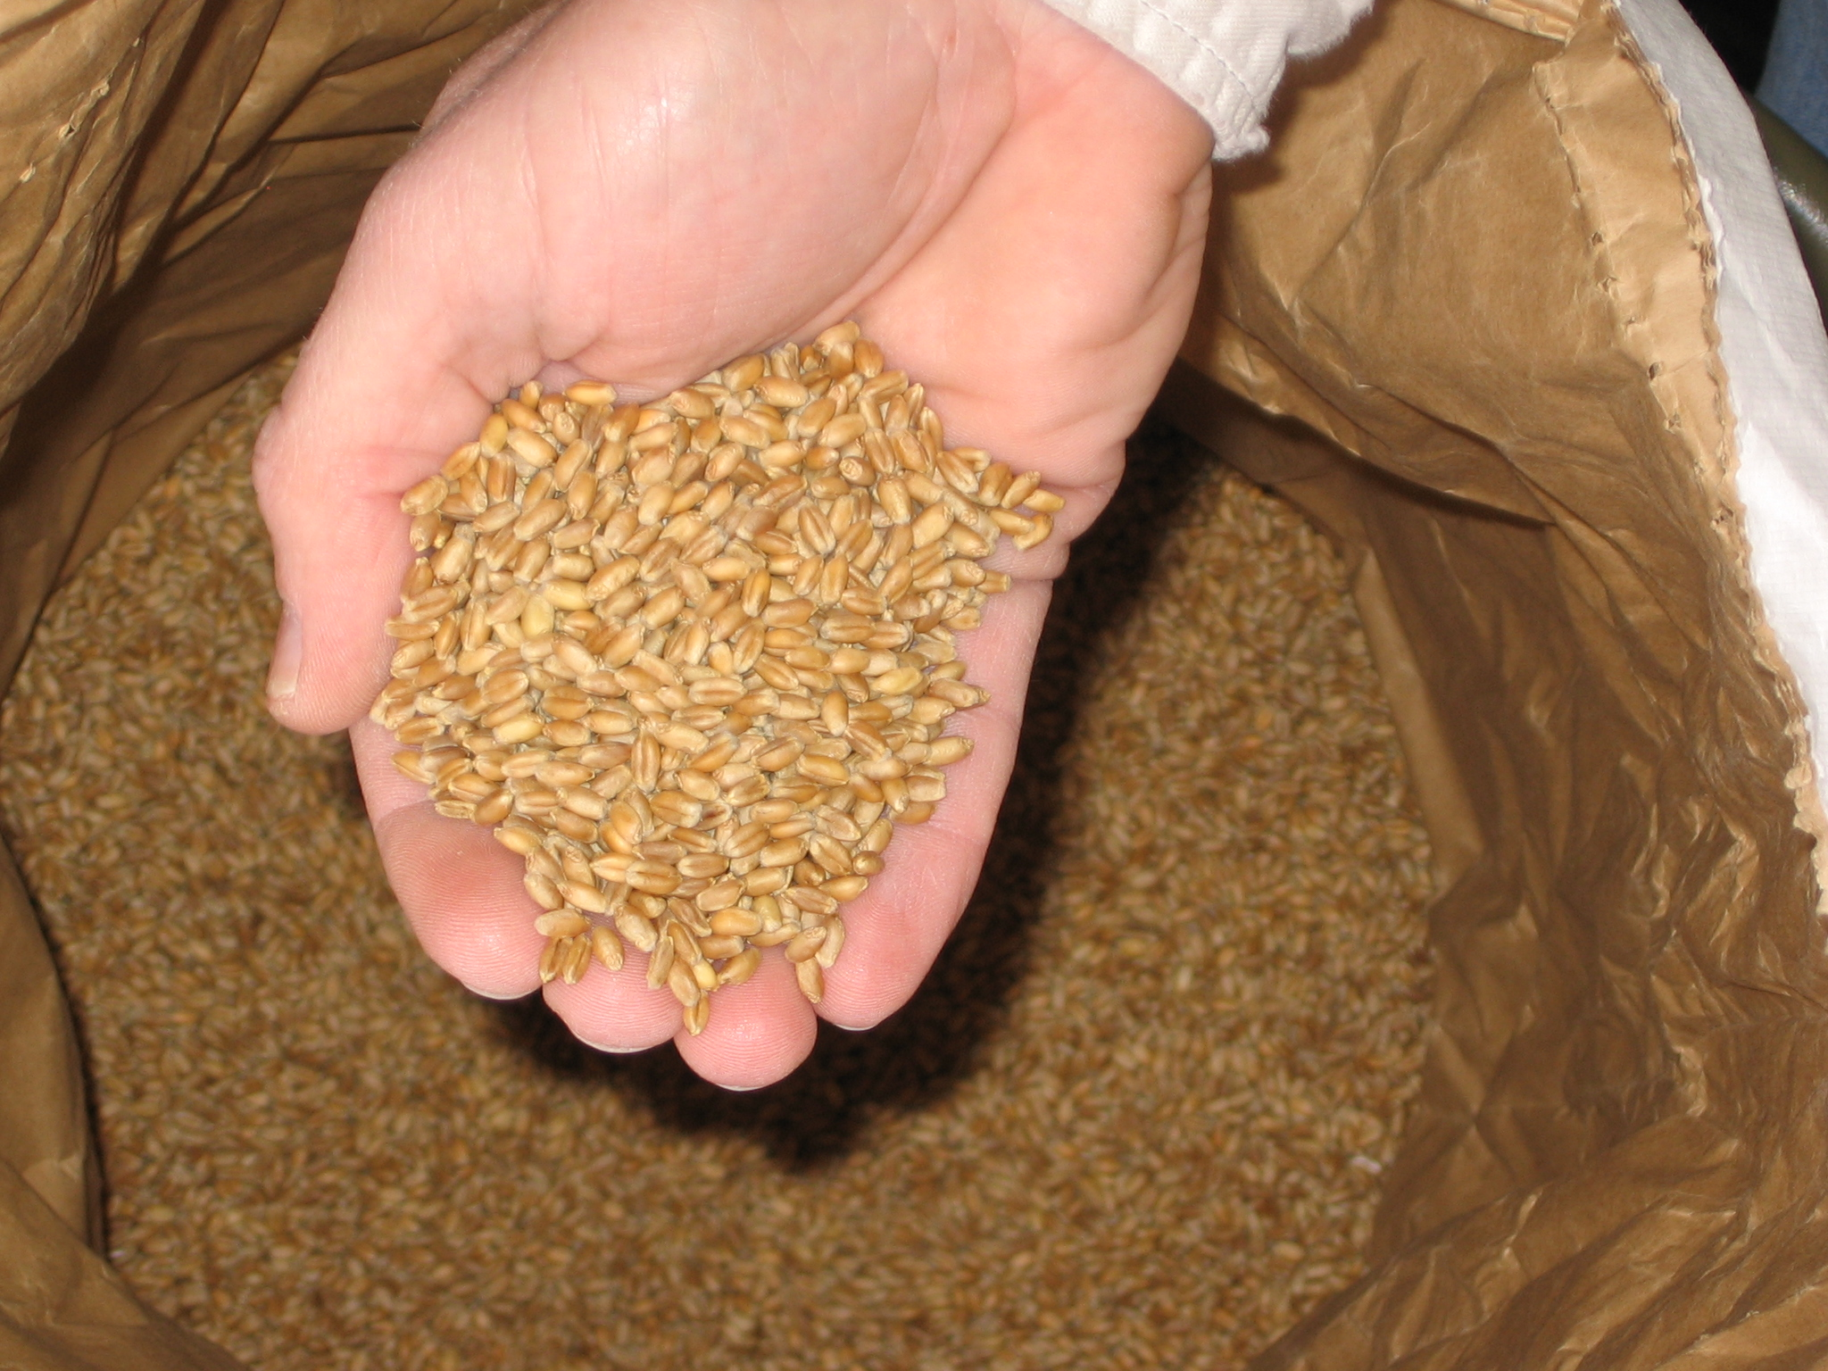
Maximum yield potential
150 bu/ac

Slide 10
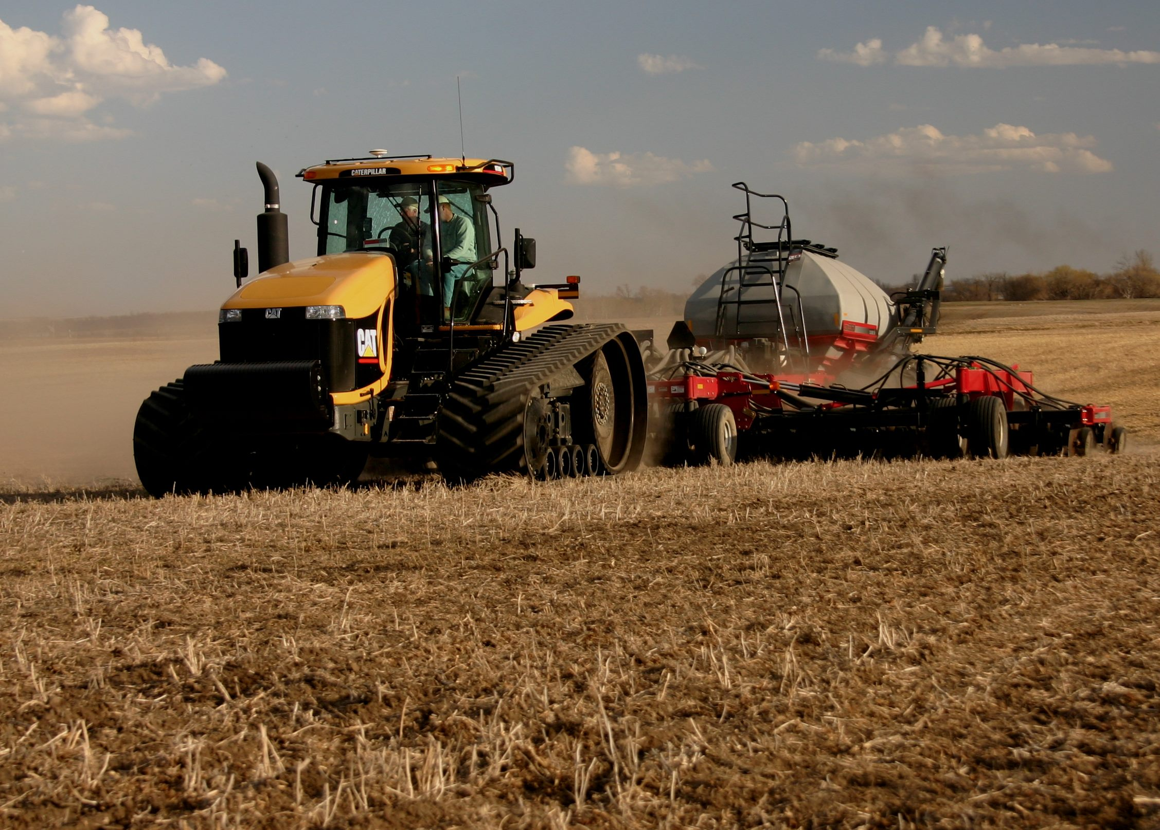
Most yield potential is lost at sowing
potential is now 45-110 bu/ac

Slide 11
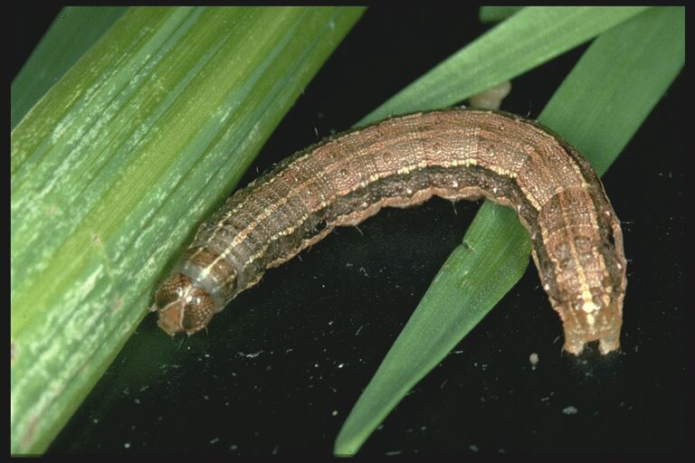
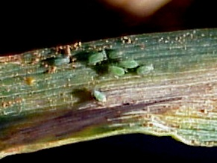
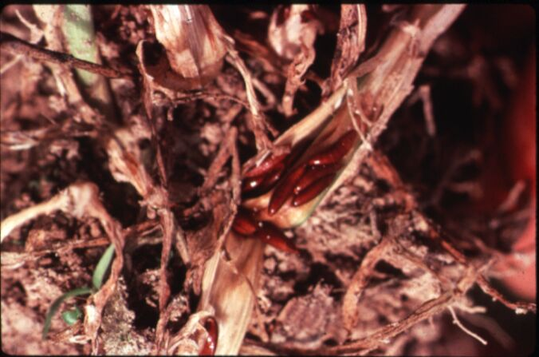
Insects and seedling diseases = more yield potential lost

Slide 12
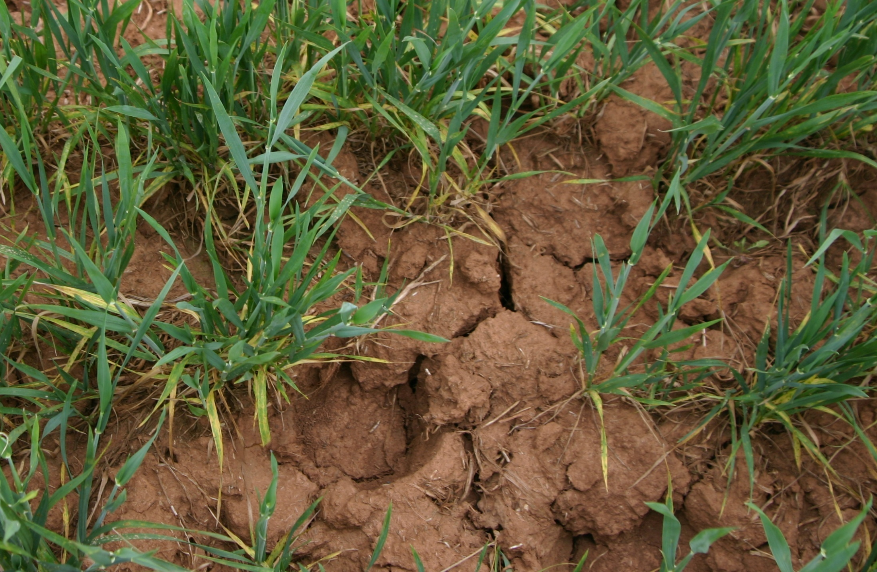
Grazing reduces yield potential

Slide 13
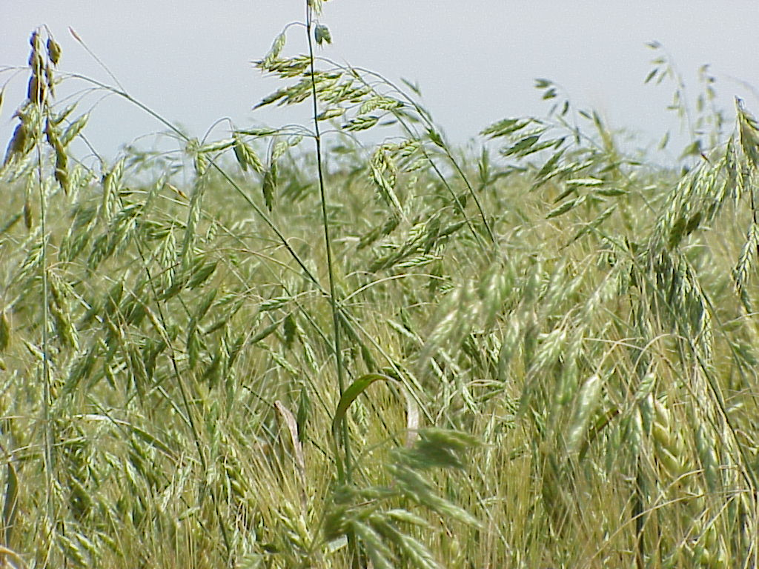
Yield potential losses due to weeds

Slide 14
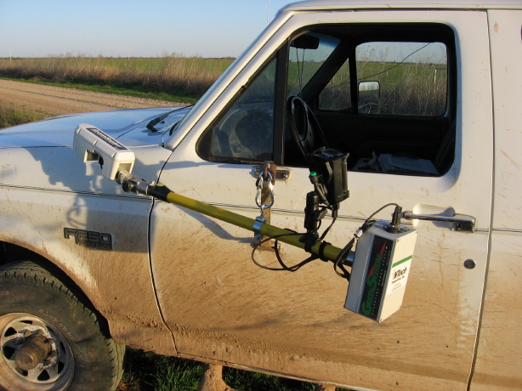
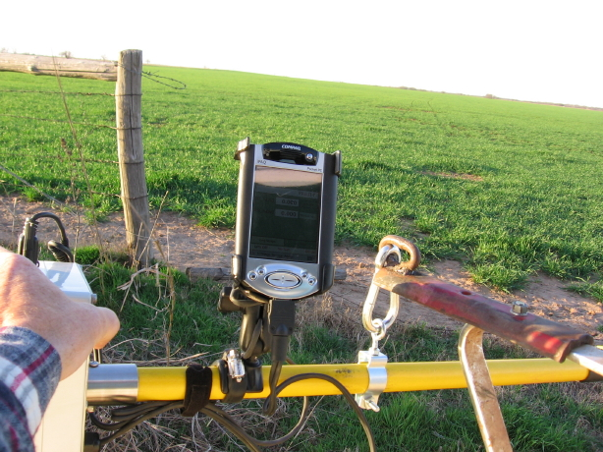
Sensor readings occur after many of these yield potential reducing factors

Slide 15
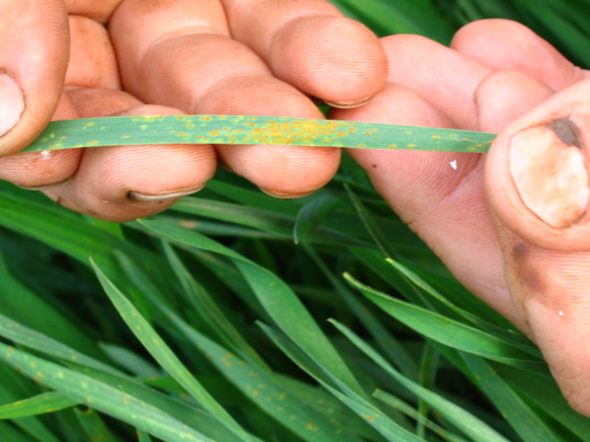
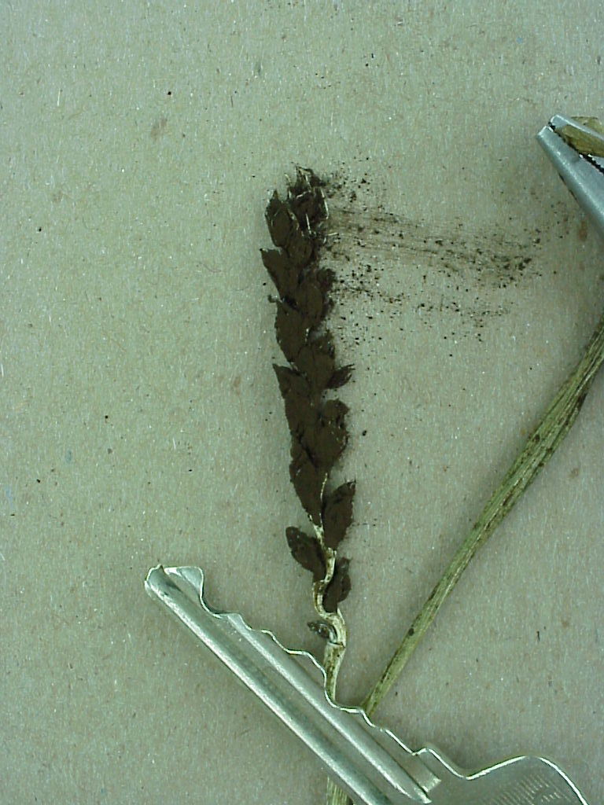
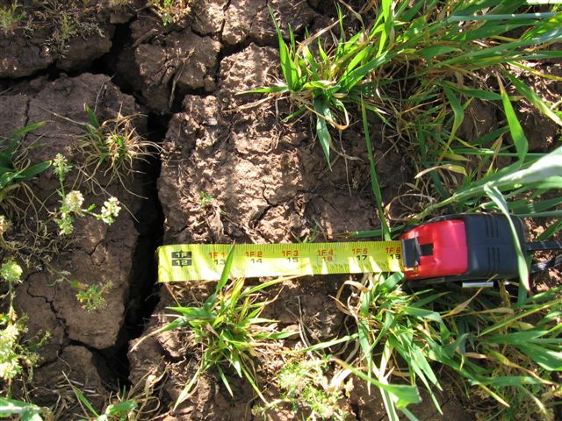
Whether or not yield potential = actual yield depends on environment

Slide 16
Myth #3: The system is perfect

Slide 17
Accuracy of nitrogen recommendations
SBNR (blackjack)
Soil testing (roulette)
Guessing (lottery)

Slide 18
Putting things in perspective
Its different so people doubt the validity
Farmers have gotten fertilizer rates wrong for years and shrugged it off
It is not perfect, but it is much better than what you have been using

Slide 19
Myth #4: all farmers will embrace this new technology

Slide 20
Soil testing has been around for a long time
11 % every year
17 % every 2 yr
32% every 3 yr
37 % never

Slide 21
Where the rubber meets the road
For those who are really serious about curbing nitrogen costs….this is the way
No other prospects on the horizon
oil prices remain high
biotech will not solve the problem
legume crops have limited use
N is dependent on biomass production
must leave everything in the field (i.e. don’t harvest grain or hay)

Slide 22
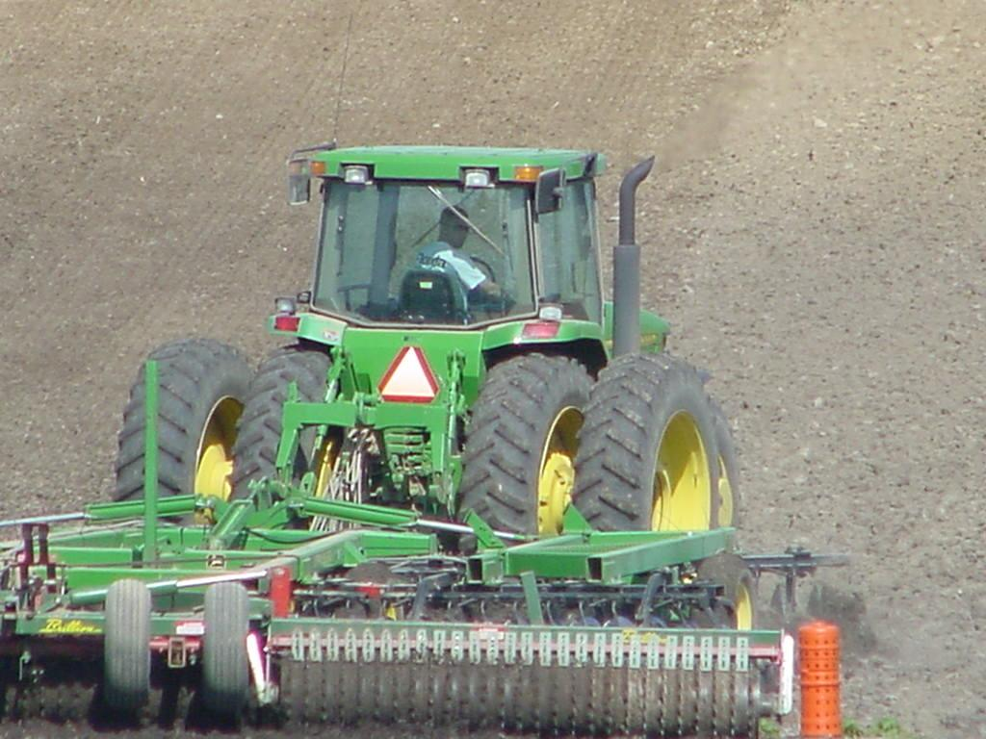
Summary

Slide 23
Check results
Have an open mind and give the SBNR program a fair chance
Focus on profit rather than yield
Compare to what you would normally do
make comparisons fair
strips work better than ½ by ½
field vs. field or year vs. year are not valid comparisons
Think about results

Slide 24
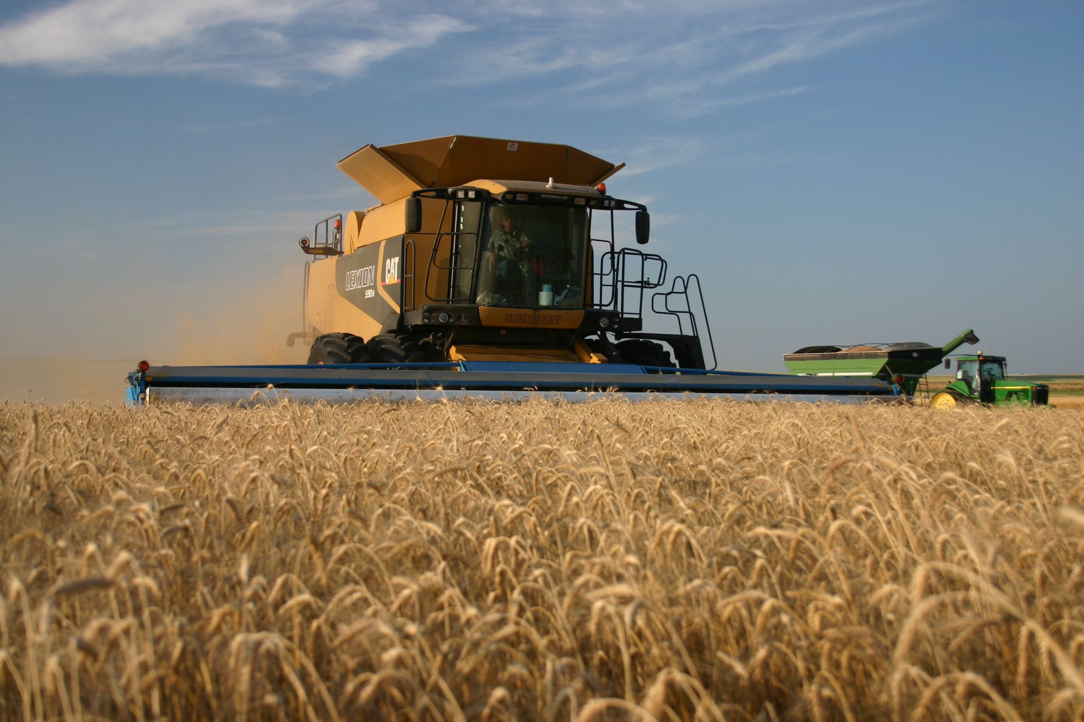
Questions and Discussion

