Slide 1
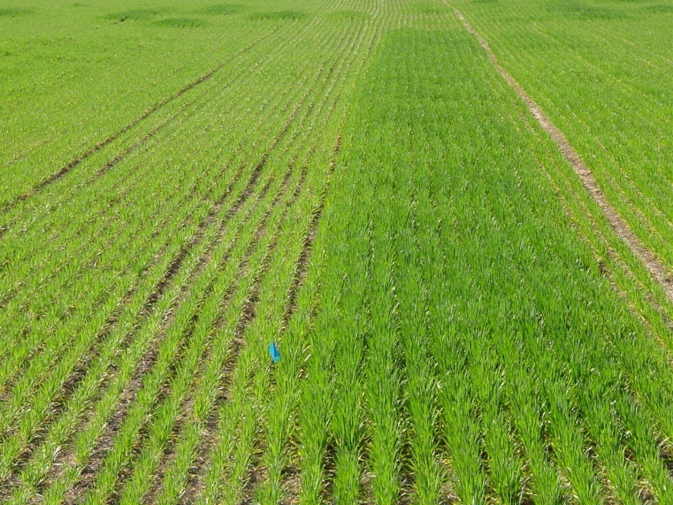
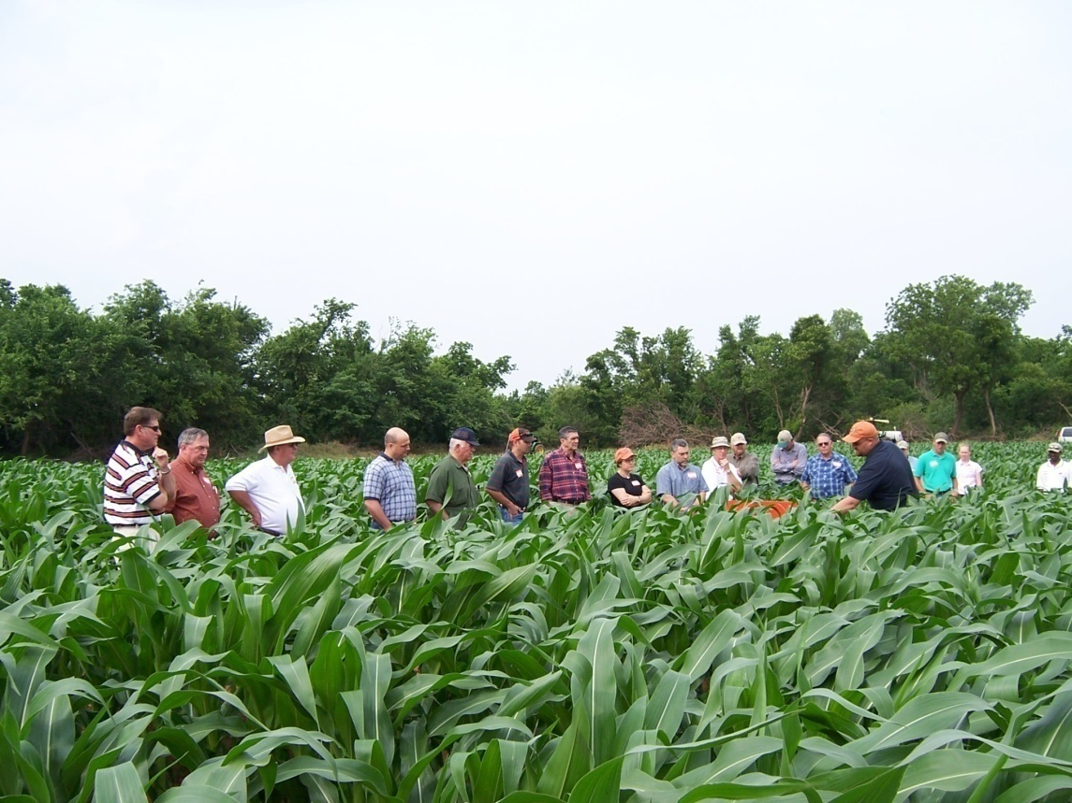
Global Issues and the
Fate of Nitrogen
W.R. Raun
Regents Professor
Presented By: Jacob P. Vossenkemper

Slide 2
Population and Food Production
Increasing population needing to be fed will fuel interest in finding and developing new practices to improve food production
Interest in improved soil nutrient management today as world population grows

Slide 3
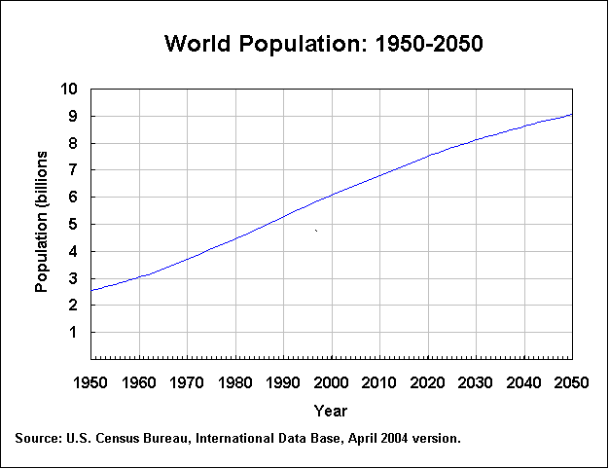
World Population

Slide 4
World Food
Current world food supplies are estimated to be more than adequate at about 2,500 to 3,000 calories per day per person.
Nonetheless, hunger is still quite common in developing countries because of the lack of resources to purchase and/or redistribute available foodstuffs.

Slide 5
World Food (www.fao.org)
Grain Source | Cal/kg | Production, Mt, 2004 | Total Calories
Wheat grain, whole | 3394 | 624,093,306 | 2.11802E+15
Cornmeal, whole | 3625 | 705,293,226 | 2.55682E+15
Rice, white, cooked | 1219 | 608,496,284 | 7.41497E+14
Soybeans | 1734 | 206,409,525 | 3.57837E+14
Potatoes | 1092 | 328,865,936 | 3.59195E+14
Total |  |  | 6.13336E+15
World Population |  |  | 6,500,000,000
 |  |  | / 6.5 billion / 365
Calories per person/day from grain |  |  | 2585

Slide 6
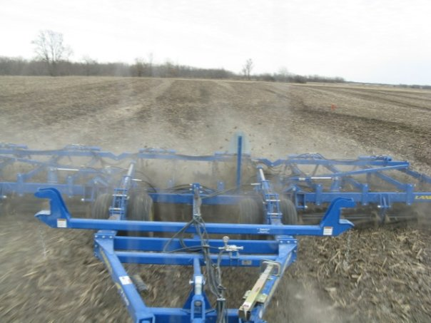
CO₂ levels in the atmosphere have increased from 260 to 360 ppm in the last 150 years
Global Warming?
What % of the increase (100 ppm) has been due to cultivation?
25 ppm or 25%

Slide 7
Organic food production
There are groups within our society that believe food should be raised “organic”, meaning ‘without the benefit of external inputs of synthetic materials’ (e.g. chemical fertilizers),
The soundness of this approach can be quickly examined by considering the amount of animal manure required to replace the current 300,000 tons of N, from commercial inorganic fertilizer, used in Oklahoma to maintain current crop production levels.

Slide 8
Using beef manure, the tons of manure required would be
300,000 tons N x 2,000 lb/ton = 6 x 10⁸ lb N required
6 x 10⁸ lb N required
1 ton (2000 lbs) has 20 lb N
6 x 10⁸ lb N required/20 lb N /ton
= 3.0 x 10⁷ tons of manure
Average manure production of 1,000 lb steers in a confined feedlot will produce 3.212 tons per year.
3.0 x 10⁷ ton manure x 1.0 animals/3.212 ton per year = 9,339,975 steers
The Oklahoma Agricultural Statistics 430,000 cattle on feed as of January 1, 1998

Slide 9
Cattle Manure
The Oklahoma Agricultural Statistics for 1997 reported 430,000 cattle on feed as of January 1, 1998 (this does not mean the number was constant throughout the year).
A 21X increase in feedlot beef cattle to produce the required N in the form of animal manure.
What would we do with all the meat?
It is also important for the promoters of ‘organic’ farming to realize that even the best recycling efforts are not 100% efficient.

Slide 10
SCIENCE Magazine
Excess nitrogen flowing down the Mississippi each year is estimated to be worth $1,000,000,000 (Science, Malakoff, 1998)
NUE in cereal production
30% or 80% ?

Slide 11


Slide 12
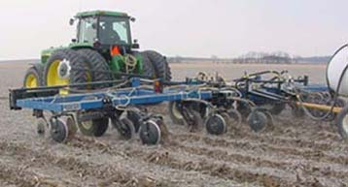
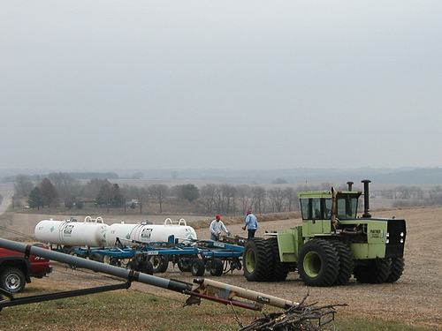
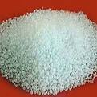
Large Scale Application

Slide 13
NUE in Cereals
Author Crop Method Year Location NUE (grain)
Varvel Corn 15N 1990 NE 43-53%
Russelle Corn Diff. 1981 NE 46%
Raun Corn Diff. 1989 NE 30-40%
Olson Wheat 15N 1984 KS 27-33%
Bronson Wheat 15N 1991 CO 53%
Raun Wheat 15N 1999 OK 21-32%
Lees Wheat 15N 2000 OK 38-41%
Westerman Sorghum 15N 1972 IL 51%
Varvel Sorghum 15N 1991 NE 48%
DeDatta Rice 15N 1988 Asia 37-47%

Slide 14
Review
Yield Goals: average of last 3-5 years +30%
Nebraska study showed that farmers overestimated yield by 2 Mg ha⁻¹ (32 bu ac⁻¹), resulting in an excess of 35 kg N ha⁻¹ (Schepers et al., 1986)
Over-optimistic yield goals were the largest contributor to excess N applications with average yield goals exceeding actual yields by over 15%, only about 30% of the fields were within 5% of the yield goal
(Daberkow et al., 2001)

Slide 15
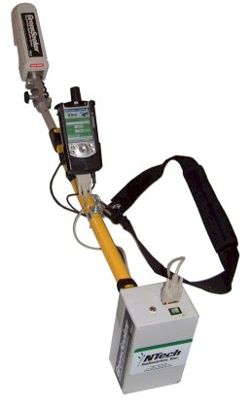
Review
For all systems, it is important to account for N contributed from other sources
  Manures, legume residues, irrigation water, rainfall (mass balance)
  The Sensor takes advantage of this natural Nitrogen

Slide 16
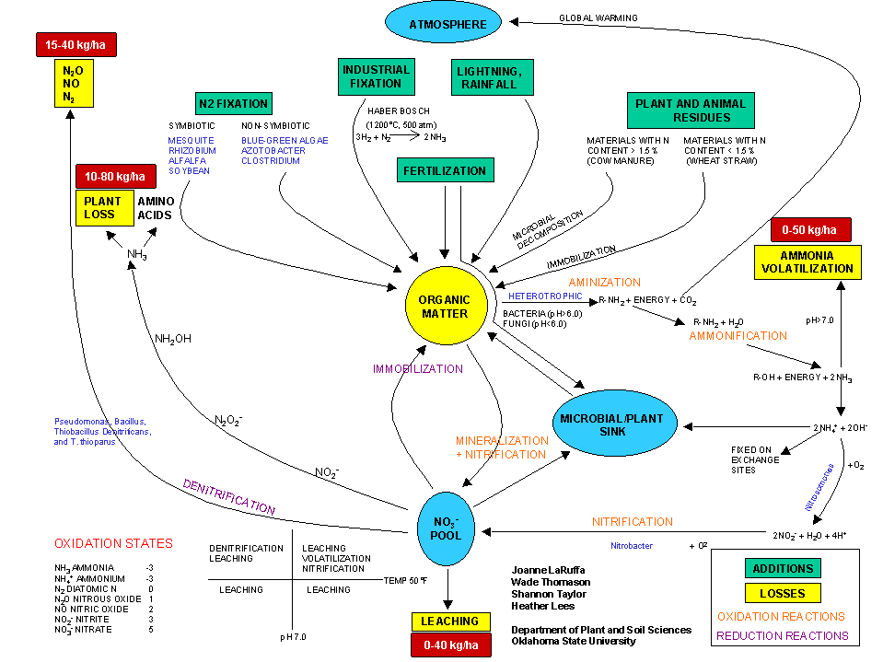



Slide 17
Plant Uptake
>50F
Moisture Stress
pH >7.0
>50F
Plant Loss
Volatilization
>50F
anaerobic
N Treasure
Denitrification
Immobilization
<50F
Leaching

Slide 18
Thief #1 Ammonia Volatilization
Influenced by
Soil pH
Temperature
Urease Activity
Application Method
CEC
Denitrification Leaching
Leaching Volatilization
Nitrification Nitrification
Leaching Leaching
50°F
If pH and temperature can be kept low, little risk exists for the loss of N as ammonia (urea or anhydrous N sources)
pH 7.0

Slide 19
Thief #2 Nitrate Leaching
Usually takes place in the winter
  Excess N applied in-season that is not used
  Temperatures below 50°F (microbial pools not active)
Denitrification Leaching
Leaching Volatilization
Nitrification Nitrification
Leaching Leaching
50°F
pH 7.0

Slide 20
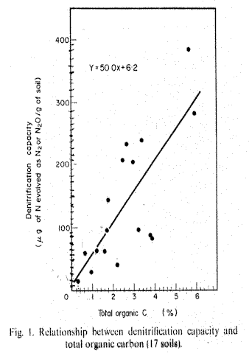
Thief #3, Denitrification
Burford and Bremner, 1975
Denitrification Leaching
Leaching Volatilization
Nitrification Nitrification
Leaching Leaching
50°F
pH 7.0

Slide 21
#406
0.1
0.9
0.09
0.8
0.08
0.7
Total Soil N, %
0.07
Organic Carbon, %
0.6
0.06
TSN
SED TSN = 0.002
0.05
0.5
OC
SED OC = 0.03
0.04
0.4
0
40
80
120
160
200
N Rate, kg/ha
Raun, W.R., G.V. Johnson, S.B. Phillips and R.L. Westerman. 1998. Effect of long-term nitrogen fertilization on soil organic C and total N in continuous wheat under conventional tillage in Oklahoma. Soil & Tillage Res. 47:323-330.

Slide 22
Thief #4, Plant N Loss
photosynthesis
carbohydrates
respiration
reducing power
carbon skeletons
NADH or NADPH
NO
NO
NH
amino
3
2
3
acids
nitrate
nitrite
reductase
reductase
ferredoxin
siroheme

Slide 23
Thief #4, Plant N Loss
Total N uptake in winter wheat with time and estimated loss following flowering.

Slide 24
VEGETATIVE
REPRODUCTIVE
R-NH₂
NO₃
NH₄
R-NH₂
Total N
moisture
heat
Total N
NH₃
NO
NO
NH
amino
3
2
3
acids
nitrate reductase
nitrite reductase
  NO₃⁻ + 2e (nitrate reductase) NO₂⁻ + 6e (nitrite reductase) NH₄⁺

Slide 25
Nitrogen Treasure
Where did all the Nitrogen Go?
Magruder Plots
1892: 4.0 % organic matter = 0.35+ 1.8 OC
OC = 2.03
TN = 0.16
Pb = 1.623 (0-12")
lb N/ac = Pb * ppm N * 2.7194
= 1.623 * 1600 * 2.7194
= 7061
+ 10 lbs N/year in the rainfall = 1050 (105 * 10)
= 8111
1997
OC = 0.62
TN = 0.0694
lb N/ac = 1.623*694 * 2.7194
=3063
Difference: 8111 - 3063 = 5048 lbs N
N

Slide 26
How to Keep the Leaching, Volatilization, Plant N Loss, and Denitrification Thieves Away from our Nitrogen Treasure?
N
N Rich Strip
Apply lower rates at Planting
Base Topdress Rates off predicted yield potential and N Responsiveness
Apply N when it is needed
Only way to know
how big the treasure is
how far we have to dig to find it

Slide 27
Size of the Treasure
Dry, Cool Winter
0-N Mineralized
Good Stand
30 bu/ac Yld Potential
60 bu/ac Yld Potential with N
Topdress N = 60 lb N/ac
Wet, warm Winter
40 lb N in rain + Mineralized
Good Stand
45 bu/ac Yld Potential
65 bu/ac Yld Potential with N
Topdress N = 40 lb N/ac
N
N
Dry, Cool Winter
0-N Mineralized
Poor Stand
20 bu/ac Yld Potential
40 bu/ac Yld Potential with N
Topdress N = 40 lb N/ac
Wet, warm Winter
40 lb N in rain + Mineralized
Poor Stand
35 bu/ac Yld Potential
45 bu/ac Yld Potential with N
Topdress N = 20 lb N/ac
N
N
What Unlocks the Mystery of the Nitrogen Treasure?
N Rich Strip and Yld Potential

Slide 28
Evidence

Slide 29
Extreme Soil Variability
Apply more N
Apply less N
Higher NUE
Lower
NUE

Slide 30
Improving Nitrogen Use Efficiency for Cereal Production
Potential Improvements
  Crop Rotations
  Forage Production Systems
  Hybrid or Cultivar
  Conservation Tillage
  NH₄-N Source
  In-Season and Foliar-Applied N
  Fertigation
  High Resolution Precision Management
OSU Has developed a tool the GreenSeeker

Slide 31
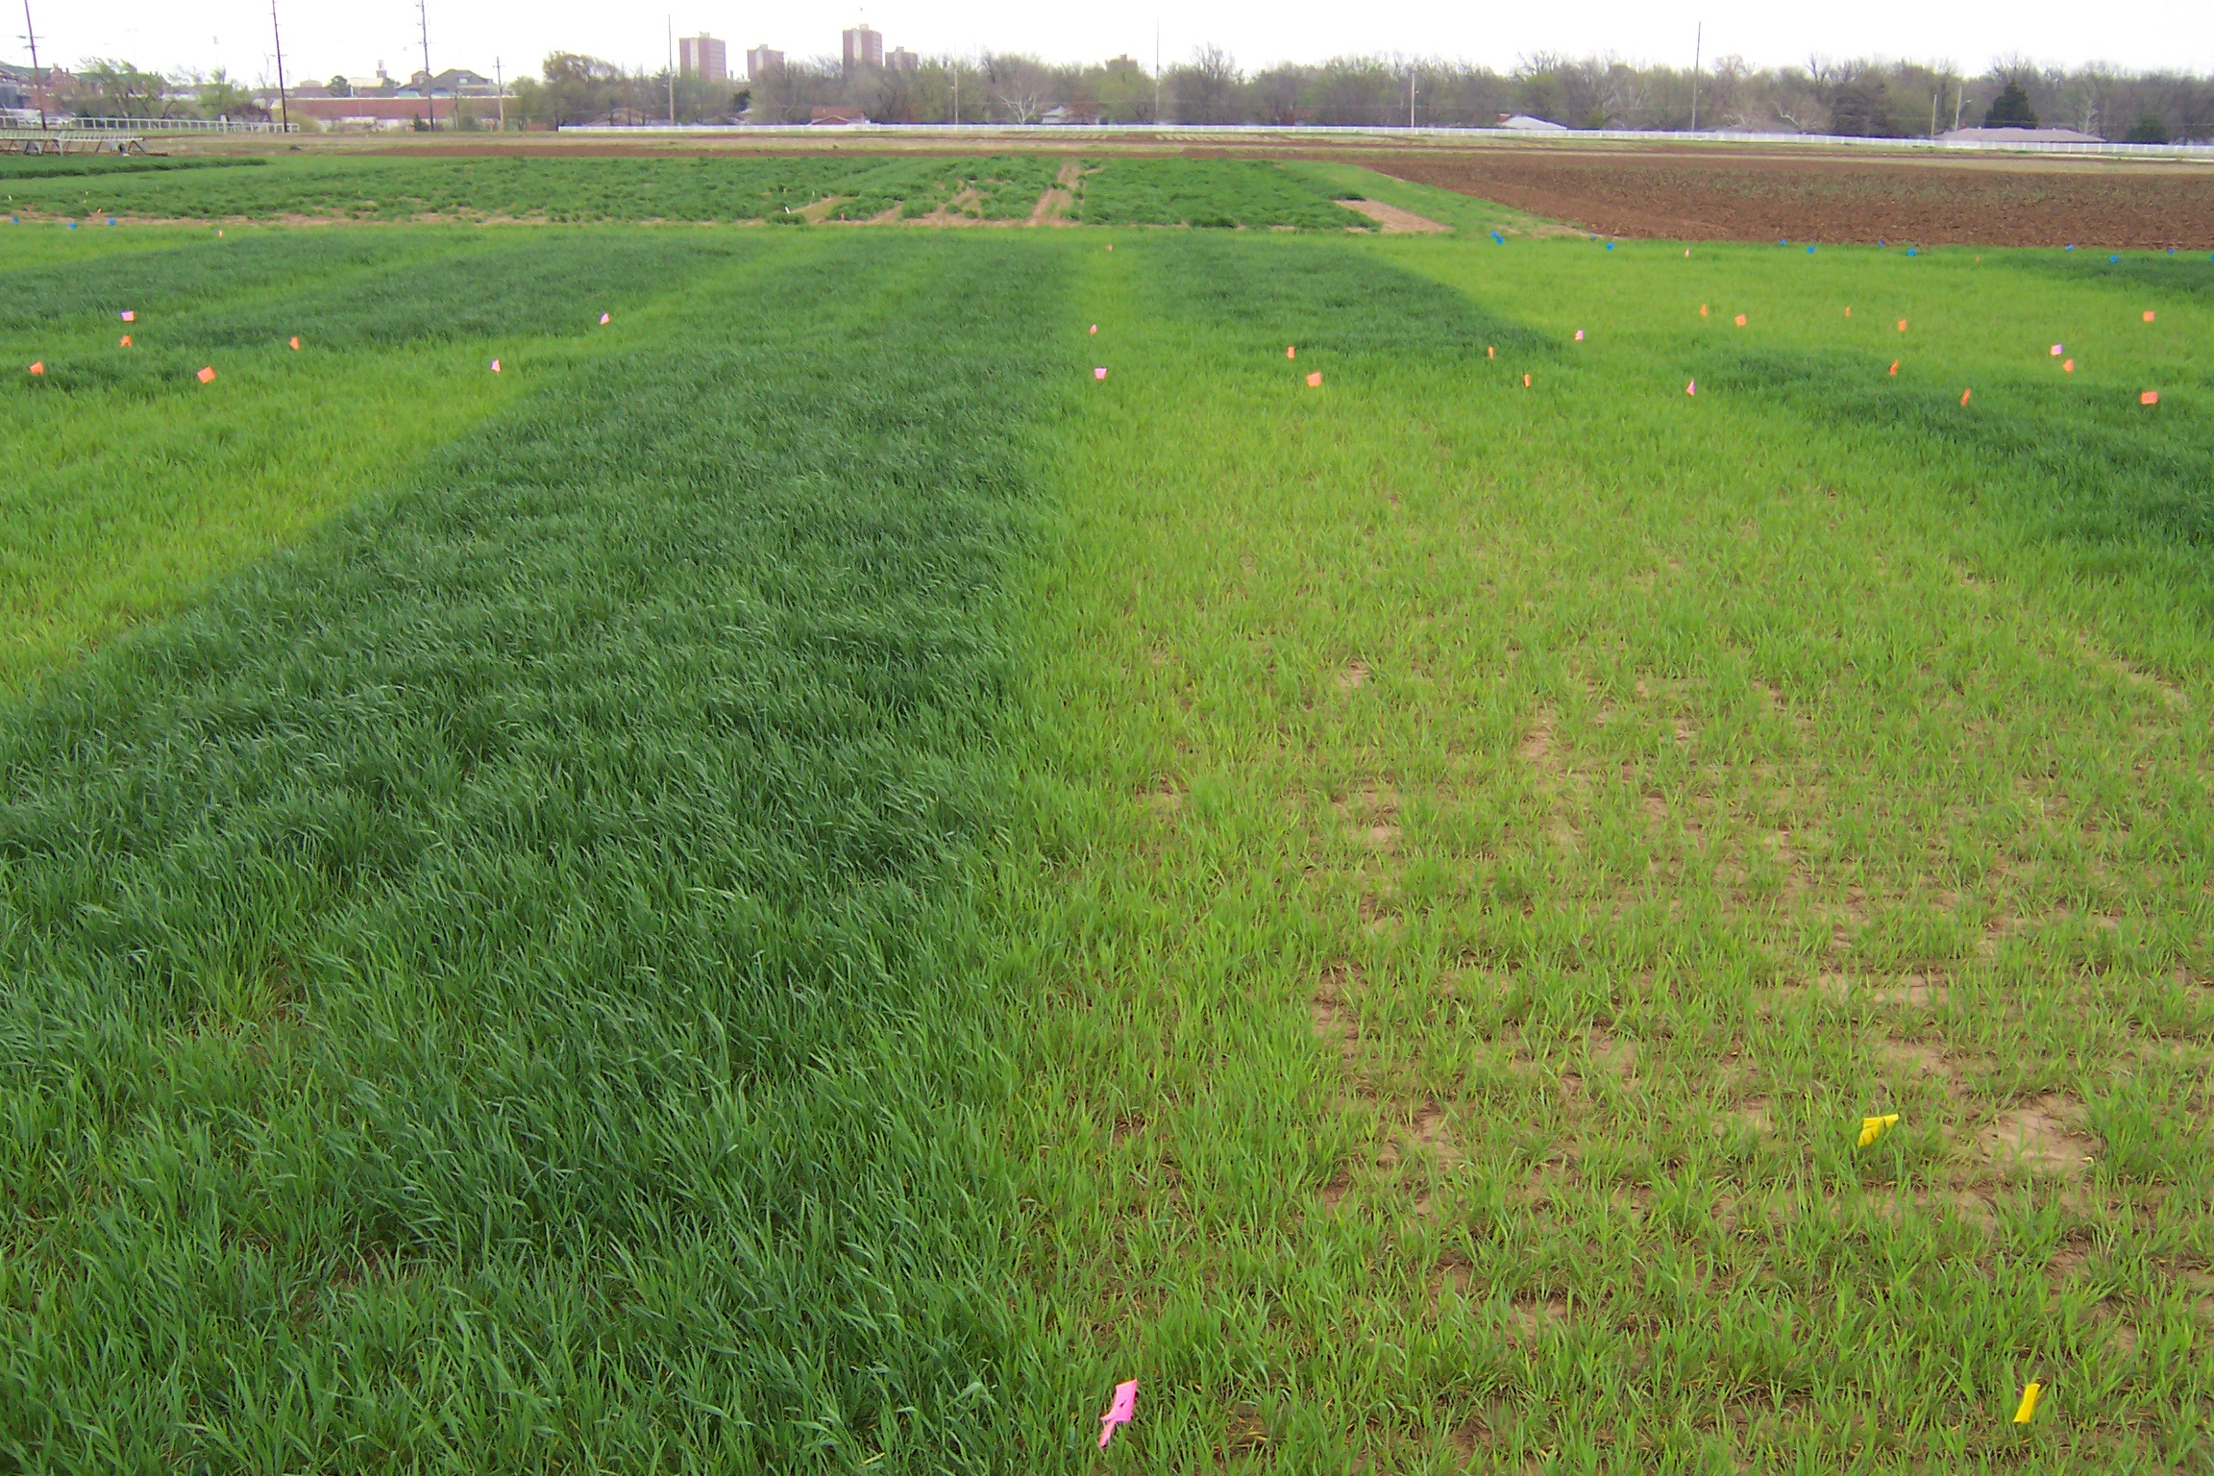
Summary
Cereal NUE < 50%
N Rich Strip (RI), SBNRC, RAMP can improve NUE and profit
Have to be committed to increasing NUE
Questions?

