Slide 1

NITROGEN demand in the Central Great Plains
Tuesday December 13, 2016
3:15 pm
Wes Watkins Center
NITROGEN DEMAND
http://nue.okstate.edu/Hand_Planter.htm
CCA_Extention_2016.ppt

Slide 2
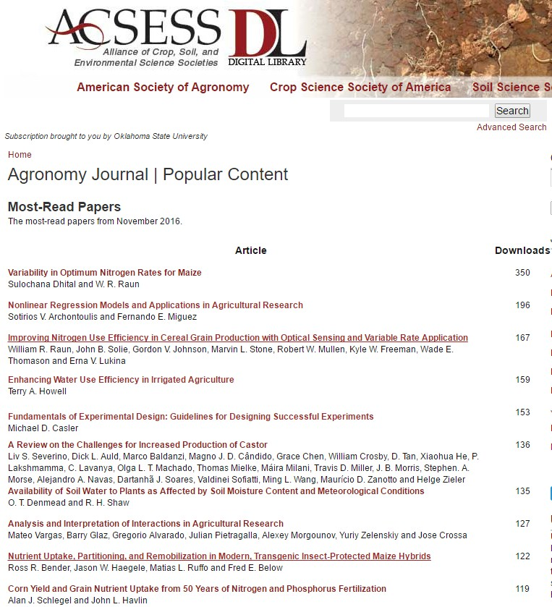
Variability in Optimum Nitrogen Rates for Maize

Slide 3
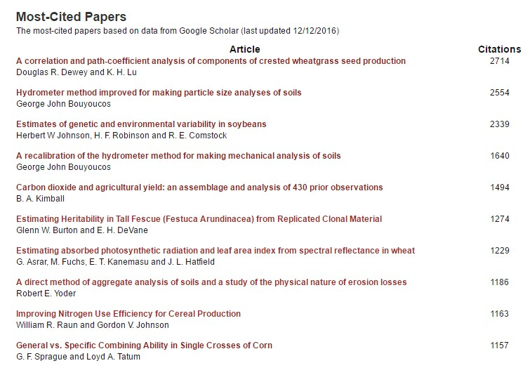
Improving Nitrogen Use Efficiency, 1999

Slide 4
Maize grain yield for the check (0N), high N treatment and optimum N rate in 26 field experiments , 213 site years of published data, 1958-2010.
Source | Location | Years | Time period | † (0-N) Yield Range | ‡ High N Yield Range | *Optimum N rate kg ha⁻¹
 |  |  |  | ---- Mg ha⁻¹ ---- |  | Min | Max | Avg. | SD
Bundy et al. (2011) | WI | 21 | 1958-1983 | 1.6-7.6 | 4.3-8.8 | 50 | 233 | 130 | 53
Bundy et al. (2011) | WI | 9 | 1984-1997 | 2.7-5.6 | 5.7-9.96 | 58 | 235 | 179 | 51
Mallarino and Torres (2006) | IA | 20 | 1979-2003 | 0.8-5.9 | 5.1-12.4 | 81 | 237 | 165 | 49
Mallarino and Torres (2006) | IA | 14 | 1985-2010 | 1.4-6.2 | 5.3-12.8 | 134 | 239 | 197 | 32
Varvel et al. (2007) | NE | 5 | 1995-2005 | 6.6-10.9 | 10.4-13.3 | 73 | 193 | 131 | 49
Jokela et al. (1989) Carroll | MN | 3 | 1982-1984 | 5.5-7.3 | 7.1-9.1 | 5 | 131 | 84 | 69
Jokela et al. (1989) Webster | MN | 3 | 1982-1984 | 1.7-5.6 | 1.8-8.7 | 70 | 113 | 91 | 21
Fenster et al. (1976) Waseca | MN | 5 | 1970-1975 | 3.2-7.4 | 7.1-10.6 | 60 | 199 | 135 | 50
Fenster et al. (1976) Martin A | MN | 7 | 1970-1976 | 3.8-8.2 | 4.0-9.6 | 23 | 126 | 69 | 36
Fenster et al. (1976) Martin B | MN | 6 | 1971-1976 | 6.2-11.3 | 6.2-12.0 | 0 | 37 | 18 | 15
Al Kaisi et al. (2003) | CO | 3 | 1998-2000 | 5.6-10.2 | 8.3-10.8 | 66 | 111 | 91 | 23
Ismail et al. (1994) NT | KY | 20 | 1998-2000 | 2.1-7.4 | 5.2-10.9 | 35 | 230 | 128 | 46
Ismail et al. (1994) CT | KY | 20 | 1970-1990 | 1.9-9.5 | 3.5-10.4 | 0 | 203 | 98 | 52
Rice et al. (1986) NT | KY | 15 | 1970-1985 | 3.1-4.9 | 5.7-9.2 | 102 | 178 | 144 | 30
Rice et al. (1986) CT | KY | 15 | 1970-1985 | 1.9-6.1 | 5.0-8.8 | 69 | 204 | 124 | 47
Stecker et al. (1993) Columbia | MO | 3 | 1988-1990 | 3.3-5.6 | 6.0-10.1 | 99 | 194 | 153 | 49
Stecker et al. (1993) Novelty | MO | 3 | 1988-1990 | 4.5-7.2 | 6.7-9.9 | 45 | 182 | 103 | 71
Stecker et al. (1993) Corning | MO | 2 | 1989-1990 | 5.0-6.0 | 8.2-8.5 | 90 | 117 | 104 | 20
Peterson et al. (1989) | NE | 4 | 1983-1986 | 2.1-6.4 | 3.9-10.0 | 11 | 218 | 104 | 88
Eck (1982) | TX | 2 | 1977-1978 | 2.7-4.4 | 5.6-5.9 | 59 | 116 | 88 | 40
Shapiro et al. (2006) RS 51cm | NE | 3 | 1996-1998 | 6.2-8.9 | 9.4-11.1 | 69 | 96 | 83 | 13
Shapiro et al. (2006) RS 76cm | NE | 3 | 1996-1998 | 5.0-8.9 | 7.1-11.0 | 13 | 114 | 75 | 54
Meisinger et al. (1985) MT | MD | 4 | 1974-1977 | 1.8-2.6 | 5.8-8.2 | 127 | 233 | 183 | 45
Meisinger et al. (1985) PT | MD | 4 | 1974-1977 | 2.7-4.2 | 5.1-8.1 | 36 | 196 | 142 | 75
Gehl et al. (2005) Rossville | KS | 2 | 2001-2002 | 6.4-7.9 | 11.3-12.6 | 182 | 204 | 193 | 15
Gehl et al. (2005) Scandia | KS | 2 | 2001-2002 | 2.7-7.4 | 3.8-11.5 | 51 | 160 | 105 | 77
Total |  | 213 |  |  | Average | 62 | 173 | 120 | 45
 |  |  |  |  | SD | 44 | 55 | 43 | 20

Slide 5
Variability in Optimum Nitrogen Rates for Maize. Agron. J. 108:2165–2173 (2016) doi:10.2134/agronj2016.03.0139
Yield level and N response contribute to the final optimum N rate
Yield level and N response need to be considered independent of one another before deciphering N rate recommendations for maize
The wide range in optimum N rates observed in all maize experiments suggests the need to adjust N rates by year and location.
A potential solution is to use midseason sensor-based technologies that can accurately predict yield potential and simultaneously encumber N responsiveness known to be independent of yield.

Slide 6
Conclusion
Static N recommendations do not account for the variability in soil available N and maize N uptake as influenced by weather.
Need to reconsider the common practice of applying the same N fertilizer rates over time.

Slide 7
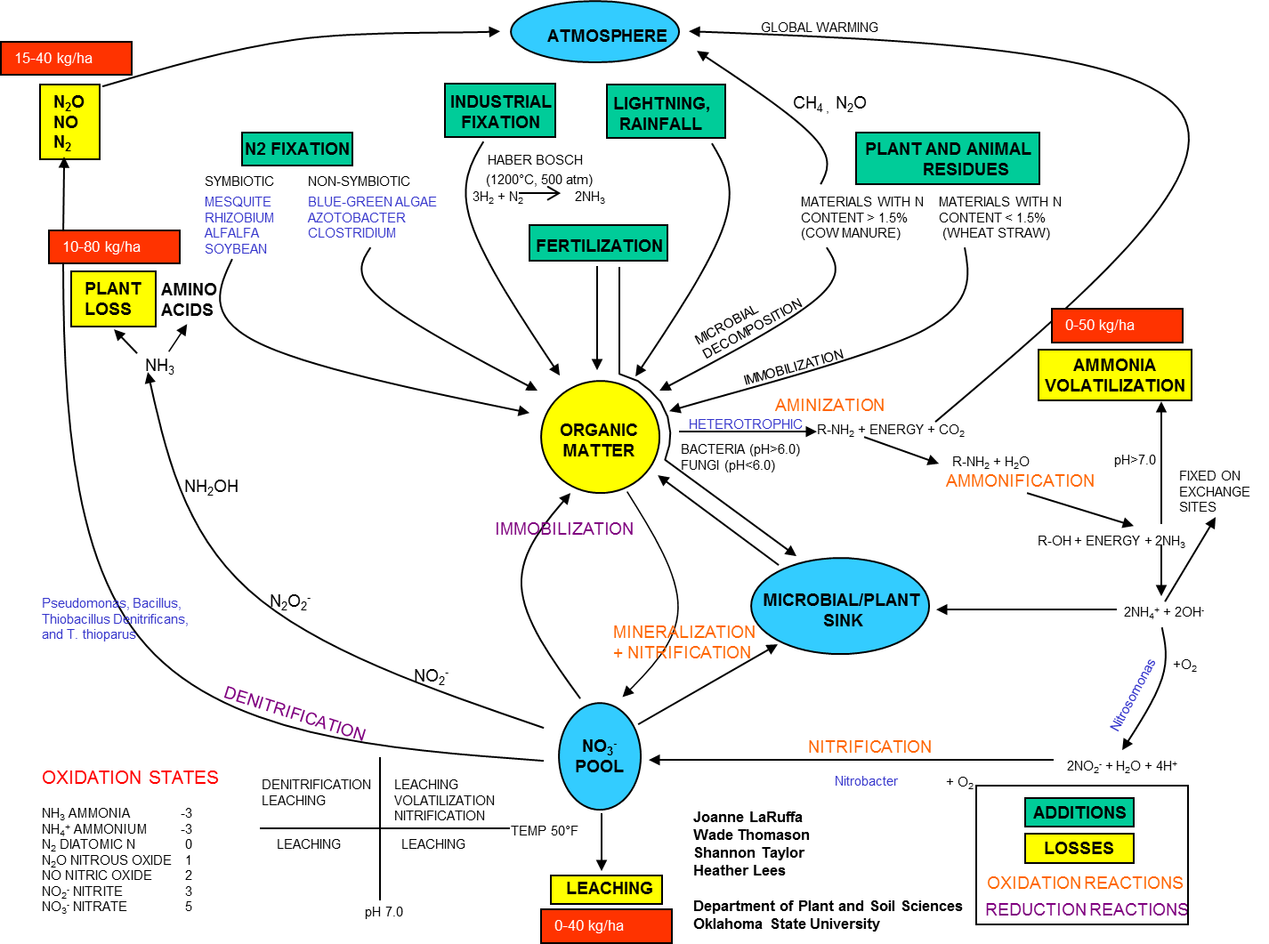
Cannot think of N independent of C

Slide 8
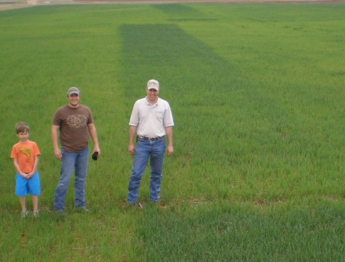
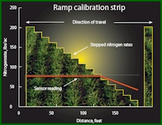
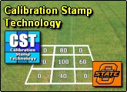
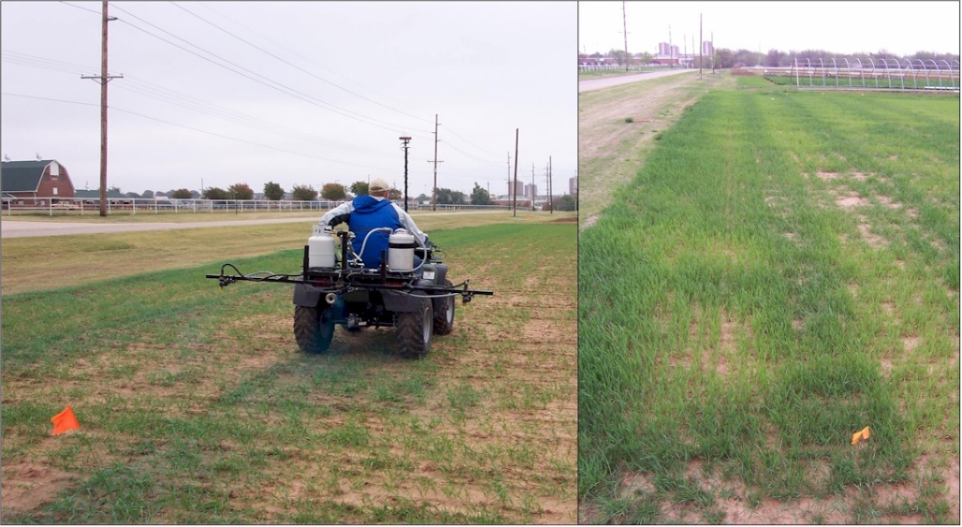
Nitrogen RAMPS
Optimum N rates in the same field vary as do N rates from year to year
Calibration Stamps
Raun, W.R., J.B. Solie, M.L. Stone, K.L. Martin, K.W. Freeman. And D.L. Zavodny. 2005. Automated calibration stamp technology for improved in-season nitrogen fertilization. Agron. J. 97:338-342.
Raun, W.R., J.B. Solie, R.K. Taylor, D.B. Arnall, C.J. Mack, and D.E. Edmonds. 2008. Ramp calibration strip technology for determining mid-season N rates in corn and wheat. Agron. J. 100:1088-1093.
Dhital, Sulochana and William Raun. 2016. Variability in optimum N rates for maize. Agron. J. doi: 10.2134/agronj2016.03.0139; Date posted: 9/19/2016.

Slide 9
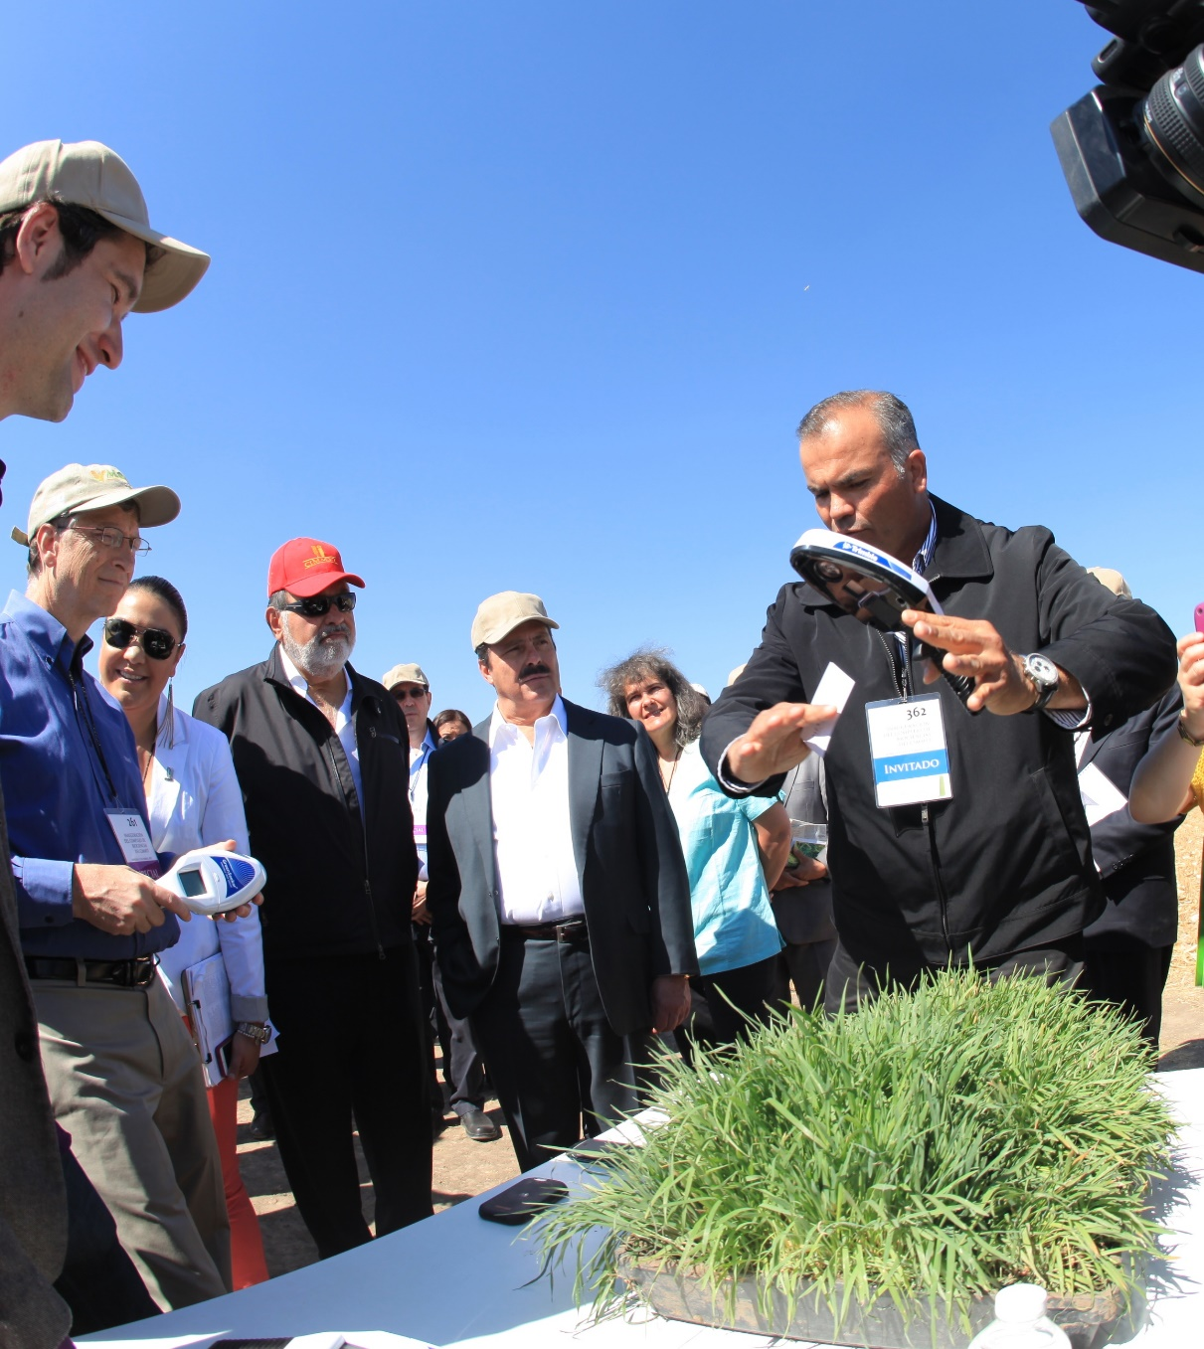
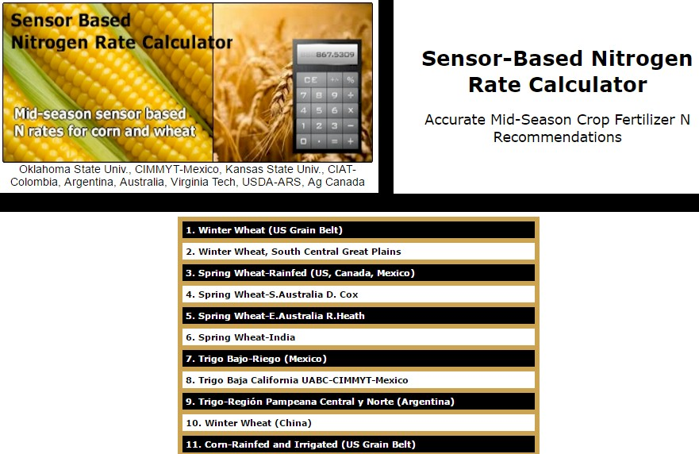
Hand-Held GreenSeeker Sensors

Slide 10
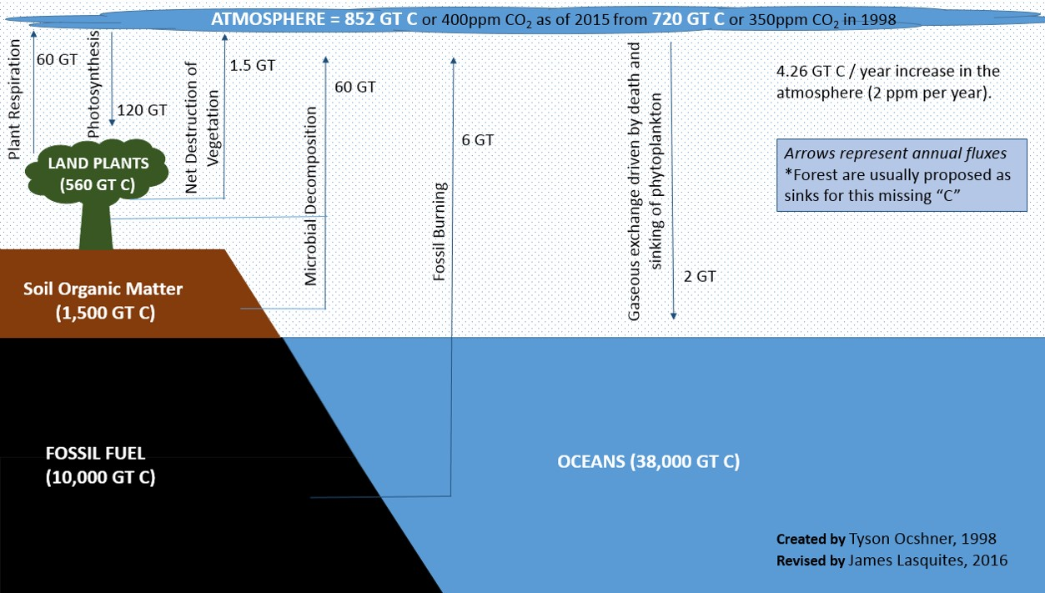


Slide 11
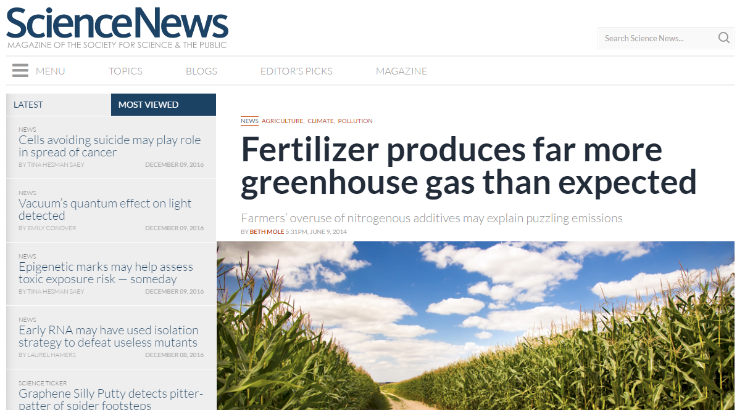
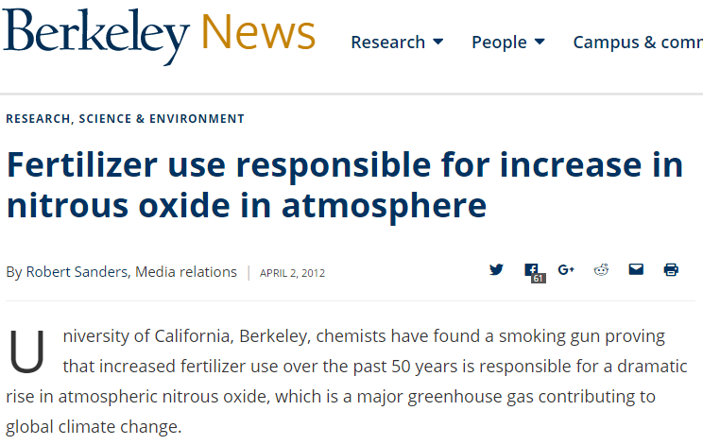
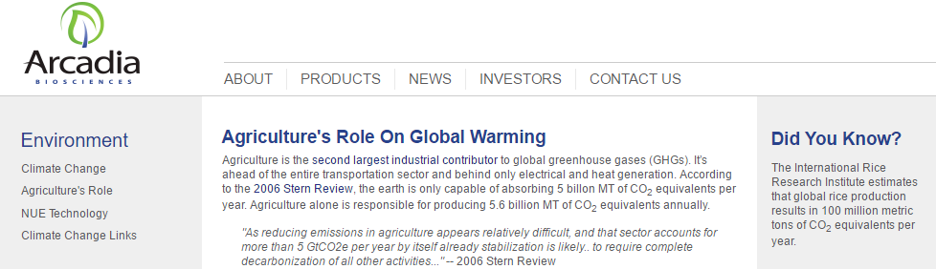
Decrease in W-SOM would have accounted for 6 to 25% of the 80 mg kg-1 (340-260) increase in atmospheric CO₂ over the last 150 years.
COMMUN. SOIL SCI. PLANT ANAL., 30, 1713-1719 (1999)

Slide 12
Maize (FAOSTAT, 2014)
Area, ha Prod.Mt avg. Mt/ha
World 183,319,737 1,038,281,035 5.7 (90 bu/ac)
USA 33,644,310 361,091,140 10.9 (174 bu/ac)
China 35,981,005 215,812,100 6.2 (98 bu/ac)
Brazil 15,450,180 80,516,571 5.2 (83 bu/ac)
Low income Food Deficit Countries
49,356,985 117,590,512 2.4 (38 bu/ac)
Developing world maize planted by hand (60% of total)
29,400,000 ha’s (72,618,000 ac)
25% increase on world hand planted maize (avg 2 Mg/ha *0.25 = 0.5 Mg/ha)
29,400,000*(2000kg/ha*0.25%)*$0.23/kg (or $6.00/bu) = $3,381,000,000

Slide 13
Wheat (FAOSTAT, 2014)
Area, ha Production, Mt avg. Mt/ha
World 220417745 729012175 3.3 (49 bu/ac)
USA 18771550 55147120 2.9 (43 bu/ac)
China 24071629 126215211 5.2 (76 bu/ac)
Brazil 2834945 6261895 2.2 (32 bu/ac)

Slide 14
Fertilizer Consumed (FAOSTAT, 2014)
Metric tons
World 108937126
USA 12428482
China 31074613
Brazil 3871997
Prod.Urea Metric tons
World -
USA 3030424
China -
Brazil 1357412

Slide 15
In the 5th century BC, The Hippocratic Oath was proposed and is believed to have been written by Hippocrates, widely known as the father of western medicine.
Requires physicians to swear that he/she will uphold several professional and ethical standards, and is essentially a promise to treat the sick to the best of their ability and to teach the secrets of medicine to the next generation. Importance reflected in it being a standard in the medical community for centuries.
truth, whole truth, nothing but the truth
testis (ancient Greek for 3), witness being a 3rd observer of events
radio caracol

Slide 16
Smil, 1997 noted that the industrial synthesis of ammonia using atmospheric N₂, heat, and pressure, stands as the most important technical invention of the twentieth century, and a required staple to feed the world’s population.
Smil, Vaclav. 1997. Global population and the nitrogen cycle. Scientific American, 277(1):76-81
“Feeding humankind now demands so much nitrogen-based fertilizer that the distribution of nitrogen on the earth has been changed in dramatic, and sometimes dangerous, ways”

Slide 17
Before the Industrial Era, 1750, atmospheric carbon dioxide (CO₂) concentration was 280 ± 10 ppm. It reached 367 ppm in 1999. Present atmospheric CO₂ concentration has not been exceeded during the past 420,000 years. Rate of increase over the past century is unprecedented, at least during the past 20,000 years. Present atmospheric CO₂ increase is caused by anthropogenic emissions of CO₂
Prentice, I.C., et al. 2001.
The carbon cycle and atmospheric carbon dioxide, pp. 183-237 in Climate Change 2001: The Scientific Basis, Contribution of Working Group I to the Third Assessment Report of the Intergovernmental Panel on Climate Change (Houghton, J.T., Y. Ding, D.J. Griggs, M. Noguer, P.J. van der Linden, X. Dai, K. Maskell, and C.A. Johnson, eds.). Cambridge University Press.

Slide 18
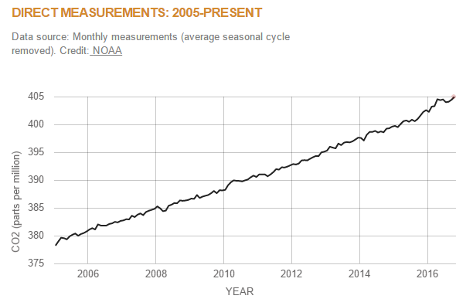

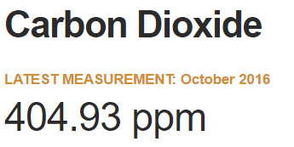
December 13, 2016
2016 - 1950
404 – 311 = 93
30% increase in 66 years

Slide 19
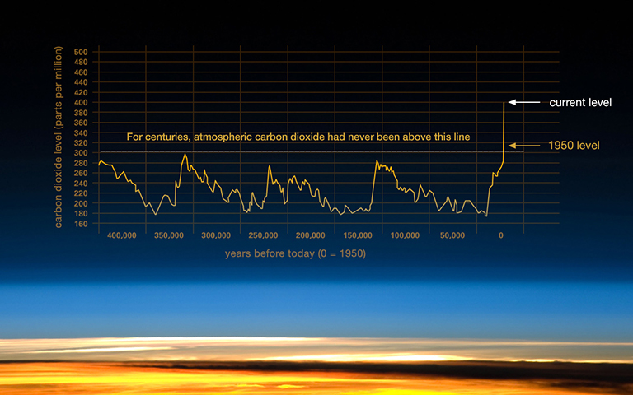

http://climate.nasa.gov/climate_resources/24/

Slide 20
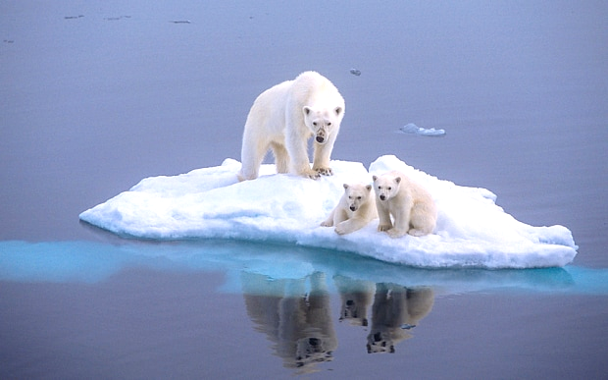
Should we rely on scientific data, or should we rather consult our very friendly neighborhood Polar Bear?

Slide 21
Cannot think of N independent of C

Slide 22
Country | 2011 Total Carbon Dioxide Emissions, Million Metric Tons | 2011 Per Capita Carbon Dioxide Emissions, Metric Tons of Carbon Dioxide per Person
China | 8715 | 6.5
United States | 5491 | 17.6
Russia | 1788 | 12.6
India | 1726 | 1.5
Japan | 1181 | 9.3
Germany | 748 | 9.2
Iran | 625 | 8.0
South Korea | 611 | 12.5
Canada | 553 | 16.2
Saudi Arabia | 514 | 19.7
United Kingdom | 497 | 7.9
Brazil | 475 | 2.4
Mexico | 462 | 4.1
www.ucsusa.org

Slide 23
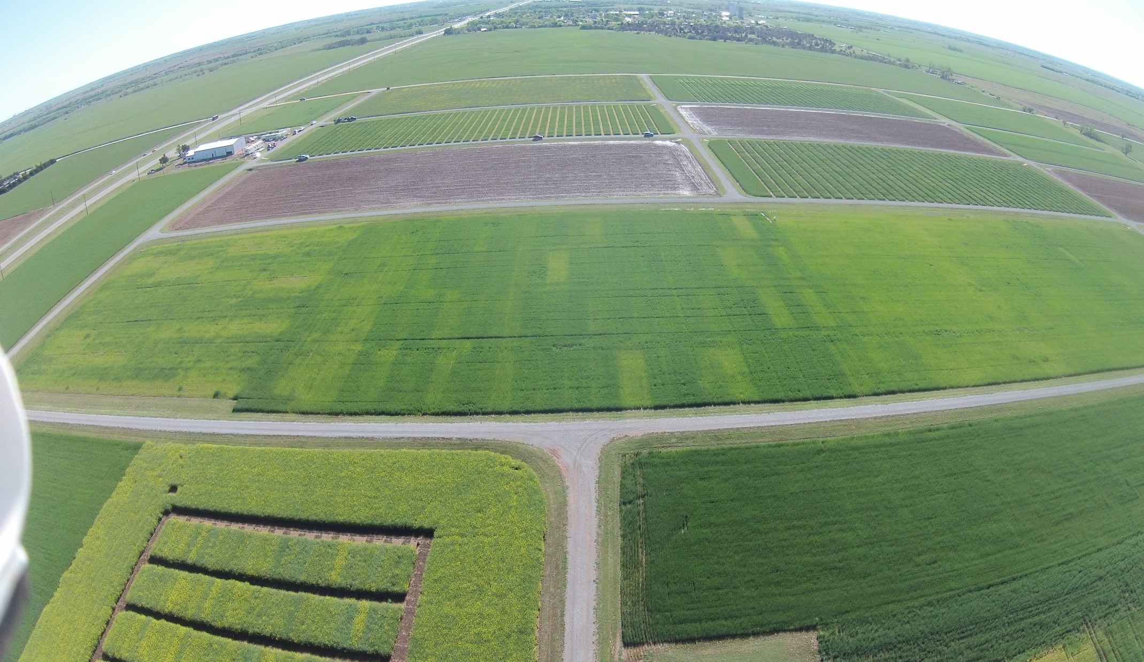
Experiment 502, 1970-present
Lahoma, OK
Nitrogen and Carbon

Slide 24
We cannot talk about agriculture without talking about the environment; we cannot talk about the environment without talking about agriculture; and we cannot talk about either without talking about the entire world. They are inextricably linked.
Bobby Stewart,
West Texas A&M

Slide 25
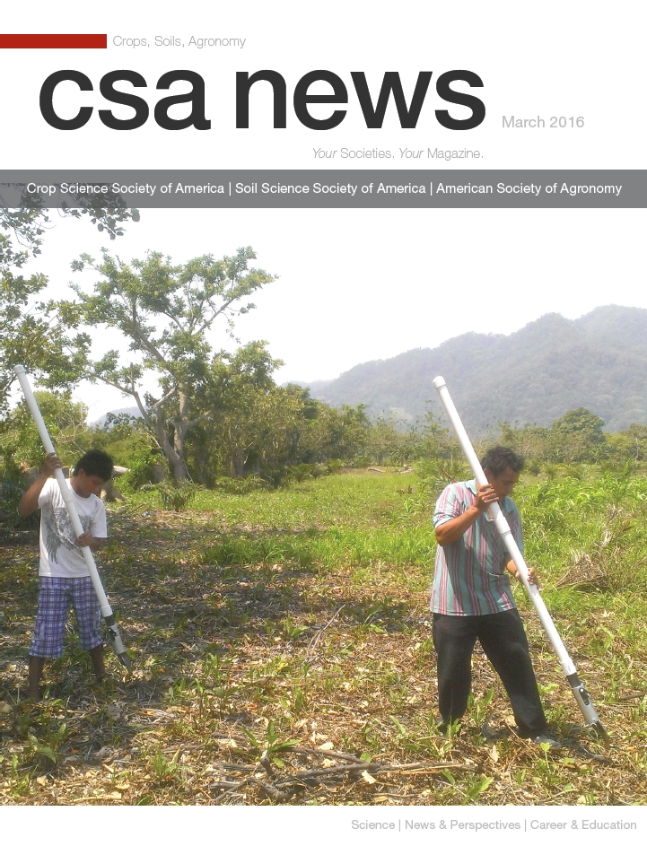
NITROGEN demand in the Central Great Plains
Tuesday December 13, 2016
3:15 pm
Wes Watkins Center
Jagmandeep Dhillon
Joshua Ringer
Wayne Kiner
Randy Taylor
Bill Raun
CSA News, March 2016
NITROGEN DEMAND
http://nue.okstate.edu/Hand_Planter.htm
CCA_Extention_2016.ppt

Slide 26

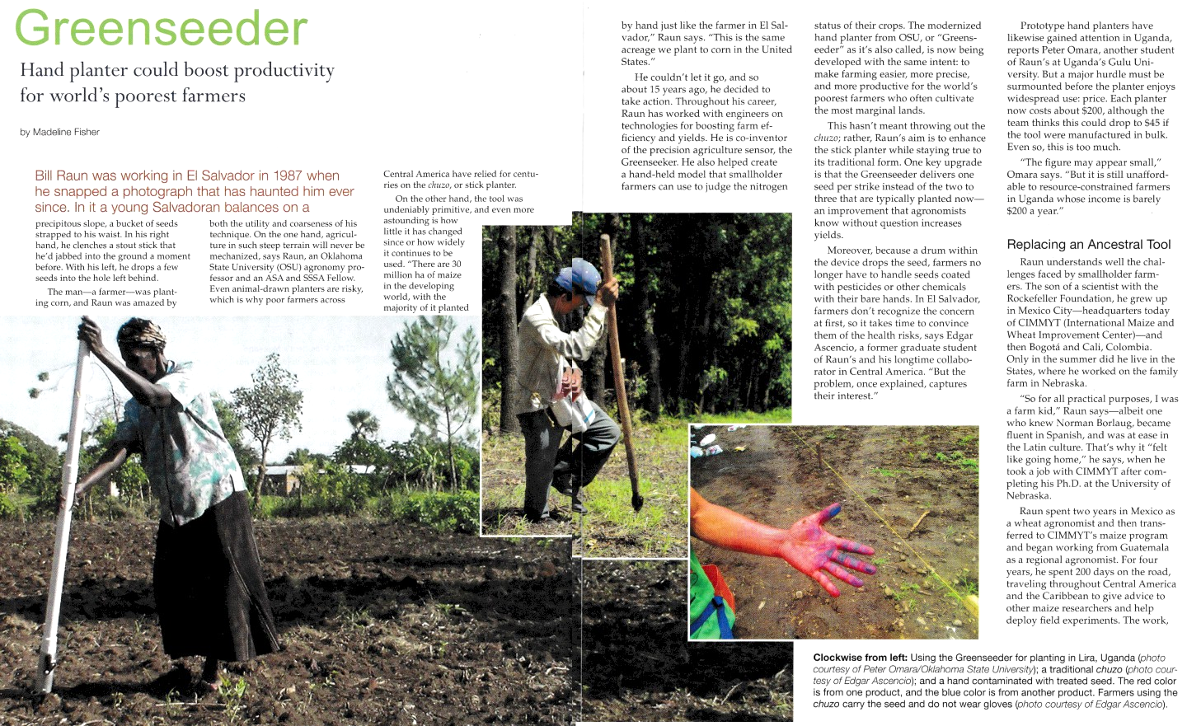
March 2016
Membership, 11,000, views 10,000

Slide 27


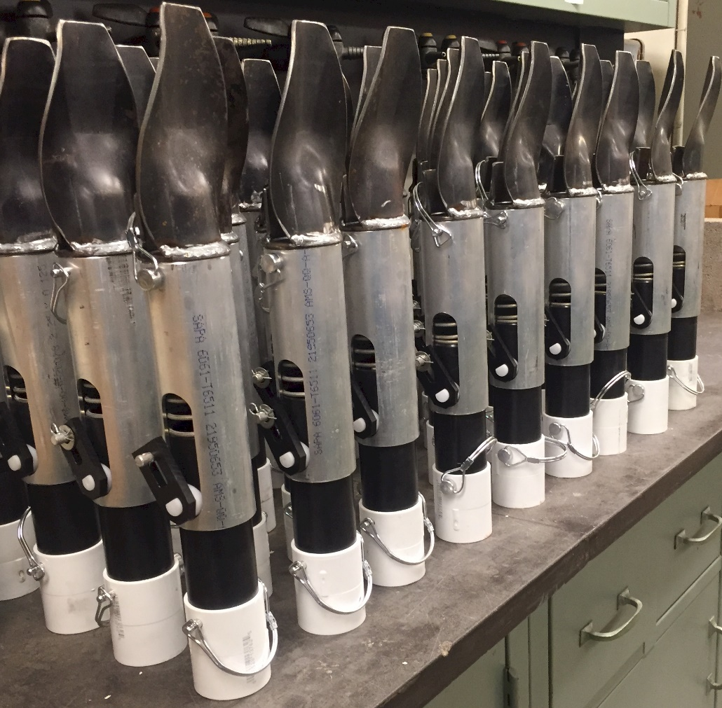
OSU Hand Planter
One Minute Video

Slide 28
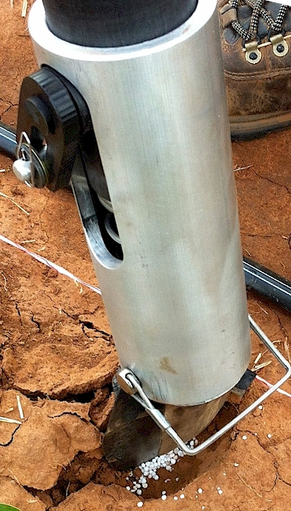
Benefits
Remove chemically treated seeds from the hands of producers
Decrease soil erosion via improved plant spacing
Accommodate mid-season application of urea-N
Place urea below the surface reducing NH3 loss
Potential to increase maize production and NUE
Khim et al. (2014). Planting 1 seed, every 0.16m increased yields by an average of 1.15 Mg ha⁻¹ (range, 0.33 to 2.46 Mg ha⁻¹) when compared to the farmer practice of placing 2 to 3 seeds per hill, every 0.48 cm.

Slide 29
“we continue to live in the shrouded thralls of world hunger with no universal pledge to eradicate it” (Borlaug et al.,2009).
Borlaug, Norman, Christopher Dowswell, Bill Raun, and Ed Runge. 2009. A generational recommitment to abolishing world hunger. American Society of Agronomy, CSA News, 54:21-22.

Slide 30
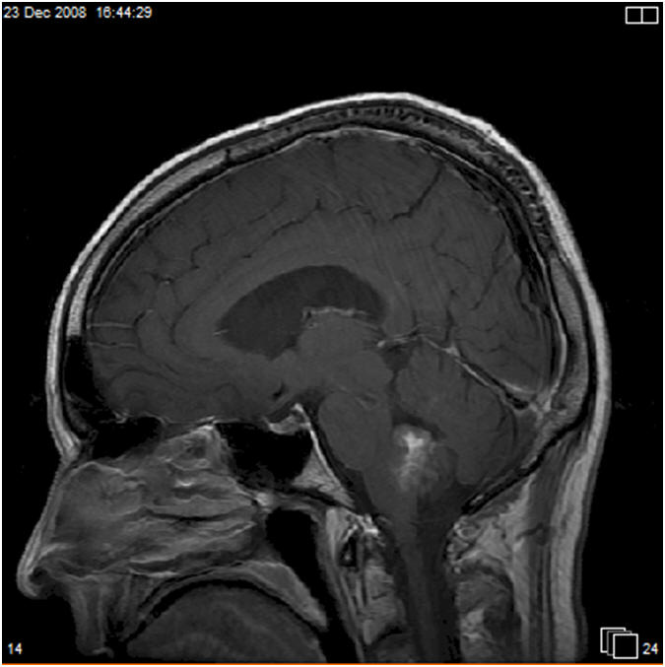
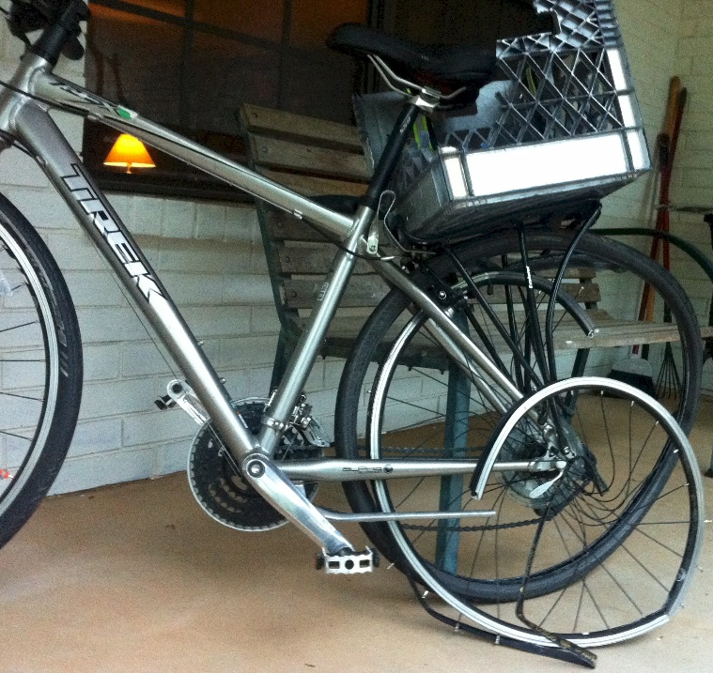

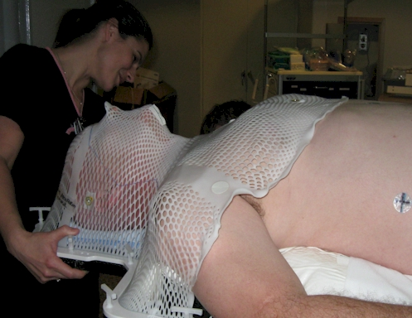

Slide 31
Yield Goals
Average of the last 3 or 5 years + 20% versus observed yield

Slide 32
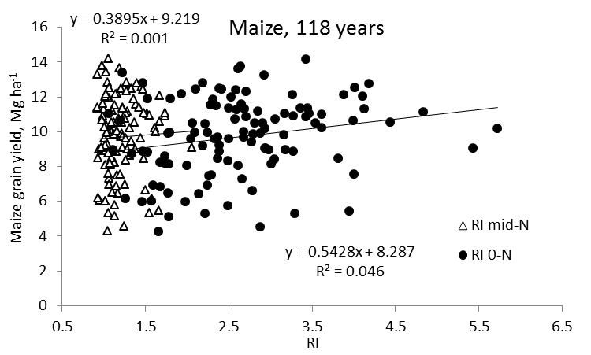
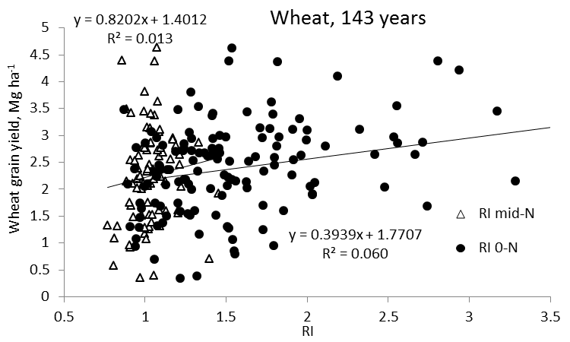
Independence of Yield potential and Nitrogen response
Iowa
Nebraska
Wisconsin
Oklahoma
2013. Relationship between grain crop yield potential and nitrogen response. Agron. J. 105:1335–1344.
Independence of yield potential and crop nitrogen response. Precision Agric. 12:508-518.

Slide 34
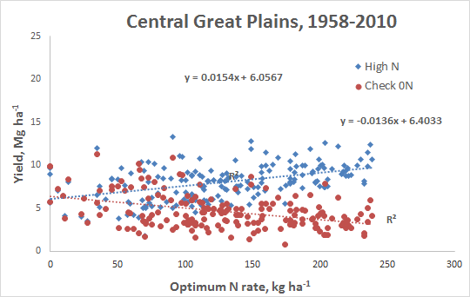

Slide 35
“Today we hear a great deal about human rights. It's a noble goal to work toward, but it can never be achieved as long as hundreds of millions of poverty stricken people in the world lack the basic necessities of life. The right to dissent? For whom: the elitist, the educated, the privileged? It doesn't mean much to the person with an empty stomach, a shirtless back, a roofless dwelling, the frustrations and fears of unemployment and poverty, the lack of education and opportunity and the pain, misery and loneliness of sickness without medical care.” (Borlaug, 1979).
Borlaug, Norman. 1979. Civilization will depend more upon flourishing crops than on flowery rhetoric. Landon Lectures, Kansas State University. March 20, 1979. (http://ome.ksu.edu/lectures/landon/trans/Borlaug79.html).

Slide 36
“The human mind, when stretched by a new idea, can never shrink to its original size” Oliver Wendell Holmes

Slide 37
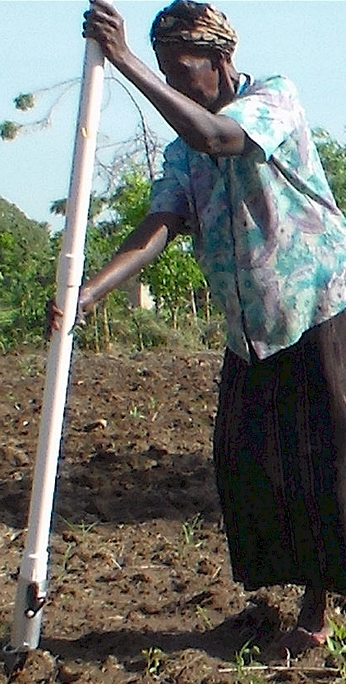
Modern researchers should therefore seek to understand the rationale behind traditional smallholder farmer behavior in technology use. J. Sust. Dev. 2012
Planter Ergonomics

Slide 38
“The most conservative man in traditional agriculture is the scientist, and sometimes I am not proud to be one of them. This is most discouraging. The scientist is a privileged person, the man should lead us out of the wilderness of static, underproductive agriculture, and yet by his apathy and failure to exercise his unique vision, he keeps us in the swamp of despair. The scientist fears change because he is in a relatively privileged position in his own society. If there is no breakthrough in yield, he will not be criticized. But if he makes a recommendation and something goes wrong, he may lose his job. “ N.E. Borlaug
“Wheat is an equal opportunity performer, it never discriminates. It grows as well for the poor as for anyone”
N.E. Borlaug

