Slide 1

Maximizing the Value of a Ph.D.
Graduate Seminar
September 8th, 2014

Slide 2
Disclaimer
Intent is to inform students and faculty
  Examples of my recent experiences
  Capitalize on what I have learned

Slide 3
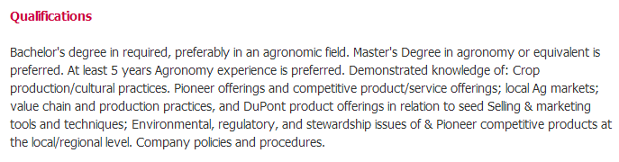
Why pursue a terminal degree?
Why am I here?
Why are you interviewing a Ph.D.?
‘Commitment to improve’
‘Desire to learn’

Slide 4

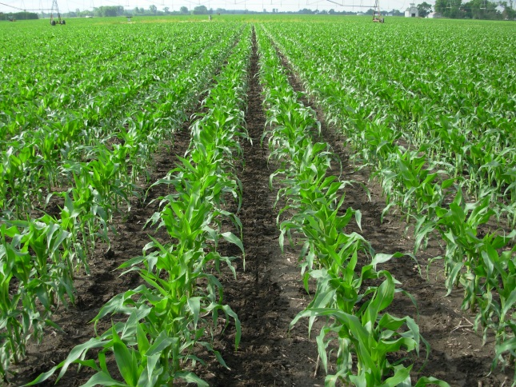
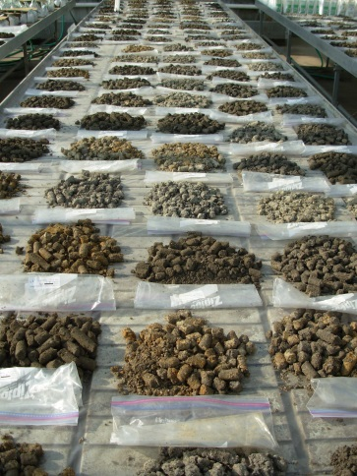
Making your selection
Figure out what ‘it’ is you want
  Crop/Discipline
  Location
  Lab/Faculty
  Funding
  Reputation
Diversify yourself as a scientist and academic
http://collegeuniversitytoday.blogspot.com/2013/05/university-college-london-football-teams.html

Slide 5
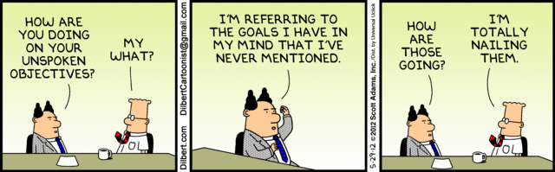
Designing your research:
Objectives
Define clear objectives before any experiment is established
Be goal oriented
No superfluous data collection
Writing will be much easier

Slide 6
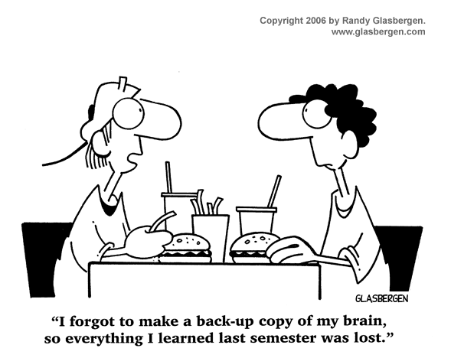
Designing your research:
Classwork
Support and reinforce research
Develop you as a scholar in your discipline
‘Bond’ with/impress committee members

Slide 7
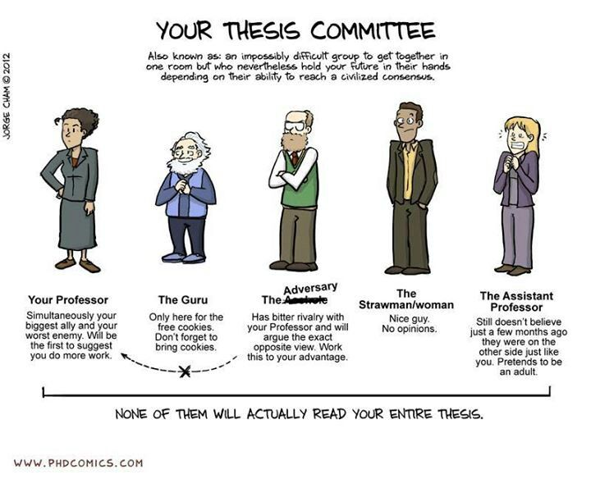
Designing your research:
Committee
Naturally evolve within your lab group or research focus
Support,
direction,
reliability
Independence

Slide 8

Public relations and marketing
Branding yourself
  Differentiate yourself (the product) in the market
Identify where you excel/
brand attributes
  Define your aspirations
Managing your brand
  Informal marketing
  Formal marketing
http://www.powerofpersonalbranding.com/brand-yourself-now/why-personal-branding/

Slide 9
Informal marketing:
Socially
Develop, manage, nurture your network
  Master the casual circle-back
Constantly interviewing
  Every interaction with someone is a short
  interview
Keep an open mind
  Opportunities can always arise
ASA graduate student social

Slide 10


Formal marketing:
Research
Presentations
  Meetings/conferences
  Field days
Publications
  Peer-reviewed
  Fact sheets
ASA events
  Graduate school forum
  Career center

Slide 11


Formal marketing:
Media
LinkedIn/Twitter/Facebook
CV/resume and cover letter
Blogs/websites
Company website
databases
http://1.bp.blogspot.com/-bJbtJJuV4Rk/UbyYYErD7PI/AAAAAAAAFoQ/OiJ_Y0I7GCc/s1600/twitter.jpg

Slide 12

CASNR career fair:
Tomorrow

Slide 13
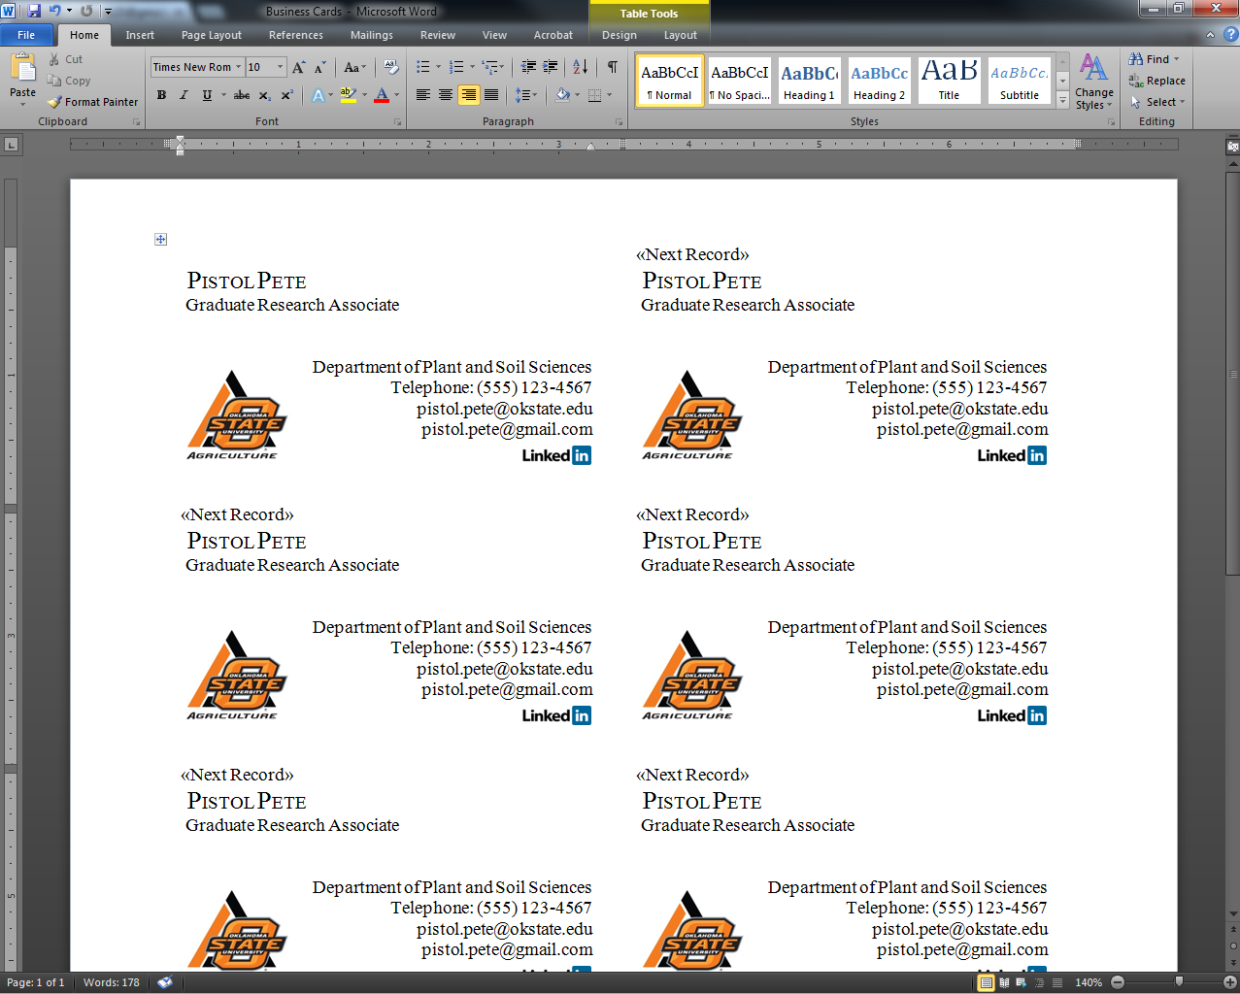

Business cards
<$10 @ ‘X’ Store

Slide 14
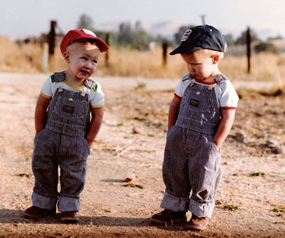
WHAT DO YOU STUDY?

Slide 15

Why is your research so important?
Why are you a good investment for the tax payers?
Three Minute Thesis (3MT)
  Thesis/dissertation topic and significance in 3 minutes using one slide
    OSU Final Competition: >$2500 in prizes

Slide 16

Career development:
Forbes
Nationally recognized leader in Business
Interview questions and appropriate responses
Branding yourself
Networking

Slide 17
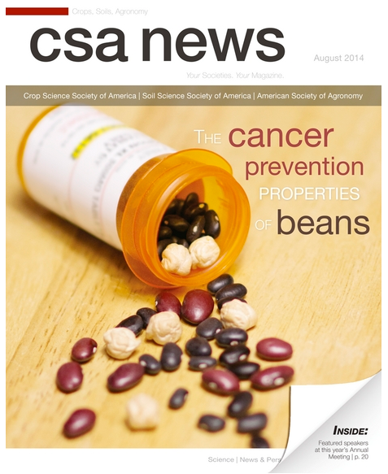
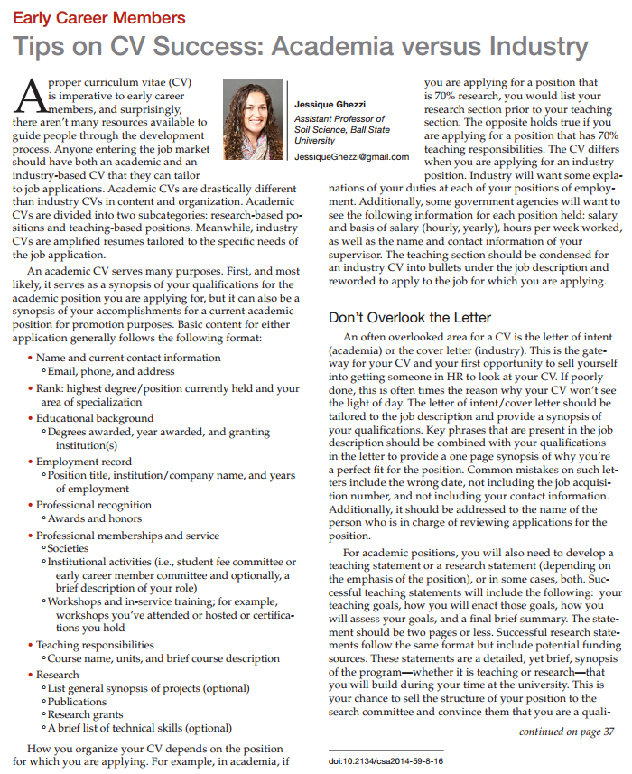
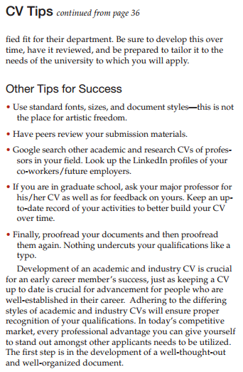
Career development is everywhere
Letter of intent
-academia
Cover letter
-industry

Slide 18
Doctor of Philosophy
“Philosophy”
  A particular set of ideas about knowledge, truth, the nature, and the meaning of life, etc.
  Merriam-Webster dictionary
How will someone from a different perspective view your research?
Think through the issue at hand
  Big picture/make it relate
Training provides you with a license to practice research

Slide 19

Ph.inally
D.one!
Goal: seamless employment transition
Get out there and
make OSU look good!

