Slide 1
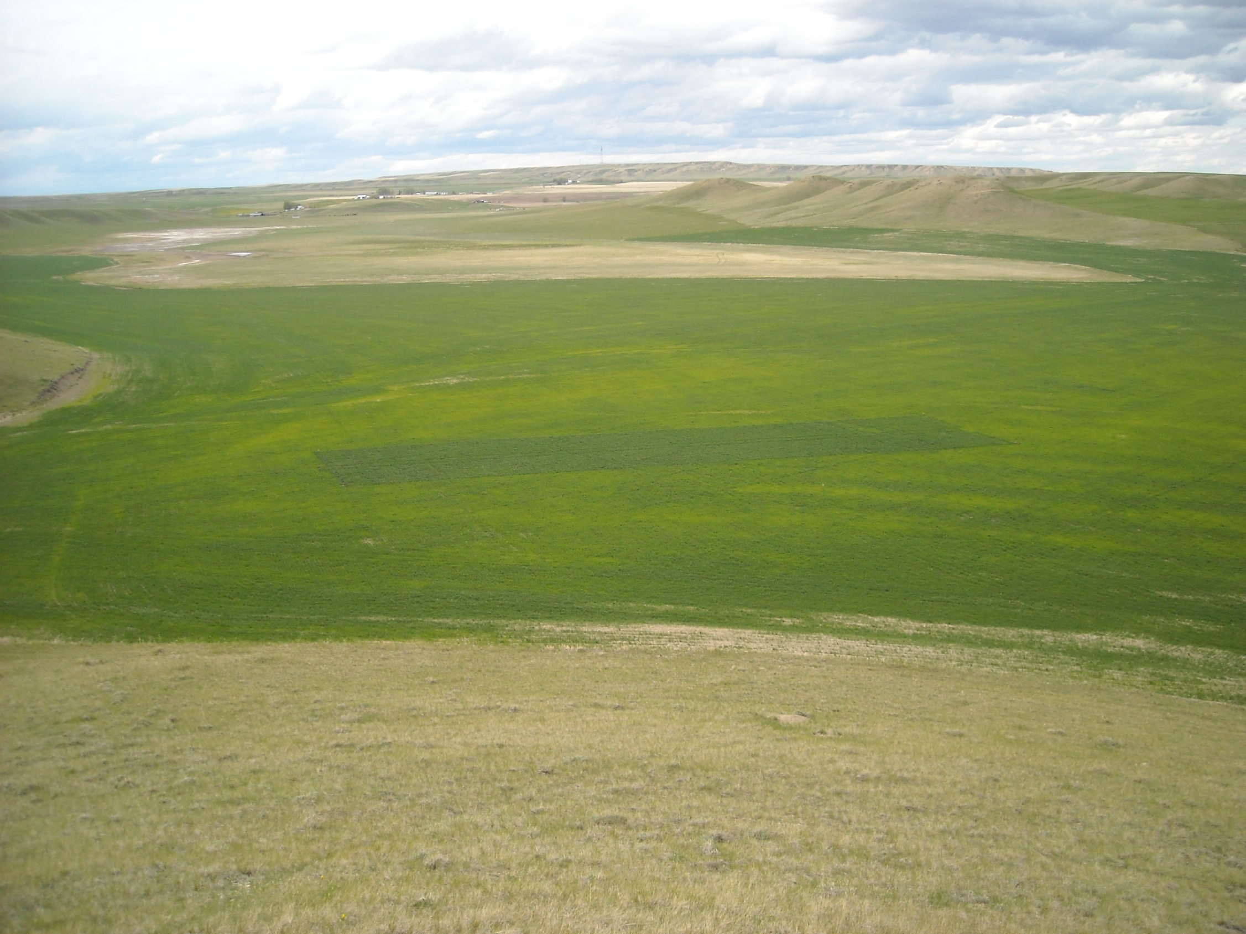


Rob Lightner
Conrad, Montana

Slide 2
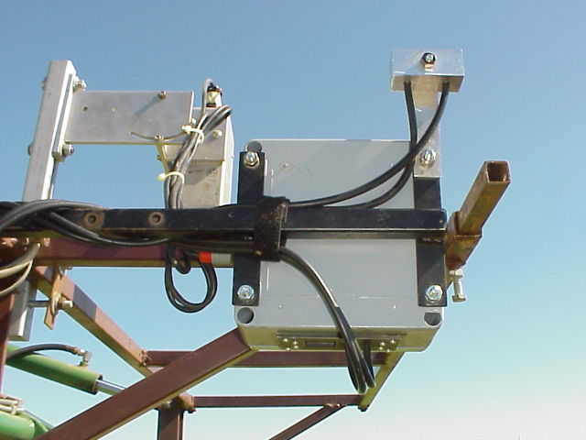
Passive Sensor Accounting for Incident Light
1994

Slide 3
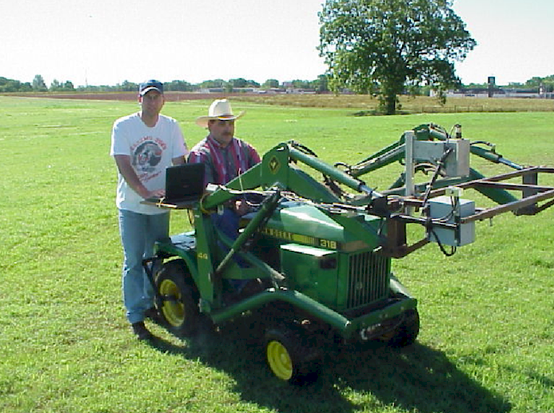
Notes:
Here is the optical sensor we used. It’s mounted on a John Deere tractor. It measures both solar irradiance and plant surface reflectance.

Slide 4
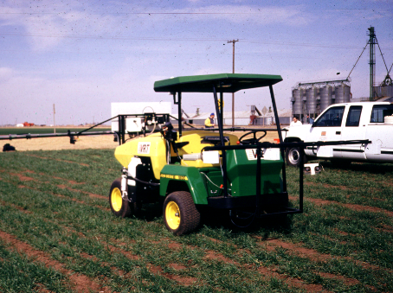
1996
Variable rate
spray nozzle
Sensor assembly
Sensed area
(treated area)

Slide 5
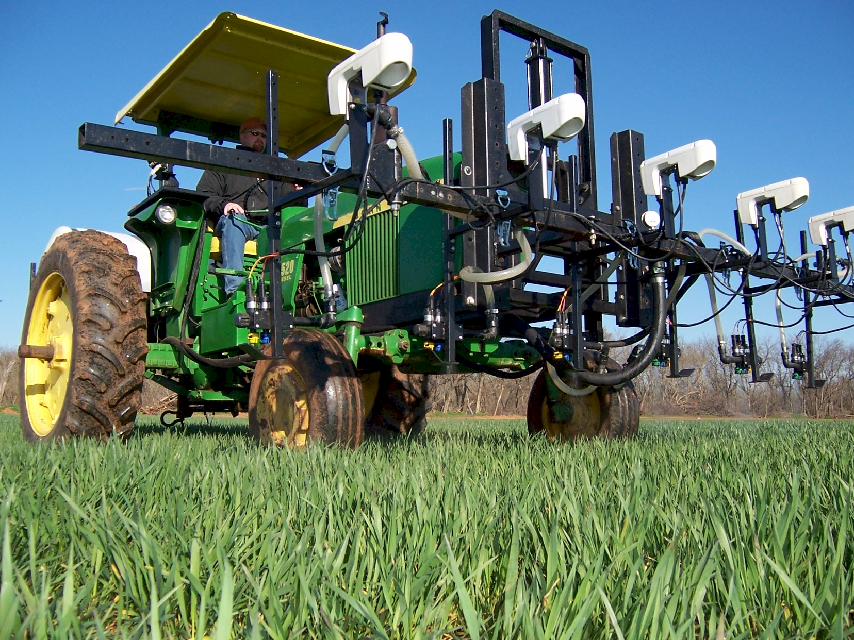
On the go sensing and fertilization

Slide 6
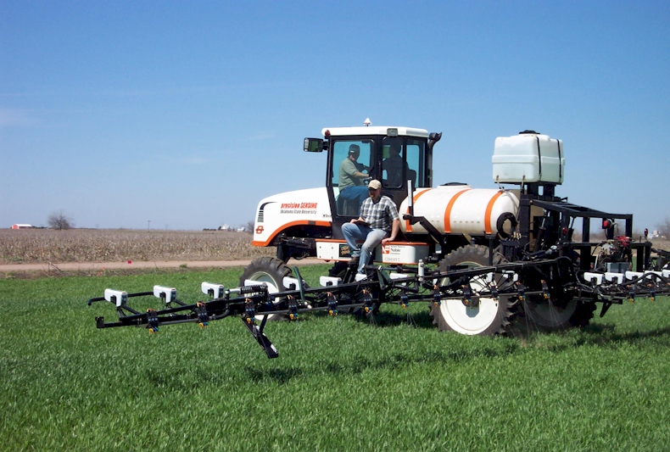

Active sensing/fertilizing
2001
precision SENSING

Slide 7
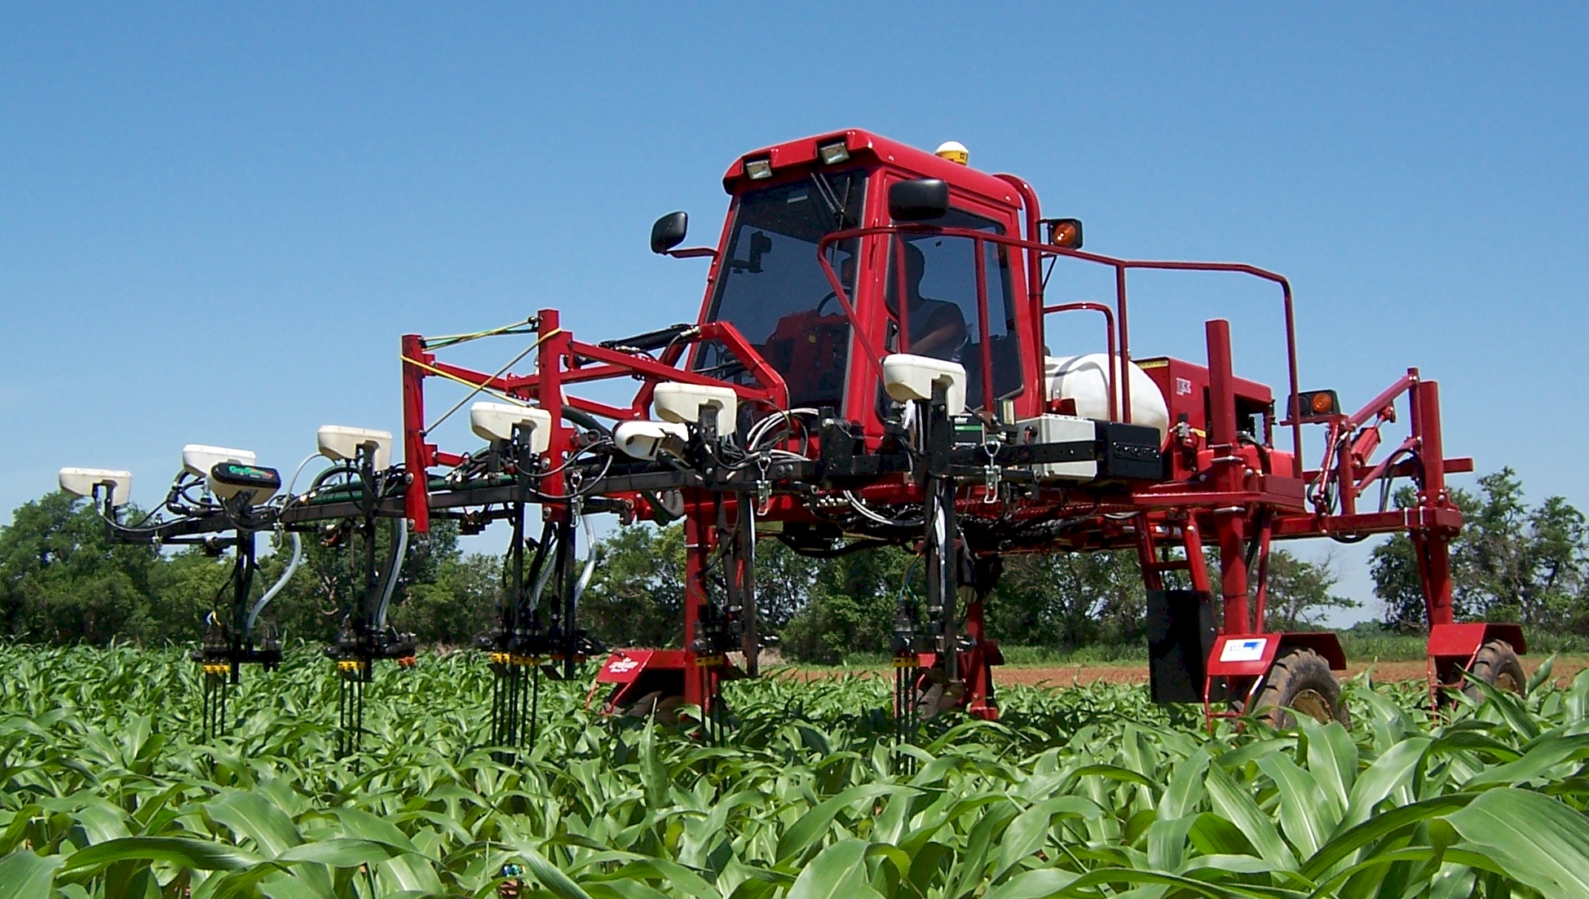
Sense and Fertilize by-plant
2006

Slide 8
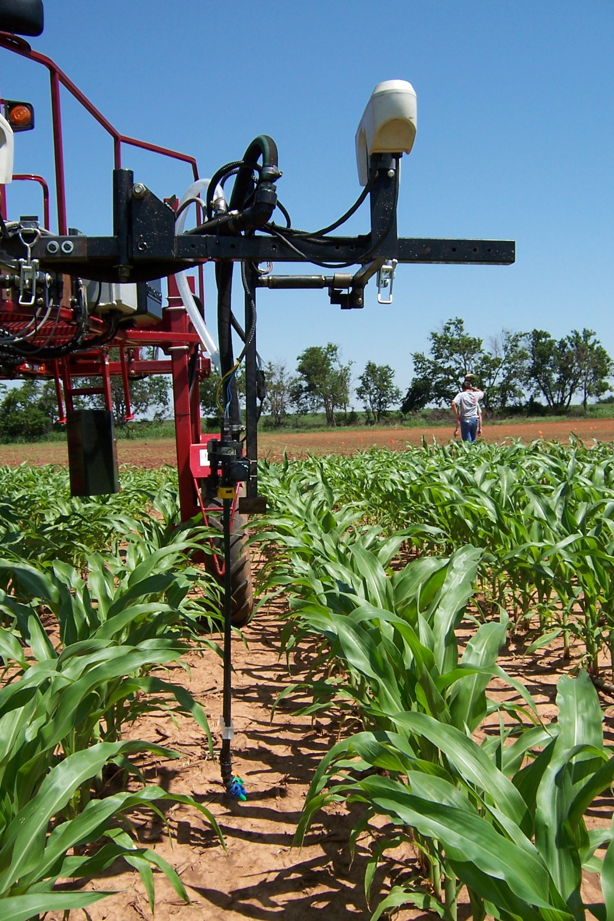

Slide 9
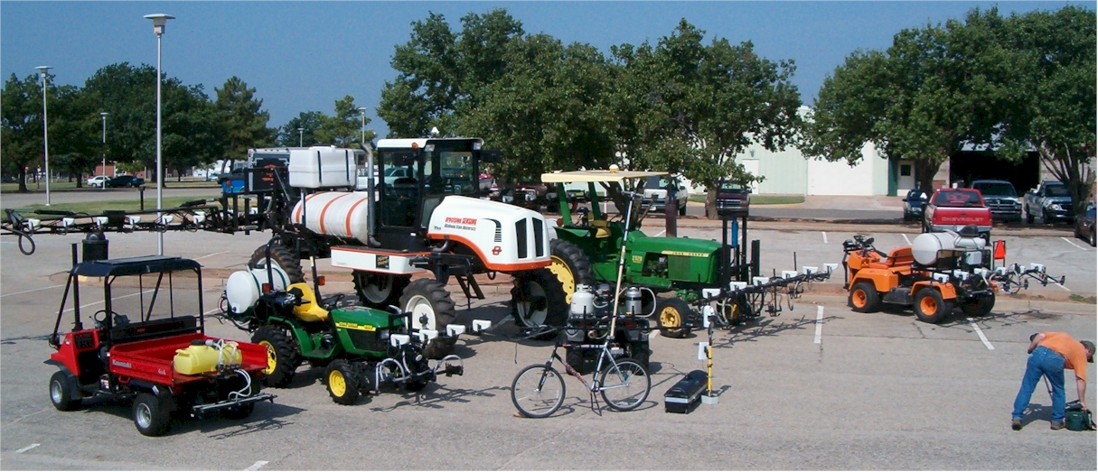

Slide 10
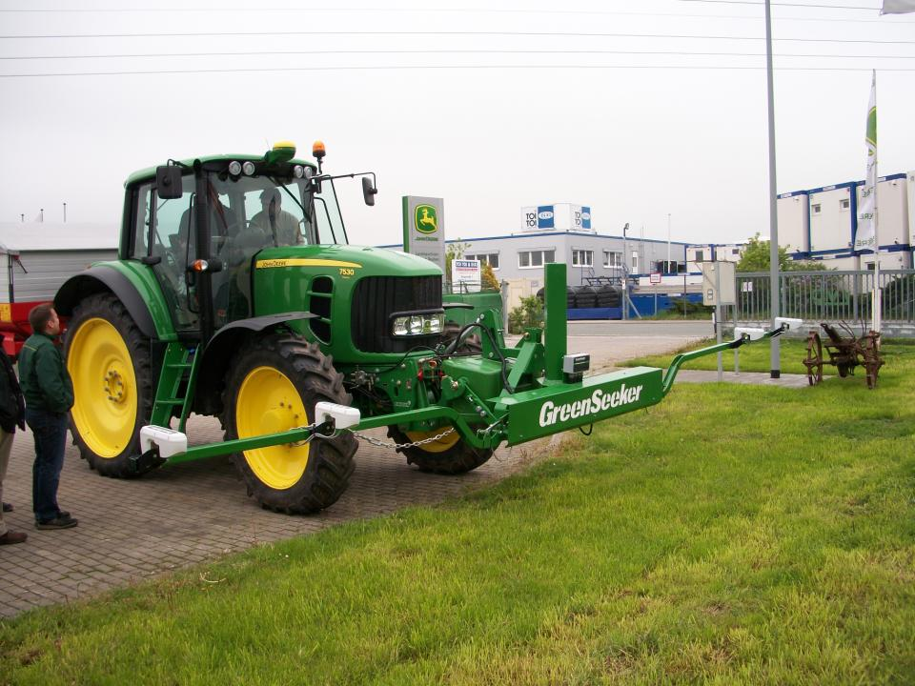

Slide 11
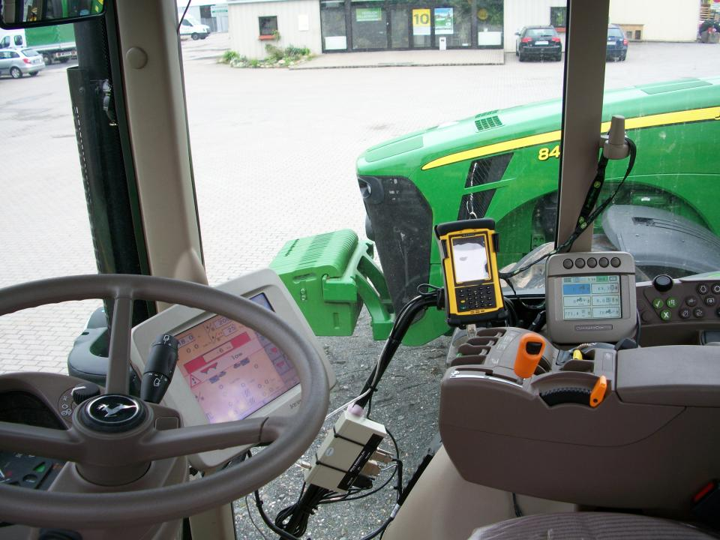
Intimidation of Precision Agriculture

Slide 12
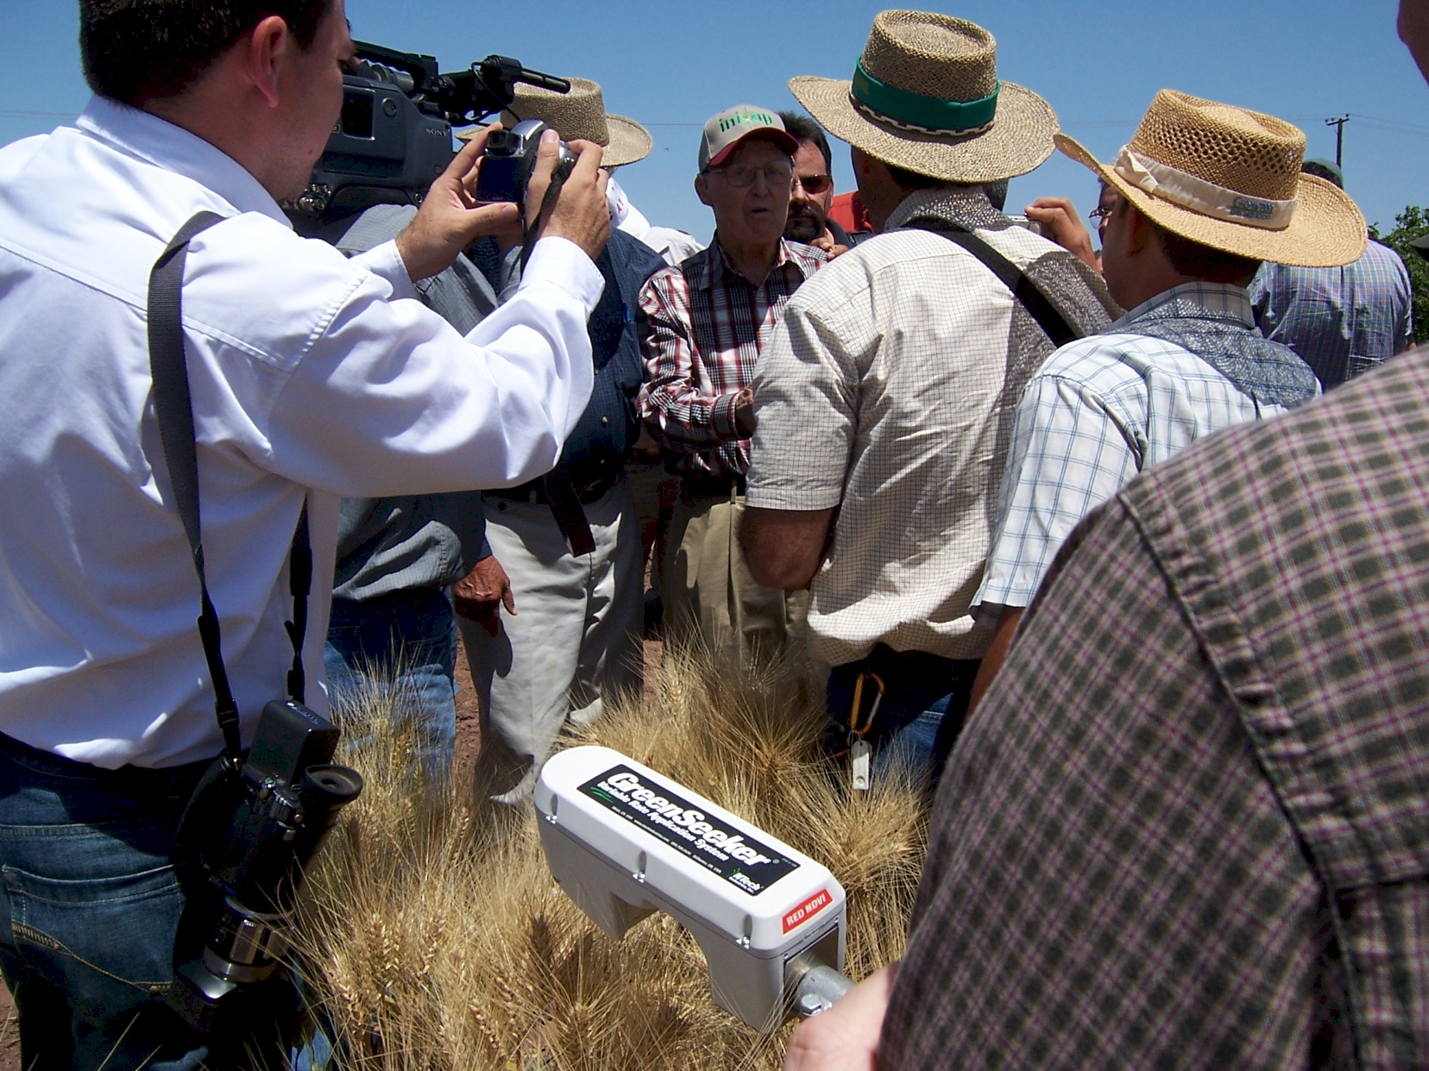
GreenSeeker sensing technology endorsed by Dr. Norman E. Borlaug, April 2007

Slide 13
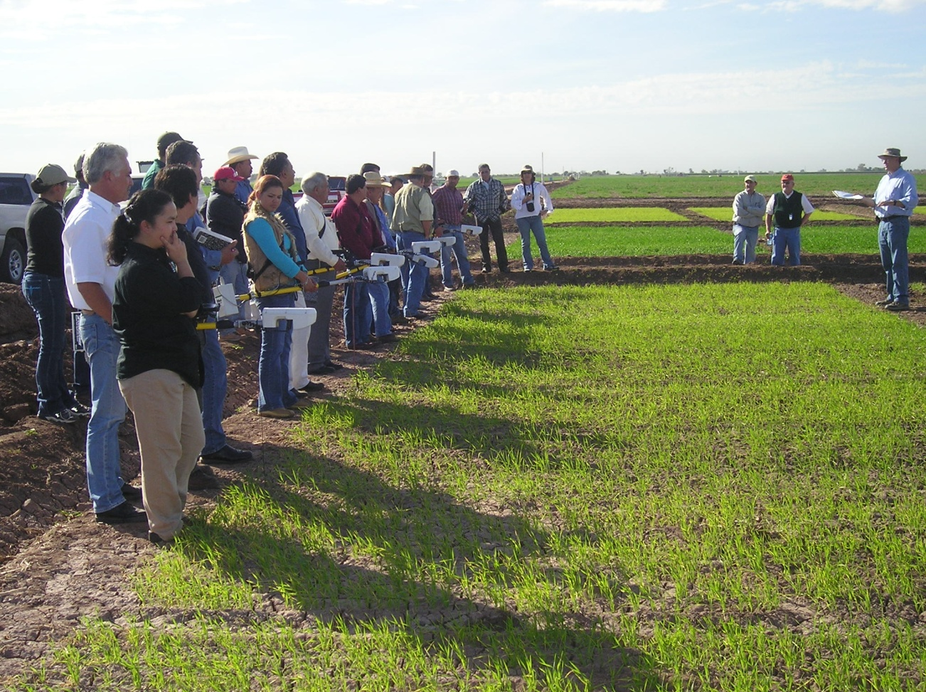
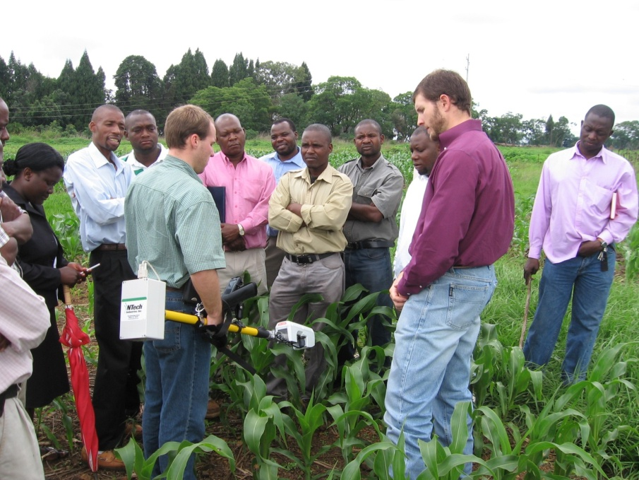
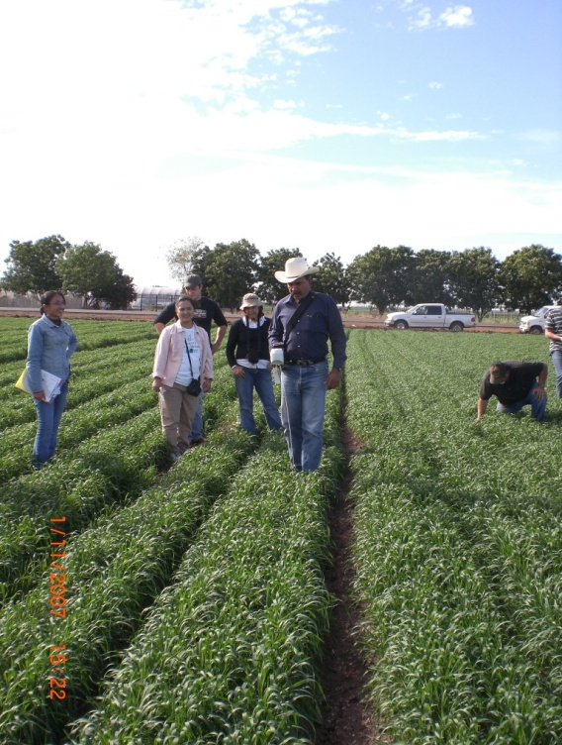
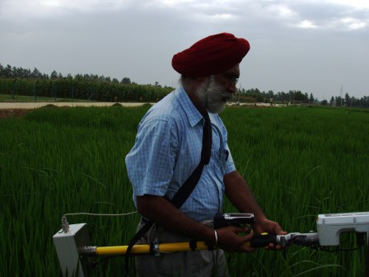
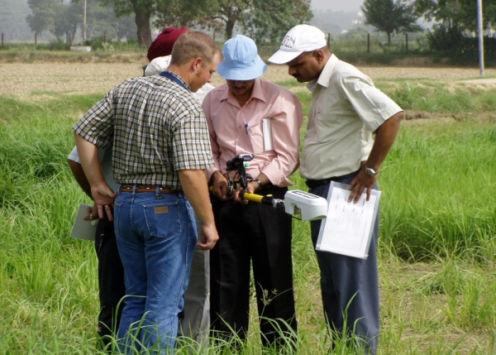
Ciudad Obregon, Mexico
Modipuram, India

Slide 14
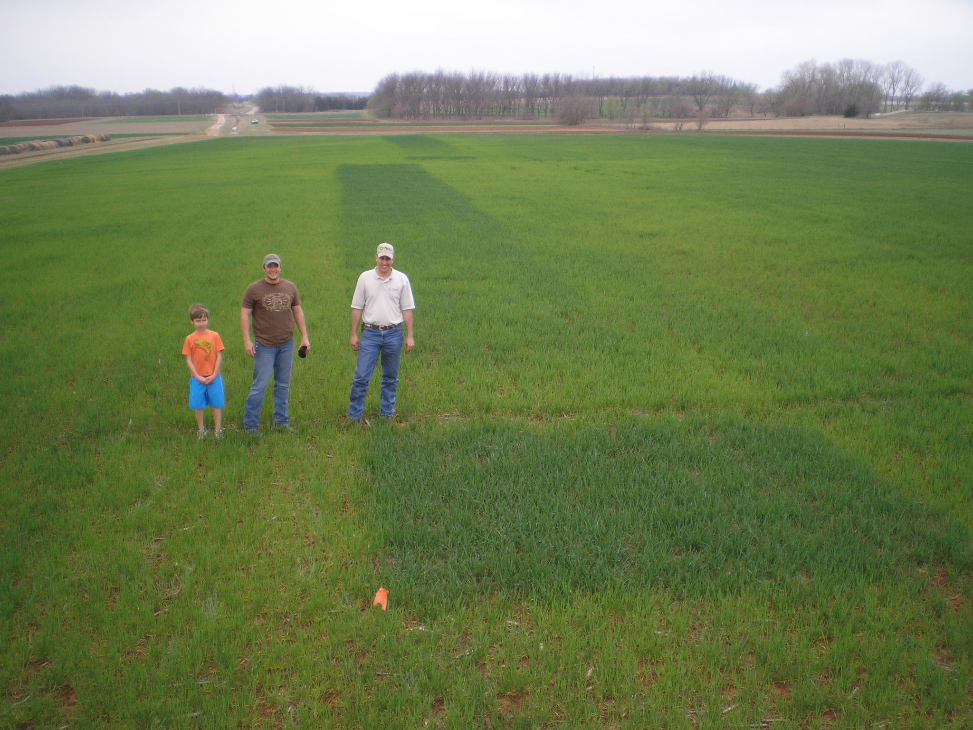
Visual Confirmation
N Ramp

Slide 15
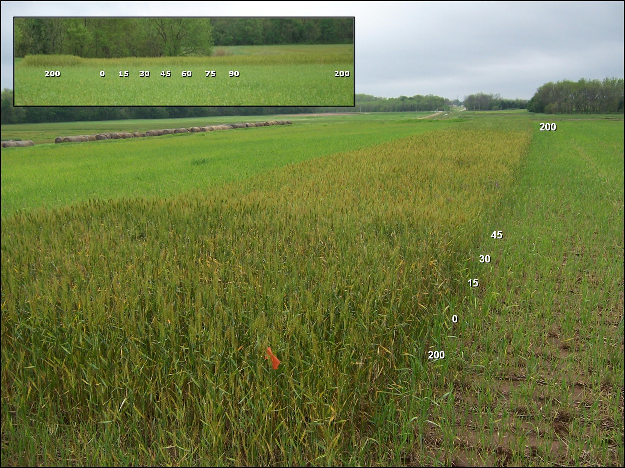
N Rich Strip, RAMP

Slide 16
Sub-Saharan Africa USA
Population, million 700 300
Cereals, million ha 88 56
Production, million tons 97 364
Yield, tons/ha 1.1 6.5
Fertilizer N, million tons 1.3 10.9
at $1.00/kg N, 46%N $598,000,000 $5,059,999,540
Avg. N rate, kg/ha 4 52
NUE >100* 35
% of world N consumed 1.4 13
% of world population 10 4
1 billon dollars in excess N flowing down the Mississippi River, annually **

Slide 17
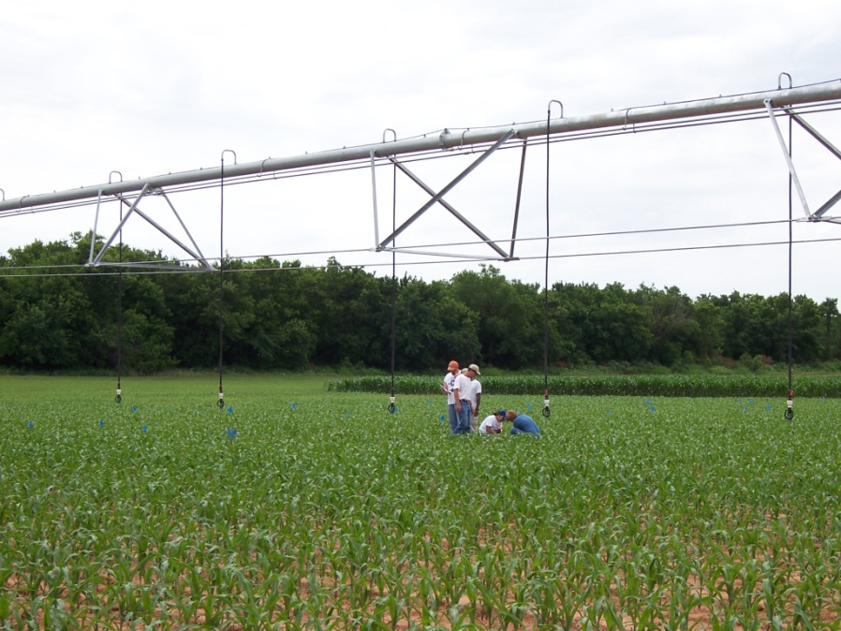
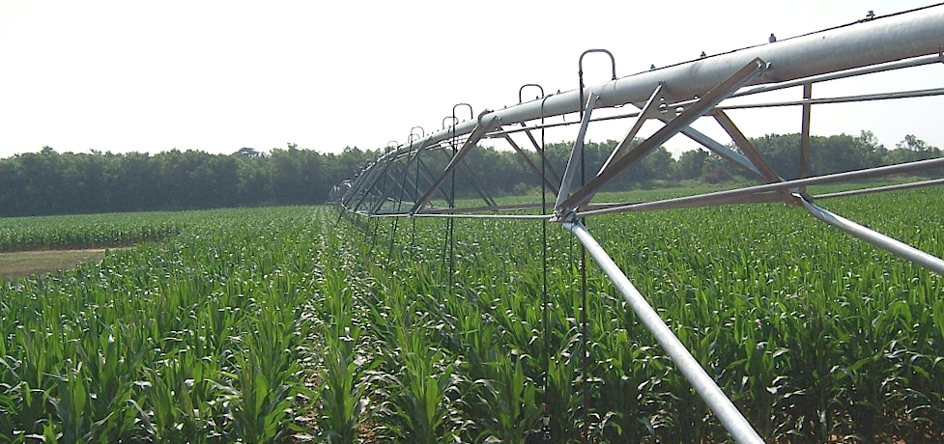

Corn Research

Slide 18
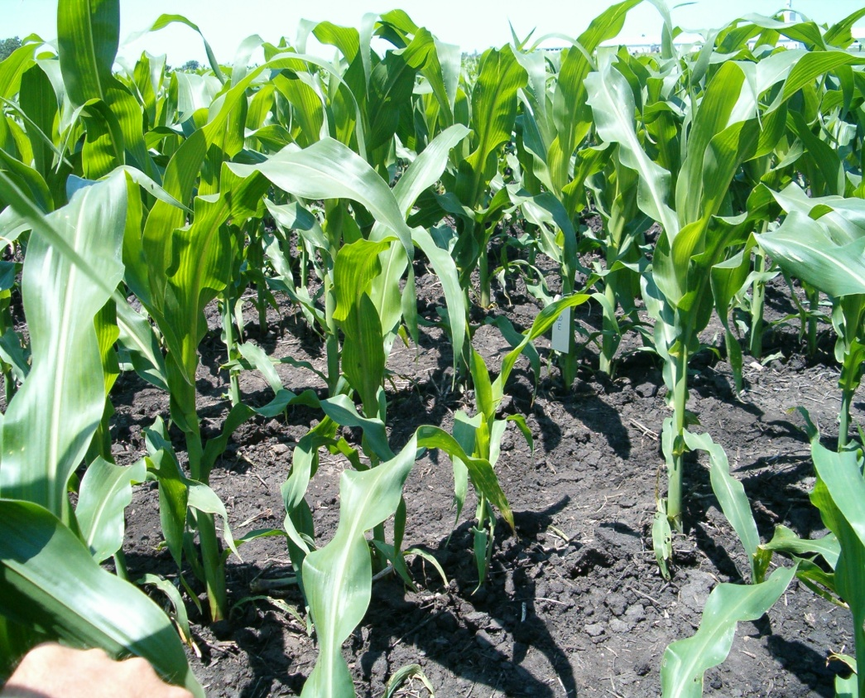
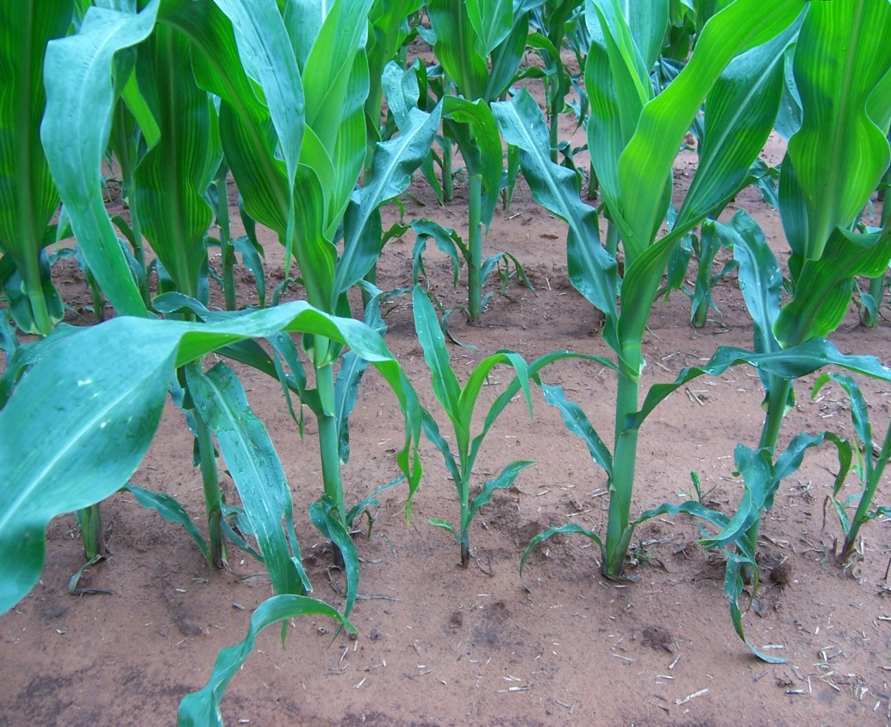
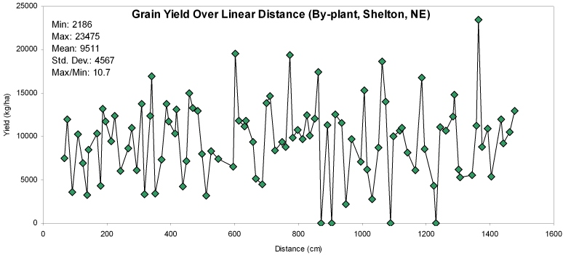
By-Plant N Management
IOWA
OKLAHOMA

Slide 20
5-Plant Sequence

Slide 21

Extension/Training
Farmer training, Ciudad Obregon, Mexico, January 2007

Slide 22
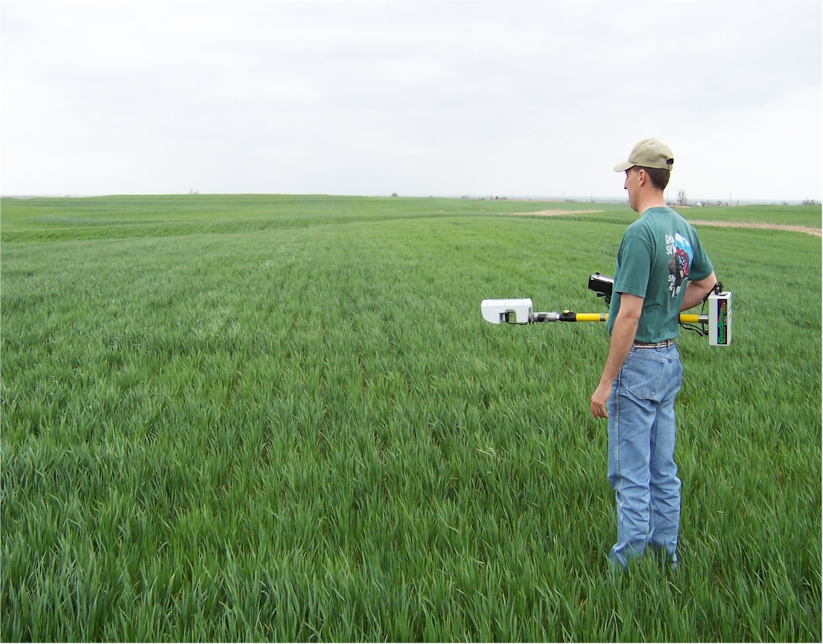
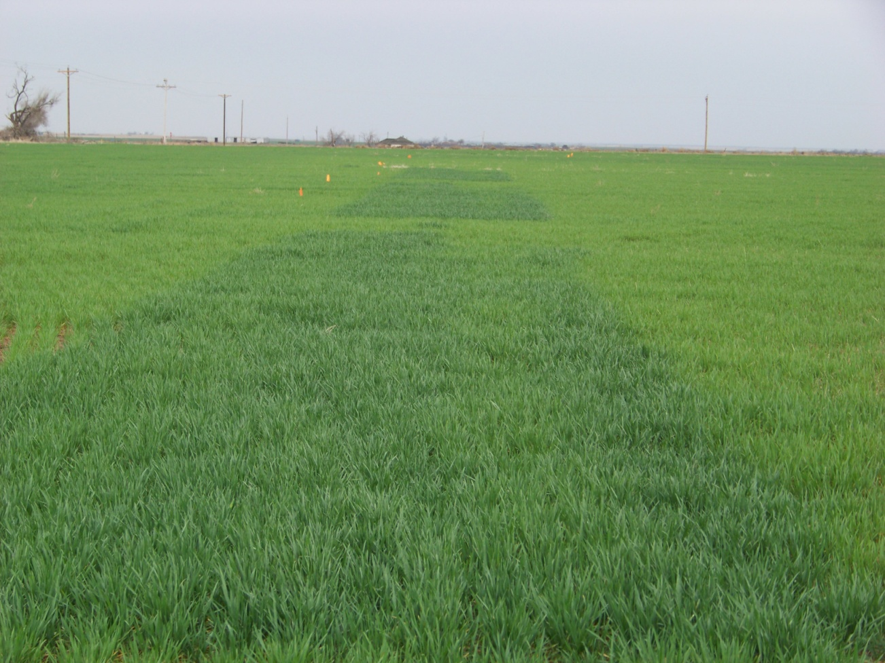
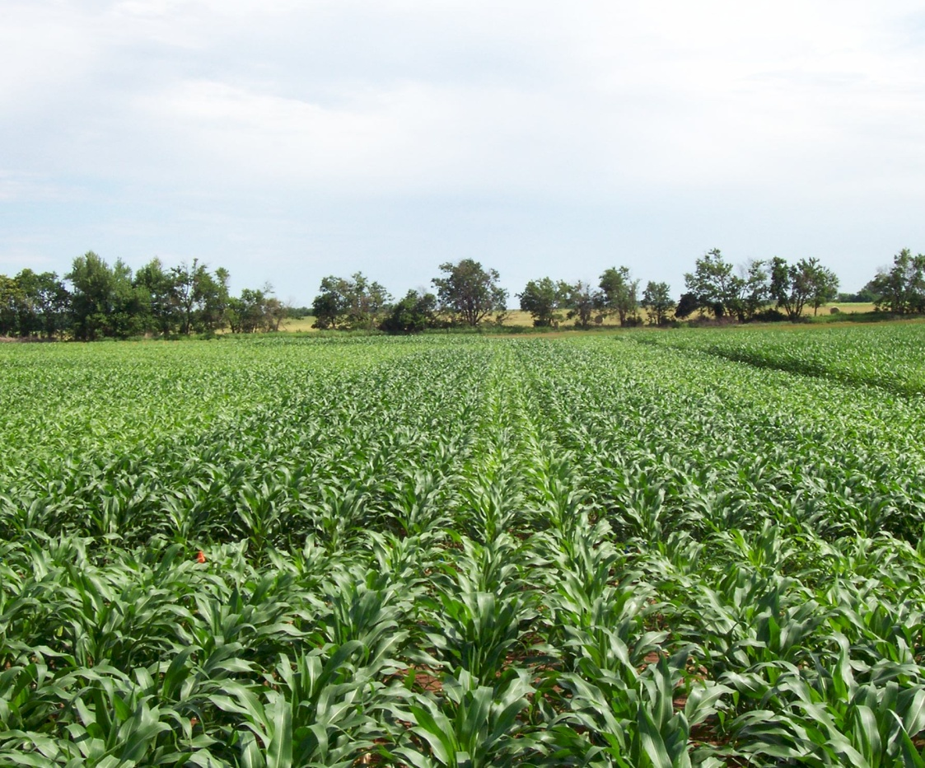
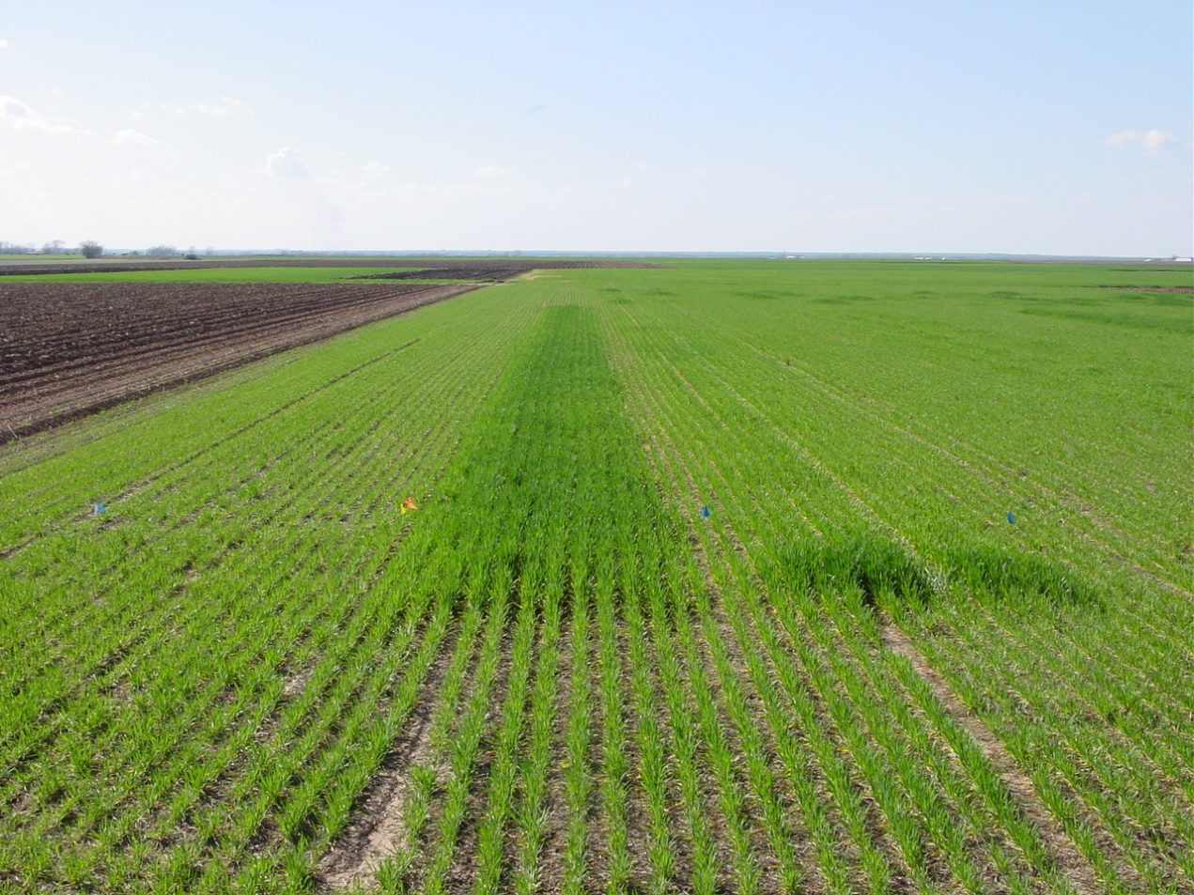

Slide 23
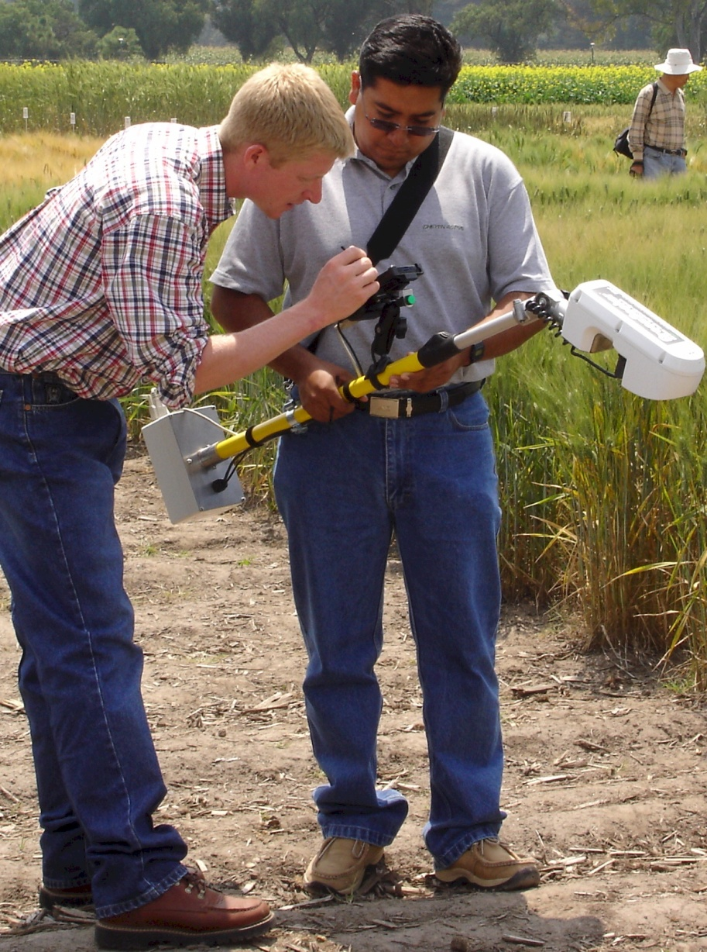
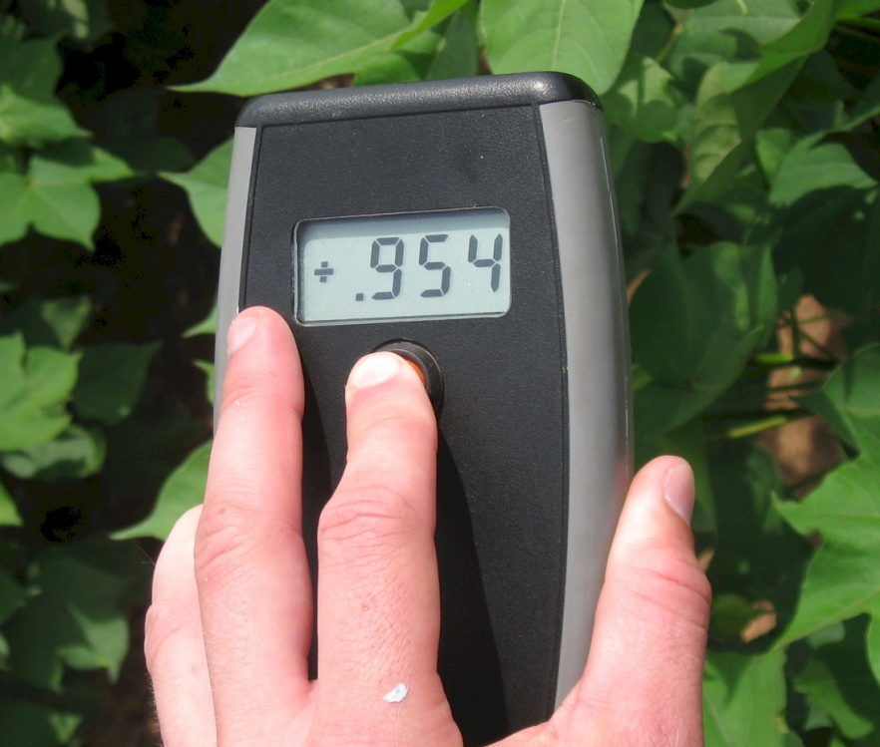
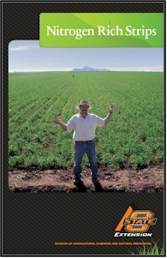
Current Work
Optical Pocket Sensor
  3rd world
  Common Farmer Tool
Pocket Sensor
Notes:
Economists: Profit is directly proportional to risk

Slide 24
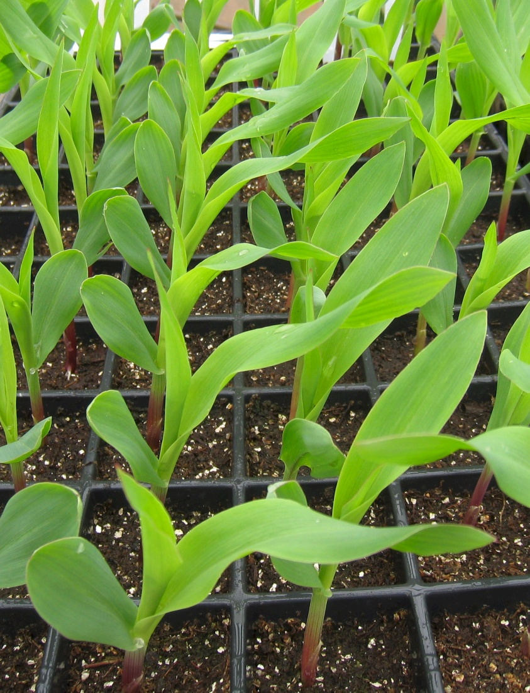
Current Work
Influence of seed placement on leaf orientation, increased light interception
Better prediction of yield potential using the MESONET
Use of soil profile moisture at sensing for improved prediction of yield

Slide 25
