Slide 1

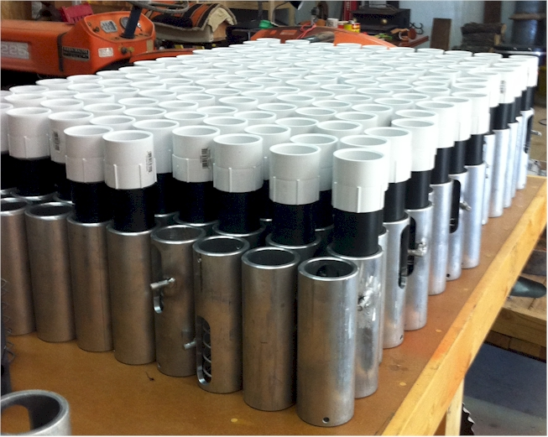
Randy Taylor
Bill Raun
Nyle Wollenhaupt
Adrian Koller

Slide 2
Current Situation
80,000,000 ac’s of corn planted, weeded, hoed, and harvested by hand
World area planted by hand = corn area in the USA
average farm sizes are 2 ac’s
NGO support, interaction, and ultimate subsidizing of this work is expected
January 2014, conducted an international hand planter workshop whereby on-line-internet attendees included locations in Africa, Asia, Latin America, and the USA
http://nue.okstate.edu/Hand_Planter/osu_hand_planter_workshop.html

Slide 3
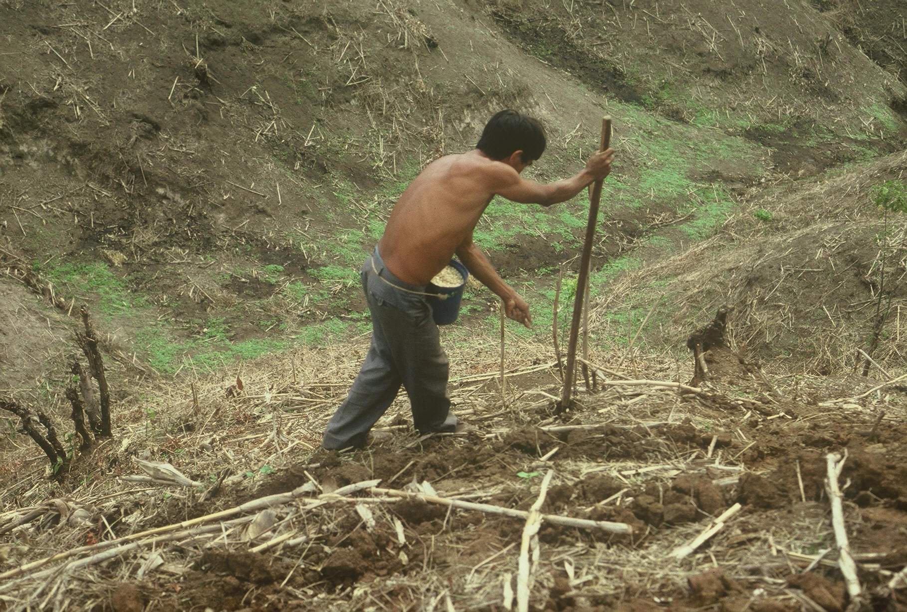



Slide 4
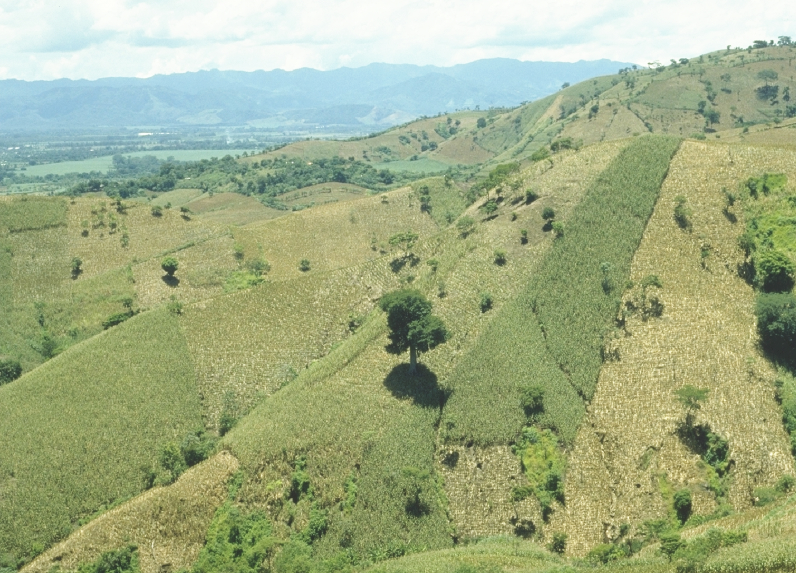
EL SALVADOR

Slide 5
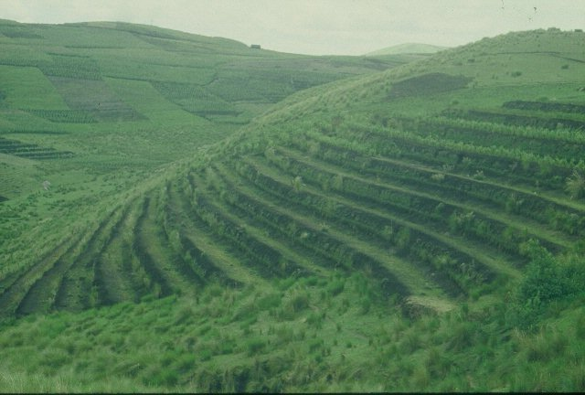
GUATEMALA

Slide 6
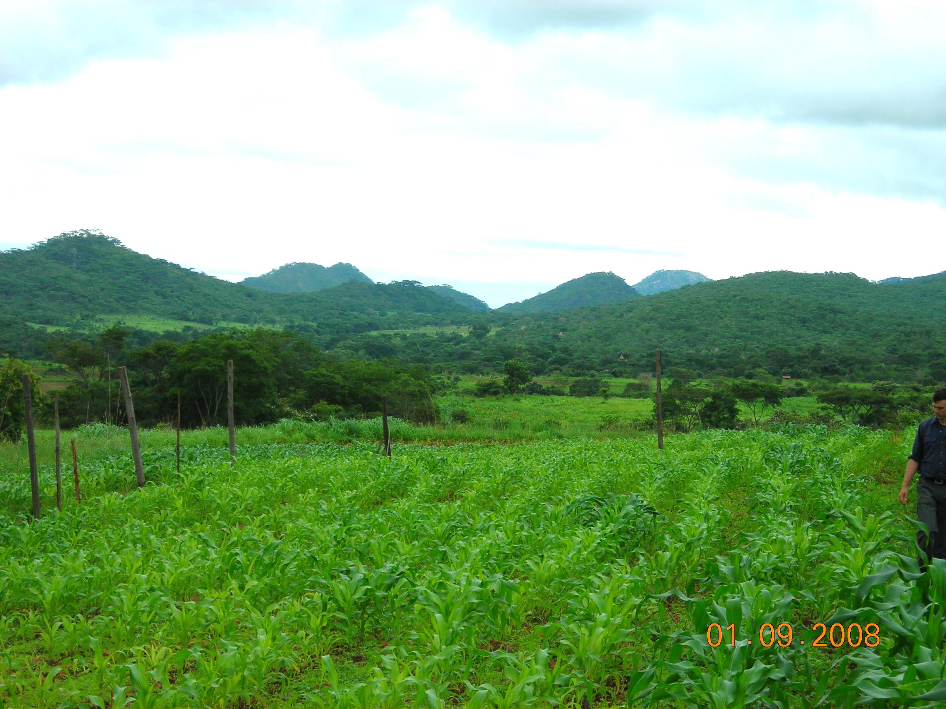
ZIMBABWE

Slide 7
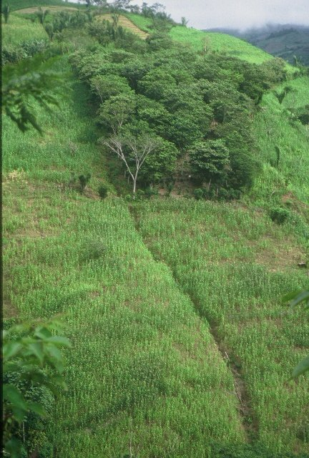
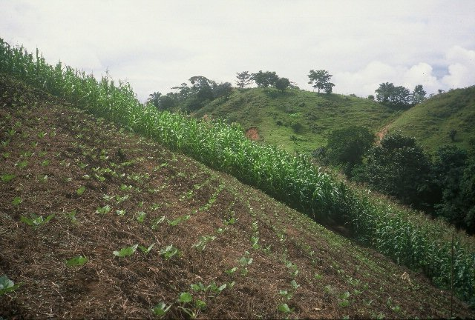
HONDURAS

Slide 8
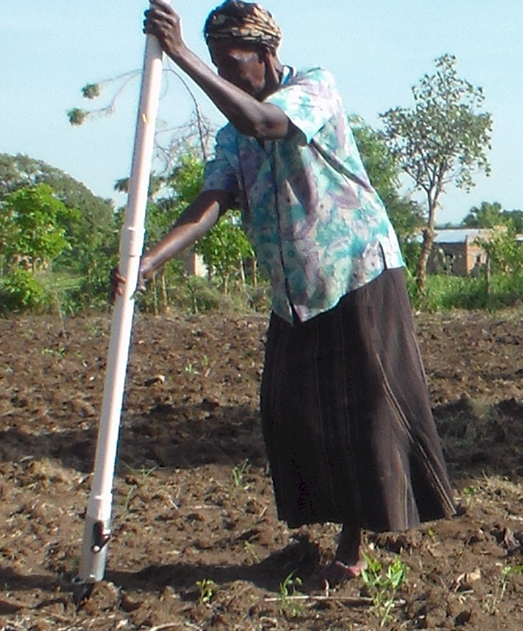
UGANDA

Slide 9
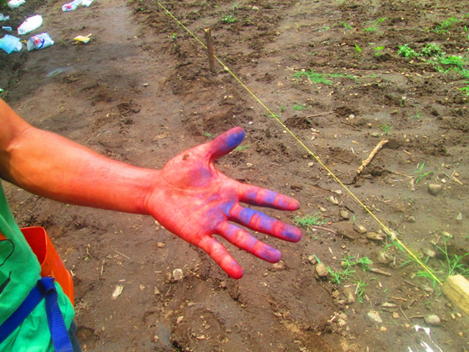
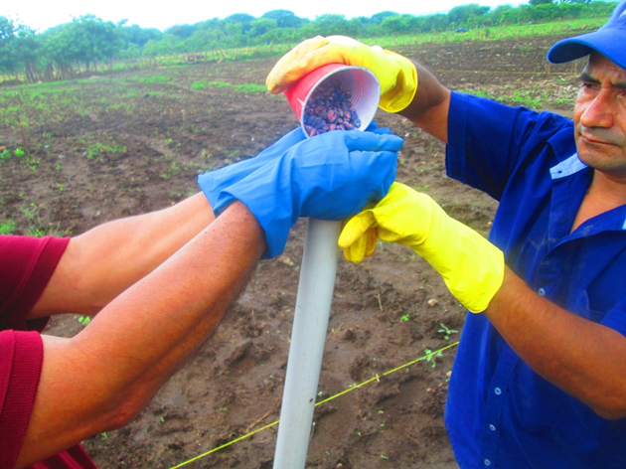
El Salvador, Hand Planter Trials, June, 2014

Slide 10
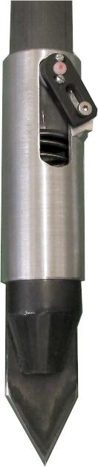
Technology to be Commercialized (OSU Hand Planter)
Remove chemically treated seed from the hands of producers
Decrease soil erosion via improved plant spacing
Accommodate mid-season application of urea-N
Place urea below the surface reducing NH₃ losses
Increase corn production and NUE

Slide 11
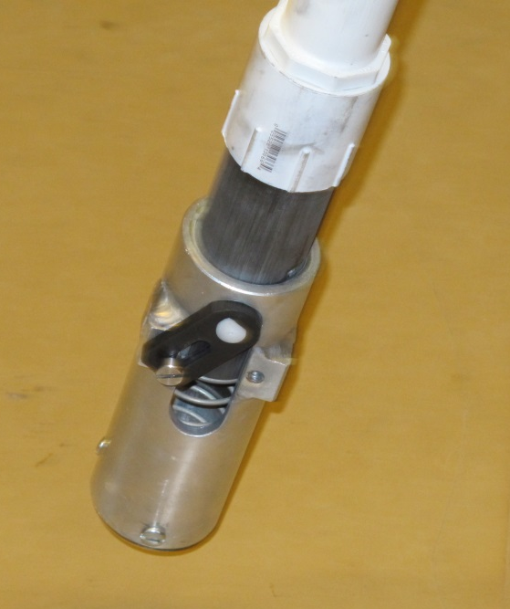
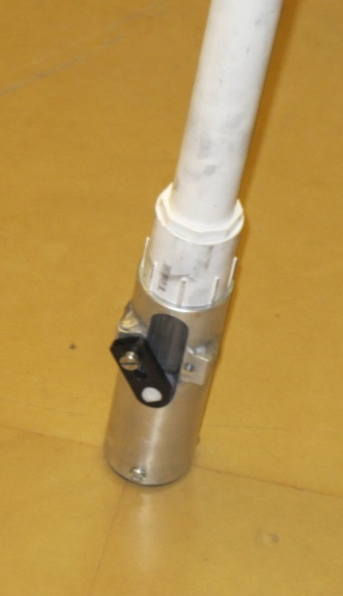
Planter Action
The planter is pressed down and compresses the internal spring.
Singulation drum rotates and seed is released on the down stroke.
The planter is ‘relaxed’ and the spring returns it to the initial position.

Slide 12
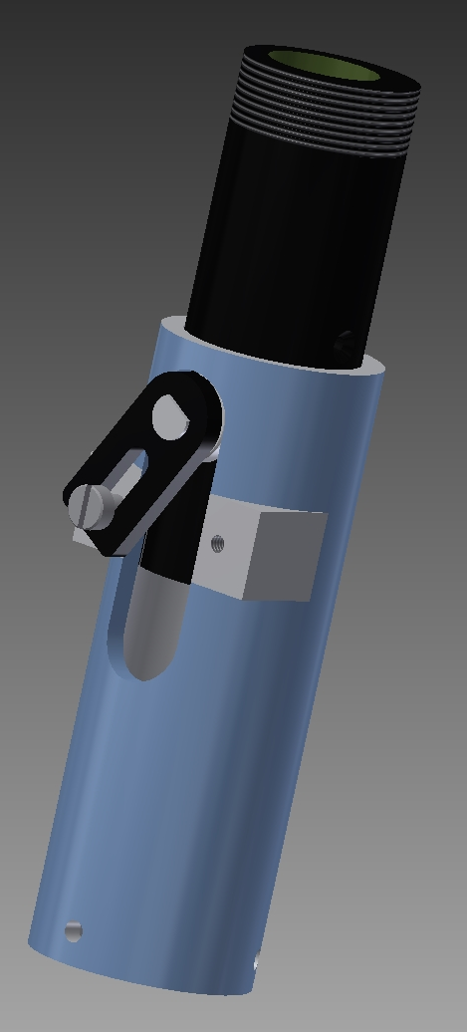
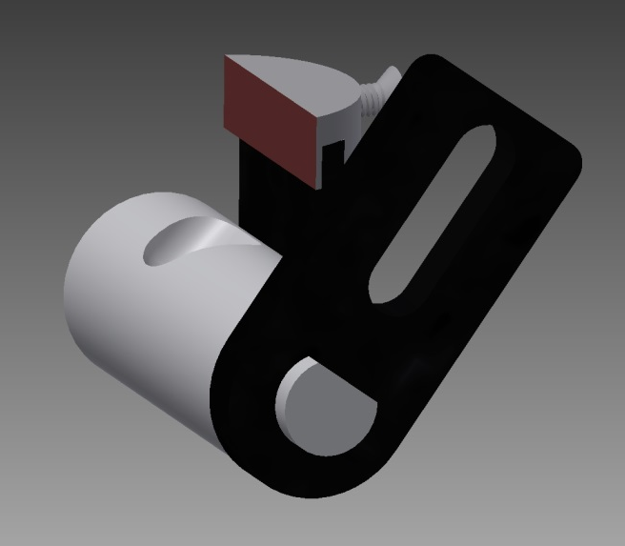
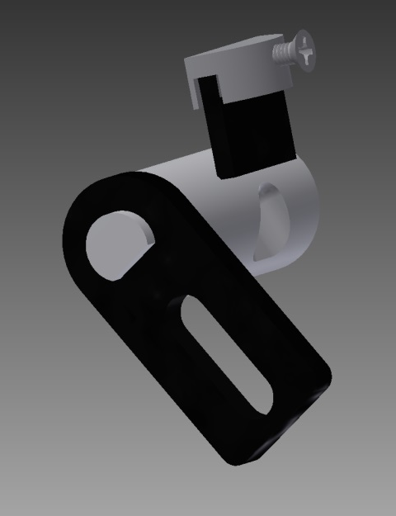
Metering System
Design has gravitated to a reciprocating drum with brush

Slide 13
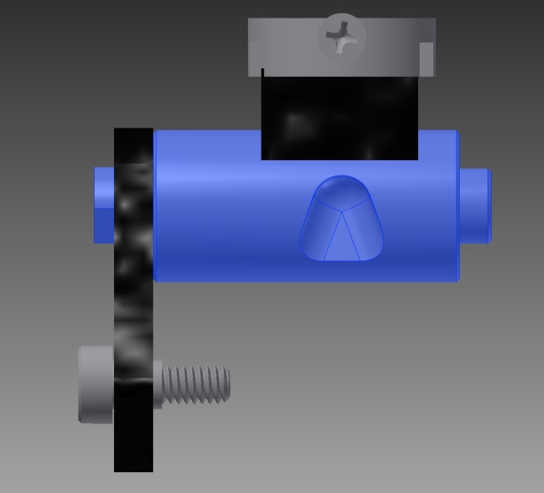
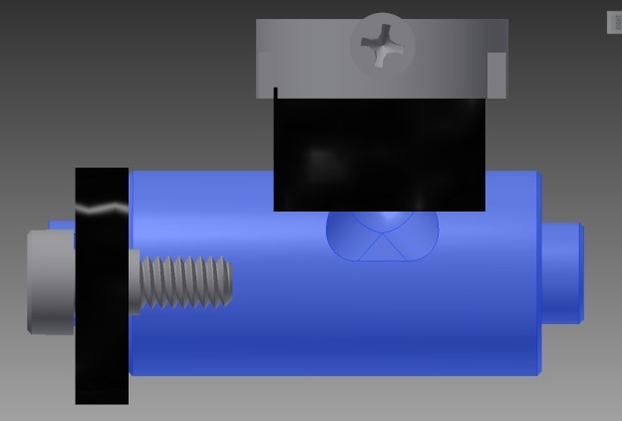
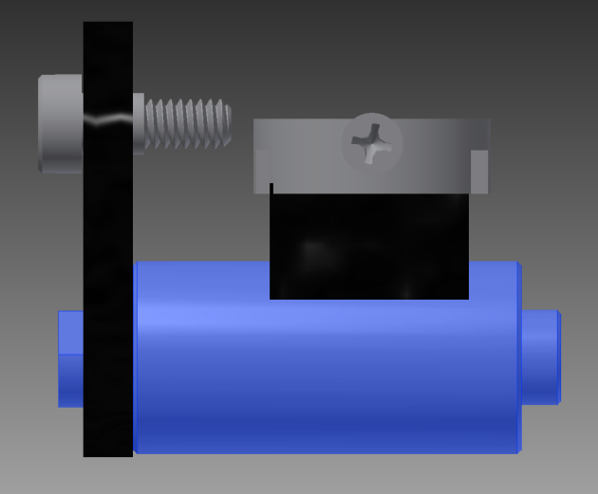
Reciprocating Drum Action
Drum rotates with the cavity moving back into the seed hopper as the spring is compressed.
Spring is fully compressed and the singulation drum cavity is exposed to seed in the hopper
Drum position when planter is relaxed.
As the force on the spring is released, the singulation drum rotates back to the initial ‘relaxed’ position and the seed is dropped.

Slide 14
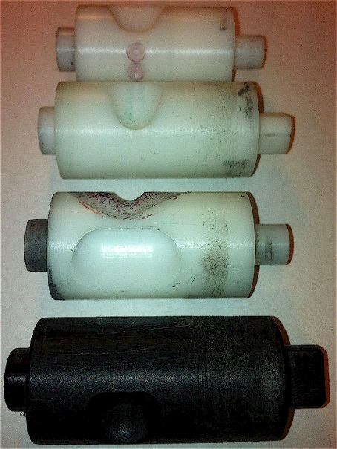
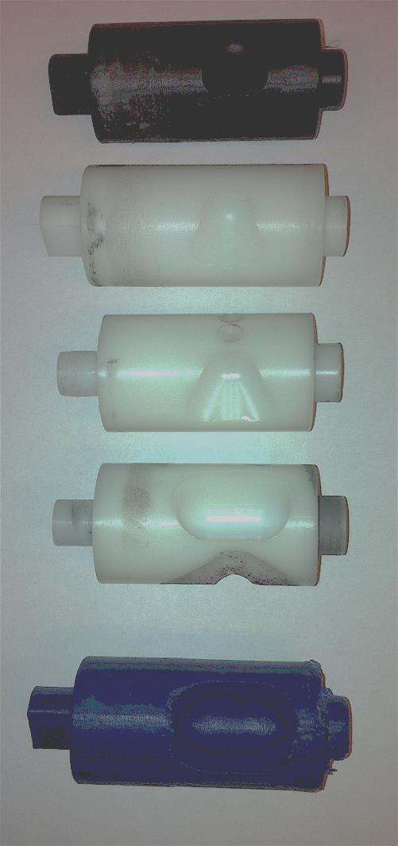
INTERNAL DRUM
Drum | Mass (g) | Volume (cm³)
A | 0.69 | 0.507
B | 0.71 | 0.521
OS | 0.88 | 0.646
OM | 3.36 | 2.468
OC | 3.38 | 2.482

Slide 15
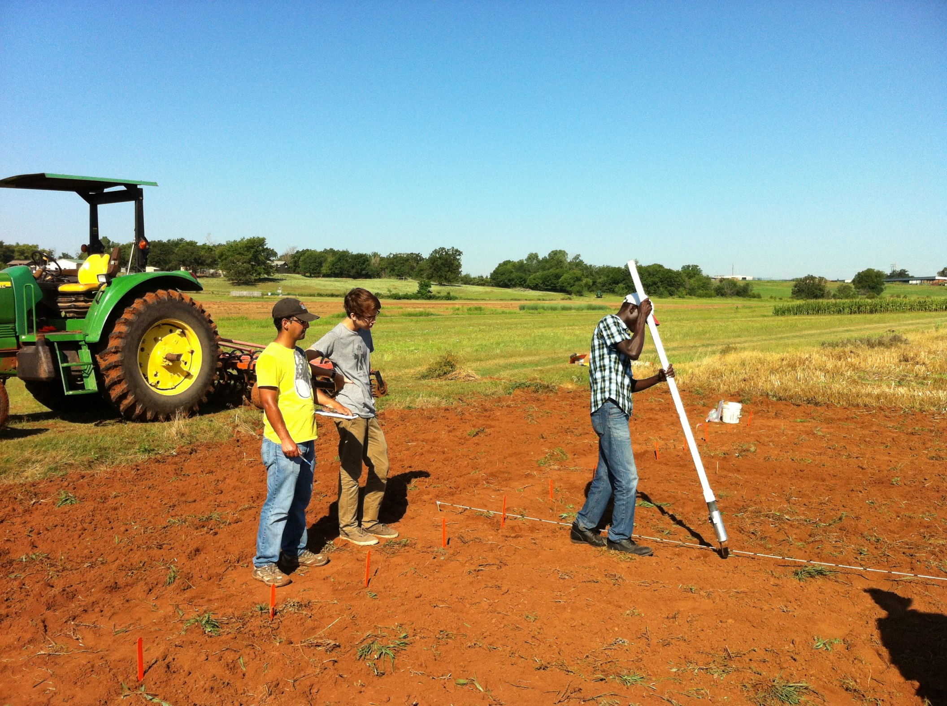



Slide 16
Nov 13, 2013
SED = 8.6
works well over a range of seed sizes (1200 to 2000 seeds/lb)

Slide 17
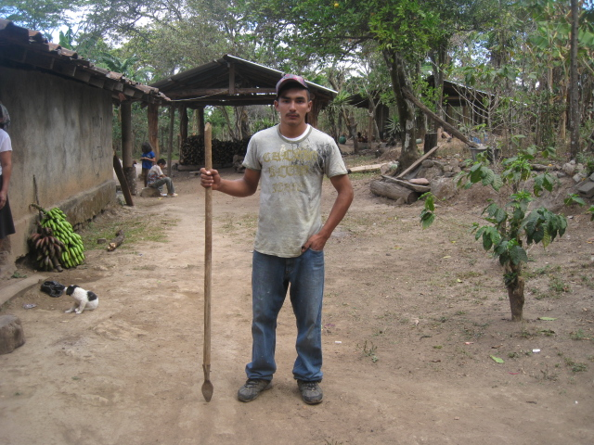
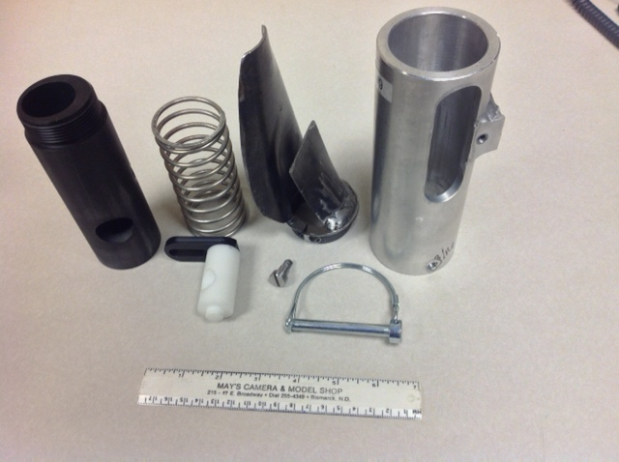
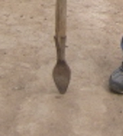
seed size (2653-4344 seeds/kg)
seed type, shape
fertilizer
1,000,000 cycles
0.29g/seed
60,000 seeds/ha
3443 seeds/kg
1.0 kg hopper
17 times refill
Regional Trials: El Salvador, Thailand, Colombia, Uganda, Zambia
http://nue.okstate.edu/Hand_Planter.htm

Slide 18
Options
Negotiate with a major, worldwide company to pay a set fee per planter to have all planters ‘branded.’ Planters could be dual branded for an additional fee by a second company, but all planters would have the primary brand. The company holding the primary brand could exclude other competitors from dual branding. The primary brand could negotiate other arrangements with other companies. All manufacturing and management would reside with a third party (not OSU or primary sponsor).
Find a company to license the technology and assume the management and manufacturing. Sub-contract with OSU for R&D. The licensing would be per unit and the sub-contract would be annual with a renewable three year commitment.
Find a company to license the technology and be solely responsible for management, manufacturing, and R&D.

Slide 19
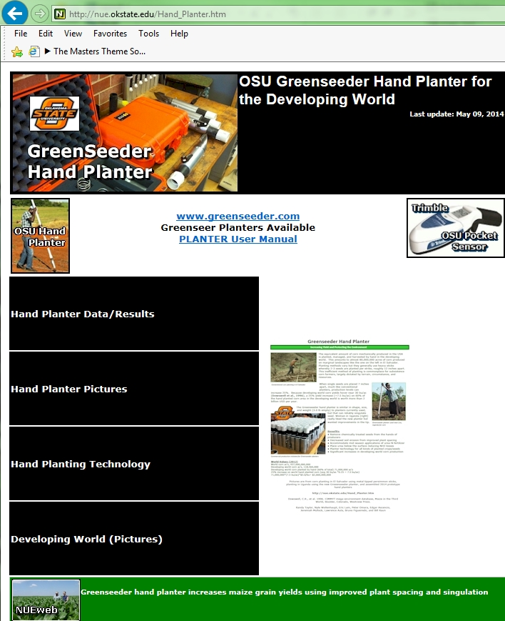
Grain production is vital because worldwide people get 48% of their calories from eating grain directly. As incomes rise, the percent drops dramatically as diets change to include more meat, milk, eggs and other foods that require more grain to produce. About 48% of grains are eaten directly, 35% fed to animals, and 17% for ethanol and other fuels.
Worldwatch Institute

