Slide 1

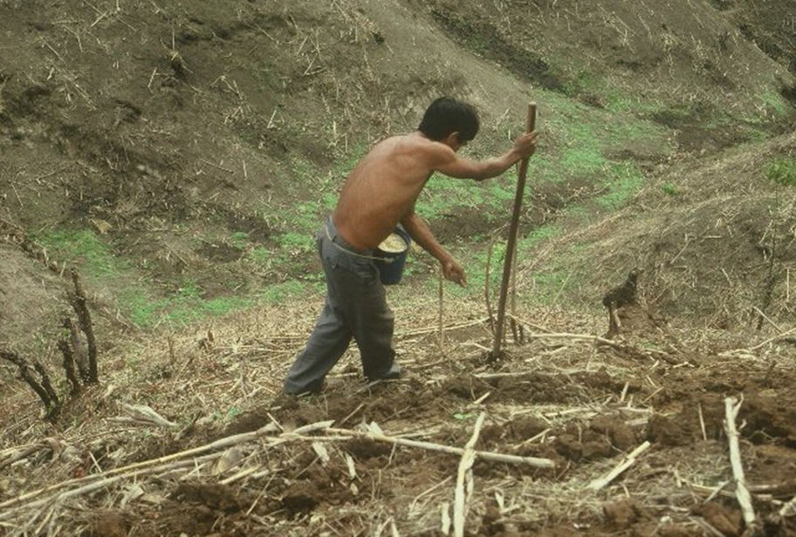


Greenseeder Composite 2017
GREEN SEEDER
OSU Hand Planter
One Minute Video Hand Planter
Jagmandeep Dhillon, Fikayo Oyebiyi, Peter Omara, Tyler Lynch, Bruno Figueiredo, Gwen Wehmeyer, Eva Nambi, Alimamy Fornah, Robert Lemings, Elizabeth Eickhoff, Wayne Kiner, Joshua Ringer, Randy Taylor, Bill Raun

Slide 2
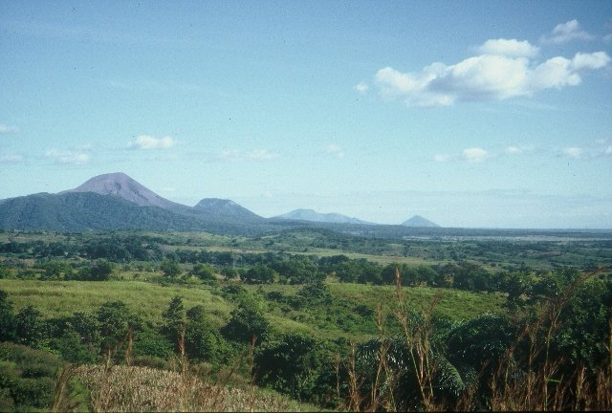
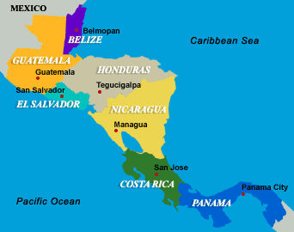

Slide 3
Time, $, Products
post PhD, 1985-present, 32 years
Greenseeker
Years: 1991 – 2001
  Delivery, 2002-present
11 years, $4.7M
Stone, Solie, many students
OSU Hand Planter (Greenseeder)
1987-2017, 30 years, $175K
Taylor, Koller, many students,
  Delivery, >350 plans for more
Former OSU graduates, Uganda, El Salvador, Kenya, Mexico, Dr. Joshua Ringer, Dr. Craig Edwards, Mandela Washington Fellows

Slide 4
Research Template
Agronomy/Engineering Partnership made this possible.
Moving the Hand Planter forward, was because of the success coming from the Greenseeker Project
Allowed direct access to Engineering graduate students, Dr. John Solie, Dr. Marvin Stone
Wayne Kiner, Adrian Koller, Max Metcalf, BAE
Dr. Randy Taylor
Contract on all new hand planters with BAE
Problems have become more complex

Slide 5
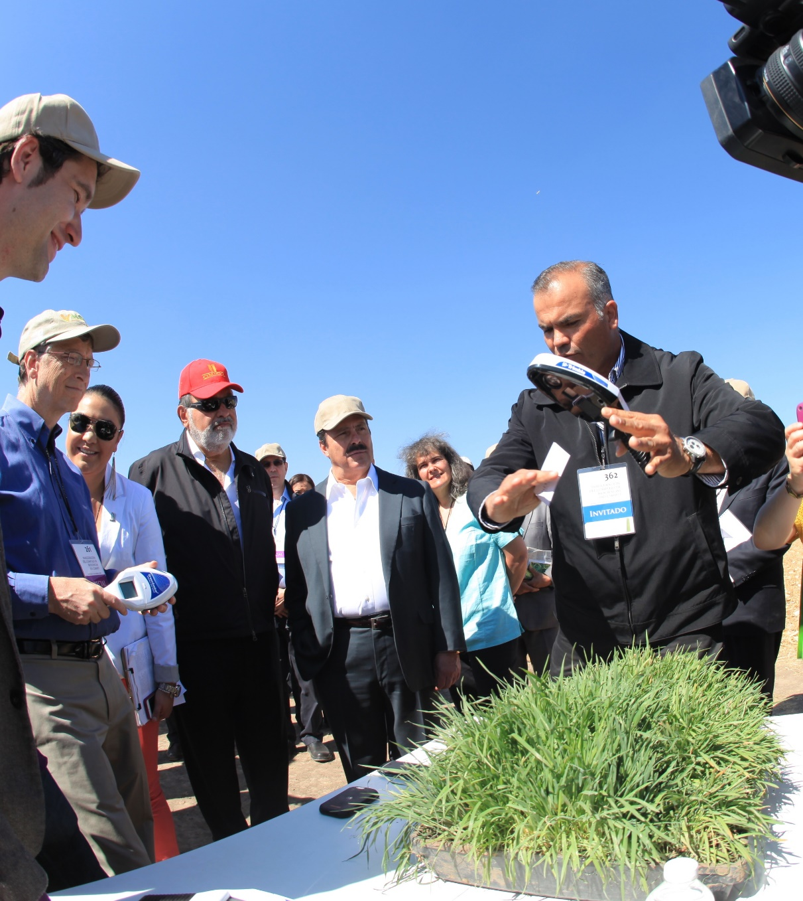
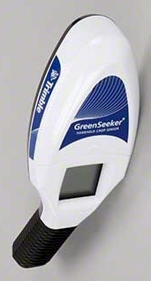

Hand-Held GreenSeeker Sensors

Slide 6
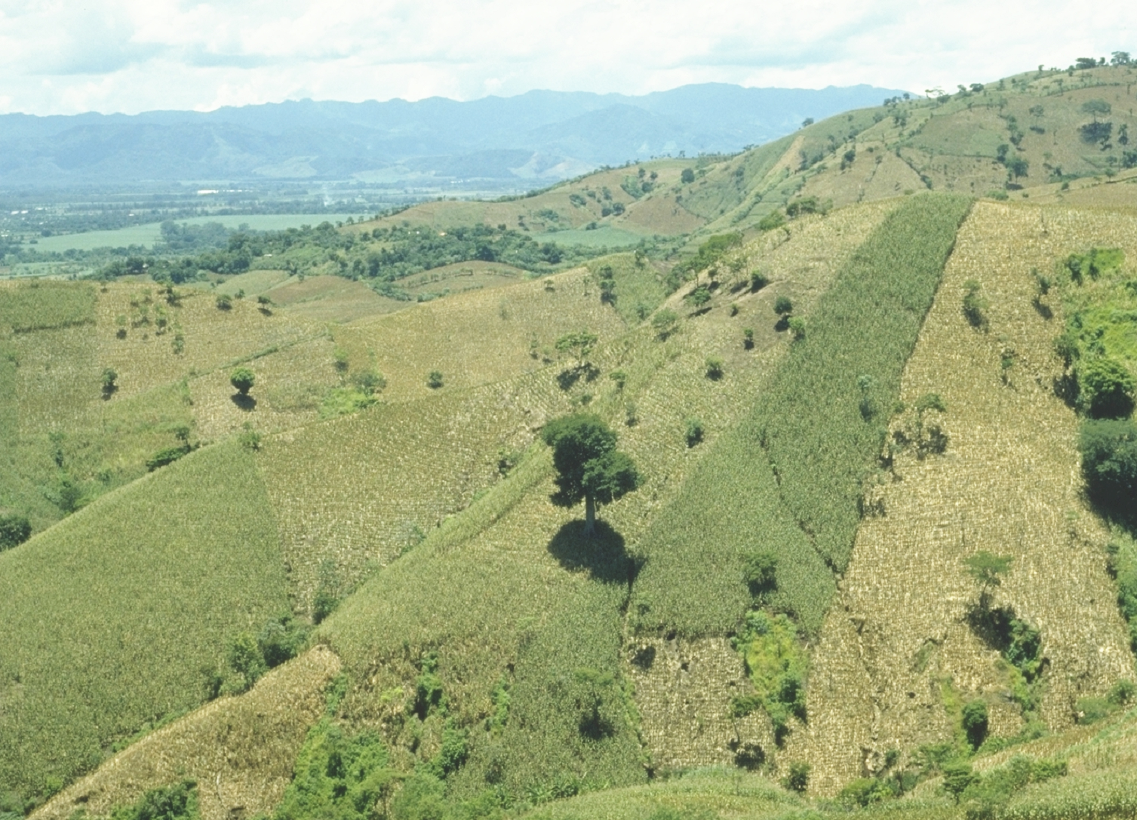
30,000,000 ha’s planted by hand ≈ corn area in the USA
USA
China
Brazil
EL SALVADOR

Slide 7
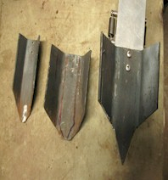
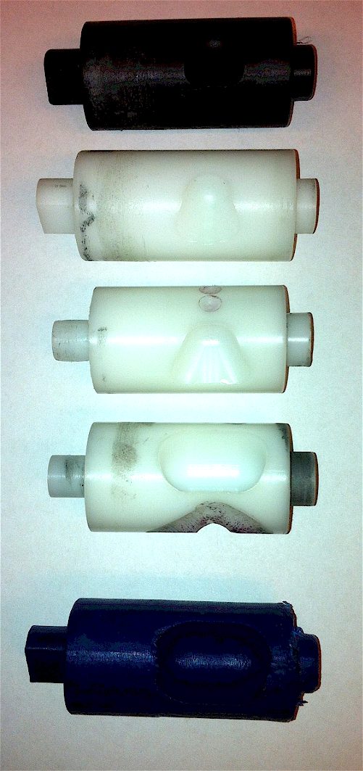
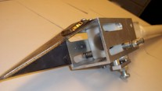
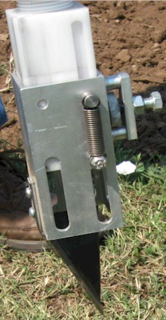
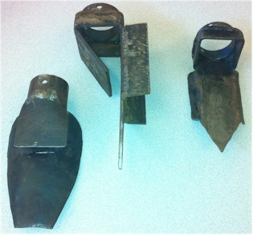
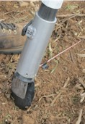
Internal Brush/Strength
Drum size/material
Cavity size/angle
Tip size/design/material
Internal/Ext. spring/tension

Slide 8
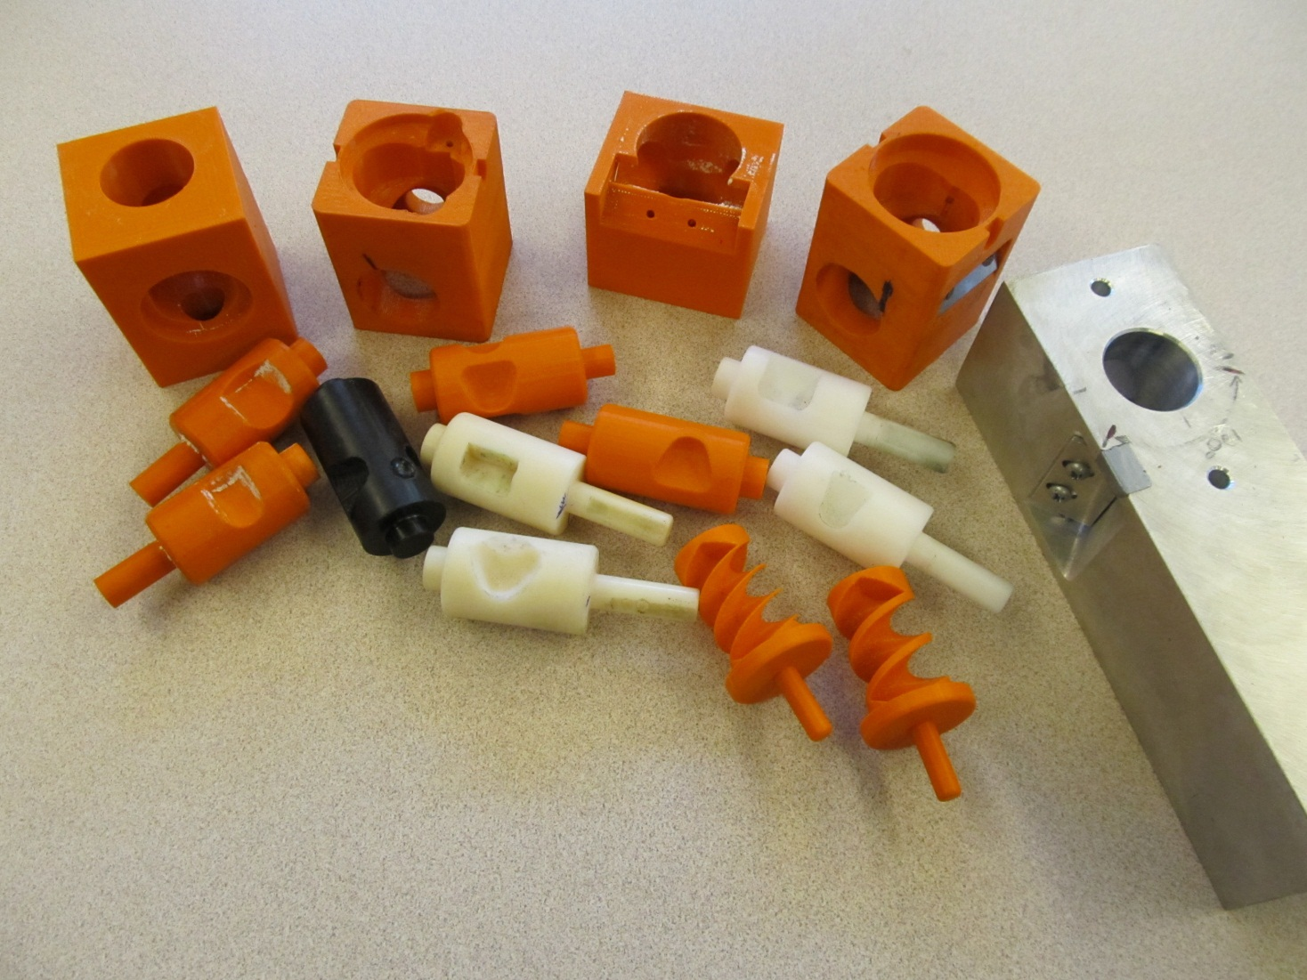
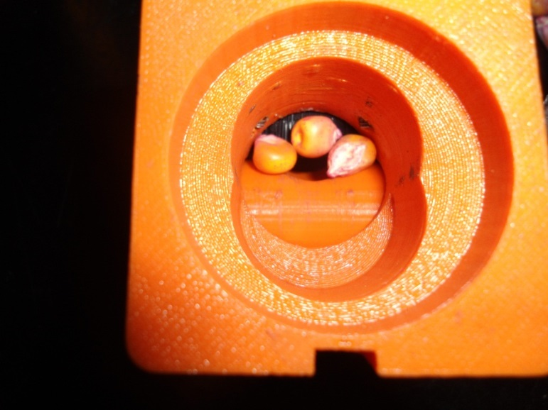
Singulation Design
3D printing

Slide 9
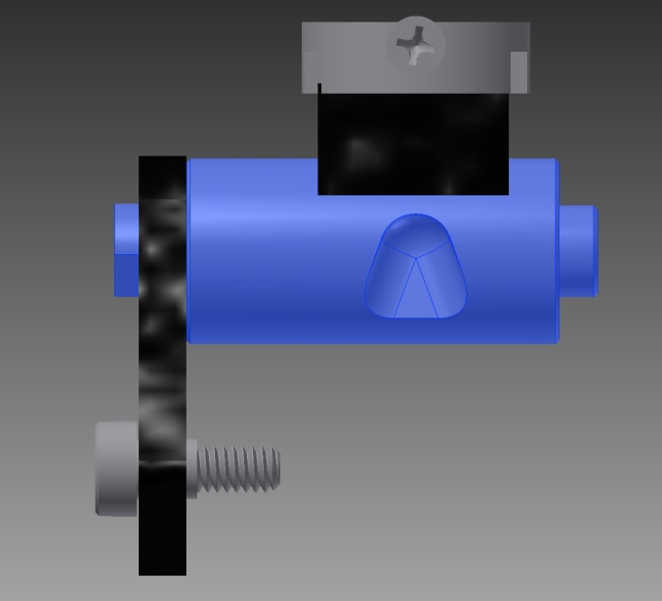
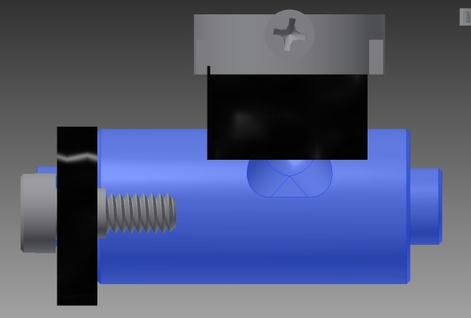
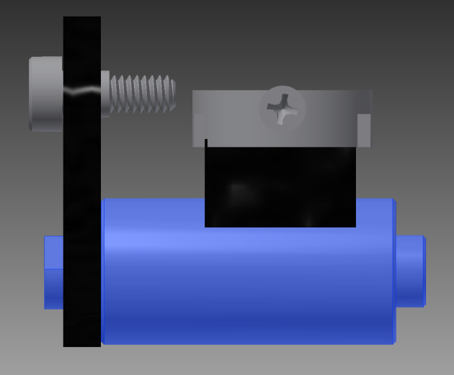
Reciprocating Drum Action
Drum rotates with the cavity moving back into the seed hopper as the spring is compressed.
Spring is fully compressed and the singulation drum cavity is exposed to seed in the hopper
Drum position when planter is relaxed.
As the force on the spring is released, the singulation drum rotates back to the initial ‘relaxed’ position and the seed is dropped.

Slide 10
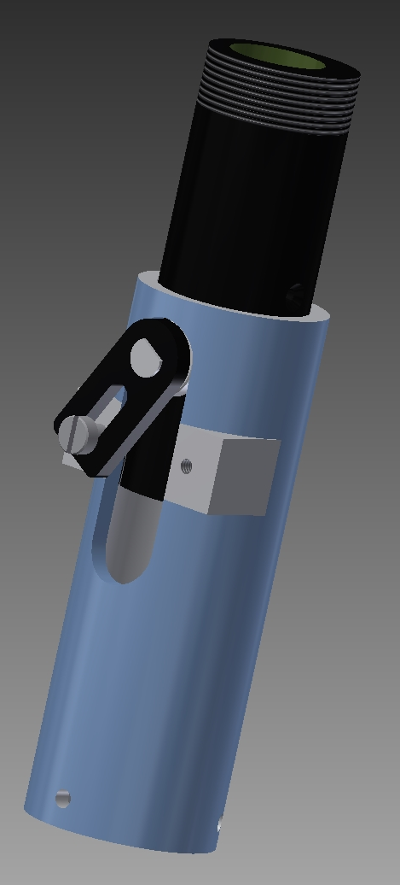
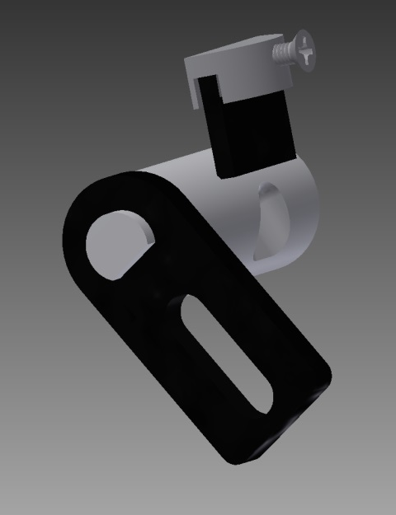
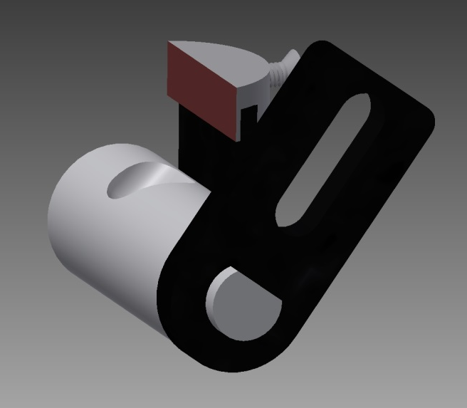
Metering System
Design has gravitated to a reciprocating drum with brush

Slide 11
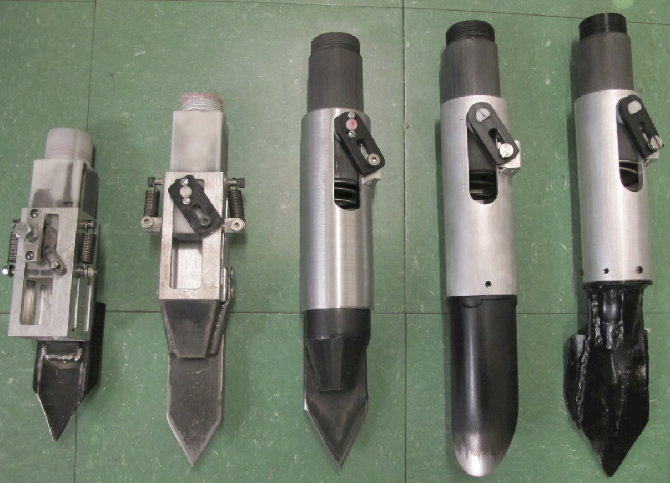

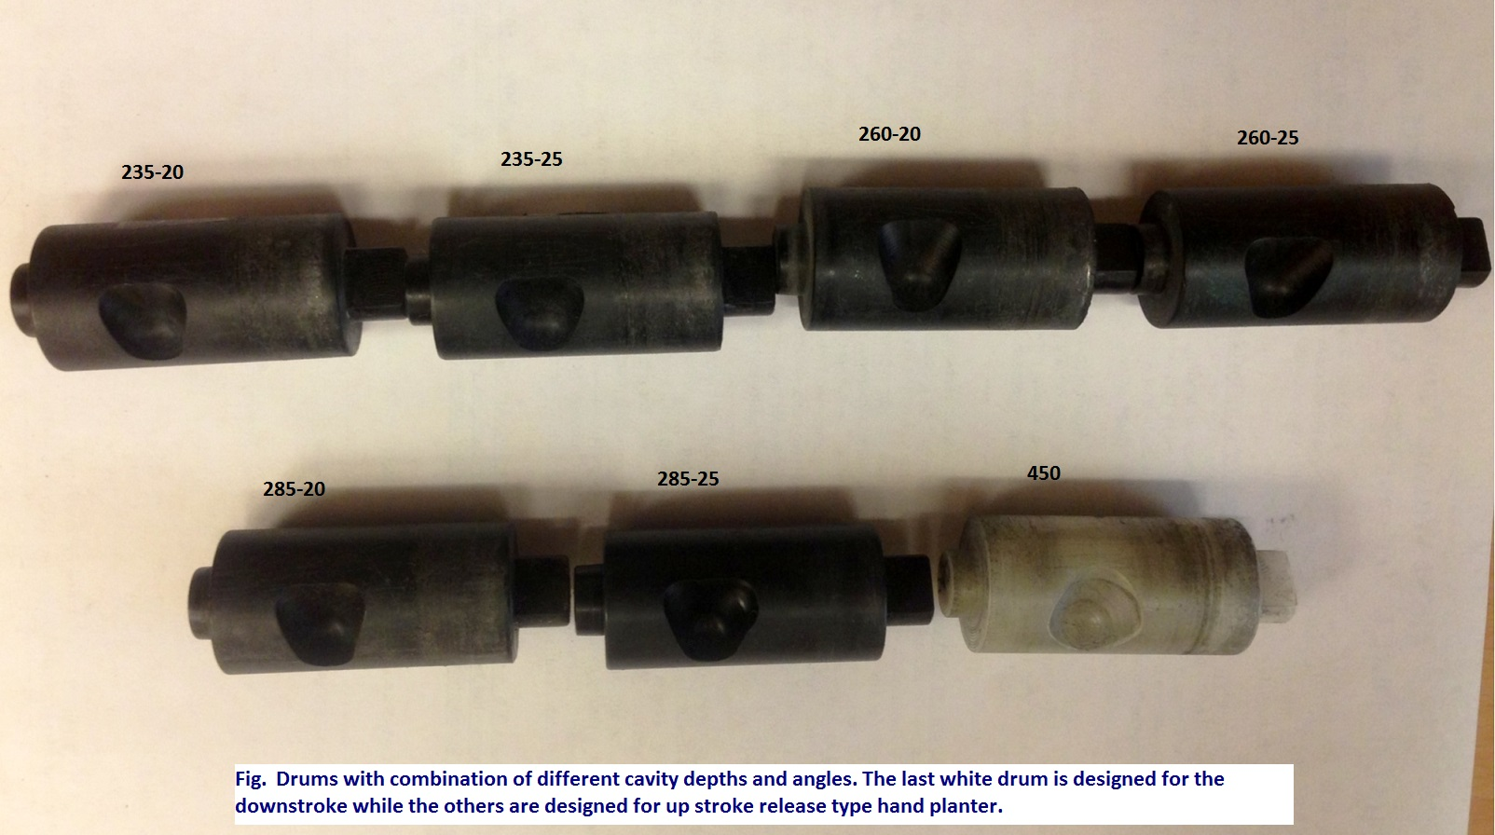
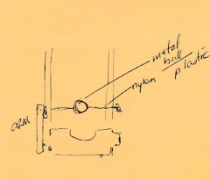

Slide 12
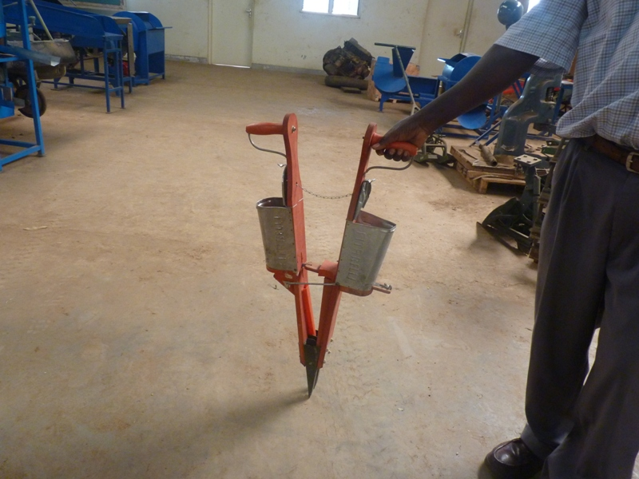
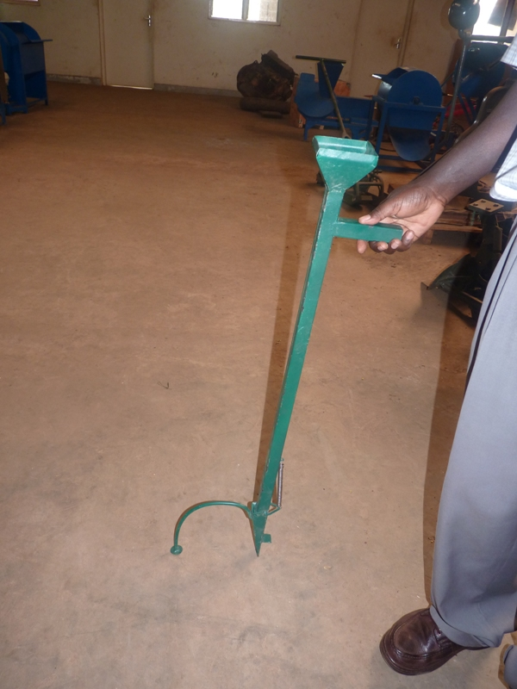
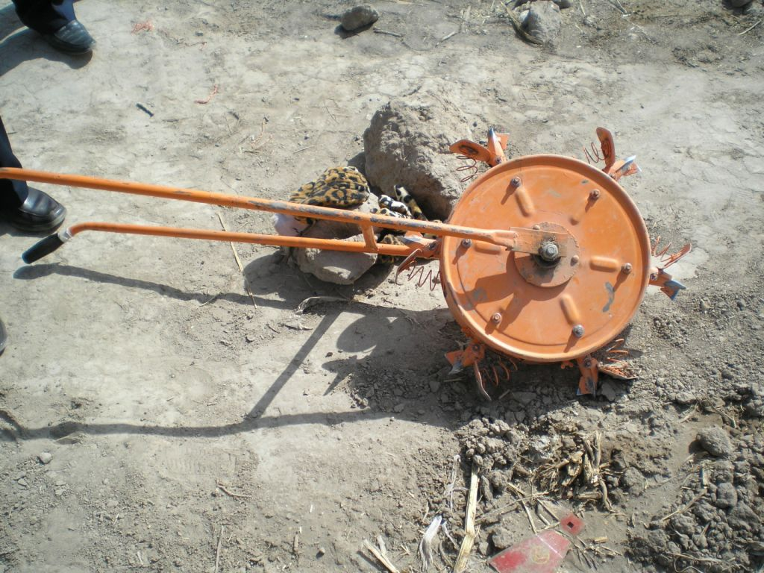
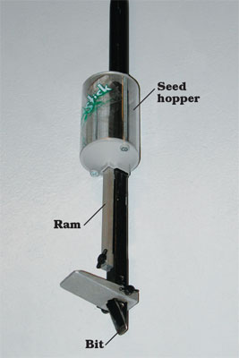
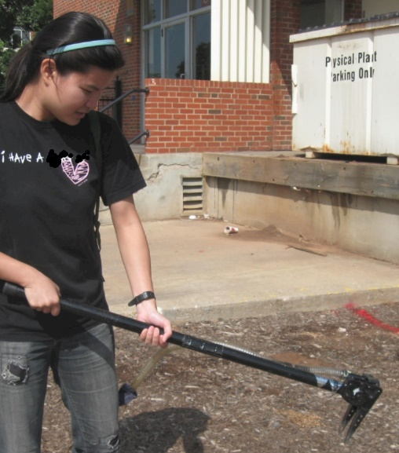
Alternative Designs

Slide 13
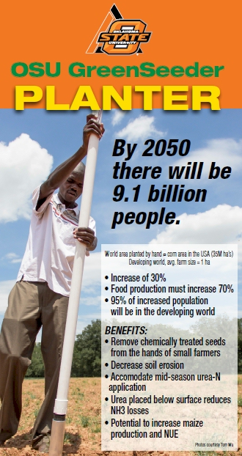
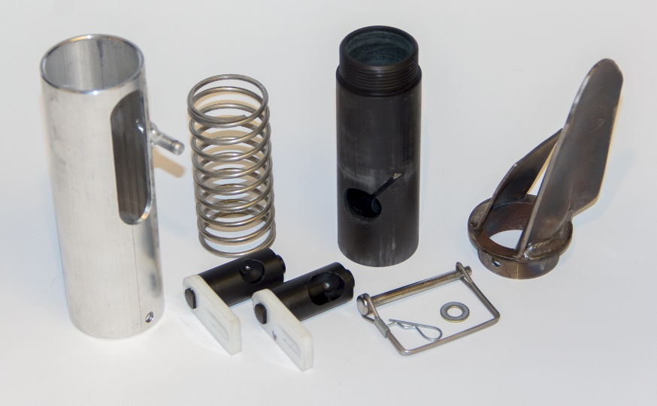
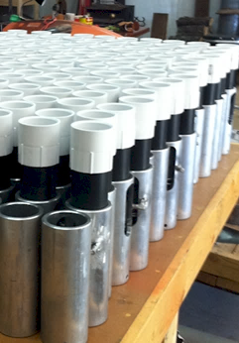
Drums

Slide 14
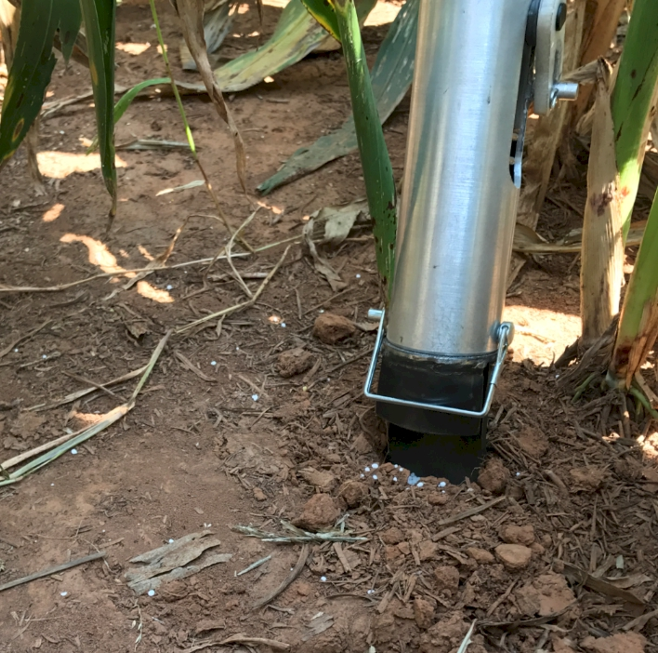
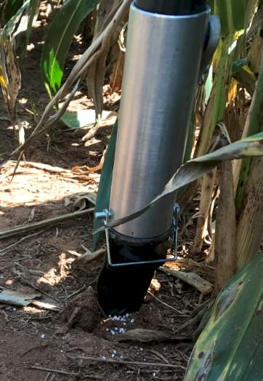
Potential Uses
Seed, all types
Fertilizer
Chemicals, EPA, Mosquito Abatement
Food plots, Hunting industry
Homeowners, gardeners

Slide 15
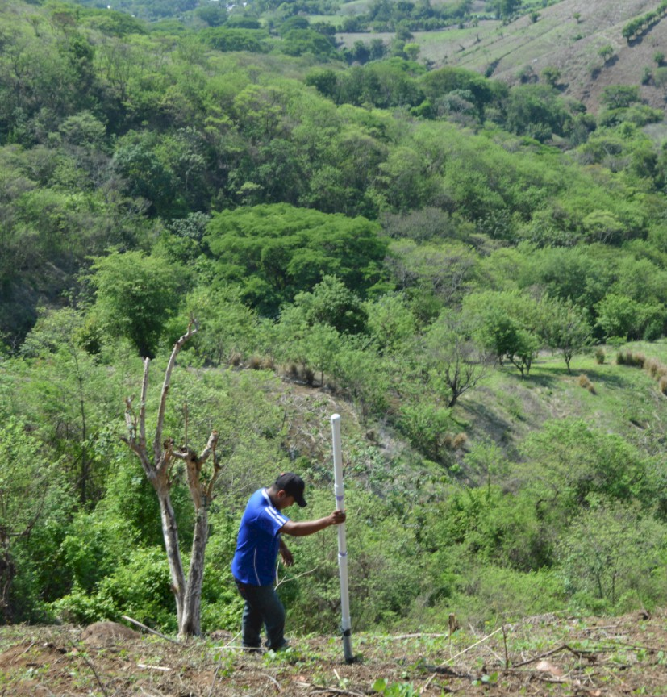
Opico Quezaltepeque, El Salvador
EL SALVADOR
Social aspects/technology transfer

Slide 16
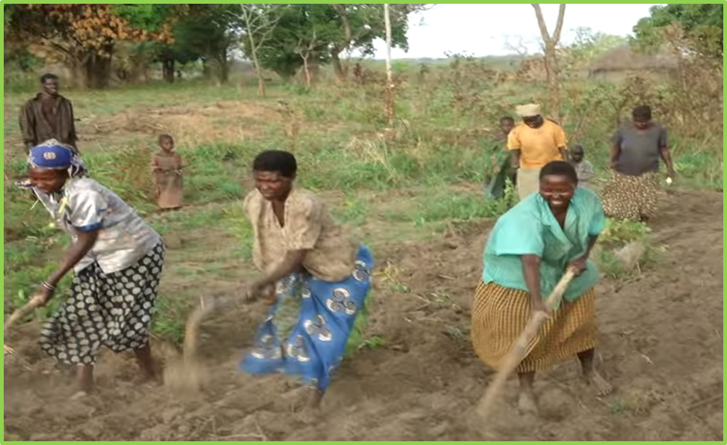
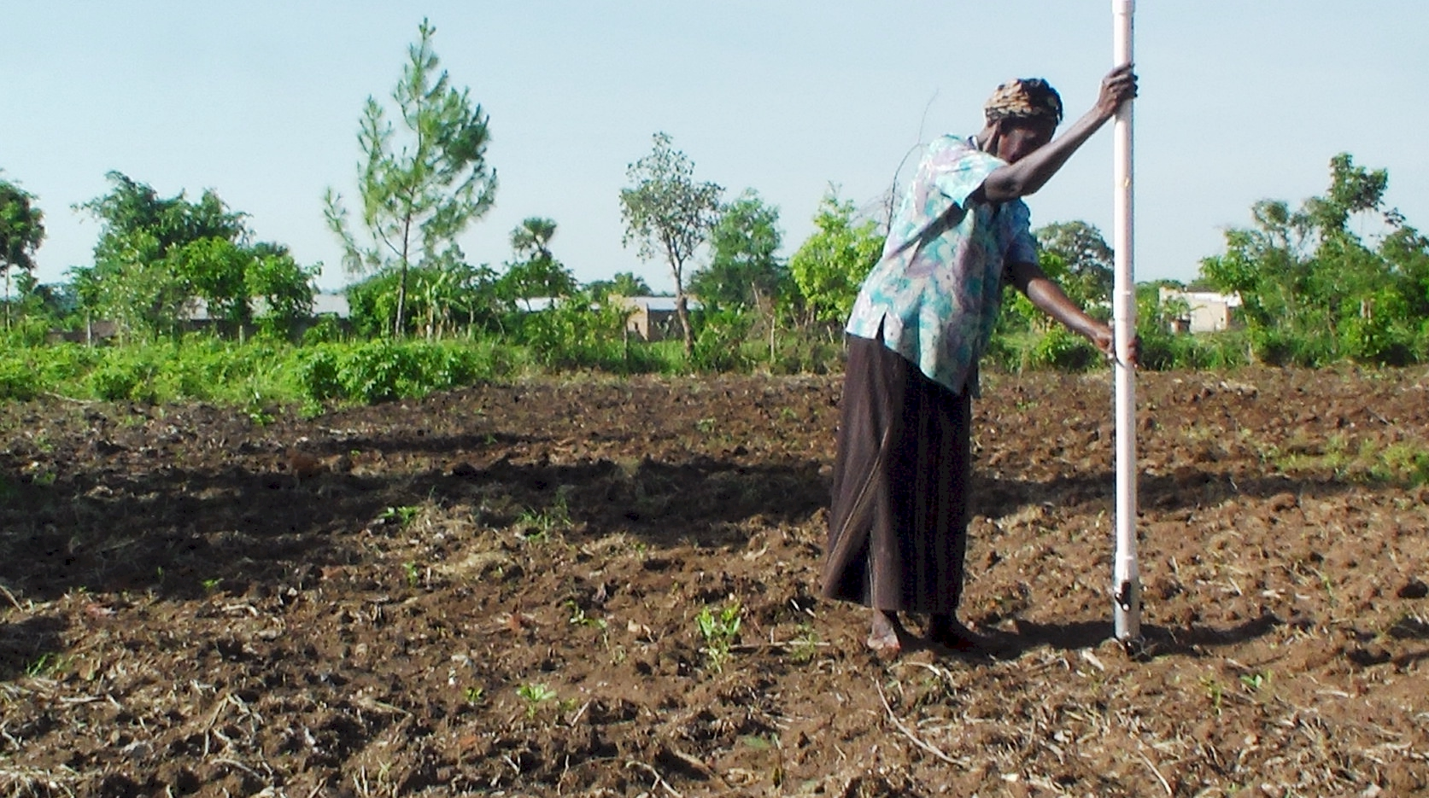
UGANDA

Slide 17
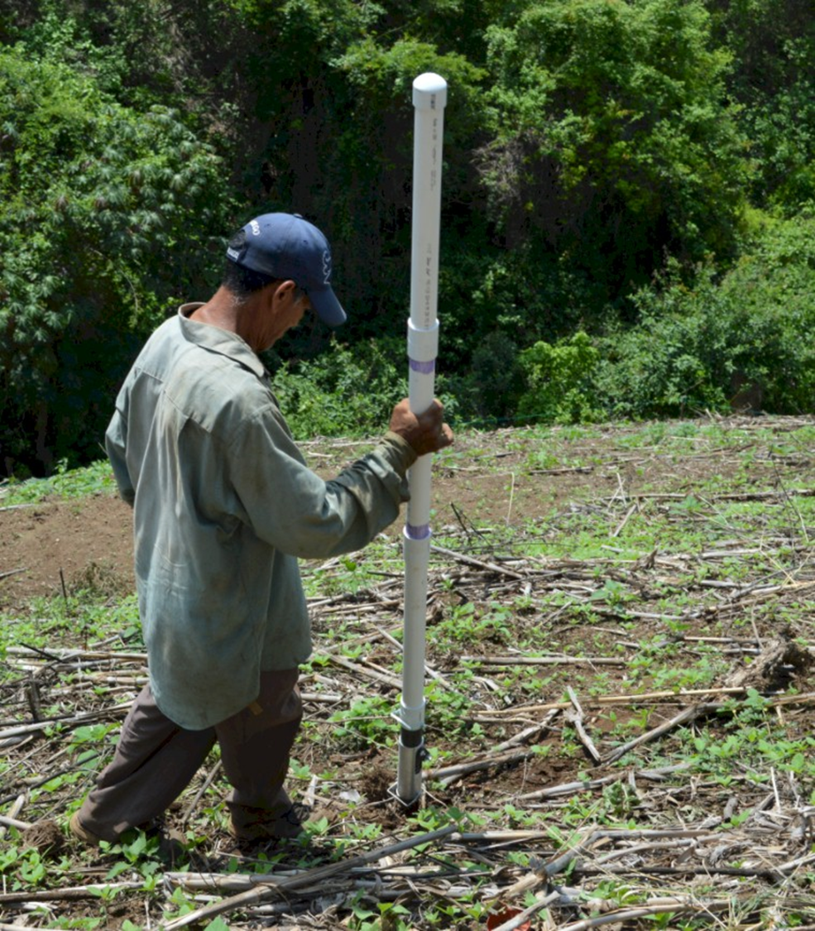

Worlds Apart
(El Salvador, Uganda)
Avg. Farm Size: 1 ha
Avg. Maize Grain Yield, 2 Mg/ha
Maize seed, Hybrids (US, others)

Slide 18
Maize (FAOSTAT.com)
Area, ha Production, Mt Avg. Mt/ha
World 183,319,737 1,038,281,035 5.7 (90 bu/ac)
USA 33,644,310 361,091,140 10.9 (174 bu/ac)
China 35,981,005 215,812,100 6.2 (98 bu/ac)
Brazil 15,450,180 80,516,571 5.2 (83 bu/ac)
Low income Food Deficit Countries
49,356,985 117,590,512 2.4 (38 bu/ac)
Developing world maize planted by hand (60% of total)
29,400,000 ha’s (72,618,000 ac)
25% increase on world hand planted maize (avg 2 Mg/ha *0.25 = 0.5 Mg/ha)
29,400,000*(2000kg/ha*0.25%)*$0.23/kg (or $6.00/bu) = $3,381,000,000

Slide 19
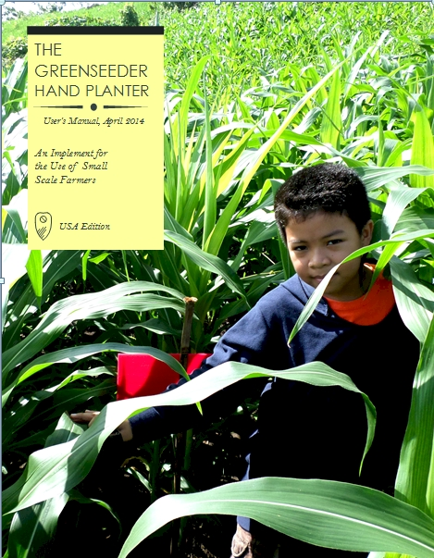
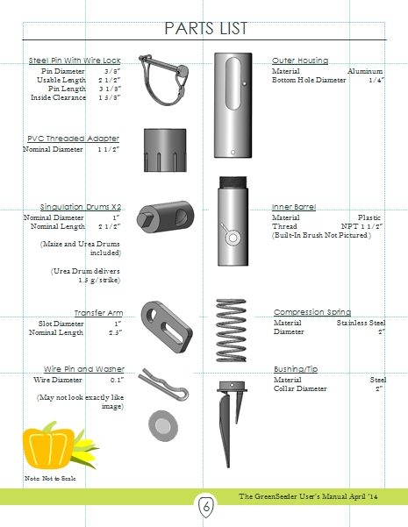
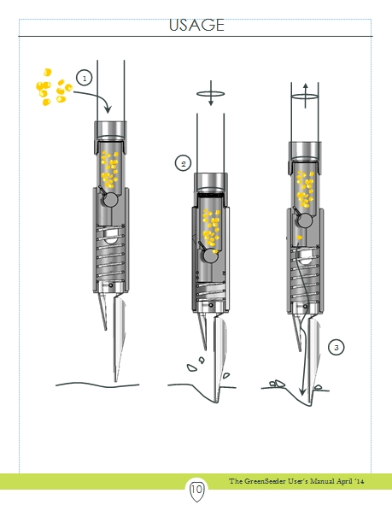
GreenSeeder Manual
http://www.nue.okstate.edu/Hand_Planter/Planter%20User's%20Manual%20EL.pdf

Slide 20
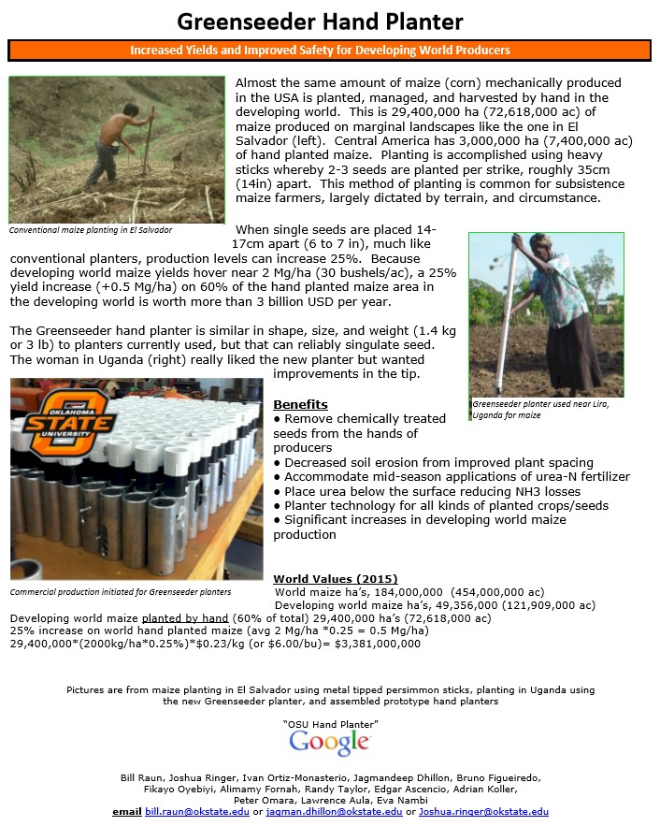
nue.okstate.edu/Hand_Planter.htm
1 page PDF (Hand Planter)

Slide 21
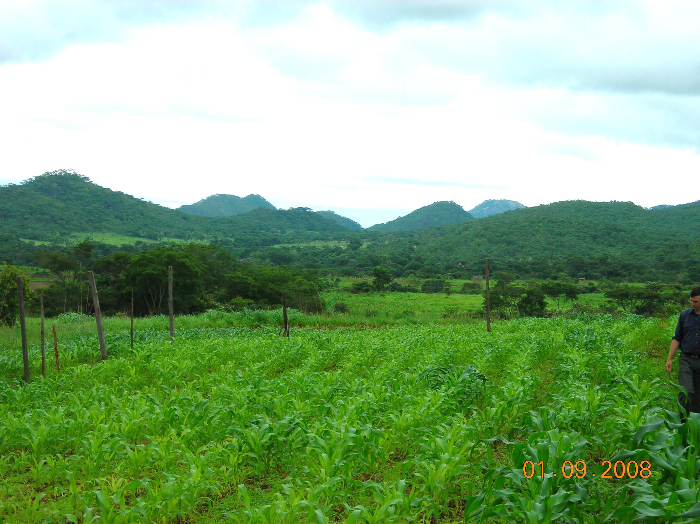
ZIMBABWE
Remote Locations
Surface applications of urea

Slide 22
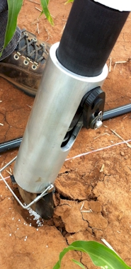
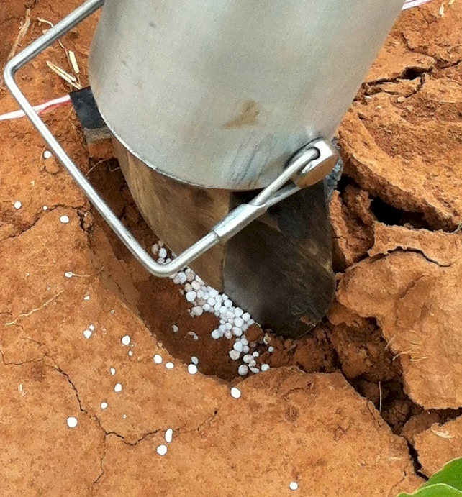
Mid Season Fertilizer N
Combined, Efaw and Perkins
Topdress N, Corn, V12 |  | 70,000 plants/ha
Methods | N, kg/ha | Mg/ha
Check | 0 | 6.6
Hand planter (0.9 g/plant) | 30 | 11.2
Hand planter (1.8 g/plant) | 60 | 10.6
Broadcast | 30 | 6.4
Broadcast | 60 | 7.0
Dribble urea | 30 | 9.3
Dribble urea | 60 | 7.8
Dribble UAN | 30 | 7.3
Dribble UAN | 60 | 10.4
SED = 1.81

Slide 23
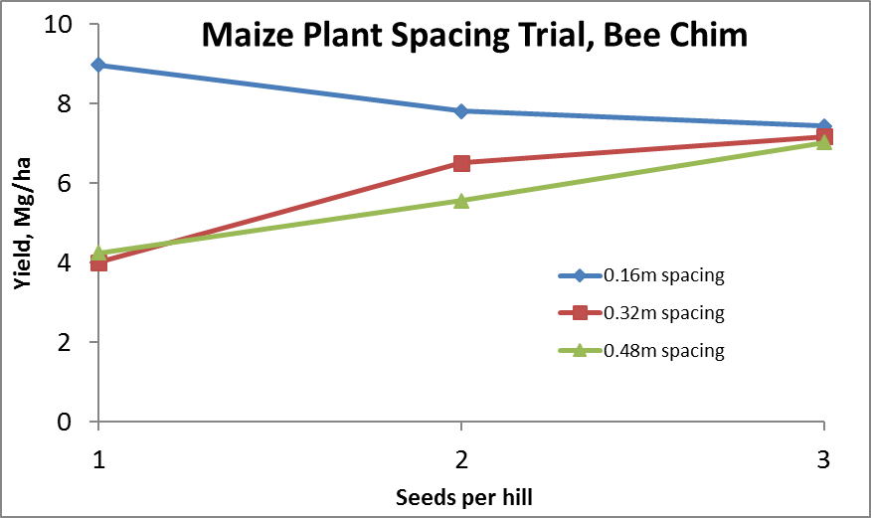
Importance of Singulation
0.76m Row Spacing
Heterogeneity in plant spacing, and plant stands reduce yields
(Bob Nielsen, http://www.agry.purdue.edu/ext/corn/pubs/agry9101.htm)

Slide 24


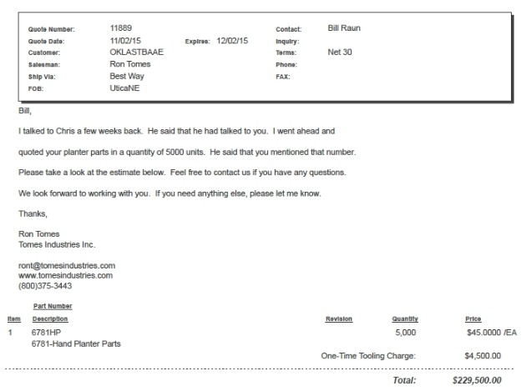
Current Cost Estimates
Grand Victory Ltd
Tsim Sha Tsui Hong Kong
Rm 1604 16/F Lee Wai Coml Bldg
Tsim Sha Tsui
1000
$25 each
5000
$49 each

Slide 25
Viability of the OSU planter at $35?
This is a very good milestone. At $35, I think we would be close. We know adoption as a "process" governed by many factors, and cost of the technology plays a great role. Depending on how we approach it, farmers can adopt and use this technology to improve their productivity.
Regards,
Peter Omara
Uganda
___________________
I´m glad the GS team is close to the amount I have heard from local farmers ($35). However, $35 can be a realistic figure for some farmers too.
Cordially
Edgar Ascencio
El Salvador

Slide 26
September 28, 2017
There is absolutely no doubt in my mind that the planter is working. As an example which I first wanted to put complete details together but will now share, a farmer supported with one HP in Oyam District reported a slightly higher yield advantage of HP (about 720 kg corn /ac) over conventional hand hoe (about 600kg corn /ac). I gave him the planting tips as well as benefits of Green Seeder & he deliberately said "I'll compare the planter you're praising with the one that I assume your parents used to send you to school".
I visited the field after planting & emergence, and saw a clear deficiency of phosphorus and no N was added plus fall armyworm infestation and I assumed that the yields could have been much higher.
Smallholder producers in Uganda who are the majority may still need a subsidy to acquire the planter perhaps through NGOs.
Thanks,
Lawrence Aula

Slide 27
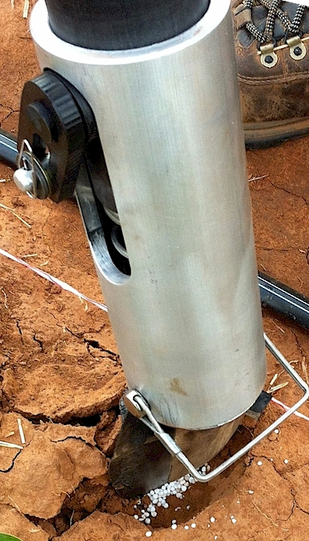
Benefits
Remove chemically treated seeds from the hands of producers
Decrease soil erosion via improved plant spacing
Accommodate mid-season application of urea-N
Place urea below the surface reducing NH3 loss
Potential to increase maize production and NUE
Chim, Bee Khim, Peter Omara, Jeremiah Mullock, Sulochana Dhital, Natasha Macnack, and William Raun. 2014. Effect of seed distribution and population on maize (Zea mays L.) grain yield. Int. J. Agronomy. V2014. . http://dx.doi.org/10.1155/2014/125258.
Omara, Peter, Lawrence, Aula, Bill Raun, Randy Taylor, Adrian Koller, Eric Lam, Joshua Ringer, Jeremiah Mullock, Sulochana Dhital and Natasha Macnack. 2015. Hand planter for maize (Zea mays L.) in the developing world. J. Plant Nutr. DOI:10.1080/01904167.2015.1022186
Dhillon, J.S., B. Figueiredo, L. Aula, T. Lynch, R.K. Taylor, and W.R. Raun. 2017. Evaluation of drum cavity size and planter tip on singulation and plant emergence in maize (Zea mays L.). J. Plant Nutr. DOI:10.1080/01904167.2017.1382532.
Planting 1 seed, every 0.16m increased yields by an average of 1.15 Mg ha⁻¹ (range, 0.33 to 2.46 Mg ha⁻¹) when compared to the farmer practice of placing 2 to 3 seeds per hill, every 0.48 cm.

Slide 28
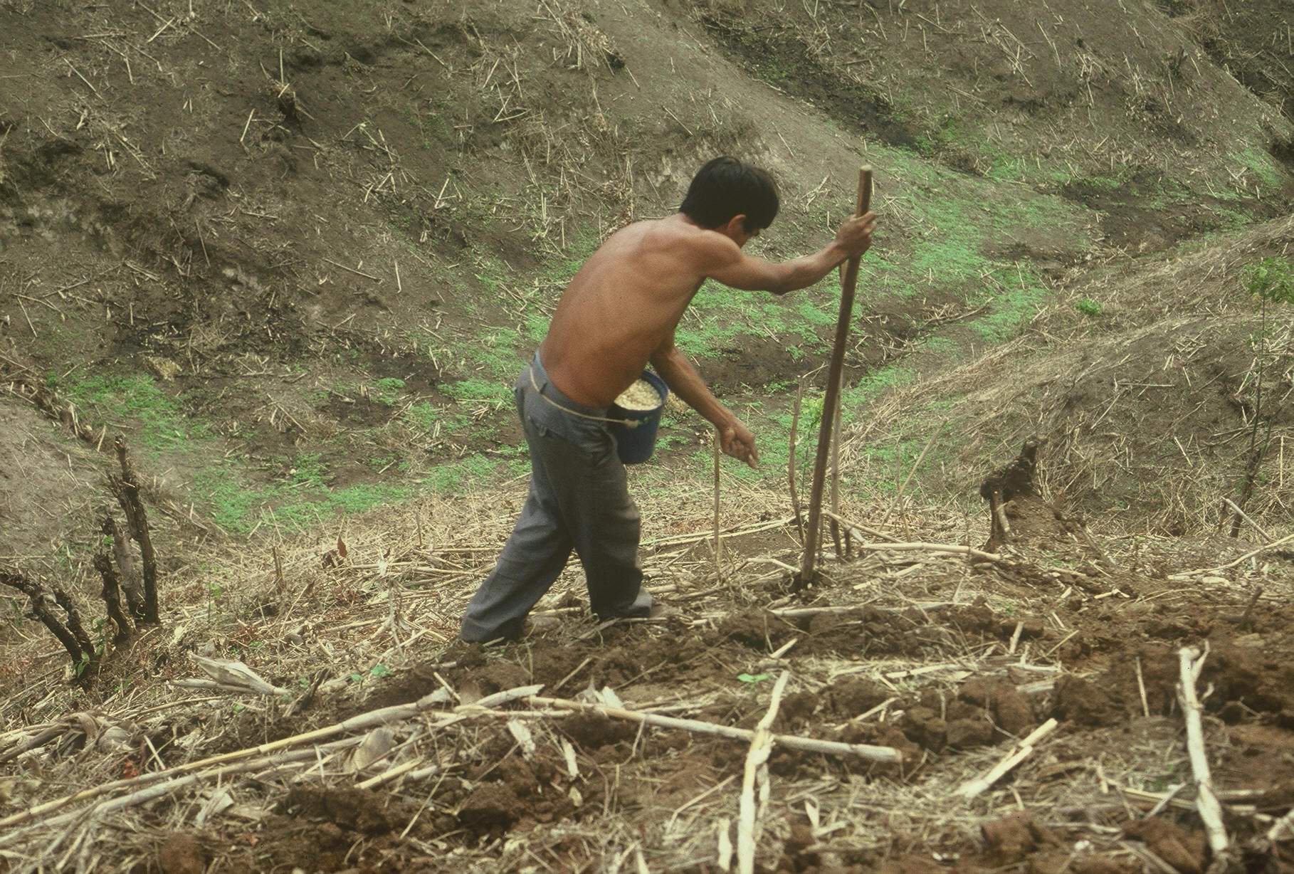

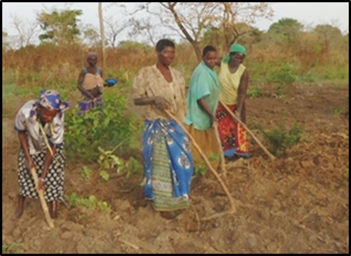
www.nue.okstate.edu

Slide 29

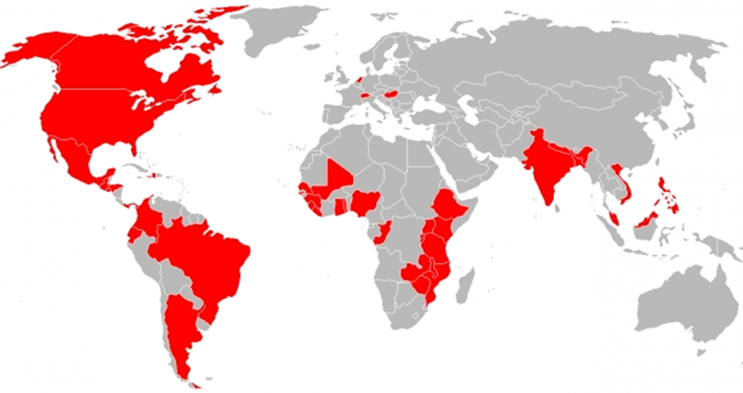
Hand Planters
Person | Organization | Where
Dr. Isaiah Nyagumbo | CIMMYT, Kenya | Zimbabwe
Dr. Pascal Kaumbutho | KENDAT, Kenya | Kenya
 | Ethiopia | Ethiopia
Dr. Peter Omara | Uganda | Uganda
Dr. Edgar Ascencio | CARE, El Savador | El Salvador
Dr. Fred Kanampiu | IITA, Kenya | Kenya
Dr. Nyle Wollenhaupt | AGCO, Kansas | Kansas
Dr. Ivan Ortiz-Monasterio | CIMMYT, Mexico | Mexico
Kristin Lacy | Semilla Nueva | Guatemala
Nyle Wollenhaupt | AGCO | Lusaka Zambia
Melvin Siwale | AGCO | Lusaka Zambia
Terry Tindall | JR Simplot | Lusaka Zambia
Eric Lam | MAG | Honduras
Eric Lam | CIMMYT | Bangladesh
Roman Gordon | IDIAP | Panama
Dr. Luis Narro | CIAT | Colombia
Dr. Joshua Ringer |  | Thailand
Dr. Assoumane Maiga |  | Mali
Notes:
29

Slide 30


March 2016
Membership, 11,000, views 10,000

Slide 31



Slide 32


Technology Adoption
Early stage technology
  Momentum
  Management Team
  Market Size, 100% = 30,000,000 planters
  Financing
Can a large company/industry benefit by developing a product for developed nation farmers?
NGO delivery
https://www.youtube.com/watch?v=VisKBsqcCWA
OSU Hand Planter

Slide 33


Modern researchers should therefore seek to understand the rationale behind traditional smallholder farmer behavior in technology use. J. Sust. Dev. 2012
Planter Ergonomics

