Slide 1
Hand Planter Workshop
Oklahoma State University CIMMYT, AGCO, Drexel University
January 16, 2013
Thursday, 8:15 – 8:45
nue.okstate.edu

Slide 2
Bangladesh
Burundi
Belize
Brazil
Colombia
El Salvador
Ethiopia
Guatemala
India
Kenya
Malawi
Attending Today
Mexico
Mozambique
Sierra Leone
Nepal
Philippines
Tanzania
Togo
Uganda
USA
Zambia
Zimbabwe

Slide 3
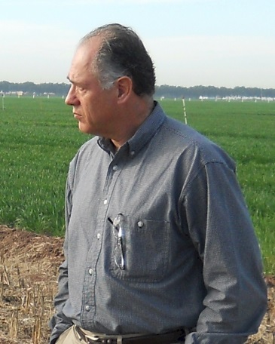
Adrian Koller
Marv Stone John Solie Randy Taylor R.L. Westerman
Ivan Ortiz-Monasterio Art Klatt Ken Sayre Ron Cantrell
nue.okstate.edu

Slide 4
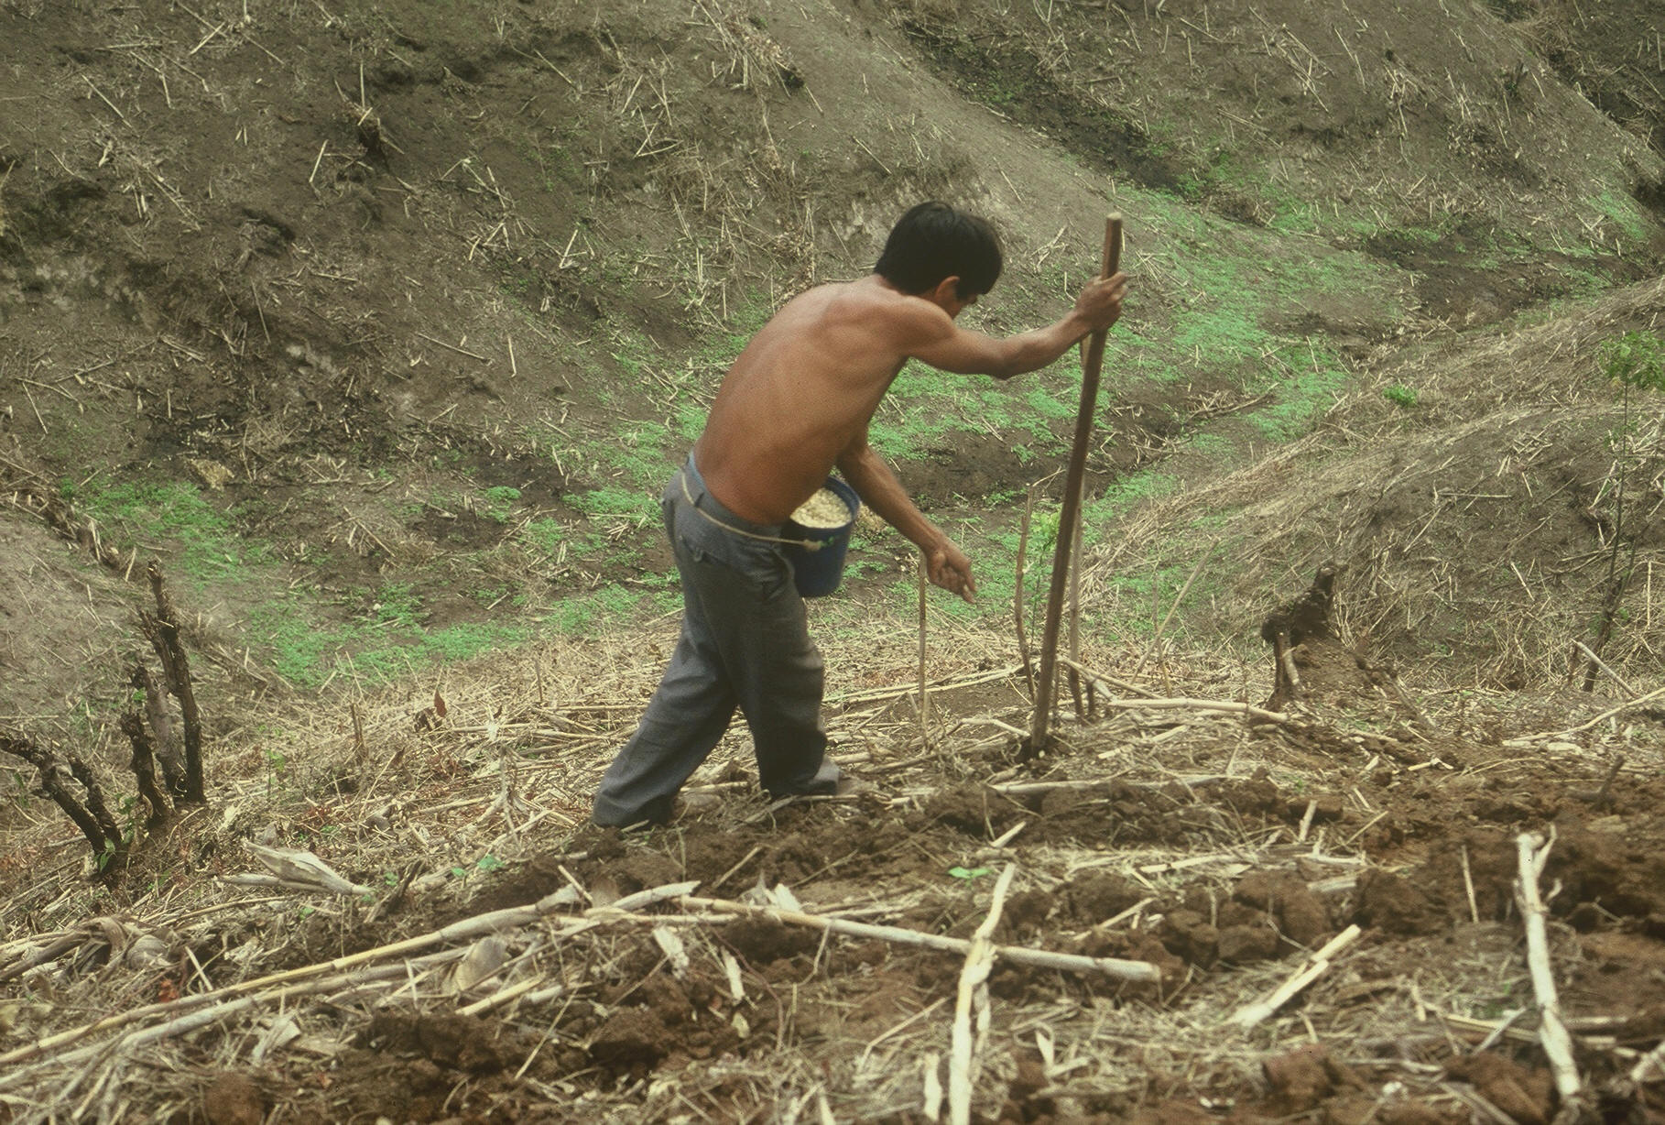
Dr. Edgar Ascencio (CARE, CENTA)

Slide 5
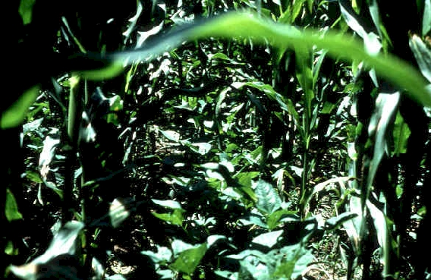
2009
Area, ha’s Production Avg. Yield
Mg/ha
Maize 159,531,000 817,000,000 5.13 USA 41%
Rice 161,421,000 678,000,000 4.21 India 19%
Wheat 225,437,000 681,000,000 3.02 China 17%
Sorghum 42,341,816 58,583,460 1.4 India 17%

Slide 6
World Maize
176,000,000 ha’s of maize in 2012 (FAOstat)
875,000,000 Mg, produced, 4.9 Mg/ha
48,370,000 ha’s in the developing world
60% planted by hand
≈ 29,000,000 hectares or 12% of the total maize area in the world
25% yield increase on world hand planted corn ($0.23/kg or $6.00/bu) 29,000,000* (2000kg/ha*0.25%)*0.23$/kg*0.6% of the land= $2,002,518,000

Slide 7
Hand Planter Need
Methods which homogenize maize plant stands and emergence can decrease plant-to-plant variation and increase grain yields (Martin et al., 2005)
Maize emergence delayed by as little as four days, resulted in a yield depression of 15 percent (Hodgen et al., 2007)
Third world maize yields hover near 2.0 Mg/ha (Dowswell, et al., 1996)
“OSU Hand Planter”

Slide 8
Hand Planter Plan 2009
Objective: Develop, test, and deliver 50 functional, durable, and affordable hand planters for use in planting maize in the third world within two years.
Phase I
1. Discover and discuss, 20 potential planter ideas that should be pursued. Present pro’s and con’s of each idea.
2. Select 5 of 20 potential ideas that should be taken to full scale prototype assembly
3. Put 5 selected prototypes through various planting tests using different seed, soil moisture, soil texture, and surface residue. Record success/failure of each prototype
4. Select two prototypes for assembly/construction analysis (need consulting engineer, outside evaluation)
Phase II
Planter selected in Phase I needs to be sent out to various manufacturers to determine cost of production and alternative costs if produced in volume.
Phase III
Select specific regions in Africa, Central America, and South America where the first prototype will be released.

Slide 9
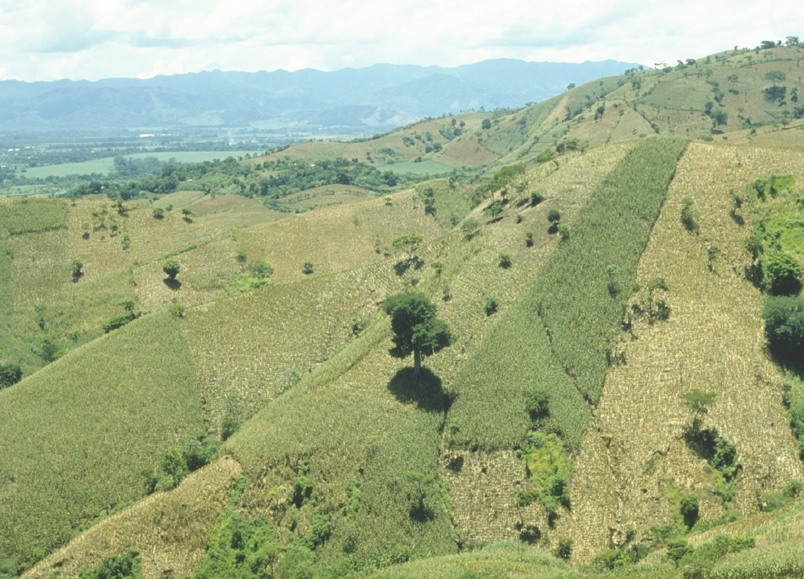
Opico Quezaltepeque, El Salvador

Slide 10
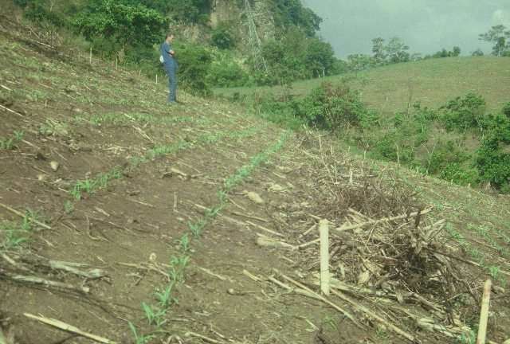
El Salvador

Slide 11
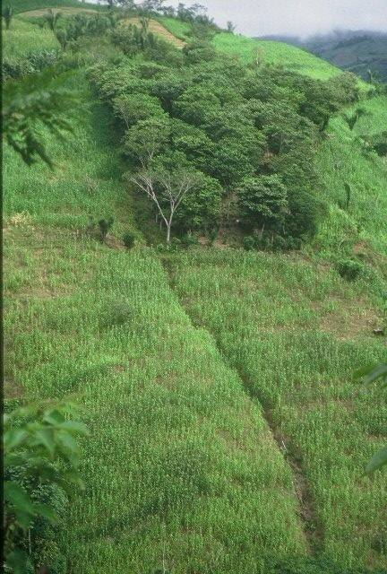
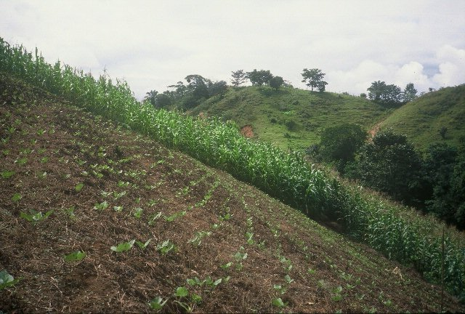
Honduras

Slide 12
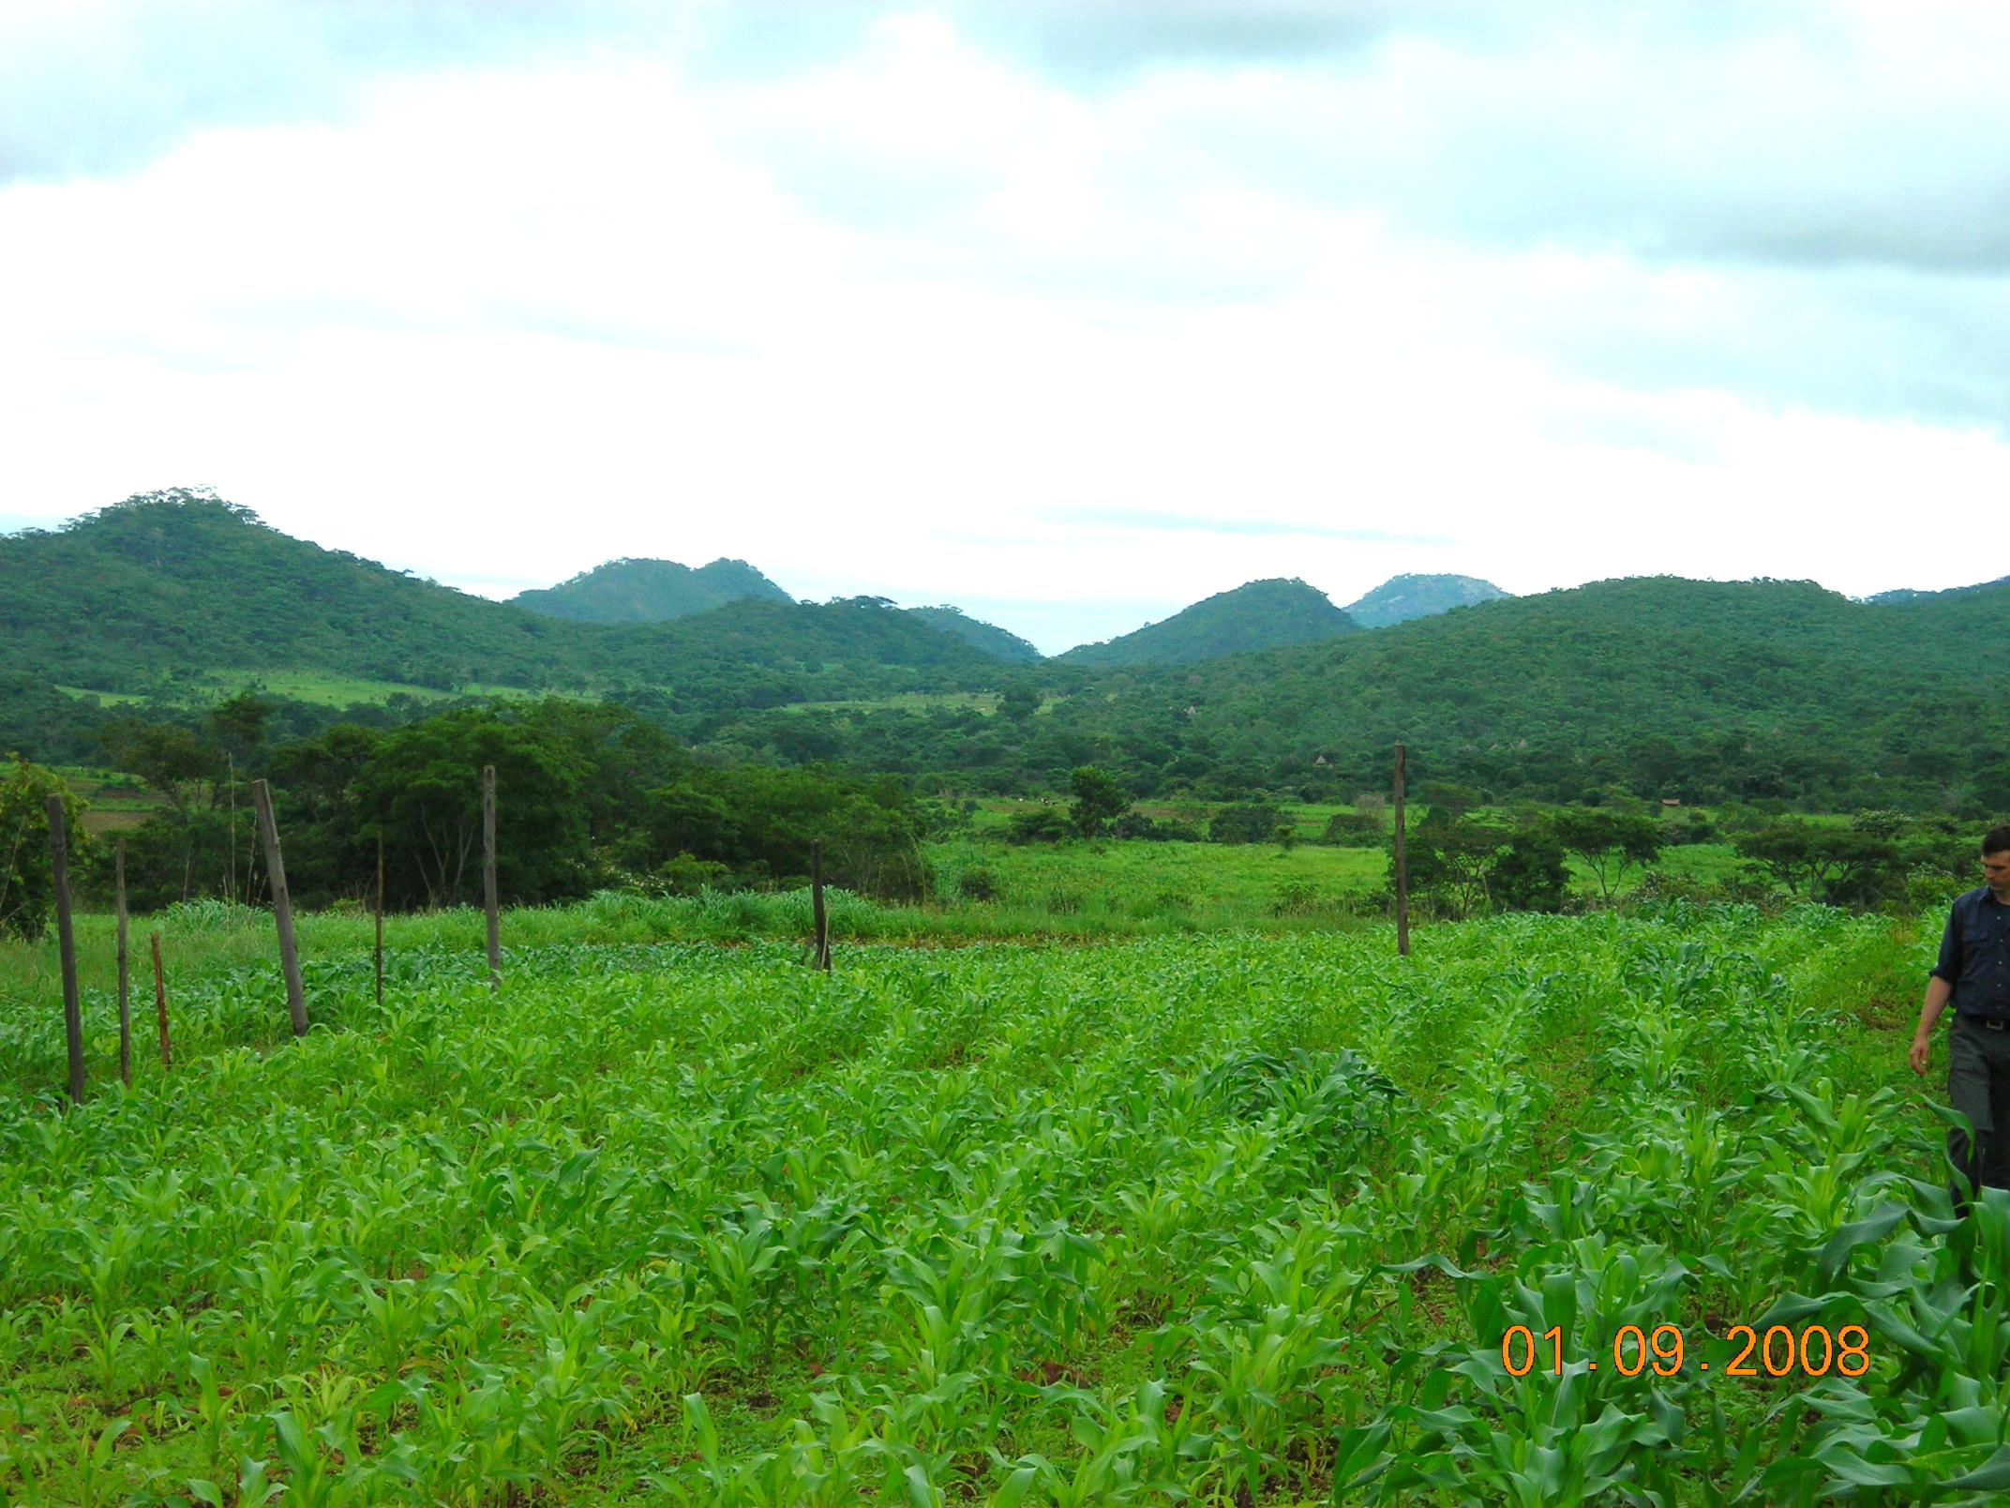
Zimbabwe

Slide 13
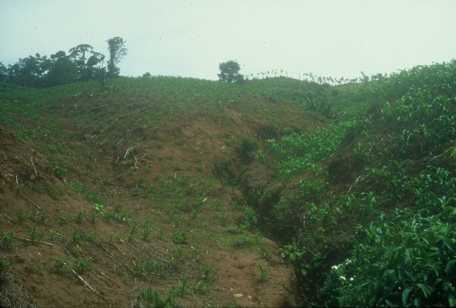
Dominican Republic

Slide 14
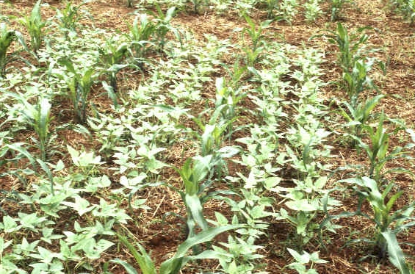
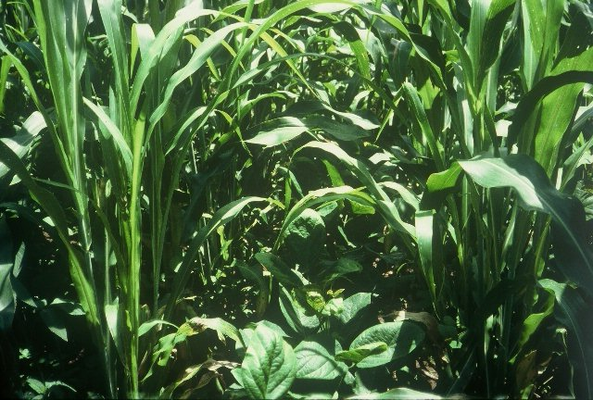

Slide 15
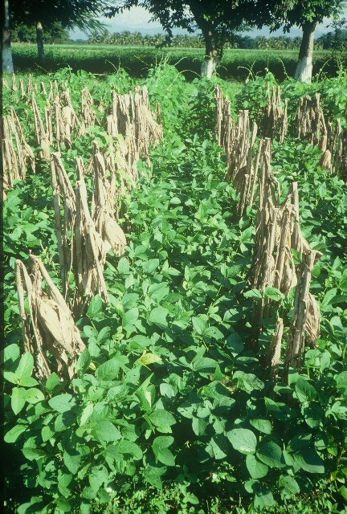
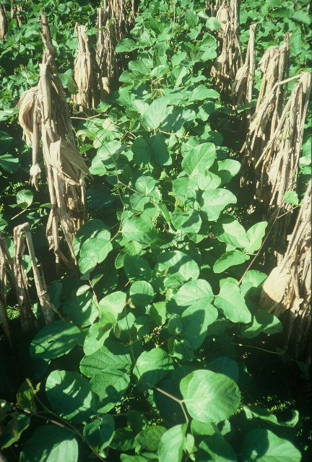

Slide 16
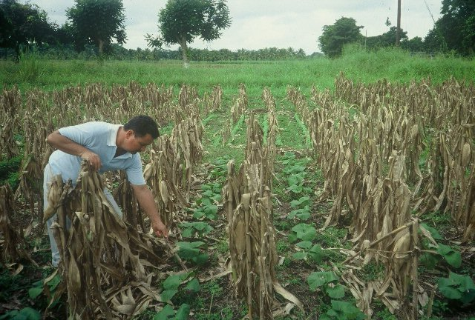
Guatemala

Slide 17
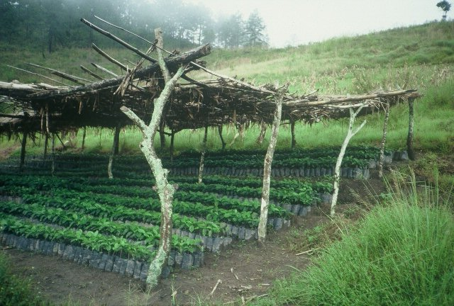
Alternatives

Slide 18
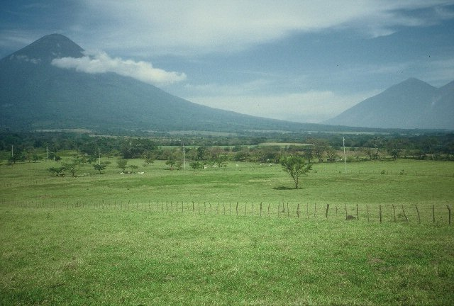
Guatemala

Slide 19
Maize Production
Source: Institute on the Environment

Slide 20
Engineering - Design

Slide 21
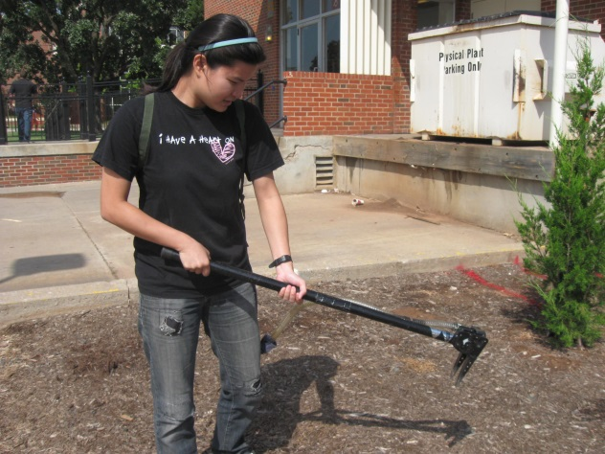
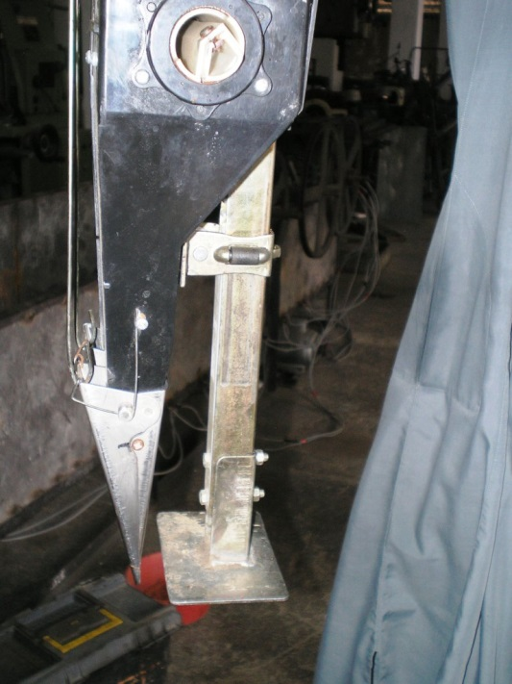
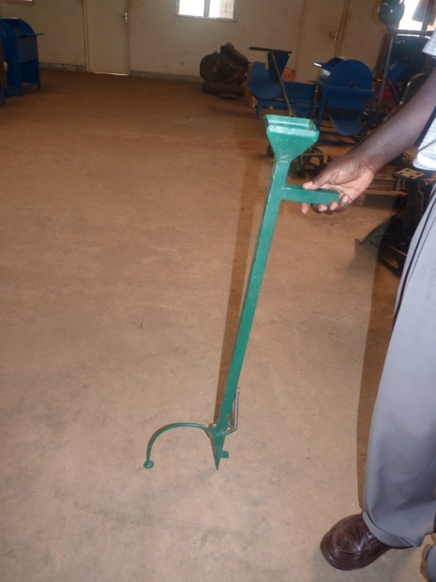
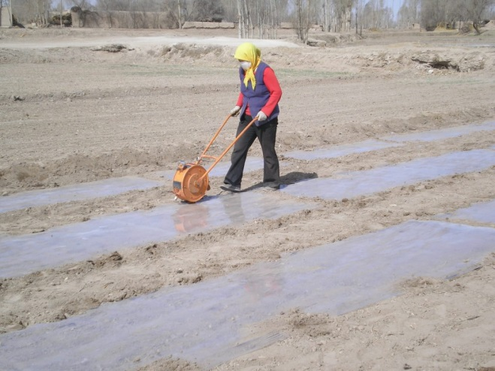
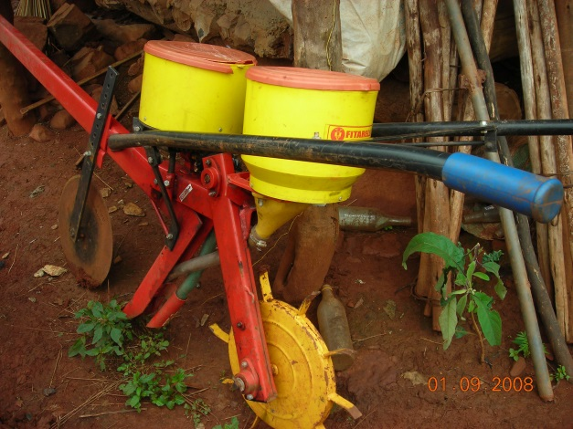
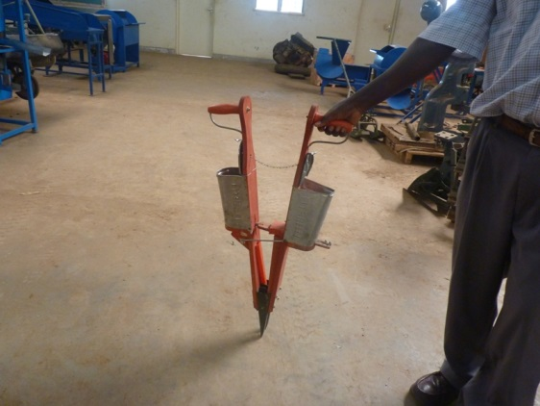
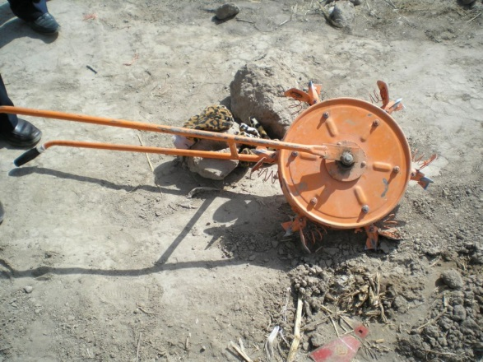

Slide 22
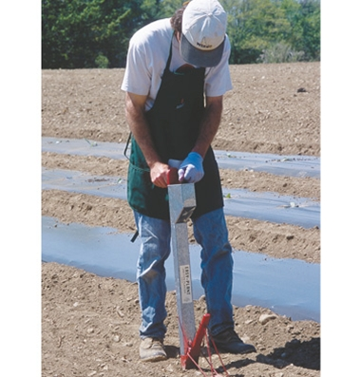
www.johnnyseeds.com
$139
“Easy-Plant Jab-Type Planter”

Slide 23
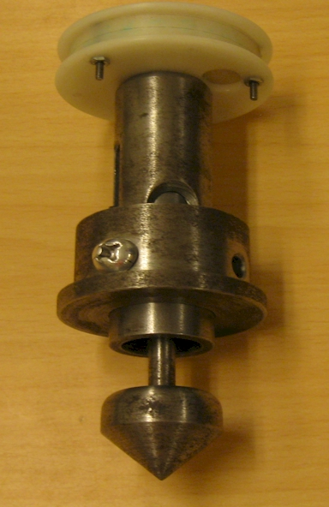
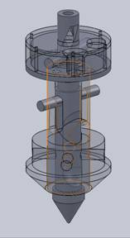
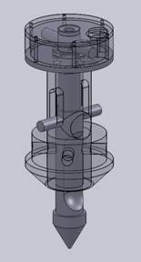
Early OSU Prototype

Slide 24
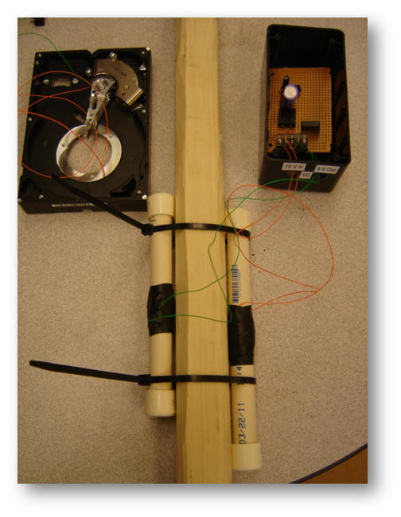
Kyle Hiner Adrian Koller Jorge Rascon

Slide 25
Design Concept
PVC pipe as hopper
Al-square tube as slider
reciprocating action, rotates a horizontal singulation drum
180° off set → cutout for urea despensing
seed/fertilizer release on up-stroke
extension springs provide restoring force
steel shovel

Slide 26
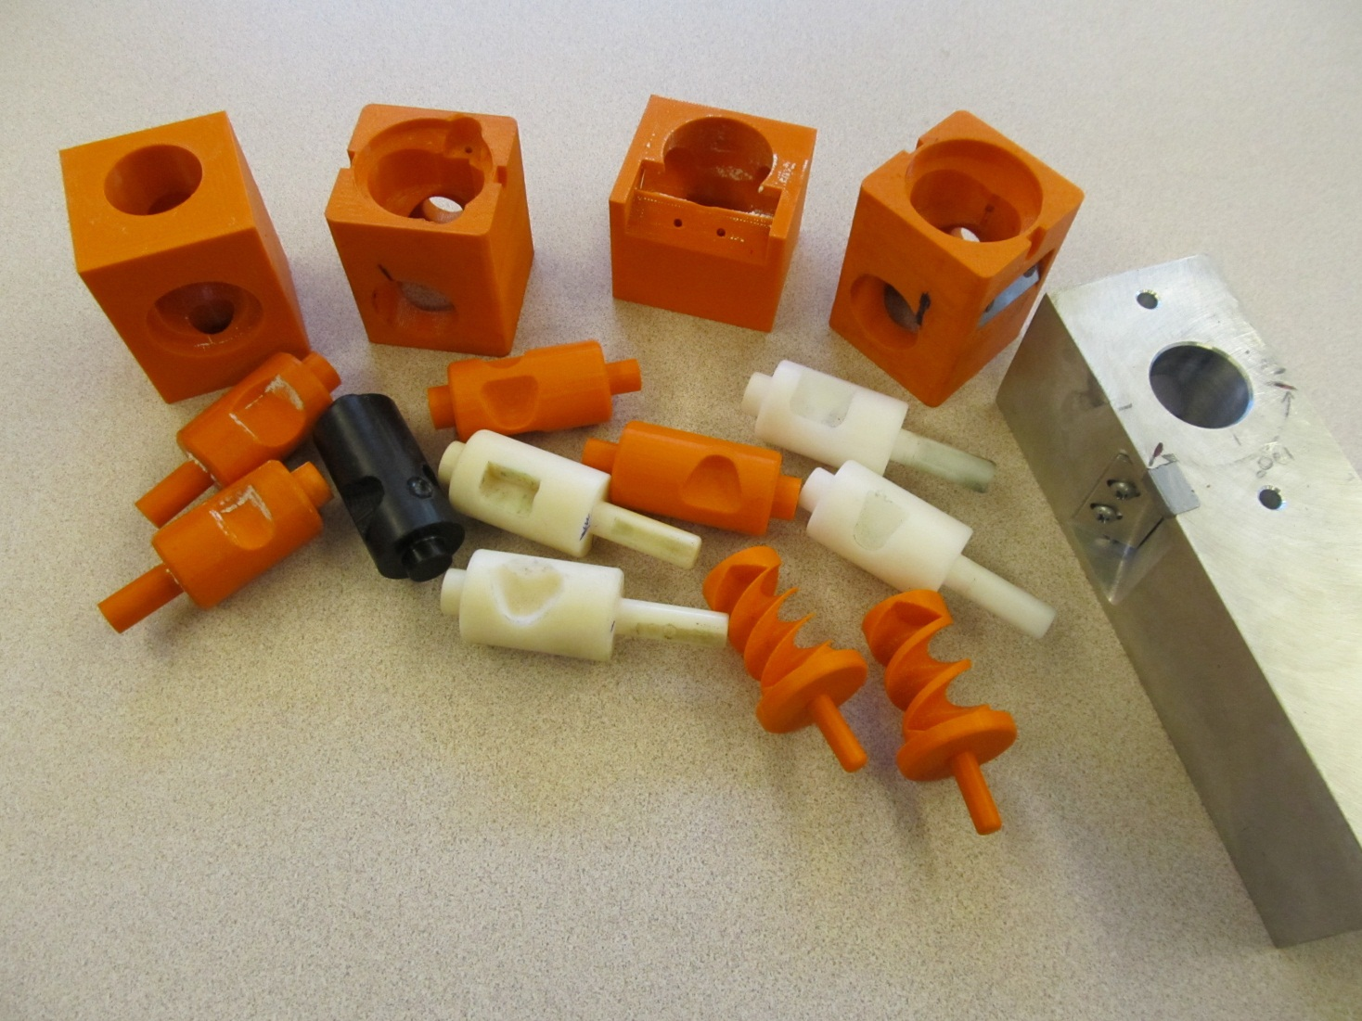
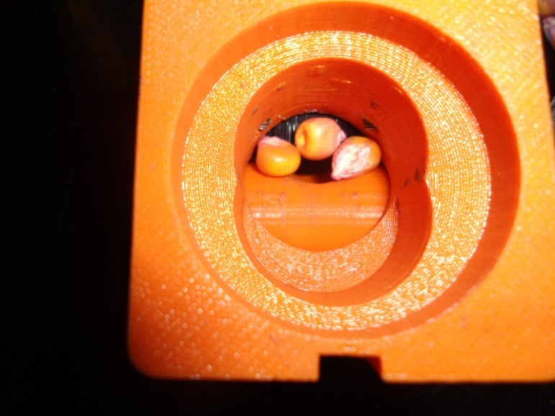
Singulator Design

Slide 27
Test Results: circa July, 2012
Empty mass 1.5kg (3.3 lbs), holds 0.9kg of seeds, weight feels comfortable
Actuation force by operators required to be much higher (80 to 100 N [18-22 lbs])
Shovel needs redesign…
Around 12’000 actuations to date, several rounds of modifications

Slide 28
Early Prototype
Challenges with metering drum alignment.
Testing with AGCO in Zambia revealed several design flaws.
Moved towards a round design with the internal spring.

Slide 29
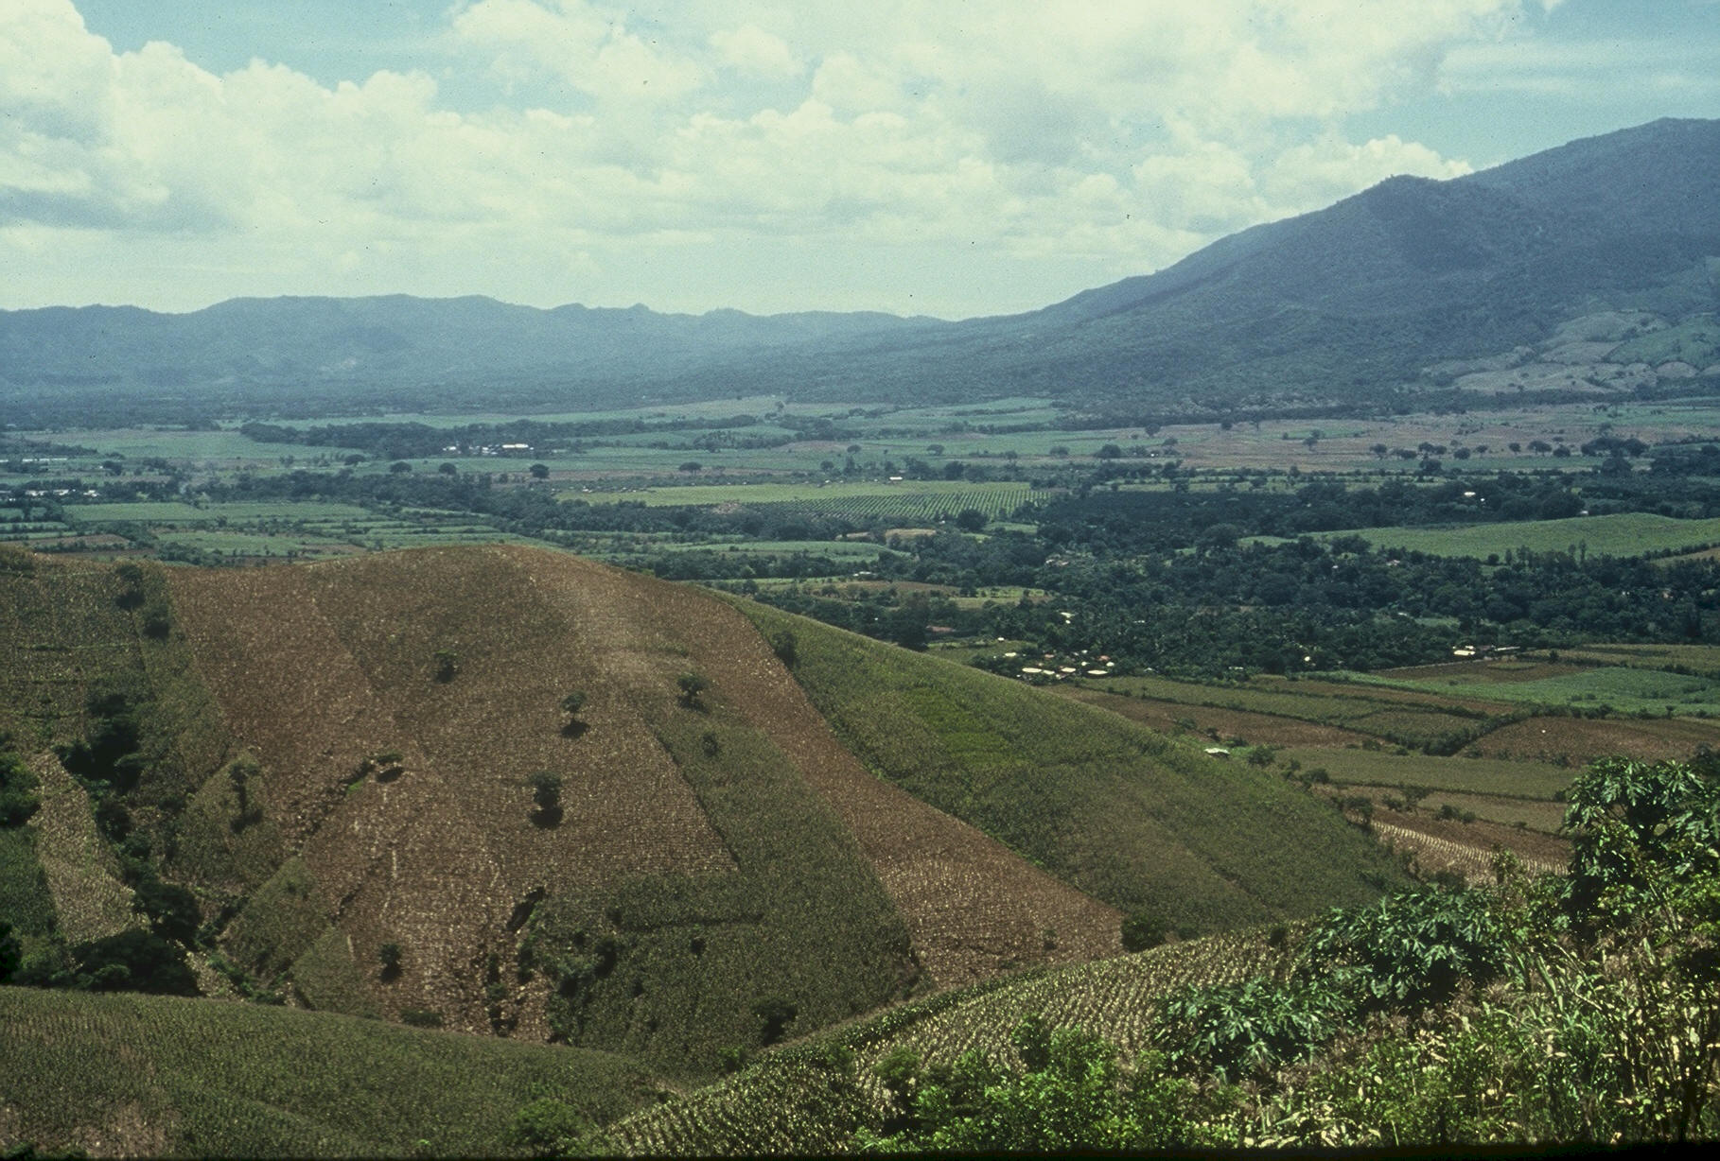
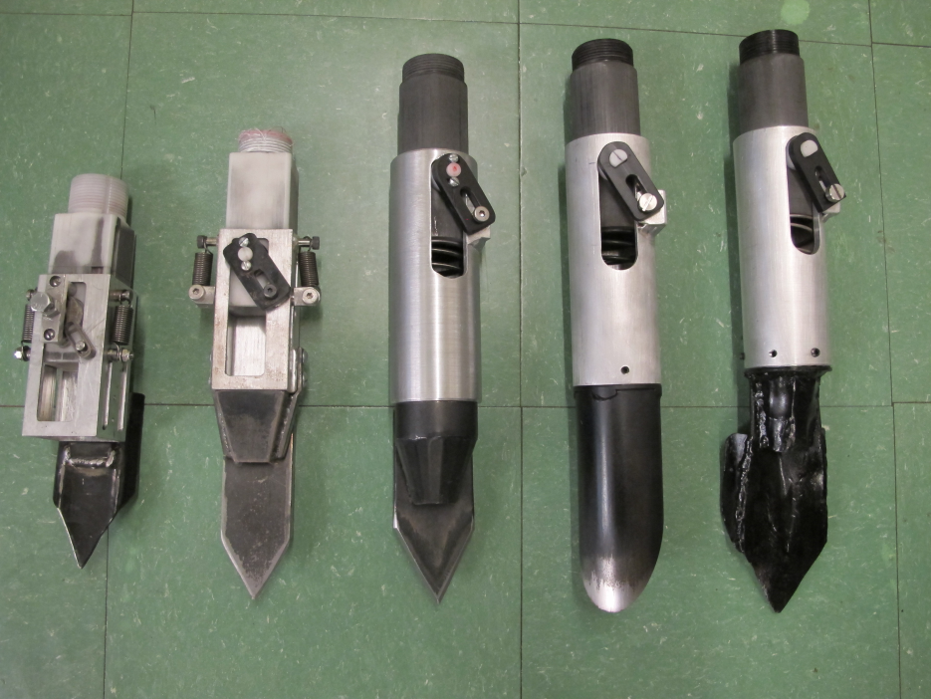

Slide 30
Thailand Mexico Zambia El Salvador Guatemala

Slide 31
Variables Evaluated
Brush size, location, stiffness
Drum orientation
Drum cavity size
Drum angle
Internal Housing (1, 2, 3) (brush position)
Seed size, shape (range from 2652 to 4344 seeds/kg)
Operator (3)

Slide 32
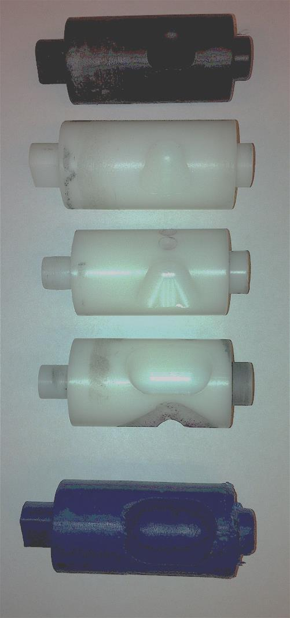
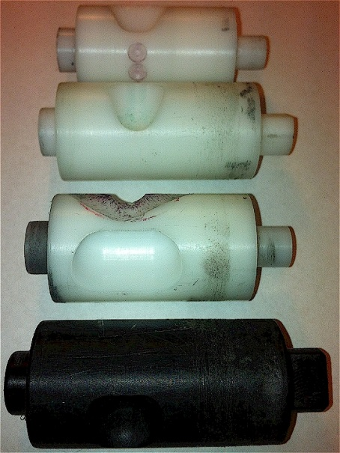
Rotating Drum
Drum | Mass (g) | Volume (cm³)
A | 0.69 | 0.507
B | 0.71 | 0.521
OS | 0.88 | 0.646
OM | 3.36 | 2.468
OC | 3.38 | 2.482

Slide 33
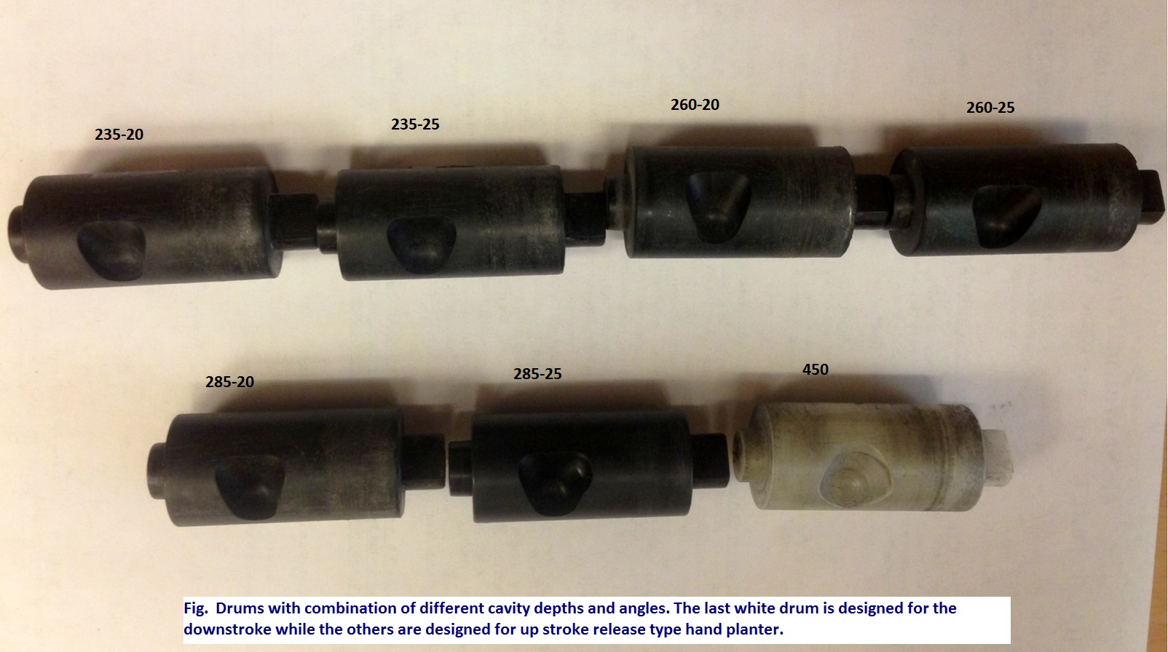

Slide 34
Metering Drum Housing
Requires a separate brush mount. Brush is oriented vertically.
Brush mounting is incorporated into the housing. Brush is radially aligned with the singulation drum.

Slide 35
Brush Mounting
New style – Brush location is fixed. Brush stiffness could be changed if desired.
Old Style – Brush location can be changed with the brush mount as well, brush stiffness can be changed.

Slide 36
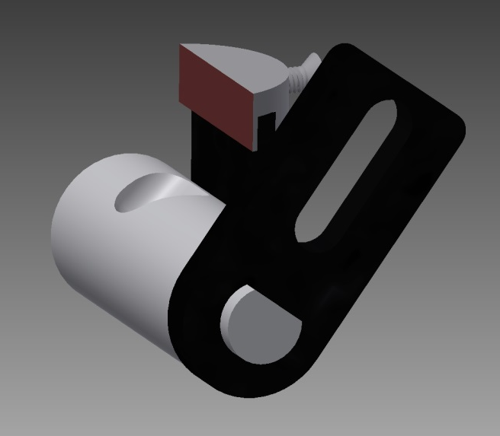
Metering System
Design has gravitated to a reciprocating drum with brush

Slide 37
Planter Action
The planter is pressed down and compresses the internal spring.
Singulation drum rotates and seed is released on the down stroke.
The planter is ‘relaxed’ and the spring returns it to the initial position.

Slide 38
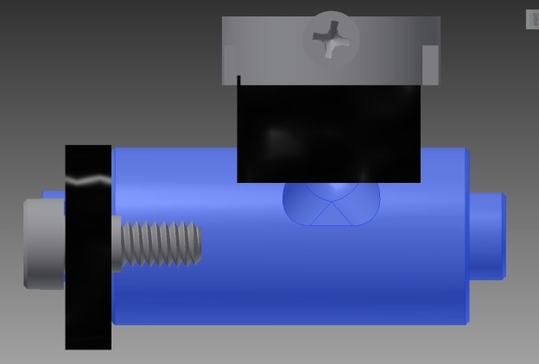
Reciprocating Drum Action
Drum rotates with the cavity moving back into the seed hopper as the spring is compressed.
Spring is fully compressed and the singulation drum cavity is exposed to seed in the hopper
Drum position when planter is relaxed.
As the force on the spring is released, the singulation drum rotates back to the initial ‘relaxed’ position and the seed is dropped.

Slide 39
Timing of Seed Release and Hole Formation
Release seed on up stroke after hole is formed
Our metering results are better when releasing the seed on the up stroke (greater than 85% singulation and less than 5% skips)
It’s harder to hit the hole with the seed
Release seed on the down stroke as the hole is formed
All of our metering has focused on releasing the seed on the up stroke, thus we need some improvement here
We feel we can make a hole that is easier to hit if we can get the timing correct

Slide 40
Test Results: circa Fall, 2013
Empty mass 1.6 kg (3.5 lbs), holds 0.9 kg of seeds, weight feels comfortable, it will likely be lighter with other material.
Actuation force required by operators (55 to 115 N [12.5-25 lbs]) depending on the spring.
Shovel design has settled on what we call the ‘Thai Tip’
Around tens of thousands of actuations to date on several components, though we recognize that final production materials will be different than current prototypes.
Several rounds of modifications, but the design has reached a very stable point.

Slide 41
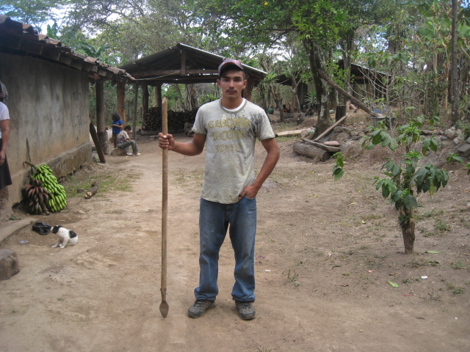
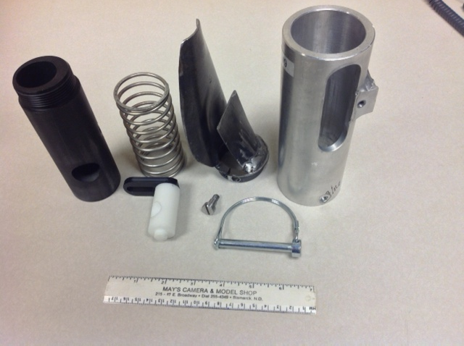
seed size (2653-4344 seeds/kg) seed type, shape
fertilizer
1,000,000 cycles
0.29g/seed
60,000 seeds/ha
3443 seeds/kg
1.0 kg hopper
17 times refill
http://nue.okstate.edu/Hand_Planter.htm

Slide 42
Agronomic Evaluation

Slide 43
Variables Measured
Singles
Multiples (more than 1)
Blanks/Misses
Emergence
Planter Weight
El Salvador: 1.3 kg (range 1 – 1.5)
Metering: 1.1 kg PVC shaft: 0.5 kg (capacity ≈ >5000 seeds)
Seed: 1.0 kg (≈3500 seeds, range 2800-4000) Total: 2.6 kg = 5.7 lb
Pop: 70,000 ≈ 20 refills/ha
Ergonomics: gender/weight

Slide 44
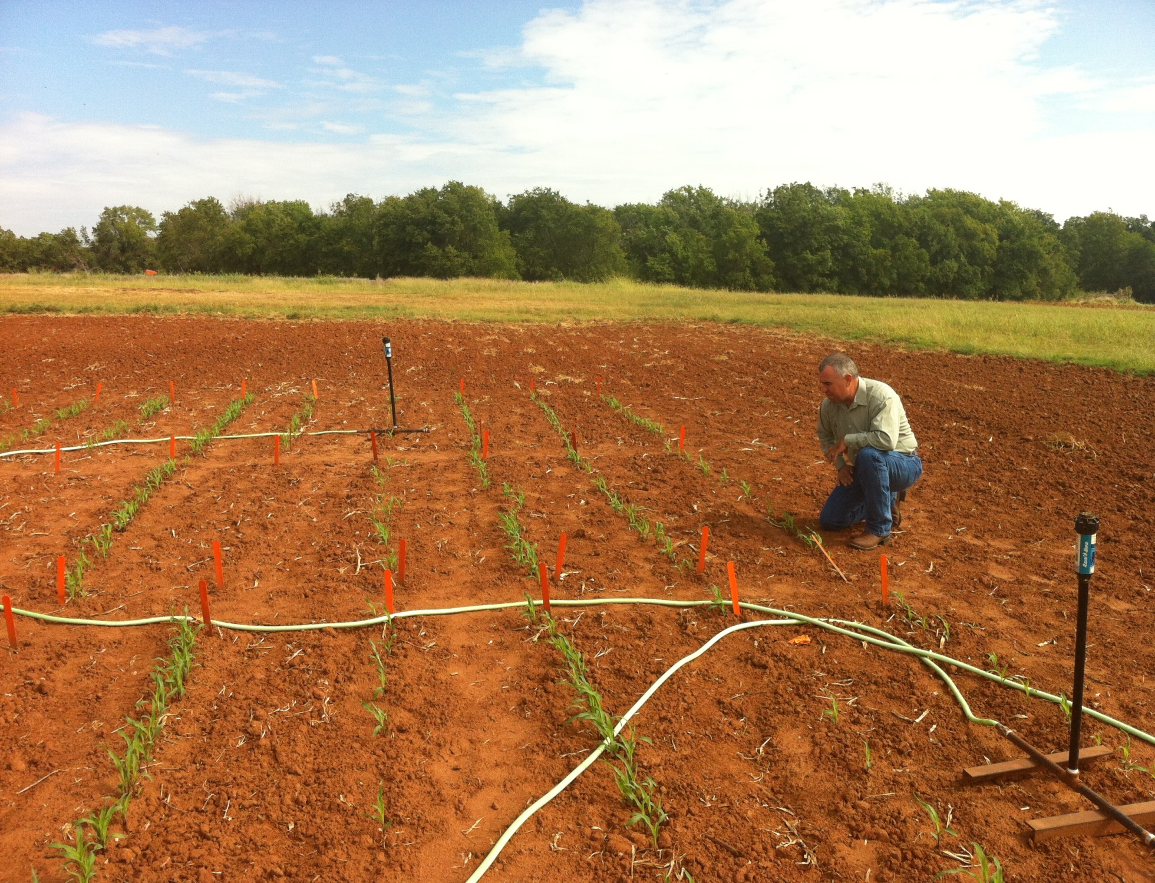
Seed Release Up stroke (US) Down stroke (DS)
Cavity Size (260, 450)

Slide 45
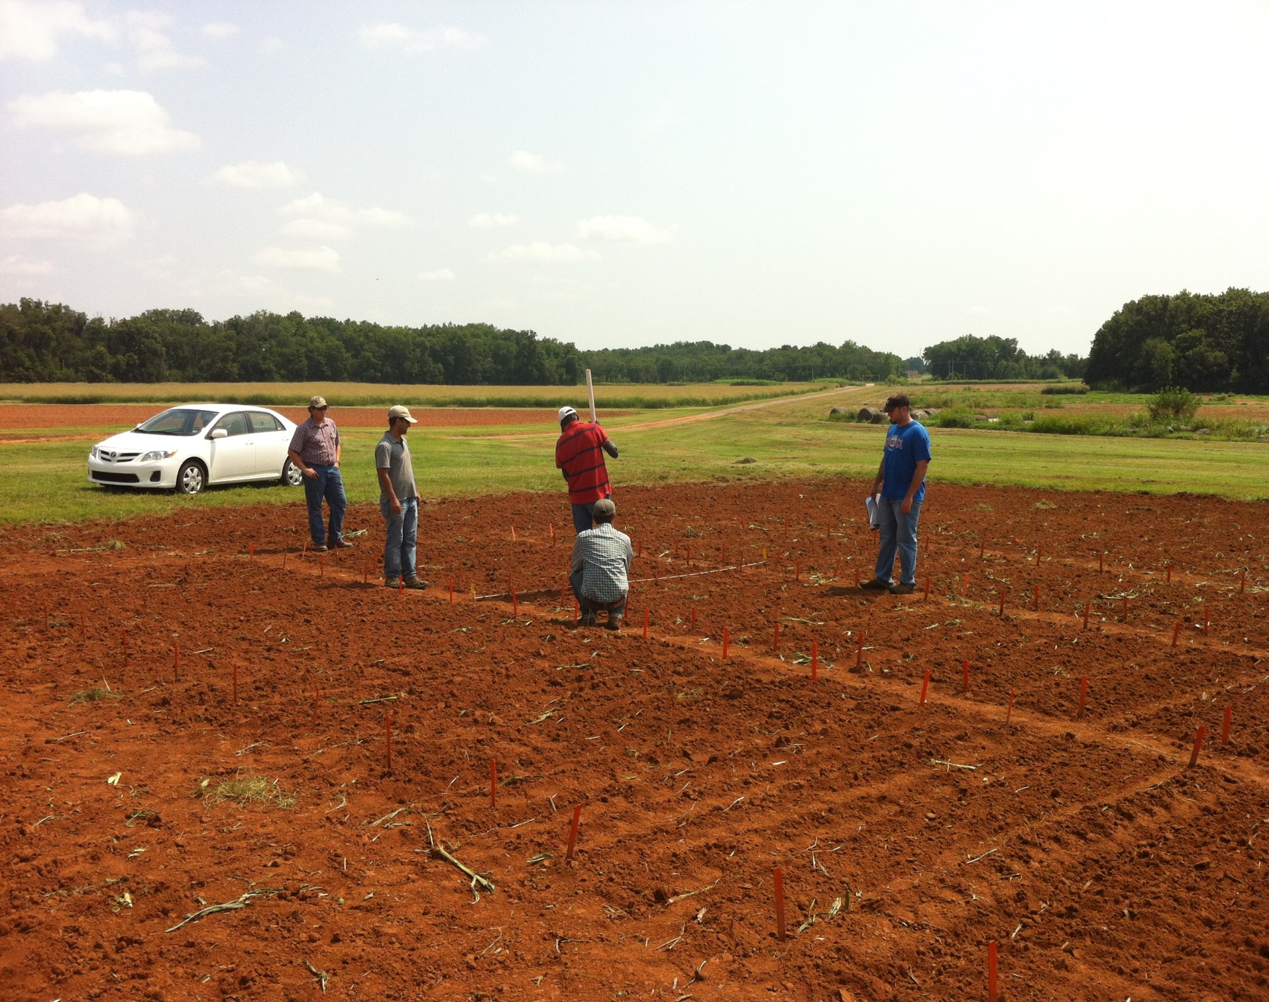

Slide 46
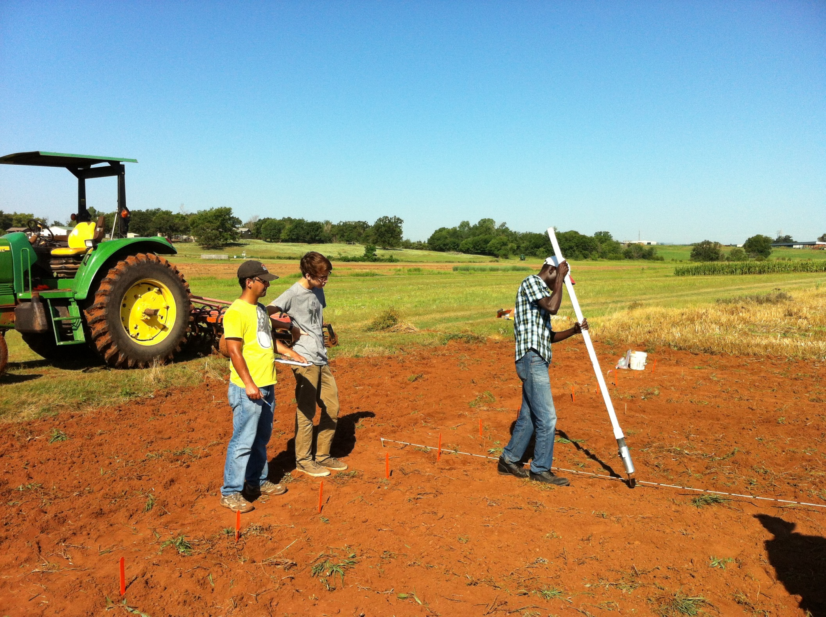

Slide 47
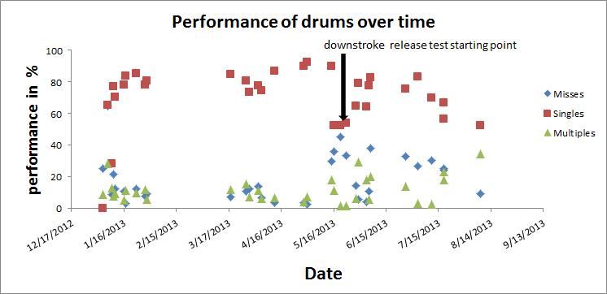

Slide 48
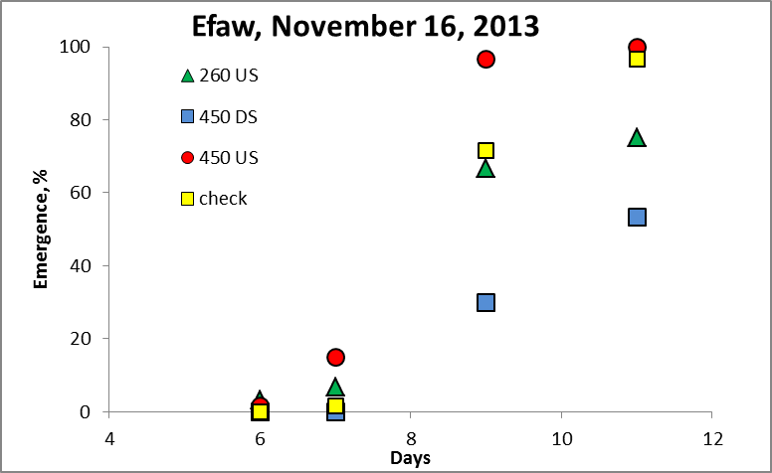
Seed Release Up stroke (US) Down stroke (DS)
Cavity Size (260, 450)
RCBD, 3 reps 10ft plots, 6 “ spacing
SED=3.5

Slide 49
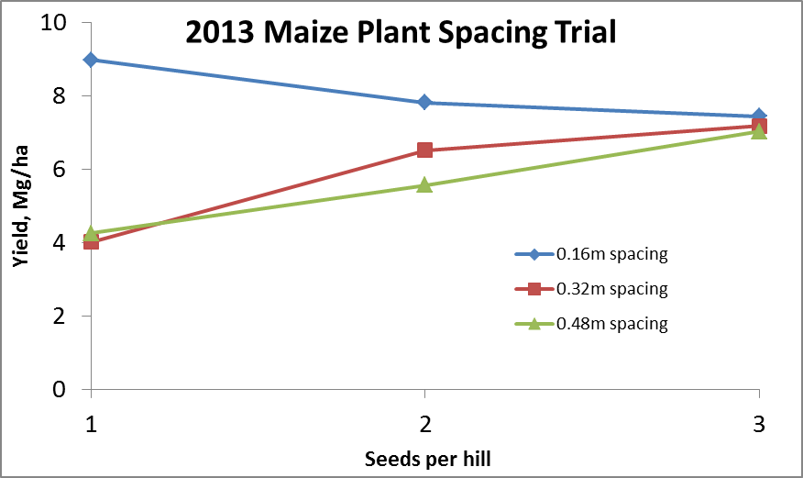
Importance of Singulation
0.76m Row Spacing
Heterogeneity in plant spacing, and plant stands reduce yields (1997, Nielsen, Purdue)

Slide 50
Mid Season Fertilizer N
Combined, Efaw and Perkins, 2013
Topdress N, Corn, V12 |  | (70,000 s/ha)
Methods | N, kg/ha | Mg/ha
Check | 0 | 6.6
Hand planter (0.9 g/plant) | 30 | 11.2
Hand planter (1.8 g/plant) | 60 | 10.6
Broadcast | 30 | 6.4
Broadcast | 60 | 7.0
Dribble urea | 30 | 9.3
Dribble urea | 60 | 7.8
Dribble UAN | 30 | 7.3
Dribble UAN | 60 | 10.4
SED = 1.81

Slide 52
Nov 13, 2013
SED = 8.6

Slide 53
Benefits
Remove chemically treated seeds from the hands of small farmers
Decrease soil erosion via improved plant spacing
Accommodate mid-season application of urea-N
Place urea below the surface reducing NH3 losses
Potential to increase third-world maize production and NUE

Slide 54
NGO-OSU model for distribution and Training
On-farm-research
National Programs
Simple Treatment Structure- need regional check
Hand Planter Treatment Structure (need several “fixed” treatments)
Social concerns (neighbors, not receiving planters)
Regional Trials

Slide 55
Regional Trials
Replications: | 3
Treatments: | 10
Sites per hand planter: | 2
Target plant population/ha | 76,000
Plot length, m | 10
Rows per plot | 4
Row width: | 70-100cm
Fertilizer application | preplant, surface
Added fertilizer | as per soil test recommendations
Maize seed | determined by location/region
Singulation estimate (pre plant) | %
Treatment Structure |  | Preplant | Distance between
 | Planter | N rate kg/ha | seeds, cm
1 | Farmer | 0 | farmer practice
2 | Farmer | 50 | farmer practice
3 | Farmer | 100 | farmer practice
4 | OSU | 0 | 18
5 | OSU | 50 | 18
6 | OSU | 100 | 18
7 | OSU | 0 | 25
8 | OSU | 50 | 25
9 | OSU | 100 | 25
10 | Determined in -country

Slide 56
Post Trial Data Needed
WE HAVE TO GET THE PLANTER BACK: (engineering wear and tear)
Grain yield by plot
Row width
Planting date (A)
Harvest date (B)
Estimate of rainfall (A to B)
Average temperature (A through B)
www.weather.com/outdoors/agriculture/growing-degree-days
Maize hybrid used
Estimate of planting population (farmer practice)
Row spacing employed
Common fertilizer N rate for the area
Planter operator: weight, gender, health

Slide 58
