Slide 1
Hand Planter Testing

Slide 2
Objective
Capable of delivering 95% (singles or doubles) (no triples, no blanks)
Consistence with seeds ranging in size from 0.175cm³ to 0.225cm³ and that includes medium round, medium flat, and large round grading.

Slide 3
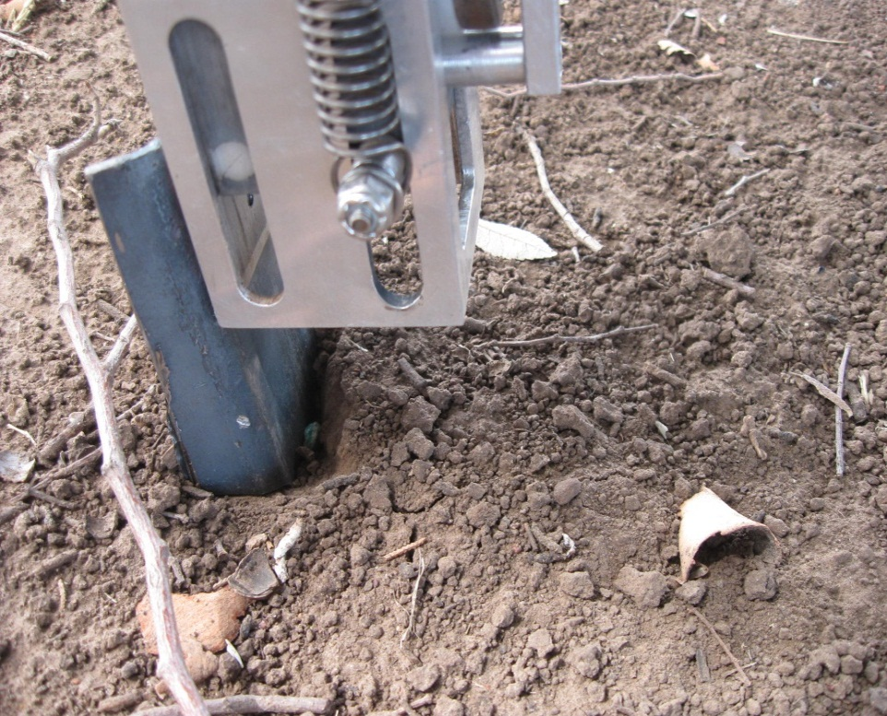
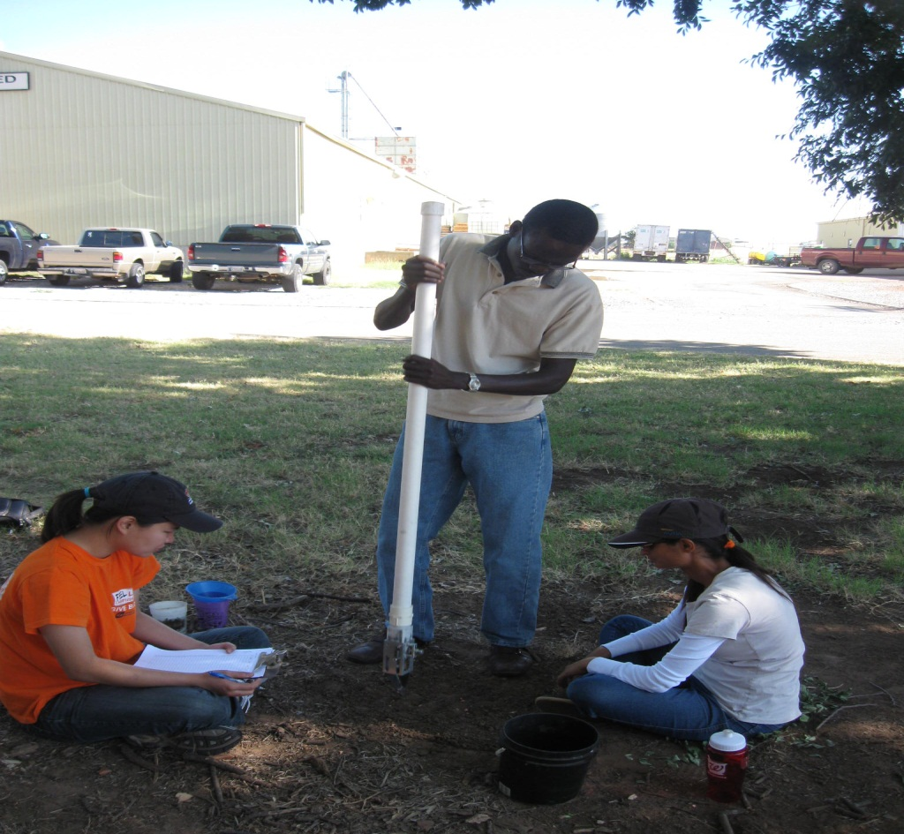
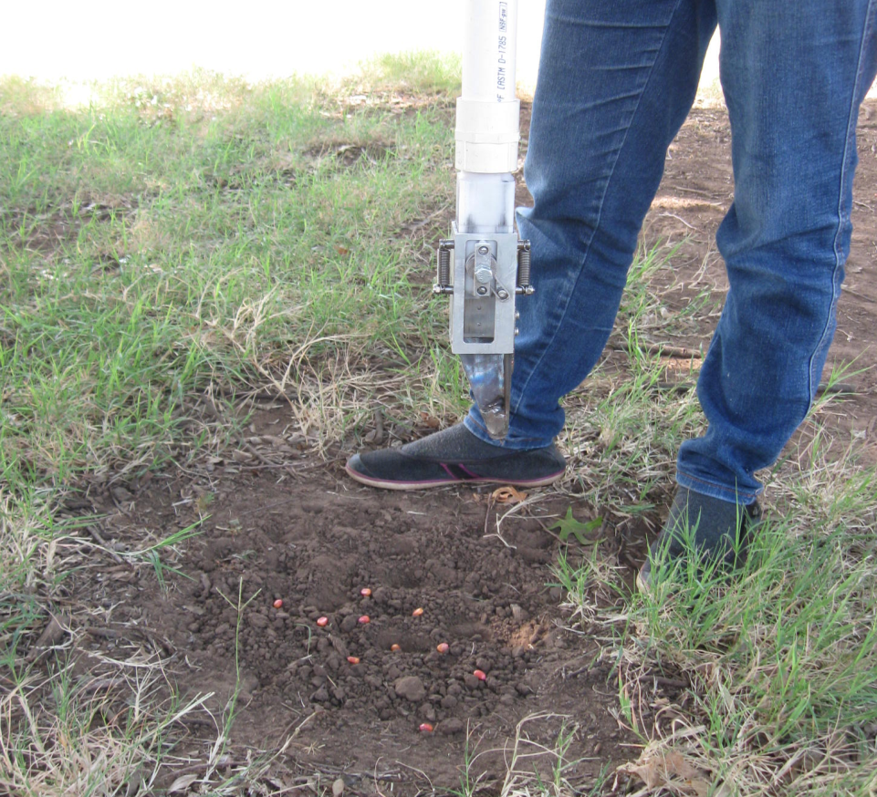

Slide 4
means for singles, blanks, doubles and triples per 100 strike
Date | Seed Size | Singles | Blanks | Doubles | Triples | Adjustments
24-Aug | LR | 82 | 17 | 7 | 0 | light spring
 | MR | 76 | 16 | 13 | 0.5 | light and lighter spring
 | MF | 67.5 | 21 | 11.5 | 0
11-Sep | LR | 83 | 8 | 8 | 1 | Light spring, welding done
 | MR | 59 | 6 | 31 | 4
 | MF | 58 | 8.5 | 4 | 2.75
21-Sep | LR | 77 | 6.5 | 16 | 0.5 | Hard spring
 |  | 70.5 | 8 | 19.5 | 2 | lighter spring
23-Sep | LR | 70 | 5.5 | 23 | 1.5 | friction problem fixed, Light spring
Drum and Brush were not changed
Dimensions : Light spring (l=2.1cm,d=1.2cm)
Lighter spring (l=2.9cm,d=0.9cm)
Hard Spring (l=1.5 cm, d=1.5cm)

Slide 5
Percent of Singles, Doubles, Triples, Blanks

Slide 6
Singles Vs. Seed Size

Slide 7
Where we are
Average is around 70 Percent singles, which is not size specific.
The combination of large round seeds and use of light springs resulted in the highest singulation (83% singles)though not consistent.
Used different spring sizes.
Need more brush types and different drum cavity sizes to be tested.

